Slide 1



ELA-LOG
Planning Strategic Approaches to Align Depot Yard Demand
This presentation illustrate the impact of unstable container terminal services on marine logistics and container management efficiency & new strategic ideas.
ELA-LOG Jimmy Zeng
EVERGREEN
Notes:
Hello Everyone, My name is Jimmy from ELA-LOG. Echoing today’s topic mainly about vessel delay, my part will present how negative impact and contingency on empty accumulation from perspective of logistics.
Later I will also introduce some office to share with us their cases (30s)

Slide 2
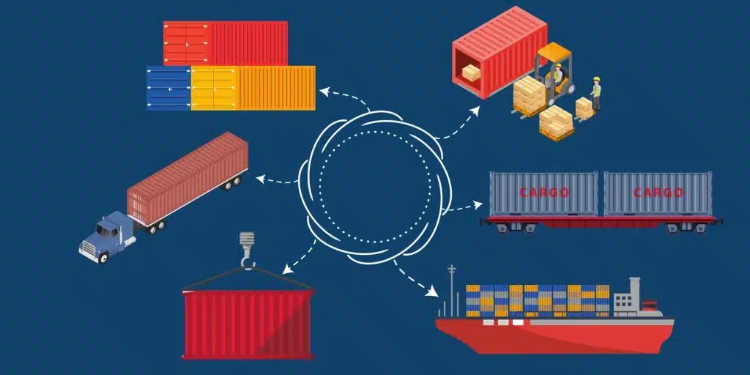
ELA-LOG
Importance of Marine Container Supply
Global Trade Flow
Container are crucial to global trade, facilitating the movement of goods and materials.
Efficiency and Reliability
Efficient and reliable container terminal operations are matter to maintaining supply chain efficiency and reducing transportation costs.
Notes:
1. As a shipping company, we play a crucial role of global supply chain to maintain smooth logistic cycle,
2. If we don’t have our empty evacuation in time POL wouldn’t have enough container to supply all shipment
3. However, we face big obstacles to this top mission last year

Slide 3
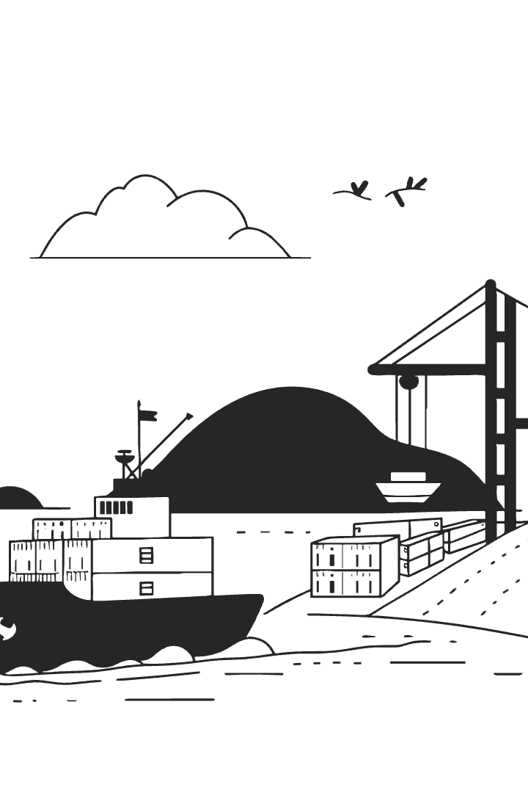



ELA-LOG
Disruptions to Marine Logistics
Schedule Delays
Unstable container terminal services can lead to delays in vessel departures and arrivals, impacting the overall shipping schedule.
Vessel Cut & Run
Delays and disruptions can lead to increased transportation costs, affecting profitability and impacting businesses.
Equipment Imbalance
Supply chains may experience stockouts or shortages due to delays in receiving shipments, impacting customer satisfaction.
Notes:
Owing to the reason of long-standing port congestion leading to continuous schedule delay, operation time will be definitely shortened and eventually faced C&R, empty container usually would be the victim. (30s)

Slide 4
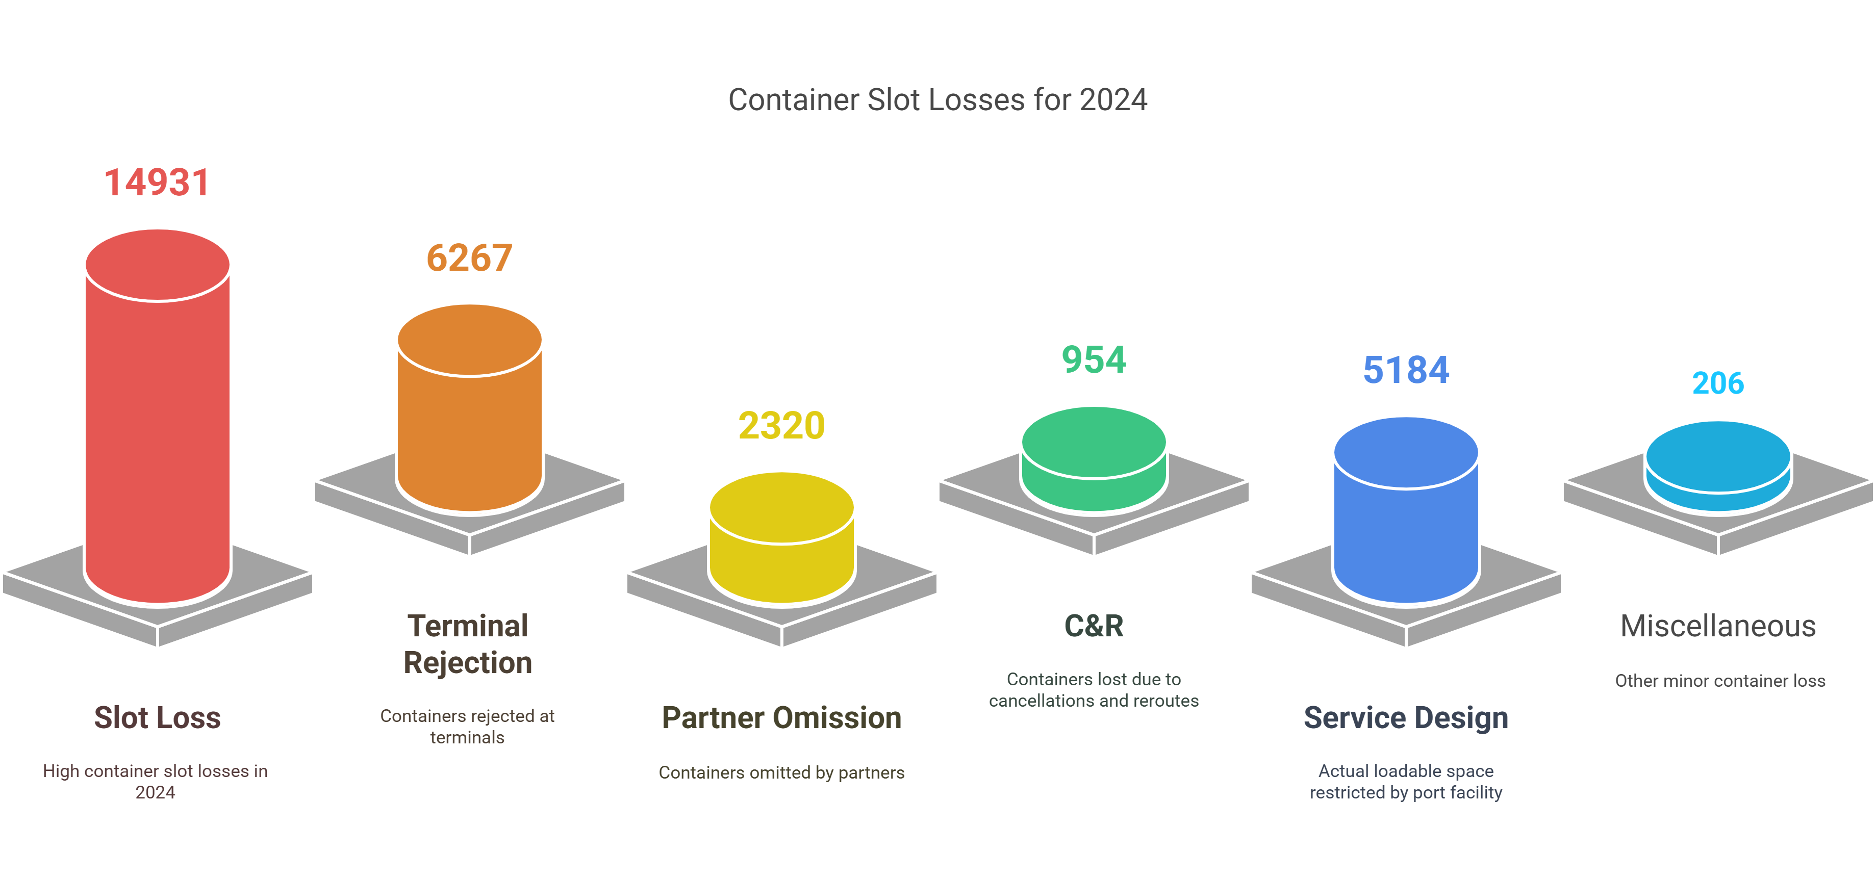
ELA-LOG
Equipment Imbalance
Supply chains may experience stockouts or shortages due to delays in receiving shipments, impacting customer satisfaction.
64% space loss attribute to terminal/schedule
42%
6.4%
34.7%
1.4%
15.5%
15%
Notes:
1. Speaking of empty C&R, overall, the 2024 totally we have lost nearly 15 thousand TEU space for empty loading
2.as high as 64% out of them attribute to schedule delay and terminal issue which significantly reveals how negative the impact comes from schedule delay.(30s)

Slide 5
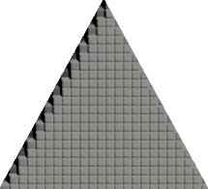







ELA-LOG
Equipment Accumulation Consequence
Customer Complaint
1
Consignee may argue with DM charge or even worse file lawsuit against carriers
Space Constraints
2
Suspension of receiving empty after yard fully occupied
Operational Inefficiency
3
Reduced accessibility to containers lead to deep stacking and bunch of overdue.
Equipment Accumulation
4
Lost space eventually turned into empty inventory growth
Notes:
4. Following the space loss will eventually become the idling stock
3. if no instant solution long overdue must be inevitable
2. even worse, as long as empty yards are fully occupied, suspension from receiving empty return from customers might be announced
1. In the end, worry about argument of DM calculation and complain from customer.(60s)

Slide 6
ELA-LOG
Collaborative Efforts for Optimization
Real-Time Data Sharing
1
Real-time data cross checking between terminals/depots and shipping companies can help optimize operations and reduce delays.
Improved Communication
2
Enhanced communication channels amongst LOG/BIZ/CSD can facilitate coordination and address challenges effectively.
Joint Planning and Investment
3
Investing in infrastructure upgrades and technology can enhance container terminal efficiency and capacity.
Strategic Partnerships
4
Developing partnerships with local authorities and other logistics providers can improve resource allocation and streamline processes.
Notes:
1. So, before those foreseeable nightmare scenarios really happens; here is guideline as four stages of scheme.

Slide 7
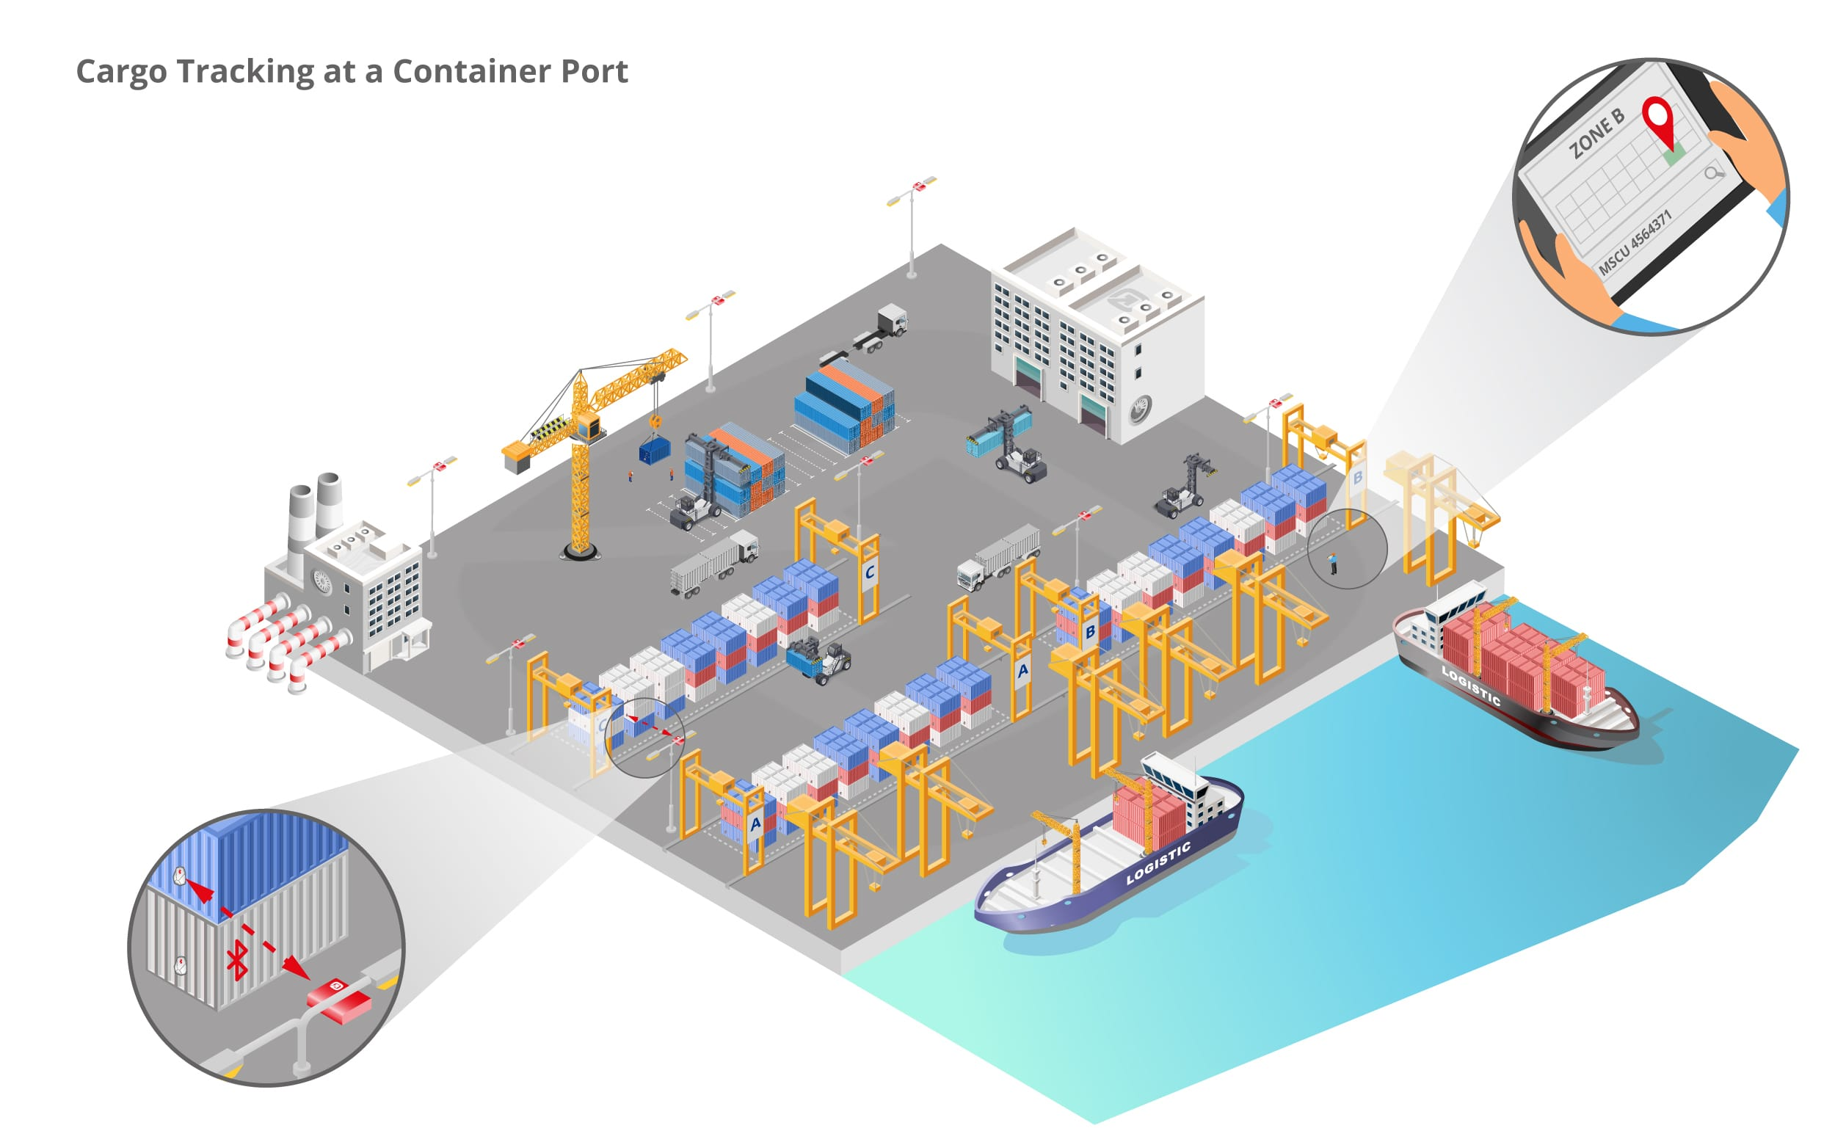
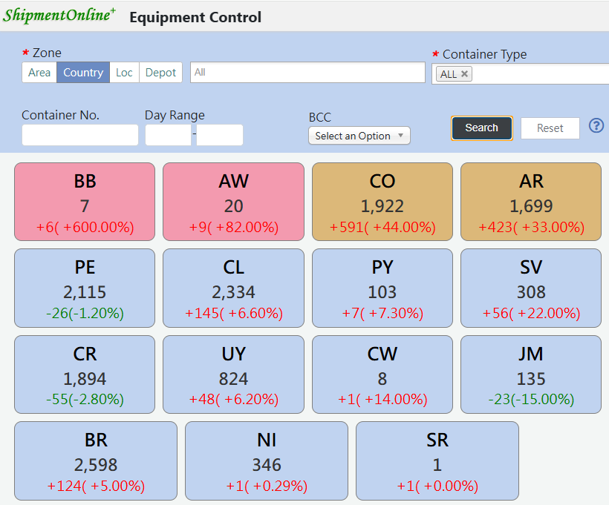
ELA-LOG
Collaborative Efforts for Optimization
Real-Time Data Sharing
1
Real-time data cross checking between terminals/depots and shipping companies can help optimize operations and reduce delays.
Notes:
1. First of all, be sensitive to any variable figure of routine such as daily productivity to make sure right action prior to any abnormal event and we believe following with IoT device deploying we will have better management on every aspect.

Slide 8

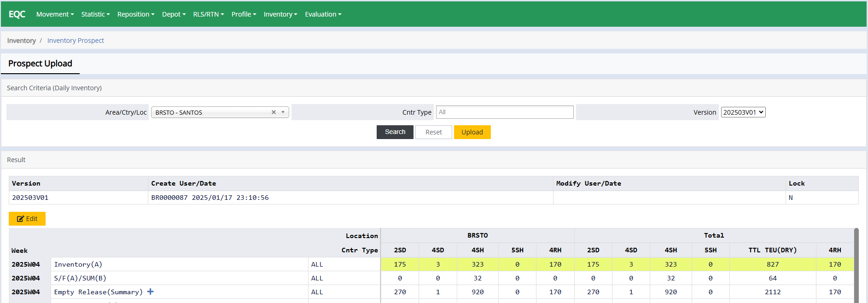
ELA-LOG
Collaborative Efforts for Optimization
Improved Communication
2
Enhanced communication channels amongst LOG/BIZ/CSD can facilitate coordination and address challenges effectively.
Strategic Partnerships
4
Developing partnerships with local authorities and other logistics providers can improve resource allocation and streamline processes.
Notes:
1. After establish good channel with vendors, internal coordination between CSD/BIZ is essential to understand whether our stock indeed proper especially overall the LAAM are surplus area with constant empty return which should keep as lower stock as possible.

Slide 9
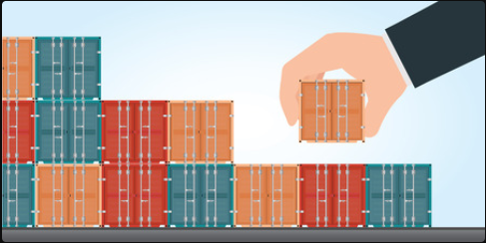

ELA-LOG
Collaborative Efforts for Optimization
3
Investing in infrastructure upgrades and technology can enhance container terminal efficiency and capacity.
Joint Planning and Investment
Developing partnerships with local authorities and other logistics providers can improve resource allocation and streamline processes.
4
Strategic Partnerships
Notes:
1. The last and also the most important is that, if everything goes with SOP to prevent our contracted depots from being paralyzed, if lucky probably we just need to sign new vendors ; but if go to dead end that no more depot vacancy available, establish our own depot could be an option with such as friend carriers, JV companies or closed vendors et.c which very rely on relationship we built up from daily routine.

Slide 10
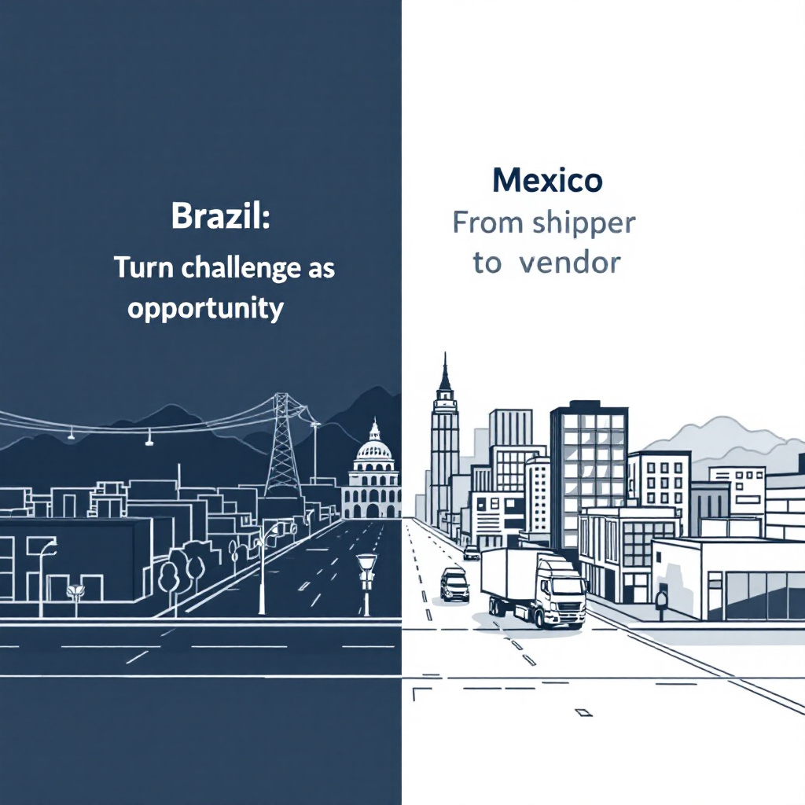
Case Study
ELA-LOG
Case No.1
Brazil :
Turn challenges into opportunities
Case No.2
Mexico :
Shipper developed as partner
Notes:
Above all are the most challenges we have encountered last year – insufficient yard for accumulating empty stock from losing space and we stream line some solution to ease or to prevent this disaster, today I would like to introduce 2 offices to share their experience of depot management
EBR to share with us about their cases so see how they overcome handicaps
EMX develop special mode of partnership with vendor.

Slide 11
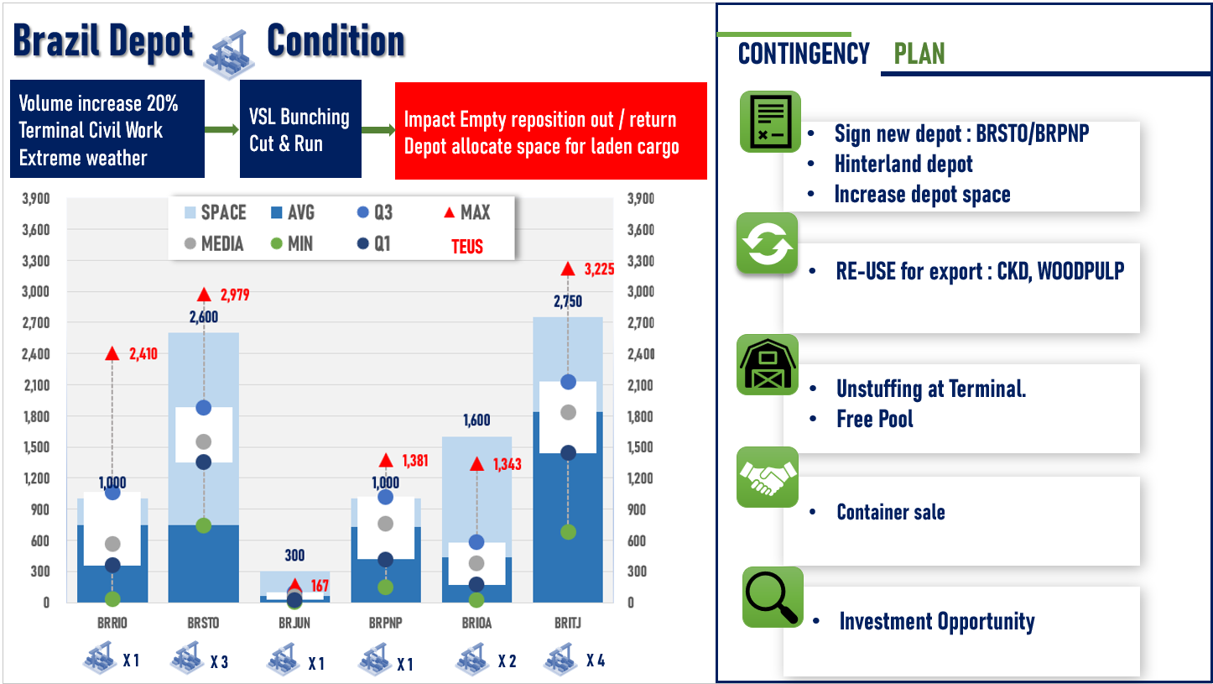

Slide 12

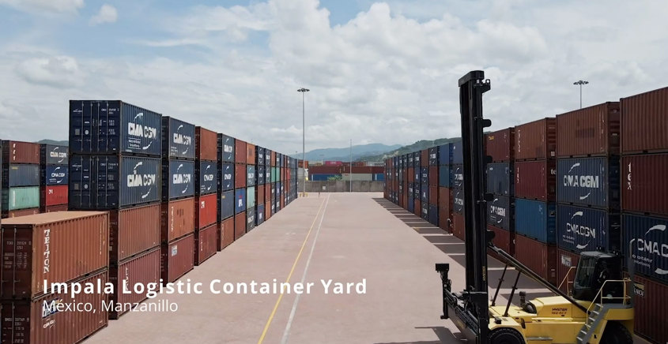

Transforming from Client to Evergreen Depot Partner Impala Case Study
Key Conditions for Transformation
Stable large-scale mineral cargo clients
(100+ TEUs per booking / Avg. 180 export containers/month)
Independently invested in a dedicated mineral export yard, meeting Evergreen’s contract & empty container evacuation requirements.
Rare instances of container damage and full payment on time
Offer Rebates
Advantages After Transformation
Reduce reliance on third-party yards for empty container supply and empty pick- up based per Evergreen’s instructions.
Provide an alternative to time-consuming empty evacuation to the port, improving container utilization.
Significantly boost export volume & operational efficiency.
Notes:
Key Conditions for Transformation
The company must have established stable large-scale customers (forwarders) that supply mineral cargo (100+ TEUs per booking / Avg. 180 export containers/month) IMPALA have been mineral concentrate BROKERS for many years, having very good facilities to opérate in their yard, a very large plot of land near the port, cranes, trucks, etc., to be able to offer an integrated service to their end customers
Rare instances of container damage and full payment on time.
The company must have independently invested in a dedicated mineral export yard that complies with our standard contract terms and mandatory empty container removal requirements.
Advantages After Transformation
No longer solely reliant on third-party yards to provide empty containers as per our instructions or to retrieve export empty containers from designated locations. Instead, we can directly determine booking volumes and redirect empty returns from other customers to these specialized yards.
Provides an alternative to the current time-consuming to time-consuming empty evacuation to the port, improving container utilization efficiency.
Significantly increases export volume and operational efficiency.

Slide 13

ELA-LOG
THANK YOU
Looking forward to seeing you in 2026
EVERGREEN
ELA-LOG-Jimmy Zeng
Date：2025.02.27
Notes:
Really appreciated and having this honor to have this presentation for everybody, if anybody interested more about this smart container it is welcome come over me when coffee break or after this meeting, thank you.

