Slide 1


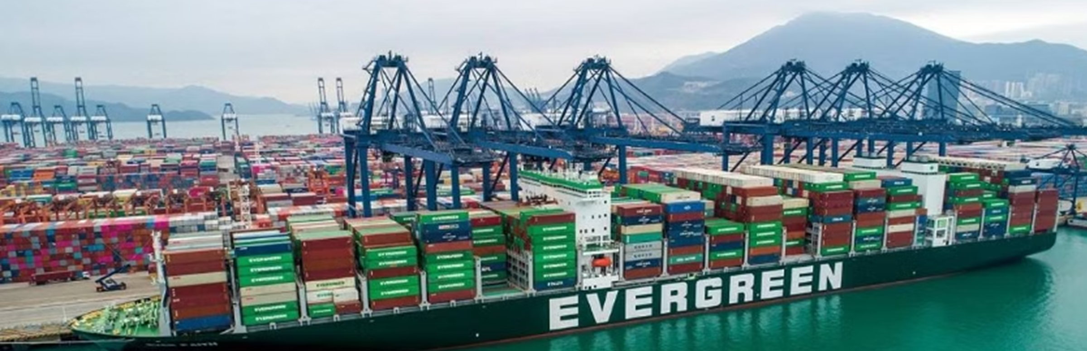
TS Performance in LATAM
Notes:
As the ELA OCD just brilliantly explained, the impact we suffered in Y2024 you may not be able to imagine. Jimmy and I will share challenges we encountered last year in transshipment and empty container evacuating and what countermeasures to the dilemma.
如ELA OCD剛剛精彩的說明，我們在2024年度所遭受到影響的嚴重性，您可能無法想像這其中到底影響了我們哪些，接下來將由我及Jimmy一一地向您介紹去年度貨載轉運及空櫃還空的業務我們遇到哪先前所未有的挑戰。

Slide 2

Presentation Outline
Notes:
Outline of my presentation is divided into three parts, namely the background, transshipment port performance review, and our strategies and new plans
我的報告大綱分為三大重點，分別是事件背景及各轉運港的分析及我們的應對策略

Slide 3





Background
Transshipment Arrangement
Climate Abnormally
& Unstable Market
Port Congestion
Inventory & Storage
El Niño impact on weather patterns disrupts schedules.
Low productivity and extended waiting times cause container roll-over.
Full yards and high storage costs.
Long T/S times, potential cargo claims, and increased storage costs.
Notes:
Frist, Let’s think back how many events happened in the past year in Latin America, unstable weather conditions, political factors, and fluctuating market demand have made our business more complicated. Let me share some stastics. During this period, our transshipment cargo to be T/S was reach to 14,000 TEU, which is more than five times of weekly CAB capacity, and our empty inventory was as high as 60,000 TEU, which is nearly three times the safety inventory.
However, in such a severe environment, the infrastructure equipment of many countries cannot cope with it. This led to a series of effects. Terminal congestion affects operating efficiency and shipping schedules, and even causes vessel to skip port and cause hidden space losses and extra storage cost.
Next, We will review T/S performance of each port in Latin America and what’s our plan to address these situations in the future.
首先，我們回顧過去一年來，在拉丁美洲受到天候因素、政治因素及市場需求不穩定的情況，導致我們於當地的業務情況更加繁雜，然而諸多港口的基礎建設無法因應這樣突發的狀況，最終造成港口壅塞，並影響貨載轉運及空櫃堆存等問題，然這不僅僅影響貨載本身的安排，也造成各地區諸多的額外成本，以下將逐一檢視拉丁美洲各港的轉運績效，及我們未來遇到這些狀況，我們又制定了哪些因應方式

Slide 4
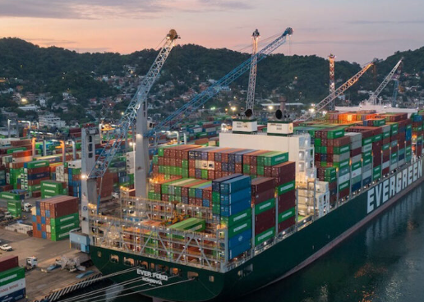
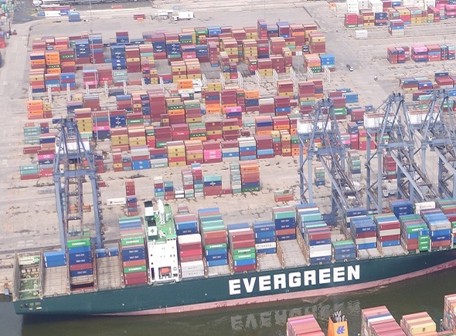
Transshipment Performance: MXMZO + MXLZC
13% of T/S in LATAM.
Port congestion in Central America(SV/GT)
Affected by skip port issue(WSA2/WSA3)
Notes:
First, T/S performance at two ports in Mexico, which account for 13% of the cargo volume in Latin America.
You can see the chart at left side, the number means the proportion of cargo transferred out within seven days in each month. and our performance in last year reached about 30%. However, in middle of last year, because PPC terminal could not accommodate these transshipment cargoes, we diverted part of the cargo to LZC and arranged for AUE/NUE to assist in transporting the cargo to CCT. Therefore, the transshipment efficiency during this period was higher than average.
The reason for this situation is that various shipping companies arranged extra voyages in the first half of 2024, and some ports in Central America are unable to accommodate these additional cargoes, which result in port congestion and affects schedule. Especially, our berth waiting time in CRCAL/SVAGR port was 24 days each, resulting in invisible space loss and even extra storage charges. Also, we encountered several time that WSA2/WSA3 services our partners announced skipping calls in Mexico due to schedule consideration.
首先看到墨西哥兩港的轉運，該兩港占比拉丁美洲貨量為13%，然在過去一年的轉運效率是有很大的進步空間，主因2024年度各航商於今年上半年安排加班船，中南美洲部分港口無法消耗這些貨載，各港壅塞影響LAE航線及WSA2/WSA3因追趕船期跳靠。

Slide 5
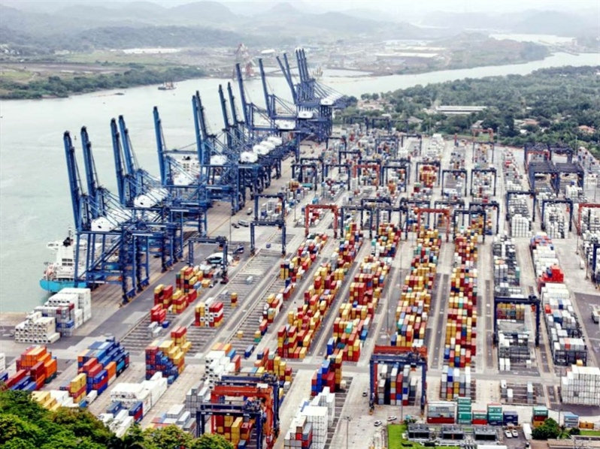
Transshipment Performance: PABBA
10% of T/S in LATAM.
Operation issue(NICPK port)
Port congestion in Central America(CRCAL)
PPC port congestion causes C&R
Notes:
Next, let's look at the TS situation at the PABBA port. The performance in the first half of the year was still acceptable, but in the second half, due to other shipping companies arranging additional services to call at PPC port, it led to port congestion and affect T/S arrangement.
再來看到PABBA碼頭的轉運狀況，上半年度的表現還可以接受，然下半年因受到其他航商安排額外的航線加靠PPC碼頭，導致該港碼頭壅塞，因這些原因，甚至WSA航線遇到C&R的情況。

Slide 6
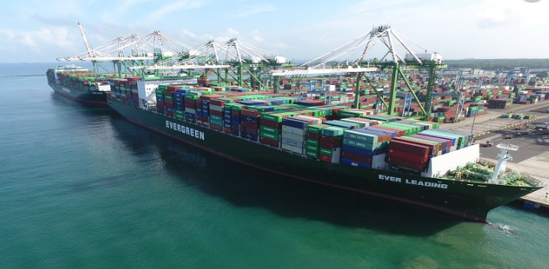

Transshipment Performance: PACCT
69% of T/S in LATAM
Port congestion in CAB area(PACCT/DOCAU)
Social unrest issue(HTPAP)
CAJ/AUE/NUE service: arranged ad hoc to CO/DO 20 times.
Outside feeder : 3 times
A total of nearly 19,000TEU of TS cargoes were relieved.
Notes:
Finally, the most important TS port/CCT, this is an important location connecting cargoes from Asia and Central America to Caribbean and USEC, its transshipment volume accounts for 69% of Latin America. Unfortunately, we encountered many challenges at this port last year. Especially, the CAN service connecting CAUCEDO, RIO HAINA and San Juan port with longest delay and situation is serious. We spend a total 60 days extra waiting time to get a berth last year. As a result, the trip number under this service is less than originally planned.
However, to relieve these transshipment cargoes, we not only arranged for CAJ to ad hoc DORHN/CO port, but also made AUE/NUE service to ad hoc DOCAU, even purchase additional space from outside feeder, we got a total extra space 19,000 TEU to rescue TS cargoes.
最後是連接拉丁美洲最重要的港口PACCT，其占比轉運貨量約69%，然該港口亦是因為受到港口壅塞影響貨載疏運，該港口是連結加勒比海重要的轉運港，然因我方於CCT及CAUCEDO港口共花費20及25天等候靠泊，這無疑是轉船港致命的殺傷力。然我們為紓解這些轉船貨載，不僅是安排CAJ加靠外，也做了XX次的FDR安排，共取得額外艙位XXTEU。

Slide 7




Strategies and Future Plans: Hotbox Arrangement
IMS Team Data Maintenance
Loading to Final Destination
Submit Application
Pricing BCC Approval
Request authorization for hotbox arrangement
Get necessary approvals from Pricing BCC
Update transshipment data according to instructions
Efficiently load and transport to final destination
Notes:
The first is hotbox arrangement, which is familiar to everyone. So, when you receive a request for customer, please be sure to follow the correct procedure to apply hotbox arrangement, please remember that such an application must get approval from pricing first, and then forward the message to colleagues in transshipment team, they will assist in arranging cargo loading on priority.
首先是hotbox安排，大家熟悉的方式，當您有收到客戶要求貨載優先運送，請您務必依循正確的流程向pricing BCC取得同意，然轉船組的同仁會協助優先安排轉運

Slide 8
T/S Arrengement
TRANSSHIPMENT ARRANGEMENT FOR PRIORITIES AND HOT CONNECTION
1- Reefers
2- DG Cargo 3- VIP 4- Fi/FO
Consult with BCC Pricing for priority / Hot Box (in partner vsls should be updated 48 hrs before ETA)
Special requests (HOLD) look for IMD approval and create DIT
Waiting for ELA MKD cargo Allocation

Slide 9



Strategies and Future Plans: Additional Space
Purchase Additional Space
CAB service Ad Hoc
Mother Vessel Ad Hoc
Extra loader
Outside FDR Plan
Secure extra space from partners
Utilize mother vessels for temporary overflow
Space supply from 3rd parties
Notes:
In addition, when we face such a situation, to increase space is a must. We will purchase additional space from existing partner, also arrange additional calls on other services, and even purchase space from outside FDR.
除此之外，當我們面臨這樣的情境時，增加艙位是不可少的，我們也利用區間航線向partner額外購艙，或者安排其他航線加靠，甚至向供應商爭取FDR加班船，然為加速這些計畫推行，ELA今年度也內部討論該事件，當轉船貨載超過三倍時，我們即會逐一地檢視應變措施，這些不再是口號，而是未來真真切切的計畫

Slide 10

Strategies and Future Plans: Optimizing Operations
1
Alternative Services
2
Service Optimization
Divert containers to nearby ports and move by truck/FDR.
LAE and CAN service reshuffle and space enlargement
Notes:
Next, we fully understand some case cannot be solved by way previously mentioned. Perhaps you can negotiate with customer to change it to alternative service, it means divert cargo to nearby country, and then deliver it to destination port by truck or FDR. Last year, we had several successful cases, and I would also like to invite Mr. William from Costa Rica to share experience with us.
Finally, would like to share with you that CAN/LAE service will change rotation and enlarge space this year. New vessel(ASPM) already phase into LAE service in February and also we will arrange new charter to CAN service. We still have to think positively and believe that the situation will gradually improve this year. But need your support, no matter operation coordination, routing optimization, etc. to make business smoother. Wish everyone would be very well this year.
最後，我們完全理解大家在前線所面臨的難處，但也有可能遇到無法透過先前提到的方法解決的案件，也許您可協調客戶更改運送方式，將貨載divert至鄰近國家，再透過卡車或者FDR等方式運送至目的港。
最後，也向大家分享今年度CAN航線將會於三月份更改rotation，LAE則會於二月份引進更大的船舶，但這都要請各位多多幫忙，不論是operation的協調，或者是優化路徑等等，希望今年度會是一個豐收的一年

Slide 11
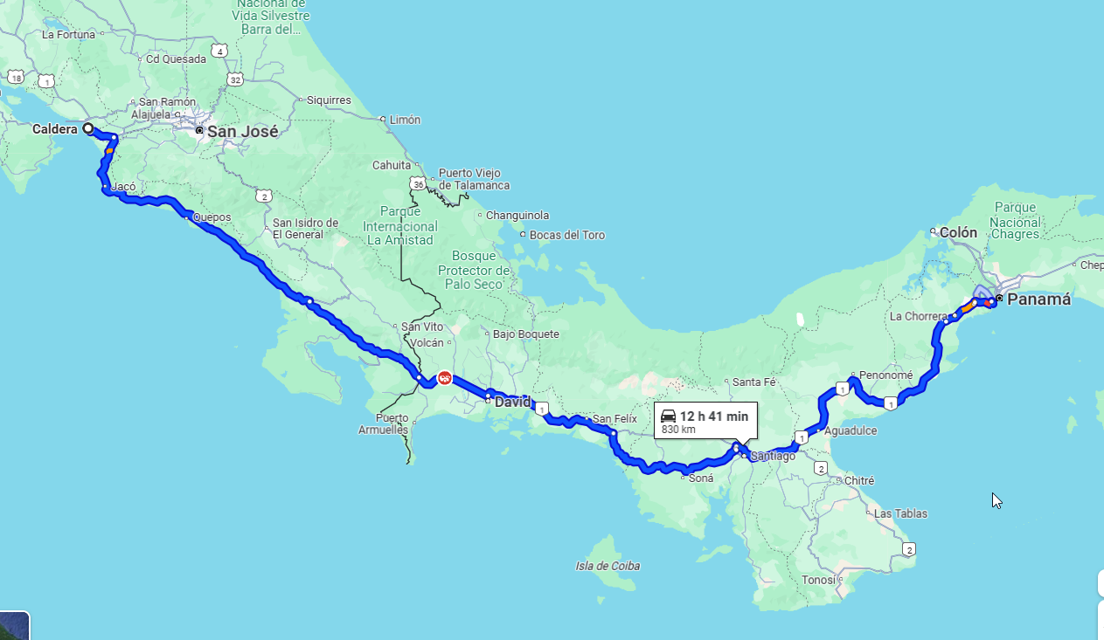
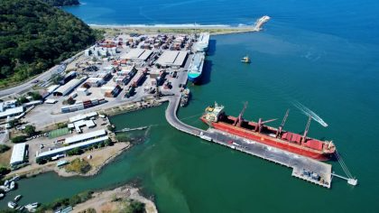
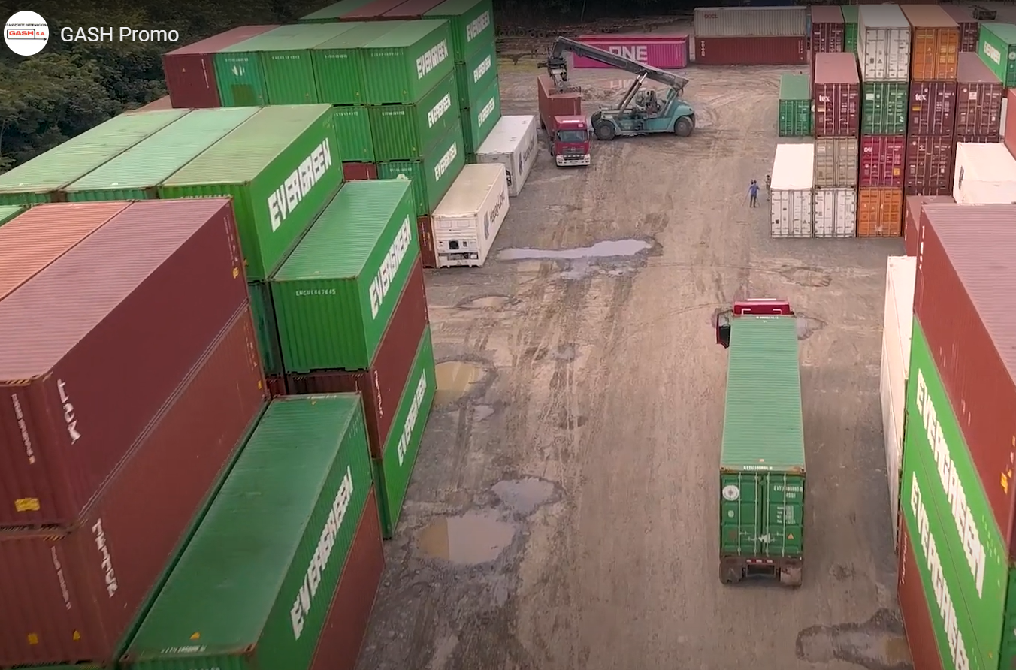
Panama – Costa Rica Intermodal service for special requests
Alternative soluation for urgent shipments that becomes more frequent among importers, driven by the increasing congestión at T/S ports.
Import cargo move PABBA – CRSJS inland delivery.
Allow customers to get full container to move the cargo to Costa Rica.
Discuss liner cost: Trucking cost, COD & Demurrage
Costa Rica Terminals
SPC (Sociedad Portuaria Caldera)
Created in 1980.
Administrated by SAAM Terminals, Hapag-Lloyd Terminal and infrastructure company.
Regulated and supervised by local government authority.
Port Area 12 hectares (container yard).
Teu capacity 5,500 teus.
Actual operational status: working at 110% to 150% of capacity.
A new concession to operate Caldera Port assigned by local government by 2026 to be published.
Transporte Internacional GASH
Depot Area 8 hectares (container yard)
Teu capacity 2,000 teus.
Local government authority allows carriers to handle the mty/laden equipment inventory at the outside depots due to Caldera Port limited space.
Actual operational status: 100% capacity.
CRCALT
(SPC)
CRCALD
(Outside depot)

Slide 12
Strategies and Future Plans: Optimizing Operations
1
Alternative Services
2
Service Optimization
Divert containers to nearby ports and move by truck/FDR.
LAE and CAN service reshuffle and space enlargement
Notes:
Next, we fully understand some case cannot be solved by way previously mentioned. Perhaps you can negotiate with customer to change it to alternative service, it means divert cargo to nearby country, and then deliver it to destination port by truck or FDR. Last year, we had several successful cases, and I would also like to invite Mr. William from Costa Rica to share experience with us.
Finally, would like to share with you that CAN/LAE service will change rotation and enlarge space this year. New vessel(ASPM) already phase into LAE service in February and also we will arrange new charter to CAN service. We still have to think positively and believe that the situation will gradually improve this year. But need your support, no matter operation coordination, routing optimization, etc. to make business smoother. Wish everyone would be very well this year.
最後，我們完全理解大家在前線所面臨的難處，但也有可能遇到無法透過先前提到的方法解決的案件，也許您可協調客戶更改運送方式，將貨載divert至鄰近國家，再透過卡車或者FDR等方式運送至目的港。
最後，也向大家分享今年度CAN航線將會於三月份更改rotation，LAE則會於二月份引進更大的船舶，但這都要請各位多多幫忙，不論是operation的協調，或者是優化路徑等等，希望今年度會是一個豐收的一年

Slide 13
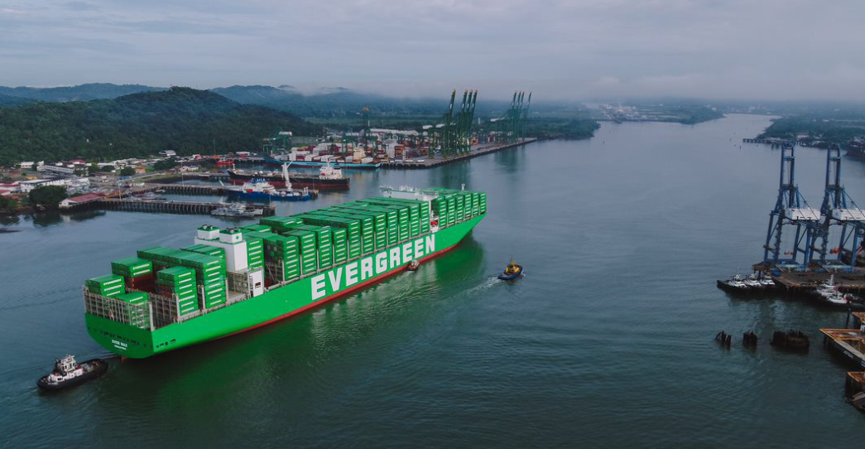
Thank you
Notes:
The above is my presentation.

Slide 14
Transshipment Performance comparison
264%
47%
169%
+650%
+1160%
179%
194%
33%
148%
47%
-11%
-42%
355%
142%
223%
46%
Notes:
Next, will share with you the situation of major transshipment ports around the world last year.
Comparing the performance of transshipment, most ports faced congestion last year and resulting storage costs increased compared with Y2023.
Among of them, you can see that the worst situation is at CCT, the number of TS cargoes over free time at CCT Terminal increased by more than six times last year, and storage charge caused by this increased by more than 11 times.
So, when we face such a huge challenge, ELA colleagues are racking their brains to help you & colleagues, so we propose the following strategies to deal with future difficulties.
比較全球各轉船港的績效，大部分的港口在去年度都是面臨壅塞且其造成的額外成本又更是較2023年度增加，然，我們在面臨如此巨大的挑戰時，ELA的同仁絞盡腦汁的想協助各位，因此提出以下對應策略

