Slide 1


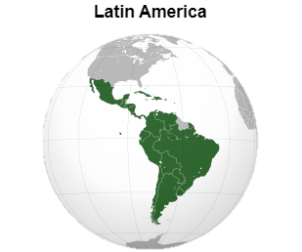

2025 LAAM
TPE OCD

Slide 2

TOPIC 1
(1) 2024 Terminal Stevedore Cost and Incentive Review
(2) 2024 Terminal Cost Control Result

Slide 3


Latin American Terminal Stevedore
Cost Control Result
Total 35 Terminals
6 Terminals
> local CPI
9 Terminals
< local CPI
Inform BCC to adjust THC accordingly when terminal handling rate increased

Slide 4


TOPIC 2
Agency Evaluation
(MAR : OPD/OCD)

Slide 5

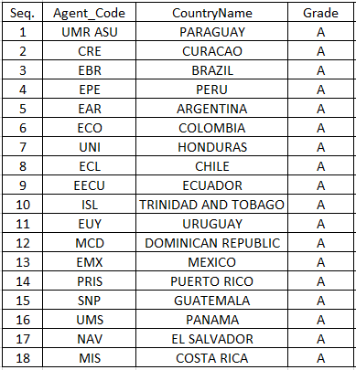
Agency Evaluation 2024 (MAR: OPD+OCD )
MAR | Item evaluation | %
OPD | Schedule Monitor | 15%
OPD | Regional Schedule Difference | 15%
OPD | Extraordinary Report | 10%
OPD | Terminal Productivity | 10%
OPD | ALDS data evaluation | 10%
OPD | MTE Invoice Evaluation | 10%
OPD | COD shipside procedure Evaluation | 10%
OPD | Shifting Data Evaluation | 10%
OCD | Rebate/Volume Incentive evaluation | 10%
Remark: The OCD incentive item will be replaced by terminal information in the near future. We will advise once the system is ready.

Slide 6

Agency Evaluation : Terminal Information
Terminal Information Collection
Will be included in agency evaluations.
The platform is under development and expected to launch in Q2.
Once ready, agents and offices will receive notifications and detailed instructions.
Monthly Data Submission
Agencies will receive an email at the start of each month to review and update terminal data in an Excel file.
The file must be uploaded to the platform, where it will be automatically processed.
Scoring Criteria
Timeliness of information submission.
Completeness of data.
Proactive notification of abnormal events to headquarters.

Slide 7



TOPIC 3
Global Terminal Operators in Latin America & Caribbean
Potential Strategic Terminal (hub)

Slide 8
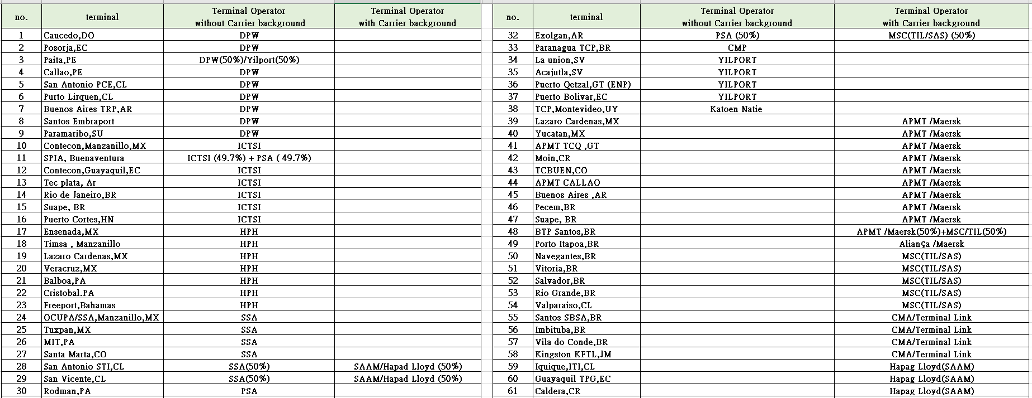
Total 63 Latin America terminals operated by global terminal operators or carrier affiliates

Slide 9
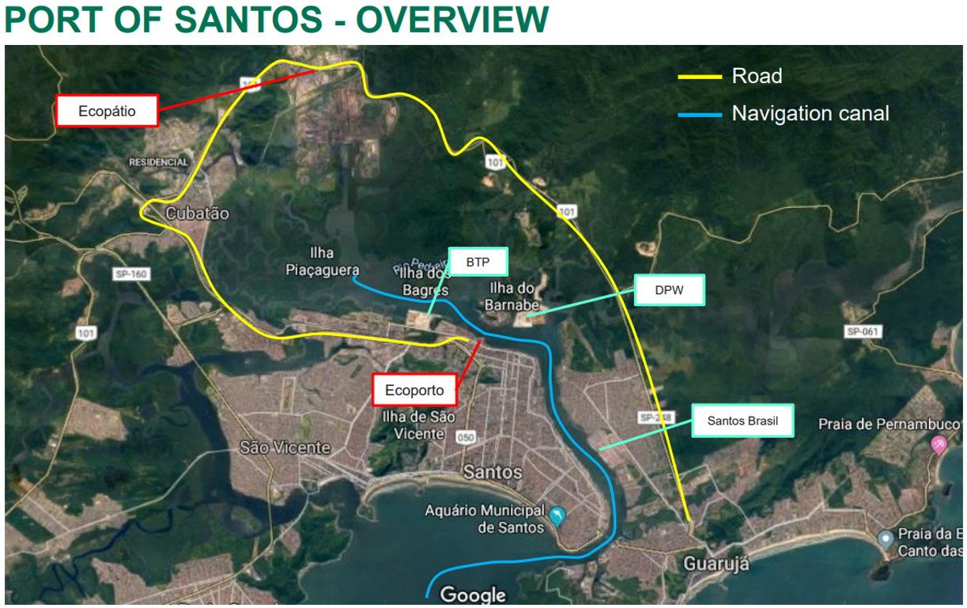
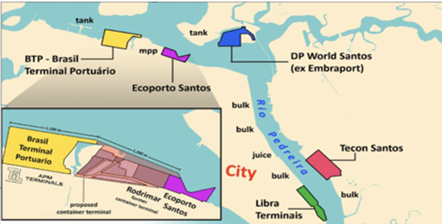
STS10 Rebranded as Tecon Santos 10
The Brazilian government will auction container terminal STS10 at Port of Santos, addressing urgent capacity needs.
Located at Saboó Pier near Parque Valongo, it will handle up to 3 million TEUs annually.
The revised plan (approved by Ministry of Ports and Airports (MPor) and the Civil House ) adds a fourth berth, increasing port capacity by 50% (from 6M to 9M TEUs).
Rebranded as Tecon Santos 10, the project will receive BRL 4.5B in investment for a 25-year concession, awarded to the highest bidder.
Timeline:
April: Submit project to Federal Court of Accounts (TCU) after _____public consultation.
September: Publish bidding notice.
December: Auction will be held.
Mid-2026: Sign concession contract.

Slide 10
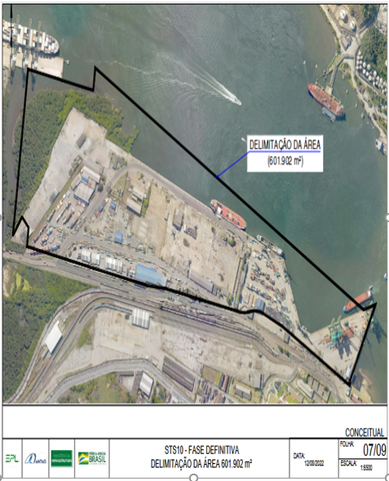
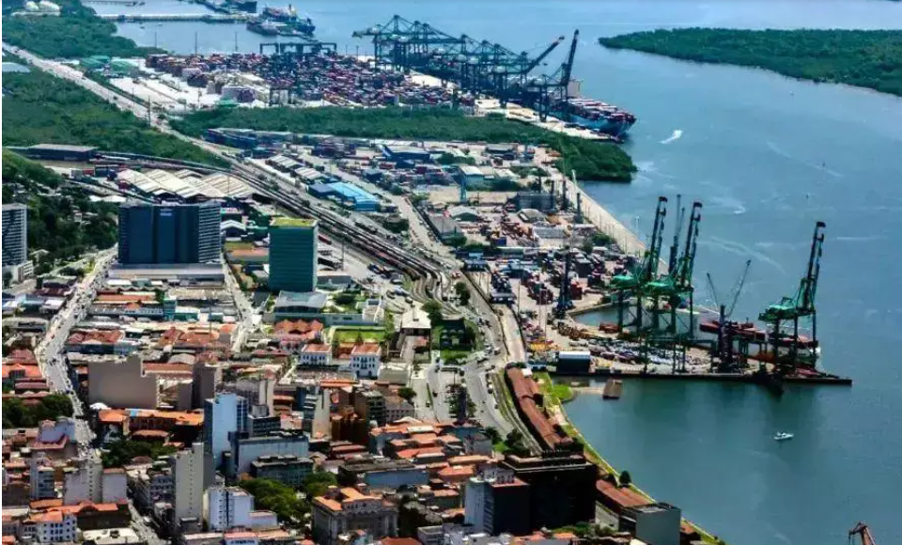
Tecon Santos 10 Location

Slide 11

TOPIC 4
OUTLOOK – Challenge
Year 2025

Slide 12



2025- Challenge Year
Costing Competitiveness
Find ways for cost-cutting & Minimize the cost increase, if statutory tariff applied, the bottom line is not higher than CPI and try to convince BCC for THC tariff review.
Close monitoring local competition and volume growth, Timely action to induce any possible rebate/incentive with respective vendors(Terminals).
Operation ____Monitoring
Close monitoring ship berth schedule, spare no efforts for BOA & maximal gang arrangement to minimize port stay, timely report to Regional Center(ELA) & HQ proactively if any abnormality confront.
Always solve the problem timely!!
Maintain ALDS/abnormal report timely.
Port Information Update
Always update port regulation such as the maximal vessel size allowed.
Close Monitoring port notice and feedback any potential new port terminal investment project.
Cost Control
Berth Management
Regulation Updates
Market Monitoring
Investment Monitoring
Incident Reporting

Slide 13

Thank you
Gracias
Merci
Obrigado

