Slide 1
Intermodal
LOG-IMD-AMS Andrew Wang
Feb/27/2025

Slide 2

CONTENT
Transshipment in Panama
Routs Alternative
。 Safe Transportation
。Swift Delivery
。Satisfying Customer
Intermodal Daily Monitor Tools

Slide 3
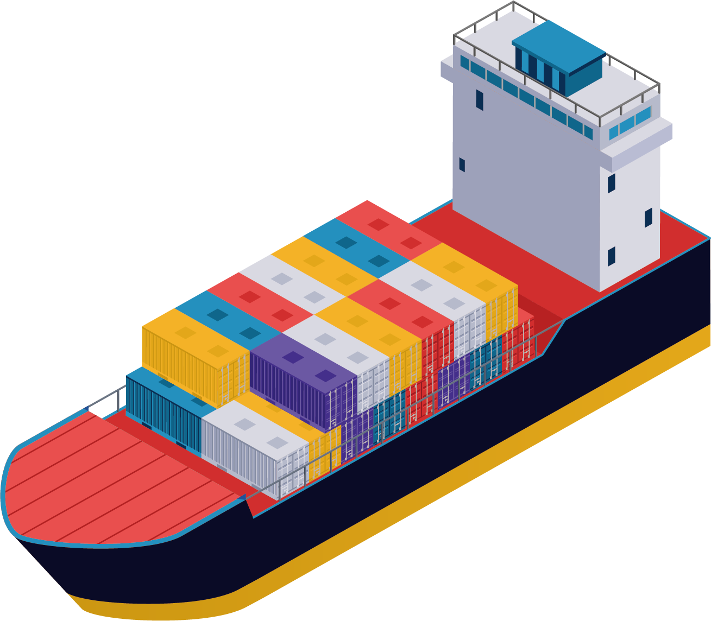

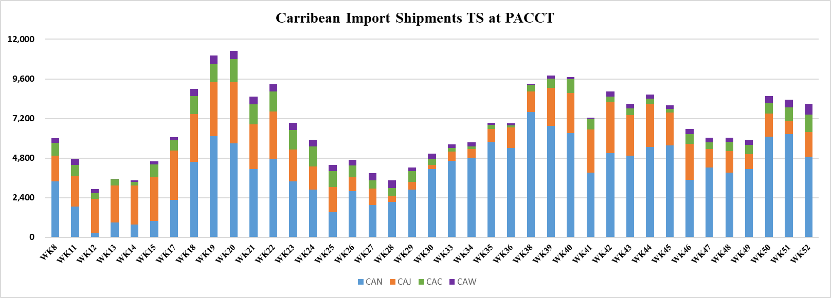





Transshipment in Panama
Routes Alternative
Vendor Management (Case Share )
High Stock Level in 2024
Current Stock: 5,918 TEU
TEU
Cause I :
Port Severe Congestion
OGPA/LOVY0013-055E (APR/28)
MXLZC-PACCT (4 Vessels AUE/NUE) +2,758 TEU
x5
OGWS/URSL0004-195E (SEP/05) +2,340 TEU
1
3
Cause II:
Extra Discharger
3 vessels (OGPA/OGWS) +6,164 TEU
x4
Avg. Stock (Q4)
7,800 TEU
Avg. Stock (Q2)
7,300 TEU
OGWS/BEDY0003-086E(JUL/28)
+1,066 TEU
x3
1
2
3
Avg. Stock (Q1)
4,500 TEU
2
Cause III:
Haiti Port Close(Feb-May / Sep-Oct)
x2
Avg. Stock (Q3)
4,300 TEU
[ Methods ]
CAN Service Revamp
CAJ/AUE/NUE Ad-Hoc
3. Outside Feeder as Option
4. Routes Alternative
Service Line
weekly allocation: 2,400TEU
Increasing to 3,250 TEU in APR,2025
Line | Destination | Schedule Delay/ Slide / Blank (Week) | Voyages | % (52WK) | Allocation (TEU) | Avg. Stock (x times/digest week)
CAN | DO(TT/GY/SR/BB), PR | WK 5/9/11/13/15/17/22/26/28/35/38/42/45/47/49/50 | 16 | 21% | 1,000 | x4
CAJ | HT, JM(BZ) | WK 4/6/8/10/12/14/16/18/20/28/30/32/34/41/49/50/51 | 17 | 33% | 950 | x1.8
CAC | CO | WK 1/2/9/14/19/22/24/28/30/38/42/45/48/50/51 | 15 | 29% | 350 | x1.8
CAW | CR, GT, HN, CO | WK 2/6/10/15/27/30/45/50/52 | 9 | 17% | 150 | x2
LAE | GT, SV, HN, NI, CR | WK 1/6/7/19/22/31/37/39/40/41/47/50/51/52 | 14 | 27% | 700 | x3
Extra Loader | DO, HT | W21(FDR*1) / W22 (AUE*1) / W24 (NUE*1) / W41(FDR*1)/ W45(FDR*1)/ W46 (FDR*1)
More TS hub added for SRPFS/GYGEO ( Sample )
New
New
3

Slide 4

Transshipment in Panama
Routes Alternative
Vendor Management (Case Share )
Transship Priority Policy
Reefer /Dangerous /Out of Gauge / VIP(HOT)：No Roll Over
General Cargo：First In/First Out
Attention : 1. To well conduct any urgent shipment, pls must notify BCC/ TS team to arrange as HOT
2. HOT Box arrangement shall agree by BCC in advance so that TS team can follow up
[ Notice was sent on Feb/02/2024 ]
As management and different departments concern the reason/(procedure) of rollover transshipment cargo,
a meeting been held between LOG-IMD and PJD BCC. A conclusion of the subject issue been agreed by PJD and Management as following.
1. When BCC provide Rollover Reefer/Dangerous/Out of gauge/VIP container list, a specific reason must be
provided and maintain it to the system.
2. A specific reason to rollover dry container without first in/first out guideline must be provided in Transshipment system in SOL+. Same as rule 1, reason as “BCC roll-over” is not advisable.
3

Slide 5


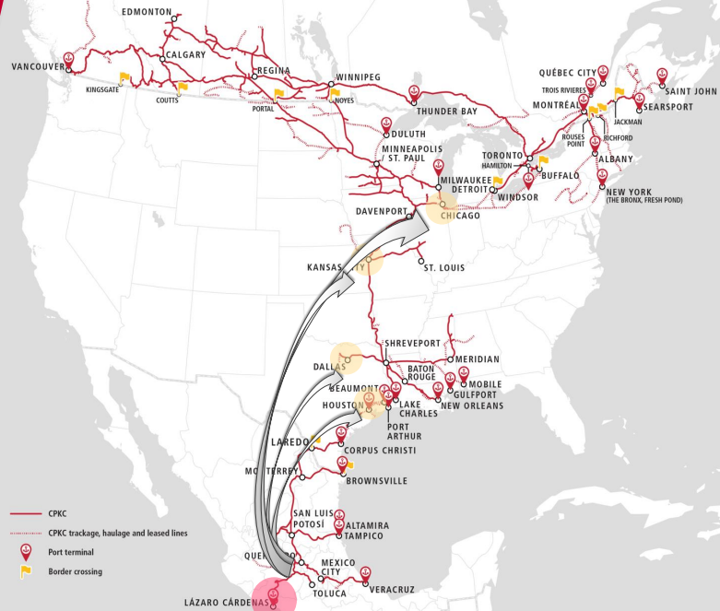




Transshipment in Panama
Routes Alternative
Vendor Management (Case Share )
Cross-border transportation (US/MX)
1881
The Canadian Pacific Railway Company (CP) becomes incorporated
1887
KCS established
1889~2005
KCS merged companies(MidSouth Rail Corporation, TFM) and renamed Kansas City Southern de Mexico (KCSM)
CP merged companies(Soo Line in the U.S. Midwest, D&H )
2021~2023
CP completes its acquisition of KCS and approved by STB on March 15, 2023. The companies combine on April 14, 2023, to create CPKC.
Land Route
THE BORDER/US RAMP
VIA | Start/Destination | Days
THE BORDER | Houston | 1
THE BORDER | Chicago | 4
THE BORDER | Kansas City | 3
THE BORDER | Dallas | 2
MXLZC /THE BORDER
MXLZC | THE BORDER | 4 Days
Inland Transit time:
To Connect Water Service
LAE: GT /SV / HN / NI / CR
WSA2: GT /PE / EC, PE-[WSA]-CL
3
Notes:
MX-US 33只(MXLZC-DLS/HUS)
US-MX 10只(DLS/HUS/CHI-MXLZC)

Slide 6
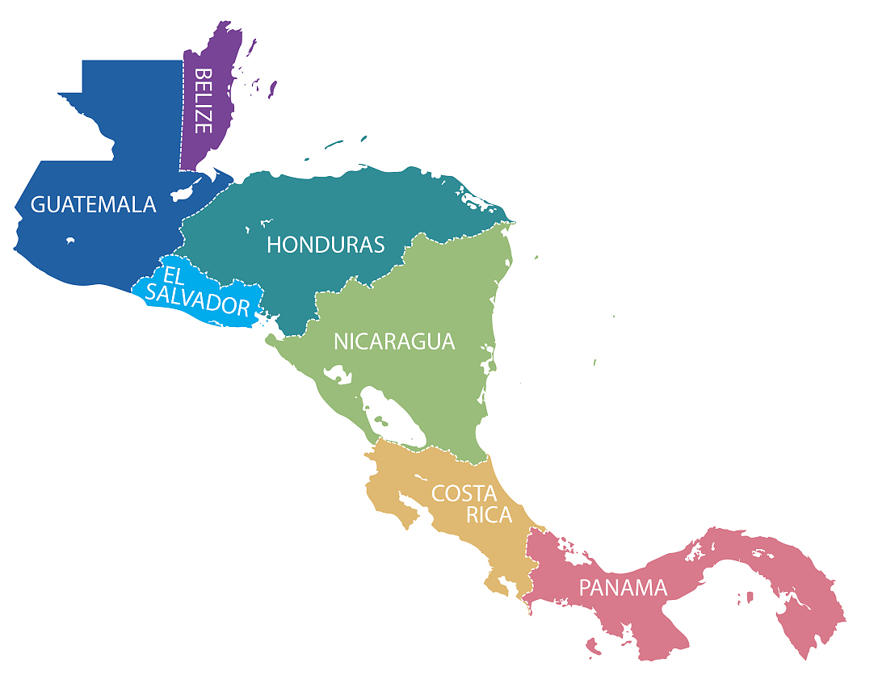

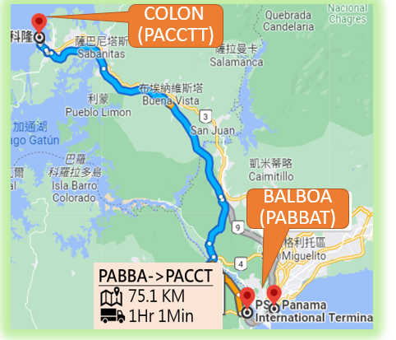
Transshipment in Panama
Routes Alternative
Vendor Management (Case Share )
Cross-border transportation (Central America)
Capital
Alternative solution due to LAE schedule delay
Water Route
East Coast (CAW): PACCT-CRMOB-GTZST-HNZPU-COCTG-PACCT
West Coast (LAE): PABBA-CRCAL-NICPK-HNSLO-MXLZC-MXMZO-GTZNJ-SVAGR-CRCAL-MXLZC
Puerto Santo Tomas De Castilla (GTZST)
/ San Salvador (SVSJH) 380 KM / 7 HR
Land Bridge
From | GTZST | GTZNJ | CRMOB | CRCAL | PABBA | PABBA | PACCT
To capital | SVSJH |  | NIMGA |  | CRSJS | PACCT | PABBA
Distance (KM) | 380 | 277 | 550 | 477 | 852 | 75
Hours | 7 | 4.5 | 9 | 8 | 13 | 1.5
Puerto Quetzel (GTZNJ)
/ San Salvador (SVSJH)
277 KM / 4.5 HR
Port of Moin (CRMOB)
/ Managua (NIMGA)
550 KM / 9 HR
10 more truckers(incl. 1 Rail) to participate
3-4 vendors to acquire, others as back up
Shuttle volume in Y2024 (laden+empty)
PABBA-PACCT: 18,446 Boxes
PACCT-PABBA: 12,933 Boxes
Caldera (CRCAL)
/ Managua (NIMGA)
477 KM / 8 HR
Colon (PACCT)
Inland Transit time:
Balboa (PABBA) / San Jose (CRSJS)
852 KM / 13 HR
3

Slide 7
Thanks for your listening.
。 Safe Transportation
。 Swift Delivery
。 Satisfying Customer
PPT模板下载：www.1ppt.com/moban/ 行业PPT模板：www.1ppt.com/hangye/
节日PPT模板：www.1ppt.com/jieri/ PPT素材下载：www.1ppt.com/sucai/
PPT背景图片：www.1ppt.com/beijing/ PPT图表下载：www.1ppt.com/tubiao/
优秀PPT下载：www.1ppt.com/xiazai/ PPT教程： www.1ppt.com/powerpoint/
Word教程： www.1ppt.com/word/ Excel教程：www.1ppt.com/excel/
资料下载：www.1ppt.com/ziliao/ PPT课件下载：www.1ppt.com/kejian/
范文下载：www.1ppt.com/fanwen/ 试卷下载：www.1ppt.com/shiti/
教案下载：www.1ppt.com/jiaoan/ PPT论坛：www.1ppt.cn

