Slide 1

2025 LAAM Meeting
EMC TPE - LOG ECD
Agenda
2024 Performance Review
  - Expense, Inventory & Evaluation
IoT Smart Container
SOL+ Dashboard
Highlights for 2025
2025 LAAM | JOE CHU

Slide 2
2024 KPI Performance - Expense Analysis
2024 total expense: $22.6M, 8% of Global Expense
Major parts are Empty Repo, i.e. BRT & Feeder (75% or 16.9M), following by LOLO (16% or 3.68M)。Only item with expense decreased is M&R.
Global Expense
CSA Expense
YOY +44.1% Compared with 2023 (VS. Global +5.24%)
Item | Cost YOY
 | 2024 | 2023 | Diff | CSA % | Others% | Global%
Storage | $1,724,501 | $998,342 | $726,159 | +72.74% | -12.88% | -9.02%
LOLO | $3,689,437 | $3,003,490 | $685,947 | +22.80% | -6.79% | -4.81%
BRT | $14,205,653 | $9,832,527 | $4,373,126 | +44.50% | +7.08% | +10.45%
M&R | $299,994 | $322,645 | -$22,650 | -7.00% | -5.41% | -5.43%
Feeder | $2,771,544 | $1,594,455 | $1,177,089 | +73.80% | +39.70% | +43.49%
Total | $22,691,129 | $15,742,651 | $6,948,478 | +44.14% | +2.29% | +5.24%
2

Slide 3

2024 KPI Performance - Expense Analysis Overview
Where CSA stands ? Compared to other areas.
Expense YOY by Areas, 2024 vs. 2023
Expense YOY in ratio, 2024 vs. 2023
* Rank 2nd on the YOY expense growth.
4
1
3
2
5
Rank 5th in terms of total expense both on 2023 & 2024.
And 1 of only 2 on 2024 Top 5 with expense increased.
3

Slide 4
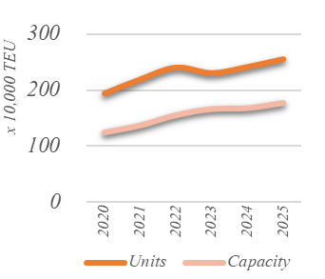
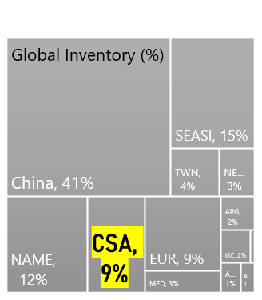
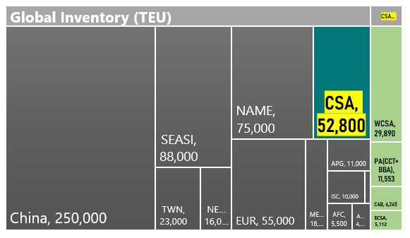
2024 KPI Performance Inventory - Global Overview
Geopolitical disruptions in global supply leading to increased turnaround time and higher cost.
Unstable sailing schedule/Terminals congestion leading to empty overstocks situation.
US Trade Policy may reshaping global supply chains which increasing the handicap of empty management.
4

Slide 5

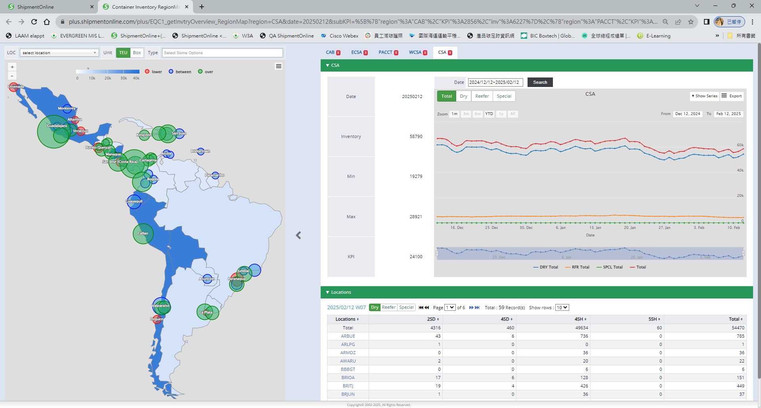


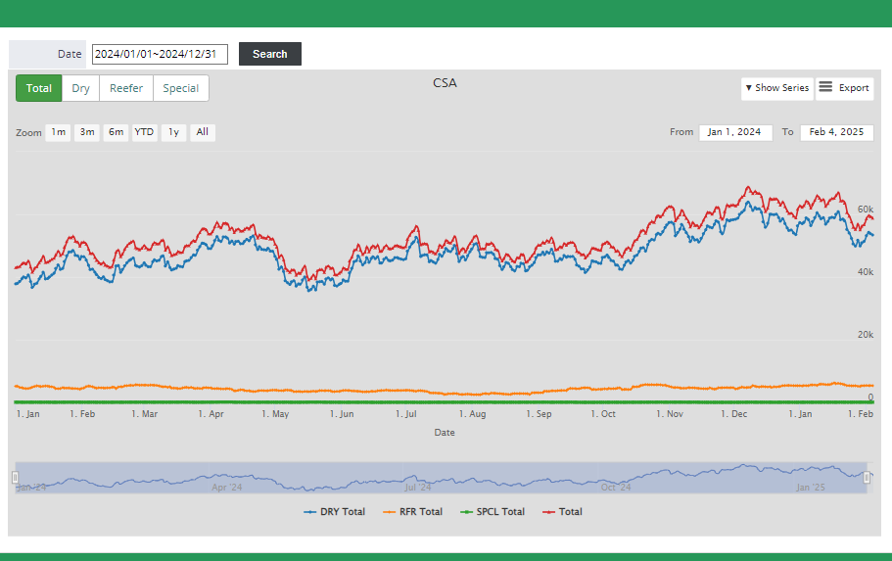
2024 KPI Performance Inventory
HTPAP : 1,231
DOCAU : 1,988
Struggled with overstock situation and evacuation plan,
  continues to exceed the KPI.
Highly depending on the performance of terminals Operation.
MZO 11,678
LZC : 1774
CCT : 9,227
BBA : 2,034
BRITJ : 977
BRSTO : 805
Tue, Dec 31, 2024
Dry Total : 56,333 TEU
CAL : 3,335
KPI 24,100
CLVAL : 1,834
CLSAI : 806
ARBUE : 1,312
5

Slide 6
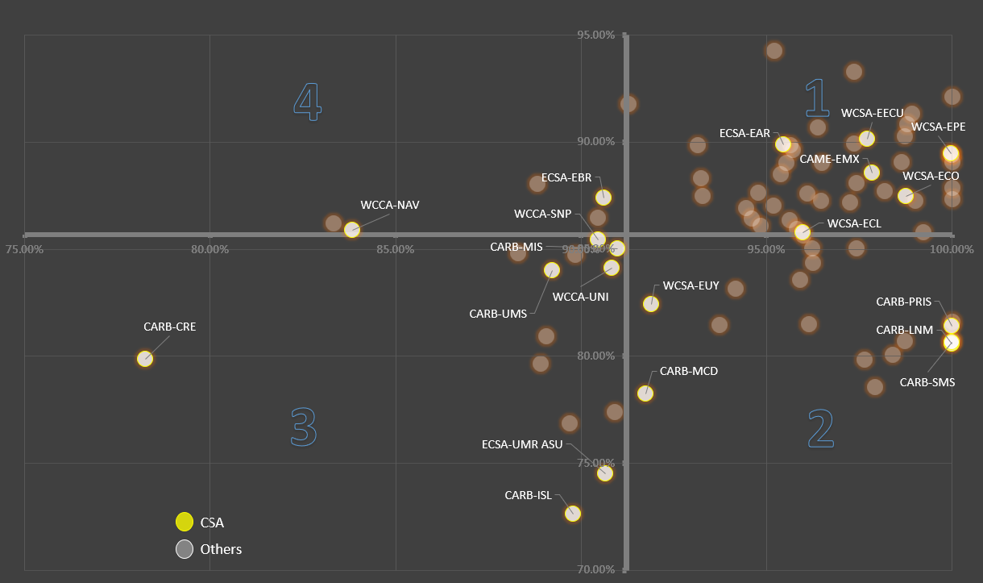
2024 KPI Performance -Agency Performance
Heads up -
Area 1 :
  Better than average both on cost and management items, please keep maintaining the good performance.
Area 2 :
  Better than average on Cost control, need to enhance Management items.
Area 3 :
  Achievement ratio lower then average both on cost/Management items, need to enhance on both.
Area 4 :
  Better than average on Management items, need to enhance on Cost control.
Global Average achievement in 91.2% / 85.69% (Cost/Management Items)
VS. CST area of 92.0% / 83.67 %
Average achievement ratio
- Management Performance (40) -
- Cost Control Performance (60) -
(Achievement Ratio in %)
6

Slide 7

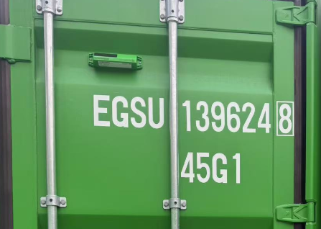
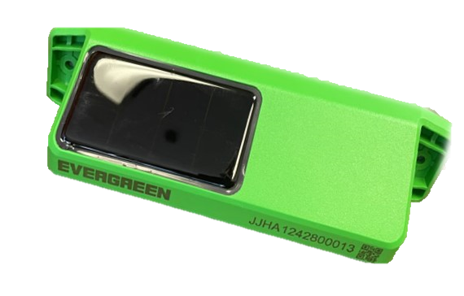

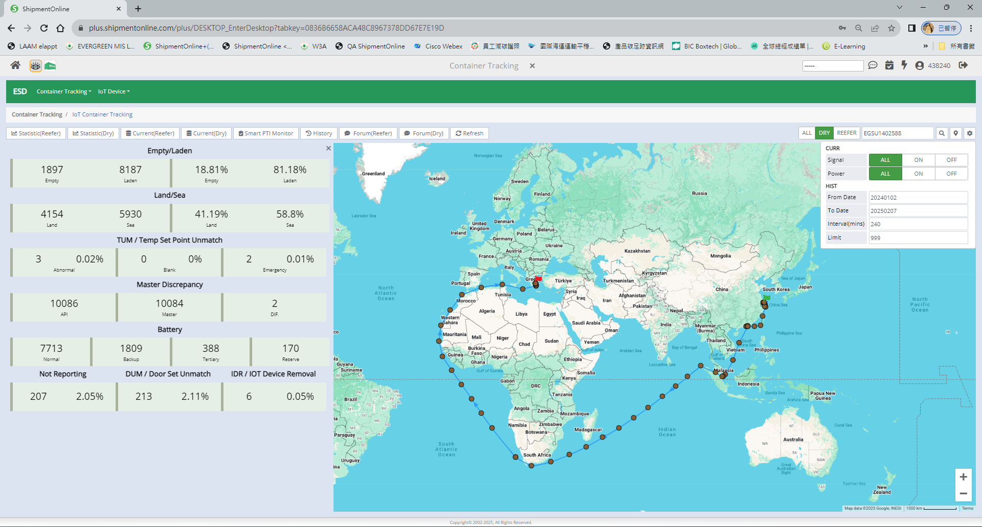
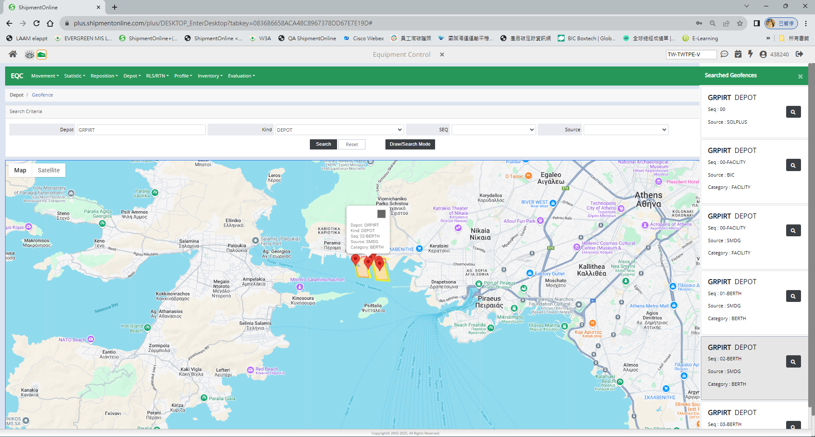




SMART (Dry) Containers - IoT
- Important Progress of Evergreen IoT -
Functions Available
2023 R&D
Powered by solar panel
2024 Test & Production
10,000+ units been installed for Validation
2025 Mass Production
Mass production 250K units, deliver 50K units/month. To make it 300K in total under Evergreen fleet.
GeoFencing
Light Detect
Position
Flip Detect
RFID
Shock Detect
Door Sensor
Temperature
Smart Container Tracking Dashboard
Powered through internal battery recharged using an integrated solar panel
Remotely programmable EPC Gen2 compliant RFID tag
Wireless cellular and BLE
3-axis digital accelerometer
Built-in cellular antenna, GPS/GNSS antenna and BLE antenna
GPS,GLONASS,BeiDou, Galieleo and QZSS support
Tamper detection sensor
Ambient temperature sensor to measure internal and external temperature for abnormal rates of change.*
Container tracking, integrated with SOL+ data, expedite inventory control, promote potential hinterland export, reduce empty repo.
With light/shock/door/Temperature sensors, helping to identify the timing and root of cause and/or L/P tracing.
Attention : DO NOT remove IOT device from container.
7

Slide 8
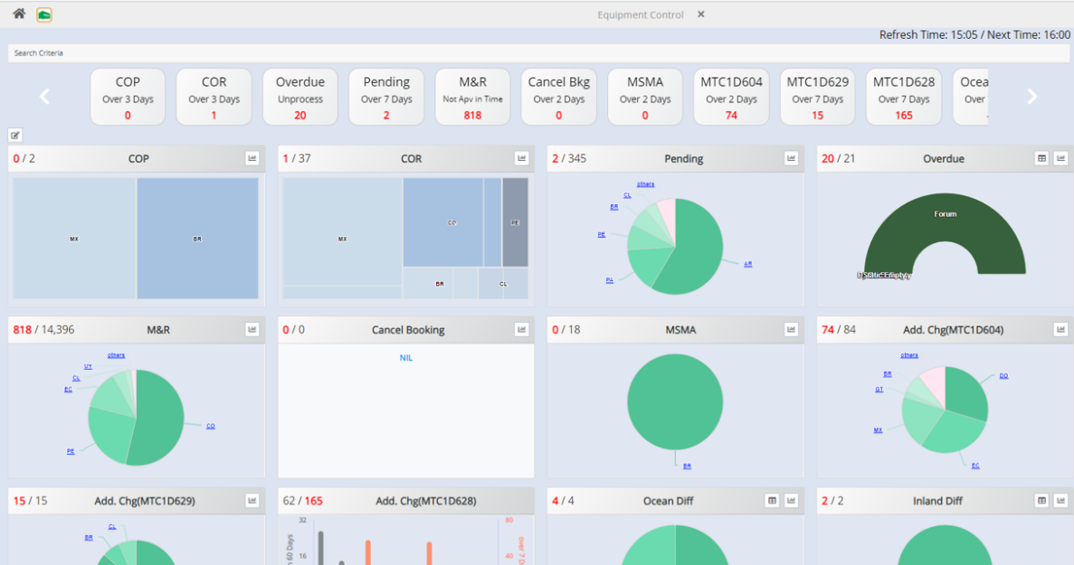
SOL⁺ MY EQC Dashboard
Daily to-do at a Glance.
Finish daily To-Do.
Make sure movement status processed timely
  and punctually.
  -EDI Transmission within 2 hours
  -Status updated within 1 day (*Applied to non-EDI Reporting)
  -Pending status should be reviewed and update
  within 3 days
Overdue container tracing:
  -Clean out 30 days overdue right away.
  -Claim for DV once fallen into long overdue
  and/or no proof of existence.
  -Comply with Custom Regulation to evacuate
  containers at 1st priority.
Reorganized according to users’ preference
Data refreshed daily
Summarized by item and pending cases
Double click to link to main screen of each items
8

Slide 9


Equipment Supply for 2025 - Container Supply (ESD)
Plan for 2025 :
Make it Balance
    Based on On Hire/New Built : +270K TEU
    Target to Off Hire/Sell : -270K TEU
    Balance +/-0 TEU
Fleet Capacity
Containers
1.91M TEU
+8.6%
2.58M TEU
+0 %
- Average ages (Year) of container fleets (2025/02)
Assistance needed -
Type/Size | OWN | LSG
20 | 5.4 | 10.3
40 | 14.2 | 12.6
HQ | 4.6 | 5.3
Dry AVG | 4.9 | 6.2
2RS | 7.4 | -
4RH | 4.1 | 4.8
YEAR | %
Before 14'(incl.) | 14 %
15'-25' | 86 %
* Please do your upmost to promote sale of old units whenever possible. *
* Push buyers to pick up sold units ASAP and also avoid misused.*
* Arrange empty or export to 2nd hand units demanding area.*
9

Slide 10
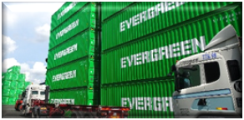
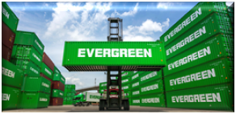
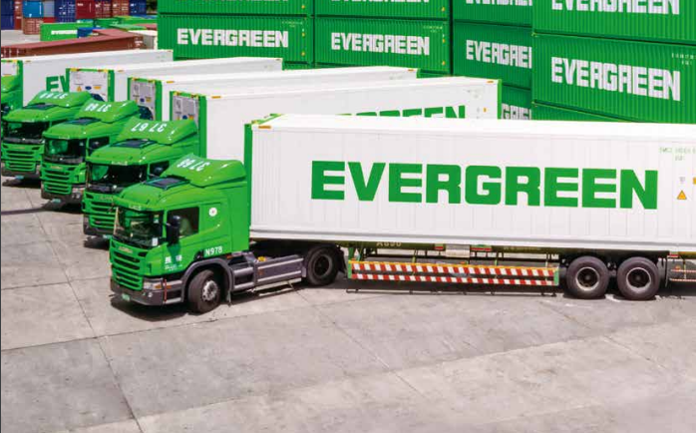
Highlights for 2025 - Important Targets
Flow Balanced to reduce Overstock
M&R On-Site Auditing (2 times/year)
No Dunnage/Residue in returned Empty
Overdue Monitor (Empty + Laden) in timing manner
聯運
聯運
df
10

Slide 11

Thank You ~
11

