Slide 1

2025
LAAM Meeting
Presented by EGA NYC / MKD ATC
February 27th, 2025

Slide 2

Part 1
S/B Market
Performance Review
Part 2
Part 3
Action Plan

Slide 3

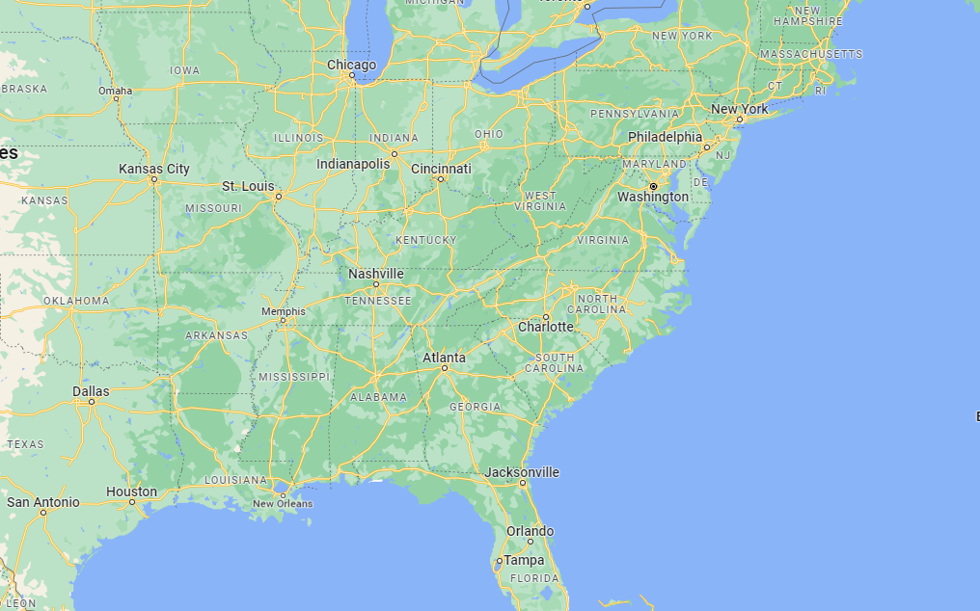
USEC from/to CARI Service Scope
USBOS
USBOS
USNYC
USNYC
USBAL
USNFK
USCHS
USCHS
USSVN
USSVN
PACCT
PACCT
Rotation | USSVN | USCHS | USBOS | USNYC
TEU | 70 | 70 | 20 | 220
AUE/E | USSVN | USNYC | USNFK | USBAL
NUE/E | USSVN | USCHS | USBOS | USNYC
Market Share | USSVN | USCHS | USBOS | USNYC
Total vs EGLV | 88,314/ 9.73% | 42,556/ 5.67% | 4,177/ 84.42% | 103,374/ 8.21%
Notes:
Additional OGEC service from time to time; not on a weekly basis service
Continue with no SAX/E service for Day9

Slide 4





Feeder Connection
EXISTING CARIBBEAN NETWORK
CAN Service
CAC Service
PRSJU
DORHN
DOCAU
COSMM
COBQL
COCTG
PACCT
PACCT
CAW Service
CAJ Service
JMKSN
COCTG
CRMOB
PACCT
PACCT

Slide 5

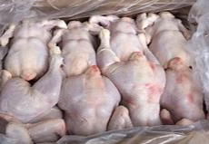








Market Share Overview
SAVANNAH - USSVN
Market volume increased to 88,314 compare to YR 2023
EGLV rank 4 @ 9.73% M/S ;
Top Commodity:
Poultry 8.38%
Beer 3.41%
Paperboard 13.8%
Raw cottons 6.11%
Woodpulp 5.12%
Clay 4.95%
CHARLESTON - USCHS
Market volume decreased to 42,556 compare to YR 2023
EGLV rank 5 @ 5.67% M/S ;
No USCHS calling on SB from May to October in YR2024
Top Commodity:
Resins 6.44%
Woodpulp 6.47%
Tires 5.19%
Auto parts 4.1%
Pet/animal feeds 4.28%
Notes:
* Data based on Datamyne Report (YR 2024)

Slide 6






Market Share Overview
BOSTON - USBOS
Market volume continues to grow from 1249 in YR2023 to 4177 in YR2024
EGLV continues to be rank no.1. – 84% M/S
Top Commodity:
Paperboard 49.68%
Auto parts 2.17%
Woodpulp 4.91%
Alumin/forgings 3.11%
Plastic prods 3.11%
Lumber 3.85%
NEW YORK - USNYC
Market volume increased to 103,374 teus compare to YR 2023
EGLV rank 5 @ 8.21% M/S – slight increased M/S compare to 2023
Top Commodity:
Poultry/chiefly 7.25%
Grocery prods 5.43%
Apparels 3.41%
Plastic prods 3.56%
Used Auto 1.97%
Notes:
* Data based on Datamyne Report (YR 2024)

Slide 7
Performance Review
Part II
CARI SB – 609 Trade
CARI NB – 610 Trade
Intra-CARI – CC Trade

Slide 8
Performance Overview
SB KPI 380/W
Total: 13,424 TEUS – 82% of KPI
Average: 312 TEUS/WEEK
Revenue : $800 / AVG GPS: $324
Total: 1,198 TEUS – 77% of KPI
Average: 24 TEUS/WEEK
Revenue: $1004 / AVG GPS: $386
NB KPI 40/W
Total: 12,044 teus - 113% of KPI
Average: 243 TEUS/WEEK
Revenue: $468 / AVG GPS: $207
Intra KPI 265/W

Slide 9
2023 vs. 2024
2024
VS
2023
82%
13,424 teus
CARI SB
13,045 teus
66%
77%
1,198 teus
CARI NB
1,848 teus
90%
113%
12,044 teus
Intra
12,029 teus
107%

Slide 10
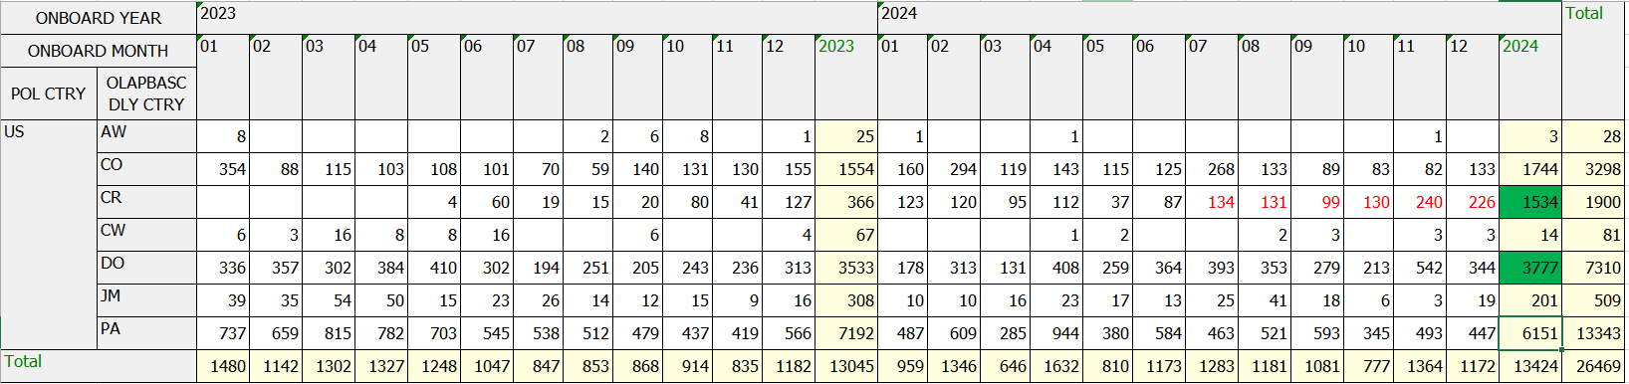
SB – 82%
2024 Review
NUE/W skipped USCHS from May to October, 2024
Strong demand to Costa Rica, but facing challenge on feeder space
Congestion in CCT, Hot Connection List Distributed on a Weekly Basis
2025 Challenges
Costa Rica?
More stable & Consistent feeder schedule?

Slide 11
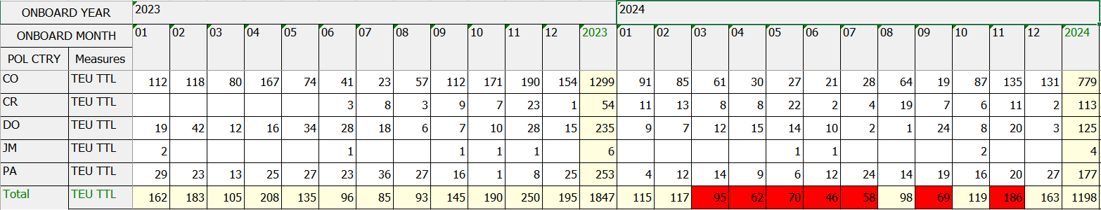
NB – 75%
2024 Review
Strong exports from CO in late Q4
Exports from Costa Rica is increasing
Excess of skipping 2nd call of DOCAU from CAN service
2025 Challenges
Costa Rica?
Space on AUE/E + NUE/E to support NB volume – Already announced 610 GRI

Slide 12
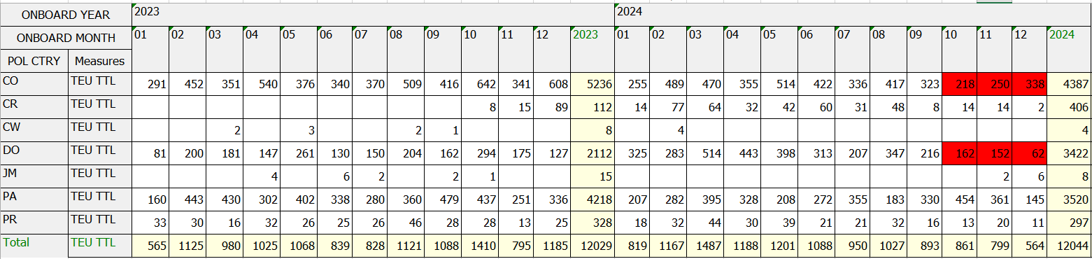
Intra – 113%
2024 Review
Lack of equipment into CO from time to time – potential market
Congestion in CCT – Hot Connection List Distribute on a weekly basis
Excess of CAN svc skipped 2nd call on DOCAU, PRSJU, impacted DO and PR exports
CAJ continue to operated under single vessel – result in bi-weekly service available
2025 Challenges
Costa Rica?
Service stability on CAC?
Feeder Cost Change on CAN starting April?

Slide 13

Office Performance
Colombia
Jan-Dec L/F AVG: 64 TEU
KPI: NB-20 / Intra: 70
85%
Puerto Rico
Jan-Dec L/F AVG: 12 TEU
KPI: Intra - 15
Panama
Jan-Dec L/F AVG: 97 TEU
KPI: NB-2 / Intra: 85
78%
107%
Jan-Dec L/F AVG: 12 TEU
KPI: NB – 4 / INTRA – 26 TEU
Jan-Dec L/F AVG: 71 TEU
KPI: NB-2 / Intra - 69
CR/JM/CW
Dominica Republic
50%
95%

Slide 14
Part III
Action Plan - 2025

Slide 15

Moving forward…
Communication
Exports Forecast
Inventory Request when not enough to support regional businesses
Tender bids
Direct Calls
Less concern on idling at t/s port
Quicker transit time
More flexibility in freight
Reefers
- More opportunity to bring cargo into the United States.

Slide 16
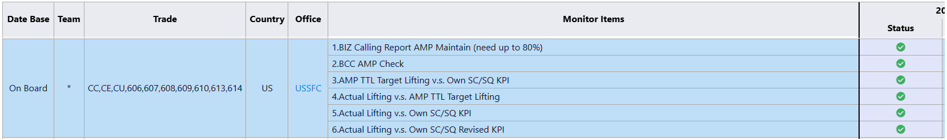
AMP Program
1.BIZ Calling Report AMP Maintain (need up to 80%)
80% of A/C base MUST be maintained
2.BCC AMP Check
We download report every 5th day of the month
3.AMP TTL Target Lifting v.s. Own SC/SQ KPI
Target(M) Lifting: maintained by BIZ
Own SC/SQ KPI: Given by BCC
4.Actual Lifting v.s. AMP TTL Target Lifting
Actual Lifting higher than 90% of AMP TTL Lifting
5.Actual Lifting v.s. Own SC/SQ KPI
Actual Lifting higher than 90% of Own SC/SQ KPI
6.Actual Lifting v.s. Own SC/SQ Revised KPI
Actual Lifting higher than Own SC/SQ Revised KPI

Slide 17
Thank you

