Slide 1


2025 Latin America Agency Meeting
Presented by
ELA MKD

Slide 2

Evergreen Marine (Latin America) S.A.
Agenda
Review
Backhaul
Regional
Feeder

Slide 3
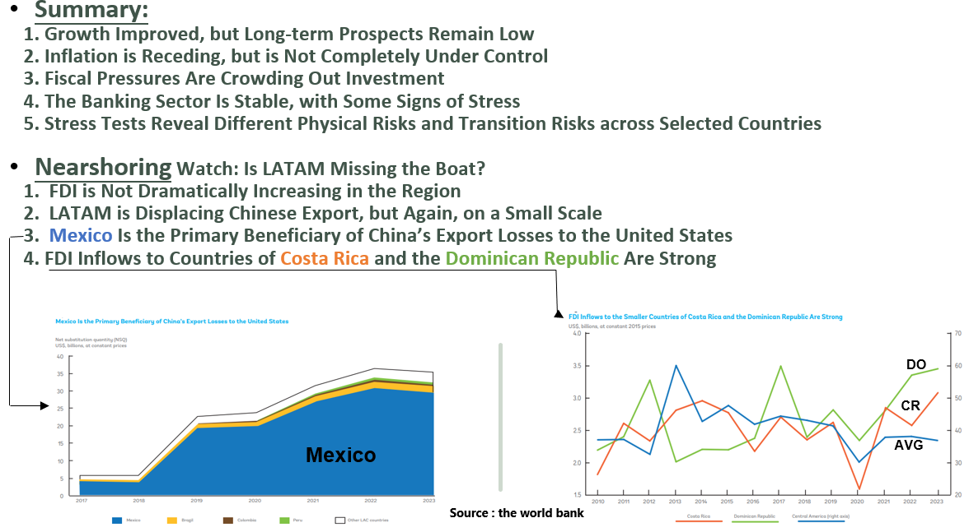
What Took Place In 2024 - Economic (LATAM)
General

Slide 4
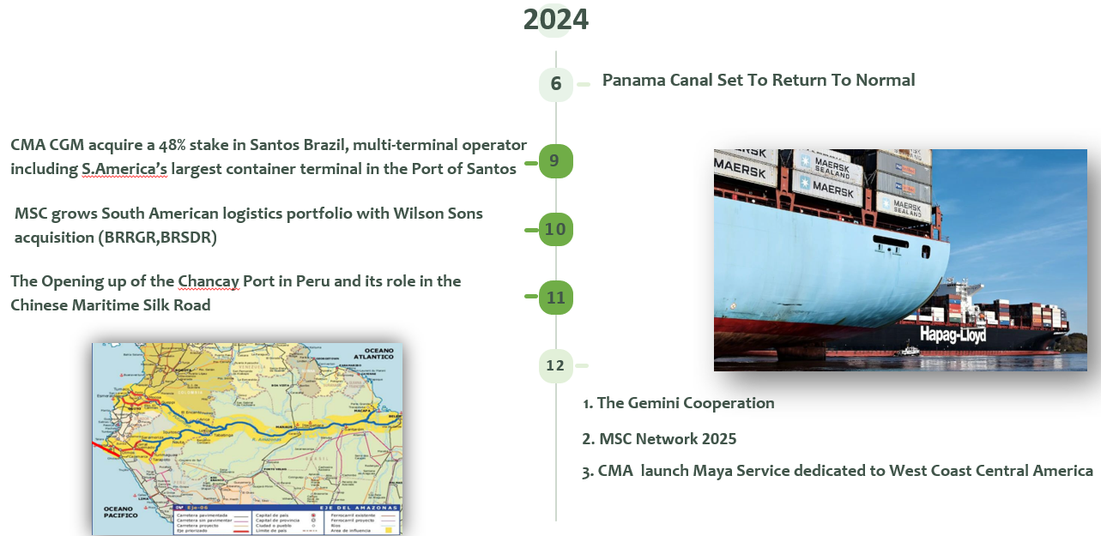
What Took Place In 2024 - Shipping Industry (LATAM)
General

Slide 5
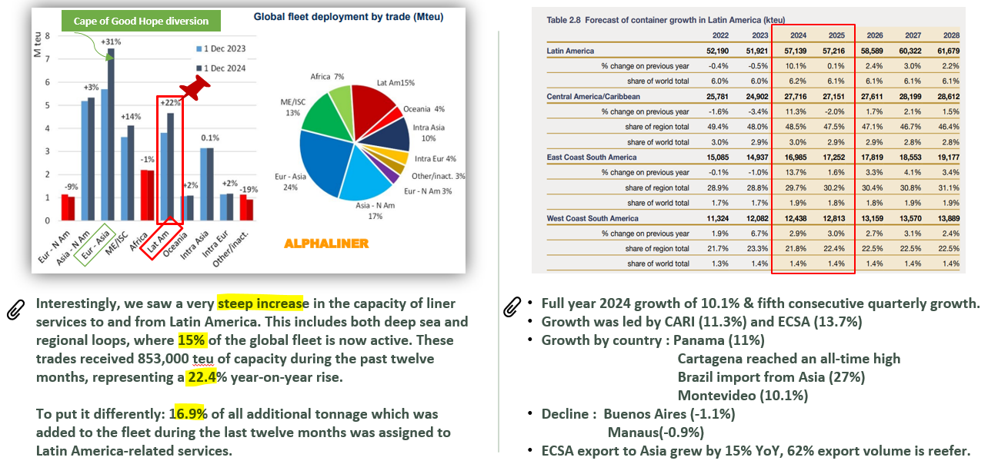
General
General
What Took Place In 2024 - Alphaliner / Drewry

Slide 6
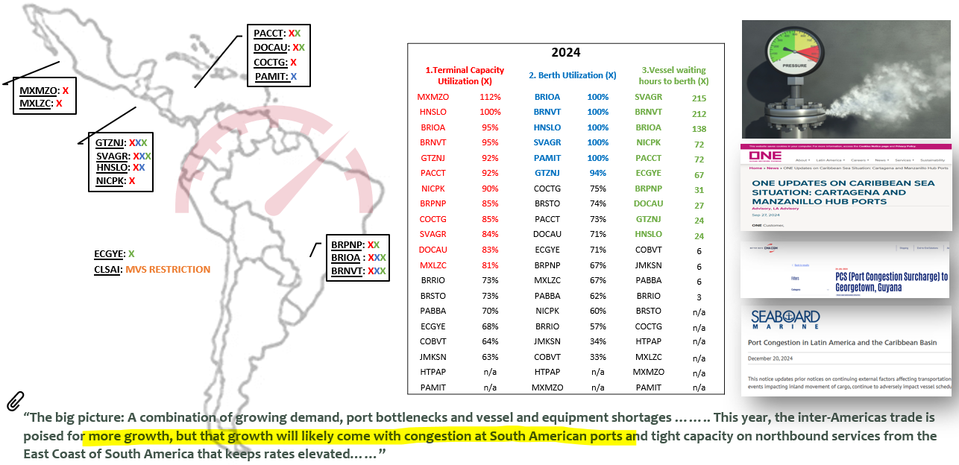
General
General
What’s The Pain In 2024 - Status of the main terminal

Slide 7
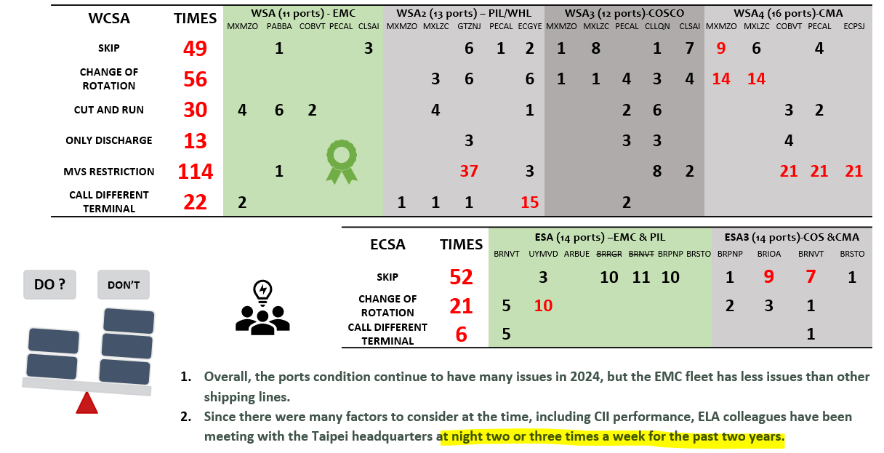
General
General
What’s The Pain In 2024 and What ELA Did?

Slide 8
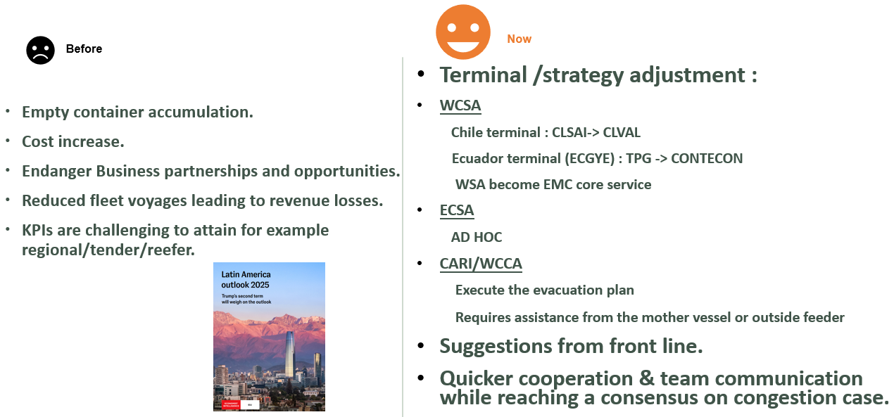
General
General
What’s The Pain In 2024 and Improvement

Slide 9
Pricing Team
Notes:
Good morning, General Manager, TPE Management, and all Latin America colleagues, I’m Omar Chen, in charge of ELA MKD pricing team, And here we start ELA MKD pricing team report.

Slide 10
Evergreen Marine (Latin America) S.A.
Backhaul
Notes:
First of all, let’s begin our backhaul trade

Slide 11
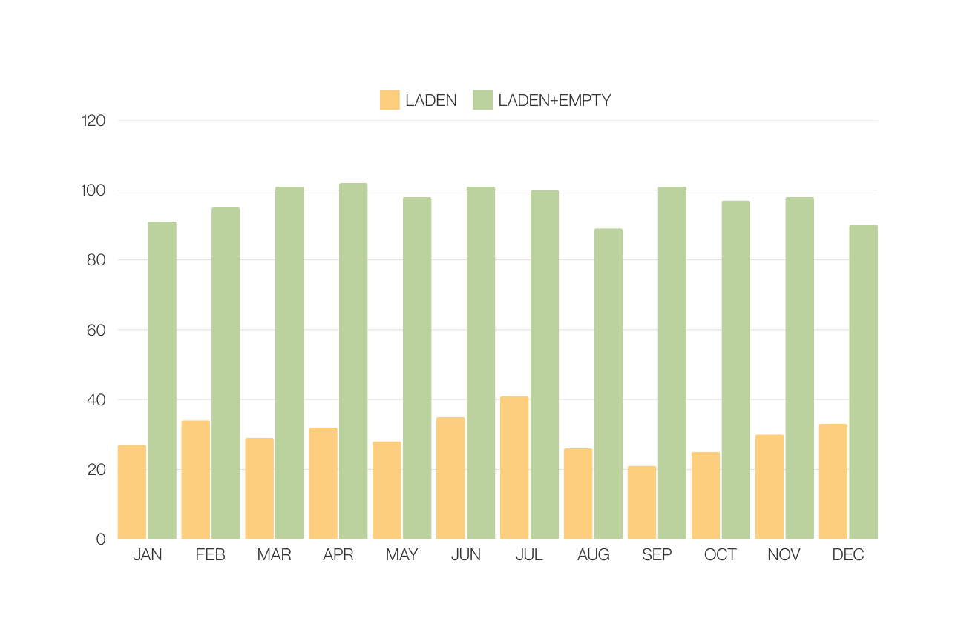
Backhaul
2024 WCSA Performance
Performance
Laden AVG: 30.1%
L+M AVG: 96.8 %
2025
Challenges
Chaotic Schedule (SKIP/ C&R/ Delay)
High density at MX/GT
Service Reshuffle (PECHY/CLLQN)
5 KPI
Notes:
In 2024 West coast of south Americia, which represent WSA/WSA2/WSA3/WSA4,
EMC avg laden performance is 30.1%, Laden + empty 96.8%
The reason we can't achieve 100% L+M is because chaotic schedule in WCSA.
What we will face in 2025, will be pretty much the same as last year,
1. Vessel still change schedule, delay even omit.
2. High density in Mexico & Guatemala.
3. New service reshuffle, for example like WSA3 call PECHY i/o PECAL, and omit direct call CLLQN.
2025 KPI laden will be 30%, L+M still stick 100%.

Slide 12
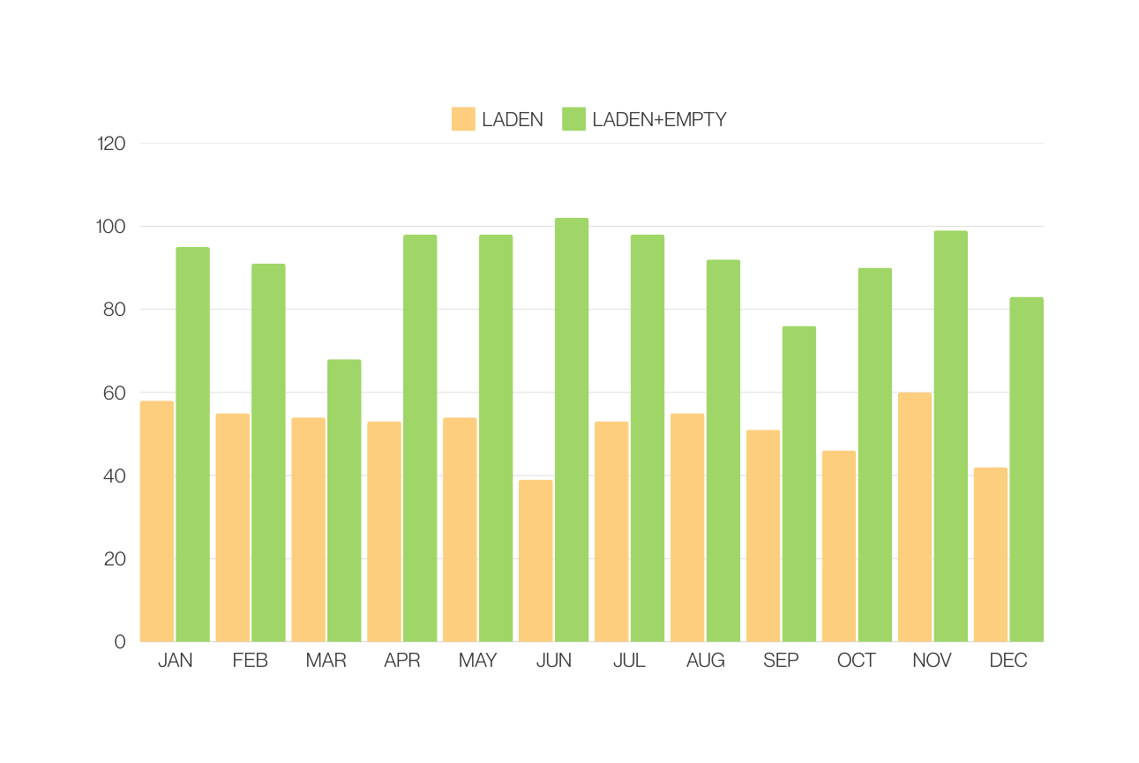
Backhaul
Backhaul
2024 ECSA Performance
Performance
Laden AVG: 50.9%
L+M AVG: 91.1 %
2025
Challenges
Chaotic Schedule (SKIP/ C&R/ Delay)
High density at BRNVT
Notes:
let's change to East Coast part.
in 2024 ECSA, which is ESA & ESA3
our AVG laden is 50.9%, L+M empty 91.1%
The reason why we can't achieve L+M 100%, is because 2024H1 Due to BRNVT terminal construction issue cause seriously delay,
However, 2024H2 ESA decide to decrease double calling port, BRNVT/BRRGR/BRPNP.
In 2025, our challenge still related to service schedule.
2025 laden KPI for 1H will be 52% in Partner v/s, for our own L type or F type will be 39%
2H is 54% partner v/s, L & F type remain 39%
L+M still need to achieve 100%.

Slide 13






Backhaul
WHAT ARE WE GOING TO DO AT 2025?
Backhaul
SCHEDULE
Service
Communicate with local partner to update schedule daily
WSA Core Service
WSA2 BSA Increase
ESA upgrade from L type to F type
TERMINAL
CONTAINER
Keep tracking terminal status all the time
Save reasonable empty by EQC system at SOL+
BSA allocation should be 100% utilized
Notes:
and how we overcome those challenges, and what EMC going to do 2025?
Here are 4 plans and suggestions.
1. service, WSA will become core service start from April, which lead us with more control on WSA. Also, 19.6% space increase, and we keep exchanging more BSA on WSA2.
ESA v/s will upgrade from L type to F type, which CII performance will become much more better.
2. Terminal, we would like to encourage local office with well-communication or relationship with terminal, always have plan B when V/S can’t departure.
3. Schedule, like previous mention, in 2024 we suffer a lot of schedule delay, encourage local office communicate with partner, and update schedule daily.
4. Container, keep reasonable empty by using EQC SOL+ tool, and BSA allocation should be 100% utilized.

Slide 14
Evergreen Marine (Latin America) S.A.
Regional
Notes:
And next let's go on our main topic, regional.before going to our performance, as you know, the characteristic of regional is so complicated but full of potential,under ELA territory,

Slide 15
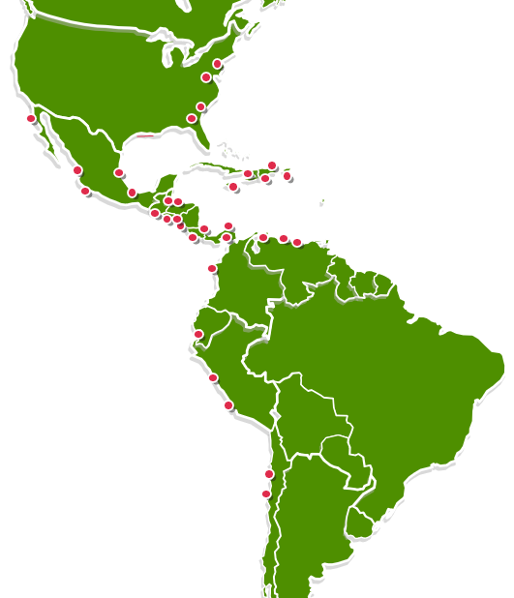
Regional
13 Trades
21 Markets
746 Port Pairs
Notes:
we have 13 Trades, 21 markets include import & export, 746 port pairs.

Slide 16
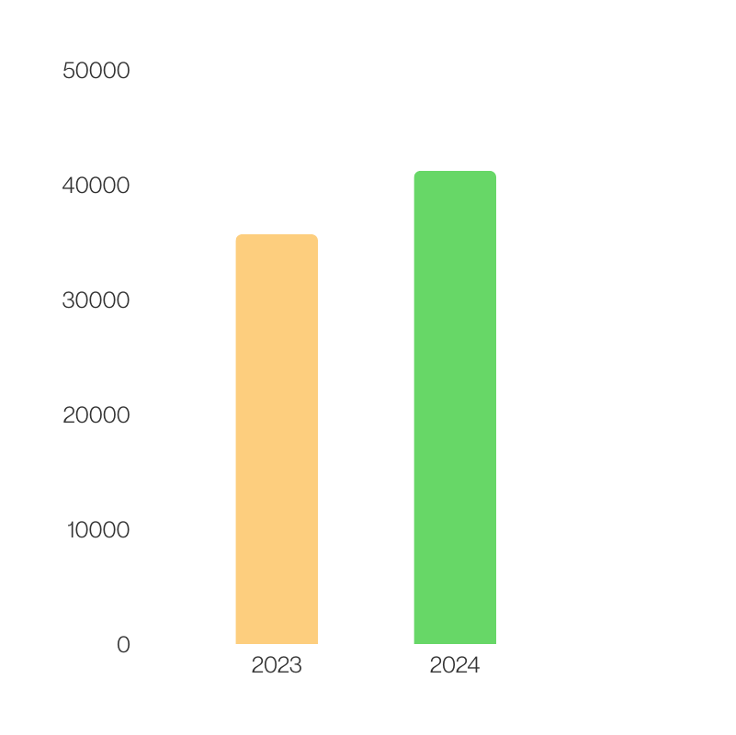

Regional
Regional
2024 ELA MKD Regional Performance
15%
41,242 TEU
35,713 TEU
Notes:
Despite with many trades and port pairs, ELA regional performance compared with 2023 we increase 15%, which is 41,242 TEU in 2024.
we really appreciate each office effort to make such performance.

Slide 17

Regional
Regional
20%
USA
15%
MX
6%
CARB
13%
WCCA
46%
WCSA
TOTAL GPS 8.4M
Source: Olap
Notes:
In this 41 thousands TEU, divided by POL export, 20% from United State, 28% from central America, 46% from West Coast regional, and 6% for CARB.
We achieved 8.4M GPS.

Slide 18
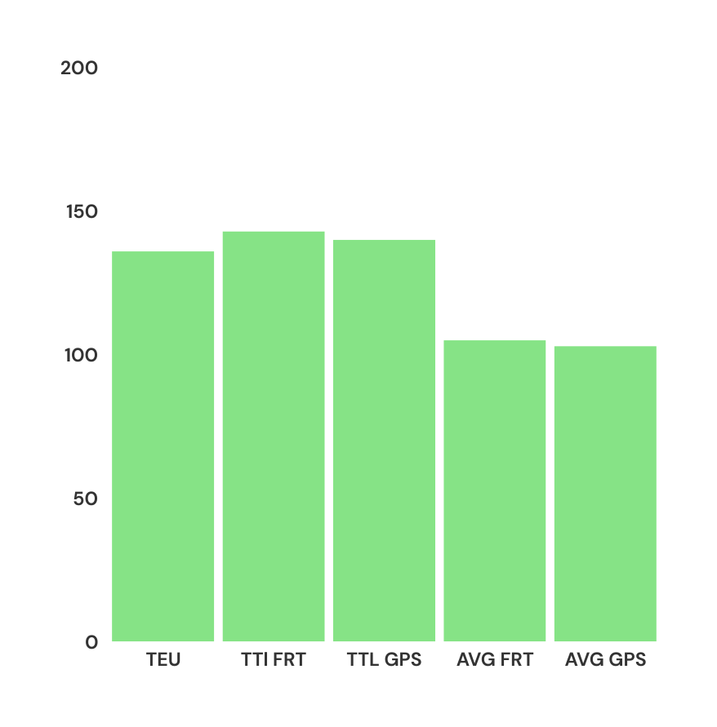

Regional
Regional
2024 ELA MKD Budget
143%
140%
136%
105%
103%
Notes:
With this performance, 2024 ELA achieve all budget KPI,
Not only TEU, but also the FRT,

Slide 19
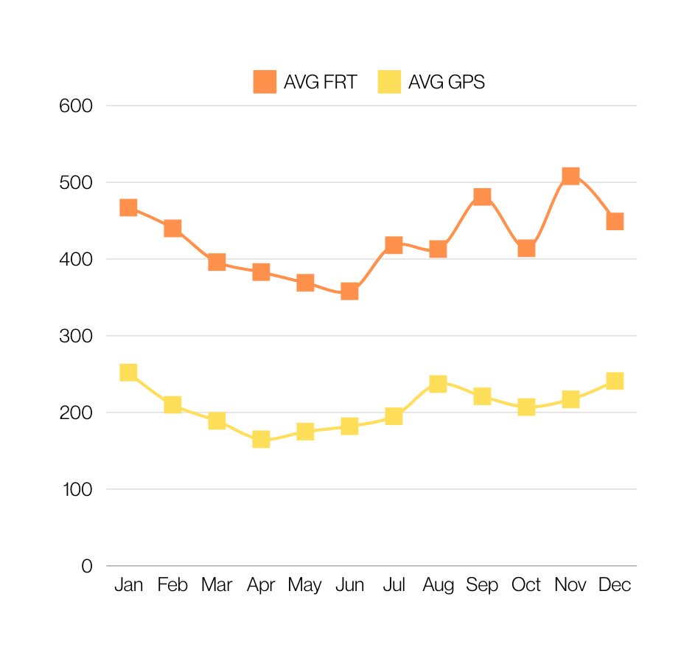

Regional
Regional
2024 ELA MKD AVG FRT/GPS
Notes:
the turning point is June,
ELA adjust rate policy to increase O.F. started from H2 2024,
as you can see our trend of AVG FRT/GPS at 2024 getting better and better.

Slide 20
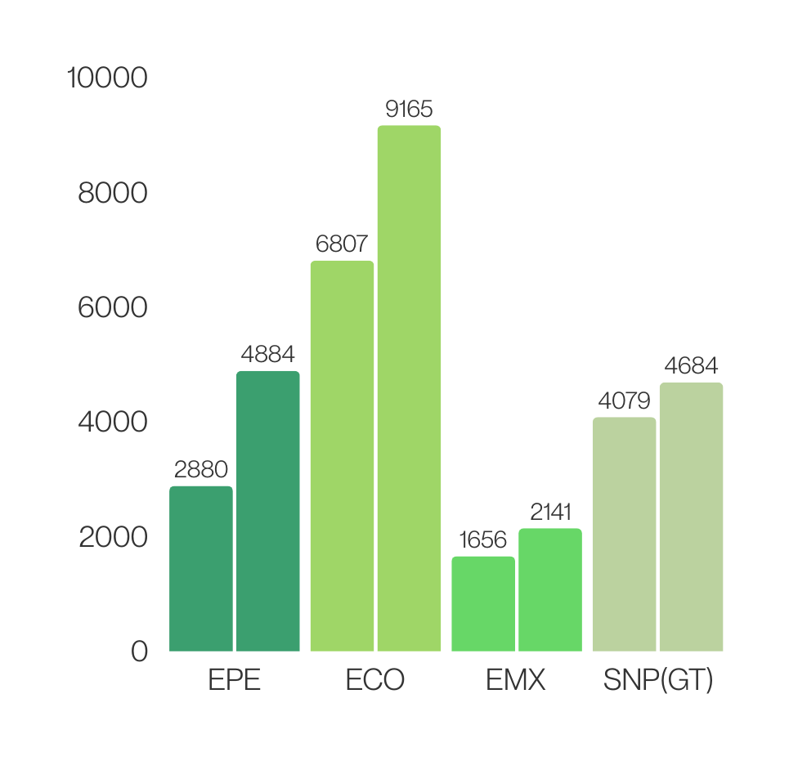
Regional
Regional
2024 Own SQ Top Growth by office
35%
15%
70%
29%
Notes:
next, 2024 Top Own SQ growth by office,
1. EPE comparte with 2023 grow70%
2. ECO 35%
3. EMX 29%
4. GT office 15%

Slide 21
Regional
Challenges
Notes:
We have very great year,
But what challenge we will face in 2025 for regional?

Slide 22
Challenges
Service Reshuffle
Direct Service
Market with direct service
Service Delays/Omissions
Chancay Effect
Notes:
There will be 4 aspects.
1. Service Reshuffle,
for example,
WSA4 wont call back MXMZO start from 2025, which we lost market from WCSA to central America biz.
WSA3 won’t call PECAL, which we might also lost a little biz from PECAL to MXMZO.
2. Market with direct service, for example: ECGYE to CLSAI, which EMC only can provide TS service.
In market, some carrier can provide direct service for exmaple CMA or ZIM.
3. As previous mentioned, Service delay & omit
4. PECHY effect, which ELA still observe how this new port effect from PERU or even WCSA.

Slide 23

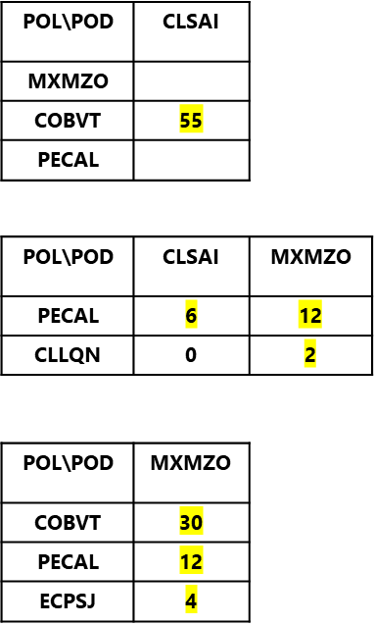
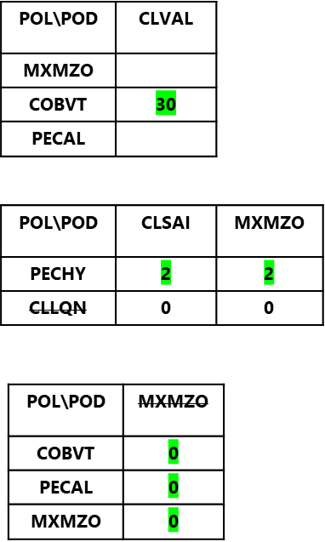



Challenges
Challenges
Service Reshuffle
WSA
- 87 TEU
per week
(-11%)
WSA3
WSA4
Notes:
Let’s deep down Service reshuffle part, which effect our regional performance
WSA change call CLVAL, which decrease 25 TEU/per week if call CLVAL.
WSA3 call PECHY, which market still need sometime to adjust
WSA3 won’t call CLLQN which we lost potential reefer Salmon biz from CLLQN to MXMZO.
WSA4 at 2024 used this service from WCSA to WCCA, however, CMA change their service not to call 2nd MXMZO, which we lost 46 TEU/per week.
In total, above service reshuffle, ELA almost lost 87 TEU/per week, which represent 11% compare with last year average
and how we gonna overcome these challenges.
ELA would like to present 2 ways and 3 KPI that we can do.

Slide 24

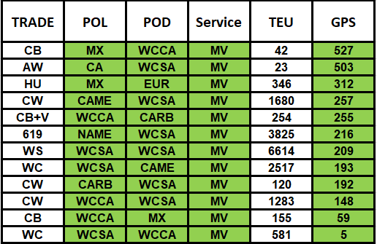
Challenges
Action Plan
Increase CASH FLOW
NO SPACE ISSUE
$6.9 M CASH FLOW
EXTRA PROFIT
MULTIPLE DIPS
COMMISSION
LOCAL CHARGE
Notes:
The first one, increase Cash Flow.
by using WSA/WSA2/WSA3/WSA4 which we so call MV service, since most of time there is no space issue,
we can make extra profit for M/V, and align with Headquater policy, Multiple Dips.
not only we can make profit for mother v/s service, but also important to local office about commission & local charge.
In 2024, we make 6.9M Cash Flow for M/V service

Slide 25
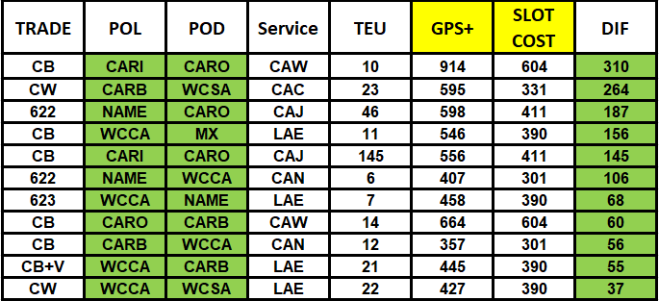

Challenges
Action Plan
Action Plan
Seeking Profitable CARB Feeder Area
PROMOTION
AREA
EX:
HTPAP/JMKSN to HNZPU/GTZST
USA to HNZPU/GTZST
CO3 to WCSA
Notes:
Second, Seeking Profitable CARB Feeder area,
CARB Feeder have a lot of Challenges last year,
with service delay, which cause space is not stable for CARB FDR service.
However, to ensure good financial at CARB FDR, ELA MKD always follow one rule, regional cargo profit should at least cover slot cost.
Following we divided to 3 areas,
First the Green Area, the profitable area, since the profit can cover slot cost, which these areas that BCC wants to promote.
for example:
Haiti or Kinstom to HN/GT
USA to HN/GT
Columbia port to West coast of south america

Slide 26
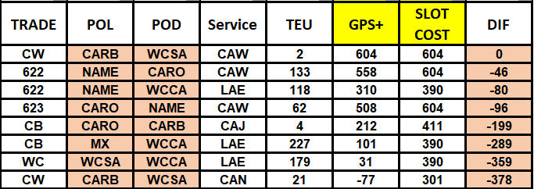

Challenges
Action Plan
Seeking Profitable CARB Feeder Area
AWARE
CONTRIBUTION
EX:
DO2 to WCSA
WCSA to WCCA
MX to WCCA
Notes:
Second the Pink Area, the profit is under the cost, which we have to aware their contribution.
for example:
Dominican Republic to West coast of south America
WCSA to central america
Mexico to central america

Slide 27
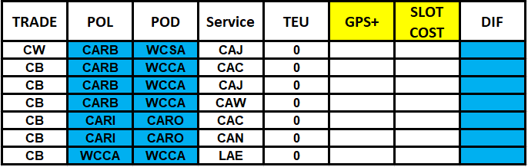

Challenges
Action Plan
Action Plan
Seeking Profitable CARB Feeder Area
MARKET WITHOUT EXPORT RECORD
EX:
HTPAP to WCSA/ WCCA
DO2 to HNZPU/GTZST
CO3 to WCCA
WCCA regional cargo
Notes:
Third, the blue Area, which we didn’t make any export record in 2024, please contact BCC if any new biz from here.
Above are 2 ways we can improve regional in 2025.
Following 3 KPI which are presented by BCC.

Slide 28
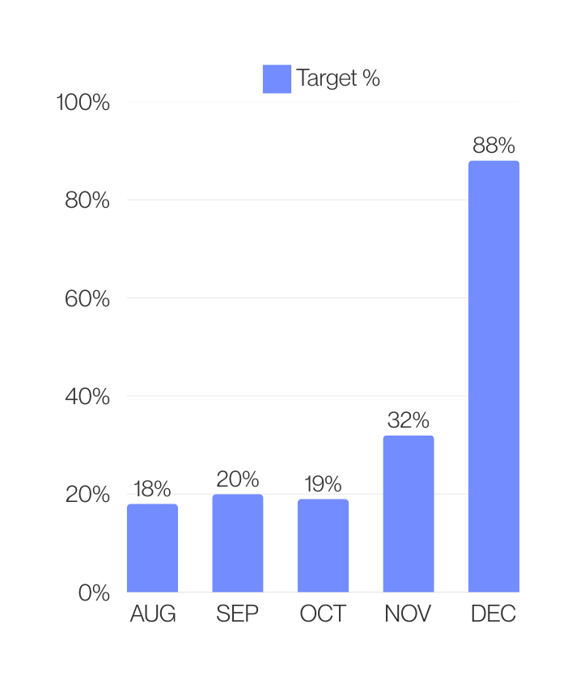
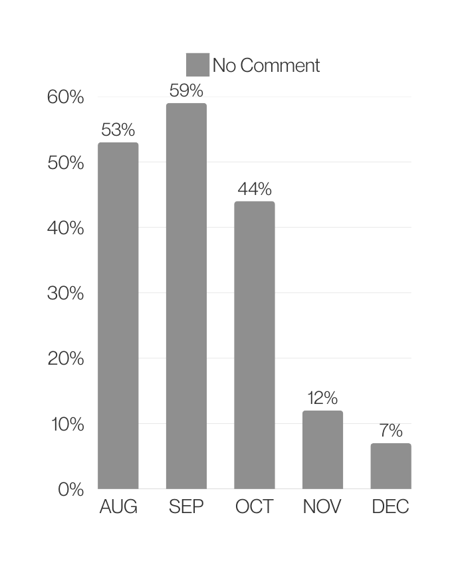
Challenges
Action Plan
Action Plan
Account Management Program
Notes:
first, Account Management Program, or we so called AMP.
Believe each office give a lot of effort at this system,
under ELA territory start from last year Aug, our Target achievement increase from 18% to 88%,
Those no comment remark decrease from 53% to 7%,

Slide 29
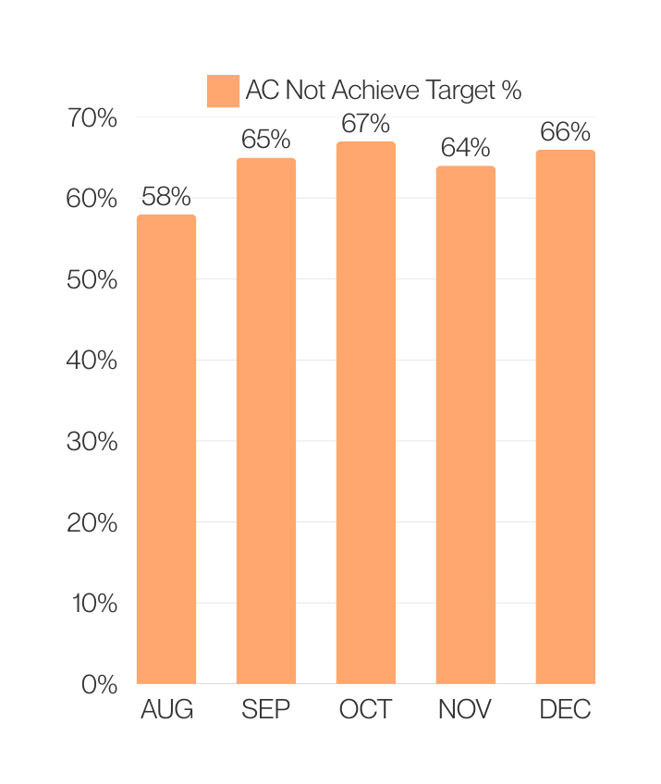
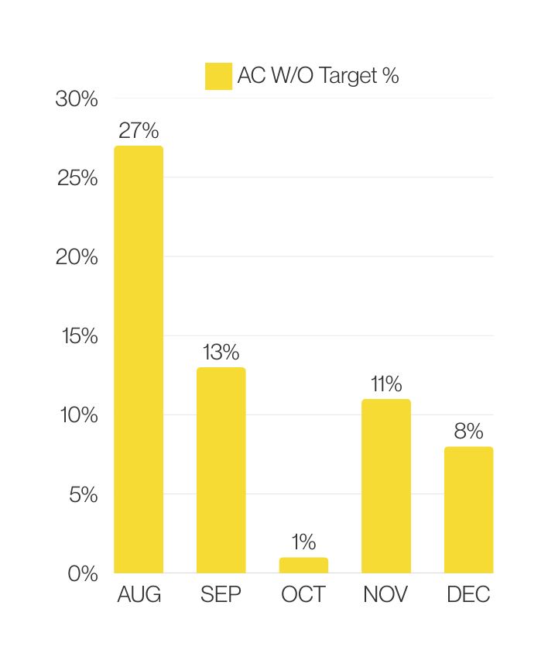

Challenges
Action Plan
Action Plan
Account Management Program
Notes:
AC didn’t achieve target remain Avg 62%, which we still need to get result from each office
AC W/O target slightly decrease to 8%.
above improvement mean each office is gradually taking more control from their A/C,
which we know where to find our cargo & how to increase it.

Slide 30
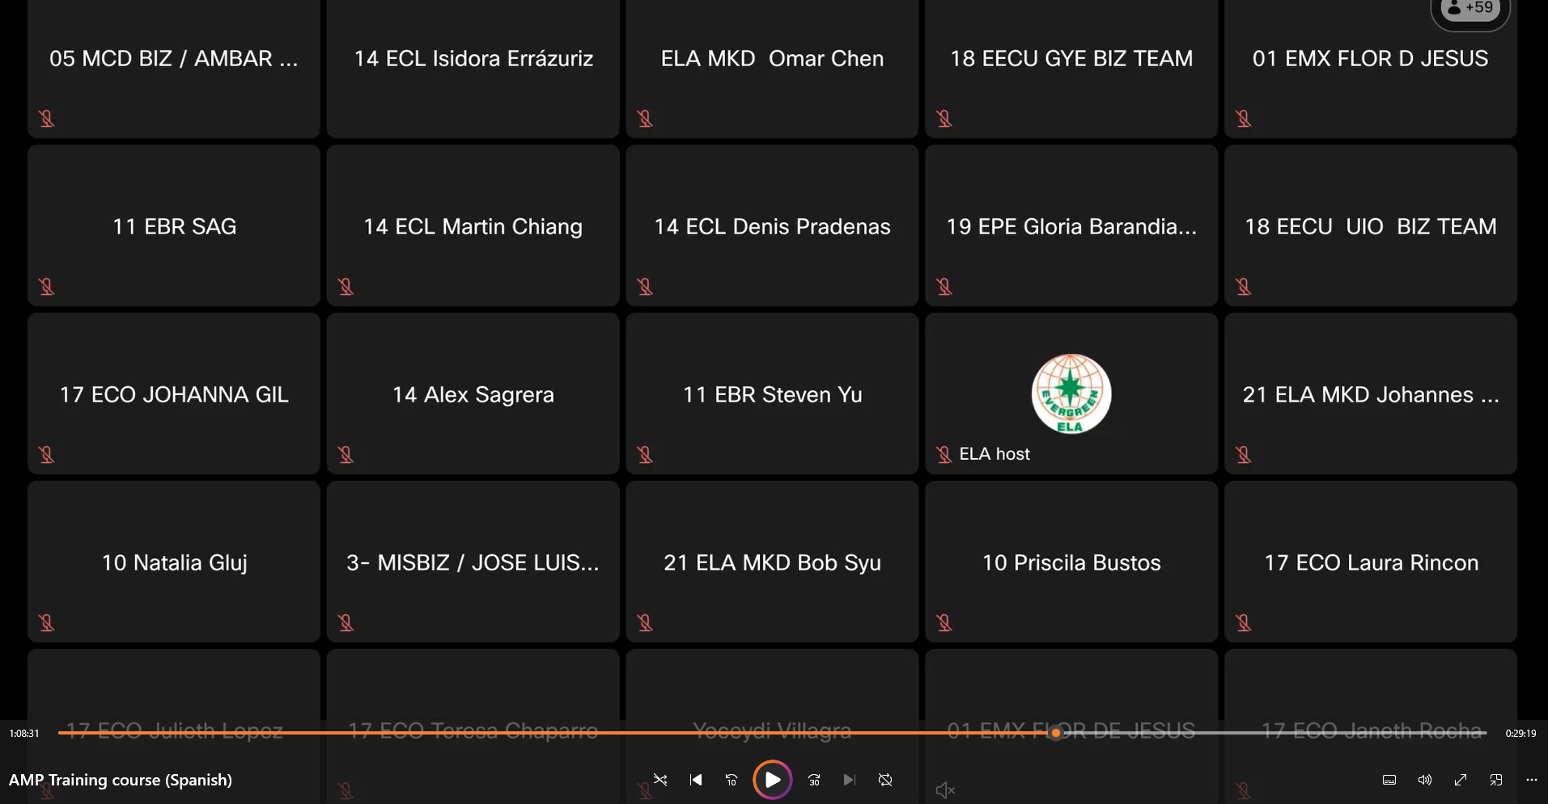
LAAM AMP Traing Course
Action Plan
Action Plan
Notes:
and here, would like to deeply appreciate ECL, Mr. Martin and Isidora. In Dec, they share their successful experience at AMP to all LATAM office.
We also record this video if your office needed.

Slide 31
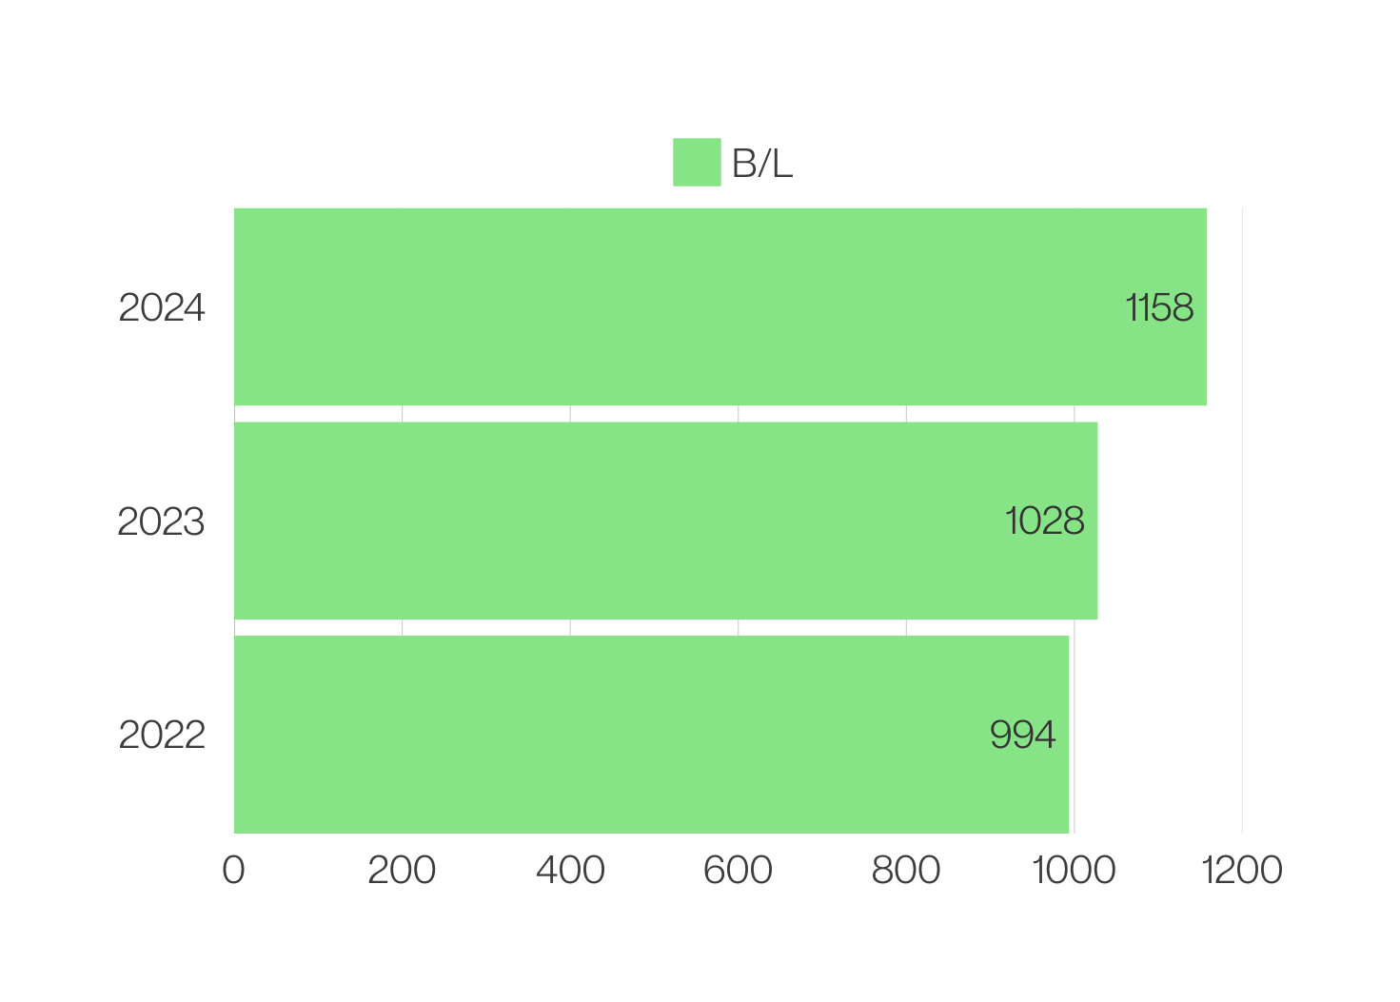
Challenges
Action Plan
GreenX
Action Plan
Notes:
second, GreenX
GreenX under ELA territory gradually increase every year.

Slide 32
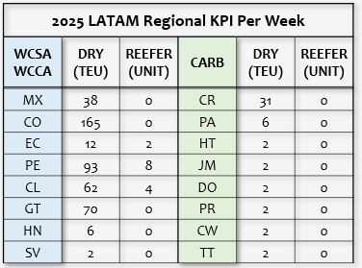

Challenges
Action Plan
Own SQ Target
Action Plan
5%↑
Notes:
last one, 2025 Own SQ, This year each office Own SQ increase around 3-5% .
At the end, Follow HQ policy and with two-way communication, using tool which company provide. Believe 2025, we will be better than last year.

Slide 33
Joint Venture Team

Slide 34
Evergreen Marine (Latin America) S.A.
Feeder Network
Notes:
Taipei Management, New York, and all Latin America colleagues.
Good Morning!
I’m Brad Chang, today i would like to share with you some information regarding our feeder network in Latin America area.
What we had, What we processed in 2024, and what we plan to do in 2025.

Slide 35



Service & CII
CARB : CAN / CAC / CAW / CAJ
WCCA : LAE
CII Performance
Feeder Review in 2024
Future Plan
Notes:
My presentation will involve 3 main topics which covered service and CII, feeder review in 2024, and we’re planning to do about the future plan.
Let’s start from our feeder service and CII first.

Slide 36


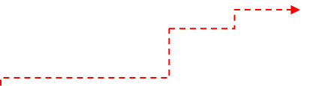
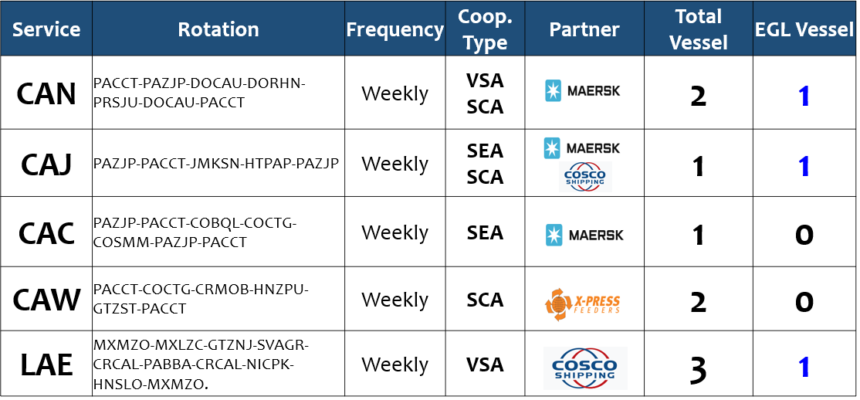
Notes:
Talking about the feeder network what we have, currently we have 5 service loops with 3* EVERGREN operated VSLs, totally 3,200TEU in weekly basis.
For CARB sea area, we have CAN / CAJ / CAC / CAW service, allocated 2,500TEU space weekly.
For WCCA area, we have LAE service and allocated 700TEU space also weekly basis included S/B and N/B.

Slide 37

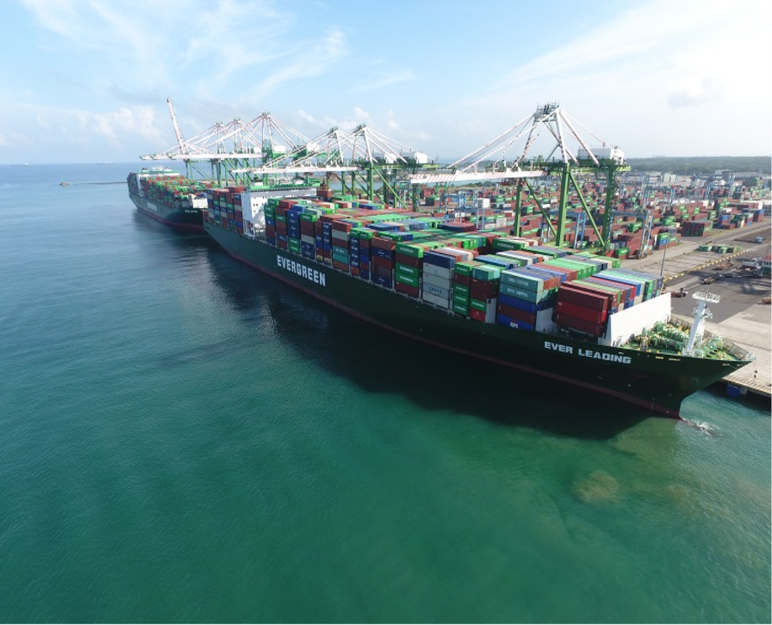

Latin America Feeder Service - Caribbean Sea
Port of C.C.T.
CAN, CAC, CAW, CAJ services
Notes:
It’s PANAMA COLON CONTAINER TERMINAL picture which is very important transit ship hub in CARB Sea.
In CCT we processed 4 service to different countries of CARB Sea area, which are CAN / CAC / CAW / CAJ services.

Slide 38
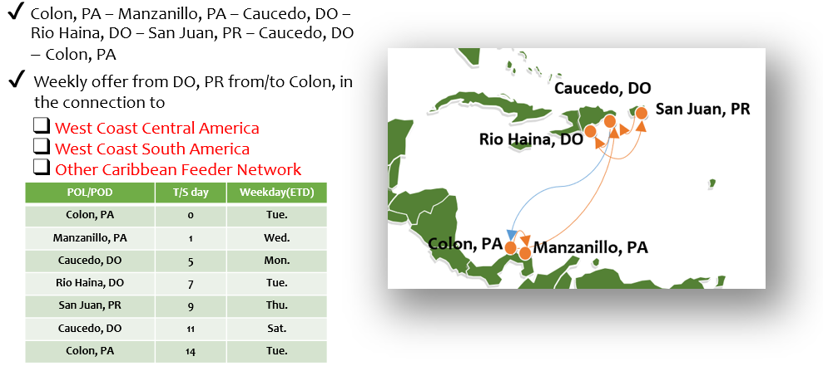
Notes:
CAN service,
Our leading service of CARB sea, it’s connected between CCT, Dominica Republic and Puerto Rico.
Join ventral with Maersk until MAR then we’ll have reshuffle plan after it,
We use the 3,400 TEU nomination capacity vessel to provide the weekly basis service, and the avg weekly space around 1,008TEU.

Slide 39
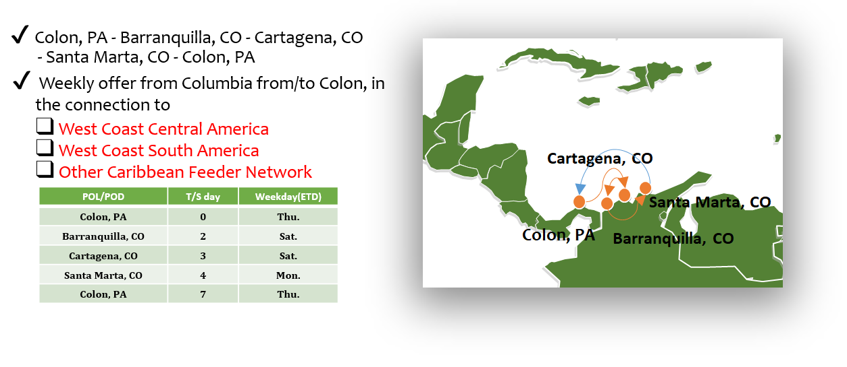
Notes:
CAC service,
Which is direct shuttle service between CCT and 3 Colombia ports in Atlantic side.
We based on the SEA(Slot exchange Agreement) with Maersk of 350TEU weekly, and the vsl type is 1,500 TEU nomination capacity.

Slide 40
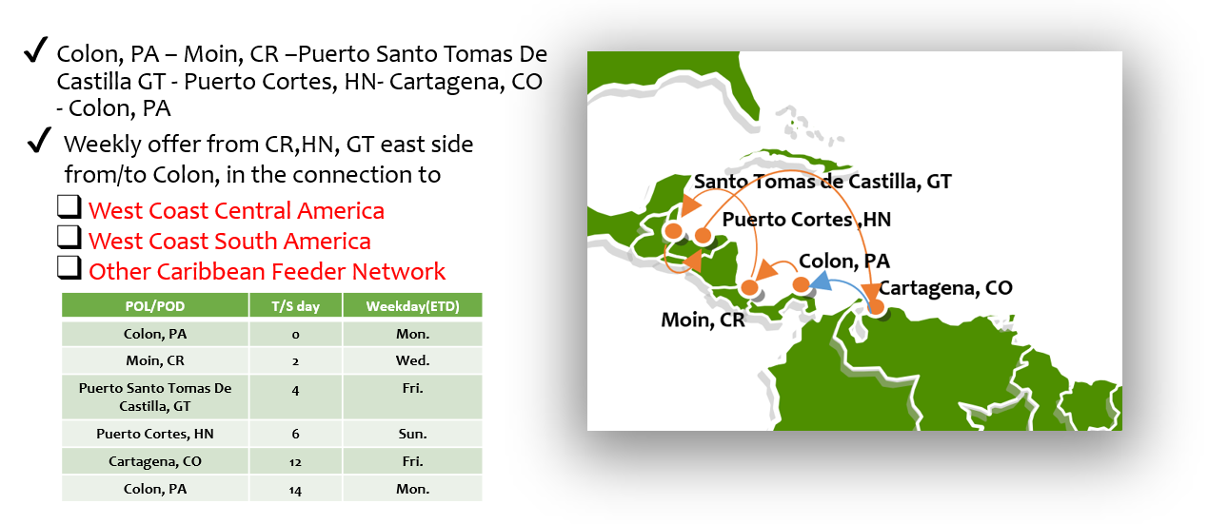
Notes:
CAW service,
This service connect between CCT and CR, GT and HN then back to COCTG.
We use the SCA(Slot charter Agreement) with XPF as 150 TEU weekly, the vsl size is 1,100TEU nomination capacity.

Slide 41
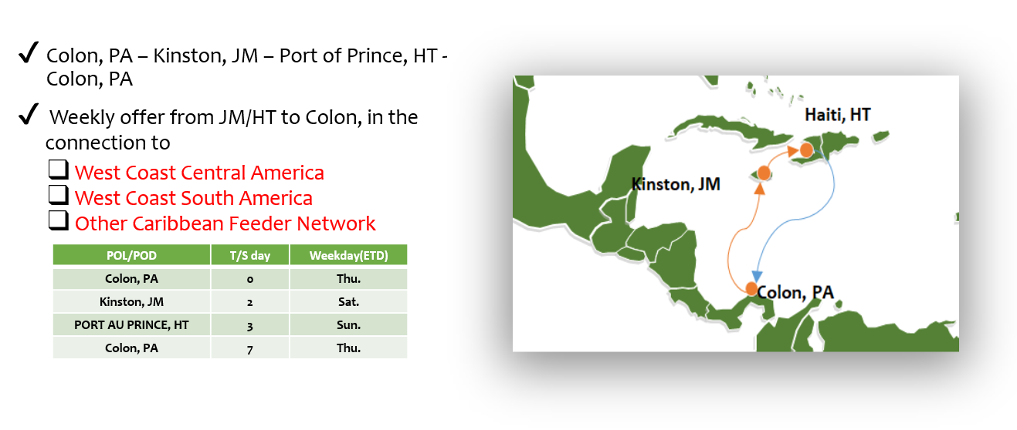
Notes:
CAJ service,
Which connect between CCT and JM and HT, this service we operated via our own vsl, C-Type of 1,800 TEU nomination capacity.
On the other hand, this service arranged several AD HOC calls to digest the backlog cntrs at CCT in peak season.

Slide 42

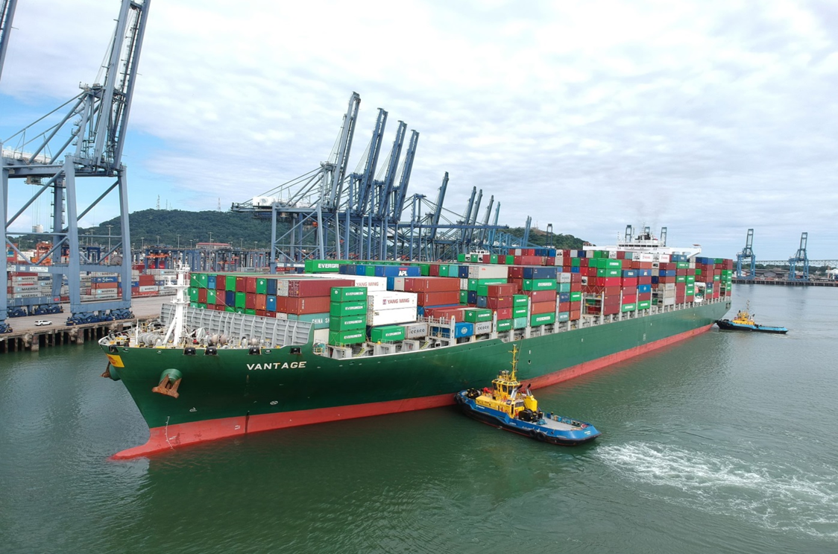

Latin America Feeder Service - West Coast Central America
Port of Balboa
LAE service
Notes:
It’s Balboa port picture, which located at Pacific side in Panama.
We have the direct service from F.E. to WCSA as WSA service at PABBA, and we apply the t/s hub here to our WCCA by LAE service.

Slide 43
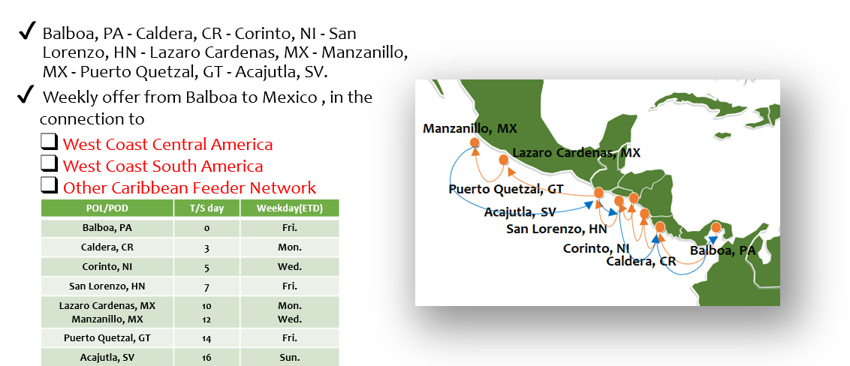
Notes:
LAE service,
Which connect between Panama and Mexico, it’s covering 7 countries in the loop to call regional ports.
We’re cooperating with COSCO via JV agreement, 1 vsl from EMG and 3 vsls from COSCO. which the vsl size is 2,400 TEU nomination capacity.

Slide 44


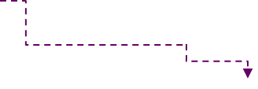
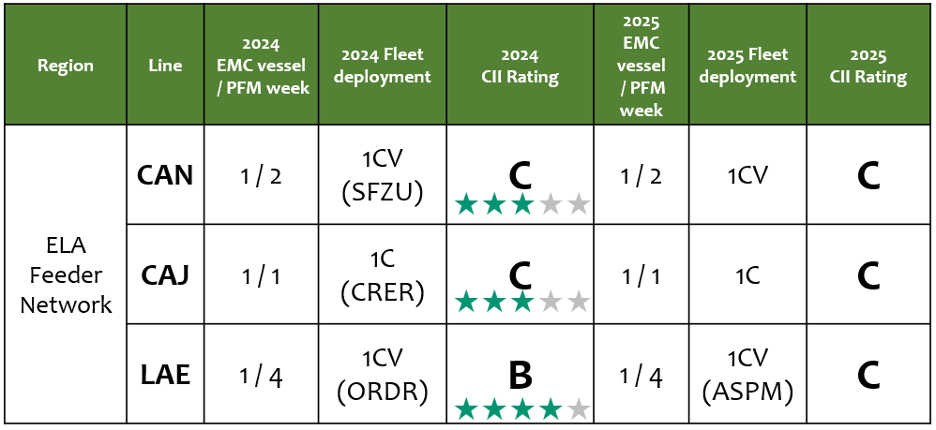
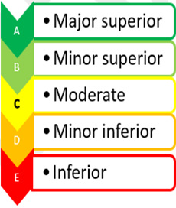
Notes:
This page showing with us the CII performance in 2024 and what’s the forecast for 2025,
The ranking or our operated vsl for 2025 still could perform as C, and we’ll work with OCD colleagues to improve them just like we processed in previous years.

Slide 45
Service & CII
Feeder Review in 2024
Loading Performance
CAN/CAJ Waiting Time Comparison
Annual Voyages Review
What solution we have been providing...
Future Plan
Notes:
The 2nd topic we would like to mention the reality of the feeder service we involved in 2024, and also share the solutions what we done in order to improve the situation of our CARB sea feeder service.

Slide 46
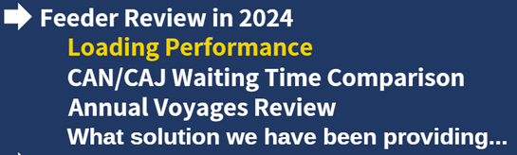


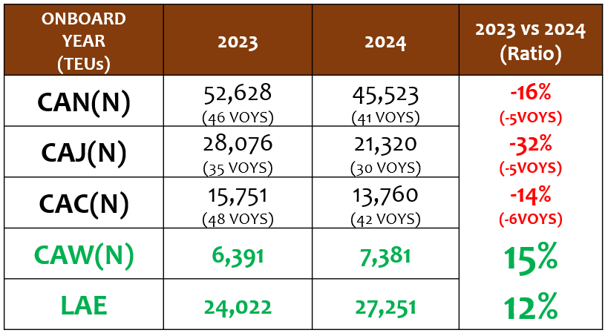

Notes:
The total loading volume compared with 2023 and 2024, in CAN / CAJ and CAC service were decreased, the main reason caused by the total waiting time increase then our available voys decreased,
So we could found the voys comparison in this slider of CAN / CAJ and CAC.
The volume of CAW and LAE service increased in double digital percentage of 2024, and we have no issue to increase the volume for 2025 as well.

Slide 47
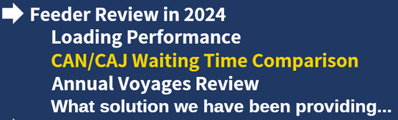

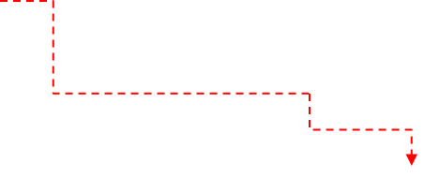
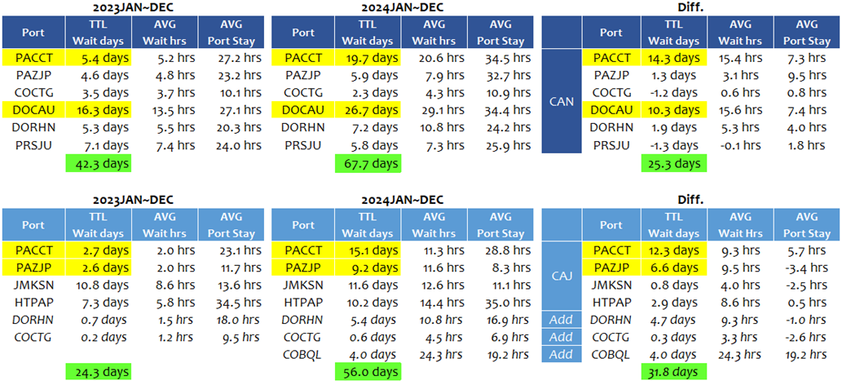
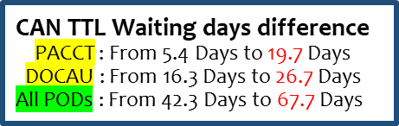
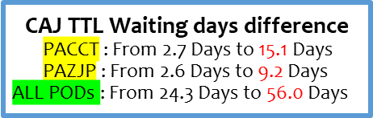
Notes:
CAN and CAJ service which involved the most impact due to the TTL waiting time increased in 2024 compare with 2023,
For CAN, the total waiting days in 2024 was 67.7 days which increased 25.3 days than 2023, the t/s hub in PACCT and DOCAU also increased 10 days in 2024.
The CAJ service also have same situation of the waiting time increase in 2024. TTL waiting days in 2024 was 56 days which increased 31.8 days than 2023.
TTL waiting time increase, so we got the result turn to the available voy decreased than previous years.

Slide 48

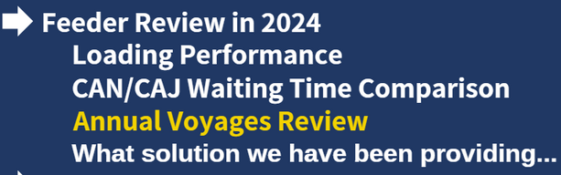
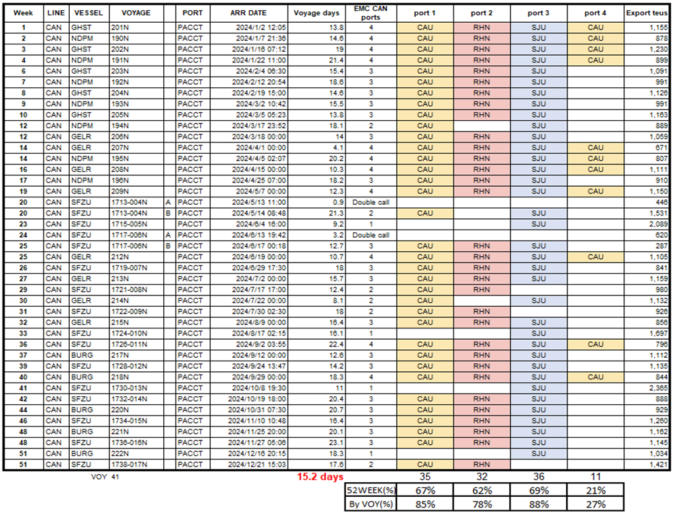
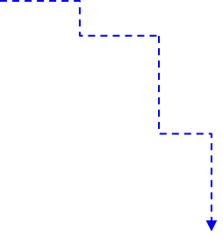
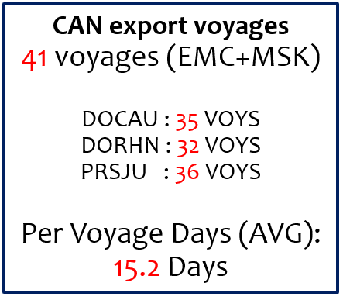
Notes:
Looking in detail of the sailing information regarding the CAN service from PACCT to PODs in N/B, we got 41 available VOYS in 2024, 35 VOYS to DOCAU, 32 VOYS to DORHN and 36 VOYS to PRSJU, TTL15.2 days in average sailing which compared with CAN regular PFM 14 days, we got 1.2 days increase.
By the way, normally CAN service we could process 46~47 Voys per year, and the decrease of available voy also affected us the final t/s volume for 2024 what we had.

Slide 49

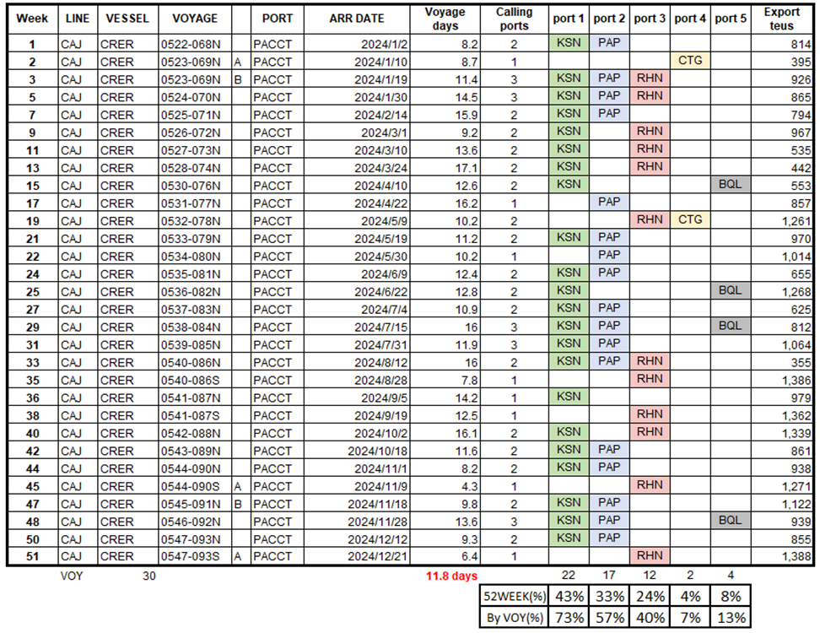


Notes:
Looking in detail of the sailing information regarding the CAJ service from PACCT to each PODs in N/B, due to the social unrest issue as gang violence in HT, we didn’t provide the calling in MAR and SEP of 2024, so we got 30 VOYs last year and 11.8 days in average sailing day per voy, the main reason almost like CAN service which available VOYS number decreased because the waiting hurs and operation hurs.
Meanwhile, CAJ service also have important mission which arranged the AD-HOC call to digest the t/s volume from PACCT to DO and CO.
Normally CAJ service we could process 35~36 Voys per year.

Slide 50







Notes:
What’s the solution we have been providing in 2024 to minimize the impact of available VOYS decrease?
We invited each depts. of ELA to review the T/S volume and schedule every week, then try to propose the AD-HOC call via Mother vsl with TPE BCC of LAD and NAD to evaluate if it’s workable.
Even we invited your good office in PODs of agent to recheck with terminal if they can provide available B/W for AD-HOC call or outside feeder to use.
Even now we still follow this procedure to review the solution via CAJ service and Mother vsl AD-HOC call or outside feeder space to purchase, when our T/S volume over the weekly capacity, but the most important thing we intend to mention, which is working together, finding the solution.

Slide 51



Notes:
In this slider we could found that we processed 17 voys AD HOC call via CAJ service from PACCT to DO and CO which digest 8,700TEU, 2 voys of AD-HOC calling via mother VSL from PACCT to DOCAU via NUE and AUE of 3,300TEU, and 2 voys via outside feeder space purchase to digest 1750 TEUs.
These arrangements provided us workable solutions to digest the t/s backlog in CARB sea area when our feeder service involved the schedule issues of 2024, and we will also follow the procedure to evaluate the solutions in future if necessary.

Slide 52
Service & CII
Feeder Review in 2024
Future Plan
Mother Vessel Service V.S. Feeder Service
2025 CAN Reshuffle & Feeder Space Analysis
Long Term Plan
Notes:
The 3rd topic we would like to mention the future plan and how could we process in feeder service, even some projects for long term survey we’re viewing now.

Slide 53





M.V. Service
Feeder Service
Notes:
This page divided into two parts, which involved mother vessel service and feeder service.
Mother vessel service:
NUE service: VSL UPDATE (L+F => T+F), space plan to release in 2025/H2.
AUE service: VSL UPDATE (F+T => M+T), space plan to release in 2025/H2.
WSA service: Average weekly space increase 19.6% after core service upgrade.400TEU will plan to release for CARB sea area weekly.
Feeder vessel service:
CAN service: Average weekly space increase 842TEU. Remove PAZJP / COCTG to improve schedule.
CAJ service: Plan to cascading W-type (2.3K) vsl in 2026. More ability to arrange the add-hoc calling for COCTG / COBQL.
CAC service: Average weekly space remain unchanged (350TEU, SEA).Maersk revised terminal at COCTG after JAN.
CAW service: Average weekly space remain unchanged(150TEU, SCA). The space provider XPF plan to revise the vsl size in Q2.
LAE service: Average weekly space increase 200TEU of BSA. 2nd own vsl from EVERGREEN to phase in will be reviewed in 2026.

Slide 54







Notes:
CAN service, we’ll have service reshuffle after MAR/2025.
Currently we have JV contract with MAERSK till MAR., which the routing we operated from PACCT – PAZJP(MIT) – COCTG(MSK private call)- DOCAU – DORHN – PRSJU – DOCAU(2nd call) then back PACCT.
And after reshuffle which new rotation will withdraw the t/s hub at PAZJP(MIT), COCTG and DOCAU(2nd call), which means our service will have more buffer time to face the increasing waiting issue as I mentioned in previous sliders.
Furthermore, the new space provider of UNIFEEDER will provide 1,250TEU on their vsl, but will not use the space in our hired vsl SFZU, so our avg weekly space will upgrade from 1008TEU to 1850TEU with 842 TEU
Increase, by this way we’ll have more ability to digest the T/S volume from PACCT to PODs, even we need your fully support to develop and dig out more cargo source after our service reshuffle.

Slide 55











Notes:
Just as we mentioned CAN service reshuffle will increase 842 TEU in weekly average, and LAE service revised the BSA due to new vsl phase in of 200TEU weekly, there have 32.7% space increasement of our feeder service after Q2/2025!
The space increase means we forecast the market trend is growing in future of this area, and we could find the different space assignment of each BCC in order to enlarge the cargo volume of right side,
LAD: increased 20.8% which majority space increased of CAN service.
EGA: increased 66.5% which majority space increased of CAN service.
ELA: increased 223.1% which we have more space to release for regional biz of our LAE and CAN service as 100TEU/weekly.
Meanwhile, accompany the space increase of CAN, CAJ service will have more ability to digest the t/s volume for COCTG / COBQL in Atlantic side, even HNZPU could be considered to arrange AD HOC if the volume can support to call.

Slide 56









Notes:
The survey of new market and develop in our current scope are processing under ELA MKD JV team both of them,
As you provided the figure or prospect in Q4/2024 regarding the EUR / WCSA in the left side,
And the direct service involved from/to USEC and WCSA what we’re discussing in Jan/Feb this year,
And the regional service reviewing of WCSA for N/B as we’re negotiating with Feeder service provider.
All of them we’re putting in our reshuffle list and keep updating with concerned parties,
Lastly but not least, we need all office to work together, and well knowing the market and competitors just like we enclosed the proverb from the art of war by Sunzi,
“Know thyself, ever-victorious” 知己知彼 百戰百勝
These’re all I have today, and back to Mr. David, thank you.

Slide 57

Please
rate us
★★★★★

