Slide 1

Evergreen Taipei
PJD Wilson Chen

Slide 2


World Economic Outlook
Reshuffle of Alliances
Evergreen Fleet Development vs. Market
Decarbonation (Score & Certification)
IOT (Internet of Thing)
MTA & Green X
Topics
Source: IMF

Slide 3

World Economic Outlook
Source: IMF Global Growth 2025 JAN
Source: IMF

Slide 4
GDP growth projections for 2024 & 2025
%, year-on- year
Source: IMF
Source: OECD Economic Outlook May 2024

Slide 5









Reshuffle of Alliance
Ocean Alliance
GEMINI
MSC
Prem. Alliance
Gemini: key hubs & strong feedering network
MSC: extensive network to leave no port unserved, such as North China, Baltic, Scandi, Southeast Asia, France, Hong Kong, etc.
OA: largest capacity provider with a competitive product, offering an extensive range of direct calls
Nom. capacity
4.8 MTEUs
2.5 MTEUs
3.1 MTEUs
2.8 MTEUs
# Loops
37
23
26
22
# Vessels
363
201
288
235
Avg. Vessel Size
13.2K
12.4K
10.8K
11.9K
# call
356
161
262
246
Capacity forecast as of Feb 2025

Slide 6
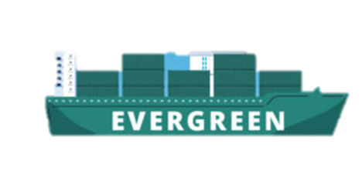

2021-2029 Group Capacity
Compare with
2021 = 69.7%
-0.4%
Notes:
含董事會通過之11艘LNG燃料船運力 (截至2/17 per JVS)

Slide 7

Top 10 Carriers
Newbuilding Delivery Schedule
TEU Thousands
K K K
2025
2029
836
Source: Alphaliner MM JAN
Notes:
Alphaliner一月數據加上董事會通過之11艘LNG燃料船運力(=24,000*11)

Slide 8
Top 10 Carrier Green Vessel Order Book and Percentage
No. | Carriers | Total Fleet (including own, chartered & NB order) | DF Fleet | Percentage
1 | MSC | 1020 | 137 | 13.43%
2 | MAERSK | 800 | 74 | 9.25%
3 | CMA CGM | 749 | 153 | 20.43%
4 | COSCO | 570 | 31 | 5.44%
5 | Hapag-Lloyd | 335 | 13 | 3.88%
6 | ONE | 302 | 22 | 7.28%
7 | EMC | 283 | 41 | 14.49%
8 | HMM | 97 | 11 | 11.34%
9 | ZIM | 134 | 23 | 17.16%
10 | YML | 103 | 5 | 4.85%
TOP 10 Average |  |  |  | 10.76%

Slide 9






































CO2 Annual Emission
Verification via class and following ISO and GHG protocol standard
Reduced 68.50%
compared with 2008
31.50
COMMITMENTS
Reduced GHG emission by 50%
Based on 2008 base line
Achieve Net-Zero
Across Evergreen Marine
Group companies worldwide
ACTION PLAN
PARTICIPATION
EEDI Phase II & III improvement
Dual-Fuel Engine
Alternative Fuel Engine

Slide 10

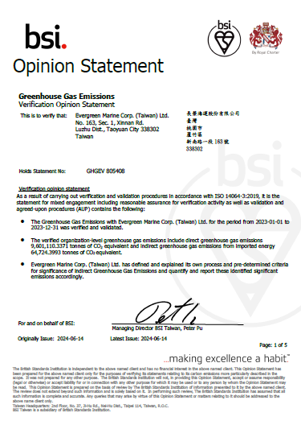
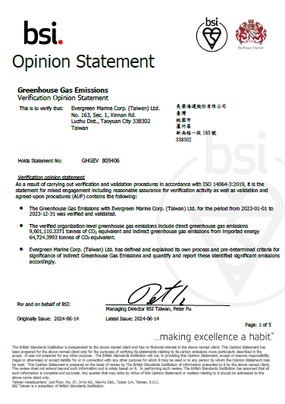
ISO 14064 & GHG Protocol
Scope
Scope 1 Direct emission
GHG emission associated with fuel combustion in boilers, furnaces, vehicles.
Scope 2 Energy indirect emission
GHG emissions associated with the purchase of electricity, steam, heat or cooling …etc. energy use.
Scope 3 Other indirect emission (C2~C7)
All indirect emissions (not included in Scope 2) including both upstream and downstream emissions.
Boundary
Onshore
EMC and its subsidiaries in consolidated financial statement
Onboard
Operating container vessels under Evergreen
14064
Notes:
64=scope

Slide 11





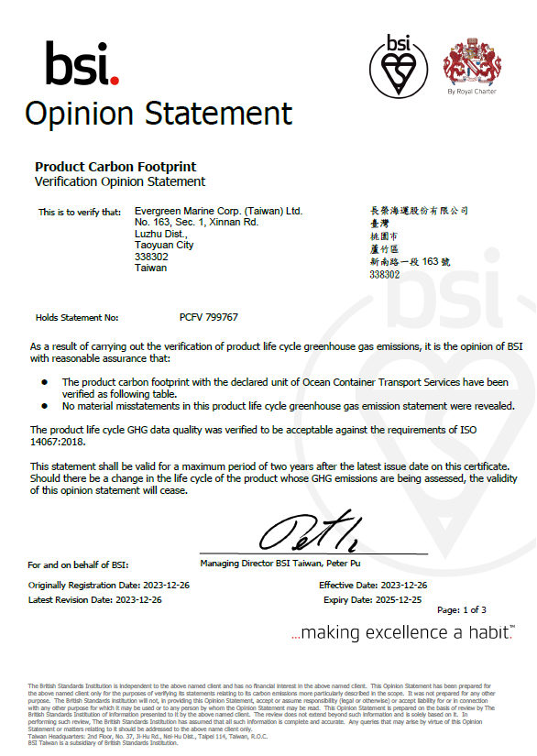
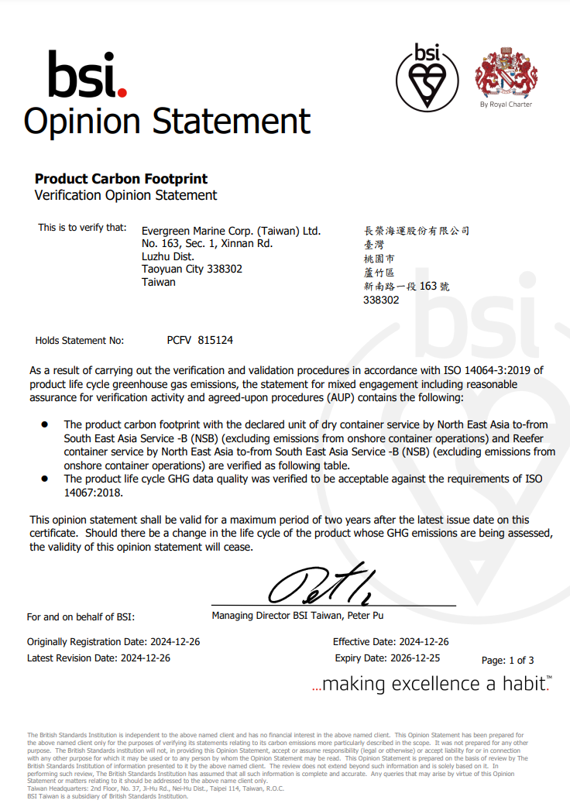
ISO 14067 Carbon Footprint
Life Cycle Assessment
Raw Materials
Service Delivery
Waste Management
2023
2024
Asia to-from North Europe
SE Asia to-from NE Asia
Asia to-from North America WC
Notes:
CEM, CES
HTW,CPS,TPA,TPN
NSB

Slide 12

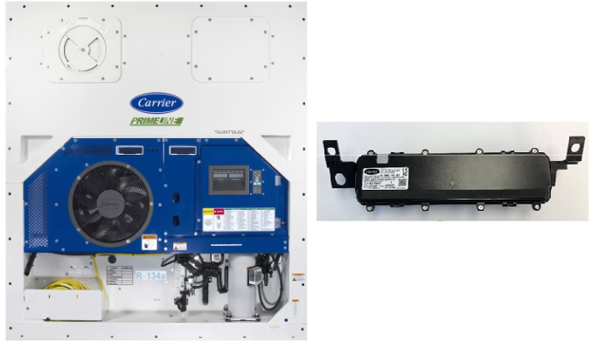
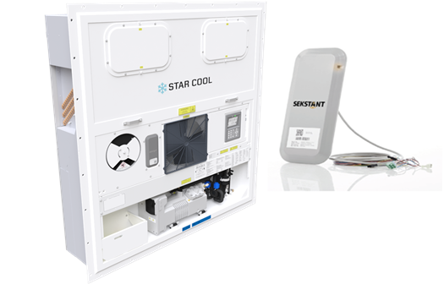



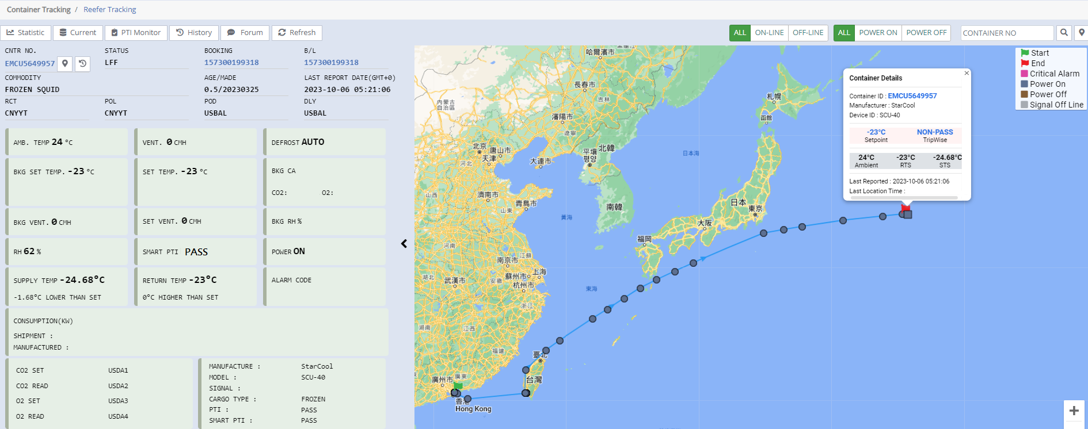


IoT Smart Container (Reefer) Development
Important Progress of Evergreen IoT -
Phase 1: 2023 Installed 2,000 IoT devices from Carrier and Star Cool
Phase 2: 2024 additional 27,035 IoT devices, finished by end of 2024
Phase 3: Finish of install of all 39,000 units by end of Q2/2025 plus 5,000 new reefer
delivered, expect to have 90% + of reefer fleets with IoT available.
Smart PTI, abnormal alarm
Collecting data for ESG control
Enhance
Monitor
Statistic
Real-time
Data
On Board
Monitor
Compare temp with BKG requirement
Assist crew monitor reefer on board
Notes:
櫃務部已於今年完成安裝開利及Star Cool兩家冷凍機原廠2,000台IoT設備，從實際使用經驗中驗證此IoT設備可：
1. 即時掌握冷凍櫃數據，導入booking資料比對機組設定正確性，進而強化冷凍貨載管理。
2. 加強冷凍櫃機組運行管理，透過智能PTI遠端檢查機組健康度，並即時通報機組異常事件，減低貨物理賠風險。
3. 協助船員於海上遠端監控冷凍櫃運行，降低因天候因素而無法人工巡櫃之限制。
4. 統計冷凍機大數據資料，應用於管理面，及節能等ESG相關報告。
另外，這套系統亦可提供客戶冷凍櫃即時資訊服務，提升市場攬貨競爭力及收取相關費用。
預計於2024年向開利及Star Cool兩家原廠追加採購27,035台IoT設備，
並於當年度完成安裝作業，屆時集團冷凍櫃除十年以上老舊櫃，將全數配備IoT設備。

Slide 13
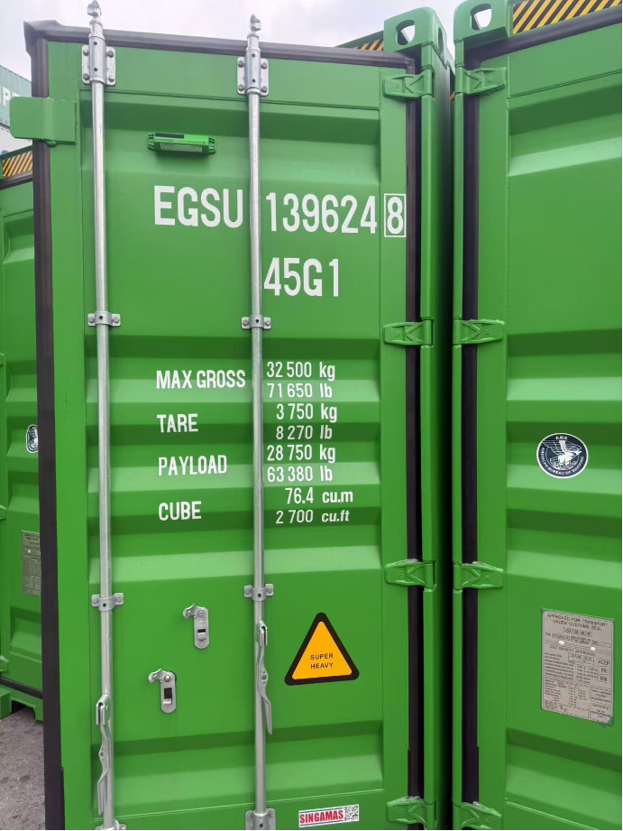
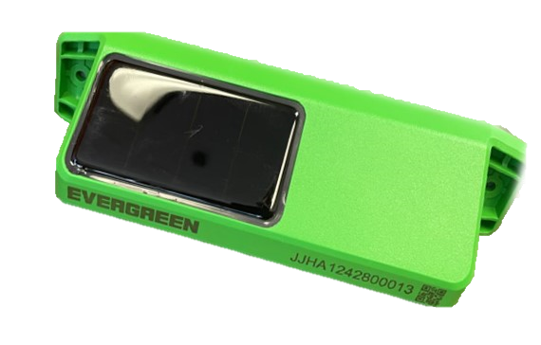
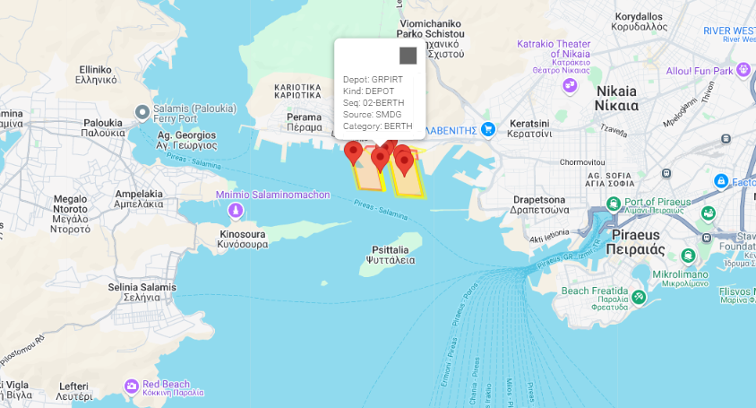
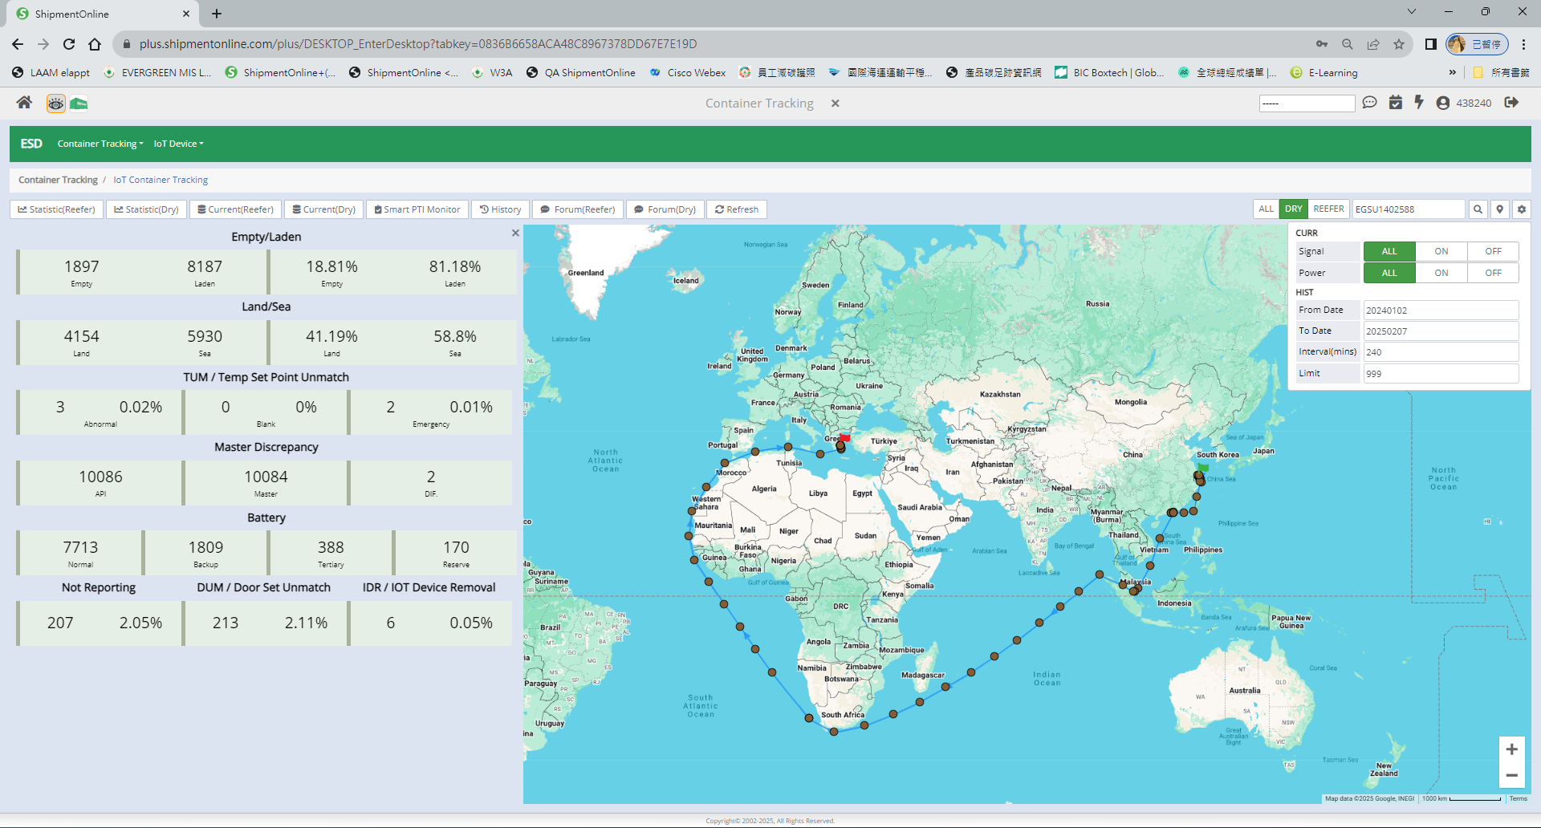




SMART (Dry) Containers - IoT
Functions Available
- Important Progress of Evergreen IoT -
Powered by solar panel
2023 R&D
2024 Test & Production
10,000+ units been installed for Validation
2025 Mass Production
Mass production 250K units, deliver 50K units/month. To make it 300K in total under Evergreen fleet.
Light Detect
Position
Flip Detect
RFID
Shock Detect
Door Sensor
Temperature
GeoFencing
Powered through internal battery recharged using an integrated solar panel
Remotely programmable EPC Gen2 compliant RFID tag
Wireless cellular and BLE
3-axis digital accelerometer
Built-in cellular antenna, GPS/GNSS antenna and BLE antenna
GPS,GLONASS,BeiDou, Galieleo and QZSS support
Tamper detection sensor
Ambient temperature sensor to measure internal and external temperature for abnormal rates of change.*
Smart Container
Tracking Dashboard
Container tracking, integrated with SOL+ data, expedite inventory control, promote potential hinterland export, reduce empty repo.
With light/shock/door/Temperature sensors, helping to identify the timing and root of cause and/or L/P tracing.
Attention : DO NOT remove IOT device from container.
Notes:
乾櫃IOT評估
一:評估階段: 各家比較及提出我方功能需求，以Orbcomm明年第一季開發的新機種CT1000 Plus為採購標的，並於8月起進行現有機種100台CT1000 IOT設備的試用。
二:新機種功能:除太陽能電池高續航力、位置追蹤、櫃外溫度及震動功能外，新增加無線射頻辨識(RFID)、開關門偵測、陀螺儀感應、櫃內溫度及光線的偵測功能，也可交互搭配電子圍籬及RFID功能監測貨櫃進出站動態。
三:需求量及安裝:
1.第一階段:以企劃本部提出亞洲至歐洲及地中海兩區域貨載為智能貨櫃的使用需求，經計算約需30萬只貨櫃，於大陸、台灣及東南亞主要港口進行安裝，所需配送及安裝時間約半年，預計於2024年底完成。
2.第二階段:在第一階段30萬只安裝進度達70%後，進行第二階段50萬只的評估，安裝時間約需8至10個月，預計2025年中完成。
Container tracking, with support of GPS position and Geofencing.
IoT device will send warning reminders when abnormal equipment status or abnormal environmental sensing is detected. For helping identify the root of cause and L/P tracing.
Expedite inventory control, promote potential hinterland export, reduce empty repo.
Integrate with SOL+ data, improve container/cargo control.

Slide 14


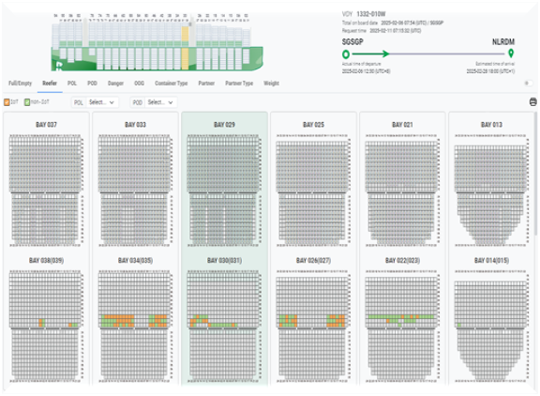
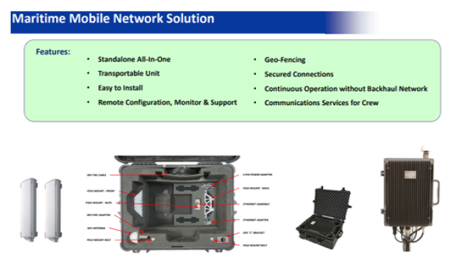


Vessel network & eShip
Installing vessel network for more than 200 vessels in 2025, enabling IoT Devices to report on the ocean.
Developing eShip system for crew to remotely monitor IoT containers on board.

Slide 15

Introduction to
M ULTIPLE
T RADE
A CCOUNT
La Presentación de MTA
Notes:
You can safely remove this slide. This slide design was provided by SlideModel.com – You can download more templates, shapes and elements for PowerPoint from http://slidemodel.com

Slide 16

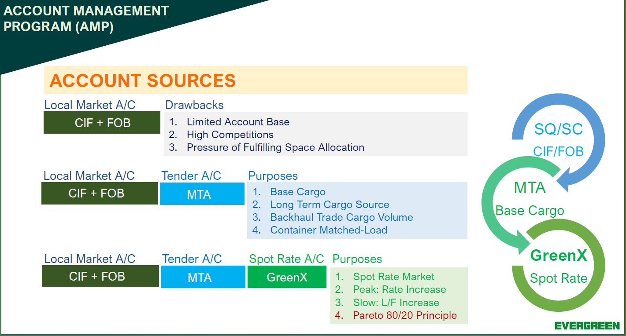

Account Management Program (AMP)
MTA
Long-Term Base
BODY
Market
GreenX
Dynamic Base
Notes:
Starting from the Account Management Program, we understand local market has their own CIF and FOB accounts that oftentimes encounter high market competitions and limited account base concerns.
With MTA team tender account joining since 2015, we might have more base cargo source with long term support and pricing can solicit backhaul trade boxes as well as match-loaded cargo (from the tender file).
Ever since 2020 GreenX product launched, a quick spot quote can immediate increase loading factor and to test the market acceptance for rate level, likewise, save biz team’s time to serve big account and leave
SME account to GreenX platform to take care.

Slide 17

TOP 10 Carriers- online spot quote/booking platform
 | MSC | MAERSK | CMA | COSCO | HPL | ONE | EVERGREEN | HMM | ZIM | YML
Launched Year | 2020 JUL | 2019 SEP | 2022 JAN | 2019 SEP | 2018 AUG 2022 FEB | 2021 FEB | 2020 FEB | 2022 JUN | 2020 MAY | X
Platform | INSTANT QUOTE | MAERSK SPOT | SPOT ON | SYNCON HUB | QUICK QUOTE QUICK QUOTE SPOT | ONE QUOTE |  | HI QUOTE | EZ QUOTE | X
Spot Rate | V | V | V | V | V | V | V | V | V | X
Secured Space | X | V | V | V | V | V | V | V | V | X
Equipment Priority | X | V | V | V | V | V | V | X | V | X
Inland Service | V | V | V | V | V | X | X | X | X | X
Service Scope | ASI-EUR NAME-EUR | ALL | ASI-EUR EUR-ASI ASI-MED EUR-IN | ALL | EXCEPT US/CA | EXCEPT US/CA | ALL (FMC Lanes are under restructuring) | KR-EUR/ASI/AUS/SAME | INTRA - ASI/AU/NZ | X

Slide 18
Booking and Actual B/L Performance
2024 GreenX
2024 all trade BKG KPI achievement : 108%
BKG KPI: 10,000
2024 all trade B/L KPI achievement : 67%
BKG KPI: 7,200
B/L KPI: 6,000
B/L KPI: 4,320

Slide 19
2024 GreenX
Booking and Actual B/L Performance
2024 GreenX Booking ( LAD + ELA )
1. KPI achievement : 112% (16,771/15,000)
2. Contribute as 15.5% (16,771/108,098) of total GreenX booking
3. Achieved 3% YOY increase (16,771/16,335)
LAD BKG KPI: 1,100
2024 GreenX Actual B/L shipped ( LAD + ELA )
1. KPI achievement : 53% (4,738/9,000)
2. Contribute as 11.7% (4,738/40,645) of total GreenX Actual B/L
3. Made 12% YOY decrease (4,738/5,365)
LAD B/L KPI: 660
ELA BKG KPI: 150
ELA B/L KPI: 90
2024

Slide 20

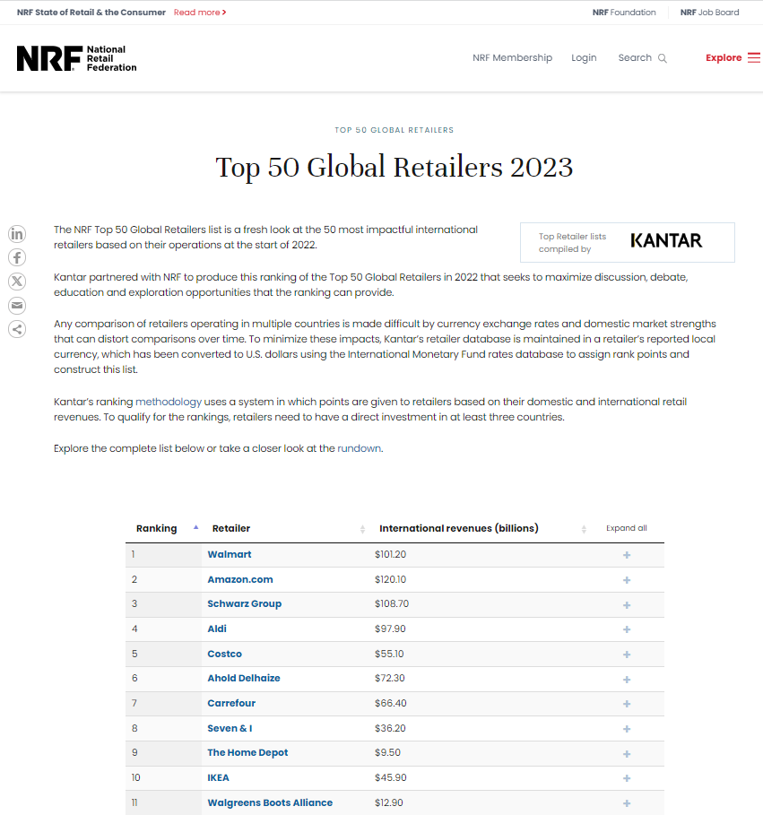
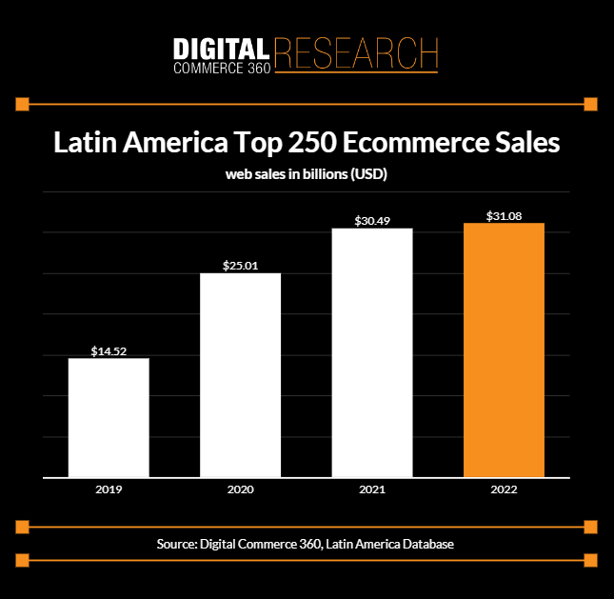
Business Development
Notes:
You can safely remove this slide. This slide design was provided by SlideModel.com – You can download more templates, shapes and elements for PowerPoint from http://slidemodel.com

Slide 21
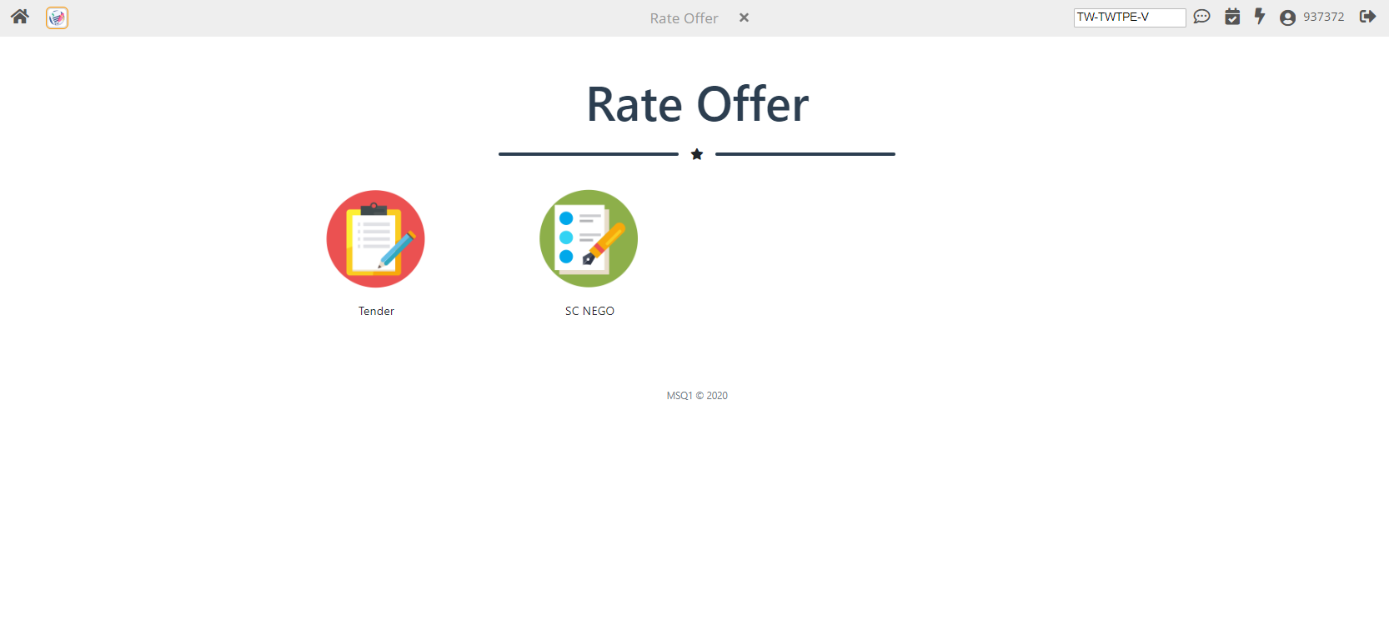


Tender Platform
All
MTA TENDERS
Processed in
SOL+
Notes:
You can safely remove this slide. This slide design was provided by SlideModel.com – You can download more templates, shapes and elements for PowerPoint from http://slidemodel.com

Slide 22



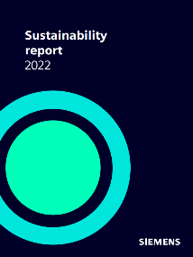
Customers’ Attention
Notes:
You can safely remove this slide. This slide design was provided by SlideModel.com – You can download more templates, shapes and elements for PowerPoint from http://slidemodel.com

Slide 23

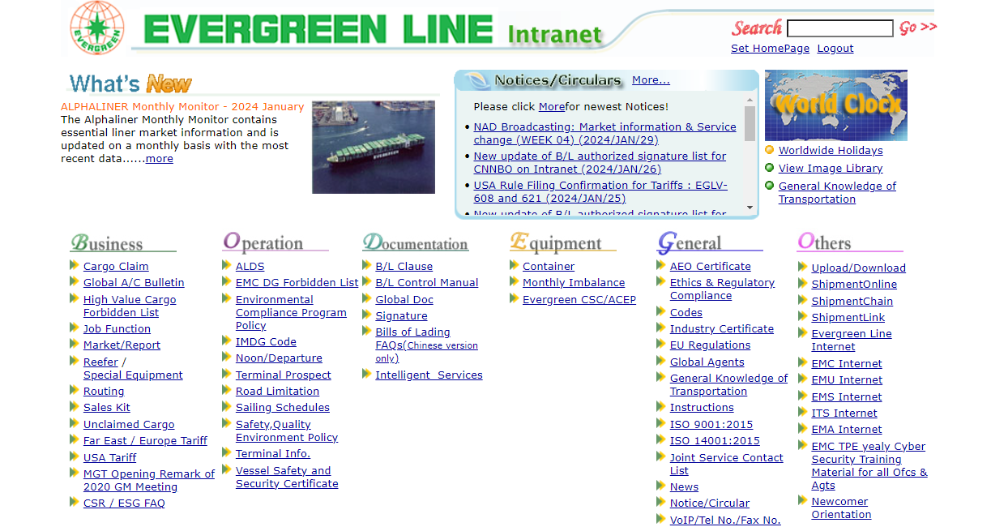
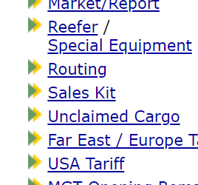

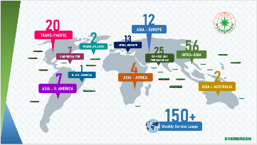
Tools – Sales Kit
Notes:
You can safely remove this slide. This slide design was provided by SlideModel.com – You can download more templates, shapes and elements for PowerPoint from http://slidemodel.com

Slide 24
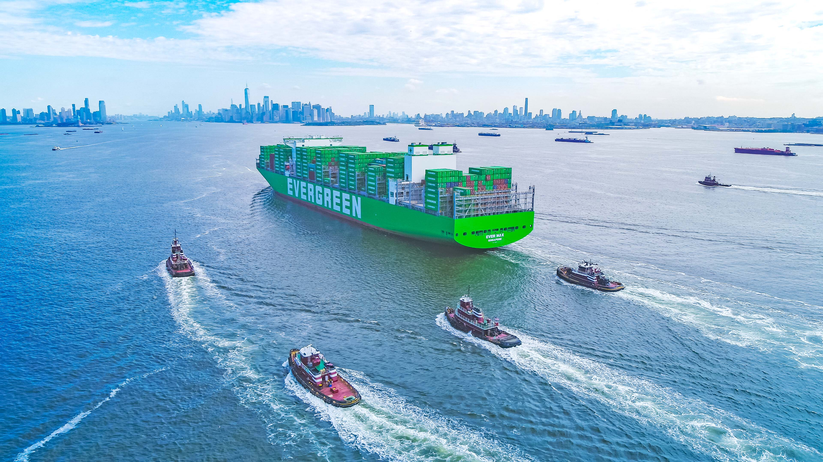

THANK YOU

