Slide 1
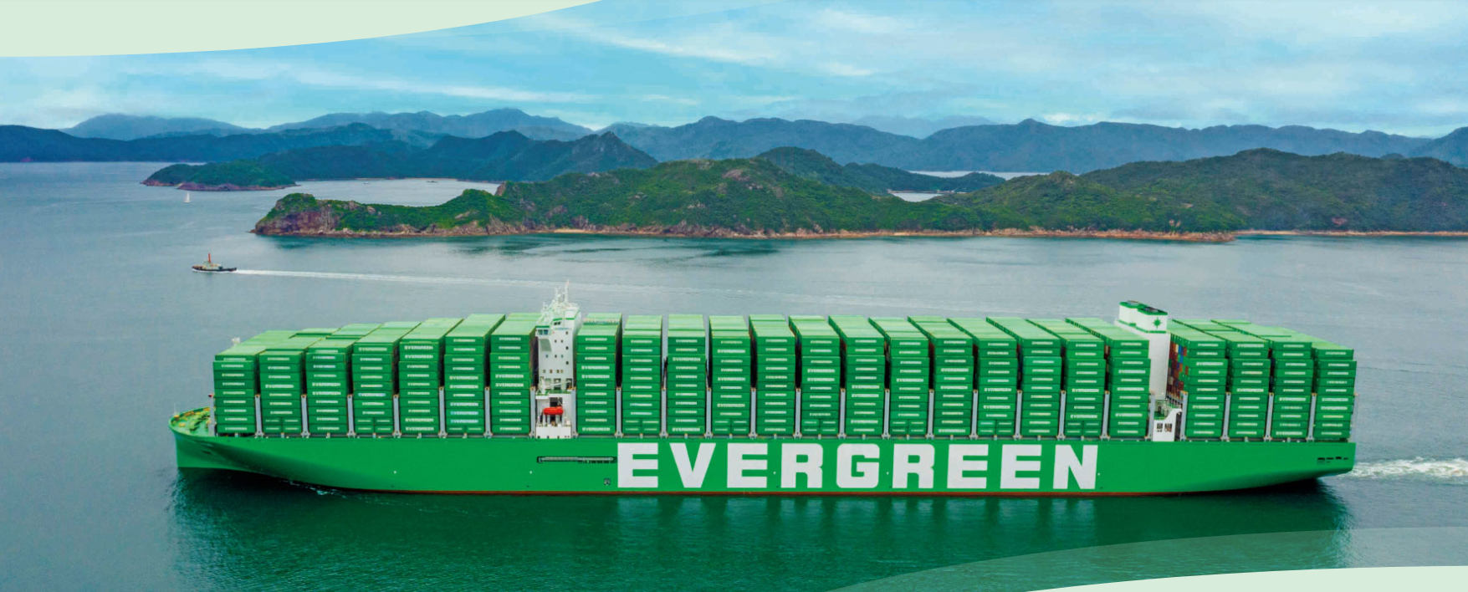
2025
LAAM FTF Meeting (WCSA)
By LAD/EGA/ELA 2025.FEB.27~28
By LAD/EGA/ELA

Slide 2
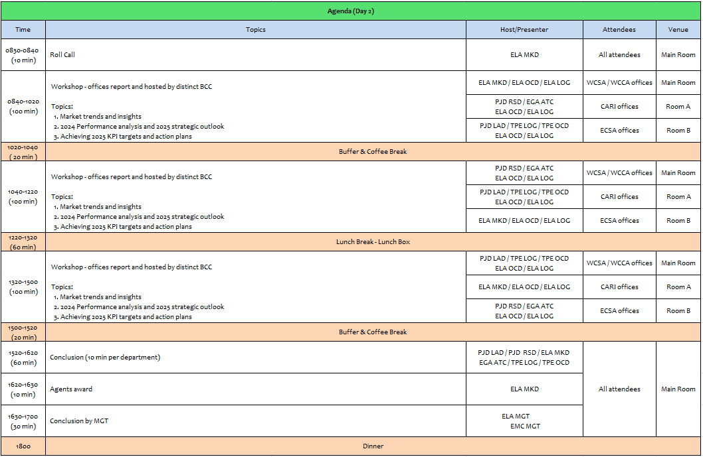
2

Slide 3
17
ECL
(CHILE)

Slide 4
Performance/Space(2024) and 2025 Market Review (CL)
Subject | Segments | BCC | 2024 Target TTL Loading(TEU) | 2024 JAN~DEC TTL Loading(TEU) | Achievement (%) | 2025 JAN~DEC TTL Loading(TEU) | Market Review & Action Plan (How to achieve 2025 target?)
 |  |  | (A) | (B) | (B)/(A) | Target
Trade Lane | F.E. => CL IMP. (G Trade) | LAD | 6,870 | 8,454 | 123% | 9,768 | Market: Like 2024 from the consumer behavior in retails sector. Retain Tender Accounts: Mabe: 800 TEU (White Goods) Comercial Eccsa (Ripley): 3,800 TEU (GDSM) Sumitomo Rubber: 200 TEU Recover Tender Target Accounts: Walmart: 1,000 TEU ~ 4,000 TEU Sindelen: 500 TEU (White Goods) CMPC: 500 TEU (Tissue / Lost Account due to Rate Issue) FALABELLA: 800 TEU (GDSM / Lost Account due to Rate Issue) Los Robles: 500 TEU (Lost Account due to Rate Issue) NAC Business: Eternity: 350 TEU Others: 350 TEU from Globe Express, Yusen Logistics, Ceva. FAK Business: 500 TEU, such asDP World, Pricer, Expeditors, Gelymar, and others.
 | CL EXP. => F.E. (Y Trade) | LAD | 28,293 | 30,502 | 108% | 14,163 | Dry Market: Expected volume in 2025 will remain similar to 2024, with no increase in woodpulp, wine, or foodstuff industries. Reefer Market: Fresh fruit exports, including cherries (30,000 boxes), are expected to maintain the same volume to FE in 2025. Woodpulp Spot Volumes: Weekly shipments from the central zone (CLVAL) remain at 60-80 TEU. Foodstuff Tenders: Renew key accounts such as G5, Carozzi, and Patagoniafresh. Frozen Meat Tenders: Renew Agrosuper and Ariztia contracts, considering their stable year-round volumes.
4

Slide 5
Performance/Space(2024) and 2025 Market Review (CL)
Subject | Segments | BCC | 2024 Target TTL Loading(TEU) | 2024 JAN~DEC TTL Loading(TEU) | Achievement (%) | 2025 JAN~DEC TTL Loading(TEU) | Market Review & Action Plan (How to achieve 2025 target?)
 |  |  | (A) | (B) | (B)/(A) | Target
Trade Lane | CL ⬄ USEC (619+620 Trade) | ELA | 3,100 | 2,826 | 91% | 3,100 | Market: Declined by -8.45% in 2024 compared to 2023, mainly impacting the food industry. Inland Service: US customers request expanded Inland service coverage with competitive rates.
 | CL ⬄ WCSA (WS Trade) | ELA | 6,600 | 4,947 | 75% | 5,500 | PE/CO volumes: Expected to increase by 26% in 2025, driven by the retail industry. Frozen fruit shipments: From PECAL via Andes Logistics and LOGPAR (2-4 containers per week). Increased CLSAI to COBVT via MX volume: Mainly for beverage and foodstuff customers like Intertank and Unified Foods. Renew avocado contract: Bagno for PECAL (180x40RH per year).
 | CL ⬄ WCCA (CW+WC Trade) | ELA | 3,190 | 4,101 | 129% | 4,100 | CW Trade Global Tenders (MT contracts): Nestlé, P&G, Kimberly-Clark, Samsung, etc. Renew tender contracts: Mabe and Comercial Eccsa to maintain regular volumes from MX and PA. Expand NAC business: Eternity, Yusen Logistics, and DP World from MX and GT. WC Trade Recover LAE service: Space for ECL cargo with competitive rates. Renew wine & foodstuff contracts: JF Hillebrand, Patagoniafresh, and Intertank (supporting 60 TEUs per week). Recover frozen tenders: Agrosuper and Ariztia.
5

Slide 6
Topic discussion (CL)
Commercial side:
Export
WSA3 Service Termination: As of February 2025, WSA3 will no longer call at CLLQN, resulting in an estimated loss of 20,000 TEUs to the Far East, primarily impacting the forestry industry’s market share.
Metal Scrap Restrictions to India: Since 2nd half of 2024 we are facing restriction in NED service to INNXV and INMUN affecting the volumes with our main customers loading metal scrap like CBP and Vanadium, if the restriction continues during 2025 this will generate a loss of around 5.000 teus.
Import
Eastbound Rate Competition (FAK & NAC): Market feedback indicates that ECL’s rates are USD 200 higher than competitors, leading to a loss of competitiveness with key customers like Eternity, Yusen Logistics, Globe Express, and Sparx.
WCSA/WCCA rates competition Increased freight rates to CLVAL in 2025 are reducing competitiveness, potentially resulting in lost business, including sugar shipments from COBVT and possibly Mabe MX contracts.
6

Slide 7
Topic discussion (CL)
Future Plan Suggestion:
Expansion to Southern Chile 60% of Chile’s export cargo originates from CLLQN, CLSVC, and CLCNL. Explore service options without increasing rate levels.
Recover Regional Service To increase way port cargo volume. Empty Reposition Reinstate export services to WCSA ports to strengthen market presence.
Cherry Service Recovery EGL was the only carrier in Chile that did not participate in last year’s cherry service. Given the 25% market growth, evaluate deploying a dedicated cherry service for the upcoming season. Consider the 2026 Lunar New Year (February) when planning service schedules.
7

Slide 8
Topic discussion (CL)
Future market forecast in 2025 (Pessimistic / Optimistic / Remain the same)?
Economic background:
GDP Growth:
Projected at 2.5% for 2025, with no significant economic expansion compared to previous years. The presidential election at year-end may contribute to political and economic instability.
External Economic Uncertainty:
The U.S. presidential election could impact global trade, with potential higher taxes on copper exports, Chile’s main revenue source. This may lead to inflation near 5% and Chilean peso devaluation due to a rising exchange rate.
Retail Sector Outlook:
Expected to continue growing in 2025, though at a moderate pace. The sector is closely monitoring the Chilean presidential elections and potential policy actions against the informal market, which could influence future investment decisions.
 | Get worse | Improve | Stay the same
2025 |  |  | X
8

Slide 9
ECD/IMD Topic discussion (CL)
ECD KPI | Item | 2023 | 2024 | Diff | Action Plan in 2025
ECD KPI | Storage | $ 533.00 | $ 102,578.00 | -19295% | Ever Lunar 0656-067W Discharge: Due to congestion at MX ports, exceptional empty units were discharged. Storage exceeded 15 days, accumulating charges over USD 200,000, later reduced by 50% through terminal negotiations. TPS Agreement 2025: To minimize extra costs, the agreement includes 7 free days for empty rollover containers.
 | Lift on/off | $ 263,867.00 | $ 305,246.00 | -15,68% | Agunsa & DPW LQN LOLO Collection: In 2024, repo instructions at Agunsa depots increased by 2,000 boxes, while DPW depot rates were adjusted by 1.86% (USPPI), per contract terms. 2025 Outlook: Empty LL charges are expected to decrease with the new CLVAL depot. Medlog’s contract does not include LL charges, further optimizing costs.
 | Reposition | $ 532,080.00 | $ 1,020,985.00 | -91,89% | Repo Out Volume Growth: Increased 63.6% from CL, with CLSCL depot’s empty return volume up by 57%, impacting release bookings and repo out demand. WSA Service Shift to TPS (2025): As depots are farther from the terminal, shunting costs will be higher than at CLSAI. However, a new agreement with Medlog—the closest depot to TPS with lower trucking costs—helps mitigate expenses.
 | M & R | $ 59,995.00 | $ 75,127.00 | -25,22% | STI Terminal Safety Policy Impact: Mandatory repairs for corner damage on empty containers before repo out increased M&R costs by 20-25% monthly. 2025 TPS Update: TPS will accept some damaged empties for repo out, reducing repair costs. Debris Restrictions for China (CN): Customs policy remains strict on debris-free empty containers, requiring compliance to avoid penalties in 2025. EOR Cost Verification: Double-check depot charges to ensure EOR costs align with agreements.
IMD KPI | Cost Saving Project | 0 | 0 | 0% | DPW LQN Depot: Rate extension confirmed until year-end 2025. Liventus Services: Extended rates for one year with no increase. CLSAI Depots (Agunsa, Sitrans & DYC): Shunting rates remain unchanged throughout 2024.
 | 90% Onboard within 7 Days | 0 | 0 | 0% | NIL
 | No Personal Negligence | 0 | 0 | 0% | NIL
9

Slide 10
OCD/OPD Topic discussion (CL)
 |  | 2023 | 2024 | Diff | Action Plan in 2025
OPD KPI | BOA | 85% | 100% | +18% | WSA services relocated to TPS in January 2025 to enhance schedule reliability and operational efficiency. Valparaíso terminal’s geographic position minimizes weather-related disruptions, improving vessel operations. Continuous monitoring to ensure berthing window security, vessel priority, and on-time proforma berthing.
 | Port Stay | 100% | 100% | 0% | TPS offers better scheduling conditions for berthing and unberthing. Vessel work planning is closely monitored to maintain optimal conditions.
 | Productivity | 57,1 MPH | 61 MPH | +6,8% | TPS commits to 60-70 moves per hour (adjusted for legal rest time) with three cranes per vessel. Flexibility to add a fourth crane when needed to achieve target MPH (moves per hour)
OCD KPI | Incentive | 41,435 (Boxes) | 56,644 (Boxes) | +36,70% | Increased productivity ensures efficient discharge and loading operations. Close collaboration with the BIZ department and terminal facilities to promote export and import volumes.
 | Empty Storage | USD 710.00 | USD 86,200.00 | -12141% | STI Terminal: Due to congestion at MXLZC, EVER LUNAR (LUNR) 0656-067E was stored at the terminal for nearly a month. DPW LQN Terminal: Rate agreement extended for one year without USPPI adjustments. 2025 Monitoring: Continuous tracking of potential disruptions and proactive reporting to HQ, including updates on local regulatory changes.
 | Rate Reduction | 0 | 0 | NIL | STI Contract Extension: Contract extended until EVER LIBRA 0705-076W (sailing date: 2025-01-03). Rate Optimization: Ongoing evaluation of better rate opportunities and improved local conditions.
10

Slide 11
18
ECO
(COLOMBIA)

Slide 12
Performance/Space(2024) and 2025 Market Review (CO)
Subject | Segments | BCC | 2024 Target TTL Loading(TEU) | 2024 JAN~DEC TTL Loading(TEU) | Achievement (%) | 2025 JAN~DEC TTL Loading(TEU) | Market Review or Action Plan (How to achieve 2025 target?)
 |  |  | (A) | (B) | (B)/(A) | Target
Trade Lane | F.E. => COBVT IMP. (G Trade) | LAD | 11,883 | 12,965 | 109% | 14,710 | EGL Market Scope Jan-Dec 2024 421.500 teus; EGL market share 12%, ranking 3 out of 14. Propose to BCC (5) new accounts (BCO) or business per week under FOB. Monitoring on weekly basis bookings/allocation from our VIP accounts (local tenders). Increase our commercial sales meeting with potential accounts, under FOB terms. Propose medium and long term business with local NVOCC. Promote Reefer FOB cargo from base ports. Continous sales lead campaing for CIF cargo. Keep updated the market rates feedback with BCC on weekly basis. Permanent AMP monitoring for own SQ KPI achievement.
 | COBVT EXP. => F.E. (Y Trade) | LAD | 1,806 | 1,929 | 97% | 2,151 | EGL Market Scope Jan-Dec 2024 14.200 teus; EGL market share 21%, ranking 2 out of 12. Continue proposing to BCC new business under CIF. Monitoring on weekly basis bookings/allocation from our current accounts. Increase our commercial sales meeting with potential accounts, under CIF terms. Focus on Coffee BIZ with POD offices & Scrap & Mineral export follow special procedures. Promoting new cargo & small customers via Green X for base & out ports. Permanent AMP monitoring for own SQ KPI achievement.
12

Slide 13
Performance/Space(2024) and 2025 Market Review (CO)
Subject | Segments | BCC | 2024 Target TTL Loading(TEU) | 2024 JAN~DEC TTL Loading(TEU) | Achievement (%) | 2025 JAN~DEC TTL Loading(TEU) | Market Review or Action Plan (How to achieve 2025 target?)
 |  |  | (A) | (B) | (B)/(A) | Target
Trade Lane | F.E. => CO3 IMP. (C Trade) | LAD | 3,989 | 5,333 | 134% | 5,390 | EGL Market Scope Jan-Dec 2024 66.000 teus; EGL market share 21%, ranking 2 out of 10. Propose to BCC (5) new accounts (BCO) or business per week under FOB. Monitoring on weekly basis bookings/allocation from our VIP accounts (local tenders). Increase our commercial sales meeting with potential accounts, under FOB terms. Propose medium and long term business with local NVOCC. Promote Reefer FOB cargo from base ports. Continous sales lead campaing for CIF cargo. Keep updated the market rates feedback with BCC on weekly basis. Permanent AMP monitoring for own SQ KPI achievement.
 | CO3 ⬄ CARB (CC Trade) | EGA-ATC | 3,740 | 2577 | 69% | 3,500 | (IN) EGL Market Scope Jan-Dec 2024 10.900 Teus; EGL market share 10%, ranking 6 out of 18. Focus on PA cargo (6.500 Teus) CIF - Sales lead Campaing to PA. (OUT) Market Share Jan- Dec 2024 51.200 Teus; EGL market share 10%, ranking 6 out of 17. Focus on Direct Service PA specially Manzanillo cargo to increase EGL participation. Try to maintain spot volume to PR & DO Permanent AMP monitoring for own SQ KPI achievement.
 | CO3 ⬄ USEC (609+610 Trade) | EGA-ATC | 1,040 | 701 | 67% | 1,040 | (610) EGL Market Scope Jan-Dec 2024 30.000 Teus; EGL market share 3%, ranking 6 out of 10. Focus on base ports as USNYC, USCHS, USSVN, USBAL & USNFK. We need more allocation from PA to US ports on NUE & AUE services and quick connection at PA. (609) EGL Market Scope Jan-Dec 2024 45.600 Teus; EGL market share 4%, ranking 7 out of 12. Continue strong sales lead campaign with US office due to main cargo under CIF terms.
13

Slide 14
Performance/Space(2024) and 2025 Market Review (CO)
Subject | Segments | BCC | 2024 Target TTL Loading(TEU) | 2024 JAN~DEC TTL Loading(TEU) | Achievement (%) | 2025 JAN~DEC TTL Loading(TEU) | Market Review or Action Plan (How to achieve 2025 target?)
 |  |  | (A) | (B) | (B)/(A) | Target
Trade Lane | COBVT ⬄ USEC (619+620 Trade) | ELA | 1,800 | 1,364 | 76% | 1,800 | (619) EGL Market Scope Jan-Dec 202412.700 Teus; EGL market share 11%, ranking 5 out of 9. Continue strong sales lead campaign with US office due to main cargo is closed under CIF terms. (620) Total Market Jan-Dec 2024 18.600 Teus (not active service) Potential market*
 | COBVT ⬄ WCSA (WS Trade) | ELA | 9,650 | 10,317 | 107% | 11,000 | (OUT) EGL Market Scope Jan-Dic 2024 71.600 Teus;EGL market share 14% ranking 4 out of 12. Promoting CLVAL as new Chile Port. Promoting new cargo via GreenX for PE & CL Enlarge account base for sugar biz. + BCO + NVOCC (DRY & RH) Monitoring on weekly basis bookings for all accounts including global & local tenders. Permanent AMP monitoring for own SQ KPI achievement. (IN) Total Market Jan-Dec 2024: 43.200 Teus (not active service). 25% of mkt is RH cargo. Potential market*
 | COBVT ⬄ WCCA (CW+WC Trade) | ELA | 1,150 | 3,699 | 321% | 100 | (OUT) WC EGL Market Scope Jan-Dec 20.000 Teus; EGL market share 8%, ranking 5 out of 9. Potential market* (IN) CW EGL Market Scope Jan-Dec 41.600 Teus; EGL market share 5%, ranking 8 out of 11. Continous sales lead campaing for CIF cargo. Promote FOB cargo (Port to port) for BCO and main NVOCC. Permanent AMP monitoring for own SQ KPI achievement.
14

Slide 15
Performance/Space(2024) and 2025 Market Review (CO)
Subject | Segments | BCC | 2024 Target TTL Loading(TEU) | 2024 JAN~DEC TTL Loading(TEU) | Achievement (%) | 2025 JAN~DEC TTL Loading(TEU) | Market Review or Action Plan (How to achieve 2025 target?)
 |  |  | (A) | (B) | (B)/(A) | Target
Trade Lane | CO3 ⬄ WCSA (CW+WC Trade) | ELA | 350 | 153 | 44% | 50 | OUT (CW TRADE) EGL Market Scope Jan-Dec 2024: 26.600 Teus; EGL market share 1%, ranking 8 out of 9. Focus on COBQL & COSMM as POL (2.300 Teus). We need BCC support to have competitive rates around USD 700 Permanent AMP monitoring for own SQ KPI achievement. IN (WC TRADE) Total Market Jan-Dec 2024 12.800 Teus (not active service); 30% of mkt is RH. Potential market*
 | CO3 ⬄ WCCA (CB Trade) | ELA | 450 | 10 | 2% | 10 | (OUT) CB EGL Market Scope Jan-Dec 2024 22.400 Teus; EGL market share 1%, ranking 7 out of 16. Actually CAW service has full space utilitation appreciate BCC comments and if we will have available space in the near future. Permanent AMP monitoring for own SQ KPI achievement. (IN) CB EGL Market Scope Jan-Dec 2024 3.600 teus; EGL market share 1%, ranking 10 out of 15. Actually CAW service has full space utilitation appreciate BCC comments and if we will have available space in the near future.
15

Slide 16
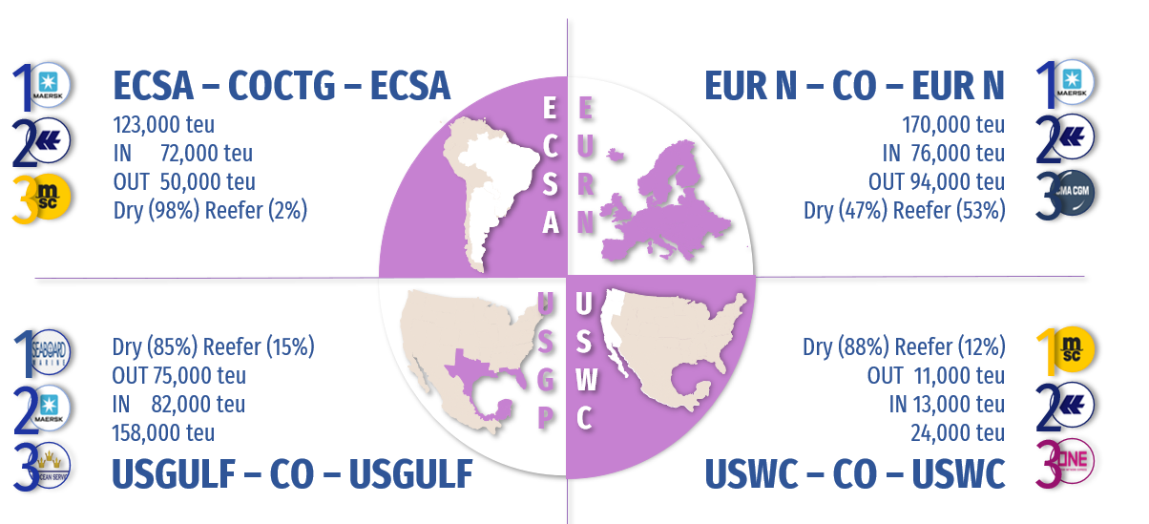
Topic discussion (CO)
Commercial side:
Future Suggestion:
Market Overview (2024) (in + out)
Colombian total market 1.700.000 TEUS (In 70% & Out 30%)
Trades: FE (31%) - NAME (20%) – SAME (18%) – EUR (17%) – CAME (14%)
BCO market (65%) & NVOCC market (35%).
Evergreen scope (49%) with 833.000 TEUS (In 78% & Out 22%)
Trades: FE (74%) - SAME (11%) – CARI (6%) – CAME (5%) – NAME (4%).
BCO market (69%) & NVOCC market (31%); market share 10% rank # 4.
Our target - Overview (2025) (in + out)
Develop INTRALATAM business: import side MX & PA to CO; export side to WCSA & PA
Recover USEC export business
Develop RH business in import side & concrete with principal commercial‘s strategy with Freight Forwarders, import side from FEAST.
Mantain the balance in inland depots to support our 70% of exports generated in hinterlands.
GREEN X : register during 2025 per week (5) new customer
AMP - permanent Follow up.
16

Slide 17
Topic discussion (CO)
Future market forecast in 2025 (Pessimistic / Optimistic / Remain the same)?
Economic background
Economic growth 2.5% 2025
Inflation rate projected 2025: 3.1%
Unemployment rate: between Around 10%
Government maintains position to hold any new oil & gas exploration. Started to see gas imports recently
Standard & Poor's revised the outlook on Colombia's long-term ratings maintain negative (2025)
Political crisis with main trade partner USA USD$ 15,3B could affect 26% of CO Imports & 27% of CO Exports
Exchange rate : Colombia peso important devaluation Q1 2025 ** USD$ 4.400
Second tax reform announced by Government (latest tax reform less than 1 year ago)
Health / Labor / Pension tax reforms going through Congress to be define during first half 2025
Currently under interior commotion decree due to guerrilla groups taking over part of the territory again
 | Get worse | Improve | Stay the same
2025 |  |  | X
17

Slide 18
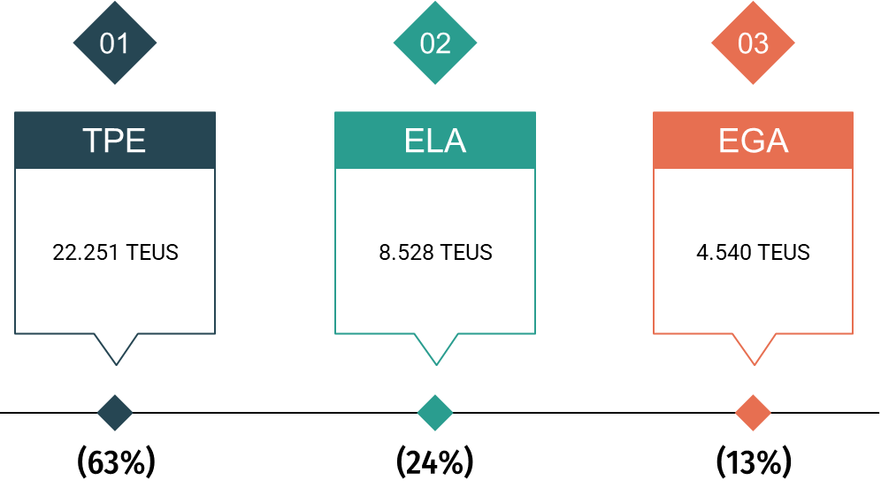
Topic discussion (CO)
Market share and Loading volume prospect 2025 (Long Haul)
Market share
Colombian Total Market 2025: According Colombian Government economy growth 2025 2.5%.
Market should be similar to last year, 1.7 million Teus IN & OUT.
Colombian Market EGL SCOPE 2025:
Scope 2025 if similar to last year 850K - EGL market share should maintain 10%.
Loading volume prospect 2025 (Long Haul):
Annual budget 91.000 TEUS – with (39% - 35.319 Teus) under KPI monitoring.
18

Slide 19
ECD/IMD Topic discussion (CO)
ECD KPI | Item | 2023 | 2024 | Diff | Action Plan
 | Storage | $71.794 | $108.475 | -$67.879 | Storage happened due to CAC vessel skip 17 times in the year and ROB issue. Using Xpres feeder service or CAJ to have a stable schedule and evacuate empties. COBQL free pool is increasing to 450 Teus (+13%)
 | Lift on/off | $19.275 | $1.810 | -$17.465 | Keep ask vendor to decrease/forzen LOLO tariff.
 | Reposition | $166.659 | $9.268 | -$157.391 | Keep COBQL inventory control with schedule stability to avoid shunting cost. Keep maintian good relationship with vendor and seek for good rate.
 | M & R | $279 | $227 | -$52 | Only emergency repair when necessary for loading.
IMD KPI | Cost Saving Project | NIL | NIL | NIL | -
 | 90% Onboard within 7 Days | 67% | 61% | +6% | Performance was affected due to WSA4 vessel schedule is unstable. Will keep monitor and make sure TS cntr loaded ASAP.
 | No Personal Negligence | 100% | 100% | 0% | -
19

Slide 20
OCD/OPD Topic discussion (CO)
 | Item | 2023 | 2024 | Diff | Action Plan
OPD KPI | BOA | COBVT: 50%/100% COCTG: 100%/100% | COBVT: 100%/100% COCTG: 50%/60% | COBVT: +50%/0% COCTG:-50%/-40% | Keep good relation with terminals and request attenting our vessel per contract. Due to COCTG terminal congestion vessel will take more days for berthing.
 | Port Stay | 100% | 100% | 0% | Keep asking all related parites’ help to finish operation.
 | Productivity | 100% | 100% | 0% | Keep good relation with terminal to maintain and further increase the productivity.
OCD KPI | Incentive | NIL | NIL | NIL | Keep looking for terminal to offer incentive to us.
 | Empty Storage | $60.883 | $108.475 | +$47.592 | 1. Storage happened due to CAC vessel skip 17 times in the year and ROB issue. 2. Using Xpres feeder service or CAJ to have a stable schedule and evacuate empties. 3. COBQL free pool is increasing to 450 Teus (+13%)
 | Rate Reduction | NIL | NIL | NIL | -
20

Slide 21
19
EECU
(ECUADOR)

Slide 22
Performance/Space(2024) and 2025 Market Review (EC)
Subject | Segments | BCC | 2024 Target TTL Loading(TEU) | 2024 JAN~DEC TTL Loading(TEU) | Achievement (%) | 2025 JAN~DEC TTL Loading(TEU) | Market Review & Action Plan (How to achieve 2025 target?)
 |  |  | (A) | (B) | (B)/(A) | Target
Trade Lane | F.E. => EC IMP. (G Trade) | LAD | 1,916 | 2,476 | 129% | 3,164 | MARKET REVIEW: Recover shipments lost from Southeast Asia (light cargo) with BCC support. China shipments under FAK terms with special negotiations based on market trends. SC being signed with NEW A/C MERCHANT GERARDO ORTIZ E HIJOS CIA. LTDA (Minimum Quantity Commitment: 3,000 TEU, over 60 TEU per week). MABE 2025 Bid: A/C increased their forecast by 40% compared to 2024. Face-to-face meeting (Round 3) scheduled for February 18th. ACTION PLAN: Maintain communication with BCC to report on market trends. Communicate with BCC to obtain competitive quotes for our own SQ. Develop new clients and maintain relationships with existing clients for AMP.
 | EC EXP. => F.E. (Y Trade) | LAD | 6,302 | 6,714 | 107% | 6841 | MARKET REVIEW: Recover our Teak Wood shipment volume to India (20-foot container market), targeting a 1% ECM market share in 2024. Increase our Cocoa Bean shipments to Southeast Asia (40-foot container market). We lost our number one ranking in this market, and our 2024 EMC market share target is 19%. Increase our shipments of refrigerated goods (Fresh Bananas, Frozen Seafood, Broccoli) to China, Japan, and Taiwan. The 2024 EMC market share target is 3%. ACTION PLAN: Increase our space allocation on Asian services to recover Teak wood loads to India and Cocoa loads to Southeast Asia. Optimize our routes for refrigerated cargo by reducing transit times to handle significant volumes, particularly for bananas. Maintain a stock of 100–200 refrigerated containers per week to increase market share, cargo volume, and achieve the 2025 KPI.
22

Slide 23
Performance/Space(2024) and 2025 Market Review (EC)
Subject | Segments | BCC | 2024 Target TTL Loading(TEU) | 2024 JAN~DEC TTL Loading(TEU) | Achievement (%) | 2025 JAN~DEC TTL Loading(TEU) | Market Review & Action Plan (How to achieve 2025 target?)
 |  |  | (A) | (B) | (B)/(A) | Target
Trade Lane | EC ⬄ USEC (619+620 Trade) | ELA | 2,100 | 208 | 9% | 250 | MARKET REVIEW: If the 619/620 trade can optimize transit times and connections, we will have an opportunity to recover shipments and increase participation to/from the USEC, especially by offering pickup services from the USEC. ACTION PLAN: Improve T/T and connections to regain customer's support.
 | EC ⬄ WCSA (WS Trade) | ELA | 3,600 | 298 | 8% | 250 | MARKET REVIEW: Recover shipment volumes to Chile/Argentina (40RH), focusing primarily on fresh bananas. EMC market share in 2024: 0.16%. Regain dry cargo volumes to Chile and Peru. EMC market share in 2024: 0.06%. PECAL-ECGYE is a highly competitive market. Rates are frequently updated and tend to drop, The WSA2 service is unstable, with COR occurring quite frequently.. COBVT-ECGYE: We lack competitiveness as our service only calls at ECPSJ, while customers continue to prefer GYE. ACTION PLAN: Secure fixed weekly spaces in the feeder service to ensure export of reefer cargo. Establish a regular service with competitive rates for this trade. Coordinate with BCC to obtain competitive quotations for our SQ PECAL-ECGYE.
 | EC ⬄ WCCA (CW+WC Trade) | ELA | 450 | 2,244 | 490% | 1,650 | MARKET REVIEW: In CW trade. Opportunity to participate in MABE BID 2025 for their shipments from MXMZO. We continue to develop GT to the best of our ability with various clients, but primarily with BCOS. In the WC trade, EMC's market share in 2024 was 4% to Central America and 0% to Colombia. ACTION PLAN: To maintain our current negotiations, we require the continued support of BCC. Due to persistent congestion at LAE affecting our export cargo, we require a route review to enable CO2 recovery with minimal transit time.
23

Slide 24
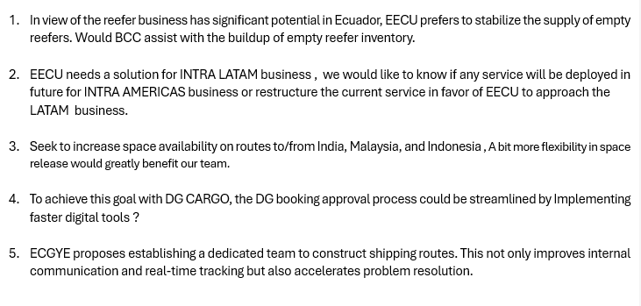
Topic discussion (EC)
Commercial side:
Future Plan Suggestion:
24

Slide 25
Topic discussion (EC)
Future market forecast in 2025 (Pessimistic / Optimistic / Remain the same)?
Economic background:
Ecuador's economy is based on the export of raw materials, such as oil, bananas, shrimp, and gold.
Key Points
Economic size The economy is the eighth largest in Latin America and the 69th largest in the world.
Economic sectors The economy is based on mining, agriculture, and fishing.
Economic challenges The country faces challenges such as climate change, energy shortages, and political uncertainty.
Economic growth In 2023, GDP growth was 2.4%, down from 6.2% in 2022. The IMF projects growth of 1.8% in 2024 and 2% in 2025.
Income inequality Income inequality is a problem, with almost half of the rural population living in poverty.
Energy Ecuador is dependent on hydroelectric energy, which was disrupted by a historic drought in 2024.
Oil The oil industry is affected by the maturation of wells, insufficient investment, and a referendum to halt operations in Yasuni National Park.
Remittances Remittances from Ecuadorian emigrants employed abroad contribute to the economy.
Ecuador's economy is also affected by political uncertainty, organized crime, and climate-related events.
 | Get worse | Improve | Stay the same
2025 |  | x
25

Slide 26








Ecuador’s economy is heavily dependent on exports, as these are one of the main sources of foreign exchange earnings in the country.
In 2023, exports accounted for 26.2% of the country’s GDP. In which, Oil represent 62.27% of exports and Non-oil products represent 37.73% of exports
Bananas: Ecuador is the world’s largest exporter of bananas, this industry is generating around 7-10% of total exports.
Frozen Shrimp: The country is one of the leading global exporters of shrimp, with this sector accounting for more than 15% of exports
Cocoa beans: Ecuador leads in the production of fine and flavoured cocoa, which also contributes significantly to agricultural exports.
Non-traditional products such as flowers, tuna, coffee, tropical fruits and superfoods (quinoa, chocho) also contribute to export diversification.

Slide 27
ECD/IMD Topic discussion (EC)
ECD KPI | Item | 2023 | 2024 | Diff | Action Plan in 2025
 | Storage | USD 4,502 | USD 2,899 | 55.29%
 | Lift on/off | USD 20,558 | USD 121,302 | 83.05% | We will keep monitoring and following Line instructions regarding the sale of containers and reposition plan through WSA4 service.
 | Reposition | USD 71,050 | USD 581,315 | 87. 78% | The reposition of empties using WSA4 service (arriving at PSJ) is instructed by our Principals to fullfill the allocation given by Vessel/voyage.
 | M & R | USD 11,119 | USD 4,705 | 136.32% | We only repair dry containers when needed, units that can not be loaded due to heavy damages or to increase the local available stock to cover the export demand, always requesting ELA approval.
IMD KPI | Cost Saving Project | USD 71,050 | USD 563,465 | 87.39% | 2024 was an atypical year in relation to vessel operations of the WSA2 svc, due to the movement limitations given by INARPI terminal, which led us to use the WSA4 svc for the empty reposition out, generating extra trucking costs. With the current change of terminal for the WSA2 service (Contecon), we can resume the regular loading of empties, it will allow us to reduce Reposition costs during 2025.
 | 90% Onboard within 7 Days | N/A | N/A |  | Terminals at Ecuador are not used as regular transshipment ports.
 | No Personal Negligence | N/A | N/A |  | Keep monitoring the pick up of all empty containers arriving at PSJ and need to be moved to ECGYE.
Aged Container Selling / Free Reposition Plan
A: Currently we are following Principals instructions to sale aged containers. We have instructed customers to paint the containers and remove all Evergreen markings to avoid any problem for the Line.
B: Repo In: there is a fumigation cost that is mandatory for all the containers arrived at Ecuador. Repo Out: no extra cost of trucking using WSA2 service arriving at ECGYET (Contecon terminal).
27

Slide 28
OCD/OPD Topic discussion (EC)
 |  | 2023 | 2024 | Diff | Action Plan in 2025
OPD KPI | BOA | 50% | 100% | 50% | Since only one of WSA2's own vessel berths at ECGYE, we will keep monitoring the performance and communicate with ELA/OPS and TPE/OPS any news.
 | Port Stay | 100% | 100% | - | Since only one of WSA2's own vessel berths at ECGYE, we will keep monitoring the performance and communicate with ELA/OPS and TPE/OPS any news.
 | Productivity | 100% | 100% | - | Since only one of WSA2's own vessel berths at ECGYE, we will keep monitoring the performance and communicate with ELA/OPS and TPE/OPS any news.
OCD KPI | Incentive | - |  |  | With the change of terminal of the WSA2 service, there is no negotiated incentive with Contecon based on discharging/loading movements.
 | Empty Storage | - |  |  | No KPI, Contecon and DP World Posorja terminal don’t include free pool for empty transshipment containers under EMC contract.
 | Rate Reduction | - |  |  | Ecuador’s main services, WSA2 and WSA4, has no regular transshipment cargo so there’s no storage or LOLO fees, but when it occurs we manage to revise with the terminals to reduce the extra costs to the Line.
28

Slide 29
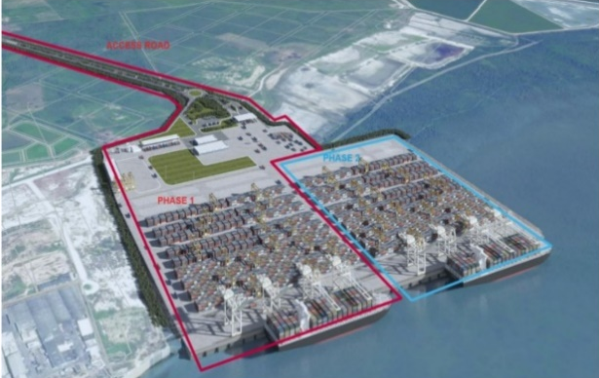
OCD/OPD Topic discussion (EC)
Topic – 2025 Projection
Terminal information update (expansion/cranes)
DPW POSORJA:
The dock expansion officially began, to cover a total of 700 meters, and it is expected to be
completed by mid-2026.
This investment will allow the simultaneous operation of two fully loaded post-Panamax vessels.
They will also add two more gantry crane to operate the new dock.
CONTECON:
They have inaugurated the first on-dock cold storage facility for banana exports, in partnership with Cool Carriers.
This facility is designed to give an uninterrupted cold chain preservation from cargo reception to shipment leading to reduced waiting times, optimized processes, and a guarantee that the fruits reach their destinations in the best possible condition.
Will increase 2 more gantry crane, to have a total of 8 by the end of 2025.
TPG:
They also has expansion plans between 2025 and 2030. They have announced an investment to extend the dock from 660 meters to 800 meters in length, as well as the acquisition and renovation of cranes and equipment for container yards and reefer plugs.
Will increase 2 more gantry cranes by the mid-2026.
29

Slide 30
20
EPE
(PERU)

Slide 31
Performance/Space(2024) and 2025 Market Review (PE)
 | Segments | BCC | 2024 Target TTL Loading(TEU) | 2024 JAN~DEC TTL Loading(TEU) | Achievement (%) | 2025 JAN~DEC TTL Loading(TEU) | Market Review & Action Plan (How to achieve 2025 target?)
 |  |  | (A) | (B) | (B)/(A) | Target
Trade Lane | F.E. => PE IMP. (G Trade) | LAD | 9,185 | 10,622 | 116% | 12,102 | 2024 G trade achieved. Target 2025~2024 = +32% 2024 market +2%, EGL +5% Action plan 2025: Increase MQC for Tender Accounts 2025: Jetour / car: secure 3,200 TEU/year = 2024~2025=+ 60% Intercorp / retail = +25%, potential MQC 6,000 TEU/year (Apr25 ~ Mar26). Mabe / white goods = +25%, 1600 TEU Mar 2025~Feb 2026. Ripley = +10%, 1900TEU in 2024 with EGL (Apr25 ~ Mar26). Target A/C: tires, construction materials, electrical products and appliances = +10% AMP increase +15% from 76 to 85 Accounts by the end of 2025. Develop Chancay WSA3; some Accounts are testing with spot shipments (Ripley).
 | PE EXP. => F.E. (Y Trade) | LAD | 27,189 | 34,628 | 127% | 39,009 | 2024 Y trade achieved. Target 2025~2024 = +42% 2024 market +37%, EGL +45% Fishmeal target 2025: 20,000 TEU/year = +8% than 2024. Fishmeal market share 2023:16% 2024: 24%, 2025: 25-26% New customer Hayduk with target 2,000 teu/year, maintain 40´s for peak season, increase DG space during peak, reduce empty reposition to avoid roll overs. Mineral: promote import full 20' especially during the slack season when no fishmeal (Apr-Jun / Oct-Nov) to promote more mineral shipments from TOP A/C: Chinalco, Trafigura, Metco, IXM. Reefer: promote NOR, Request 300 CA+ Units (avocado shipments).
31

Slide 32
Performance/Space(2024) and 2025 Market Review (PE)
Subject | Segments | BCC | 2024 Target TTL Loading(TEU) | 2024 JAN~DEC TTL Loading(TEU) | Achievement (%) | 2025 JAN~DEC TTL Loading (TEU) | Market Review & Action Plan (How to achieve 2025 target?)
 |  |  | (A) | (B) | (B)/(A) | Target
Trade Lane | PE ⬄ USEC (619+620 Trade) | ELA | 4,900 | 3,234 | 66% | 4,000 | 2024 not achieved. Target 2025~2024 = -18% 619 trade controlled by EGA Main POL USSVN (61%), USNYC (24%) Sales Leads: Plastics 1,150 TEU (EMC 2.4%), Resins 660 TEU (EMC 3.5%), Frozen Poultry 440 TEU (EMC 0%), Cotton: 380 TEU (EMC 11%) Open USHUS-PECAL O/O: 14,000 TEU/ year (MSC main Carrier with 50%) 620: No service since March 2021
 | PE ⬄ WCSA (WS Trade) | ELA | 9,300 | 9,430 | 101% | 10,000 | 2024 achieved. Target 2025~2024 = +7.5% Action plan: Increase Market Share COBVT/PECAL to 18% (500 TEU more), focus on BCOs Continue participating with MABE and RIPLEY to improve lifting. Promote Avocado Shipments to CLVAL (compete with truckers)
 | PE ⬄ WCCA (CW+WC Trade) | ELA | 2,900 | 5,958 | 205% | 3,500 | 2024 achieved. Target 2025~2024 = +20% Action plan: CW: Promote Sugar Shipments from GTZNJ, NICPK / require 20´s WC: Increase allocation on WSA2 to 1,500 ton to secure current dry and RH shipments to MXMZO (grapes, citrus, with C/T). – due to WSA3 & WSA4 reshuffle. Need stable space in LAE Service to develop new cargo sources for CAME (e.g., paprika, foodstuff).
32
32

Slide 33
Topic discussion (PE)
ASIA
Commercial side:
Send 300x4RH Starcool units for avocado peak season (Apr - Jul).
Protect FOB high paying cargo from ASI to PECAL to avoid rollovers: Hiraoka, Impulso Infomático, Tecnimotors, DPWLog.
Promote more 2SD and NOR shipments to balance export demand.
Increase allocation DG from India to Callao to secure motorcycle biz from A/C Crossland.
Future Plan:
Suggest to participate on Cosco WSA5 Chancay–Shanghai (23 days) starting in 2025~Q1 or COD WSA during blueberry peak season Sep~Nov (CAL-VAL-CHY-HKG) to secure 100x4RH blueberry reefers per week during 4-6 calls.
Evaluate to purchase CPX service Matarani-Callao to connect with WSA1 for export fishmeal, minerals, seaweed, and also for import cargo from far east and sugar shipments from COBVT.
REGIONAL
Commercial side:
Increase capacity to MXMZO to improve market share: grapes, citrus, paper, plastic, coal, etc. (EMC 8.4%).
Promote more avocado shipments to Chile.
Future Plan:
Suggest to participate on AMERICA XL (CMA/COS/ONE), which calls weekly Callao and adds call at Pisco port during reefer peak season.
33

Slide 34
Topic discussion (PE)
Future market forecast in 2025 (Pessimistic / Optimistic / Remain the same)?
Economic background
Market share and Loading volume prospect 2024 vs 2025 (Long Haul)
 | Get worse | Improve | Stay the same
2025
Economic figures | 2024 | 2025 (estimated)
GDP | 3.1% | 2.8%
Inflation | 2.0% | 2.5%
Ex. Rate | 3.76 | 3.8
Data source: Central Bank
 | Loading Volume - TEU |  | Market Share EGL
 | 2024 | 2025 (est) | 2024 | 2025 (est.)
G trade Asia/Callao | 41,065 | 46,000 | 9.20% | 10.50%
Y trade Callao/Asia | 37,063 | 39,000 | 16.70% | 17.60%
Data source: Escomar
34

Slide 35
ECD/IMD Topic discussion (PE)
ECD KPI | Item | 2023 | 2024 | Diff | Action Plan in 2025
ECD KPI | Storage | $0 | $23,025 | $ 23,025 | DPW storage bonus = USD5,000 per month (non-cumulative) 2024: KPI not achieved due to transshipment connection. 2025: Continue coordinating with ELA and terminal to control transshipments to avoid costs.
 | Lift on/off (container sell) | $7,781 | $5,559 | (-29%) -$2,222 | 2024: KPI achieved. 2025: Continue promote container sell locally to save LOLO (paid by CNEE).
 | Reposition | $0 | $0 | 0% | No trucking cost for repo in /out. 2024: No cost for repo. KPI achieved. 2025: Continue
 | M & R | $ 85,689 | $ 58,156 | (-32%) -$ 27,533 | 2024: KPI achieved. 2025: Continue with low standard repair for mineral to reduce the cost.
IMD KPI | Cost Saving Project | $4,012 | $38,953 | (971%) $ 34,941 | 2024: Not achieved due to transshipment storage cost. 2025: Continue to manage with terminal to connect transshipments within free time (10 days). Monthly storage bonus USD 5,000 (non-cumulative) under revision for renewal.
 | 90% Onboard within 7 Days | 866 / 1016 0.15/0.9 = 85% achievement | 993 / 1733 0.57/0.9 = 64% achievement | -21% | 2024: KPI Achieved. 2025: EPE will continue monitoring to achieve the connection on time.
 | No Personal Negligence | 0 | 0 | 0% | 2024: KPI Achieved. 2025: maintain current procedures
35

Slide 36
OCD/OPD Topic discussion (PE)
 | Item | 2023 | 2024 | Diff | Action Plan in 2025
OPD KPI | BOA KPI : Off slot≧88% /On Slot≧97%) | 92% | 80% | -12% | 2024: KPI not achieved due to abnormal swell. 2025: Continue monitoring to maintain BOA according to proforma and inform if congestion.
 | Port Stay KPI : ≧ 97% 28HRS | 100% (24HRS) | 85% (31HRS) | -15% | 2024: KPI not achieved due to port congestion. 2025: close communication with Terminal, notify in case any delay in OPS report.
 | Productivity 72.6MPH | 100% (87 MPH) | 100% (77 MPH) | 100% | 2024: KPI Achieved. 2025: Continue with good cargo split/distribution to improve port productivity.
OCD KPI | Incentive | 0 | 25,451.80 | 100% | 2024: KPI Achieved: DPW & PSA tugboat. 2025: Review with DPW and Chancay Port for any additional requirement.
 | Empty Storage | 0 | 0 | 0% | 2024: KPI Achieved. 2025: Connect empty/full cargo timely to avoid storage, extra yard moves, renomination, etc.
 | Rate Reduction | 0 | 0 | 0% | 2024: KPI Achieved 2025: : increase has been applied according CPI by PSA MARINE (tugboat) and DPW port.
36

Slide 37
