Slide 1
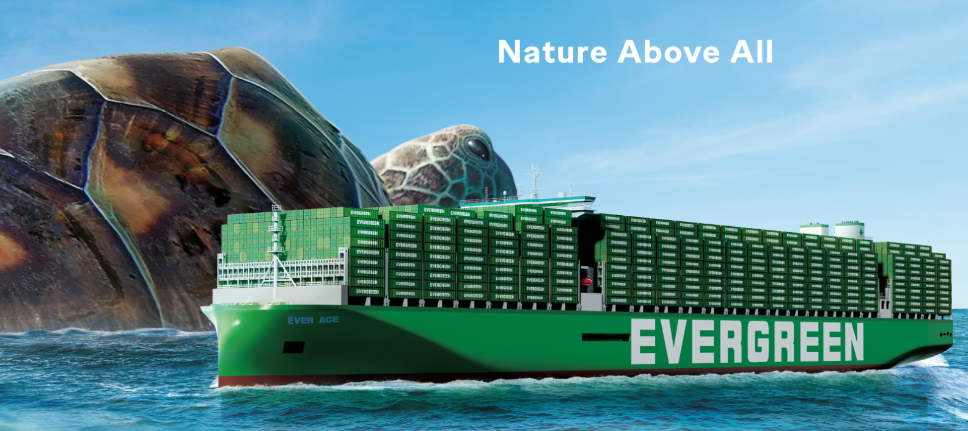
2025
LAAM FTF Meeting (CAME+WCCA)
By LAD/EGA/ELA 2025.FEB.27~28
By LAD/EGA/ELA

Slide 2
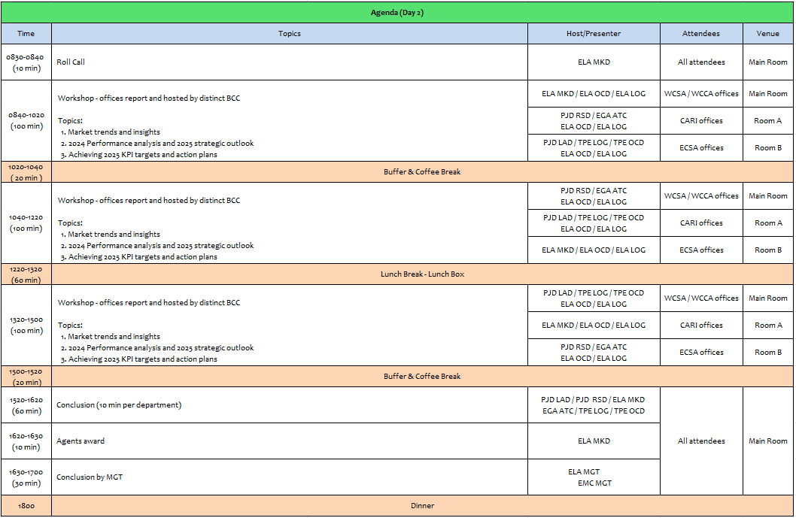
2

Slide 3
01
EMX
(MEXICO)

Slide 4
Performance/Space(2024) and 2025 Market Review (MX)
Subject | Segments | BCC | 2024 Target TTL Loading(TEU) | 2024 JAN~DEC TTL Loading(TEU) | Achievement (%) | 2025 JAN~DEC TTL Loading(TEU) | Market Review & Action Plan (How to achieve 2025 target?)
 |  |  | (A) | (B) | (B)/(A) | Target
Trade Lane | F.E. => MX IMP. (Q Trade) | LAD | 20,581 | 22,492 | 109% | 27,308 | Action plan, in order to enlarge our customers base list and get our target, we will be to achieve 2 new A/C regain 1 lost customer per month. Visit target at least 10 new and current customers per month, offering our allocation in our 4 service WSA/WSA2/WSA4/WSA5 persuade them to provide us better loading support this 2024. Catching more volume from Annual Tenders participated as: Walmart, Mabe, Soriana, Coppel and Mirage and try to get support for other VIP A/C like Italika and Chedraui.
 | MX EXP. => F.E. (Y Trade) | LAD | 8,948 | 10,771 | 120% | 12,959 | For Q1 maintain base volumes from two main A/C´s IMPALA TERMINAL/STEINWEG with ore concentrates regular cargo 600/700 TEU´s per month + regular FAK A/C´s to achieve around 320 TEU´s in weekly basis. Looking for cargo to base ports on WSA5 meanly, regain cargo to Asia southeast. For Q2/Q3/Q4 after MX government permissions release to export Iron Mineral we will focus in 2 A/C´s DOLPHIN & CIMA LOG looking for 400/500 TEU´s per month in order to get over 900 TEUS from all mineral exporters, rest of our volume will be get from medium size A/C as MAX EXPRESS, AMR SHIPPING,JJL PACIFIC, LA HANSIATICA KINTETSU WORLD,etc., + FAK from other small shots customers . Increase volumes from big shots customers 60/70% with comm., ORE/CONCENTRATES, REYICLED PELLET/HOME APPLIANCE+ 40/30% from FAK cargo.
4

Slide 5
Performance/Space(2024) and 2025 Market Review (MX)
Subject | Segments | BCC | 2024 Target TTL Loading(TEU) | 2024 JAN~DEC TTL Loading(TEU) | Achievement (%) | 2025 JAN~DEC TTL Loading(TEU) | Market Review & Action Plan (How to achieve 2025 target?)
 |  |  | (A) | (B) | (B)/(A) | Target
Trade Lane | MX ⬄ CARB (CB+V Trade) | ELA | 400 | 495 | 124% | 450 | Main PODs for V trade can be PABBA, having regular space on Express feeders or using WSA with T/S on Balboa KPI can be covered all depends on space asigned by BCC customers can supporting us MABE /LX PANTOS/MACOPA +FAK cargo, carribean cargo is very limited by MXMZO due to MX has natural east coast ports to CARI from MXVRC/MXALT.
 | MX ⬄ WCSA (CW+WC Trade) | ELA | 8,500 | 9,584 | 113% | 9,800 | With current customers TENDER/FAK cargo without problem to achieve KPI MABE/LX PANTOS/P&G/ CORGO AGENTS this means 60% from volume asigned + small FAK cargo shippers 40% can be covered acheaving new accounts with better guide line rates.
 | MX ⬄ WCCA (CB Trade) | ELA | 1,300 | 1,583 | 122% | 1,450 | Stable allocation on express feeders will be de key to fulfill our KPI along of all 2023 MX allocation was 5 to 10 TEUs per week, we can grant 200 TEUS per month as having competitive rates and space as Mexican market is, KPI can be achieved without problem, base cargo that MX can provoide from MABE/MACOPA/FFW and general FAK exporters (small shippers)
5

Slide 6
Topic discussion (MX)
Commercial side:
Q trade: Get more space at main ports for Own SQ cargo
Booking confirmation as soon as possible in order to provide best service for our own SQ and avoid roll overs in POL.
Y trade: Focusing to maintain base volume from ORE/MINERAL from 4 main accounts IMPALA/STEINWEG/DOLPHIN/CIMA + medium size A/C’S, enlarge FAK A/C´s regain Southeast
Y trade: volume offering WSA5 service with bigger space, using WSA2/3 for small shots vol’s 4 main accounts IMPALA/YAVA/STEINWEG/DOLPHIN, rest of volume will be covered by current and new small shots A/C´S.
Future Plan Suggestion:
Q Trade: To increase our lifting and enlarge our participation in MXLZC more space allocation needed to cover areas as MXJMJ / MXUCK / MXVUJ / MXQRO where this area service can be covered.
Y Trade: Promote WSA/ WSA5 service for big volumes, O/O cargo for all trades.
CW/WCA/V/B Trades: achieve cargo from many medium and small A/C´S, BCC needs to grant space on each service to maintain our market participation.
6

Slide 7
Topic discussion (MX)
Future market forecast in 2025 (Pessimistic / Optimistic / Remain the same)?
Economic background
Considering all the risk factors for the coming year, we anticipate that the economic slowdown will continue, with expected growth in 2025 of 0.8%, below the 1.4% of 2024.
The Mexican economy itself will face some additional challenges. Private investment is expected to decrease, and public investment is also likely to shrink in 2025. The peso will continue to slide downward slowly over 2025.
The unemployment rate in Mexico was forecast to continuously increase between 2024 and 2029 by in total 0.7 percentage points.
Mexico's economic growth is expected to slow in the coming years, with 2025 GDP projections revised down to 1% from a previous estimate of 1.2%
Inflation (3.5%) and interest rate forecasts (monetary policy rate of 8.0% by year-end).
Market share and Loading volume prospect 2024 (Long Haul)
Q trade MS 2024, 2,523,417 TEU´s EMC with 11.87%. 2025 MS volume to grow around 10%
Y trade MS 2024, 163,350 TEU´s EMC with 8.5%. 2025 MS volume to grow around 15%
 | Get worse | Improve | Stay the same
2025 |  |  | X
7

Slide 8
ECD/IMD Topic discussion (MX)
ECD KPI | Item | 2023 | 2024 | Diff | Action Plan in 2025
ECD KPI | Storage | $19,174 | $0 | $-19,174 | Properly arrange and monitor the number of gate-in empty containers. When the expected inventory is likely to exceed the free pool, efforts will also be made in advance to negotiate with the terminal for storage fee reductions. Additionally, based on the 2025 cargo volume forecast, EMX will request OCD for help to negotiate with the terminal to expand the free pool.
 | Lift on/off | $1,867,572 | $1,957,571 | $89,999 | Redirect empty containers to depots offering higher rebate rates, such as CIMA and TEP. During negotiations for new depots, efforts will be made to ensure that suppliers match the current highest rebate rates level and align LOLO fees with the most competitive market prices. Strict control measures will also be implemented to minimize the number of empty containers returned to depots offering low rebate rates and charging high LOLO fees.
 | Reposition | $6,756,686 | $7,857,250 | $1,100,564 | Increase the inland export container pickup volume and boost the empty repositioning along the cost-effective transport route to reduce empty repositioning costs
 | M & R | $3,950 | $2,033 | $-1,917 | The costs were incurred due to urgent repairs of empty and loaded containers. EMX will continue to work closely with ELA to rigorously review the necessity of each repair case and carry out repairs to the minimum required standards
8

Slide 9
OCD/OPD Topic discussion (MX)
 |  | 2023 | 2024 | Diff | Action Plan in 2025
OPD KPI | BOA | OUT OF WINDOW MXMZO 86% MXLZC 83% ON WINDOW MXMZO 92% MXLZC 100% | OUT OF WINDOW MXMZO 89% MXLZC 94% ON WINDOW MXMZO 97% MXLZC 95% | MXMZO 3% MXLZC 11% MXMZO 5% MXLZC -5% | MXZLO: Arrangements has been performed with local authorities in order to grant the pier availability upon arrival, anyhow there are some cases where we couldn't arrange it due to competition vessel were working before us. Actions to keep doing are keep constinous communication with port administrator in order to keep granting berth upon arrival MXLZC: Lazaro Cardenas has been congested by competition vessel due to recent new services, which now it has been more dificult to grant a pier availability to our good vessels, extra loaders has been granted with commercial team but due to competition started asking their berthing window we couldn’t arrange it upon arrival.
 | Port Stay | MXMZO 91% MXLZC 91% | MXMZO 83% MXLZC 64% | MXMZO -8% MXLZC -27% | We have manage to improve port stay in a way where we have negotiated on empty evacuation to be loaded directly from truck I/o going to yard and drop the empty, with this movement port stay has improve and terminal could focus in import attendance I/o managing the empties inside the yard
 | Productivity | MXMZO 44 MXLZC 61 | MXMZO 45 MXLZC 47 | MXMZO 1% MXLZC 14% | On this year 2025 TIMSA has bought 1 MOBILE CRANE Y 4 RTG in order to help the release and the attendance of import, this new mobile crane will help terminal to reach new generation vessel of 22 row and the RTG will help them the attendance of the import delivery and flow to the vessel operation.
9

Slide 10
14
NAV
(EL SALVADOR)

Slide 11
Performance/Space(2024) and 2025 Market Review (SV)
Subject | Segments | BCC | 2024 Target TTL Loading(TEU) | 2024 JAN~DEC TTL Loading(TEU) | Achievement (%) | 2025 JAN~DEC TTL Loading(TEU) | Market Review & Action Plan (How to achieve 2025 target?)
 |  |  | (A) | (B) | (B)/(A) | Target
Trade Lane | F.E. => SV IMP. (Q Trade) | LAD | 129 | 83 | 65% | 102 | LAE Service continues to experience considerable delays. Mostly due to berthing delays and terminal congestions. Current vessel rotation with constant Acajutla Port omissions (SVAGR). No vessel calling SVAGR on December 2024 minimized 2024 KPI achievement. Considering current conditions: Support from both Carrier and Terminal is needed to reach 2025 target (Regular service, faster berth and operations, aggressive rates).
 | SV EXP. => F.E. (CF Trade) | LAD | 409 | 377 | 92% | 479 | No vessel calling SVAGR on December 2024 prevented reaching 2024 KPI. To achieve 2025 KPI target considering current conditions: Maintain a regular service, Maintain support from BCC and Space Controller. Support from both Carrier and Terminal (Regular service, faster berth and operations).
11

Slide 12
Performance/Space(2024) and 2025 Market Review (SV)
Subject | Segments | BCC | 2024 Target TTL Loading(TEU) | 2024 JAN~DEC TTL Loading(TEU) | Achievement (%) | 2025 JAN~DEC TTL Loading(TEU) | Market Review & Action Plan (How to achieve 2025 target?)
 |  |  | (A) | (B) | (B)/(A) | Target
Trade Lane | SV ⬄ USEC (622+623 Trade) | ELA | 580 | 23 | 4% | 50 | Import from US to SV via SVAGR is not competitive since we do not have a call on LAE NB, so cargo has to go from US to PANAMA (T/S #1) then MEXICO (T/S #2) and then to SV on LAE SB call (Transit time too long). More CIF Cargo from US to SV (Via GTZST) is needed. Not enough empty units at SVSJHD to offer to export customers (Via GTZST). There are units in SVAGR available but for exports to US via SVAGR only.
 | SV ⬄ WCSA (CW+WC Trade) | ELA | 150 | 221 | 147% | 200 | MABE’s volume from WCSA to SVAGR (WC Trade) helped achieve 2024 KPI. Working on MABE’s 2025 Tender Agreement to achieve 2025 KPI target.
 | SV ⬄ WCCA+CARB (CB Trade) | ELA | 220 | 70 | 32% | 100 | Faster T/S connection in PANAMA for cargo going to Caribbean. No support from Sugar exporters as they do not accept to pay for port storages not generated by them.
12

Slide 13
Topic discussion (SV)
Commercial Side:
Imports
Still facing serious delays on ETA’s for most of our import cargo due to poor reliable LAE Service.
When under critical situation at depots, import cargo is detained/not released due to there is no space to receive the empty, unless customer accepts to bear all the cost related for the empty return of the unit.
Import customers from Asia are asking for same treatment they receive when using CIF rates (Easier to place a booking) than when they choose to use FOB rates (Harder to get a booking).
Exports
Export customers are pushing for support from Carrier to avoid storages caused by delays beyond their control.
Customers are supporting EMC with export volumes, but LAE service being not reliable is generating port storage costs that Carrier also claims is beyond their control and therefore not their responsability.
13

Slide 14
Topic discussion (SV)
Future Plan Suggestion:
Increase cargo volume from Far East to El Salvador (If it is light cargo, it’s better).
Enlarge customer database for both Inbound and Outbound cargo in order to maximize usage of spaces on each vessel.
Avoid confrontations with customers due to poor LAE Service and its implications.
Improve Customer Service to use it as our power tool to keep current customers’ support through time.
Work on approaching lost customers to regain their trust and support.
Encourage Carrier to study feasibility of a dedicated service between Mexico ports and Acajutla so situation is isolated from the rest.
14

Slide 15
Topic discussion (SV)
Future market forecast in 2025 (Pessimistic / Optimistic / Remain the same)?
*Under current conditions in el Salvador our Future Market forecast for 2025 is to Improve.
 | Get worse | Improve | Stay the same
2025 |  | V
15

Slide 16
Topic discussion (SV)
Economic Background:
According to Trading Economics, El Salvador's GDP is expected to reach $35,85 billion by the end of 2024. The IMF forecasts GDP growth of 4.5% in 2025. The World Bank projects the national economy will grow by 2.9% in 2025.
El Salvador's economy grew by 1.58% in the third quarter of 2024, slightly accelerating from an upwardly revised 1.53 percent growth in the previous period. Net foreign demand slowed (7.26% vs. 20.12% in Q2), while imports plummeted (1.75% vs. 7.77%). From a spending perspective, gross fixed capital formation rebounded sharply (7.84% vs. -3.61%), while growth in household consumption (1.65% vs. 3.0%) and government spending (-1.55% vs. 0.21%) decelerated. On a quarterly basis, the economy contracted by 0.2%, down from previous quarter. source: Central Reserve Bank of El Salvador
El Salvador's main growth drivers are domestic demand and household consumption. The country's economic activity is heavily dependent on the United States, its main trading partner and source of remittances
Recent developments:
Improved security: Government initiatives to combat crime have led to a decrease in gang violence, potentially boosting economic activity.
Focus on public investment: Government investments in infrastructure and development projects aimed at stimulating growth
Increased tourism: Efforts to promote tourism as a source of revenue
16

Slide 17
Topic discussion (SV)
IMPORT Market share and Loading volume prospect:
17

Slide 18
Topic discussion (SV)
EXPORT Market share and Loading volume prospect:
18

Slide 19
ECD/IMD Topic discussion (SV)
ECD KPI | Item | 2023 | 2024 | Diff | Action Plan in 2025
ECD KPI | Storage | $3,210.36 | $12,408,12 | + $9,197.76 | Empty container reposition rotation was slower in 2024 than in 2023, due to we had less vessels calling SVAGR and also congestion lead to storage days to increase at depots before units are REPO OUT. We will continue to REPO OUT older containers before their free time expires if conditions allow.
 | Lift on/off | $52,111.59 | $42,970,51 | - $9,141.08 | Decrease is a result of less Import (-23%) and Export (-33%) volume on 2024 compared to 2023.
 | Reposition | $18,699.69 | $25,780,83 | + $7,081.14 | Increase is a result of more empty units being REPO OUT (Some from 2023 accumulated at Depots for 2024) + Increase on Shunting cost from ex Depot SVAGRD on August 2024 and also from one of current depot SVAGRB on October 2024.
 | M & R | US$0.00 | US$0.00 | 0.00% | There is no M&R performed in SVAGR.
IMD KPI | Cost Saving Project | N/A | N/A | N/A | Not available
 | 90% Onboard within 7 Days | N/A | N/A | N/A | Not available
 | No Personal Negligence | N/A | N/A | N/A | Not available
Aged Container Selling / Free Reposition Plan
We sell Aged Containers in El Salvador since 2020.
There is no Free Reposition Plan for El Salvador.
19

Slide 20
OCD/OPD Topic discussion (SV)
 |  | 2023 | 2024 | Diff | Action Plan in 2025
OPD KPI | BOA | 31.26 Hrs. | 92.23 Hrs. | + 60.97 Hrs. | SVAGRT is mostly congested. Terminal Works on a first come – first berth basis. No berthing Windows available. Public terminal, operated by the government.
 | Port Stay | 30.3 Hrs. | 46.0 Hrs | + 15.7 Hrs. | Terminal is facing personnel shortages, which creates a shortage of gangs. Terminal is facing trucking shortages for transfers between pier and CY.
 | Productivity | 10.99 Cntr/Hr. | 8.00 Cntr/Hr. | - 2.99 Cntr/Hr | We have no control over SVAGRT’s productivity. Public terminal operated by the government.
OCD KPI | Incentive | N/A | N/A | N/A | There are no incentives. Port tariffs are public and equal for all users.
 | Empty Storage | N/A | N/A | N/A | Empty Containers do not generate storage charges at port, since they are moved directly from the off dock depot to the vessel.
 | Rate Reduction | N/A | N/A | N/A | The last rate increase was made on January 26, 2022. Tariffs will be valid for 5 years.
20

Slide 21
OCD/OPD Topic discussion (SV)
Terminal info update (expansion/dredge/crane):
The port of Acajutla, in El Salvador, is being developed to become a modern logistics platform.
The goal is for it to be able to handle more load and reduce operating times.
Development of the port of Acajutla:
The container yard is being expanded.
A new specialized container dock is being built.
New cold storage warehouses are being built.
The port is being dredged to increase its depth.
New equipment is being purchased.
Importance of the port of Acajutla:
It is the only port in El Salvador that moves all types of cargo.
It is vital for national and international trade.
Allows access to markets in North America, South America and Asia.
21

Slide 22
15
SNP
(GUATEMALA include BELIZE)

Slide 23
Performance/Space(2024) and 2025 Market Review (GT+BZ)
Subject | Segments | BCC | 2024 Target TTL Loading(TEU) | 2024 JAN~DEC TTL Loading(TEU) | Achievement (%) | 2025 JAN~DEC TTL Loading(TEU) | Market Review & Action Plan (How to achieve 2025 target?)
 |  |  | (A) | (B) | (B)/(A) | Target
Trade Lane | F.E. => GT+BZ IMP. (Q Trade) | LAD | 9,823 | 7,430 | 76% | 9,269 | In order to achieve 2025 target, we need support from Principals to negotiate additional move counts with APMT GT / our WSA2 Service, APMT is blocking our capacity to develop more cargoes and achieve our targets. We will persuade tender accounts to nominate additional volume during 2025. (Mabe, Sopesa &Nasa, Autocom) Approach clients to recover cargoes lost under FAK rate level We will be focused on clients that handles 4SD /4SH shipments.
 | GT+BZ EXP. => F.E. (CF Trade) | LAD | 1,952 | 2,357 | 121% | 2,989 | In order to achieve 2025 target, need support from Principals to negotiate special storate term at POL APMT. Need, at least 5 free days. Any vessel delay deeply aftect us but our competitors do have better conditions at APMT or absorb costs. We will be focused on cargo to Asia base ports on 40´ in order to increase EMC market share. We will be working on getting additional nominations of sugar, cardamom and coffee shipments. Approach clients to recover cargoes lost. Promote our service to reefer market.
23

Slide 24
Performance/Space(2024) and 2025 Market Review (GT+BZ)
Subject | Segments | BCC | 2024 Target TTL Loading(TEU) | 2024 JAN~DEC TTL Loading(TEU) | Achievement (%) | 2025 JAN~DEC TTL Loading(TEU) | Market Review & Action Plan (How to achieve 2024 target?)
 |  |  | (A) | (B) | (B)/(A) | Target
Trade Lane | GT+BZ ⬄ USEC (622+623 Trade) | ELA | 2,350 | 499 | 21% | 700 | In order to achieve 2025 target, need support on transhipment priority at CCT. Approach clients that handle cargo not sensitive to transit time. Close communication with US offices in order to secure cargo that is negotiated in US side. In order to increase coffee market share to North USEC, due to the lack of 2SD units, we are promoting 4SD / 4SH.
 | GT+BZ ⬄ WCSA (CW+WC Trade) | ELA | 3,550 | 4,641 | 131% | 4,300 | In order to achieve 2025 target, we will maintain close communication with actual accounts in order to secure current participation and get additional nomination. Enlarge A/C date base with clients that handle 40’ size containers. Promote routing from GTZNJ to CLVAL
 | GT+BZ ⬄ WCCA+CARB (CB Trade) | ELA | 650 | 1,039 | 160% | 800 | In order to achieve 2025 target, maintain close communication with actual accounts to secure participation and get additional nomination. Enlarge A/C data base to PABBA, CRCAL and Caribbean Ports. We will maintain close communication with BCC in order to get available allocation in advance to fully utilize it.
24

Slide 25
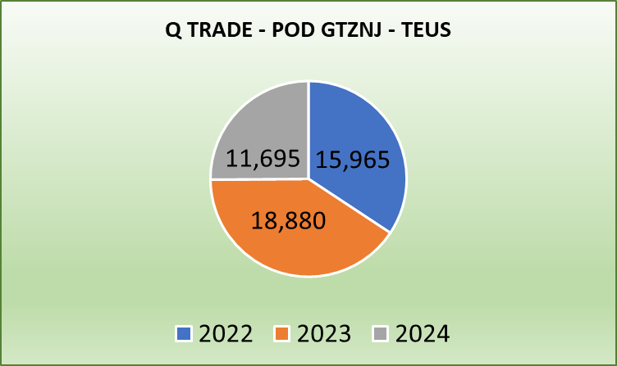
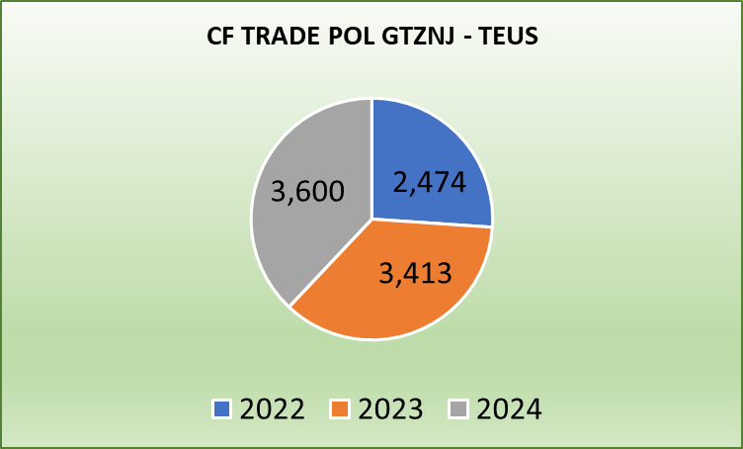
Topic discussion (GT)
Commercial side:
Q trade
Avoid roll overs at CNSHG and CNNBO.
Space & T/S protection on own SQ VIP accounts.
FAK rate validity time to be extended in order to cover available sailing dates.
Support on booking confirmation, no more than 24 hrs as from requested date.
Need special rate level on own SQ special accounts / VIP customers.
Approve and promote 4RH NOR ASIA/ GT
SNP evaluation C03 is based on initial KPI not under current movements availability.
Approval to release more 2SD bkgs to cover CF trade seasonal export demand.
WSA and or WSA2 enlarge capacity to GT, by negotiating with APMT for more move counts. APMT is blocking our capacity to develop more cargoes and achieve our targets.
Consider WSA and/or WSA2 to enlarge capacity to GT, by doing T/S to LAE and discharge more at EPQ.
CF trade
Release space on T/S ports ( TWKSG and SGSGP) in order to increase market share on long distance bkgs.
Negotiate 5 free days of storage at POL APMT (GTZNJ), as per other carrier's practice.
In case roll overs or vessel skip in Guatemala, consider to cover the terminal storages and eliminate the BT charges.
Since our exports are mostly in 2SD, need to increase laded imports from different trades to have more equipment available for our export.
Grant 6 months rates validity time to secure long term nomination.
To increase cardamom market share, need to set up routing POL GTZST and GTZNJ to SAJED and JOAQA
25

Slide 26
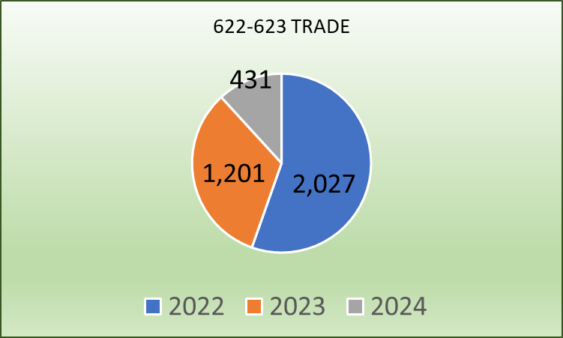
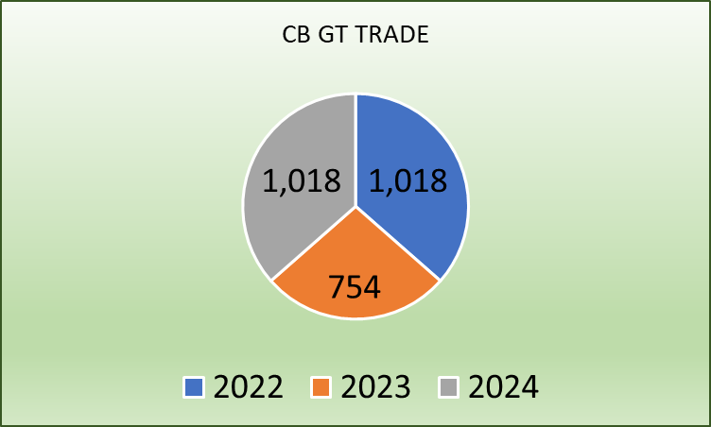
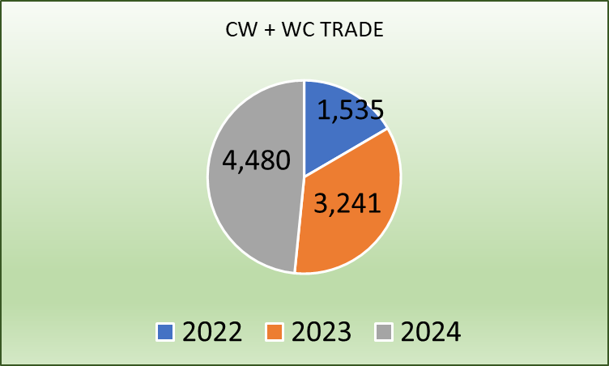
Topic discussion (GT)
Commercial side:
LAE S Service
CB Trade
Improve vessel schedule stability to secure more cargoes and recover accounts.
Avoid skipping call at GTZNJ. Due it affects import transit time.
Grant space from GT to cover export demand.
Grant 6 months rates validity time to secure long term nomination of sugar cargoes.
Transhipment priority at PA.
CAW Service
622 & 623: Need BCC support to recover market share lost due to long transit time and high rates level.
622 & 623 Transhipment priority at PACCT
622: Need to assign allocation to GT market and get prompt bkg confirmation.
CB: GTZST / Caribbean Ports, EMC rate level is around $1,200 p/c on top of market. Transhipment priority at PACCT is needed.
CB: GTZST / WCSA, EMC rate level is $1,000/2SD and $1,700/4SH on top of market. Need review EMC rate level.
To increase cardamom market share, need to set up routing POL GTZST and GTZNJ to SAJED and JOAQA
Set up direct routing based on CAW service schedule
(GT– HN – CO – PA – CR - GT)
Open direct routing from GTZST to JMKSN as per XPF calling ports. (GT– HN – JM- CO – PA – CR - GT)
WSA2 Service
CW / WC Trade
GTZNJ / WCSA: market demands 6 months rates validity time.
Request for transhipment priority at T/S port .
Market needs 5 days free of storage at APMT Guatemala.
26

Slide 27
Topic discussion (GT)
Future Plan Suggestion:
Promote 40´RH NOR from ASIA to Guatemala, to have 40´RH available in the country and return them laden to Asia or South America market.
Promote RH GT to ASIA
Consider Ad-hoc calls at EPQ to evacuate empties and promote the call to load as many as possible laden containers with sugar shipments to Taiwan.
In order to increase cardamom market share, need to set up routing GTZST and GTZNJ to SAJED / Jeddah and JOAQA / Aqaba
Consider direct routing calls based on CAW service schedule (GTZST – HNZPU – COCTG – PACCT – CRMOB)
Open direct routing on CAW Service from GTZST to JMKSN as per XPF calling ports. (GT– HN – JM- CO – PA – CR - GT)
Set up routing COBVT / GTZNJ
Set up routing CLVAL / GTZNJ
27

Slide 28
Topic discussion (GT)
Future market forecast in 2025 (Pessimistic / Optimistic / Remain the same)?
Year 2025 is the second year of President Bernando Arevalo in Guatemala
Economy keeps growing and optimistic
President is focuses to promoting the foreign investment
As from 2025, President has a very aggressive plan to recover public infrastructure; schools, roads, ports, among others.
The return of Immigrants from USA to the country is a very challenging issue for the country
Economic background
Guatemala GDP 3.5% 2024
Rate of exchange: 7.8116
Unemployment rate 4.65% Metropolitan Area
Inflation 8%
Expected GDP 4.02% / 4.07% for 2025
 | Get worse | Improve | Stay the same
2025 |  | Y
28

Slide 29
ECD/IMD Topic discussion (GT)
ECD KPI | Item | 2023 | 2024 | Diff | Action Plan in 2025
ECD KPI | Storage | N/A | $156,564.92 | $156,564.92 | Storage for laden increased due to VO for W721-W017 and KTMZ-014W announced a COR in LZC in order to secure berthing window in APMT, at that time, export units were already inside the terminal, however due overtonnage issue we were not able to complete loading. In regards of empties, we have been facing difficulties for empty repositioning due move counts restriction at APMT, which caused an increase of stock at depot. Depot has been supporting us a lot, giving us better benefits than other carriers, because of long time and good relationship with EMC.
 | Lift on/off | $293,812.93 | $229,500.14 | $64,312.79 | Due low productivity in EPQ, it was requested ELA to approve the use of external trucks in the terminal to improve empty transfers from stacking to alongside the vessel and increase loading productivity when empty evacuation at mentioned terminal; despite this, EPQ is economically more convenient than APMT. Therefore, we are trying to promote Ad-hoc calls at EPQ to load as many laden containers to Asia and empties.
 | Reposition | $187,624.73 | $125,191.00 | $62,433.73 | In consequence to import limitation because move count restriction imposed by APM Terminals, empty repositioning as basically null. We are focused to promote more laden exports to new markets and reduce empty repos.
 | M & R | $241.00 | $1,890.82 | $1,649.82 | Due limited 2SD units for exports shipments, we have been forced to request containers repairs locally. Hope we can get more 2SD containers to have more available.
IMD KPI | Cost Saving Project | $2,721,759.00 | $183,100.00 | $2,538,659.00 | Under evaluation the use of GPS instead of escort guard in the laden inland transportation , to reduce costs, but complying with insurance policies. In spite of many costs increases because of Salaries Increase by President decree of 10%, we are deeply negotiating with vendors to avoid increases or try to make it as little as possible.
 | 90% Onboard within 7 Days |  |  |  | Keep negotiating and asking for Principal support to increase move counts at APMT and be able to evacuate as many empties as posible and avoid overdue.
 | No Personal Negligence |  |  |  | No personal negligence case until now.
29

Slide 30
OCD/OPD Topic discussion (GT)
 |  | 2023 | 2024 | Diff | Action Plan in 2025
OPD KPI | BOA | 35% | WSA2 GTZNJP 0% LAE GTZNJT 0% | -35% | APMT delayed berthing due most of WSA2 vessels have arrived late and out of window, hence we are subject to adjustments in berthing planning. LAE vessels due arrangements for regular carriers and quantity of vessels waiting window operation frame. We will continue monitoring the treaceability and getting in close contact with Terminal in order to secure better conditions for berthing and to perform complete operation for laden and empty units.
 | Port Stay | 76% | WSA2 GTZNJP 100% LAE GTZNJT 80% | 5.35% | Port Stay increased at GTZNJP/AMPT due to Yard density, Terminal is limited to discharge and stack Inbound cargo efficiently, in order to digest the main Yard they assigned a Temporary Yard by operating only one or two STS cranes. Action plan, to request Terminal to accept direct empty evacuation so Terminal may be dedicated on full units. GTZNJT due to limited resources it affected Port Stay. Action Plan: We consider that promoting a window operation may assist to reduce Port Stay, request Terminal to accept direct empty evacuation so Terminal may be dedicated on full units and continue using LOLO and transfering external service provided by Depot.
 | Productivity LAE | 21 P/H | GTZNJT 28 P/H | > 6.25 P/H | Productivity in LAE service increased from 21 to 28 moves P/H and it was due we used external service from Consersa with LOLO and transfering which helped us a lot to speed up operations. Yilport at EPQ has 4 shore cranes, however all very used and out only 1 or 2 are operating, expect to have better conditions in a medium term due EPQ invited all private vendors to present offers to operate additional cranes.
 | Productivity WSA2 | 46 P/H | GTZNJP 46 P/H | Keep the same | APMT reached higher density records, and on week # 48 with General occupation of 172% what did not permit to improve productivity since some vessels were operated with only 1 or 2 STS cranes while yard was improving density from inbound cargoes.
OCD KPI | Incentive |  |  |  | There are no incentive programs in Guatemala
 | Empty Storage | $61,455.49 | 96,435.58 | 34,980.09 | It increase due restriction for repositioning in WSA2 service due move counts limitation. Action plan, request extension in the operation window frame from 1500 moves to 2000 (at least).
 | Rate Reduction |  |  |  | Due to current economical situation and wage increase , we do not see rate reduction
30

Slide 31
OCD/OPD Topic discussion (GT)
Topic
Terminal information, update (expansion/dredging/cranes)

Slide 32
Topic discussion (BZ)
Commercial side:
We continue to pursue all leads, but we are always faced with the many challenges such as long transit times and for the past 3 years significant delays in T/S Port in Panama.
Clients are eager to use our services plus our rates are always much higher.
Future Plan Suggestion:
As we realize due to double transshipment in Panama and Jamaica; different terminals connecting CAJ with CFS we will never be competitive rate wise.
However, if the delays can be minimized and our rates improve a bit we could see some improvement in our overall volumes.
32

Slide 33
Topic discussion (BZ)
Future market forecast in 2025 (Pessimistic / Optimistic / Remain the same)?
 | Get worse | Improve | Stay the same
2025 |  | Y
33

Slide 34
Topic discussion (BZ)
Economic background:
Overall, Belize's economy is projected to experience growth in 2025, fueled by a thriving tourism sector, increased foreign investment, and the development of new economic opportunities.
Tourism as the main driver:
The tourism industry is anticipated to remain the primary driver of economic growth, with increased visitor arrivals and new developments in the hospitality sector.
Foreign investment growth:
Foreign investment is expected to rise steadily, contributing significantly to the economy.
Low unemployment:
Belize is predicted to experience historically low unemployment rates.
Emerging sectors:
Sectors like trade finance, logistics, and near-shoring are expected to play a growing role in diversifying the economy.
Infrastructure development:
Expansion of the international airport and potential development of the Maya Train could further boost tourism and economic activity.
Potential challenges:
Sustainability concerns:
Balancing economic growth with environmental protection and managing the impact of tourism on sensitive ecosystems like the Belize Barrier Reef.
Taxation and fiscal policy:
Addressing potential challenges related to low tax collection and managing public debt.
34

Slide 35
ECD/IMD Topic discussion (BZ)
ECD KPI | Item | 2023 | 2024 | Diff | Action Plan in 2024
ECD KPI | Storage | $3,389.50 | $2,722.00 | $667.50 | Subject to FDR availability space.
 | Lift on/off | $6,960.00 | $6,135.00 | $825.00 | It was reduced import lifting from 2023 425 units to 2024 378 units.
 | (Ocean) Reposition | $269,179.00 | $248,426.00 | $20,753.00 | It was reduced import lifting.
 | M & R | N/A | N/A
IMD KPI | Cost Saving Project | N/A | N/A
 | 90% Onboard within 7 Days |  |  |  | Subject to FDR availability space.
 | No Personal Negligence
Aged Container Selling / Free Reposition Plan
customs taxes make it uncompetitive
35

Slide 36
OCD/OPD Topic discussion (GT+BZ)
 |  | 2023 | 2024 | Diff | Action Plan in 2024
OPD KPI | BOA | N/A | N/A
 | Port Stay | N/A | N/A
 | Productivity | N/A | N/A
OCD KPI | Incentive | N/A | N/A
 | Empty Storage | $3,389.50 | $2,722.00 | $675.50 | * Reduced port Stay at Terminal
 | Rate Reduction | N/A | N/A
36

Slide 37
16
UNI
(HONDURAS)

Slide 38
Performance/Space(2024) and 2025 Market Review (HN)
Subject | Segments | BCC | 2024 Target TTL Loading(TEU) | 2024 JAN~DEC TTL Loading(TEU) | Achievement (%) | 2025 JAN~DEC TTL Loading(TEU) | Market Review & Action Plan (How to achieve 2025 target?)
 |  |  | (A) | (B) | (B)/(A) | Target
Trade Lane | F.E. => HN IMP. (Q Trade) | LAD | 1,766 | 1,513 | 86% | 1,754 | Unstable LAE service made clients to find another solutions as HNZPU, GTZNJ or SVACJ with other carriers as EMC TT more 100 days. We lost almost 500 TEU‘s due to long TT of LAE service, as well from POL services WSA and others making T/S MXLZC, several clients TT 200 days their shipments.
 | F.E. => HN IMP. (C Trade) | LAD | 223 | 284 | 127% | 245 | Need to stay market rate level so we can be competitive. Promote more spot rates so can capture volume and comply KPI.
 | HN EXP. => F.E. (CF Trade) | LAD | 707 | 428 | 61% | 439 | Due to LAE unstable service RH equipment was not fluent as past years, we lost around 400 TEU‘s export from HN to TW. Free trade agreement between HN and TW expiration made exports of frozen shrimp drop. Need support on second leg to IN, right now is our main market.
38

Slide 39
Performance/Space(2024) and 2025 Market Review (HN)
Subject | Segments | BCC | 2024 Target TTL Loading(TEU) | 2024 JAN~DEC TTL Loading(TEU) | Achievement (%) | 2025 JAN~DEC TTL Loading(TEU) | Market Review & Action Plan (How to achieve 2025 target?)
 |  |  | (A) | (B) | (B)/(A) | Target
Trade Lane | HN ⬄ USEC (622+623 Trade) | ELA | 800 | 286 | 36% | 500 | No competitive rates against market rate level, we lost almost 100% of our volume.
 | HN ⬄ WCSA (CW+WC Trade) | ELA | 220 | 248 | 112% | 250 | We can improve numbers if EMC rates match market rate level, almost $1,000.00 higher right now.
 | HN ⬄ WCCA+CARB (CB Trade) | ELA | 250 | 104 | 42% | 150 | No competitive rates against market rate level, we lost almost 100% of our volume.
39

Slide 40
Topic discussion (HN)
Commercial side:
LAE Service it is a must to be stable, clients that ussually work trough HNSLO are searching for other POD’s as Service comply with TT 30 days.
Expect this year more support on RH Equipment.
Return market rate level for 622/623/CW/CB trades.
Future Plan Suggestion:
Action plan for LAE services have backlog and need to digest shipments at T/S ports.
If not have market rate level for 622/623/CW/CB trades at least provide monthly a spot rate for each trade in order to comply with KPI.
40

Slide 41
Topic discussion (HN)
Future market forecast in 2025 (Pessimistic / Optimistic / Remain the same)?
Economic background
At the beginning of the year, the economic outlook for Honduras shows moderate growth. Economic growth is projected to reach 3.4% in 2024, with a moderate slowdown by 2025. Regarding inflation, a year-on-year rate of 3.88% was recorded in January 2025, lower than in 2024.
 | Get worse | Improve | Stay the same
2025 |  |  | Y
41

Slide 42
ECD/IMD Topic discussion (HN)
ECD KPI | Item | 2023 | 2024 | Diff | Action Plan in 2025
ECD KPI | Storage | N/A | N/A
 | Lift on/off | $85,359.00 | $148,166.10 | $62,807.10 | Terminal Tariff maintain same. Difference is due to ncrease of import and export cargo in HN territory service.
 | Reposition | $118,345.50 | $105,788.50 | $82,188.50 | Due to increase of cargo volume on import and export and accumulation of idle equipment at HNZPU and HNSLO due to innestability of CAW and LAE service provided an increase in reposition costs.
 | M & R | $5,947.34 | $4,140.00 | $1,807.34 | M&R’s were approved for empty 4RH for frozen shrimp exports only.
IMD KPI | Cost Saving Project | N/A | N /A |  | No cost saving was contemplated in 2024 and for 2025 due to decrease in drivers and economic slow recovery we do not expect to get any reduction from trucking services or Depots.
 | 90% Onboard within 7 Days |  |  |  | Subject to allocation approval on LAE by ELA
 | No Personal Negligence | 0 | 0 |  | No negligence reported
Aged Container Selling 2024:
182 CONTAINERS SOLD (29X2SD / 39X4SD / 114X4SH)
42

Slide 43
OCD/OPD Topic discussion (HN)
 |  | 2023 | 2024 | Diff | Action Plan in 2025
OPD KPI | BOA | 2HRS | 2HRS | 0 | HNSLO terminal continued giving preference to container vessels which maintained same period as last year.
 | Port Stay | 40 HRS | 32 HRS | -8 | CONSERSA stevedore company improved vessel crane operativeness.
 | Productivity | 16 M/H | 19 M/H | +3 | We expect to improve productivity once CV ASPM is introduce at HNSLO in mid February 2025.
OCD KPI | Incentive | N/A | N/A |  | Terminal tariff does not offer incentives for Carriers or customers
 | Empty Storage | N/A | N/A |  | No empty storage at Terminal
 | Rate Reduction | N/A | N/A |  | No rate reduction for HNSLOT is contemplated for 2025. OPC terminal operator made general increase of 3.06% for all port tariffs at HNZPU.
43

Slide 44
OCD/OPD Topic discussion (HN)
TERMINAL INFORMATION – HNSLO
The government of Honduras has promised to start in the dredge before mid year and also investment in expansion of the dock and bridge at HNSLO is contemplated. Investment will be achieved thru brazilian company DTA Engenharia with a total investment of USD177mm. Investment will start in mid May 2025.

Slide 45
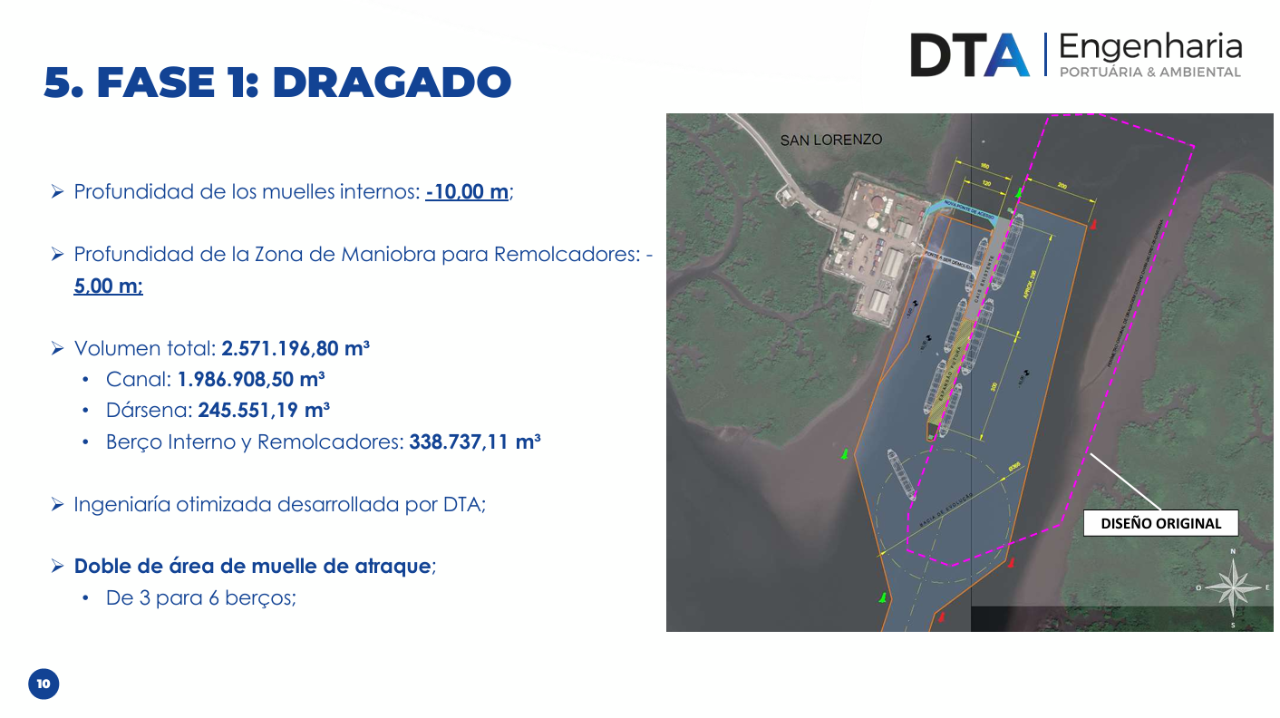

Slide 46
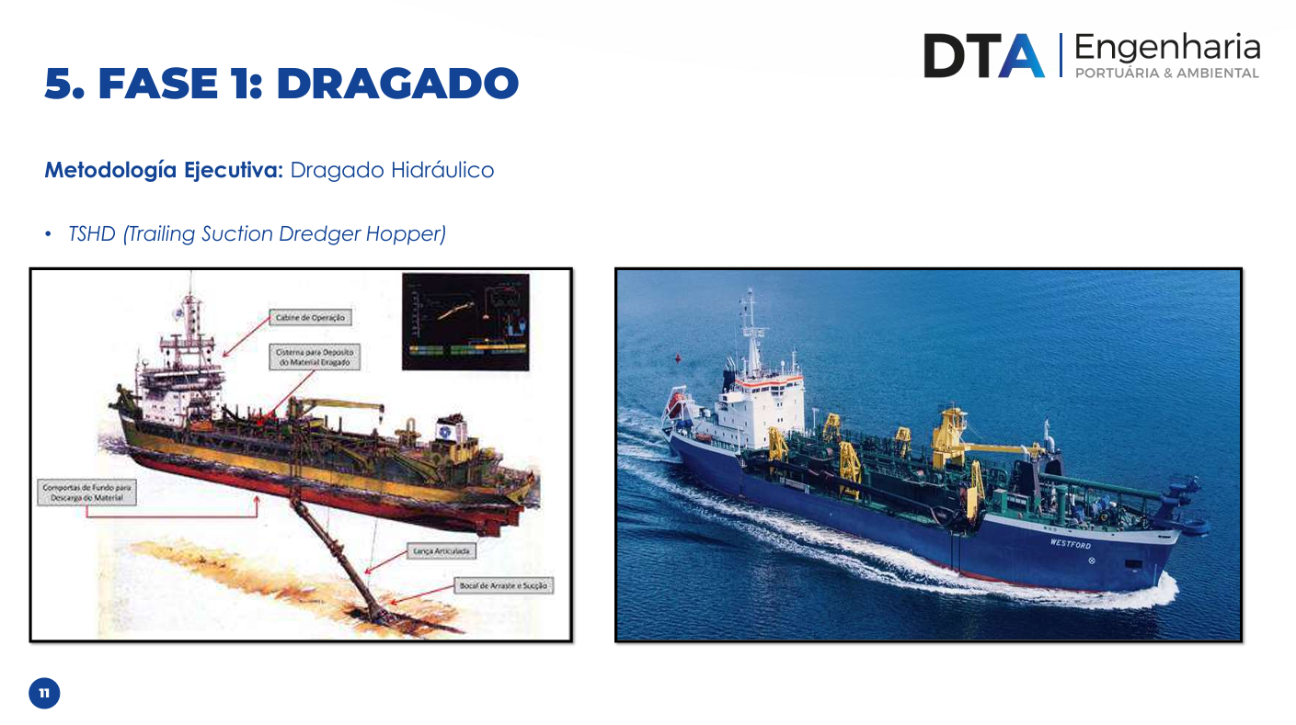

Slide 47
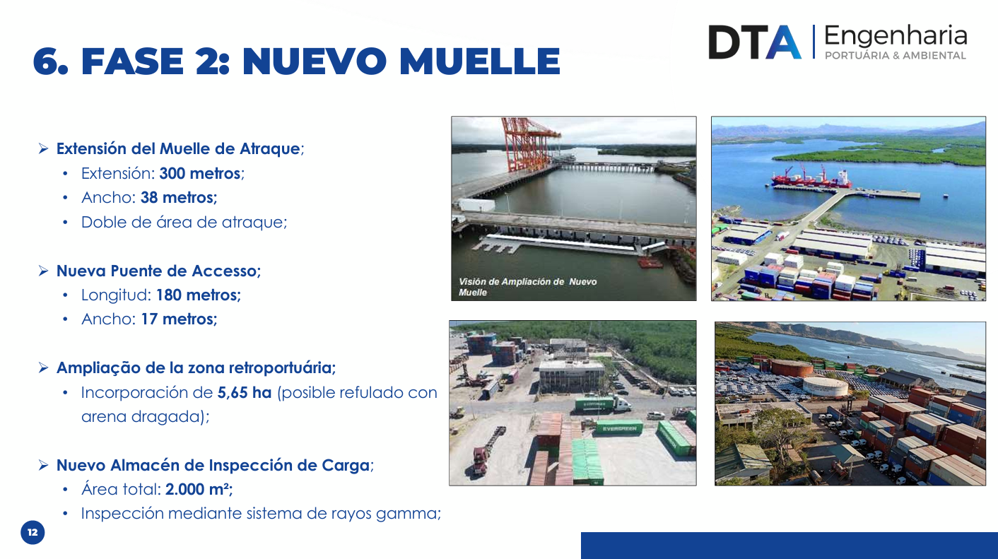

Slide 48
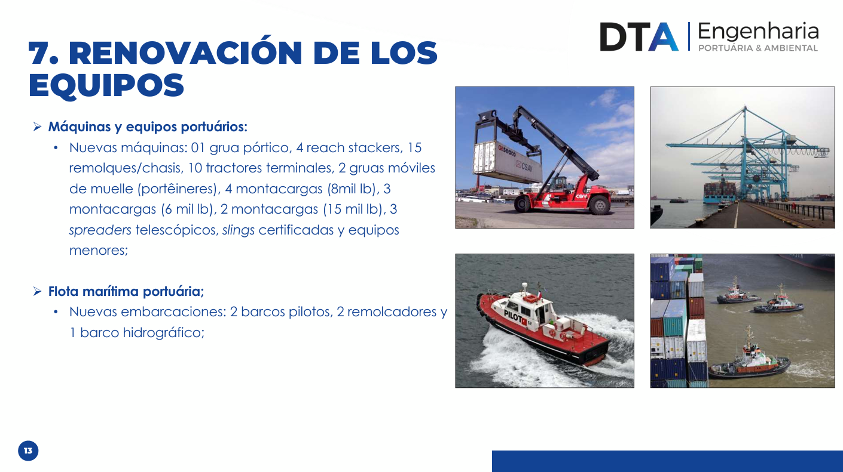

Slide 49
OCD/OPD Topic discussion (HN)
TERMINAL INFORMATION – HNZPU
Pivate operator at Puerto Cortes, OPC will be starting in 2025 the new expansion program of the Terminal for a maximum capacity of 1.8 million teus when the project is finished.

Slide 50
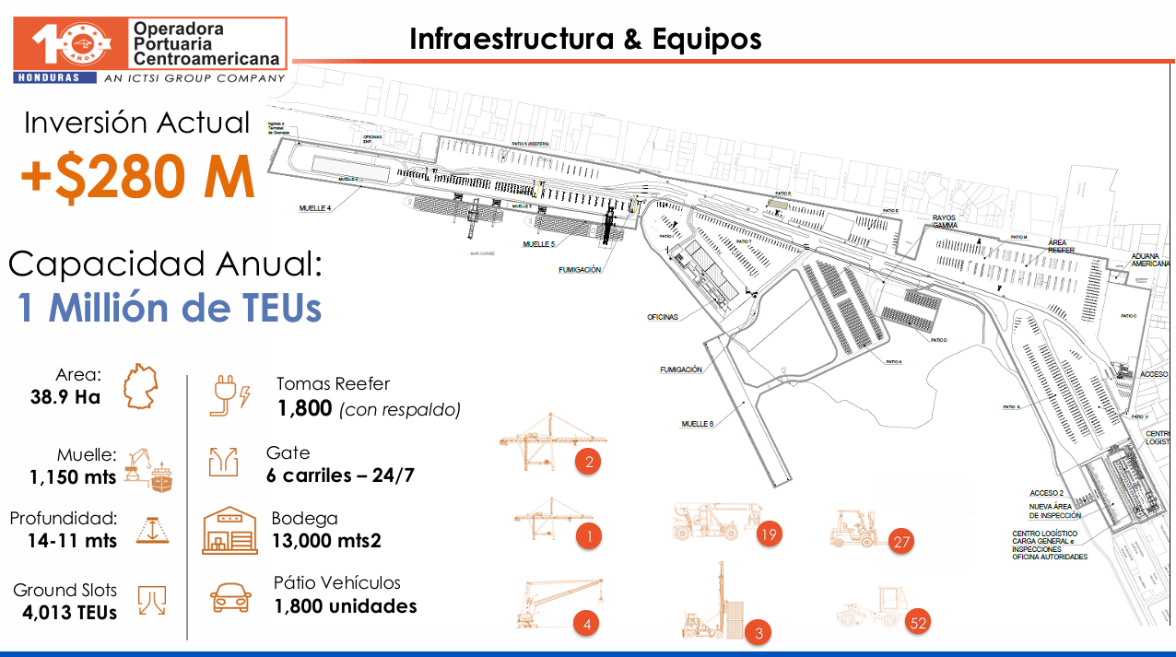

Slide 51
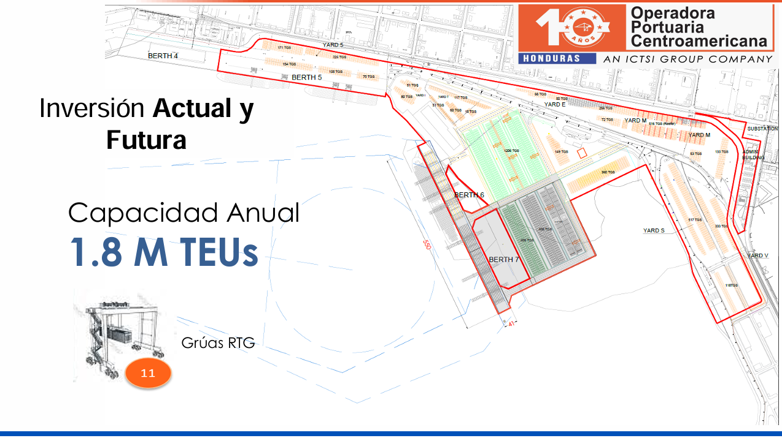

Slide 52


