Slide 1
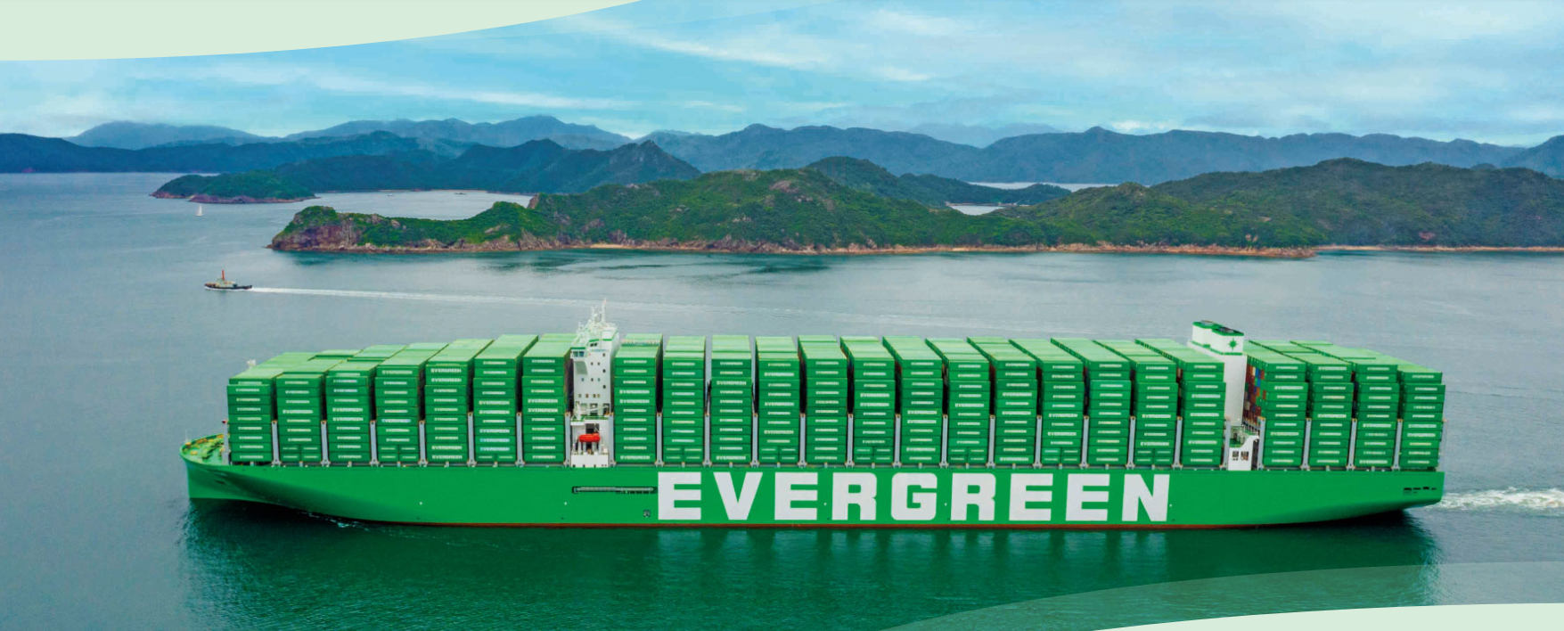
2025
LAAM FTF Meeting (WCSA)
By LAD/EGA/ELA 2025.FEB.27~28
By LAD/EGA/ELA

Slide 2
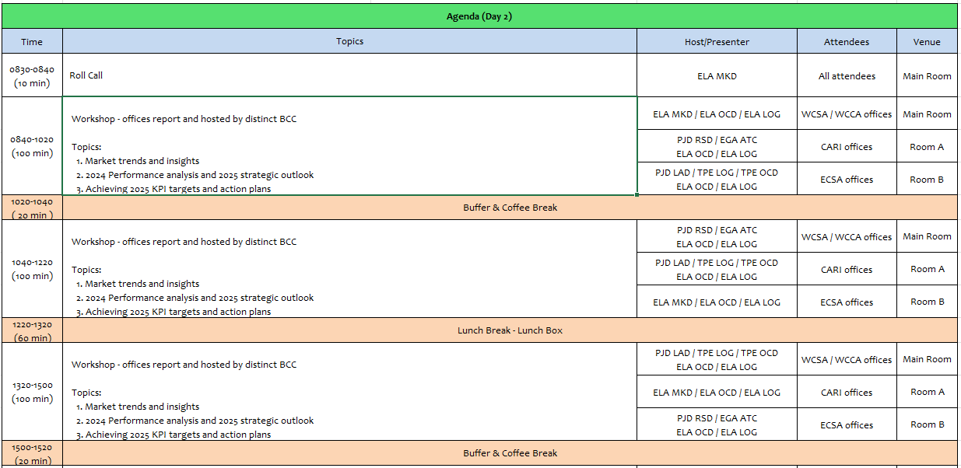
2

Slide 3
17
ECL
(CHILE)

Slide 4
Performance/Space(2024) and 2025 Market Review (CL)
Subject | Segments | BCC | 2024 Target TTL Loading(TEU) | 2024 JAN~DEC TTL Loading(TEU) | Achievement (%) | 2025 JAN~DEC TTL Loading(TEU) | Market Review & Action Plan (How to achieve 2025 target?)
 |  |  | (A) | (B) | (B)/(A) | Target
Trade Lane | F.E. => CL IMP. (G Trade) | LAD | 6,870 | 8,454 | 123% | 9,768 | Market: Like 2024 from the consumer behavior in retails sector. Retain Tender Accounts: Mabe: 800 TEU (White Goods) Comercial Eccsa (Ripley): 3,800 TEU (GDSM) Sumitomo Rubber: 200 TEU Recover Tender Target Accounts: Walmart: 1,000 TEU ~ 4,000 TEU Sindelen: 500 TEU (White Goods) CMPC: 500 TEU (Tissue / Lost Account due to Rate Issue) FALABELLA: 800 TEU (GDSM / Lost Account due to Rate Issue) Los Robles: 500 TEU (Lost Account due to Rate Issue) NAC Business: Eternity: 350 TEU Others: 350 TEU from Globe Express, Yusen Logistics, Ceva. FAK Business: 500 TEU, such asDP World, Pricer, Expeditors, Gelymar, and others.
 | CL EXP. => F.E. (Y Trade) | LAD | 28,293 | 30,502 | 108% | 14,163 | Dry Market: Expected volume in 2025 will remain similar to 2024, with no increase in woodpulp, wine, or foodstuff industries. Reefer Market: Fresh fruit exports, including cherries (30,000 boxes), are expected to maintain the same volume to FE in 2025. Woodpulp Spot Volumes: Weekly shipments from the central zone (CLVAL) remain at 60-80 TEU. Foodstuff Tenders: Renew key accounts such as G5, Carozzi, and Patagoniafresh. Frozen Meat Tenders: Renew Agrosuper and Ariztia contracts, considering their stable year-round volumes.
4

Slide 5
Performance/Space(2024) and 2025 Market Review (CL)
Subject | Segments | BCC | 2024 Target TTL Loading(TEU) | 2024 JAN~DEC TTL Loading(TEU) | Achievement (%) | 2025 JAN~DEC TTL Loading(TEU) | Market Review & Action Plan (How to achieve 2025 target?)
 |  |  | (A) | (B) | (B)/(A) | Target
Trade Lane | CL ⬄ USEC (619+620 Trade) | ELA | 3,100 | 2,826 | 91% | 3,100 | Market: Declined by -8.45% in 2024 compared to 2023, mainly impacting the food industry. Inland Service: US customers request expanded Inland service coverage with competitive rates.
 | CL ⬄ WCSA (WS Trade) | ELA | 6,600 | 4,947 | 75% | 5,500 | PE/CO volumes: Expected to increase by 26% in 2025, driven by the retail industry. Frozen fruit shipments: From PECAL via Andes Logistics and LOGPAR (2-4 containers per week). Increased CLSAI to COBVT via MX volume: Mainly for beverage and foodstuff customers like Intertank and Unified Foods. Renew avocado contract: Bagno for PECAL (180x40RH per year).
 | CL ⬄ WCCA (CW+WC Trade) | ELA | 3,190 | 4,101 | 129% | 4,100 | CW Trade Global Tenders (MT contracts): Nestlé, P&G, Kimberly-Clark, Samsung, etc. Renew tender contracts: Mabe and Comercial Eccsa to maintain regular volumes from MX and PA. Expand NAC business: Eternity, Yusen Logistics, and DP World from MX and GT. WC Trade Recover LAE service: Space for ECL cargo with competitive rates. Renew wine & foodstuff contracts: JF Hillebrand, Patagoniafresh, and Intertank (supporting 60 TEUs per week). Recover frozen tenders: Agrosuper and Ariztia.
5

Slide 6
Topic discussion (CL)
Commercial side:
Export
WSA3 Service Termination:
Metal Scrap Restrictions to India:
Import
Eastbound Rate Competition (FAK & NAC):
WCSA/WCCA Rate Competition:
As of February 2025, WSA3 will no longer call at CLLQN, resulting in an estimated loss of 20,000 TEUs to the Far East, primarily impacting the forestry industry’s market share.
Since mid-2024, NED service restrictions to INNXV and INMUN have affected shipments from key customers such as CBP and Vanadium. If these restrictions continue in 2025, it could lead to an additional loss of 5,000 TEUs.
Market feedback indicates that ECL’s rates are USD 200 higher than competitors, leading to a loss of competitiveness with key customers like Eternity, Yusen Logistics, Globe Express, and Sparx.
Increased freight rates to CLVAL in 2025 are reducing competitiveness, potentially resulting in lost business, including sugar shipments from COBVT and possibly Mabe MX contracts.
6

Slide 7
Topic discussion (CL)
Future Plan Suggestion:
Expansion to Southern Chile
60% of Chile’s export cargo originates from CLLQN, CLSVC, and CLCNL. Explore service options without increasing rate levels.
Recover Regional Service
Cherry Service Recovery
EGL was the only carrier in Chile that did not participate in last year’s cherry service.
To increase way port cargo volume.
Empty Reposition
Reinstate export services to WCSA ports to strengthen market presence.
Given the 25% market growth, evaluate deploying a dedicated cherry service for the upcoming season.
Consider the 2026 Lunar New Year (February) when planning service schedules.
7

Slide 8
Topic discussion (CL)
Future market forecast in 2025 (Pessimistic / Optimistic / Remain the same)?
Economic background.
GDP Growth:
Projected at 2.5% for 2025, with no significant economic expansion compared to previous years. The presidential election at year-end may contribute to political and economic instability.
External Economic Uncertainty:
The U.S. presidential election could impact global trade, with potential higher taxes on copper exports, Chile’s main revenue source. This may lead to inflation near 5% and Chilean peso devaluation due to a rising exchange rate.
Retail Sector Outlook:
Expected to continue growing in 2025, though at a moderate pace. The sector is closely monitoring the Chilean presidential elections and potential policy actions against the informal market, which could influence future investment decisions.
 | Get worse | Improve | Stay the same
2025 |  |  | X
8

Slide 9
ECD/IMD Topic discussion (CL)
ECD KPI | Item | 2023 | 2024 | Diff | Action Plan in 2025
ECD KPI | Storage | USD 533.00 | USD 102,578.00 | -19295% | Ever Lunar 0656-067W Discharge: Due to congestion at MX ports, exceptional empty units were discharged. Storage exceeded 15 days, accumulating charges over USD 200,000, later reduced by 50% through terminal negotiations. TPS Agreement 2025: To minimize extra costs, the agreement includes 7 free days for empty rollover containers.
 | Lift on/off | USD 263,867.00 | USD 305,246.00 | -15,68% | Agunsa & DPW LQN LOLO Collection: In 2024, repo instructions at Agunsa depots increased by 2,000 boxes, while DPW depot rates were adjusted by 1.86% (USPPI), per contract terms. 2025 Outlook: Empty LL charges are expected to decrease with the new CLVAL depot. Medlog’s contract does not include LL charges, further optimizing costs.
 | Reposition | USD 532,080.00 | USD 1,020,985.00 | -91,89% | Repo Out Volume Growth: Increased 63.6% from CL, with CLSCL depot’s empty return volume up by 57%, impacting release bookings and repo out demand. WSA Service Shift to TPS (2025): As depots are farther from the terminal, shunting costs will be higher than at CLSAI. However, a new agreement with Medlog—the closest depot to TPS with lower trucking costs—helps mitigate expenses.
 | M & R | USD 59,995.00 | USD 75,127.00 | -25,22% | STI Terminal Safety Policy Impact: Mandatory repairs for corner damage on empty containers before repo out increased M&R costs by 20-25% monthly. 2025 TPS Update: TPS will accept some damaged empties for repo out, reducing repair costs. Debris Restrictions for China (CN): Customs policy remains strict on debris-free empty containers, requiring compliance to avoid penalties in 2025. EOR Cost Verification: Double-check depot charges to ensure EOR costs align with agreements.
IMD KPI | Cost Saving Project | 0 | 0 | 0% | DPW LQN Depot: Rate extension confirmed until year-end 2025. Liventus Services: Extended rates for one year with no increase. CLSAI Depots (Agunsa, Sitrans & DYC): Shunting rates remain unchanged throughout 2024.
 | 90% Onboard within 7 Days | 0 | 0 | 0% | NIL
 | No Personal Negligence | 0 | 0 | 0% | NIL
9

Slide 10
OCD/OPD Topic discussion (CL)
 |  | 2023 | 2024 | Diff | Action Plan in 2025
OPD KPI | BOA | 85% | 100% | +18% | WSA services relocated to TPS in January 2025 to enhance schedule reliability and operational efficiency. Valparaíso terminal’s geographic position minimizes weather-related disruptions, improving vessel operations. Continuous monitoring to ensure berthing window security, vessel priority, and on-time proforma berthing.
 | Port Stay | 100% | 100% | 0% | TPS offers better scheduling conditions for berthing and unberthing. Vessel work planning is closely monitored to maintain optimal conditions.
 | Productivity | 57,1 MPH | 61 MPH | +6,8% | TPS commits to 60-70 moves per hour (adjusted for legal rest time) with three cranes per vessel. Flexibility to add a fourth crane when needed to achieve target MPH (moves per hour).
OCD KPI | Incentive | 41,435 (Boxes) | 56,644 (Boxes) | +36,70% | Increased productivity ensures efficient discharge and loading operations. Close collaboration with the BIZ department and terminal facilities to promote export and import volumes.
 | Empty Storage | USD 710.00 | USD 86,200.00 | -12141% | STI Terminal: Due to congestion at MXLZC, EVER LUNAR (LUNR) 0656-067E was stored at the terminal for nearly a month. DPW LQN Terminal: Rate agreement extended for one year without USPPI adjustments. 2025 Monitoring: Continuous tracking of potential disruptions and proactive reporting to HQ, including updates on local regulatory changes.
 | Rate Reduction | 0 | 0 | NIL | STI Contract Extension: Contract extended until EVER LIBRA 0705-076W (sailing date: 2025-01-03). Rate Optimization: Ongoing evaluation of better rate opportunities and improved local conditions.
10

Slide 11
