Slide 1
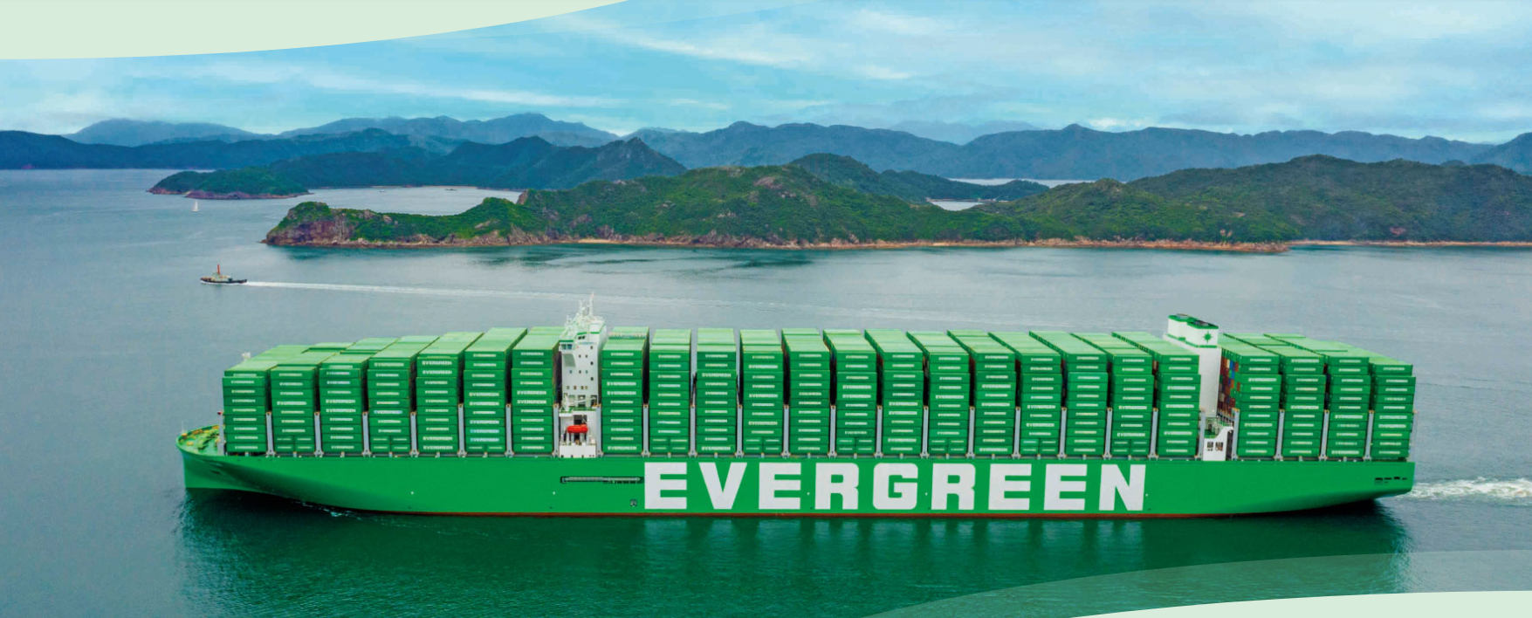
2025
LAAM FTF Meeting (WCSA)
By LAD/EGA/ELA 2025.FEB.27~28
By LAD/EGA/ELA

Slide 2
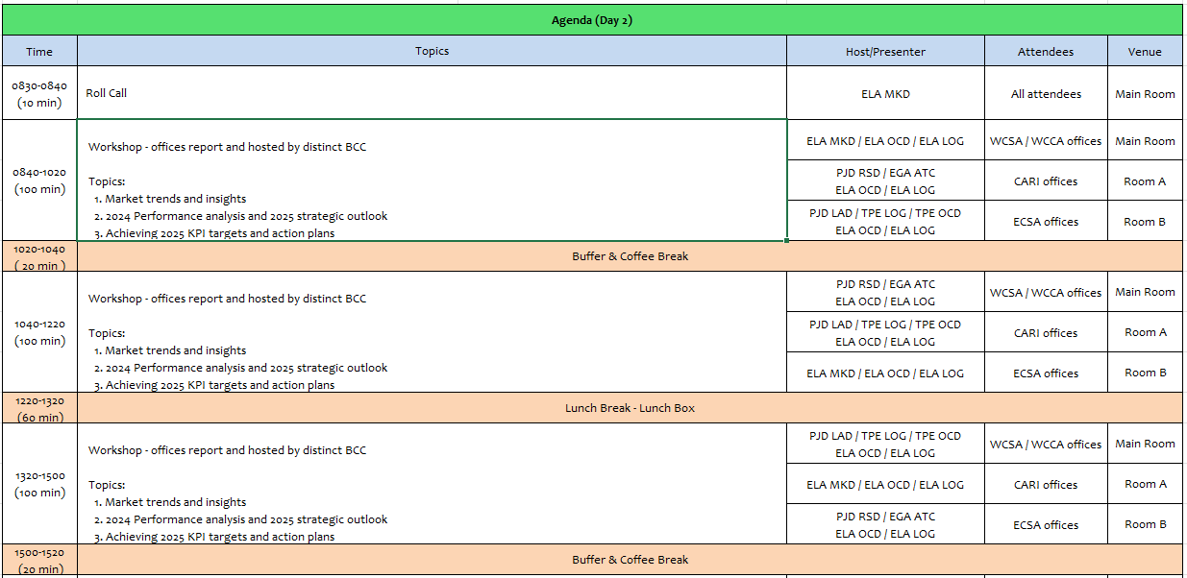
2

Slide 3
18
ECO
(COLOMBIA)

Slide 4
Performance/Space(2024) and 2025 Market Review (CO)
Subject | Segments | BCC | 2024 Target TTL Loading(TEU) | 2024 JAN~DEC TTL Loading(TEU) | Achievement (%) | 2025 JAN~DEC TTL Loading(TEU) | Market Review or Action Plan (How to achieve 2025 target?)
 |  |  | (A) | (B) | (B)/(A) | Target
Trade Lane | F.E. => COBVT IMP. (G Trade) | LAD | 11,883 | 12,965 | 109% | 14,710 | EGL Market Scope Jan-Dec 2024 421.500 teus; EGL market share 12%, ranking 3 out of 14. Propose to BCC (5) new accounts (BCO) or business per week under FOB. Monitoring on weekly basis bookings/allocation from our VIP accounts (local tenders). Increase our commercial sales meeting with potential accounts, under FOB terms. Propose medium and long term business with local NVOCC. Promote Reefer FOB cargo from base ports. Continous sales lead campaing for CIF cargo. Keep updated the market rates feedback with BCC on weekly basis. Permanent AMP monitoring for own SQ KPI achievement.
 | COBVT EXP. => F.E. (Y Trade) | LAD | 1,806 | 1,929 | 97% | 2,151 | EGL Market Scope Jan-Dec 2024 14.200 teus; EGL market share 21%, ranking 2 out of 12. Continue proposing to BCC new business under CIF. Monitoring on weekly basis bookings/allocation from our current accounts. Increase our commercial sales meeting with potential accounts, under CIF terms. Focus on Coffee BIZ with POD offices & Scrap & Mineral export follow special procedures. Promoting new cargo & small customers via Green X for base & out ports. Permanent AMP monitoring for own SQ KPI achievement.
 | COBVT ⬄ USEC (619+620 Trade) | ELA | 1,800 | 1,364 | 76% | 1,800 | (619) EGL Market Scope Jan-Dec 202412.700 Teus; EGL market share 11%, ranking 5 out of 9. Continue strong sales lead campaign with US office due to main cargo is closed under CIF terms. (620) Total Market Jan-Dec 2024 18.600 Teus (not active service) Potential market*
 | COBVT ⬄ WCSA (WS Trade) | ELA | 9,650 | 10,317 | 107% | 11,000 | (OUT) EGL Market Scope Jan-Dic 2024 71.600 Teus;EGL market share 14% ranking 4 out of 12. Promoting CLVAL as new Chile Port. Promoting new cargo via GreenX for PE & CL Enlarge account base for sugar biz. + BCO + NVOCC (DRY & RH) Monitoring on weekly basis bookings for all accounts including global & local tenders. Permanent AMP monitoring for own SQ KPI achievement. (IN) Total Market Jan-Dec 2024: 43.200 Teus (not active service). 25% of mkt is RH cargo. Potential market*
 | COBVT ⬄ WCCA (CW+WC Trade) | ELA | 1,150 | 3,699 | 321% | 100 | (OUT) WC EGL Market Scope Jan-Dec 20.000 Teus; EGL market share 8%, ranking 5 out of 9. Potential market* (IN) CW EGL Market Scope Jan-Dec 41.600 Teus; EGL market share 5%, ranking 8 out of 11. Continous sales lead campaing for CIF cargo. Promote FOB cargo (Port to port) for BCO and main NVOCC. Permanent AMP monitoring for own SQ KPI achievement.
4

Slide 5
Performance/Space(2024) and 2025 Market Review (CO)
Subject | Segments | BCC | 2024 Target TTL Loading(TEU) | 2024 JAN~DEC TTL Loading(TEU) | Achievement (%) | 2025 JAN~DEC TTL Loading(TEU) | Market Review or Action Plan (How to achieve 2025 target?)
 |  |  | (A) | (B) | (B)/(A) | Target
Trade Lane | F.E. => CO3 IMP. (C Trade) | LAD | 3,989 | 5,333 | 134% | 5,390 | EGL Market Scope Jan-Dec 2024 66.000 teus; EGL market share 21%, ranking 2 out of 10. Propose to BCC (5) new accounts (BCO) or business per week under FOB. Monitoring on weekly basis bookings/allocation from our VIP accounts (local tenders). Increase our commercial sales meeting with potential accounts, under FOB terms. Propose medium and long term business with local NVOCC. Promote Reefer FOB cargo from base ports. Continous sales lead campaing for CIF cargo. Keep updated the market rates feedback with BCC on weekly basis. Permanent AMP monitoring for own SQ KPI achievement.
 | CO3 ⬄ CARB (CC Trade) | EGA-ATC | 3,740 | 2577 | 69% | 3,500 | (IN) EGL Market Scope Jan-Dec 2024 10.900 Teus; EGL market share 10%, ranking 6 out of 18. Focus on PA cargo (6.500 Teus) CIF - Sales lead Campaing to PA. (OUT) Market Share Jan- Dec 2024 51.200 Teus; EGL market share 10%, ranking 6 out of 17. Focus on Direct Service PA specially Manzanillo cargo to increase EGL participation. Try to maintain spot volume to PR & DO Permanent AMP monitoring for own SQ KPI achievement.
 | CO3 ⬄ USEC (609+610 Trade) | EGA-ATC | 1,040 | 701 | 67% | 1,040 | (610) EGL Market Scope Jan-Dec 2024 30.000 Teus; EGL market share 3%, ranking 6 out of 10. Focus on base ports as USNYC, USCHS, USSVN, USBAL & USNFK. We need more allocation from PA to US ports on NUE & AUE services and quick connection at PA. (609) EGL Market Scope Jan-Dec 2024 45.600 Teus; EGL market share 4%, ranking 7 out of 12. Continue strong sales lead campaign with US office due to main cargo under CIF terms.
 | CO3 ⬄ WCSA (CW+WC Trade) | ELA | 350 | 153 | 44% | 50 | OUT (CW TRADE) EGL Market Scope Jan-Dec 2024: 26.600 Teus; EGL market share 1%, ranking 8 out of 9. Focus on COBQL & COSMM as POL (2.300 Teus). We need BCC support to have competitive rates around USD 700 Permanent AMP monitoring for own SQ KPI achievement. IN (WC TRADE) Total Market Jan-Dec 2024 12.800 Teus (not active service); 30% of mkt is RH. Potential market*
 | CO3 ⬄ WCCA (CB Trade) | ELA | 450 | 10 | 2% | 10 | (OUT) CB EGL Market Scope Jan-Dec 2024 22.400 Teus; EGL market share 1%, ranking 7 out of 16. Actually CAW service has full space utilitation appreciate BCC comments and if we will have available space in the near future. Permanent AMP monitoring for own SQ KPI achievement. (IN) CB EGL Market Scope Jan-Dec 2024 3.600 teus; EGL market share 1%, ranking 10 out of 15. Actually CAW service has full space utilitation appreciate BCC comments and if we will have available space in the near future.
5

Slide 6
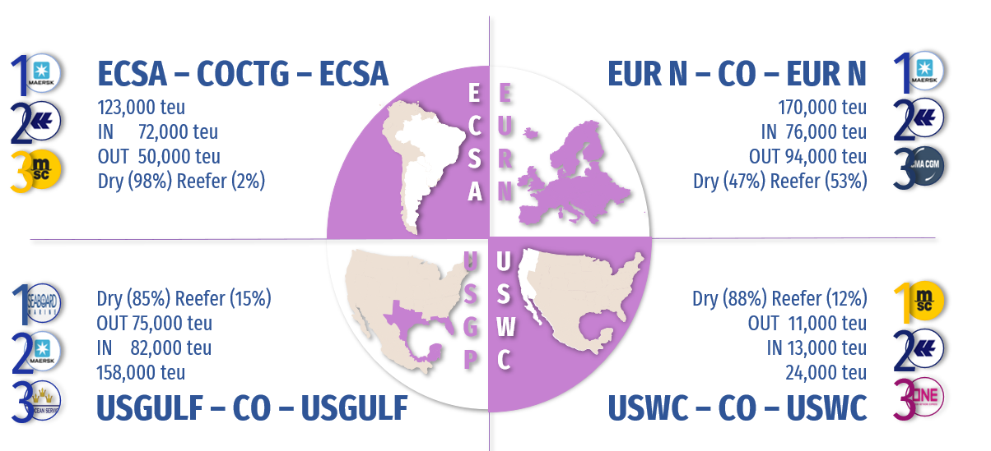
Topic discussion (CO)
Commercial side:
Future Suggestion:
Market Overview (2024) (in + out)
Colombian total market 1.700.000 TEUS (In 70% & Out 30%)
Trades: FE (31%) - NAME (20%) – SAME (18%) – EUR (17%) – CAME (14%)
BCO market (65%) & NVOCC market (35%).
Evergreen scope (49%) with 833.000 TEUS (In 78% & Out 22%)
Trades: FE (74%) - SAME (11%) – CARI (6%) – CAME (5%) – NAME (4%).
BCO market (69%) & NVOCC market (31%); market share 10% rank # 4.
2. Our target - Overview (2025) (in + out)
Develop INTRALATAM business: import side MX & PA to CO; export side to WCSA & PA
Recover USEC export business
Develop RH business in import side & concrete with principal commercial‘s strategy with Freight Forwarders, import side from FEAST.
Mantain the balance in inland depots to support our 70% of exports generated in hinterlands.
GREEN X : register during 2025 per week (5) new customer
AMP - permanent Follow up.
6

Slide 7
Topic discussion (CO)
Future market forecast in 2025 (Pessimistic / Optimistic / Remain the same)?
Economic background.
Economic growth 2.5% 2025
Inflation rate projected 2025: 3.1%
Unemployment rate: between Around 10%
Government maintains position to hold any new oil & gas exploration. Started to see gas imports recently
Standard & Poor's revised the outlook on Colombia's long-term ratings maintain negative (2025)
Political crisis with main trade partner USA USD$ 15,3B could affect 26% of CO Imports & 27% of CO Exports
Exchange rate : Colombia peso important devaluation Q1 2025 ** USD$ 4.400
Second tax reform announced by Government (latest tax reform less than 1 year ago)
Health / Labor / Pension tax reforms going through Congress to be define during first half 2025
Currently under interior commotion decree due to guerrilla groups taking over part of the territory again
 | Get worse | Improve | Stay the same
2025 |  |  | X
7

Slide 8
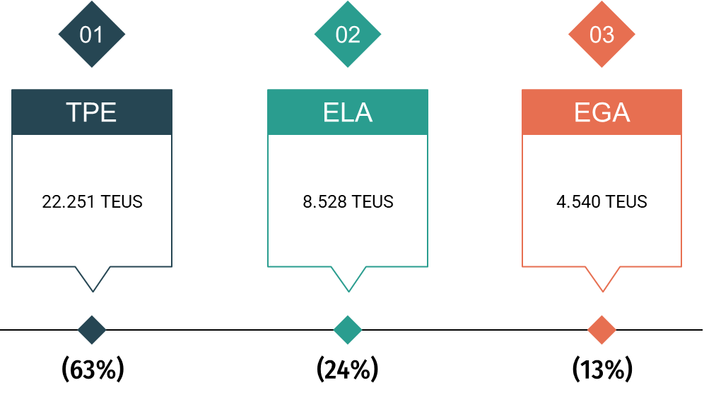
Topic discussion (CO)
Market share and Loading volume prospect 2025 (Long Haul)
Market share
Colombian Total Market 2025: According Colombian Government economy growth 2025 2.5%.
Market should be similar to last year, 1.7 million Teus IN & OUT.
Colombian Market EGL SCOPE 2025: Scope 2025 if similar to last year 850K - EGL market share should maintain 10%.
Loading volume prospect 2025 (Long Haul):
Annual budget 91.000 TEUS – with (39% - 35.319 Teus) under KPI monitoring.
8

Slide 9
ECD/IMD Topic discussion (CO)
ECD KPI | Item | 2023 | 2024 | Diff | Action Plan
 | Storage | $71.794 | $108.475 | -$67.879 | Storage happened due to CAC vessel skip 17 times in the year and ROB issue. Using Xpres feeder service or CAJ to have a stable schedule and evacuate empties. COBQL free pool is increasing to 450 Teus (+13%)
 | Lift on/off | $19.275 | $1.810 | -$17.465 | Keep ask vendor to decrease/forzen LOLO tariff.
 | Reposition | $166.659 | $9.268 | -$157.391 | Keep COBQL inventory control with schedule stability to avoid shunting cost. Keep maintian good relationship with vendor and seek for good rate.
 | M & R | $279 | $227 | -$52 | Only emergency repair when necessary for loading.
IMD KPI | Cost Saving Project | NIL | NIL | NIL | -
 | 90% Onboard within 7 Days | 67% | 61% | +6% | Performance was affected due to WSA4 vessel schedule is unstable. Will keep monitor and make sure TS cntr loaded ASAP.
 | No Personal Negligence | 100% | 100% | 0% | -
9

Slide 10
OCD/OPD Topic discussion (CO)
 | Item | 2023 | 2024 | Diff | Action Plan
OPD KPI | BOA | COBVT: 50%/100% COCTG: 100%/100% | COBVT: 100%/100% COCTG: 50%/60% | COBVT: +50%/0% COCTG:-50%/-40% | Keep good relation with terminals and request attenting our vessel per contract. Due to COCTG terminal congestion vessel will take more days for berthing.
 | Port Stay | 100% | 100% | 0% | Keep asking all related parites’ help to finish operation.
 | Productivity | 100% | 100% | 0% | Keep good relation with terminal to maintain and further increase the productivity.
OCD KPI | Incentive | NIL | NIL | NIL | Keep looking for terminal to offer incentive to us.
 | Empty Storage | $60.883 | $108.475 | +$47.592 | 1. Storage happened due to CAC vessel skip 17 times in the year and ROB issue. 2. Using Xpres feeder service or CAJ to have a stable schedule and evacuate empties. 3. COBQL free pool is increasing to 450 Teus (+13%)
 | Rate Reduction | NIL | NIL | NIL | -
10

Slide 11
