Slide 1
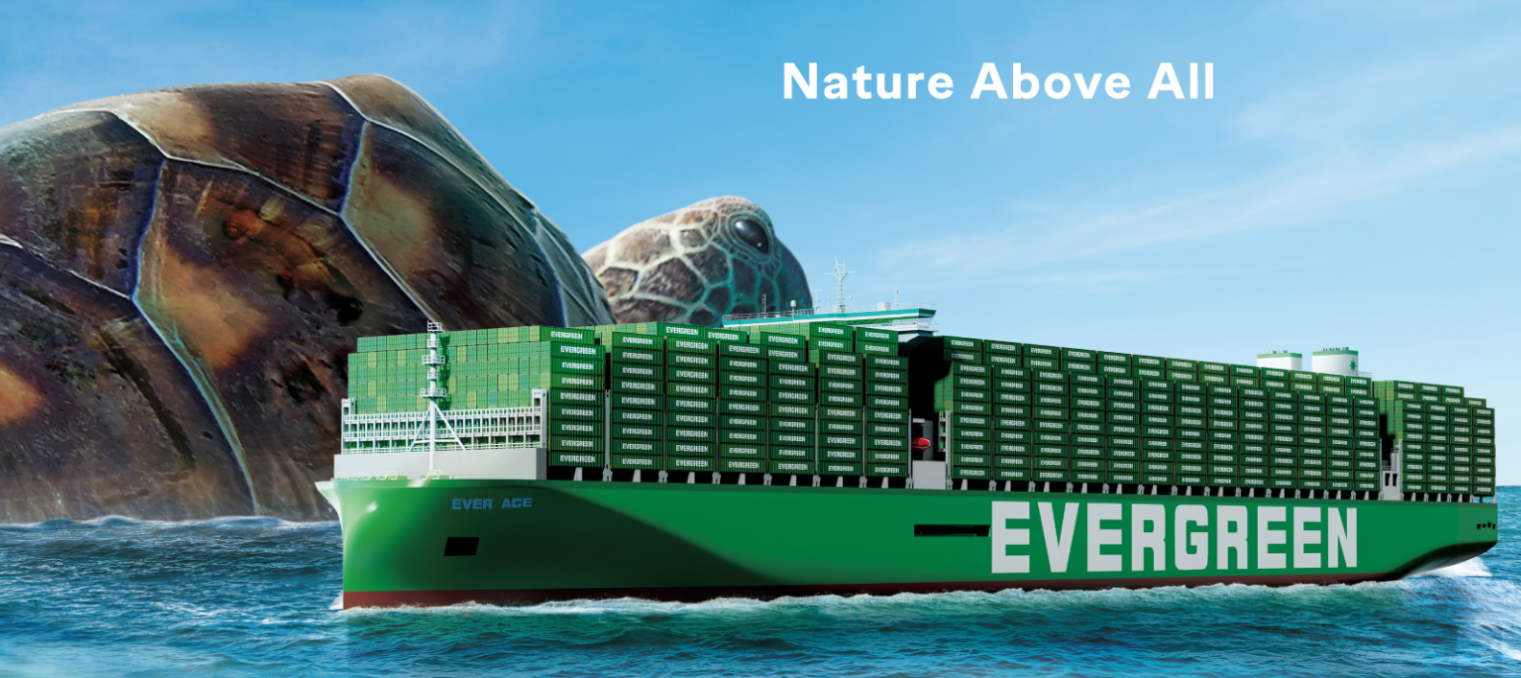
2025
LAAM FTF Meeting (CAME+WCCA)
By LAD/EGA/ELA 2025.FEB.27~28
By LAD/EGA/ELA

Slide 2
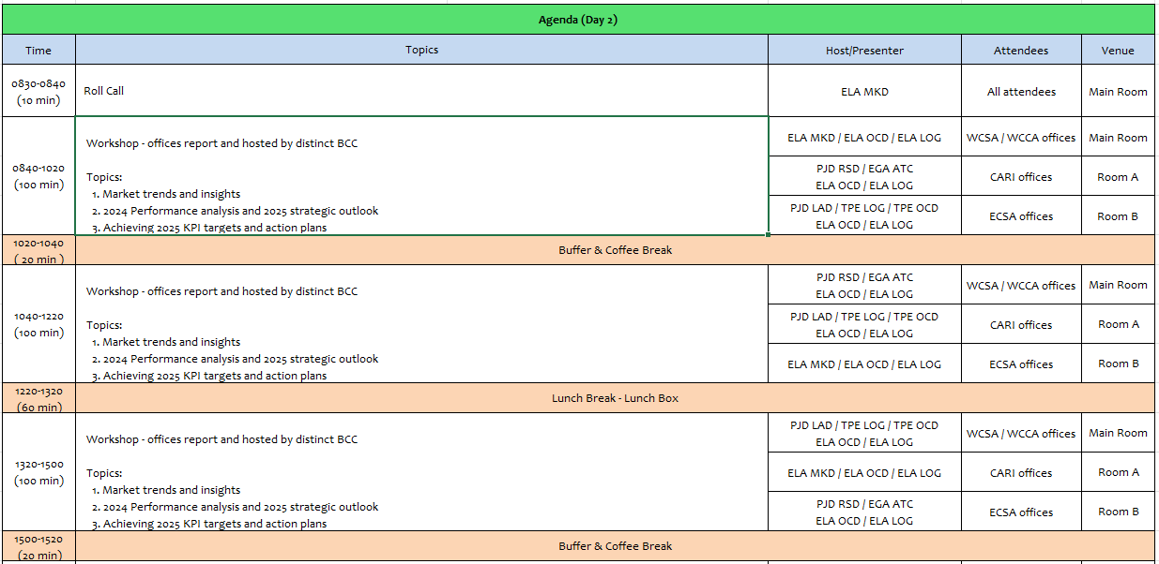
2

Slide 3
01
EMX
(MEXICO)

Slide 4
Performance/Space(2024) and 2025 Market Review (MX)
Subject | Segments | BCC | 2024 Target TTL Loading(TEU) | 2024 JAN~DEC TTL Loading(TEU) | Achievement (%) | 2025 JAN~DEC TTL Loading(TEU) | Market Review & Action Plan (How to achieve 2025 target?)
 |  |  | (A) | (B) | (B)/(A) | Target
Trade Lane | F.E. => MX IMP. (Q Trade) | LAD | 20,581 | 22,492 | 109% | 27,308
 | MX EXP. => F.E. (Y Trade) | LAD | 8,948 | 10,771 | 120% | 12,959
4

Slide 5
Performance/Space(2024) and 2025 Market Review (MX)
Subject | Segments | BCC | 2024 Target TTL Loading(TEU) | 2024 JAN~DEC TTL Loading(TEU) | Achievement (%) | 2025 JAN~DEC TTL Loading(TEU) | Market Review & Action Plan (How to achieve 2025 target?)
 |  |  | (A) | (B) | (B)/(A) | Target
Trade Lane | MX ⬄ CARB (CB+V Trade) | ELA | 400 | 495 | 124% | 450
 | MX ⬄ WCSA (CW+WC Trade) | ELA | 8,500 | 9,584 | 113% | 9,800
 | MX ⬄ WCCA (CB Trade) | ELA | 1,300 | 1,583 | 122% | 1,450
5

Slide 6
Topic discussion (MX)
Commercial side:
Future Plan Suggestion:
6

Slide 7
Topic discussion (MX)
Future market forecast in 2025 (Pessimistic / Optimistic / Remain the same)?
Economic background.
Market share and Loading volume prospect 2025 (Long Haul)
 | Get worse | Improve | Stay the same
2025
7

Slide 8
ECD/IMD Topic discussion (MX)
ECD KPI | Item | 2023 | 2024 | Diff | Action Plan in 2025
ECD KPI | Storage
 | Lift on/off
 | Reposition
 | M & R
IMD KPI | Cost Saving Project
 | 90% Onboard within 7 Days
 | No Personal Negligence
8

Slide 9
OCD/OPD Topic discussion (MX)
 |  | 2023 | 2024 | Diff | Action Plan in 2025
OPD KPI | BOA
 | Port Stay
 | Productivity
OCD KPI | Incentive
 | Empty Storage
 | Rate Reduction
9

Slide 10
14
NAV
(EL SALVADOR)

Slide 11
Performance/Space(2024) and 2025 Market Review (SV)
Subject | Segments | BCC | 2024 Target TTL Loading(TEU) | 2024 JAN~DEC TTL Loading(TEU) | Achievement (%) | 2025 JAN~DEC TTL Loading(TEU) | Market Review & Action Plan (How to achieve 2025 target?)
 |  |  | (A) | (B) | (B)/(A) | Target
Trade Lane | F.E. => SV IMP. (Q Trade) | LAD | 129 | 83 | 65% | 102
 | SV EXP. => F.E. (CF Trade) | LAD | 409 | 377 | 92% | 479
11

Slide 12
Performance/Space(2024) and 2025 Market Review (SV)
Subject | Segments | BCC | 2024 Target TTL Loading(TEU) | 2024 JAN~DEC TTL Loading(TEU) | Achievement (%) | 2025 JAN~DEC TTL Loading(TEU) | Market Review & Action Plan (How to achieve 2025 target?)
 |  |  | (A) | (B) | (B)/(A) | Target
Trade Lane | SV ⬄ USEC (622+623 Trade) | ELA | 580 | 23 | 4% | 50
 | SV ⬄ WCSA (CW+WC Trade) | ELA | 150 | 221 | 147% | 200
 | SV ⬄ WCCA+CARB (CB Trade) | ELA | 220 | 70 | 32% | 100
12

Slide 13
Topic discussion (SV)
Commercial Side:
Future Plan suggestion:
13

Slide 14
Topic discussion (SV)
Future market forecast in 2025 (Pessimistic / Optimistic / Remain the same)?
 | Get worse | Improve | Stay the same
2025
Economic Background
14

Slide 15
ECD/IMD Topic discussion (SV)
ECD KPI | Item | 2023 | 2024 | Diff | Action Plan in 2025
ECD KPI | Storage
 | Lift on/off
 | Reposition
 | M & R
IMD KPI | Cost Saving Project
 | 90% Onboard within 7 Days
 | No Personal Negligence
Topic
15

Slide 16
OCD/OPD Topic discussion (SV)
 |  | 2023 | 2024 | Diff | Action Plan in 2025
OPD KPI | BOA
 | Port Stay
 | Productivity
OCD KPI | Incentive
 | Empty Storage
 | Rate Reduction
Topic
Terminal info update (expansion/dredge/crane)
The expansion of the container yard at the port of Acajutla includes an area of ​​more than 91,000 m2. It also includes an area for refrigerated containers and heavy transport, to facilitate more than 7,000 monthly operations.
16

Slide 17
15
SNP
(GUATEMALA include BELIZE)

Slide 18
Performance/Space(2024) and 2025 Market Review (GT+BZ)
Subject | Segments | BCC | 2024 Target TTL Loading(TEU) | 2024 JAN~DEC TTL Loading(TEU) | Achievement (%) | 2025 JAN~DEC TTL Loading(TEU) | Market Review & Action Plan (How to achieve 2025 target?)
 |  |  | (A) | (B) | (B)/(A) | Target
Trade Lane | F.E. => GT+BZ IMP. (Q Trade) | LAD | 9,823 | 7,430 | 76% | 9,269
 | GT+BZ EXP. => F.E. (CF Trade) | LAD | 1,952 | 2,357 | 121% | 2,989
18

Slide 19
Performance/Space(2024) and 2025 Market Review (GT+BZ)
Subject | Segments | BCC | 2024 Target TTL Loading(TEU) | 2024 JAN~DEC TTL Loading(TEU) | Achievement (%) | 2025 JAN~DEC TTL Loading(TEU) | Market Review & Action Plan (How to achieve 2024 target?)
 |  |  | (A) | (B) | (B)/(A) | Target
Trade Lane | GT+BZ ⬄ USEC (622+623 Trade) | ELA | 2,350 | 499 | 21% | 700
 | GT+BZ ⬄ WCSA (CW+WC Trade) | ELA | 3,550 | 4,641 | 131% | 4,300
 | GT+BZ ⬄ WCCA+CARB (CB Trade) | ELA | 650 | 1,039 | 160% | 800
19

Slide 20
Topic discussion (GT)
Commercial side:
CAW Service
Q trade
.
CF trade
LAE S Service
WSA2 Service
20

Slide 21
Topic discussion (GT)
Future Plan Suggestion:
21

Slide 22
Topic discussion (GT)
Future market forecast in 2025 (Pessimistic / Optimistic / Remain the same)?
Economic background
 | Get worse | Improve | Stay the same
2025
22

Slide 23
ECD/IMD Topic discussion (GT)
ECD KPI | Item | 2023 | 2024 | Diff | Action Plan in 2025
ECD KPI | Storage
 | Lift on/off
 | Reposition
 | M & R
IMD KPI | Cost Saving Project
 | 90% Onboard within 7 Days
 | No Personal Negligence
23

Slide 24
OCD/OPD Topic discussion (GT)
 |  | 2023 | 2024 | Diff | Action Plan in 2025
OPD KPI | BOA
 | Port Stay
 | Productivity LAE
 | Productivity WSA2
OCD KPI | Incentive
 | Empty Storage
 | Rate Reduction
24

Slide 25
Topic discussion (BZ)
Commercial side:
Future Plan Suggestion:
25

Slide 26
Topic discussion (BZ)
Future market forecast in 2025 (Pessimistic / Optimistic / Remain the same)?
Economic background.
 | Get worse | Improve | Stay the same
2025
26

Slide 27
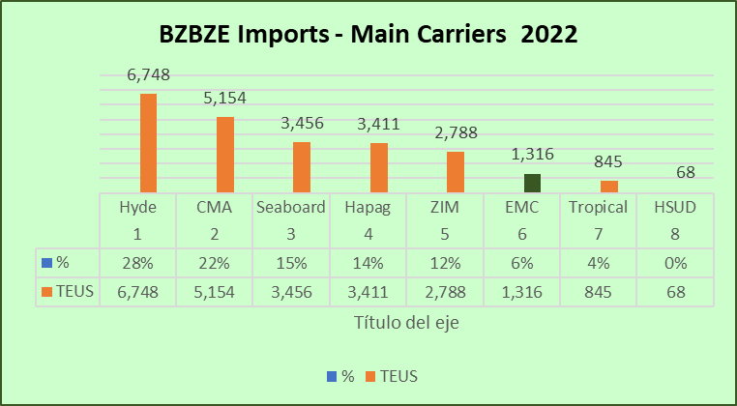
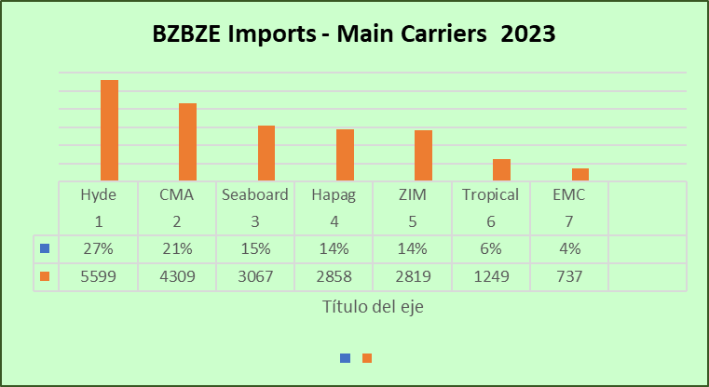
Topic discussion (BZ)
Market share and Loading volume prospect 2024 (Long Haul)
27

Slide 28
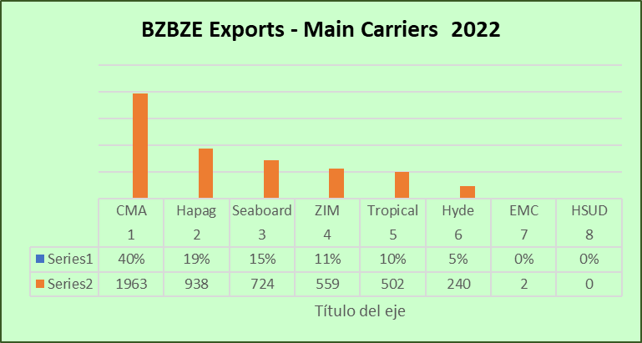
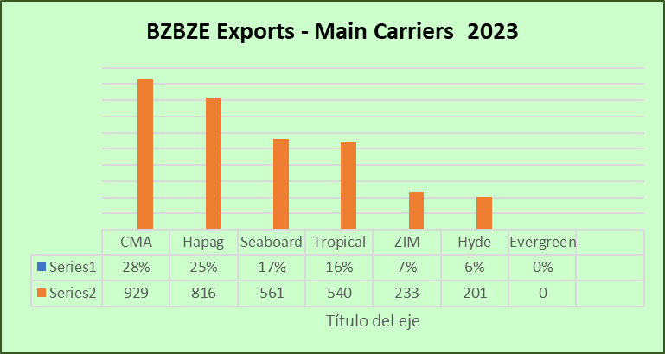
Topic discussion (BZ)
Market share and Loading volume prospect 2024 (Long Haul)
28

Slide 29
ECD/IMD Topic discussion (BZ)
ECD KPI | Item | 2023 | 2024 | Diff | Action Plan in 2024
ECD KPI | Storage
 | Lift on/off
 | (Ocean) Reposition
 | M & R
IMD KPI | Cost Saving Project
 | 90% Onboard within 7 Days
 | No Personal Negligence
Topic
Aged Container Selling / Free Reposition Plan
A
B
29

Slide 30
OCD/OPD Topic discussion (GT+BZ)
 |  | 2023 | 2024 | Diff | Action Plan in 2024
OPD KPI | BOA
 | Port Stay
 | Productivity
OCD KPI | Incentive
 | Empty Storage
 | Rate Reduction
Topic
Terminal info update (expansion/dredge/crane)
A
B
30

Slide 31
16
UNI
(HONDURAS)

Slide 32
Performance/Space(2024) and 2025 Market Review (HN)
Subject | Segments | BCC | 2024 Target TTL Loading(TEU) | 2024 JAN~DEC TTL Loading(TEU) | Achievement (%) | 2025 JAN~DEC TTL Loading(TEU) | Market Review & Action Plan (How to achieve 2025 target?)
 |  |  | (A) | (B) | (B)/(A) | Target
Trade Lane | F.E. => HN IMP. (Q Trade) | LAD | 1,766 | 1,513 | 86% | 1,754 | Unstable LAE service made clients to find another solutions as HNZPU, GTZNJ or SVACJ with other carriers as EMC TT more 100 days. We lost almost 500 TEU‘s due to long TT of LAE service, as well from POL services WSA and others making T/S MXLZC, several clients TT 200 days their shipments.
 | F.E. => HN IMP. (C Trade) | LAD | 223 | 284 | 127% | 245 | Need to stay market rate level so we can be competitive. Promote more spot rates so can capture volume and comply KPI.
 | HN EXP. => F.E. (CF Trade) | LAD | 707 | 428 | 61% | 439 | Due to LAE unstable service RH equipment was not fluent as past years, we lost around 400 TEU‘s export from HN to TW. Free trade agreement between HN and TW expiration made exports of frozen shrimp drop. Need support on second leg to IN, right now is our main market.
32

Slide 33
Performance/Space(2024) and 2025 Market Review (HN)
Subject | Segments | BCC | 2024 Target TTL Loading(TEU) | 2024 JAN~DEC TTL Loading(TEU) | Achievement (%) | 2025 JAN~DEC TTL Loading(TEU) | Market Review & Action Plan (How to achieve 2025 target?)
 |  |  | (A) | (B) | (B)/(A) | Target
Trade Lane | HN ⬄ USEC (622+623 Trade) | ELA | 800 | 286 | 36% | 500 | No competitive rates against market rate level, we lost almost 100% of our volume.
 | HN ⬄ WCSA (CW+WC Trade) | ELA | 220 | 248 | 112% | 250 | We can improve numbers if EMC rates match market rate level, almost $1,000.00 higher right now.
 | HN ⬄ WCCA+CARB (CB Trade) | ELA | 250 | 104 | 42% | 150 | No competitive rates against market rate level, we lost almost 100% of our volume.
33

Slide 34
Topic discussion (HN)
Commercial side:
LAE Service it is a must to be stable, clients that ussually work trough HNSLO are searching for other POD’s as Service comply with TT 30 days.
Expect this year more support on RH Equipment.
Return market rate level for 622/623/CW/CB trades.
Future Plan Suggestion:
Action plan for LAE services have backlog and need to digest shipments at T/S ports.
If not have market rate level for 622/623/CW/CB trades at least provide monthly a spot rate for each trade in order to comply with KPI.
34

Slide 35
Topic discussion (HN)
Future market forecast in 2025 (Pessimistic / Optimistic / Remain the same)?
Economic background:
At the beginning of the year, the economic outlook for Honduras shows moderate growth. Economic growth is projected to reach 3.4% in 2024, with a moderate slowdown by 2025. Regarding inflation, a year-on-year rate of 3.88% was recorded in January 2025, lower than in 2024.
 | Get worse | Improve | Stay the same
2025 |  |  | Y
35

Slide 36
ECD/IMD Topic discussion (HN)
ECD KPI | Item | 2023 | 2024 | Diff | Action Plan in 2025
ECD KPI | Storage | N/A | N/A
 | Lift on/off | $85,359.00 | $148,166.10 | $62,807.10 | Terminal Tariff maintain same. Difference is due to ncrease of import and export cargo in HN territory service.
 | Reposition | $118,345.50 | $105,788.50 | $82,188.50 | Due to increase of cargo volume on import and export and accumulation of idle equipment at HNZPU and HNSLO due to innestability of CAW and LAE service provided an increase in reposition costs.
 | M & R | $5,947.34 | $4,140.00 | $1,807.34 | M&R’s were approved for empty 4RH for frozen shrimp exports only.
IMD KPI | Cost Saving Project | N/A | N /A |  | No cost saving was contemplated in 2024 and for 2025 due to decrease in drivers and economic slow recovery we do not expect to get any reduction from trucking services or Depots.
 | 90% Onboard within 7 Days |  |  |  | Subject to allocation approval on LAE by ELA
 | No Personal Negligence | 0 | 0 |  | No negligence reported
Topic
Aged Container Selling 2024:
182 CONTAINERS SOLD (29X2SD / 39X4SD / 114X4SH)
Free Reposition Plan:
N/A
36

Slide 37
OCD/OPD Topic discussion (HN)
 |  | 2023 | 2024 | Diff | Action Plan in 2025
OPD KPI | BOA | 2HRS | 2HRS | 0 | HNSLO terminal continued giving preference to container vessels which maintained same period as last year.
 | Port Stay | 40 HRS | 32 HRS | -8 | CONSERSA stevedore company improved vessel crane operativeness.
 | Productivity | 16 M/H | 19 M/H | +3 | We expect to improve productivity once CV ASPM is introduce at HNSLO in mid February 2025.
OCD KPI | Incentive | N/A | N/A |  | Terminal tariff does not offer incentives for Carriers or customers
 | Empty Storage | N/A | N/A |  | No empty storage at Terminal
 | Rate Reduction | N/A | N/A |  | No rate reduction for HNSLOT is contemplated for 2025. OPC terminal operator made general increase of 3.06% for all port tariffs at HNZPU.
37

Slide 38
OCD/OPD Topic discussion (HN)
TERMINAL INFORMATION – HNSLO
The government of Honduras has promised to start in the dredge before mid year and also investment in expansion of the dock and bridge at HNSLO is contemplated. Investment will be achieved thru brazilian company DTA Engenharia with a total investment of USD177mm. Investment will start in mid May 2025.

Slide 39
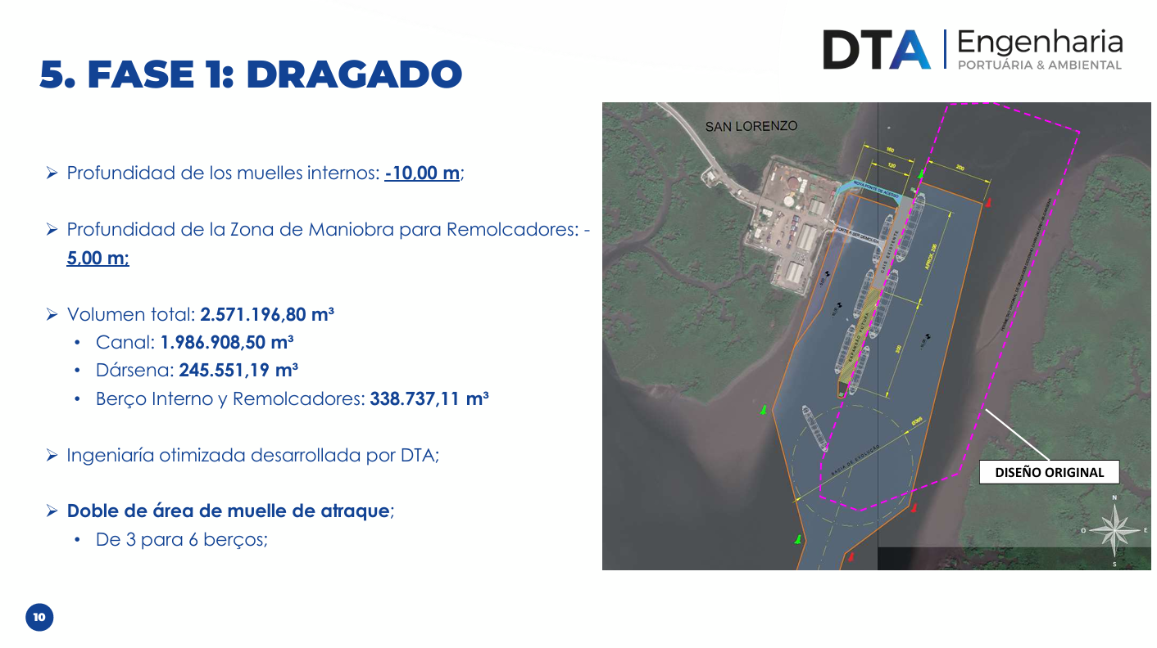

Slide 40
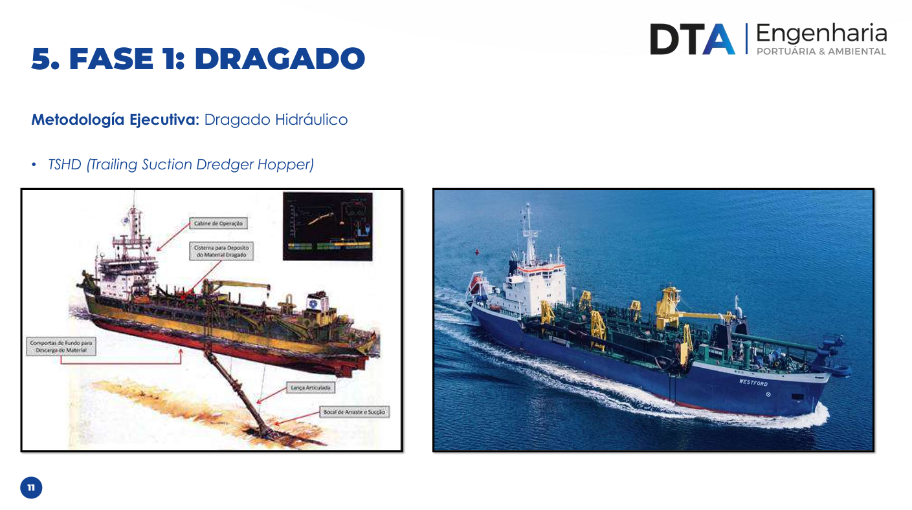

Slide 41
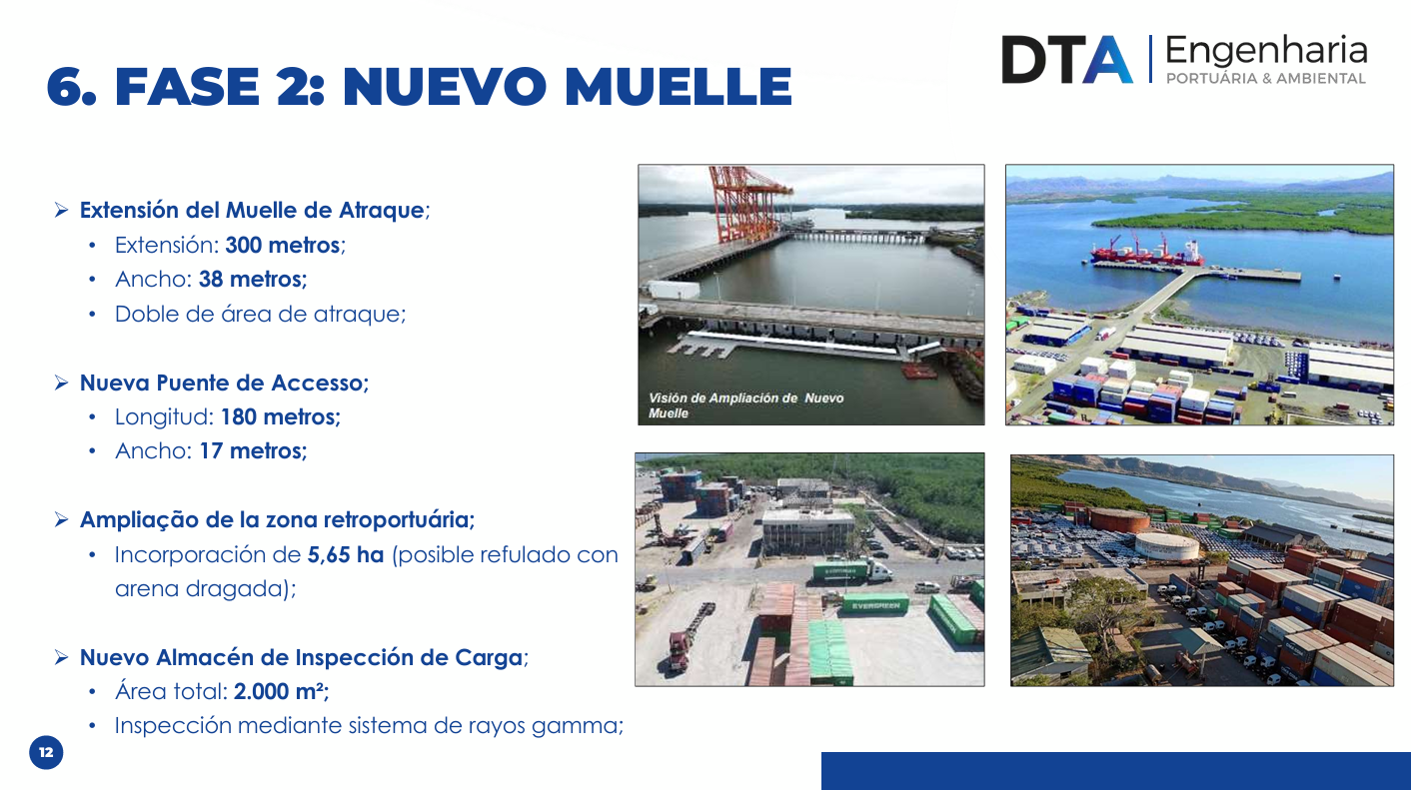

Slide 42
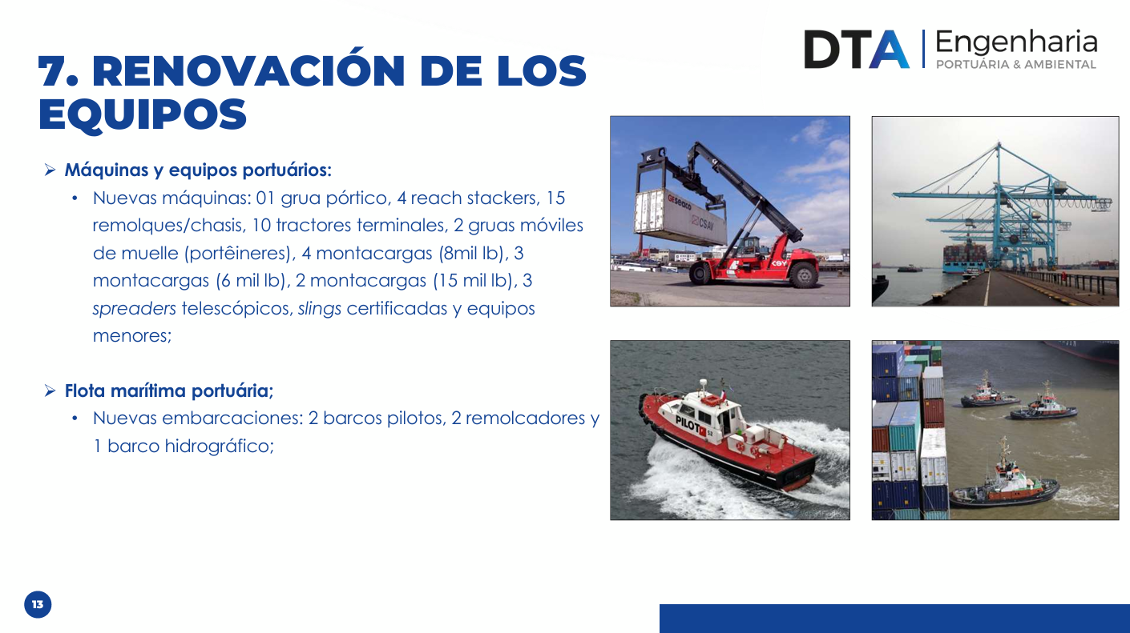

Slide 43
OCD/OPD Topic discussion (HN)
TERMINAL INFORMATION – HNZPU
Pivate operator at Puerto Cortes, OPC will be starting in 2025 the new expansion program of the Terminal for a maximum capacity of 1.8 million teus when the project is finished.

Slide 44
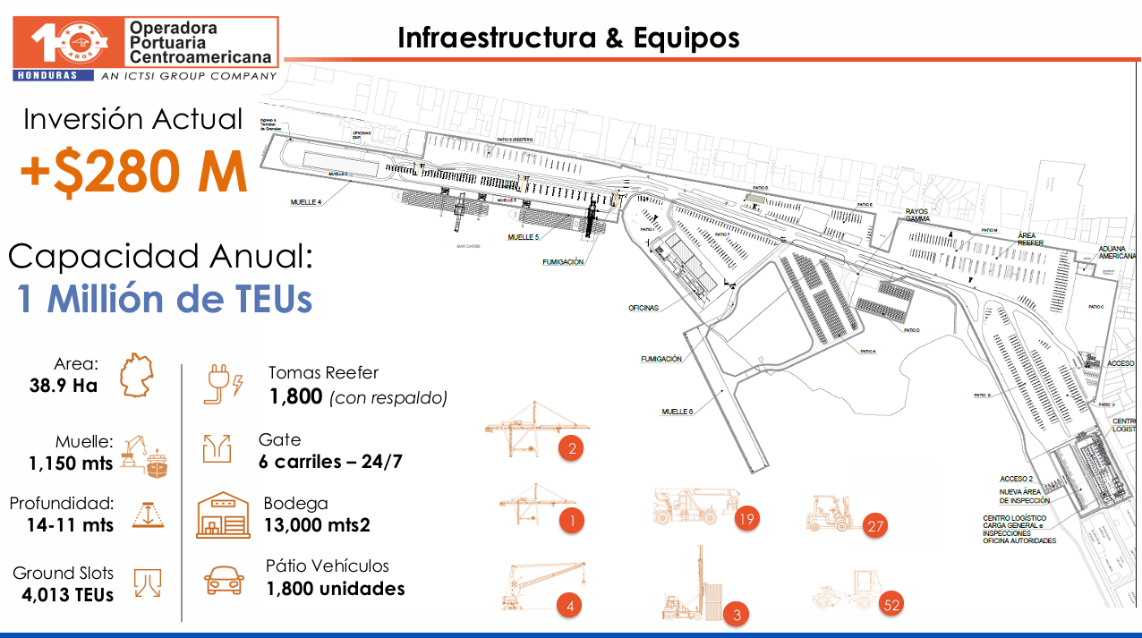

Slide 45
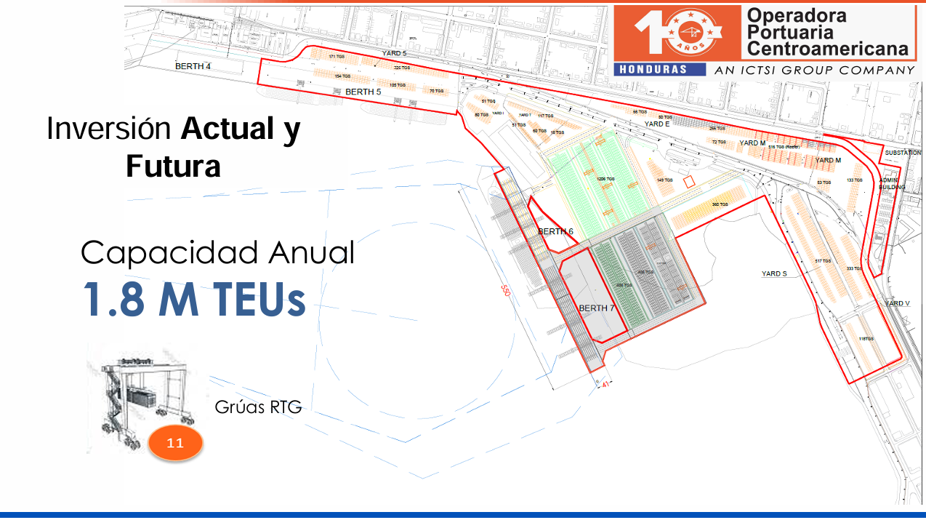

Slide 46


