Slide 1
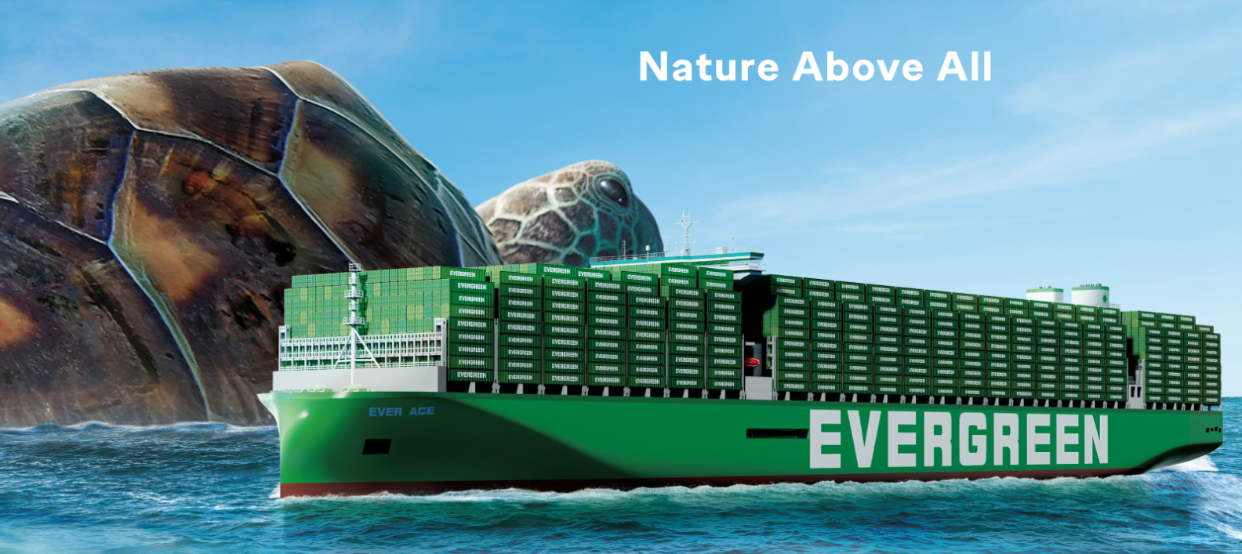
2025
LAAM FTF Meeting (CAME+WCCA)
By LAD/EGA/ELA 2025.FEB.27~28
By LAD/EGA/ELA

Slide 2
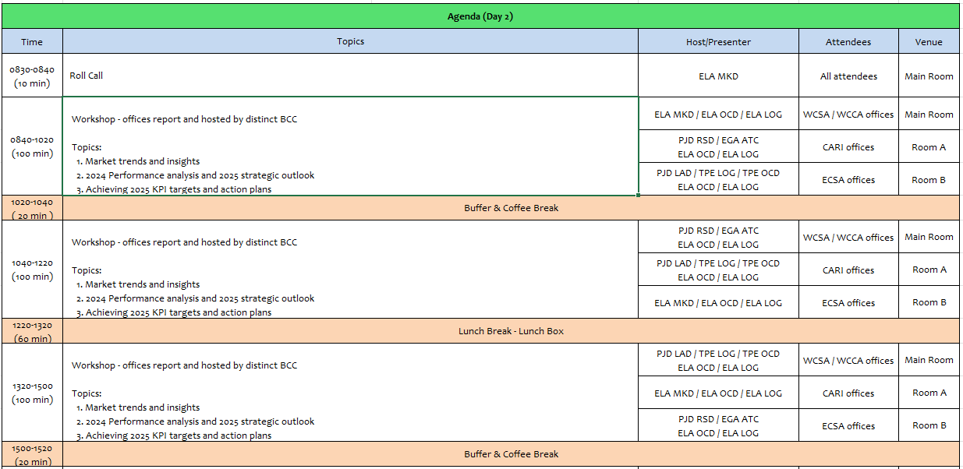
2

Slide 3
01
EMX
(MEXICO)

Slide 4
Performance/Space(2024) and 2025 Market Review (MX)
Subject | Segments | BCC | 2024 Target TTL Loading(TEU) | 2024 JAN~DEC TTL Loading(TEU) | Achievement (%) | 2025 JAN~DEC TTL Loading(TEU) | Market Review & Action Plan (How to achieve 2025 target?)
 |  |  | (A) | (B) | (B)/(A) | Target
Trade Lane | F.E. => MX IMP. (Q Trade) | LAD | 20,581 | 22,492 | 109% | 27,308
 | MX EXP. => F.E. (Y Trade) | LAD | 8,948 | 10,771 | 120% | 12,959
4

Slide 5
Performance/Space(2024) and 2025 Market Review (MX)
Subject | Segments | BCC | 2024 Target TTL Loading(TEU) | 2024 JAN~DEC TTL Loading(TEU) | Achievement (%) | 2025 JAN~DEC TTL Loading(TEU) | Market Review & Action Plan (How to achieve 2025 target?)
 |  |  | (A) | (B) | (B)/(A) | Target
Trade Lane | MX ⬄ CARB (CB+V Trade) | ELA | 400 | 495 | 124% | 450
 | MX ⬄ WCSA (CW+WC Trade) | ELA | 8,500 | 9,584 | 113% | 9,800
 | MX ⬄ WCCA (CB Trade) | ELA | 1,300 | 1,583 | 122% | 1,450
5

Slide 6
Topic discussion (MX)
Commercial side:
Future Plan Suggestion:
6

Slide 7
Topic discussion (MX)
Future market forecast in 2025 (Pessimistic / Optimistic / Remain the same)?
Economic background.
Market share and Loading volume prospect 2025 (Long Haul)
 | Get worse | Improve | Stay the same
2025
7

Slide 8
ECD/IMD Topic discussion (MX)
ECD KPI | Item | 2023 | 2024 | Diff | Action Plan in 2025
ECD KPI | Storage
 | Lift on/off
 | Reposition
 | M & R
IMD KPI | Cost Saving Project
 | 90% Onboard within 7 Days
 | No Personal Negligence
8

Slide 9
OCD/OPD Topic discussion (MX)
 |  | 2023 | 2024 | Diff | Action Plan in 2025
OPD KPI | BOA
 | Port Stay
 | Productivity
OCD KPI | Incentive
 | Empty Storage
 | Rate Reduction
9

Slide 10
14
NAV
(EL SALVADOR)

Slide 11
Performance/Space(2024) and 2025 Market Review (SV)
Subject | Segments | BCC | 2024 Target TTL Loading(TEU) | 2024 JAN~DEC TTL Loading(TEU) | Achievement (%) | 2025 JAN~DEC TTL Loading(TEU) | Market Review & Action Plan (How to achieve 2025 target?)
 |  |  | (A) | (B) | (B)/(A) | Target
Trade Lane | F.E. => SV IMP. (Q Trade) | LAD | 129 | 83 | 65% | 102
 | SV EXP. => F.E. (CF Trade) | LAD | 409 | 377 | 92% | 479
11

Slide 12
Performance/Space(2024) and 2025 Market Review (SV)
Subject | Segments | BCC | 2024 Target TTL Loading(TEU) | 2024 JAN~DEC TTL Loading(TEU) | Achievement (%) | 2025 JAN~DEC TTL Loading(TEU) | Market Review & Action Plan (How to achieve 2025 target?)
 |  |  | (A) | (B) | (B)/(A) | Target
Trade Lane | SV ⬄ USEC (622+623 Trade) | ELA | 580 | 23 | 4% | 50
 | SV ⬄ WCSA (CW+WC Trade) | ELA | 150 | 221 | 147% | 200
 | SV ⬄ WCCA+CARB (CB Trade) | ELA | 220 | 70 | 32% | 100
12

Slide 13
Topic discussion (SV)
Commercial Side:
Future Plan suggestion:
13

Slide 14
Topic discussion (SV)
Future market forecast in 2025 (Pessimistic / Optimistic / Remain the same)?
 | Get worse | Improve | Stay the same
2025
Economic Background
14

Slide 15
ECD/IMD Topic discussion (SV)
ECD KPI | Item | 2023 | 2024 | Diff | Action Plan in 2025
ECD KPI | Storage
 | Lift on/off
 | Reposition
 | M & R
IMD KPI | Cost Saving Project
 | 90% Onboard within 7 Days
 | No Personal Negligence
Topic
15

Slide 16
OCD/OPD Topic discussion (SV)
 |  | 2023 | 2024 | Diff | Action Plan in 2025
OPD KPI | BOA
 | Port Stay
 | Productivity
OCD KPI | Incentive
 | Empty Storage
 | Rate Reduction
Topic
Terminal info update (expansion/dredge/crane)
The expansion of the container yard at the port of Acajutla includes an area of ​​more than 91,000 m2. It also includes an area for refrigerated containers and heavy transport, to facilitate more than 7,000 monthly operations.
16

Slide 17
15
SNP
(GUATEMALA include BELIZE)

Slide 18
Performance/Space(2024) and 2025 Market Review (GT+BZ)
Subject | Segments | BCC | 2024 Target TTL Loading(TEU) | 2024 JAN~DEC TTL Loading(TEU) | Achievement (%) | 2025 JAN~DEC TTL Loading(TEU) | Market Review & Action Plan (How to achieve 2025 target?)
 |  |  | (A) | (B) | (B)/(A) | Target
Trade Lane | F.E. => GT+BZ IMP. (Q Trade) | LAD | 9,823 | 7,430 | 76% | 9,269 | In order to achieve 2025 target, we need support from Principals to negotiate additional move counts with APMT GT / our WSA2 Service, APMT is blocking our capacity to develop more cargoes and achieve our targets. We will persuade tender accounts to nominate additional volume during 2025. (Mabe, Sopesa &Nasa, Autocom) Approach clients to recover cargoes lost under FAK rate level We will be focused on clients that handles 4SD /4SH shipments.
 | GT+BZ EXP. => F.E. (CF Trade) | LAD | 1,952 | 2,357 | 121% | 2,989 | In order to achieve 2025 target, need support from Principals to negotiate special storate term at POL APMT. Need, at least 5 free days. Any vessel delay deeply aftect us but our competitors do have better conditions at APMT or absorb costs. We will be focused on cargo to Asia base ports on 40´ in order to increase EMC market share. We will be working on getting additional nominations of sugar, cardamom and coffee shipments. Approach clients to recover cargoes lost. Promote our service to reefer market.
18

Slide 19
Performance/Space(2024) and 2025 Market Review (GT+BZ)
Subject | Segments | BCC | 2024 Target TTL Loading(TEU) | 2024 JAN~DEC TTL Loading(TEU) | Achievement (%) | 2025 JAN~DEC TTL Loading(TEU) | Market Review & Action Plan (How to achieve 2024 target?)
 |  |  | (A) | (B) | (B)/(A) | Target
Trade Lane | GT+BZ ⬄ USEC (622+623 Trade) | ELA | 2,350 | 499 | 21% | 700 | In order to achieve 2025 target, need support on transhipment priority at CCT. Approach clients that handle cargo not sensitive to transit time. Close communication with US offices in order to secure cargo that is negotiated in US side. In order to increase coffee market share to North USEC, due to the lack of 2SD units, we are promoting 4SD / 4SH.
 | GT+BZ ⬄ WCSA (CW+WC Trade) | ELA | 3,550 | 4,641 | 131% | 4,300 | In order to achieve 2025 target, we will maintain close communication with actual accounts in order to secure current participation and get additional nomination. Enlarge A/C date base with clients that handle 40’ size containers. Promote routing from GTZNJ to CLVAL
 | GT+BZ ⬄ WCCA+CARB (CB Trade) | ELA | 650 | 1,039 | 160% | 800 | In order to achieve 2025 target, maintain close communication with actual accounts to secure participation and get additional nomination. Enlarge A/C data base to PABBA, CRCAL and Caribbean Ports. We will maintain close communication with BCC in order to get available allocation in advance to fully utilize it.
19

Slide 20
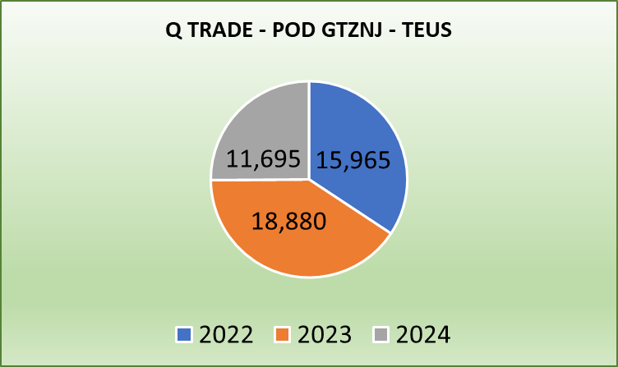
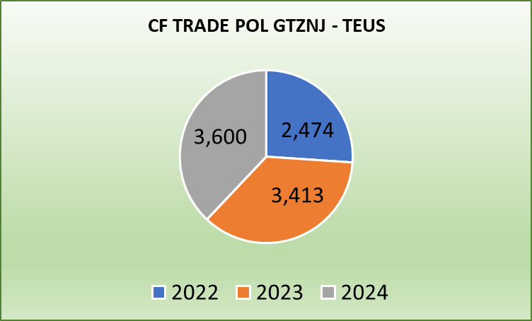
Topic discussion (GT)
Commercial side:
Q trade
Avoid roll overs at CNSHG and CNNBO.
Space & T/S protection on own SQ VIP accounts.
FAK rate validity time to be extended in order to cover available sailing dates.
Support on booking confirmation, no more than 24 hrs as from requested date.
Need special rate level on own SQ special accounts / VIP customers.
Approve and promote 4RH NOR ASIA/ GT
SNP evaluation C03 is based on initial KPI not under current movements availability.
Approval to release more 2SD bkgs to cover CF trade seasonal export demand.
WSA and or WSA2 enlarge capacity to GT, by negotiating with APMT for more move counts. APMT is blocking our capacity to develop more cargoes and achieve our targets.
Consider WSA and/or WSA2 to enlarge capacity to GT, by doing T/S to LAE and discharge more at EPQ.
CF trade
Release space on T/S ports ( TWKSG and SGSGP) in order to increase market share on long distance bkgs.
Negotiate 5 free days of storage at POL APMT (GTZNJ), as per other carrier's practice.
In case roll overs or vessel skip in Guatemala, consider to cover the terminal storages and eliminate the BT charges.
Since our exports are mostly in 2SD, need to increase laded imports from different trades to have more equipment available for our export.
Grant 6 months rates validity time to secure long term nomination.
To increase cardamom market share, need to set up routing POL GTZST and GTZNJ to SAJED and JOAQA
20

Slide 21
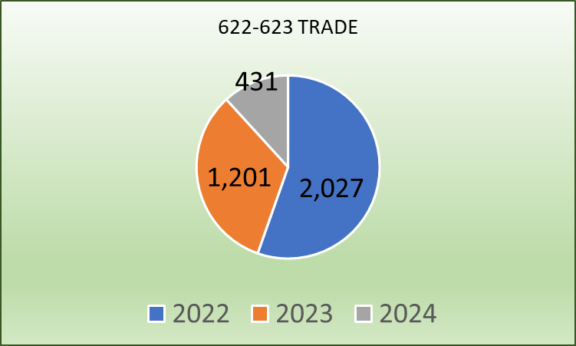
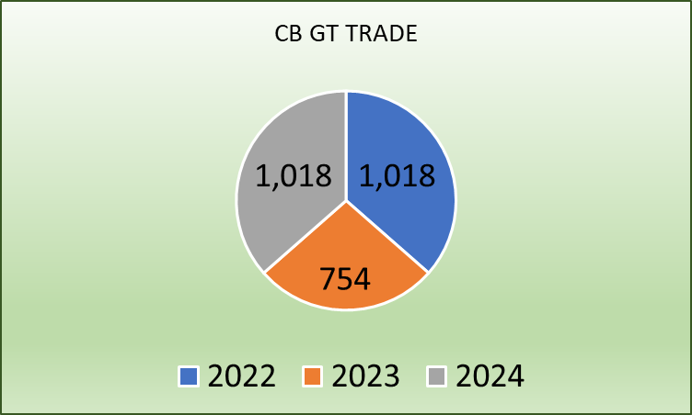
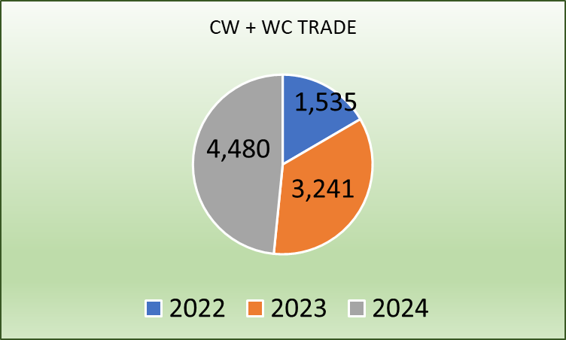
Topic discussion (GT)
Commercial side:
LAE S Service
CB Trade
Improve vessel schedule stability to secure more cargoes and recover accounts.
Avoid skipping call at GTZNJ. Due it affects import transit time.
Grant space from GT to cover export demand.
Grant 6 months rates validity time to secure long term nomination of sugar cargoes.
Transhipment priority at PA.
CAW Service
622 & 623: Need BCC support to recover market share lost due to long transit time and high rates level.
622 & 623 Transhipment priority at PACCT
622: Need to assign allocation to GT market and get prompt bkg confirmation.
CB: GTZST / Caribbean Ports, EMC rate level is around $1,200 p/c on top of market. Transhipment priority at PACCT is needed.
CB: GTZST / WCSA, EMC rate level is $1,000/2SD and $1,700/4SH on top of market. Need review EMC rate level.
To increase cardamom market share, need to set up routing POL GTZST and GTZNJ to SAJED and JOAQA
Set up direct routing based on CAW service schedule
(GT– HN – CO – PA – CR - GT)
Open direct routing from GTZST to JMKSN as per XPF calling ports. (GT– HN – JM- CO – PA – CR - GT)
WSA2 Service
CW / WC Trade
GTZNJ / WCSA: market demands 6 months rates validity time.
Request for transhipment priority at T/S port .
Market needs 5 days free of storage at APMT Guatemala.
21

Slide 22
Topic discussion (GT)
Future Plan Suggestion:
Promote 40´RH NOR from ASIA to Guatemala, to have 40´RH available in the country and return them laden to Asia or South America market.
Promote RH GT to ASIA
Consider Ad-hoc calls at EPQ to evacuate empties and promote the call to load as many as possible laden containers with sugar shipments to Taiwan.
In order to increase cardamom market share, need to set up routing GTZST and GTZNJ to SAJED / Jeddah and JOAQA / Aqaba
Consider direct routing calls based on CAW service schedule
(GTZST – HNZPU – COCTG – PACCT – CRMOB.
Open direct routing on CAW Service from GTZST to JMKSN as per XPF calling ports. (GT– HN – JM- CO – PA – CR - GT)
Set up routing COBVT / GTZNJ
Set up routing CLVAL / GTZNJ
22

Slide 23

Topic discussion (GT)
Future market forecast in 2025 (Pessimistic / Optimistic / Remain the same)?
Year 2025 is the second year of President Bernando Arevalo in Guatemala
Economy keeps growing and optimistic
President is focuses to promoting the foreign investment
As from 2025, President has a very aggressive plan to recover public infrastructure; schools, roads, ports, among others.
The return of Immigrants from USA to the country is a very challenging issue for the country
Economic background
Guatemala GDP 3.5% 2024
Rate of exchange: 7.8116
Unemployment rate 4.65% Metropolitan Area
Inflation 8%
Expected GDP 4.02% / 4.07% for 2025
 | Get worse | Improve | Stay the same
2025
23

Slide 24
ECD/IMD Topic discussion (GT)
ECD KPI | Item | 2023 | 2024 | Diff | Action Plan in 2025
ECD KPI | Storage | N/A | $156,564.92 | $156,564.92 | Storage for laden increased due to VO for W721-W017 and KTMZ-014W announced a COR in LZC in order to secure berthing window in APMT, at that time, export units were already inside the terminal, however due overtonnage issue we were not able to complete loading. In regards of empties, we have been facing difficulties for empty repositioning due move counts restriction at APMT, which caused an increase of stock at depot. Depot has been supporting us a lot, giving us better benefits than other carriers, because of long time and good relationship with EMC.
 | Lift on/off | $293,812.93 | $229,500.14 | $64,312.79 | Due low productivity in EPQ, it was requested ELA to approve the use of external trucks in the terminal to improve empty transfers from stacking to alongside the vessel and increase loading productivity when empty evacuation at mentioned terminal; despite this, EPQ is economically more convenient than APMT. Therefore, we are trying to promote Ad-hoc calls at EPQ to load as many laden containers to Asia and empties.
 | Reposition | $187,624.73 | $125,191.00 | $62,433.73 | In consequence to import limitation because move count restriction imposed by APM Terminals, empty repositioning as basically null. We are focused to promote more laden exports to new markets and reduce empty repos.
 | M & R | $241.00 | $1,890.82 | $1,649.82 | Due limited 2SD units for exports shipments, we have been forced to request containers repairs locally. Hope we can get more 2SD containers to have more available.
IMD KPI | Cost Saving Project | $2,721,759.00 | $183,100.00 | $2,538,659.00 | Under evaluation the use of GPS instead of escort guard in the laden inland transportation , to reduce costs, but complying with insurance policies. In spite of many costs increases because of Salaries Increase by President decree of 10%, we are deeply negotiating with vendors to avoid increases or try to make it as little as possible.
 | 90% Onboard within 7 Days |  |  |  | Keep negotiating and asking for Principal support to increase move counts at APMT and be able to evacuate as many empties as posible and avoid overdue.
 | No Personal Negligence |  |  |  | No personal negligence case until now.
24

Slide 25
OCD/OPD Topic discussion (GT)
 |  | 2023 | 2024 | Diff | Action Plan in 2025
OPD KPI | BOA | 35% | WSA2 GTZNJP 0% LAE GTZNJT 0% | -35% | APMT delayed berthing due most of WSA2 vessels have arrived late and out of window, hence we are subject to adjustments in berthing planning. LAE vessels due arrangements for regular carriers and quantity of vessels waiting window operation frame. We will continue monitoring the treaceability and getting in close contact with Terminal in order to secure better conditions for berthing and to perform complete operation for laden and empty units.
 | Port Stay | 76% | WSA2 GTZNJP 100% LAE GTZNJT 80% | 5.35% | Port Stay increased at GTZNJP/AMPT due to Yard density, Terminal is limited to discharge and stack Inbound cargo efficiently, in order to digest the main Yard they assigned a Temporary Yard by operating only one or two STS cranes. Action plan, to request Terminal to accept direct empty evacuation so Terminal may be dedicated on full units. GTZNJT due to limited resources it affected Port Stay. Action Plan: We consider that promoting a window operation may assist to reduce Port Stay, request Terminal to accept direct empty evacuation so Terminal may be dedicated on full units and continue using LOLO and transfering external service provided by Depot.
 | Productivity LAE | 21 P/H | GTZNJT 28 P/H | > 6.25 P/H | Productivity in LAE service increased from 21 to 28 moves P/H and it was due we used external service from Consersa with LOLO and transfering which helped us a lot to speed up operations. Yilport at EPQ has 4 shore cranes, however all very used and out only 1 or 2 are operating, expect to have better conditions in a medium term due EPQ invited all private vendors to present offers to operate additional cranes.
 | Productivity WSA2 | 46 P/H | GTZNJP 46 P/H | Keep the same | APMT reached higher density records, and on week # 48 with General occupation of 172% what did not permit to improve productivity since some vessels were operated with only 1 or 2 STS cranes while yard was improving density from inbound cargoes.
OCD KPI | Incentive |  |  |  | There are no incentive programs in Guatemala
 | Empty Storage | $61,455.49 | 96,435.58 | 34,980.09 | It increase due restriction for repositioning in WSA2 service due move counts limitation. Action plan, request extension in the operation window frame from 1500 moves to 2000 (at least).
 | Rate Reduction |  |  |  | Due to current economical situation and wage increase , we do not see rate reduction
25

Slide 26
OCD/OPD Topic discussion (GT)
Topic
Terminal information, update (expansion/dredging/cranes)

Slide 27
Topic discussion (BZ)
Commercial side:
We continue to pursue all leads, but we are always faced with the many challenges such as long transit times and for the past 3 years significant delays in T/S Port in Panama.
Clients are eager to use our services plus our rates are always much higher.
Future Plan Suggestion:
As we realize due to double transshipment in Panama and Jamaica; different terminals connecting CAJ with CFS we will never be competitive rate wise.
However, if the delays can be minimized and our rates improve a bit we could see some improvement in our overall volumes.
27

Slide 28
Topic discussion (BZ)
Future market forecast in 2025 (Pessimistic / Optimistic / Remain the same)?
Economic background.
Overall, Belize's economy is projected to experience growth in 2025, fueled by a thriving tourism sector, increased foreign investment, and the development of new economic opportunities.
Tourism as the main driver:
The tourism industry is anticipated to remain the primary driver of economic growth, with increased visitor arrivals and new developments in the hospitality sector.
Foreign investment growth:
Foreign investment is expected to rise steadily, contributing significantly to the economy.
Low unemployment:
Belize is predicted to experience historically low unemployment rates.
Emerging sectors:
Sectors like trade finance, logistics, and near-shoring are expected to play a growing role in diversifying the economy.
Infrastructure development:
Expansion of the international airport and potential development of the Maya Train could further boost tourism and economic activity.
Potential challenges:
Sustainability concerns:
Balancing economic growth with environmental protection and managing the impact of tourism on sensitive ecosystems like the Belize Barrier Reef.
Taxation and fiscal policy:
Addressing potential challenges related to low tax collection and managing public debt.
 | Get worse | Improve | Stay the same
2025
28

Slide 29
ECD/IMD Topic discussion (BZ)
ECD KPI | Item | 2023 | 2024 | Diff | Action Plan in 2024
ECD KPI | Storage | $3,389.50 | $2,722.00 | $667.50 | Subject to FDR availability space.
 | Lift on/off | $6,960.00 | $6,135.00 | $825.00 | It was reduced import lifting from 2023 425 units to 2024 378 units.
 | (Ocean) Reposition | $269,179.00 | $248,426.00 | $20,753.00 | It was reduced import lifting.
 | M & R | N/A | N/A
IMD KPI | Cost Saving Project | N/A | N/A
 | 90% Onboard within 7 Days |  |  |  | Subject to FDR availability space.
 | No Personal Negligence
Topic
Aged Container Selling / Free Reposition Plan
  A - customs taxes make it uncompetitive
  B
29

Slide 30
OCD/OPD Topic discussion (GT+BZ)
 |  | 2023 | 2024 | Diff | Action Plan in 2024
OPD KPI | BOA | N/A | N/A
 | Port Stay | N/A | N/A
 | Productivity | N/A | N/A
OCD KPI | Incentive | N/A | N/A
 | Empty Storage | $3,389.50 | $2,722.00 | $675.50 | * Reduced port Stay at Terminal
 | Rate Reduction | N/A | N/A
Topic
Terminal info update (expansion/dredge/crane)
  A - No expansion plan
  B
30

Slide 31
16
UNI
(HONDURAS)

Slide 32
Performance/Space(2024) and 2025 Market Review (HN)
Subject | Segments | BCC | 2024 Target TTL Loading(TEU) | 2024 JAN~DEC TTL Loading(TEU) | Achievement (%) | 2025 JAN~DEC TTL Loading(TEU) | Market Review & Action Plan (How to achieve 2025 target?)
 |  |  | (A) | (B) | (B)/(A) | Target
Trade Lane | F.E. => HN IMP. (Q Trade) | LAD | 1,766 | 1,513 | 86% | 1,754
 | F.E. => HN IMP. (C Trade) | LAD | 223 | 284 | 127% | 245
 | HN EXP. => F.E. (CF Trade) | LAD | 707 | 428 | 61% | 439
32

Slide 33
Performance/Space(2024) and 2025 Market Review (HN)
Subject | Segments | BCC | 2024 Target TTL Loading(TEU) | 2024 JAN~DEC TTL Loading(TEU) | Achievement (%) | 2025 JAN~DEC TTL Loading(TEU) | Market Review & Action Plan (How to achieve 2025 target?)
 |  |  | (A) | (B) | (B)/(A) | Target
Trade Lane | HN ⬄ USEC (622+623 Trade) | ELA | 800 | 286 | 36% | 500
 | HN ⬄ WCSA (CW+WC Trade) | ELA | 220 | 248 | 112% | 250
 | HN ⬄ WCCA+CARB (CB Trade) | ELA | 250 | 104 | 42% | 150
33

Slide 34
Topic discussion (HN)
Commercial side:
Future Plan Suggestion:
34

Slide 35
Topic discussion (HN)
Future market forecast in 2025 (Pessimistic / Optimistic / Remain the same)?
Economic background.
 | Get worse | Improve | Stay the same
2025
35

Slide 36
ECD/IMD Topic discussion (HN)
ECD KPI | Item | 2023 | 2024 | Diff | Action Plan in 2025
ECD KPI | Storage
 | Lift on/off
 | Reposition
 | M & R
IMD KPI | Cost Saving Project
 | 90% Onboard within 7 Days
 | No Personal Negligence
Topic
Aged Container Selling / Free Reposition Plan
  A
  B
36

Slide 37
OCD/OPD Topic discussion (HN)
 |  | 2023 | 2024 | Diff | Action Plan in 2025
OPD KPI | BOA
 | Port Stay
 | Productivity
OCD KPI | Incentive
 | Empty Storage
 | Rate Reduction
Topic
Terminal info update (expansion/dredge/crane)
  A
  B
37

Slide 38


