Slide 1
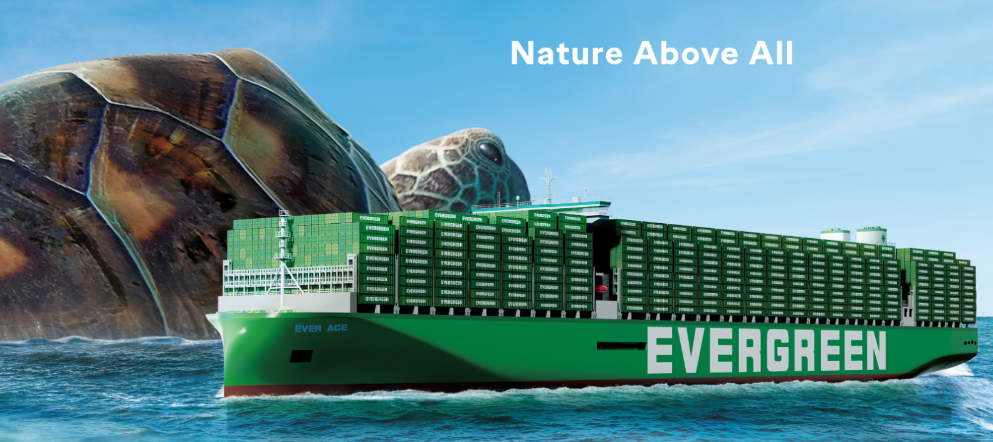
2025
LAAM Meeting (ECSA)
By LAD/EGA/ELA 2025.FEB.27~28

Slide 2
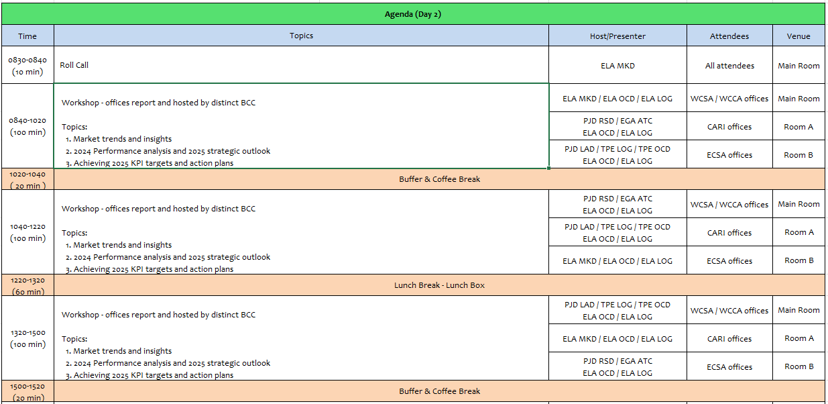
2

Slide 3
12
UMR
(PARAGUAY)

Slide 4
Performance/Space(2024) and 2025 Market Review (PY)
Subject | Segments | BCC | 2024 Target TTL Loading(TEU) | 2024 JAN~DEC TTL Loading(TEU) | Achievement (%) | 2025 JAN~DEC TTL Loading(TEU) | Market Review & Action Plan (How to achieve 2025 target?)
 |  |  | (A) | (B) | (B)/(A) | Target
Trade Lane | F.E. => PY IMP. (5 Trade) | LAD | 4,545 | 6,890 | 152% | 6,197 | Keep promoting light cargo/POL: Base as first priority. Secure support with POL about GD MIDEA shipment which is the biggest shipper of e-goods for PYASU. Get support thru strategic alliance with main F/F like ETERNITY, FEIDA, AC GROUP, CRAFT M. Amonth other Protect and increase volume of local SQ‘s negotiaton in order to achieve not only KPI but to increase liftting. Propose spot and special biz to BCC for consideration about rate/volume specially for EMC‘s own vessel Competitive rates offered by BCC in due time to confirm bookings. Space and containers availability for PYASU cargo.
 | PY EXP. => F.E. (6 Trade) | LAD | 3,650 | 2,886 | 79% | 3,789 | 1-) Maintain support for cotton‘s trader/shippers in order to be carrier #1 to load this comm to F.E. Destination. 2-) Keep promoting seed shipments like sesame, DDGS, soybeans, chia. 3-) Try to work together with BCC in order to analyze resume back shipments of bone meal to VN destination. 4-) Keep working with BCC to improve 2nd leg connection to Indian ports, to promote metal scraps shipments. 5-) Consider opening Red Sea destination in order to recover back lifting lost. 6-) Try to have permanent repo in/NOR shipment to PYASU in order to keep increasing participation in RH shipments. 7-) Protect PYASU mv space avoiding too much roll over cases and clients complaints.
4

Slide 5
Topic discussion (PY)
Commercial side:
Import
1-) Strengthen our participation with e-goods shipments CIF & FOB, as it’s voluminous/light cargo as we did in 2,024 with very success
2-) Rate policy/adjustment in due time to respond to market trend.
3-) Matching rate offer between POL and POD.
4-) Include PYASU for tender and negotiation with global a/c to secure lifting.
5-) Consider to get participation on tires shipments negotiated at POL QND/SHG.
Export
1-) Protect our current main commodity: Cotton in order to support them as carrier #1 as we did last year.
2-) Resume back bone meal shipments to VN destination, as it is 100% send to this country considering F.E. trade.
3-) Promote metal scrap to Indian ports, mainly Nhava Sheva and Mumbai which are the main destination, to increase lifting.
4-) Permanent 4RH repo-in program to PYASU fm F.E and/or AR o UY, not only NOR, because there are very few in the trade, also not stable volume.
5-) Keep promoting seeds shipment as sesame, DDGS, soybeans, chia, among others.
Future Plan Suggestion:
1-) As a new cargo source, consider transit cargo F/E to CL, with final destination PY by cnee’s risk and count, in same condition of agent/commission as we do with ECSA ports.
2-) Enlarge EMC’s service to other trades.
5

Slide 6
Topic discussion (PY)
Future market forecast in 2025 (Pessimistic / Optimistic / Remain the same)?
Economic background.
 | Get worse | Improve | Stay the same
2025 |  |  | Y
Growth: 3,6 %
Total Exports’23
$ 17.518,2 millions
Total Exports’24
$ 15.840,6 millions
Total Imports’23
$ 15.680,6 millions
Total Imports’24
$ 16.379,4 millions
Growth:
-7,7 %
2.023
4,5%
4,1%
2.024
4,0%
3,8%
2.025 (*)
3,8%
3,7%
3,7%
3,8%
N/A
GDP
INFLATION - Projection
INFLATION Interanual acum till Dec
6

Slide 7
Topic discussion (PY)
Market share and Loading volume prospect 2025 (Long Haul)
IMPORT F.E/ASU
IMPORT F.E/UDZ
EMC’ target’25 ➔ 6,197 teus / – 4% Res 2.024
F.E. Market target’25 ➔58.000 / 1% Res 2.024
EMC’ target’25 ➔ 2,930 teus / -12 % Res 2.024
F.E. Market target’25 ➔17.000 / -2 Res 2.024
7

Slide 8
Topic discussion (PY)
Market share and Loading volume prospect 2025 (Long Haul)
EXPORT DRY
EXPORT RH
EMC’ target’25 ➔ 3.789 teus / 34% Res 2.024
F.E. Market target’24 ➔14.500 / 4% Res 2.024
EMC’ target’24 ➔ N/A
F.E. Market target’24 ➔5.000 / 21% Res 2.024
8

Slide 9
ECD/IMD Topic discussion (PY)
ECD KPI | Item | 2023 | 2024 | Diff | Action Plan in 2025
ECD KPI | Storage | 1,307 | 96 | -1,211 | Most of the cases are related to cntr sold fm PYAS’s stock
 | Lift on/off | 6,270 | 825 | -5,445 | No increases on cost registered for 2024.
 | Reposition | 0 | 0 | 0 | We have repositioned cntrs in 2024 more than 2023 because of increase on import and some important comm restriction on export which caused imbalance in PY stock
 | M & R | 677 | 580 | -97 | It’s related to cntr damaged before arrival to PYASU. Usually at t/s port MVD or even before.
IMD KPI | Cost Saving Project | $ 3,903,480 $ 1,009 per unit | 5,686,080 $923,33 per unit |  | No costs increased about feeder’s freight tariff in 2024 compared with 2023. Import qties have increased 70% compared wtih 2023, export decreased 9%. Repo out units increased because of imbalance.in 2024. For 2025 suggest to analyze resume back mportant export comm suspended within 2024, to increase export full bookings.
 | 90% Onboard within 7 Days | N/A | N/A |  | Related to t/s port according IMD PNM
 | No Personal Negligence | N/A | N/A |  | Related to t/s port according IMD PNM
Topic
Aged Container Selling: Keep working with EQC/TPE to keep increasing Sales containers.
Free Reposition Plan: Mainly fm UYMVD, but also Fm Brazilian ports, referred to import cargo discharged there to final destination Paraguay, by cnee’s risk and count (trucking service). We confirm that EMC as carrier don’t have extra cost with PYASU8 terminal to deliver empty there, as cnee already is in charge of trucking service to Py, it could be considered as container source in any case.
9

Slide 10
OCD/OPD Topic discussion (PY)
 |  | 2023 | 2024 | Diff | Action Plan in 2025
OPD KPI | BOA | N/A | N/A | N/A | PYASU is inland port
 | Port Stay | N/A | N/A | N/A | PYASU is inland port
 | Productivity | N/A | N/A | N/A | PYASU is inland port
OCD KPI | Incentive | N/A | N/A | N/A | PYASU is inland port
 | Empty Storage | N/A | N/A | N/A | PYASU is inland port
 | Rate Reduction | N/A | N/A | N/A | PYASU is inland port
Topic
Terminal info update (expansion/dredge/crane)
A ----------
B -----------
10

Slide 11


