Slide 1
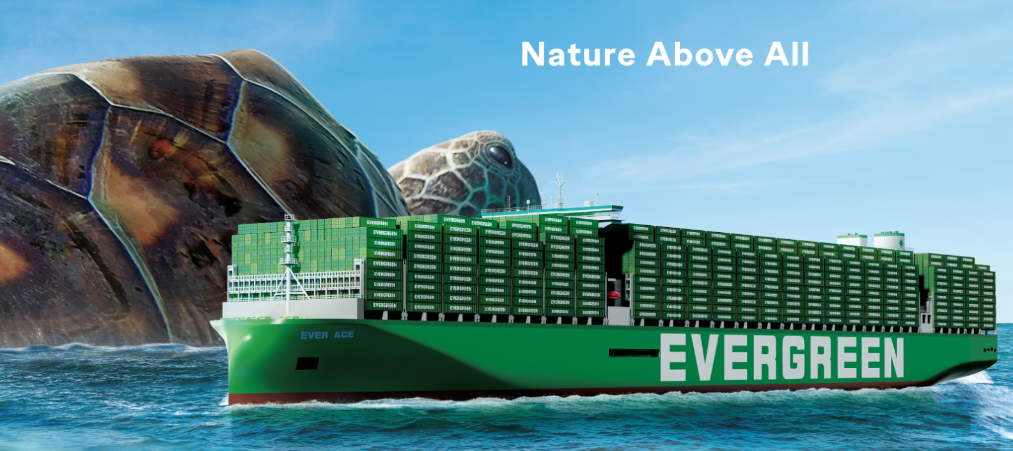
2025
LAAM Meeting (ECSA)
By LAD/EGA/ELA 2025.FEB.27~28

Slide 2
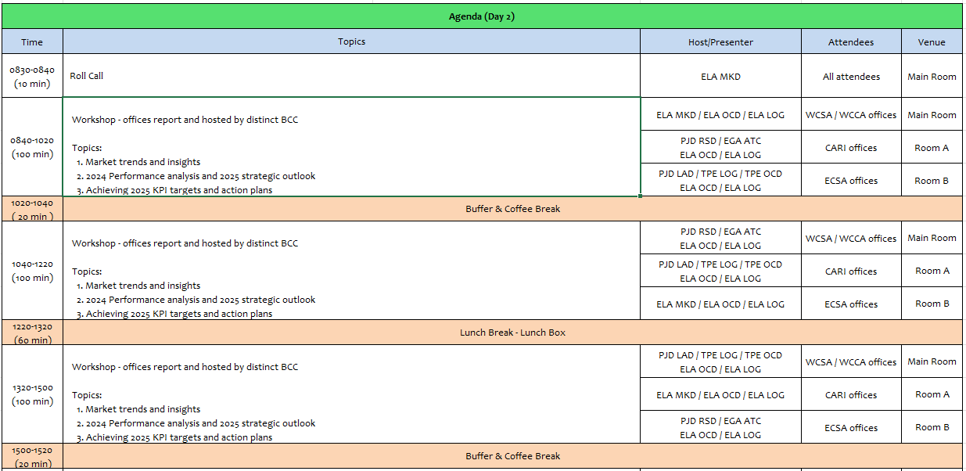
2

Slide 3
10
EAR
(ARGENTINA)

Slide 4
Performance/Space(2024) and 2025 Market Review (AR)
Subject | Segments | BCC | 2024 Target TTL Loading(TEU) | 2024 JAN~DEC TTL Loading(TEU) | Achievement (%) | 2025 JAN~DEC TTL Loading(TEU) | Market Review & Action Plan (How to achieve 2025 target?)
 |  |  | (A) | (B) | (B)/(A) | Target
Trade Lane | F.E. => AR IMP. (5 Trade) | LAD | 12,513 | 12,673 | 101% | 22,500 | Develop new sources of cargo and clients (Market monitoring and close contact with clients and meetings with clients program). Business trips plan to AR internal strategic cities such as Mendoza, Cordoba, Rosario, Ushuaia, etc. Including the case study of new depots for empty containers (DEFIBE DEPOT). Adjust drop off fee to improve Mendoza depot performance. NOR aggressive policy to enlarge our cargo sources & supply E/B reefer cargo. Promote ARLPG and resume ARUHA. Develop additional AR POD services (ARZAR/ARROS).
 | AR EXP.=> F.E. (6 Trade) | LAD | 13,016 | 13,185 | 101% | 13,850 | Develop new sources of cargo (Market monitoring and close contact with clients and meetings program). Business trips plan to AR internal strategic cities such as Mendoza, Cordoba, Rosario, Ushuaia, etc. Including the case study of new depots for empty containers (DEFIBE DEPOT). Adjust pick up fee to improve Mendoza depot performance. Promote reefer shipments to improve revenue, mainly focusing on smart containers. Working in new AR POL services (ARZAR/ARROS).
4

Slide 5
Topic discussion (AR)
Commercial side:
To compete in the market and react quickly, we need to receive aggressive and competitive rates on time from BCC.
E/B
Empty reefer equipment availability for E/B on time.
Mineral shipments (Lithium / Silver concentrate). (50X4SH per week)
Space availability on feeders at T/S for cotton shipments to Middle East, mainly PKKHI. (110x4SH weekly)
4SH Food grade containers availability for E/B. – (50X4SH Milk powder + 10X4SH wool, per month).
Green X status.
W/B
Try to be in line with Competitors regarding S.E.A. rates to improve our performance from these POLs (W/B). (Total volume 2024: 39047TEUS – EGL Loaded 8847TEUS – Share 23%)
Equipment and feeder availability at CNCHG (W/B). (Total volume 2024: 2380TEUS – EGL Loaded 1206TEUS – Share 49%). It is expected an increase in the volume of motorbike shipments for 2025.
Equipment availability at IN main ports (INNXV, INMUN) for W/B. (Total volume 2024: 12360TEUS – EGL Loaded 1749TEUS – Share 14%)
NOR availability at POLs to achieve KPI and supply E/B demands.
Resume ARUHA Service for W/B. Depending on second feeder deployment.
Future Plan Suggestion:
- Evaluate new trade services, such as USEC, CARB, EUR or MED.
- Evaluate new AR ports or depots in strategic cities so as to develop with an alternative connection.
5

Slide 6
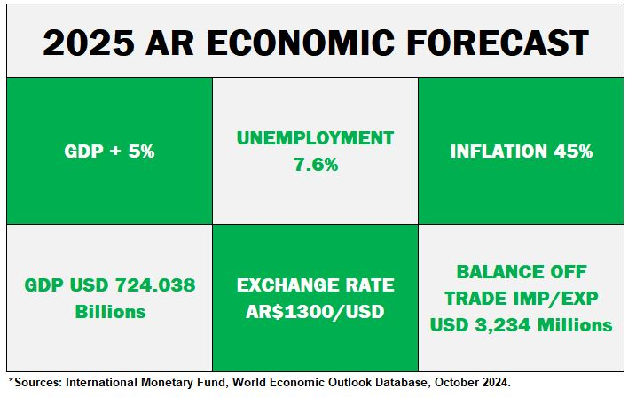
Topic discussion (AR)
Future market forecast in 2025 (Pessimistic / Optimistic / Remain the same)?
Economic background.
 | Get worse | Improve | Stay the same
2025 |  | X
6

Slide 7
Market share and Loading volume prospect 2025 (Long Haul)
Market Share
Import: 13 % Economic background and scenario in Argentina expects to be better in 2025.
It will be possible to get an improvement for Import volume, but among other issues (such as space and
schedule) it will be very important to increase of FOB shipments, thus we will need full support from BCC
and pricing efforts to achieve said goal.
Export: 11% Argentina economic outlook suggests a gradual recovery.
It is expected to have better export volume than 2024 on RH market, which will require BCC support on
competitive rates on time and equipment availability. Regarding dry cargoes, the government reduced
or eliminated taxes some concepts for some exports such us grains/seeds up to jun/30th/2025 so it is
expected that cargo volume may increase.
Volume Prospect
- Import: Market lifting the same (300,000 TEUS) / EGL 38,400 TEUS
- Export: Market lifting (170,000 TEUS) / EGL 18,000 TEUS

Slide 8
ECD/IMD Topic discussion (AR)
ECD KPI | Item | 2023 | 2024 | Diff | Action Plan in 2025
ECD KPI | Storage | USD16,516 | USD2,608 | -USD13,908 | Exceeding the 1600 TEU free per day, may be affected by Schedule delays and bunching of vsls beyond our control. Action plan: to move out empties, following mty repo instructions fm ELA Office.
 | Lift on/off | USD14,972 | USD1,556 | -USD13,416 | To promote empty return to Terminal, instead of outside depot making usage of Free Pool quota.
 | Reposition | USD86,645 | USD12,261 | -USD74,384 | To promote more EXPORT shipments.
 | M & R | USD0- | USD0- | USD0- | Only for emergency repair cases (full imp + full exp).
IMD KPI | Cost Saving Project | USD864 | USD60,000 | + USD59,136 | Our contract with the Terminal providor has a table scale incentive rebate, which includes Imports + Exports (exclude T/S & Mties). As per our recent contract extensión until 2027, incentive cash back has been increased for Principal’s benefit in USD2 x box, on top of former cost base on each scale. A new Signing bonus of USD60,000 has been agreed for Principal’s benefit in the negotiation of contract extension up to 2027. Both issues contribute to an important saving for the Principal.
 | 90% Onboard within 7 Days | N/A | USD5,580 | - USD5,580 | T/S FREE TIME at BUE: 14 straight days as per contract. EX LBRL1574-056W to BRRGR (FULL 48 cntrs/ 85 Teus) : USD4,230 Storage over free/p EX CSBZ002W to BRNVT (FULL 15 cntrs/ 28 Teus) : USD1,350 Storage over free/p EX LTUS1585-061W to BRRGR (FULL 3 cntrs/ 3 Teus) : NIL EX LKIN 1602-062W to BRPNP (FULL 77 cntrs/ 146 Teus) (MTYS 100cntrs/200Teus) : NIL
 | No Personal Negligence | NIL | NIL | NIL | NIL
8

Slide 9
ECD/IMD Topic discussion (AR)
Topic : Aged Container Selling / Free Reposition Plan
Selling available only for operations closed and paid abroad (transferences abroad restricted by Government).
There is no Free Reposition plan as per contract terms.
9

Slide 10
OCD/OPD Topic discussion (AR)
 |  | 2023 | 2024 | Diff | Action Plan in 2025
OPD KPI | BOA | 92,86 % | 100 % | +7,14 % | ARBUE Berth is free at all times, for our svc vsls. However 1 vsl at a time is allowed for berthing. in case of own svc vsls overlap due to out of Schedule. Navigation Channel Traffic congestion is observed at most of cases beyond our control (20 own vsls operated in 2024, all with Y BOA).
 | Port Stay | 100 % | 100 % | NIL | To keep promoting and monitoring an efficient productivity (20 own vsls operated in 2024, all with Y PORT STAY).
 | Productivity (Target is 57MPH) | 100 % | 100 % | NIL | For TPE evaluation, our Prod KPI is ≥57 MPH. Our AVG Product for 2023 was 62MPH while for 2024 was 58,6MPH. Additionally, as per Terminal contract valid until 2027, another Productivity KPI set up for cgo lifting is 70MPH (AVG PRODUCT 2024: 76,1MPH)
OCD KPI | Incentive | Fm May’23 24,047 Boxes | To Apr’24 24,047 Boxes | N/A | From May 2023 to Apr 2024, the total bonus for the period achieved, was USD48.094 (24.047 x USD 2,00). Next bonus incentive period is set as from May 2024 up to April 2025, currently in process of cgo development. Due to volume drop in 2024 as consequence to banned abroad remittances, more conservative KPI volume of 1,600 boxes/month was settled. However, volume is presently increasing. USD2 x box has been increased, in addition to former cost base on each scale.
 | Empty Storage | 1600 Teu | 1600 Teu | NIL | 1600Teus is the Free pool quota settled at ARBUE. We will keep promoting the usage of this Terminal pool, in order not to incur in extra costs in outer Depot. Eventual increase of quota due to Schedule disorder, is beyond our control. Monitor and reinforce our REPO OUT.
 | Rate Reduction | USD 212,153.40 | USD 96,355.34 | -USD 115,798.06 | It was recently achieved a competitive THC rate extensión until 2027, not applying any increase on other Terminal rates. Furthermore, in the usage of Outer Depot (GAMMA) for VIP customer TOYOTA, we achieved that the terminal does not invoice to us Gates in/out GAMMA nor TRP Gate in; when repo out Mties returned by TOYOTA into outer depot. Additionally to this benefit, 40 transportations per month were achieved as well to be under Terminal’s account service. Potential additional GATES saving of USD111,888 per year has been achieved in addition to 2024 figure.

Slide 11
OCD/OPD Topic discussion (AR)
Topic : Terminal info update (expansion/dredge/crane)
Since the change of Government by 20th December 2023, the new port project has been freeze. There are no news about the tender for the refurbishing of the port Terminals, and new & deeper berths constructions.
There are no plans for terminals investment on cranes, or other issues under this scenario.
The surrounding area of the two terminals located within the City of Buenos Aires (TRP & APM), is improving, experiencing
important changes helping to elevate the condition of the connecting surrounding roads and highways.
There are deeper depth areas all along the ARBUE Access channel, however, the Draft limitation at ARBUE keeps being 10Mts (at Zero tidal value) which is located at Basins berths (quay walls at 10mts basement construction). Our current vessels type have the green light from our Pilots to reach a maximum draft of 10,20mts in/out subject to high/slack tide to proceed.
TRP & APM have concessions valid until year 2027. Our Terminal contract is in fact valid until this deadline at the moment. According to a recent renewal process which included additional benefits for the Principal (new cash bonus + waive outer Depot gates in/out and TRP gate in for TOYOTA containers as per special agreement, freeze current terminal rates and increase cash back scales in volume incentive).
11

Slide 12
11
EBR
(BRAZIL)

Slide 13
Performance/Space(2024) and 2025 Market Review (BR)
Subject | Segments | BCC | 2024 Target TTL Loading(TEU) | 2024 JAN~DEC TTL Loading(TEU) | Achievement (%) | 2025 JAN~DEC TTL Loading(TEU) | Market Review & Action Plan (How to achieve 2025 target?)
 |  |  | (A) | (B) | (B)/(A) | Target
Trade Lane | F.E. => BR IMP. (5 Trade) | LAD | 10,006 | 10,071 | 101% | 13,000
 | BR EXP. => F.E. (6 Trade) | LAD | 55,052 | 59,540 | 108% | 61,250
13

Slide 14
Topic discussion (BR)
Commercial side:
Future Plan Suggestion:
14

Slide 15
Topic discussion (BR)
Future market forecast in 2025 (Pessimistic / Optimistic / Remain the same)?
Economic background.
Market share and Loading volume prospect 2025 (Long Haul)
 | Get worse | Improve | Stay the same
2025
15

Slide 16
ECD/IMD Topic discussion (BR)
ECD KPI | Item | 2023 | 2024 | Diff | Action Plan in 2025
ECD KPI | Storage
 | Lift on/off
 | Reposition
 | M & R
IMD KPI | Cost Saving Project
 | 90% Onboard within 7 Days
 | No Personal Negligence
Topic
Aged Container Selling / Free Reposition Plan
A
B
16

Slide 17
OCD/OPD Topic discussion (BR)
 |  | 2023 | 2024 | Diff | Action Plan in 2025
OPD KPI | BOA
 | Port Stay
 | Productivity
OCD KPI | Incentive
 | Empty Storage
 | Rate Reduction
Topic
Terminal info update (expansion/dredge/crane)
A
B
17

Slide 18
12
UMR
(PARAGUAY)

Slide 19
Performance/Space(2024) and 2025 Market Review (PY)
Subject | Segments | BCC | 2024 Target TTL Loading(TEU) | 2024 JAN~DEC TTL Loading(TEU) | Achievement (%) | 2025 JAN~DEC TTL Loading(TEU) | Market Review & Action Plan (How to achieve 2025 target?)
 |  |  | (A) | (B) | (B)/(A) | Target
Trade Lane | F.E. => PY IMP. (5 Trade) | LAD | 1,333 | 1,298 | 97% | 2,050
 | PY EXP. => F.E. (6 Trade) | LAD | 2,691 | 3,092 | 115% | 3,500
19

Slide 20
Topic discussion (PY)
Commercial side:
Future Plan Suggestion:
20

Slide 21
Topic discussion (PY)
Future market forecast in 2025 (Pessimistic / Optimistic / Remain the same)?
Economic background.
Market share and Loading volume prospect 2025 (Long Haul)
 | Get worse | Improve | Stay the same
2025
21

Slide 22
ECD/IMD Topic discussion (PY)
ECD KPI | Item | 2023 | 2024 | Diff | Action Plan in 2025
ECD KPI | Storage
 | Lift on/off
 | Reposition
 | M & R
IMD KPI | Cost Saving Project
 | 90% Onboard within 7 Days
 | No Personal Negligence
Topic
Aged Container Selling / Free Reposition Plan
A
B
22

Slide 23
OCD/OPD Topic discussion (PY)
 |  | 2023 | 2024 | Diff | Action Plan in 2025
OPD KPI | BOA
 | Port Stay
 | Productivity
OCD KPI | Incentive
 | Empty Storage
 | Rate Reduction
Topic
Terminal info update (expansion/dredge/crane)
A
B
23

Slide 24
13
EUY
(URUGUAY)

Slide 25
Performance/Space(2024) and 2025 Market Review (UY)
Subject | Segments | BCC | 2024 Target TTL Loading(TEU) | 2024 JAN~DEC TTL Loading(TEU) | Achievement (%) | 2025 JAN~DEC TTL Loading(TEU) | Market Review & Action Plan (How to achieve 2025 target?)
 |  |  | (A) | (B) | (B)/(A) | Target
Trade Lane | F.E. => UY IMP. (5 Trade) | LAD | 1,907 | 1978 | 104% | 2,700
 | UY EXP. => F.E. (6 Trade) | LAD | 6,838 | 7,871 | 115% | 8,250
25

Slide 26
Topic discussion (PY)
Commercial side:
Future Plan Suggestion:
26

Slide 27
Topic discussion (PY)
Future market forecast in 2025 (Pessimistic / Optimistic / Remain the same)?
Economic background.
Market share and Loading volume prospect 2025 (Long Haul)
 | Get worse | Improve | Stay the same
2025
27

Slide 28
ECD/IMD Topic discussion (PY)
ECD KPI | Item | 2023 | 2024 | Diff | Action Plan in 2025
ECD KPI | Storage
 | Lift on/off
 | Reposition
 | M & R
IMD KPI | Cost Saving Project
 | 90% Onboard within 7 Days
 | No Personal Negligence
Topic
Aged Container Selling / Free Reposition Plan
A
B
28

Slide 29
OCD/OPD Topic discussion (PY)
 |  | 2023 | 2024 | Diff | Action Plan in 2025
OPD KPI | BOA
 | Port Stay
 | Productivity
OCD KPI | Incentive
 | Empty Storage
 | Rate Reduction
Topic
Terminal info update (expansion/dredge/crane)
A
B
29

Slide 30


