Slide 1
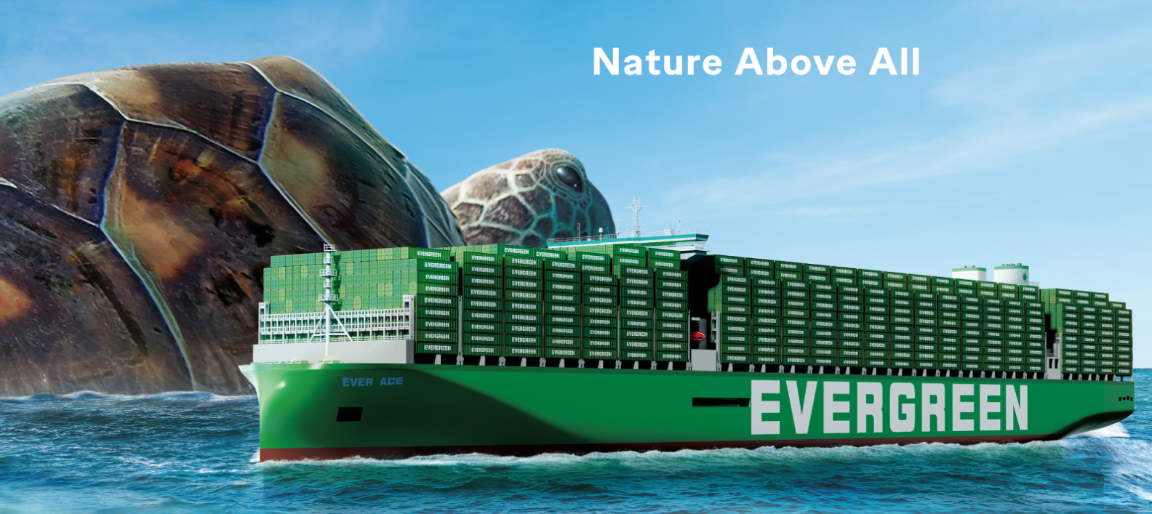
2025
LAAM Meeting (CARB)
By LAD/EGA/ELA 2025.FEB.27~28
By LAD/EGA/ELA

Slide 2
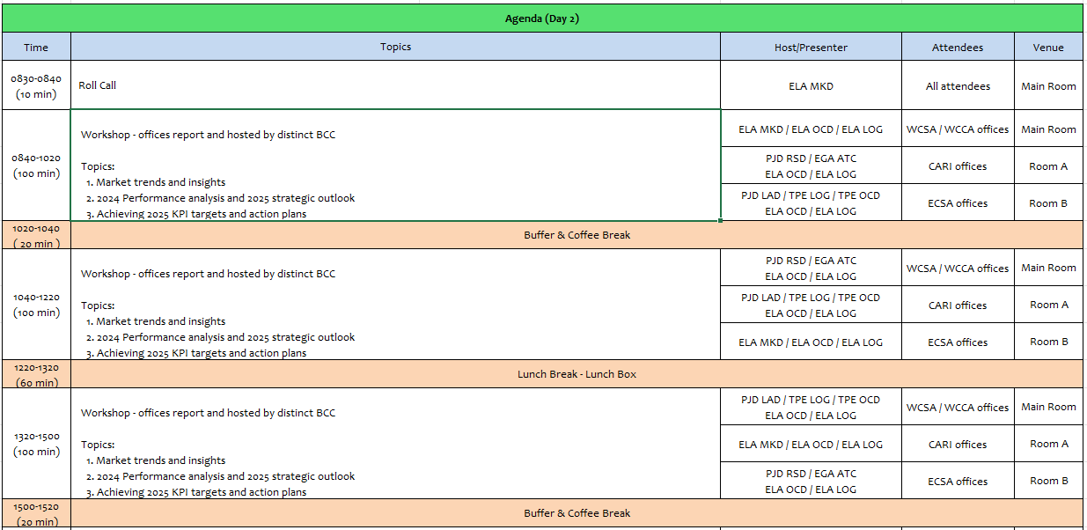
2

Slide 3
02
MIS
(COSTA RICA include NICARAGUA)

Slide 4
Performance/Space(2024) and 2025 Market Review (CR+NI)
Subject | Segments | BCC | 2024 Target TTL Loading(TEU) | 2024 JAN~DEC TTL Loading(TEU) | Achievement (%) | 2025 JAN~DEC TTL Loading(TEU) | Market Review & Action Plan (How to achieve 2025 target?)
 |  |  | (A) | (B) | (B)/(A) | Target
Trade Lane | F.E. => CR+NI IMP. (C Trade) | LAD | 127 | 212 | 167% | 245
 | F.E. => CR+NI IMP. (Q Trade) | LAD | 6,221 | 6,354 | 102% | 7,265
 | CR+NI EXP. => F.E. (CF Trade) | LAD | 5,483 | 5,106 | 93% | 5,140
4

Slide 5
Performance/Space(2024) and 2025 Market Review (CR+NI)
Subject | Segments | BCC | 2024 Target TTL Loading(TEU) | 2024 JAN~DEC TTL Loading(TEU) | Achievement (%) | 2025 JAN~DEC TTL Loading(TEU) | Market Review & Action Plan (How to achieve 2025 target?)
 |  |  | (A) | (B) | (B)/(A) | Target
Trade Lane | CR+NI ⬄ USEC (609+610 Trade) | EGA-ATC | 1,000 | 1,476 | 147% | 1,800
 | CR+NI ⬄ CARB+WCCA (CB Trade) | ELA | 2,350 | 1,188 | 51% | 1,350
 | CR+NI ⬄ WCSA (CW+WC Trade) | ELA | 500 | 797 | 159% | 650
 | CR+NI ⬄ USEC (622+623 Trade) | ELA | 1,100 | 1,710 | 155% | 1,500
5

Slide 6
Topic discussion (CR+NI)
Commercial side:
Future Plan Suggestion:
6

Slide 7
Topic discussion (CR+NI)
Future market forecast in 2025 (Pessimistic / Optimistic / Remain the same)?
Economic background.
Market share and Loading volume prospect 2025 (Long Haul)
 | Get worse | Improve | Stay the same
2025
7

Slide 8
ECD/IMD Topic discussion (CR+NI)
ECD KPI | Item | 2023 | 2024 | Diff | Action Plan in 2025
ECD KPI | Storage
 | Lift on/off
 | Reposition
 | M & R
IMD KPI | Cost Saving Project
 | 90% Onboard within 7 Days
 | No Personal Negligence
Topic
Aged Container Selling / Free Reposition Plan
  A
  B
8

Slide 9
OCD/OPD Topic discussion (CR+NI)
 |  | 2023 | 2024 | Diff | Action Plan in 2025
OPD KPI | BOA
 | Port Stay
 | Productivity
OCD KPI | Incentive
 | Empty Storage
 | Rate Reduction
Topic
Terminal info update (expansion/dredge/crane)
  A
  B
9

Slide 10
03
CRE
(CURACAO)

Slide 11
Performance/Space(2024) and 2025 Market Review (CW)
Subject | Segments | BCC | 2024 Target TTL Loading(TEU) | 2024 JAN~DEC TTL Loading(TEU) | Achievement (%) | 2025 JAN~DEC TTL Loading(TEU) | Market Review & Action Plan (How to achieve 2025 target?)
 |  |  | (A) | (B) | (B)/(A) | Target
Trade Lane | F.E. => CW IMP. (C Trade) | LAD | 332 | 566 | 170% | 588
 | CW ⬄ USEC (609+610 Trade) | EGA-ATC | 20 | 16 | 80% | 20
 | CW ⬄ CARI (CC Trade) | EGA-ATC | 20 | 23 | 115% | 20
11

Slide 12
Performance/Space(2024) and 2025 Market Review (CW)
Subject | Segments | BCC | 2024 Target TTL Loading(TEU) | 2024 JAN~DEC TTL Loading(TEU) | Achievement (%) | 2025 JAN~DEC TTL Loading(TEU) | Market Review & Action Plan (How to achieve 2025 target?)
 |  |  | (A) | (B) | (B)/(A) | Target
Trade Lane | CW ⬄ WCSA (CW+WC Trade) | ELA | 10 | 0 | 0% | 10
 | CW ⬄ WCCA+CARO (CB Trade) | ELA | 15 | 0 | 0% | 10
12

Slide 13
Topic discussion (CW)
Commercial side:
Future Plan Suggestion:
13

Slide 14
Topic discussion (CW)
Future market forecast in 2025 (Pessimistic / Optimistic / Remain the same)?
Economic background.
Market share and Loading volume prospect 2025 (Long Haul)
 | Get worse | Improve | Stay the same
2025
14

Slide 15
ECD/IMD Topic discussion (CW)
ECD KPI | Item | 2022 | 2023 | Diff | Action Plan in 2025
ECD KPI | Storage
 | Lift on/off
 | Reposition
 | M & R
IMD KPI | Cost Saving Project
 | 90% Onboard within 7 Days
 | No Personal Negligence
15

Slide 16
OCD/OPD Topic discussion (CW)
 |  | 2022 | 2023 | Diff | Action Plan in 2025
OPD KPI | BOA
 | Port Stay
 | Productivity
OCD KPI | Incentive
 | Empty Storage
 | Rate Reduction
Topic
Terminal info update (expansion/dredge/crane)
  A
  B
16

Slide 17
04
SMS
(HAITI)

Slide 18
Performance/Space(2024) and 2025 Market Review (HT)
Subject | Segments | BCC | 2024 Target TTL Loading(TEU) | 2024 JAN~DEC TTL Loading(TEU) | Achievement (%) | 2025 JAN~DEC TTL Loading(TEU) | Market Review & Action Plan (How to achieve 2025 target?)
 |  |  | (A) | (B) | (B)/(A) | Target
Trade Lane | F.E. => HT IMP. (C Trade) | LAD | 1,219 | 1,450 | 119% | 1,715
 | HT ⬄ CARI+CARO (CB Trade) | ELA | 1,000 | 222 | 22% | 500
18

Slide 19
Performance/Space(2024) and 2025 Market Review (HT)
Subject | Segments | BCC | 2024 Target TTL Loading(TEU) | 2024 JAN~DEC TTL Loading(TEU) | Achievement (%) | 2025 JAN~DEC TTL Loading(TEU) | Market Review & Action Plan (How to achieve 2025 target?)
 |  |  | (A) | (B) | (B)/(A) | Target
Trade Lane | HT ⬄ WCSA+WCCA (CW+WC+CB Trade) | ELA | 1,000 | 60 | 6% | 80
 | HT ⬄ USEC (622+623 Trade) | ELA | 500 | 75 | 15% | 250
19

Slide 20
Topic discussion (HT)
Commercial side:
Future Plan Suggestion:
20

Slide 21
Topic discussion (HT)
Future market forecast in 2025 (Pessimistic / Optimistic / Remain the same)?
Economic background.
Market share and Loading volume prospect 2025 (Long Haul)
 | Get worse | Improve | Stay the same
2025
21

Slide 22
ECD/IMD Topic discussion (HT)
ECD KPI | Item | 2023 | 2024 | Diff | Action Plan in 2025
ECD KPI | Storage
 | Lift on/off
 | Reposition
 | M & R
IMD KPI | Cost Saving Project
 | 90% Onboard within 7 Days
 | No Personal Negligence
Topic
Aged Container Selling / Free Reposition Plan
  A
  B
22

Slide 23
OCD/OPD Topic discussion (HT)
 |  | 2023 | 2024 | Diff | Action Plan in 2025
OPD KPI | BOA
 | Port Stay
 | Productivity
OCD KPI | Incentive
 | Empty Storage
 | Rate Reduction
Topic
Terminal info update (expansion/dredge/crane)
  A
  B
23

Slide 24
05
MCD
(DOMINICAN REPUBLIC)

Slide 25
Performance/Space(2024) and 2025 Market Review (DO)
Subject | Segments | BCC | 2024 Target TTL Loading(TEU) | 2024 JAN~DEC TTL Loading(TEU) | Achievement (%) | 2025 JAN~DEC TTL Loading(TEU) | Market Review & Action Plan (How to achieve 2025 target?)
 |  |  | (A) | (B) | (B)/(A) | Target
Trade Lane | F.E. => DO IMP. (C Trade) | LAD | 2,708 | 2,530 | 96% | 4,900
25

Slide 26
Performance/Space(2024) and 2025 Market Review (DO)
Subject | Segments | BCC | 2024 Target TTL Loading(TEU) | 2024 JAN~DEC TTL Loading(TEU) | Achievement (%) | 2025 JAN~DEC TTL Loading(TEU) | Market Review & Action Plan (How to achieve 2025 target?)
 |  |  | (A) | (B) | (B)/(A) | Target
Trade Lane | DO ⬄ USEC (609+610 Trade) | EGA-ATC | 200 | 209 | 104% | 200
 | DO ⬄ CARI (CC Trade) | EGA-ATC | 2,900 | 3466 | 119% | 2,900
26

Slide 27
Performance/Space(2024) and 2025 Market Review (DO)
Subject | Segments | BCC | 2024 Target TTL Loading(TEU) | 2024 JAN~DEC TTL Loading(TEU) | Achievement (%) | 2025 JAN~DEC TTL Loading(TEU) | Market Review & Action Plan (How to achieve 2025 target?)
 |  |  | (A) | (B) | (B)/(A) | Target
Trade Lane | DO ⬄ WCSA (CW+WC Trade) | ELA | 150 | 21 | 14% | 50
 | DO ⬄ WCCA+CARO (CB Trade) | ELA | 300 | 70 | 23% | 100
27

Slide 28
Topic discussion (DO)
Commercial side:
Future Plan Suggestion:
28

Slide 29
Topic discussion (DO)
Future market forecast in 2025 (Pessimistic / Optimistic / Remain the same)?
Economic background.
Market share and Loading volume prospect 2025 (Long Haul)
 | Get worse | Improve | Stay the same
2025
29

Slide 30
ECD/IMD Topic discussion (DO)
ECD KPI | ITEM | 2023 | 2024 | Diff | Action Plan in 2025
ECD KPI | Storage
 | Lift on/off
 | Reposition
 | M & R
IMD KPI | Cost Saving Project
 | 90% Onboard within 7 Days
 | No Personal Negligence
Topic
Aged Container Selling / Free Reposition Plan
  A
  B
30

Slide 31
OCD/OPD Topic discussion (DO)
 | ITEM | 2023 | 2024 | Diff | Action Plan in 2025
OPD KPI | BOA
 | Port Stay
 | Productivity
OCD KPI | Incentive
 | Empty Storage
 | Rate Reduction
Topic
Terminal info update (expansion/dredge/crane)
  A
  B
31

Slide 32
06
LNM
(JAMAICA)

Slide 33
Performance/Space(2024) and 2025 Market Review (JM)
Subject | Segments | BCC | 2024 Target TTL Loading(TEU) | 2024 JAN~DEC TTL Loading(TEU) | Achievement (%) | 2025 JAN~DEC TTL Loading(TEU) | Market Review & Action Plan (How to achieve 2025 target?)
 |  |  | (A) | (B) | (B)/(A) | Target
Trade Lane | F.E. => JM IMP. (C Trade) | LAD | 379 | 339 | 90% | 490
 | JM ⬄ USEC (609+610 Trade) | EGA-ATC | 10 | 9 | 90% | 10
 | JM ⬄ CARI (CC Trade) | EGA-ATC | 25 | 28 | 112% | 25
33

Slide 34
Performance/Space(2024) and 2025 Market Review (JM)
Subject | Segments | BCC | 2024 Target TTL Loading(TEU) | 2024 JAN~DEC TTL Loading(TEU) | Achievement (%) | 2025 JAN~DEC TTL Loading(TEU) | Market Review & Action Plan (How to achieve 2025 target?)
 |  |  | (A) | (B) | (B)/(A) | Target
Trade Lane | JM ⬄ WCSA (CW+WC Trade) | ELA | 10 | 0 | 0% | 10
 | JM ⬄ WCCA+CARO (CB Trade) | ELA | 515 | 204 | 40% | 250
34

Slide 35
Topic discussion (JM)
Commercial side:
Future Plan Suggestion:
35

Slide 36
Topic discussion (JM)
Future market forecast in 2025 (Pessimistic / Optimistic / Remain the same)?
Economic background.
Market share and Loading volume prospect 2025 (Long Haul)
 | Get worse | Improve | Stay the same
2025
36

Slide 37
ECD/IMD Topic discussion (JM)
ECD KPI | ITEM | 2023 | 2024 | Diff | Action Plan in 2025
ECD KPI | Storage
 | Lift on/off
 | Reposition
 | M & R
IMD KPI | Cost Saving Project
 | 90% Onboard within 7 Days
 | No Personal Negligence
Topic
Aged Container Selling / Free Reposition Plan
  A
  B
37

Slide 38
OCD/OPD Topic discussion (JM)
 | ITEM | 2023 | 2024 | Diff | Action Plan in 2025
OPD KPI | BOA
 | Port Stay
 | Productivity
OCD KPI | Incentive
 | Empty Storage
 | Rate Reduction
Topic
Terminal info update (expansion/dredge/crane)
  A
  B
38

Slide 39
07
UMS
(PANAMA)

Slide 40
Performance/Space(2024) and 2025 Market Review (PA)
Subject | Segments | BCC | 2024 Target TTL Loading(TEU) | 2024 JAN~DEC TTL Loading(TEU) | Achievement (%) | 2025 JAN~DEC TTL Loading(TEU) | Market Review & Action Plan (How to achieve 2025 target?)
 |  |  | (A) | (B) | (B)/(A) | Target
Trade Lane | F.E. => PA IMP. (C Trade) | LAD | 15,512 | 17,444 | 112% | 16,415
 | PA ⬄ USEC (609+610 Trade) | EGA-ATC | 210 | 138 | 66% | 210
 | PA ⬄ CARI (CC Trade) | EGA-ATC | 5,700 | 4881 | 86% | 5,500
40

Slide 41
Performance/Space(2024) and 2025 Market Review (PA)
Subject | Segments | BCC | 2024 Target TTL Loading(TEU) | 2024 JAN~DEC TTL Loading(TEU) | Achievement (%) | 2025 JAN~DEC TTL Loading(TEU) | Market Review & Action Plan (How to achieve 2025 target?)
 |  |  | (A) | (B) | (B)/(A) | Target
Trade Lane | PA ⬄ WCSA (CW+WC Trade) | ELA | 310 | 289 | 93% | 310
 | PA ⬄ WCCA+CARO (CB Trade) | ELA | 950 | 291 | 31% | 350
41

Slide 42
Topic discussion (PA)
Commercial side:
Future Plan Suggestion:
42

Slide 43
Topic discussion (PA)
Future market forecast in 2025 (Pessimistic / Optimistic / Remain the same)?
Economic background.
Market share and Loading volume prospect 2025 (Long Haul)
 | Get worse | Improve | Stay the same
2025
43

Slide 44
ECD/IMD Topic discussion (PA)
ECD KPI | ITEM | 2023 | 2024 | Diff | Action Plan in 2025
ECD KPI | Storage
 | Lift on/off
 | Reposition
 | M & R
IMD KPI | Cost Saving Project
 | 90% Onboard within 7 Days
 | No Personal Negligence
Topic
Aged Container Selling / Free Reposition Plan
  A
  B
44

Slide 45
OCD/OPD Topic discussion (PA)
 | ITEM | 2023 | 2024 | Diff | Action Plan in 2025
OPD KPI | BOA
 | Port Stay
 | Productivity
OCD KPI | Incentive
 | Empty Storage
 | Rate Reduction
Topic
Terminal info update (expansion/dredge/crane)
  A
  B
45

Slide 46
08
PRIS
(PUERTO RICO)

Slide 47
Performance/Space(2024) and 2025 Market Review (PR)
Subject | Segments | BCC | 2024 Target TTL Loading(TEU) | 2024 JAN~DEC TTL Loading(TEU) | Achievement (%) | 2025 JAN~DEC TTL Loading(TEU) | Market Review & Action Plan (How to achieve 2025 target?)
 |  |  | (A) | (B) | (B)/(A) | Target
Trade Lane | F.E. => PR IMP. (618 Trade) | LAD | 6,511 | 9,247 | 142% | 9,800
 | PR ⬄ CARI (609+610 Trade) | EGA-ATC | 830 | 354 | 43% | 500
47

Slide 48
Performance/Space(2024) and 2025 Market Review (PR)
Subject | Segments | BCC | 2024 Target TTL Loading(TEU) | 2024 JAN~DEC TTL Loading(TEU) | Achievement (%) | 2025 JAN~DEC TTL Loading(TEU) | Market Review & Action Plan (How to achieve 2025 target?)
 |  |  | (A) | (B) | (B)/(A) | Target
Trade Lane | PR ⬄ WCSA (619+620 Trade) | ELA | 250 | 0 | 0% | 10
 | PR ⬄ WCCA+CARO (622+623 Trade) | ELA | 850 | 44 | 5% | 70
48

Slide 49
Topic discussion (PR)
Commercial side:
Future Plan Suggestion:
49

Slide 50
Topic discussion (PR)
Future market forecast in 2025 (Pessimistic / Optimistic / Remain the same)?
Economic background.
Market share and Loading volume prospect 2025 (Long Haul)
 | Get worse | Improve | Stay the same
2025
50

Slide 51
ECD/IMD Topic discussion (PR)
ECD KPI | ITEM | 2023 | 2024 | Diff | Action Plan in 2025
ECD KPI | Storage
 | Lift on/off
 | Reposition
 | M & R
IMD KPI | Cost Saving Project
 | 90% Onboard within 7 Days
 | No Personal Negligence
Topic
Aged Container Selling / Free Reposition Plan
  A
  B
51

Slide 52
OCD/OPD Topic discussion (PR)
 | ITEM | 2023 | 2024 | Diff | Action Plan in 2025
OPD KPI | BOA
 | Port Stay
 | Productivity
OCD KPI | Incentive
 | Empty Storage
 | Rate Reduction
Topic
Terminal info update (expansion/dredge/crane)
  A
  B
52

Slide 53
09
ISL
(TRINIDAD)

Slide 54
Performance/Space(2024) and 2025 Market Review (TT)
Subject | Segments | BCC | 2024 Target TTL Loading(TEU) | 2024 JAN~DEC TTL Loading(TEU) | Achievement (%) | 2025 JAN~DEC TTL Loading(TEU) | Market Review & Action Plan (How to achieve 2025 target?)
 |  |  | (A) | (B) | (B)/(A) | Target
Trade Lane | F.E. => TT IMP. (C Trade) | LAD | 130 | 0 | 0 | 10 | For 2024 China to Trinidad and Tobago exports were valued at $46.4M, major exports were Telephones, Motor vehicles, Iron Pipes and Rubber Tires. As of January, market prices for exports stood at an average of $5200 - $5700/ 20’& $5500 - $6100/40’ units. These rates vary weekly and are subject to peak season increases. To achieve goals for 2025 rates need to be made more accessible to sales personnel in Trinidad and Tobago and should be more competitive compared to the market average. Consistency and reliability need to be the focus of operations ensuring that customers receive shipments promptly and in situations where expectations cannot be met proper updates to customers need to be provided both from a local and international level.
54

Slide 55
Performance/Space(2024) and 2025 Market Review (TT)
Subject | Segments | BCC | 2024 Target TTL Loading(TEU) | 2024 JAN~DEC TTL Loading(TEU) | Achievement (%) | 2025 JAN~DEC TTL Loading(TEU) | Market Review & Action Plan (How to achieve 2025 target?)
 |  |  | (A) | (B) | (B)/(A) | Target
Trade Lane | TT ⬄ CARB (CB Trade) | ELA | 10 | 6 | 60% | 5 | Trinidad and Tobago mainly exports to the Dominican Republic, Jamaica, Guyana and Colombia (Cartagena), with rates averaging from $900 - $1500/ 20‘ & $1300 - $2500/ 40‘. Exports include Food and Beverage Products, Furniture, Minerals and Materials, Chemicals etc. For WCSA & WCCA rates average from $1100 - $2900/20‘ & $1600 - $3700/40‘. Exports include Food and Beverage Products, Furniture, Minerals and Materials, Chemicals etc. As of 2024, Trinidad and Tobago's total export value is estimated at approximately $11.5 billion USD. The country’s main exports include anhydrous ammonia ($3.68 billion), petroleum oils ($2.06 billion), methanol ($1.77 billion), liquefied natural gas ($1.12 billion), and ferrous products ($852 million). The United States is Trinidad and Tobago’s largest export market, accounting for 42.18% of exports ($4.86 billion USD). Other key export partners include Belgium, Morocco, Spain, Dominican Republic, Guyana, Suriname and Brazil. The country's economy remains heavily reliant on hydrocarbon exports, which could face challenges due to international carbon border taxes, particularly from the European Union. This may affect revenue in the long term if diversification efforts are not intensified. To achieve targets for 2025 routes need to be made available for exports and rates need to be more competitive compared to the market average. A constant availability of units will also be required to acheive targets.
 | TT ⬄ WCSA (CW+WC Trade) | ELA | 10 | 0 | 0% | 5 | Continue to share market data and competitive rates from other carriers with our BCC. Aiming to offer more competitive rates to customers. Target per week is 10 TEU once competitive rates are offered. Enhance marketing communication by launching an Evergreen campaign which will build awareness of the line and services offered.
 | TT ⬄ WCCA (CB Trade) | ELA | 10 | 0 | 0% | 5 | Continue to share market data and competitive rates from other carriers with our BCC. Aiming to offer more competitive rates to customers. Target per week is 10 TEU once competitive rates are offered. Enhance marketing communication by launching an Evergreen campaign which will build awareness of the line and services offered.
55

Slide 56
Topic discussion (TT)
Commercial side:
Trinidad and Tobago is a major exporter in the region with constant exports to Jamaica, Dominican Republic, Guyana and Suriname (regionally) and exports to India (scrap and recyclables) (internationally). Regional rates tend to average from $900 - $1500/ 20‘ & $1300 - $2500/ 40‘. As rates for India exports average from $650 - $900/ 20‘ and $800 - $1100/ 40‘.
Over recent time there has been a major increase in exports to Guyana with their recent increase in Oil and Gas activities, this has introduced an increase in the shipping of chemicals and other materials used in the production of Oil and Gas.
Future Plan Suggestion:
Develop a consistent export market within the region
Target major scrap exporters, which can lead to a major increase in export volumes as the average customer exports 20-40 units per month
Target exports to Guyana, specifically entities involved in the Oil and Gas market as it presents a consistent flow of business opportunities
Develop and maintain a consistent trade route with Dominican Republic and Jamaica, as these countries are two major trade partners with Trinidad and Tobago.
56

Slide 57
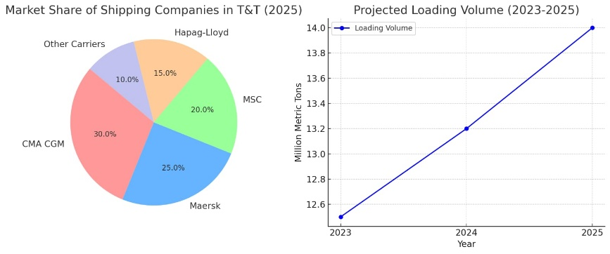
Topic discussion (TT)
Future market forecast in 2025 (Pessimistic / Optimistic / Remain the same)?
Economic background.
  Oil and Gas
  Scrap Metals and Recyclables
  Consumer Goods (CARICOM)
  Chemicals
  Mineral Fuels and Oils and Products of their distillation
Market share and Loading volume prospect 2025 (Long Haul)
  Currently CMA CGM, MAERSK, MSC and Hapag Lloyd control a major portion of the market share with most entities engaging their services, this has also allowed these companies to provide substantially low rates compared to other lines. (See Graph attached)
 | Get worse | Improve | Stay the same
2025 |  | X
57

Slide 58
ECD/IMD Topic discussion (TT)
ECD KPI | ITEM | 2023 | 2024 | Diff | Action Plan in 2025
ECD KPI | Storage | 14.59 |  |  | Minimum Storage cost by evacuating empties on earliest available vessel
 | Lift on/off | 8.25
 | Reposition |  |  |  | Conduct repositions on units promptly upon availability
 | M & R | 0 | 0 | 0 | N/A
IMD KPI | Cost Saving Project
 | 90% Onboard within 7 Days |  |  |  | Maintain 90% Onboard within 7 days for all regions but actively monitoring units and ensure prompt exports of units returned to storage.
 | No Personal Negligence | 4.83 |  |  | Ensure all team members are prompt and accurate when providing information, and also ensure that any errors or issues are resolved within a time-specific period. Also increasing the level of accountability among team members, as we work to increase productivity and efficiency.
58

Slide 59
OCD/OPD Topic discussion (TT)
 | ITEM | 2023 | 2024 | Diff | Action Plan in 2025
OPD KPI | BOA |  |  |  | Maintain communication and good working relations with vessel agents to ensure a continues streamline process with cargo arrival and departure
 | Port Stay |  |  |  | Continuously work to decrease excessive stay periods of units at the port facility, greater efforts need to be placed on units at Guyana port to ensure fast and effective export of empty units at the terminal. A more streamlined process would also have to be developed to improve the export process
 | Productivity |  |  |  | Maintain and improve communications between both vessel agents and Evergreen personnel to ensure maximum productivity is maintained, ensure proper and timely communications to assist in the alleviation of any issues that may occur during operations
OCD KPI | Incentive
 | Empty Storage |  |  |  | Ensure units are made ready (sealing, documentation etc.) in a prompt manner to ensure export on next available sailing. Monitor and communicate with the team any port or sailing disruptions.
 | Rate Reduction |  |  |  | An active rate system to be developed and constantly monitored against competitors’ rates.
Topic
Terminal info update (expansion/dredge/crane)
  Port Expansion & Infrastructure Investments: Major investments are being made to upgrade the Port of Port of Spain and PLIPDECO (Point Lisas Industrial Port Development Corporation). This includes deepening channels, expanding berths, and modernizing cargo-handling equipment to reduce congestion and turnaround times.A Public-Private Partnership (PPP), supported by the Inter-American Development Bank (IDB) and the Global Infrastructure Facility (GIF), aims to increase the port's handling capacity from 340,000 TEUs to 620,000 TEUs in the short term and 1.1 million TEUs in the long term.
59

Slide 60


