Slide 1

2025
LAAM Meeting (CARB)
By LAD/EGA/ELA 2025.FEB.27~28
By LAD/EGA/ELA

Slide 2
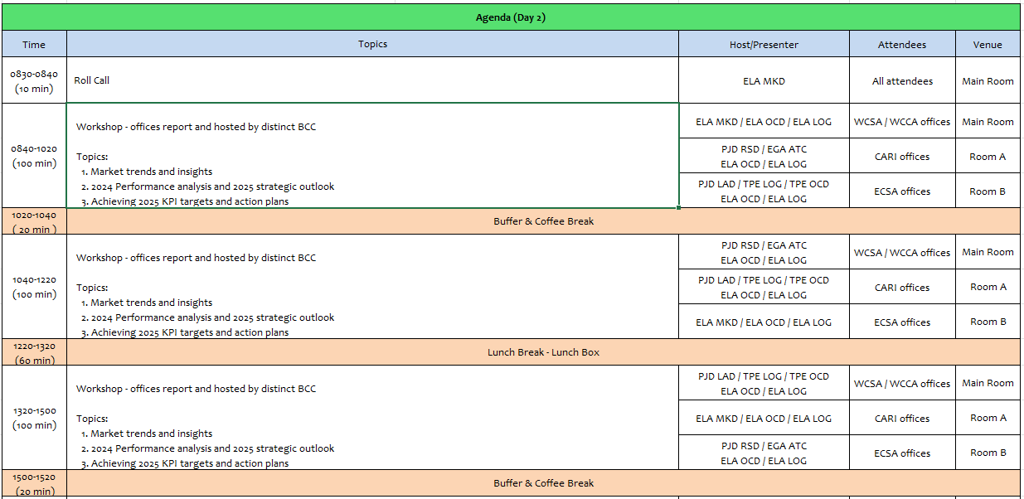
2

Slide 3
04
SMS
(HAITI)

Slide 4
Performance/Space(2024) and 2025 Market Review (HT)
Subject | Segments | BCC | 2024 Target TTL Loading(TEU) | 2024 JAN~DEC TTL Loading(TEU) | Achievement (%) | 2025 JAN~DEC TTL Loading(TEU) | Market Review & Action Plan (How to achieve 2025 target?)
 |  |  | (A) | (B) | (B)/(A) | Target
Trade Lane | F.E. => HT IMP. (C Trade) | LAD | 14,000 | 10,870 | 78% | 14,000 | -The decrease in volume (-2%) in 2024 was primarily due to port closures caused by civil unrests from Feb-June and again in Sept. 2024 -Despite these challenges, we remain commited to keeping BCC informed with the latest market rates/share ensuring we align with our customers demand for more competitive pricing. -Our key objective this year is to drive a significant increase in bookings by actively promoting Evergreen and its services to restore growth and exceed our target.
 | HT ⬄ CARI+CARO (CB Trade) | ELA | 1,000 | 234 | 23% | 1000 | -Volume decline and targets have not been met due to the security crisis in the country over the past months. -The need to increase allocation, and enhance the availability of foodgrade containers, particularly for sugar/confectionery imports. -Our focus this year is on driving volume growth by actively promoting Evergreen and its reliable services.
4

Slide 5
Performance/Space(2024) and 2025 Market Review (HT)
Subject | Segments | BCC | 2024 Target TTL Loading(TEU) | 2024 JAN~DEC TTL Loading(TEU) | Achievement (%) | 2025 JAN~DEC TTL Loading(TEU) | Market Review & Action Plan (How to achieve 2025 target?)
 |  |  | (A) | (B) | (B)/(A) | Target
Trade Lane | HT ⬄ WCSA+WCCA (CW+WC+CB Trade) | ELA | 1,000 | 92 | 10% | 1,000 | -Volume decrease due to the country insecurity. -The need to increase allocation, and enhance the availability of foodgrade containers, particularly for sugar/confectionery imports especially for GTZNJ, CRCAL, SVAGR & NICPK. -Services from COBVT & PECAL still suspended. [2024 Q1-Q4] COBVT – 4,051 TEU PECAL – 2,789 TEU -Our primary goal this year is to significantly boost bookings by strategically promoting Evergreen and its services, aiming to restore growth and surpass our target.
 | HT ⬄ USEC (622+623 Trade) | ELA | 500 | 87 | 18% | 500 | -Volume decrease due to the country insecurity. -main challenges impacting this trade are equipment shortage and limited trucking schedule availability. 2024 Imports to HTPAP – 5,777 TEU USHUS – 42% USNYC – 27% USSVN – 18% -Goal this year is to secure more bookings by actively promoting Evergreen and its services.
5

Slide 6
Topic discussion (HT)
Commercial side:
Pleased to share that in 2024, we have secured the 1st position in imports from Far East Asia (C Trade) despite facing significant challenges, including political instability. This achievement reflects our resilience and strategic efforts in navigating complex market conditions. However, we have yet to attain the top position in CB and other trade, primarily due to the non-resumption of COBVT, PECAL, USHUS services. Additionally, both CMACGM and MSC continue to provide services from these ports, including Europe and Brazil, which has impacted our position.
We sincerely appreciate the unwavering support and understanding of our BCC partners during this challenging period. Their cooperation and proactive efforts have played a crucial role in helping us navigate the difficulties arising from the political situation in HTPAP.
Future Plan Suggestion:
We are fully committed to reinforcing our competitive position and expanding our market presence in the Haiti imports sector. With a strong foundation established with our clients in Haiti, it is essential to address existing gaps in our service offerings to further solidify our standing and increase our market share. There is a clear demand for services to Brazil, Europe, and key ports such as COBVT and PECAL. By incorporating these routes into our service portfolio, we can effectively meet the needs of underserved clients and capitalize on new growth opportunities.
In addition, we recommend the integration of Port Everglades and USHUS into the CAJ service, which will strengthen our market presence and align with our strategic objective of becoming the leading carrier in Haiti.
6

Slide 7
Topic discussion (HT)
Future market forecast in 2025 (Pessimistic / Optimistic / Remain the same)?
Economic background.
Haiti has been receiving international support from organizations like the World Bank and the IMF, aimed at boosting economic stability and development. Collaborations with regional partners, including the Caribbean Community (CARICOM) and other trade blocks, can open new avenues for trade and economic growth. Haiti's import dependencies in 2025 remain high in several key sectors due to its limited domestic production capacity and infrastructure challenges such as food, agricultural products, fuel, construction & machinery materials, consumer goods and healthcare supplies.
Market share and Loading volume prospect 2025 (Long Haul)
We expect to enhance our market share by re-establishing services at the ports we previously lost, COBVT, PECAL, ECGYE, CLSAI, and USHUS. Additionally, we aim to expand our offerings with the inclusion of Port Everglades (USPEV), as well as services from Brazil and European countries.
 | Get worse | Improve | Stay the same
2025 |  | ✓
7

Slide 8
ECD/IMD Topic discussion (HT)
ECD KPI | Item | 2023 | 2024 | Diff | Action Plan in 2025
ECD KPI | Storage
 | Lift on/off
 | Reposition
 | M & R
IMD KPI | Cost Saving Project
 | 90% Onboard within 7 Days
 | No Personal Negligence
Topic
Aged Container Selling / Free Reposition Plan
A
B
8

Slide 9
OCD/OPD Topic discussion (HT)
 |  | 2023 | 2024 | Diff | Action Plan in 2025
OPD KPI | BOA
 | Port Stay
 | Productivity
OCD KPI | Incentive
 | Empty Storage
 | Rate Reduction
Topic
Terminal info update (expansion/dredge/crane)
A
B
9

Slide 10


