Slide 1

Business Report
2026 LATIN AMERICA AGENCY MEETING

Slide 2









AGENDA
Economic Status
Cargo Flow
GDP Forecast , Inflation , USA Tariff
Import/Export
2025 KPI
Operations KPI
Performance Review (LAD/EGA/ELA)
ECD/IMD & OCD/OPD Review
2026 Goals
Strategy & Targets

Slide 3
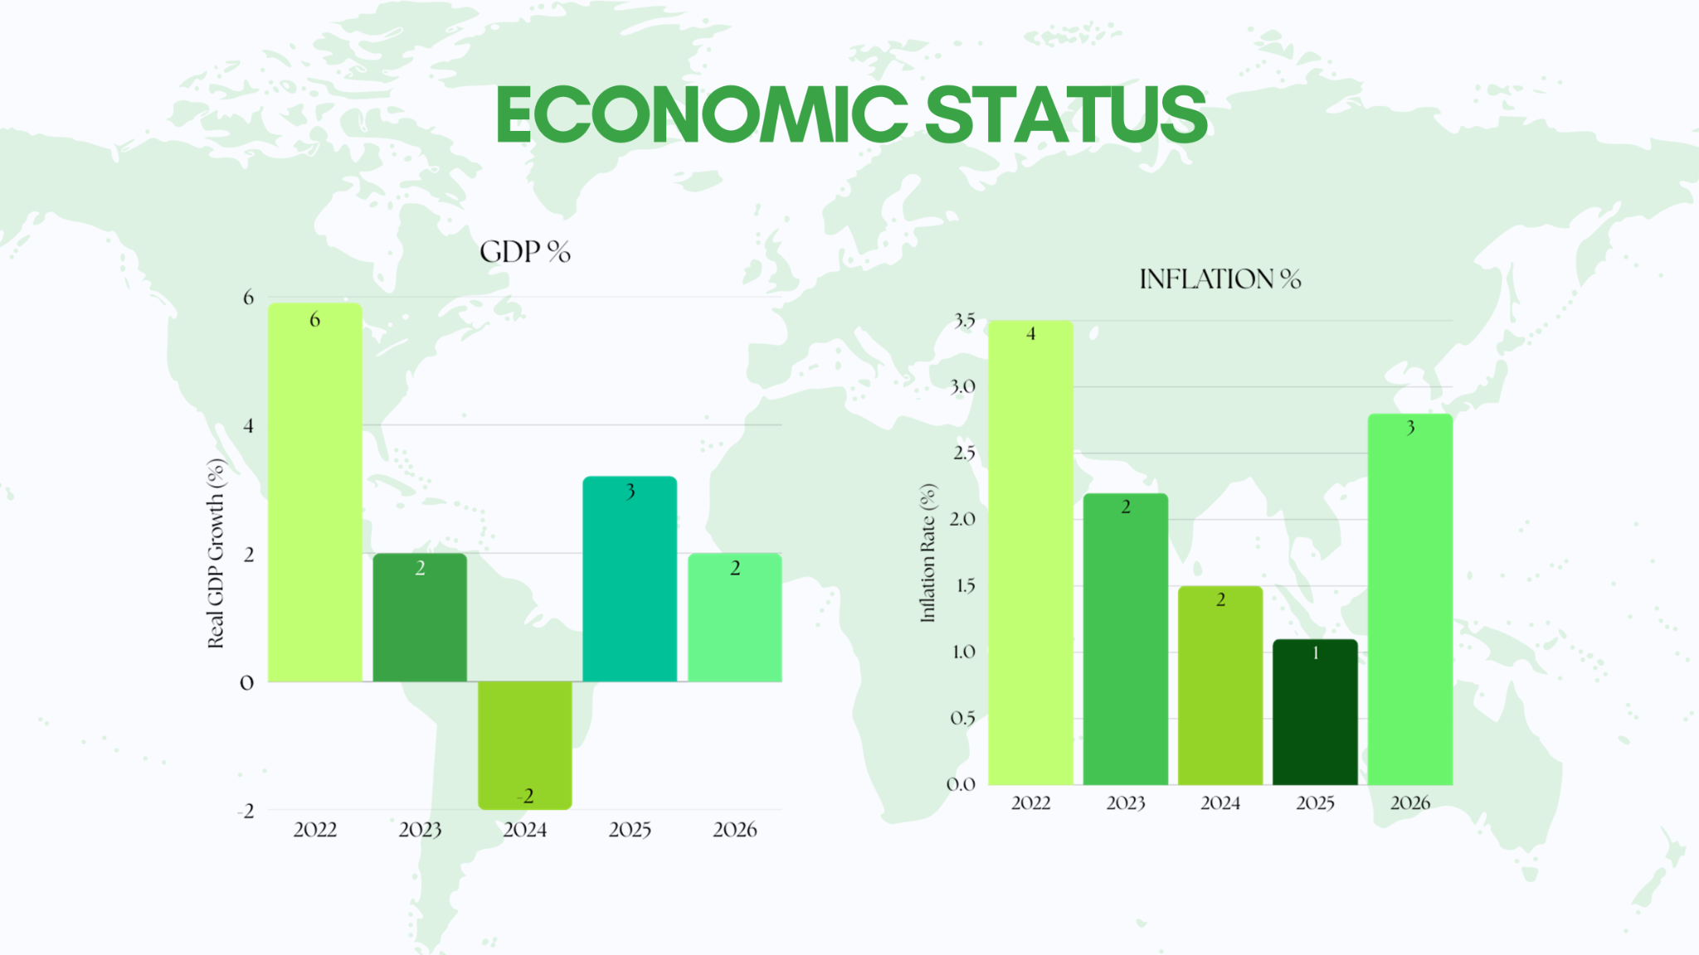
ECONOMIC STATUS

Slide 4
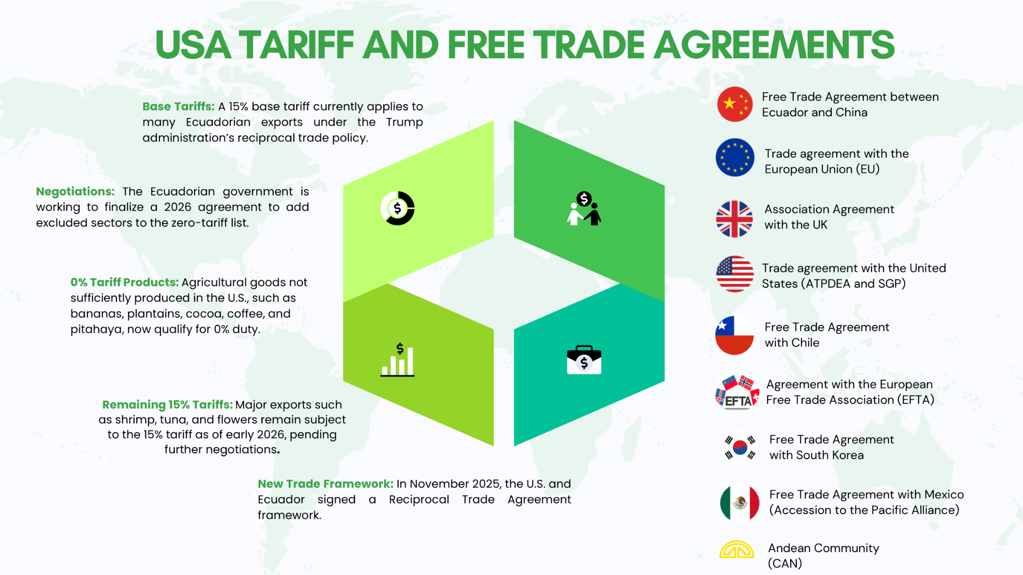
USA TARIFF - FREE TRADE AGREEMENTS

Slide 5
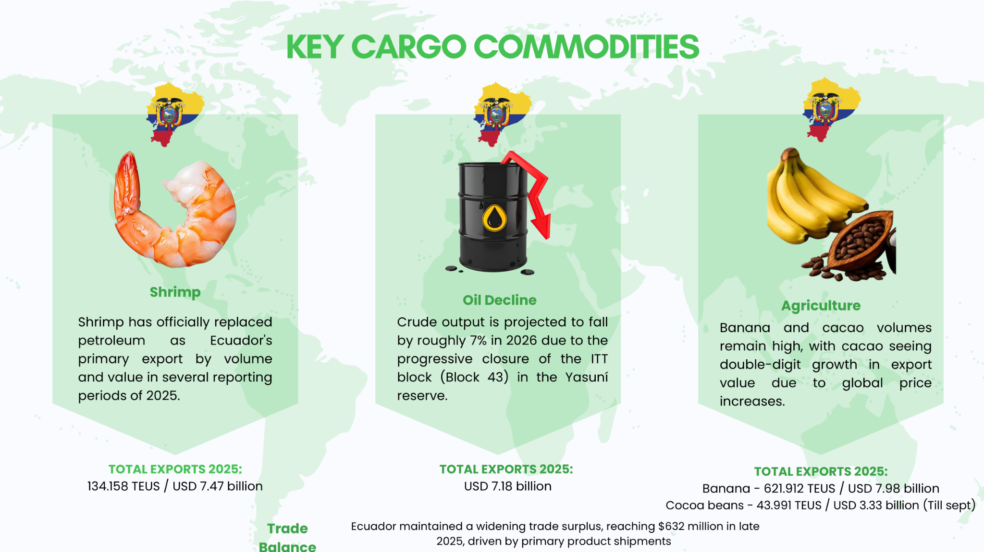

Slide 6
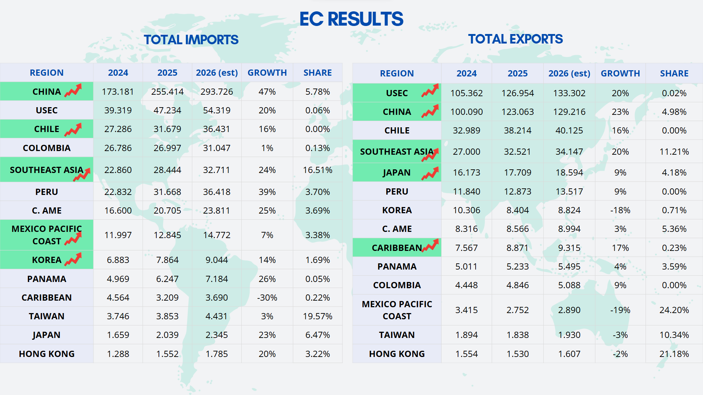

Slide 7
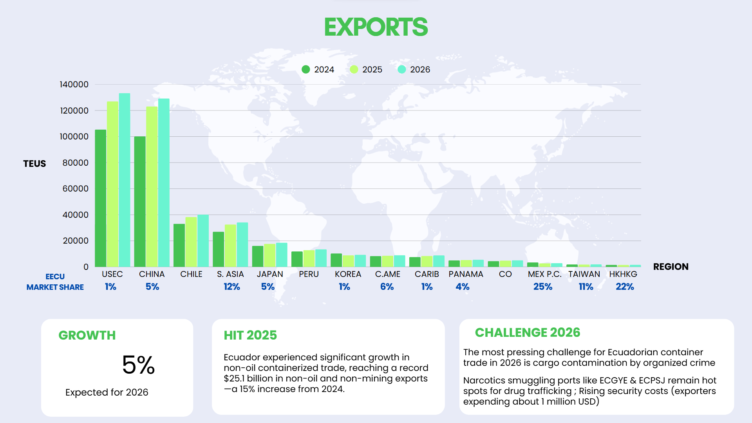

Slide 8
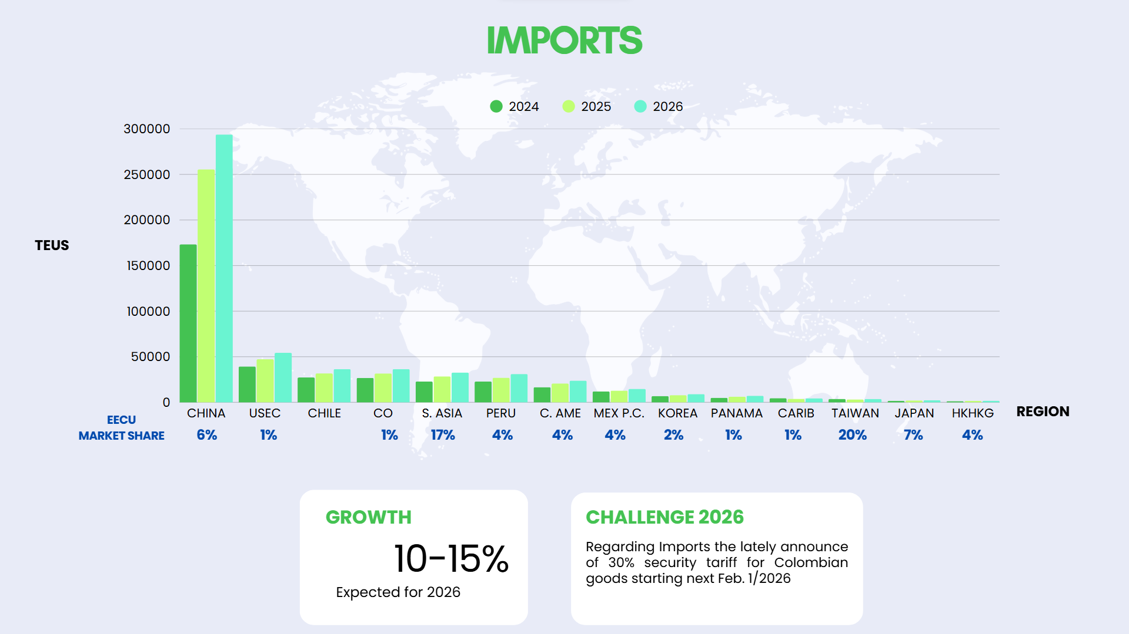

Slide 9
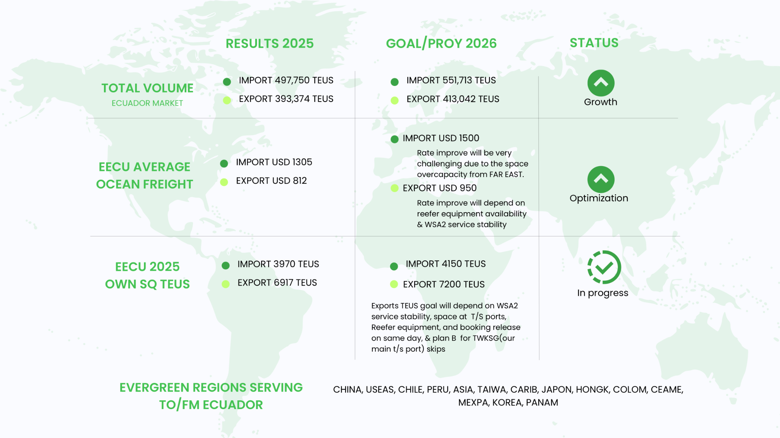

Slide 10
2025 KPI PERFORMANCE (LAD)
Trade | OWN SQ KPI (Year) | ACTUAL | %
F.E. – EC (G) | 3,163 | 4,092 | 129%
EC – F.E. (Y) | 5,408 | 5,888 | 109%

Slide 11
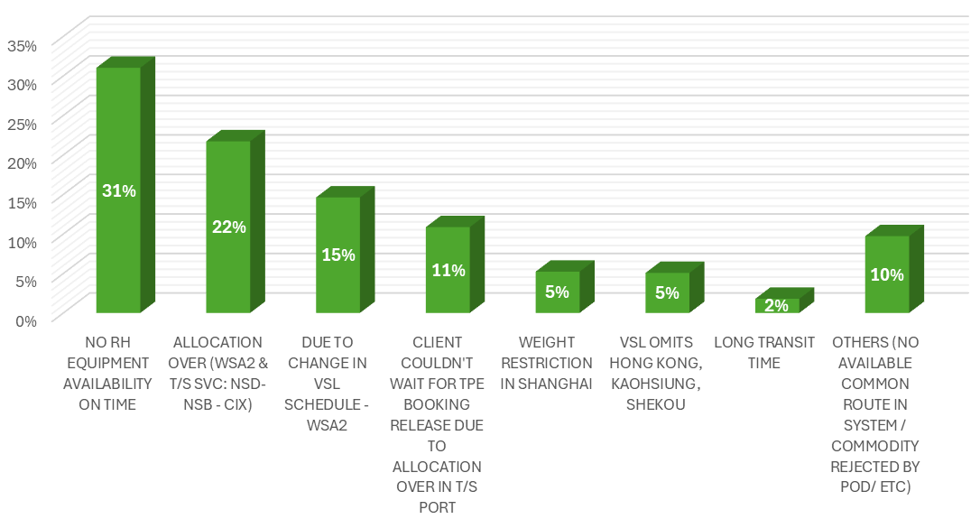
2025 Why can’t achieve KPI
LOST CARGO - 2025 (Export)
MAIN REASONS | TEUS | %
NO RH EQUIPMENT AVAILABILITY ON TIME | 380 | 31%
ALLOCATION OVER (WSA2 & T/S SVC: NSD- NSB - CIX) | 266 | 22%
DUE TO CHANGE IN VSL SCHEDULE - WSA2 | 179 | 15%
CLIENT COULDN'T WAIT FOR TPE BOOKING RELEASE DUE TO ALLOCATION OVER IN T/S PORT | 133 | 11%
WEIGHT RESTRICTION IN SHANGHAI | 64 | 5%
VSL OMITS HONG KONG, KAOHSIUNG, SHEKOU | 62 | 5%
LONG TRANSIT TIME TO: XINGANG, YOKOHAMA, ZHANJIANG, QINGDAO | 22 | 2%
OTHERS (NO AVAILABLE COMMON ROUTE IN SYSTEM / COMMODITY REJECTED BY POD/ ETC) | 119 | 10%
TOTAL | 1225 | 100%

Slide 12
2025 KPI PERFORMANCE (ELA)
Trade | OWN SQ KPI (Year) | ACTUAL | %
CAME/WCCA – EC (CW) | 293 | 460 | 156%
EC – CAME/WCCA (WC) | 283 | 919 | 324%
WCSA – EC (WS) | 34 | 79 | 232%
IMPORT

Slide 13
ECD / IMD KPI
ITEM | 2025 | 2026 KPI | Action Plan in 2026
Storage | USD 32,043 | N/A | The increase in storage costs from 2024 to 2025 is mainly driven by the terminal change and its different commercial conditions. In 2024, operations at ECGYEI included 7 free storage days for empty containers, counted only until vessel berthing regardless of volume. In contrast, ECGYET grants a free pool limited to 200 TEU, including both loading and discharge containers.
Lift on/off | USD 79,572 | USD 87,756 | We will keep monitoring and following Line instructions regarding the sale of containers.
Reposition | USD 122,675 | N/A | Empty repositioning trucking costs decreased since August 2025, due to the end of WSA4 calls at ECPSJD.
M & R | USD 169 | USD 252 | We will continue to ensure sufficient import volume to cover our export demand to avoid the need to repair units.

Slide 14
OCD / OPD KPI
ITEM | 2025 | 2026 KPI | Action Plan in 2026
BOA | 100% | <4 hrs | Since only one of WSA2's own vessel berths at ECGYE, we will keep monitoring the performance and communicate with ELA/OPS and TPE/OPS any news.
Port Stay | 100% | <62 hrs | Since only one of WSA2's own vessel berths at ECGYE, we will keep monitoring the performance and communicate with ELA/OPS and TPE/OPS any news.
Productivity | 80% | >60 moves per hour | Since only one of WSA2's own vessel berths at ECGYE, we will keep monitoring the performance and communicate with ELA/OPS and TPE/OPS any news.
ITEM | 2025 | 2026 KPI | Action Plan in 2026
Incentive | N/A | N/A | There is no incentive negotiated with Contecon based on discharging/loading movements.
Empty Storage | USD 12,076.32 | N/A | We will continue to work closely with partners to keep container movements smooth and improve overall efficiency
Rate Reduction | N/A | N/A | The WSA2 has only one ship and calls at Contecon terminal. After deploying the F‑type vessel and increasing slot capacity, we’re actively seeking a volume incentive to improve efficiency and revenue.

Slide 15
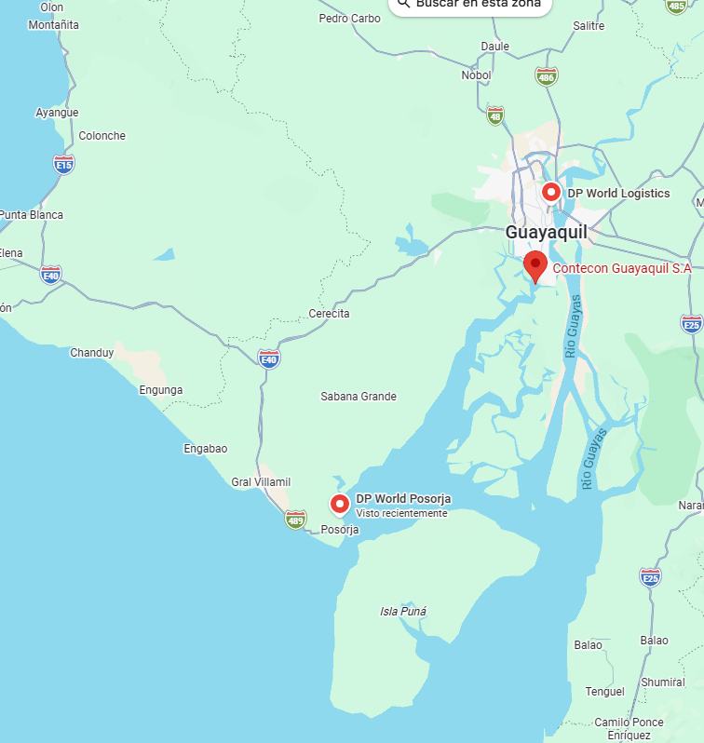
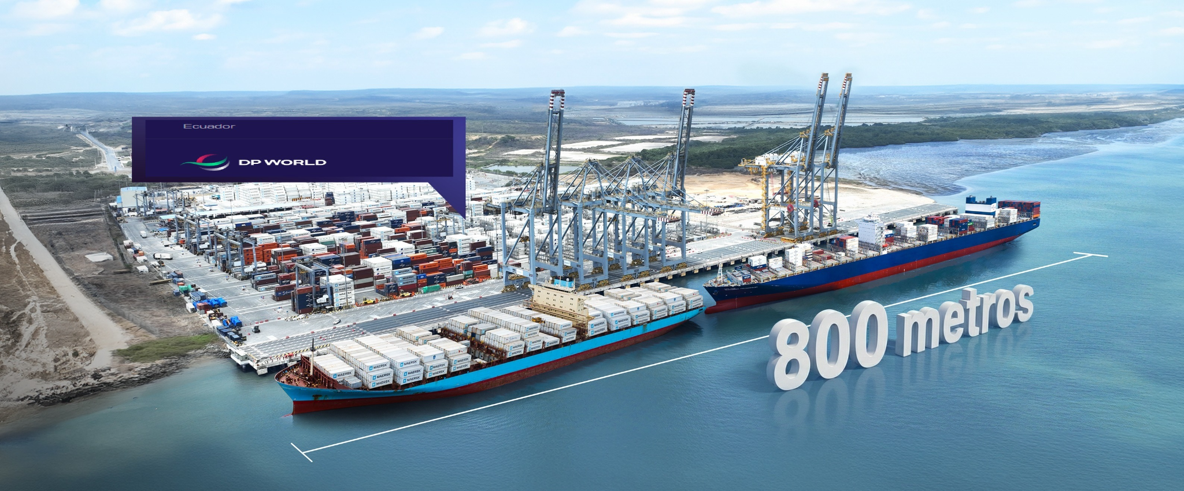
TERMINAL INFORMATION: DPW POSORJA
Currently, DPW berth has 467.5 meters and will reach the first 700 meters in April 2026, while the additional 100 meters will be completed by the end of October.
Two additional gantry cranes will be incorporated to support operations at the expanded berth.

Slide 16


2026 Strategy
How to Achieve KPI Goals

Slide 17


HOW TO ACHIEVE 2026 OWN SQ?
Trade | Target (Year)
F.E. – EC (G) | 3,312
EC – F.E. (Y) | 7,440
Trade | Target (Year)
CAME/WCCA – EC (CW) | 258
EC – CAME/WCCA (WC) | 628
IMPORT

Slide 18
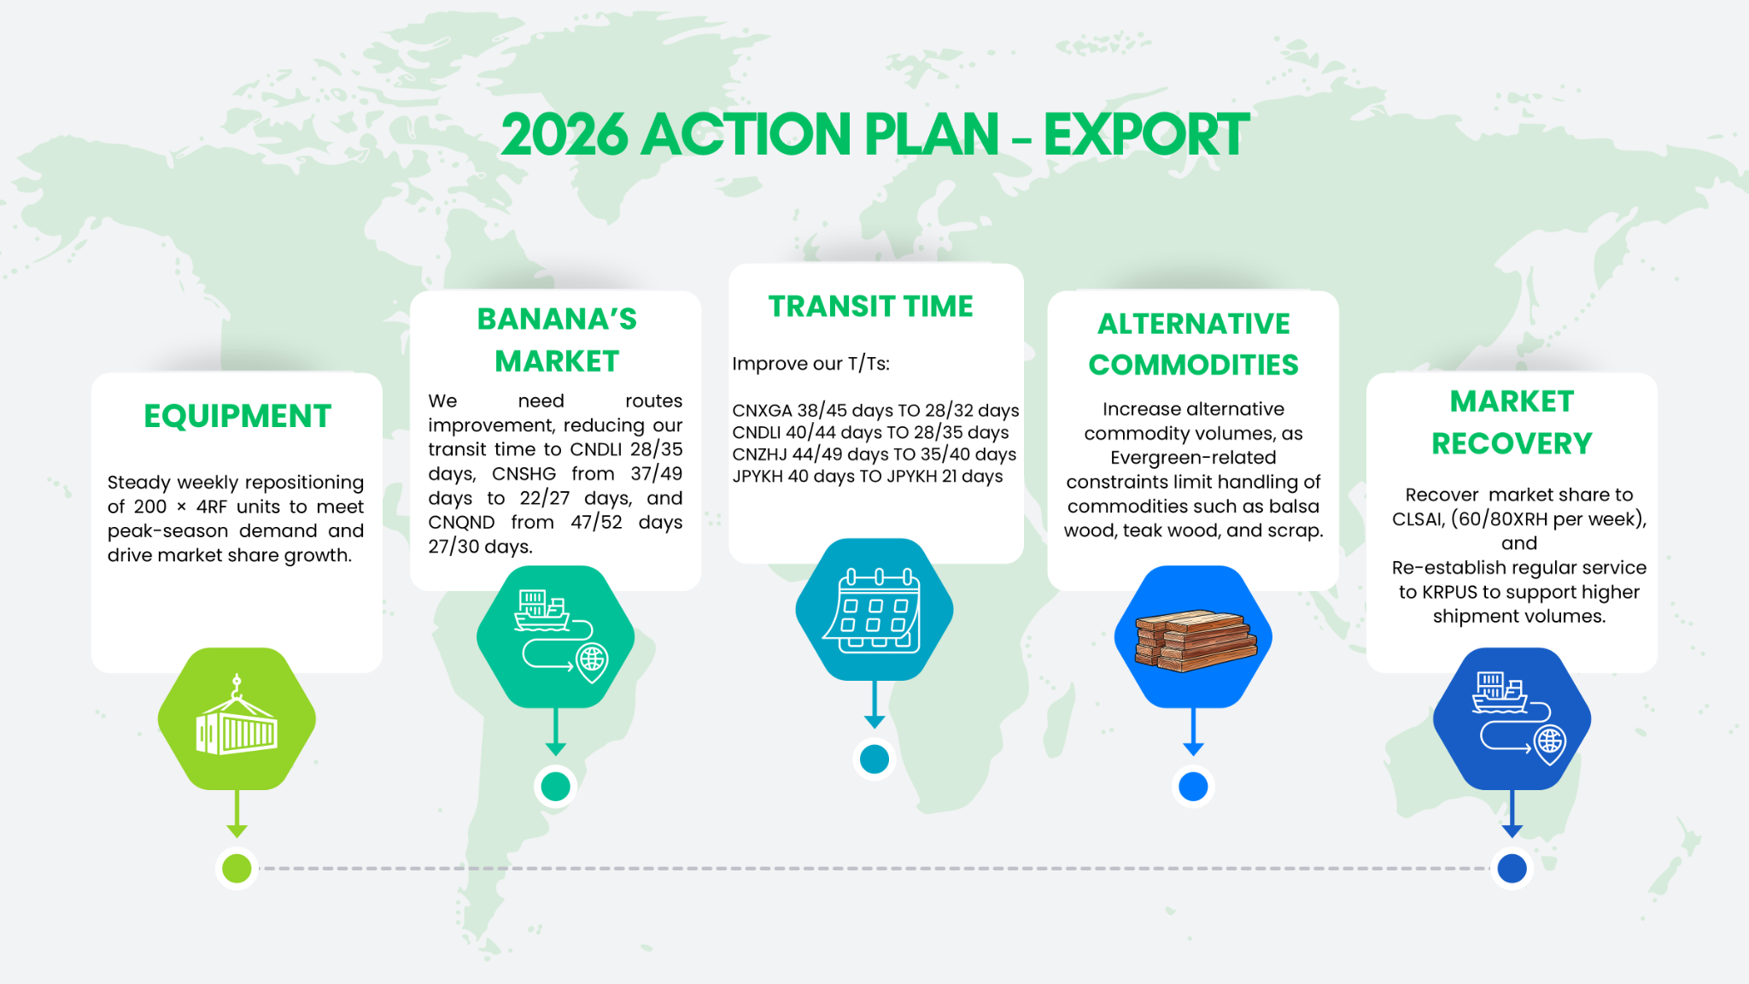

Slide 19
