Slide 1


Business Report
2026 LATIN AMERICA AGENCY MEETING

Slide 2









AGENDA
Economic Status
Cargo Flow
GDP Forecast , Inflation , USA Tariff
Import/Export
2025 KPI
Operations KPI
Performance Review (LAD/EGA/ELA)
ECD/IMD & OCD/OPD Review
2026 Goals
Strategy & Targets

Slide 3

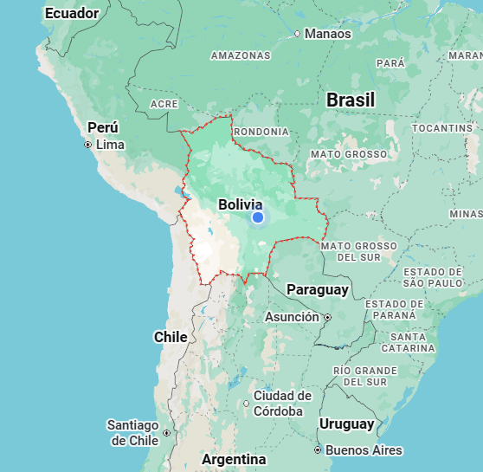
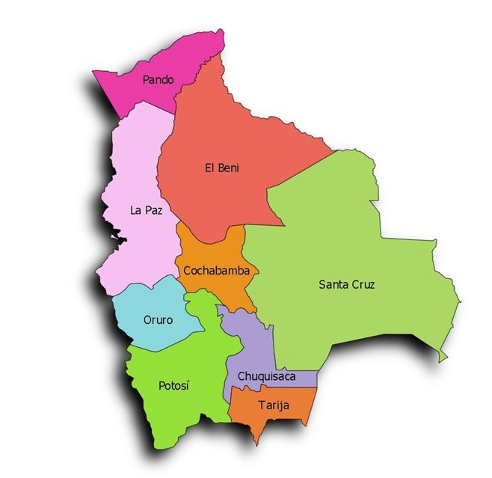
Bolivia Market Introduction
Plurinational State of Bolivia
1. Population 12.58 million
2. Territory 1,098,581 sqm
3. GDP growth 1.50%
4. GDP per capita $4,590
5. Exports $5,776 million
6. Imports $7,220 million
7. Inflation rate 20%
8. Currency Official 6.96 / Blue 9.3
9. Trade policy Open market
Export promotion
Zero import tariff (2026)

Slide 4
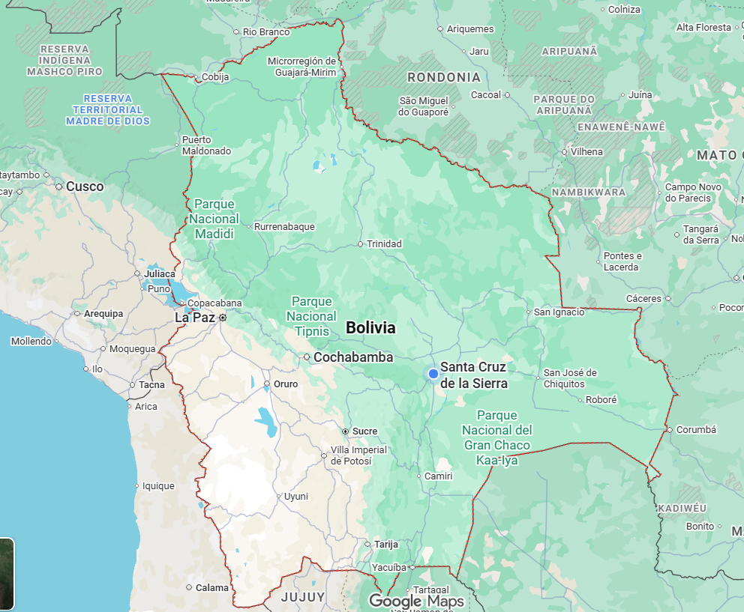
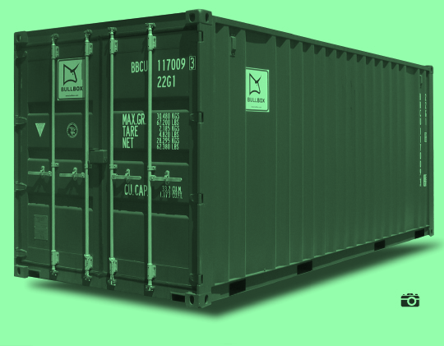


Bolivia Market Introduction
Main Export Commodities
Brazil nuts
Wood
Almonds
Minerals:
Zinc, Silver, Tin
Coffee
Leather
Soy & derivatives
Frozen beef
Chia
Mineral
Sugar
Leather
Wood
La Paz
Cochabamba
Santa Cruz
Oruro
de la Sierra
Minerals:
Zinc, Silver, Tin
Quinoa
Potosí
Quinoa

Slide 5
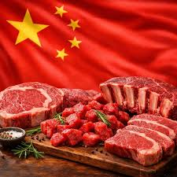
Bolivia Market Introduction
Throughput Bolivia 127,360 TEU
In TEU
53% IMPO
47% EXPO
ARICA
75%
IQUIQUE
25%
ARICA + IQUIQUE
Over 2,000
Reefer/year - Asia

Slide 6
Bolivia Market Introduction
Market share
by Shipping Line
FE SHIPPING LINE SERVICES
MSC 🡪 ALPACA | INCA
MAERSK 🡪 ATACAMA
HAPAG LLOYD 🡪 AN1 | AN2 | PEX2
ONE 🡪 ALX1 |ALX2
CMA CGM 🡪 ACSA2 | INCA
COSCO 🡪 WSA2

Slide 7
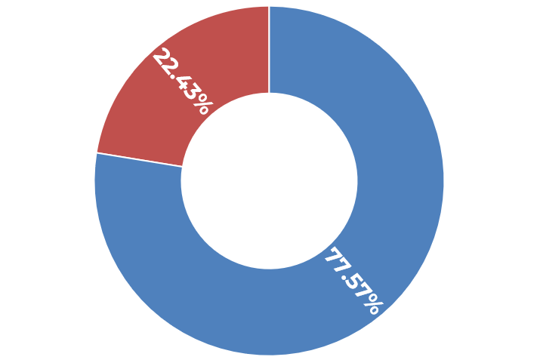
Bolivia Market Introduction
EXPO
FE
WS
CHINA OTHERS
COLOMBIA ECUADOR PERU

Slide 8
Bolivia Market Introduction
IMPO
WS
CHINA OTHERS
COLOMBIA ECUADOR PERU

Slide 9

Bolivia Market Introduction
O/O Service only. Trucking under merchant´s costs
Empty Drop-Off in Bolivia important for exports
21 free days DM/DT by law
Arica offers 365 days free import storage. “ASPB” - clearance at Arica port
Iquique offers 30 days free import storage no “ASPB” clearance at the border
D&D insurance collected by STME, covers container damage up to $2,000

Slide 10
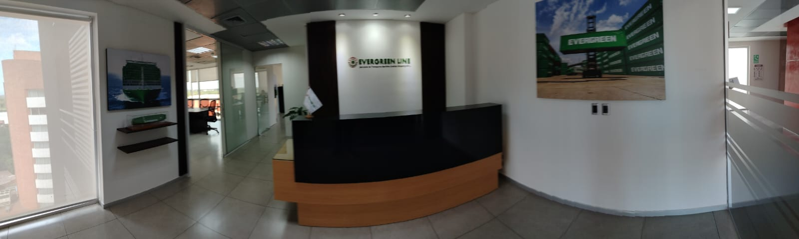
Bolivia Market Introduction
Target Indicators (2026 – 2030)
Export Growth 🡪 8% – 12%
Import Growth 🡪 2% – 4%
Trade Balance 🡪 Surplus (+$1.5B / year)
Primary Driver 🡪 Mining and Industrial Agribusiness

Slide 11
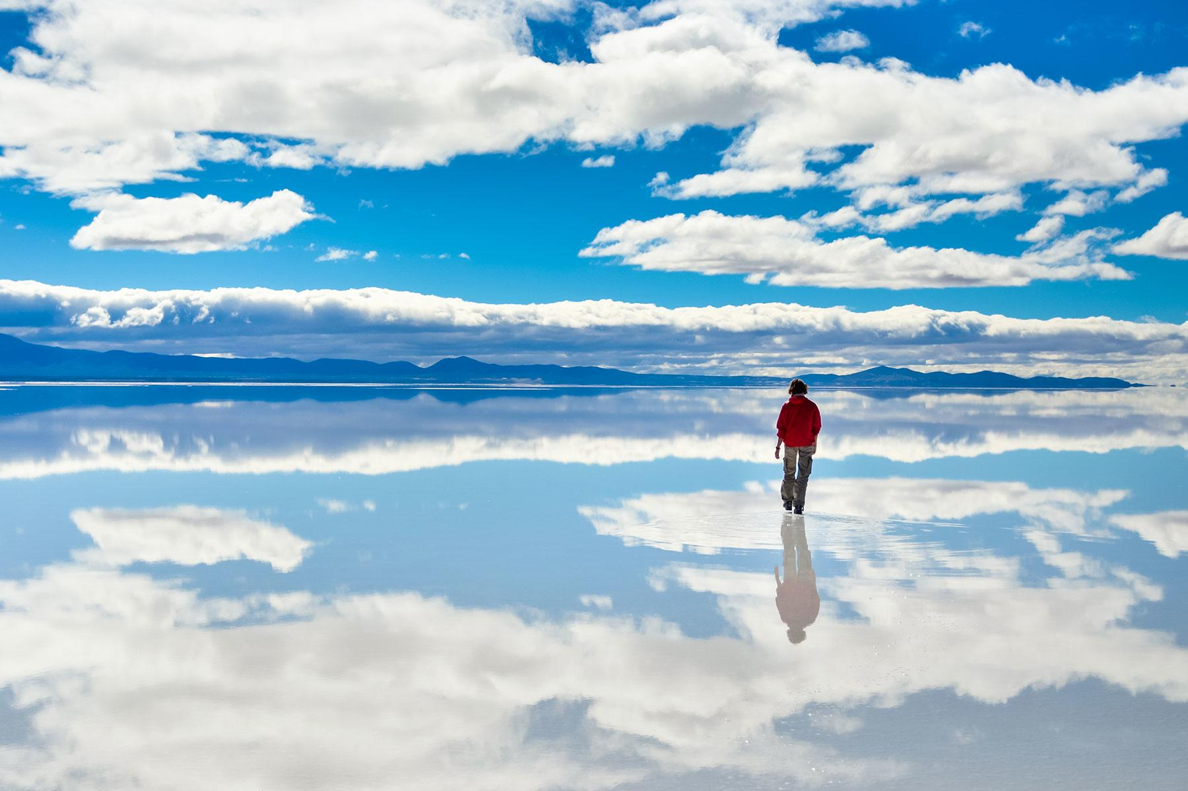
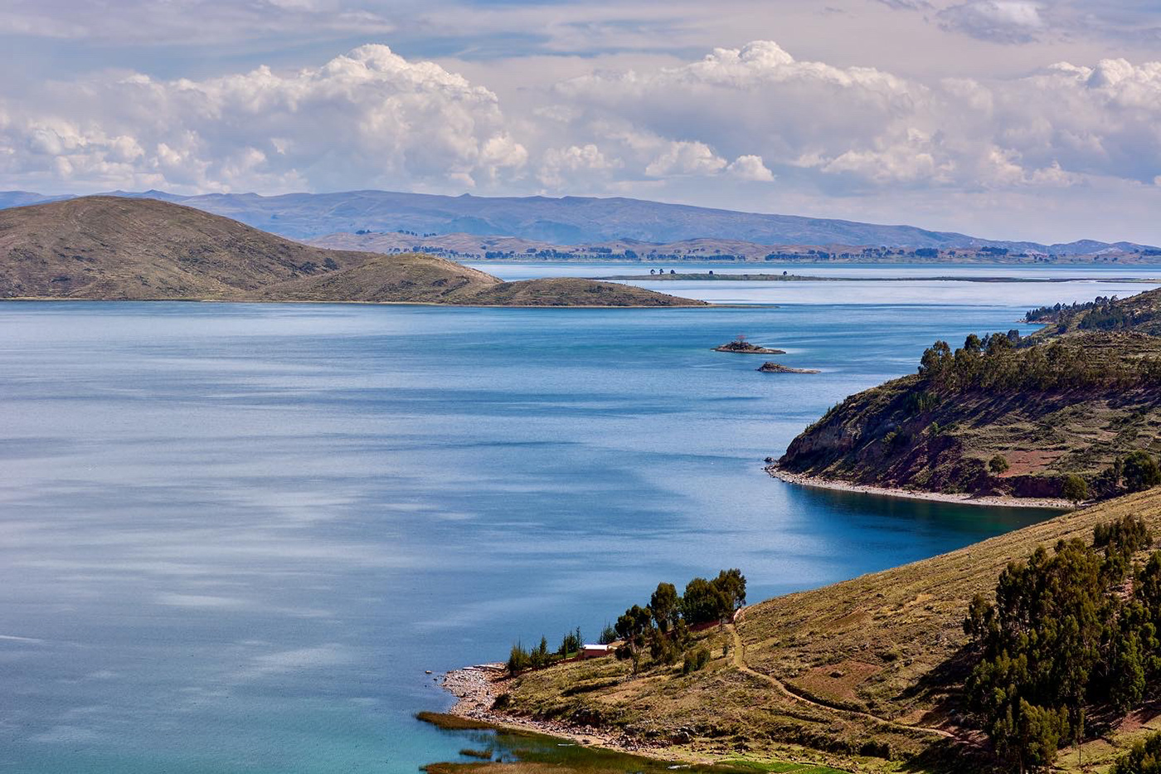
THANK YOU
Salar de Uyuni
Titicaca Lake

