Slide 1




PERÚ
2026 LATIN AMERICA
AGENCY MEETING
Sao Paulo, March 26-27

Slide 2

Perú Outlook
Cargo Flow
2025 KPI
Operations KPI
2026 Strategy
Q&A

Slide 3

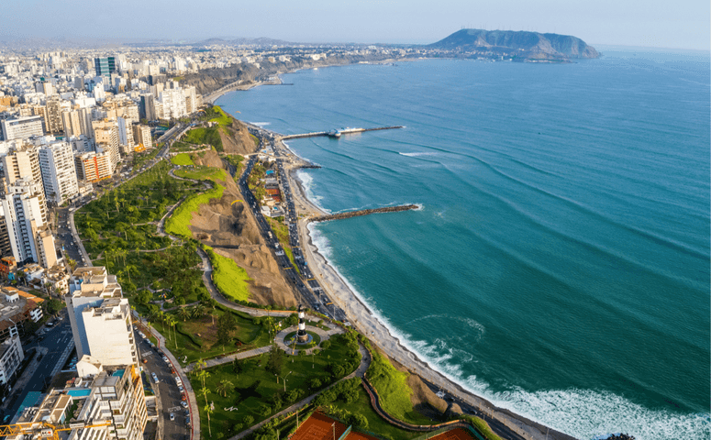
1.
Perú
Outlook

Slide 4

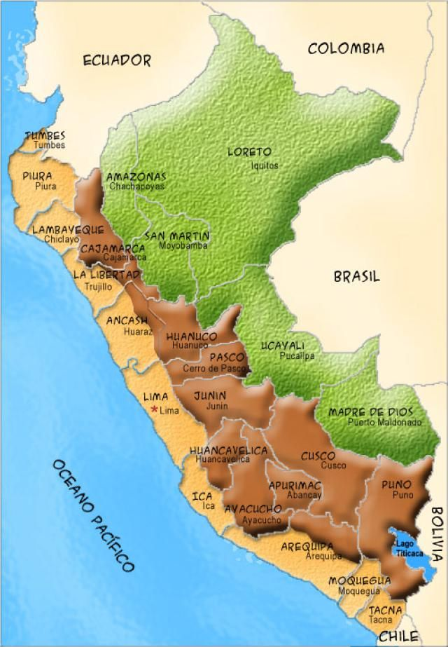


35 times TW
1´258,215
35 million
Capital: Lima
90 microclimates
World #1 exporter: fishmeal, fishoil, grapes, blueberries
Mining country
Machu Picchu
World famous gastronomy
3,000 varieties of potato
Best Chocolate Award 2025
75% world's alpacas
*Source: World Bank, Central Bank
‹#›

Slide 5
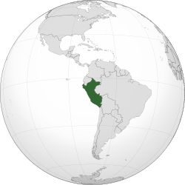
GDP Forecast 2026
3.2% according to Central Bank
Source: IMF, Central Bank

Slide 6

ECONOMIC STATUS – Why positive for 2026?
Inflation
below 2%
Stable currency
Private investment ongoing
22 FTA agreements
mineral prices boost up
❓
USA zero tariff for 100 agricultural products
General Elections
April 2026

Slide 7

2.
Cargo
Flow
Import
Export

Slide 8
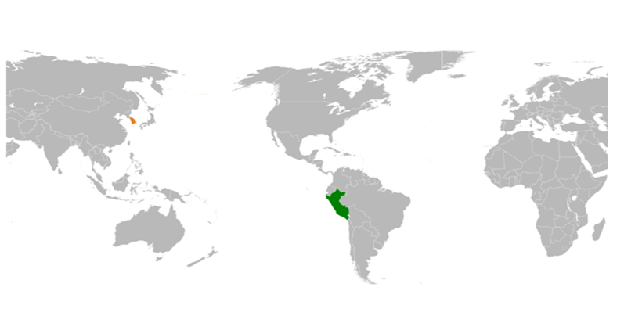

2025 PERU THROUGHPUT (Laden only)
2.04M TEU Laden +18% vs 2024
191,000 RH export unit +27% vs 2024 (80% USA+EUR)
NAME 16%
EUR 14%
FAR EAST
46%
CAME +CARI 7%
OTHERS 5%
WCSA 11%
Source: Qeneto

Slide 9
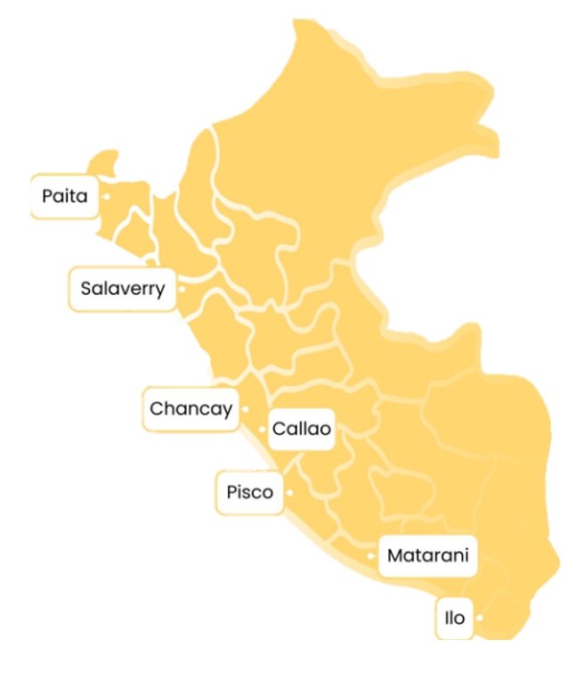
2025 PERU PORTS: Throughput 4´203,855 TEU
Figures include laden, empty and t/s
+21% vs 2024
10%
885 km
467 km
8%
APMT 30%
65 km
DPW 49%
CALLAO
2%
204 km
0.2%
787 km
*Without Chancay could be 19%
954 km
‹#›
Source: APN

Slide 10



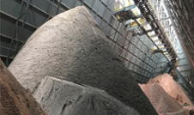






2025 Top EXP Commodities – TEU per year
Agricultural
336K TEU
Minerals
160K TEU
Fishmeal, Fish oil & Frozen Seafood
142K TEU
42% USA
38% EUR
70% ASIA
7% USA
5% EUR
75% ASIA

Slide 11
EPE 2018-2025 (TEU) LADEN
EPE 2018-2025 (TEU)

Slide 12

2025 MARKET SHARE CALLAO - ASIA
LADEN / TEU
22.4%
18.2%
11.3%
10.5%
9.9%
8.4%
4.8%
4.7%
4.5%
2.3%
3%
OTHERS
Source: Qeneto

Slide 13
2025 MARKET SHARE ASIA - CALLAO
LADEN / TEU
18.6%
14.9%
12.5%
10.5%
10.2%
8.4%
7.4%
6.8%
5.1%
3.6%
2%
OTHERS
Source: Qeneto

Slide 14

EPE 2025: Where we stand?
EPE 2018-2025 (TEU)
139,104 TEU throughput
43% export
57% import
Asia trade:
90% exports
75% imports
PE market +18% EPE +44%
#1 TOP Carrier Asia (Callao)
Fishmeal share #1 = 40%
2026 Budget: 141,000 TEU

Slide 15
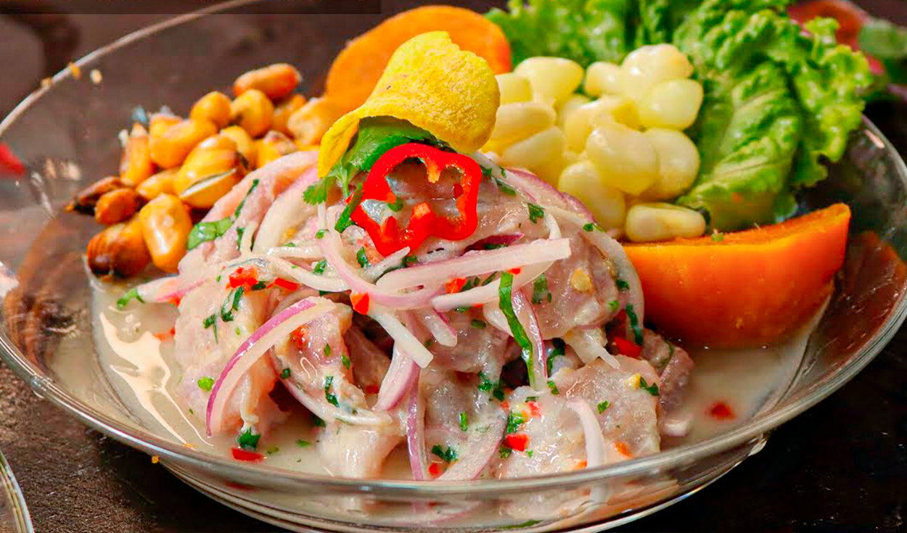
3.
2025 KPI
Performance
Review

Slide 16

2025 OWN SQ PERFORMANCE
OWN SQ | IMP/EXP |  | TRADE |  | 2025/1~12 Target TEU | 2025/1~12 Actual TEU | 2025/1~12 Achieve
EPE | IMP (TEU) |  | G |  | 15,682 | 18,396 | 117%
 |  |  | CW |  | 690 | 793 | 114%
 | EXP (TEU) |  | Y |  | 44,336 | 52,605 | 119%
 |  |  | WC |  | 1,838 | 1,948 | 105%
 | IMP + EXP (TEU) |  | WS |  | 2,609 | 3,693 | 159%
TOTAL TEU |  |  |  |  | 65,155 | 77,435 | 119%
REEFER (UNIT) |  |  |  |  | 1,910 UNIT | 2,603 UNIT | 133%

Slide 17
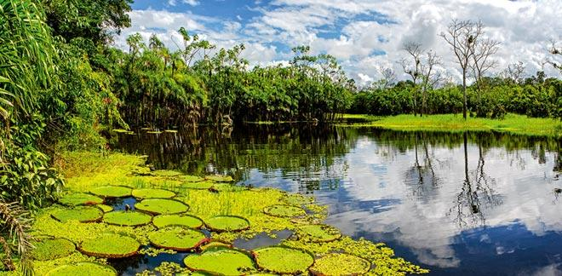
4.
Operations
KPI
ECD/IMD &
OCD/OPD
Review

Slide 18


ECD / IMD KPI 2025
ITEM | TARGET | ACTUAL | KPI | Action Plan in 2026
Storage | $24 | $4 |  | Empty pool control, TS connection monitoring.
Lift on/off | $6,804 | $4,655 |  | Promote container sell.
Reposition | $71,365 | $27,317 |  | Repo cost PECHY <-> PECAL = $ 413.
M & R | $87,131 | $81,467 |  | 2025 export demand increased 37%. Mín. repair.
ITEM | TARGET | ACTUAL | KPI | Action Plan in 2026
90% Onboard within 7 Days | 90% | 72% |  | Monitoring the connection on time.
No Personal Negligence | 0 | 0 |  | Achieved

Slide 19
OCD / OPD KPI 2025
ITEM | TARGET | ACTUAL | KPI | Action Plan in 2026
BOA | 85%/95% | 100%/98% |  | Monitor arrival according the berth window.
Port Stay | 97% | 100% |  | Push Terminal for more resources in case needed.
Productivity | 72.6 mph | 84 mph |  | Continue sending the information in advance for stowage plan.
ITEM | TARGET | ACTUAL | KPI | Action Plan in 2026
Incentive | $ 0 | $ 660,287.00 |  | LAR discounts to terminal when repo out of deadline.
Empty Storage | $ 0 | $ 41,362.66 |  | Storage bonus for Transshipments and mty containers.
Rate Reduction | $ 0 | $ 26,415.46 |  | Request discount in our new negotiations with Terminal.

Slide 20
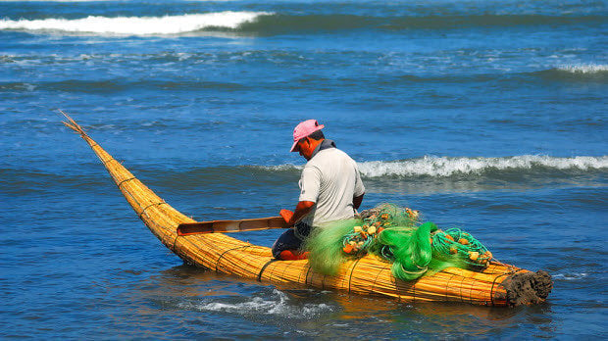

5.
2026
Strategy
How to Achieve KPI Goals

Slide 21



2026 ACTION PLAN - OWN SQ ASIA
Y = TO ASIA
54,6K TEU
FISHMEAL 18,7K TEU
MINERAL 24 K TEU
REEFER 5,6K TEU
OTHERS 6K TEU
EXALMAR, TASA, AUSTRAL, DIAMANTE, CHINALCO, IXM, CORP. FORTUNA, SUNFRUITS, ESMERALDA,VANGUARD-WESTFALIA
RETAIL 8K TEU
CARS 4,6K TEU
TIRES 0.8K TEU
APLIANCES 0.5K TEU
FAK 4K TEU
G = FROM ASIA
17,9K TEU
•INTERCORP 5.5K TEU
•RIPLEY 2,5K TEU
•JETOUR 4,6K TEU
•FAK 3,6K TEU

Slide 22
2026 ACTION PLAN - OWN SQ REGIONAL
CW= CAME-PE
700 TEU
FOODSTUFF 360 TEU
SUGAR 200 TEU
WHITEWOODS 150 TEU
FAK 150 TEU
CW: MABE, C&B LOGISTICS, LABOCER, DELICORP, ADICORP.
WC= PE-CAME
1,797 TEU
COAL 550 TEU
FOODSTUFF 450 TEU
REEFER 350 TEU
FAK 400 TEU
WC: ESMERALDA, CARBOMINERALES, LA ESTRELLA, ULEXANDES, S&M FOODS.
FOODSTUFF 630 TEU
DETERGENT 200 TEU
PAPER 650 TEU
WITHEGOODS 650 TEU
AVOCADO 350 TEU
WS: MABE, INTERCORP (SUPERMERCADOS PERUANOS), BAIKA, EXPEDITORS, SOFTYS, OPP FILM.
Intra WSA
3,711 TEU

Slide 23

2SD inventory
Maintain 40HQ inventory
4NOR/live reefer
Reliable schedule for reefer
Faster
connections to S.E.A.
Plugs on
WSA5 (Chancay)
Possible Costal Service in WCSA ??

Slide 24

2026 EPE Control
Unclaimed cargo
Outstanding
DMDT collection
ZERO non conformity

Slide 25




2026 EPE Additionals
Local charge: R244015 – ADM Container
USD 500k/year
Local charge Delivery order
USD 450k/year
Port Agency manifest data USD 20k/year
USD 970,000 additional revenue estimated for 2026

Slide 26
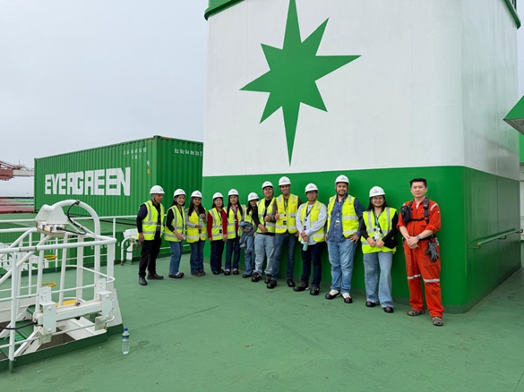
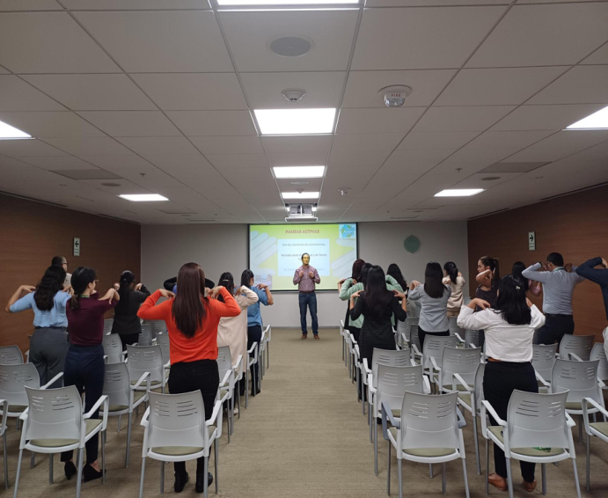
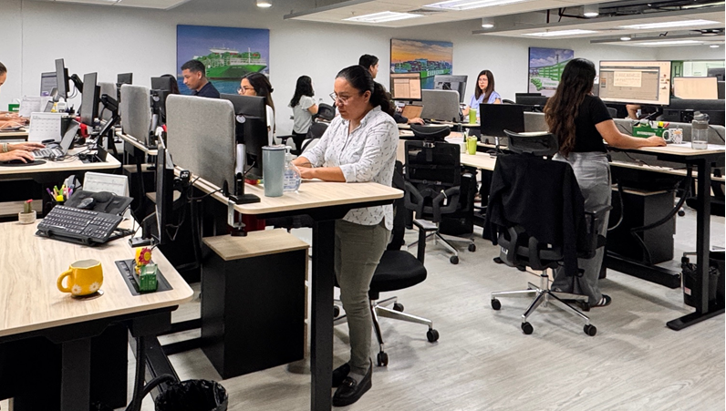
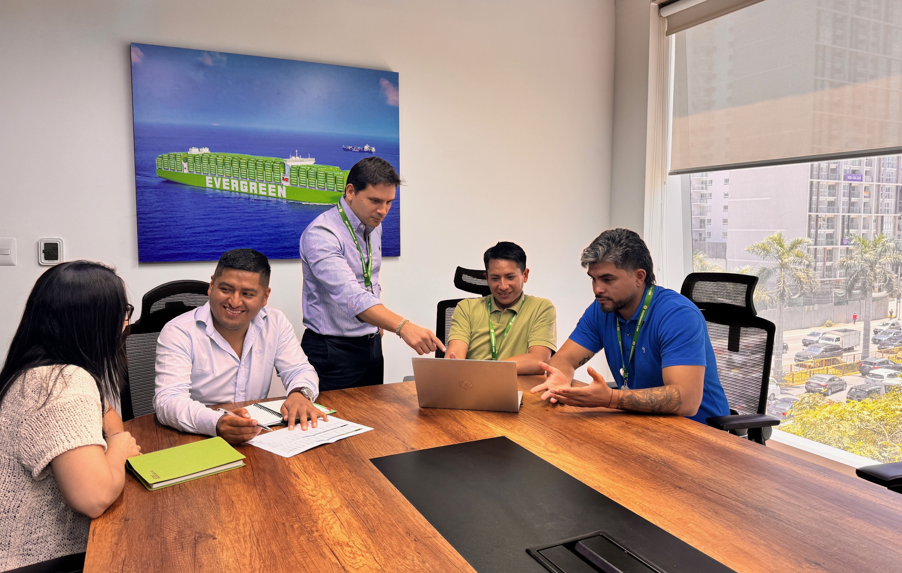
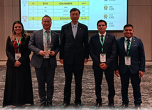

Professional
Integrity
Sustainability
Communication
Outstanding results
PISCO

