Slide 1


Slide 2





01
Economic Status
AGENDA
02
Cargo Flow
03
2025 KPI
04
Operations KPI
05
2026 Goals
GDP Forecast , Inflation , USA Tariff
Import/Export
Performance Review (LAD/EGA/ELA)
ECD/IMD & OCD/OPD Review
Strategy & Targets

Slide 3


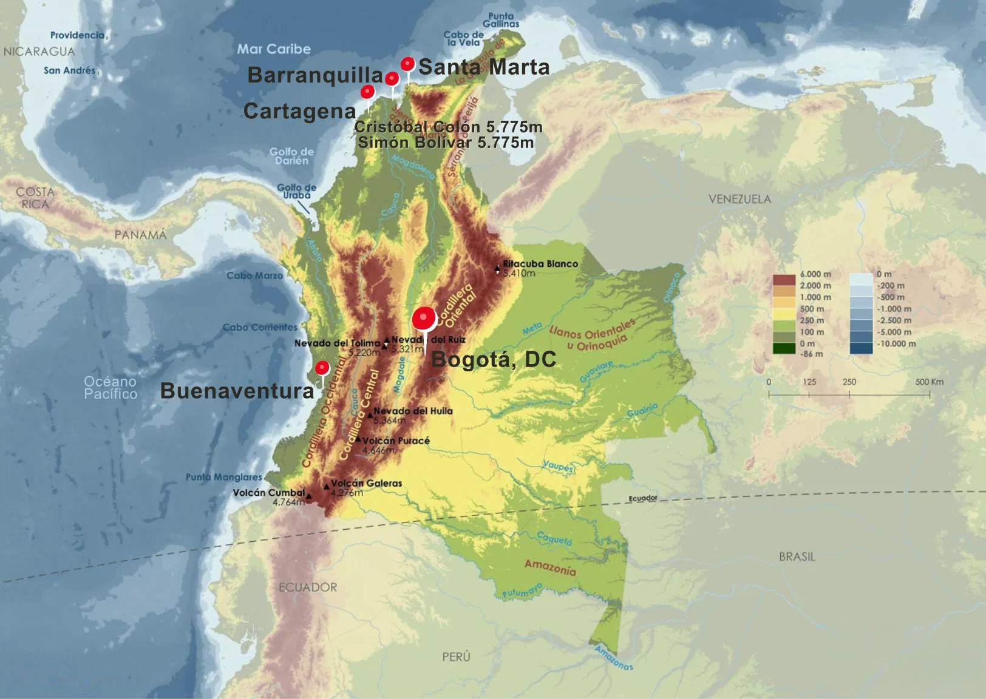
COLOMBIA AT A GLANCE
AREA
1.14M. Km2 (World 25)
POPULATION
52.7M (World 28)
CAPITAL
Bogotá
LIFE EXPECTANCY
77.23y. Avg (World 62)
LABOR FORCE
39.25M (World 28)

Slide 4

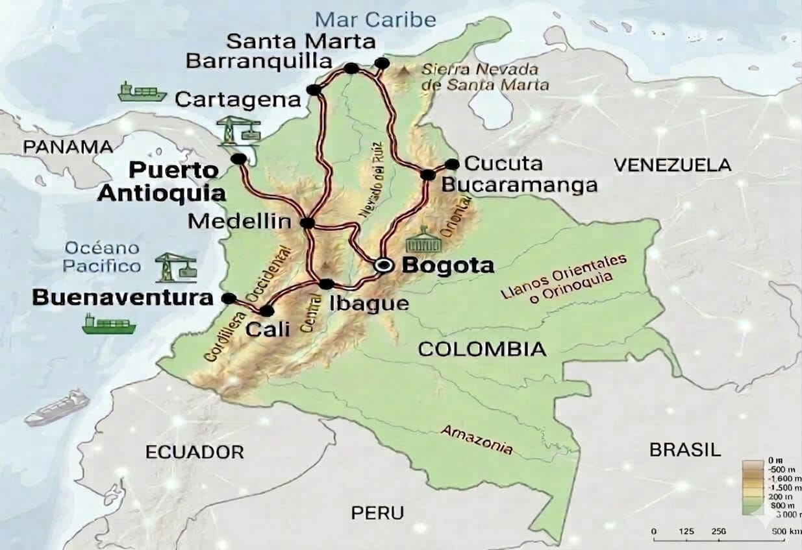
DISTANCES AMONG MAIN INLAND CITIES
ROUTE (Origin - Destination) | Distance | Approximate Time
Buenaventura - Cali | 120 Km | 5 hours
Buenaventura - Bogotá | 500 Km | 24 hours
Buenaventura - Medellín | 490 Km | 18 hours
Cartagena - Bogotá | 980 Km | 30 hours
Cartagena - Medellín | 650 Km | 20 hours
Barranquilla - Bogotá | 1,000 Km | 32 hours
Barranquilla - Medellín | 710 Km | 22 hours
Santa Marta-Bogotá | 950 KM | 26 hours
Santa Marta-Medellín | 830 KM | 24 hours
Puerto Antioquia - Bogotá | 729 Km | 24 hours
Puerto Antioquia- Medellín | 312 Km | 10 hours
Buenaventura - Cali → 120 Km Time:5 hours
Turbo - Bogota → 729 Km Time:24 hours

Slide 5






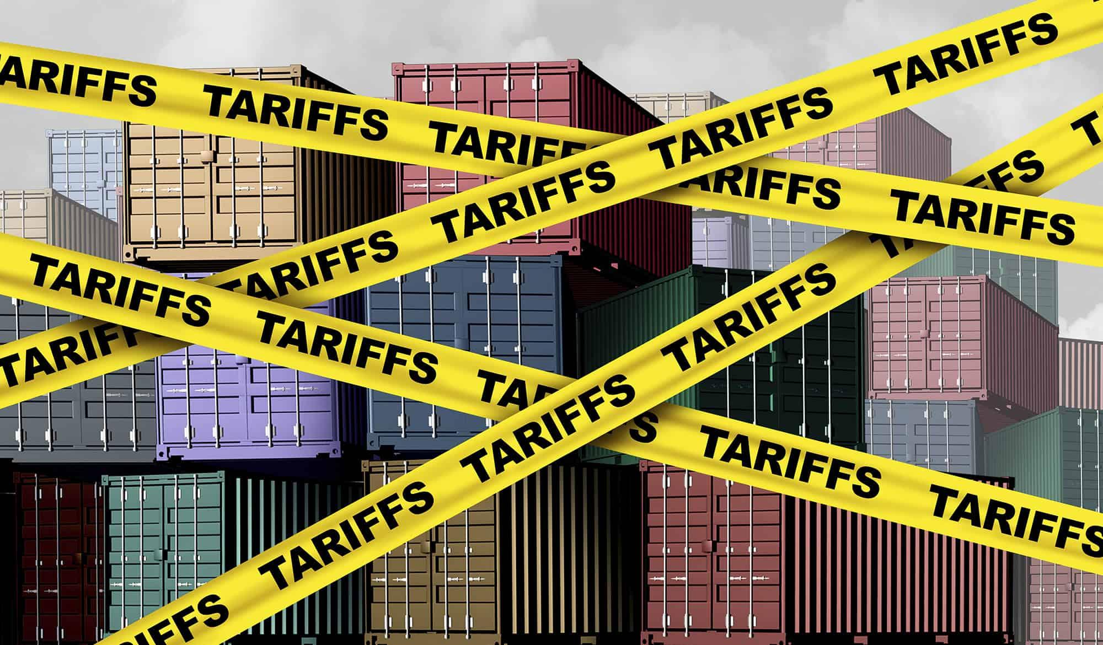

ECONOMIC STATUS
2025
INDICATORS
GDP
STOCK MARKET
Ex. Rate
INFLATION
MONETARY POLICY
UNEMPLOYMENT
FOREIGN TRADE
2.6%
External Debt
Household and public consumption
Employment
5.1%
Decreased Trend
43.8%
Growth
9.25%
Interest Rate
8.9%
Historically lowest rate
$4.052COP
Average
+21.6% - Outbound
Non energy & Mining
+8.5% - Inbound
All markets
2026 ESTIMATIONS
2.7% to 3.2%
6.5% to 6.7%
11.25%
$3.830COP
PRESIDENTIAL ELECTION YEAR
Mar/Jun
FISCAL RULE & EXTERNAL DEBT BEHAVIOUR
FOREIGN POLICY & DIPLOMATIC RELATION
US-EC-VE

Slide 6
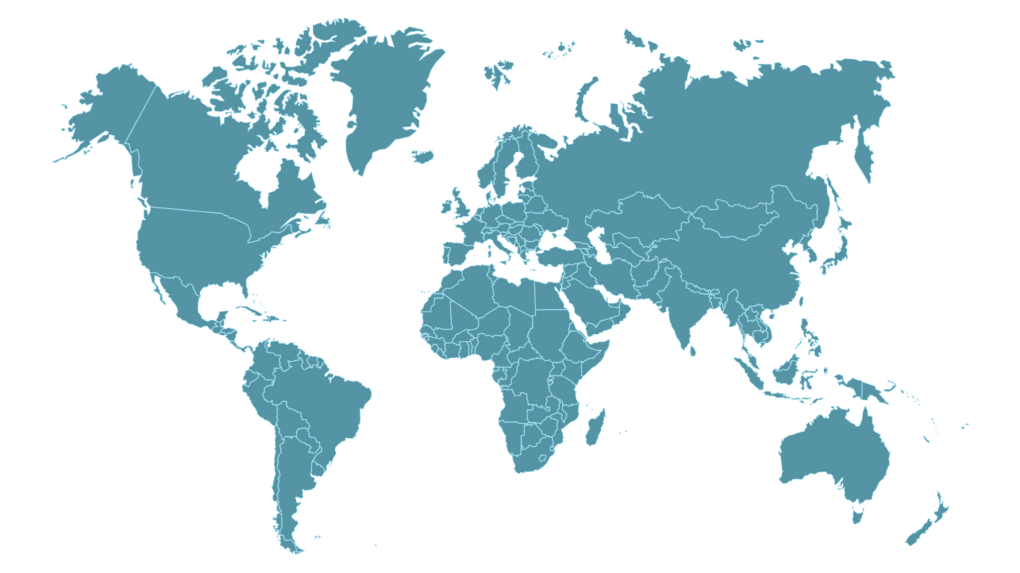





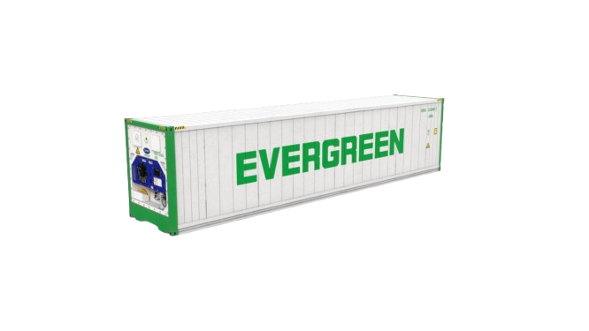


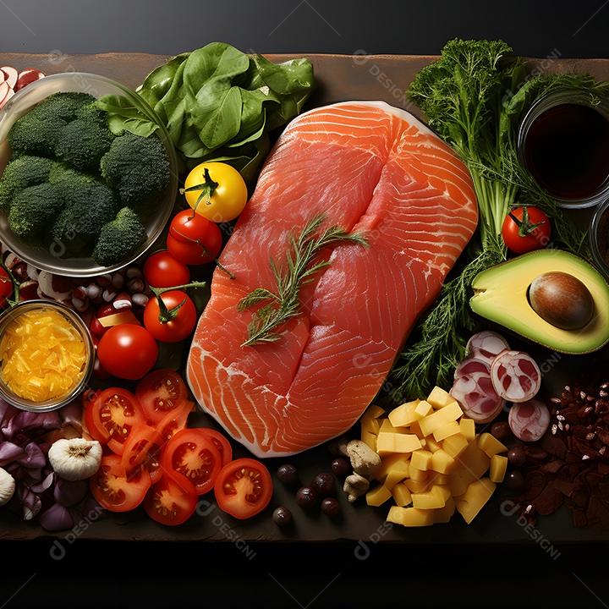
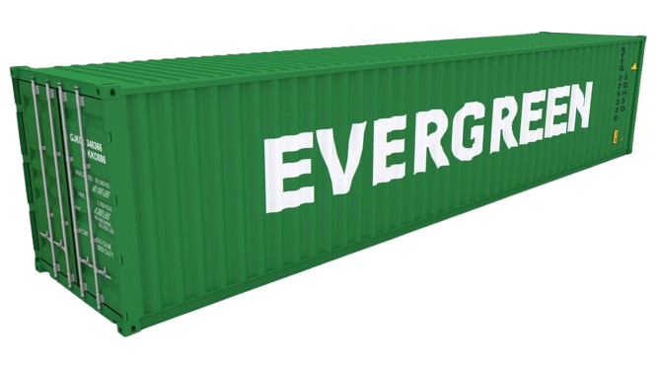
2025 COUNTRY CARGO FLOW STATUS
Thousand teus by region
COLOMBIAN MARKET
2.051.788 Teus
(24%)
(16%)
(16%)
(11%)
(7%) - 143.966
NAME 390 (9%)
IN 188 (48%) OUT 202 (52%)
EU 345 (17%)
IN 142 (41%) OUT 203(59%)
FE 711 (35%)
IN 668 (94%) OUT 43 (6%)
CENTRAL A. 255 (12%)
IN 94 (37%) OUT 161 (63%)
SAME 348 (17%)
IN 175 (50%) OUT 173 (50%)
INBOUND
OUTBOUND
(19%)
(81%)
1.268
62%
783
38%
(11%)
(10%)
(10%)
Notes:
MS Feast 35% - Scope 71.5%
MS Norame 19% - cope 9.4%
MS Southame 17% - Scope 7.4%
MS Eur 17%
MS CentralAme 12% - Scope Cari 6.7% / Scope WCCA 5%

Slide 7


2025 COUNTRY CARGO FLOW STATUS
Thousand teus by region
CO EGL SCOPE
959.860 Teus (47%)
(20%)
(18%)
(15%)
(12%)
(8%)
USEC 90 (9%)
IN 56 (62%) OUT 34 (38%)
FAR EAST 685 (71%)
IN 650 (95%) OUT 35 (5%)
CARI + CARO + WCCA 112 (12%)
IN 51 (45%) OUT 61 (55%)
WCSA 71 (7%)
IN 0.4 (1%) OUT 70 (99%)
INBOUND
OUTBOUND
(7%)
(93%)
758
79%
201
21%
(9%)
(8%)
(8%)
Notes:
MS Feast 35% - Scope 71.5%
MS Norame 19% - cope 9.4%
MS Southame 17% - Scope 7.4%
MS Eur 17%
MS CentralAme 12% - Scope Cari 6.7% / Scope WCCA 5%

Slide 8
2025 COUNTRY CARGO FLOW STATUS
CO PORTS
2026 KEY ESTIMATIONS
3. COSMM (1%)
0.7T EGL RNK 3rd
4. COBQL (6%)
20T EGL RNK 1st
Export demand & New markets
Monitor demand behaviour to US (28%) LATAM (PA-MX-BR-EC) & EU.
Development new ASI-MID EAST- AFR markets.
2. COCTG (20%)
10T EGL RNK 7th
Goods imports
Slight increase of goods pushed by E-Commerce (2025 Growth 20%).
5. Turbo
Tariffs & Exchange rates
Effects of new tariffs impositions; like EC over 30% in imports & exports.
Impact over imports (+) & exports (-) by low exchange rates.
1. COBVT (73%)
112T EGL RNK 3rd
Port development
Puerto Antioquia terminal (6%) received on january 29th the operational license
Starting operation on February 9th
Commodities growth
Agroindustrial -avocado, flowers, palm oil & cocoa- Industrial -sugar confections- Manufacturing -steel products & health care-
Thousand teus EGL Scope
Notes:
MS BVT 45% - SCOPE 73%
MS CTG 36% - SCOPE 20%
MS SMM 7% - SCOPE 1%
MS BQL 6& - SCOPE 6%
MS PAN 6%

Slide 9
2025 KPI PERFORMANCE (TPE LAD)
OWN SQ KPI
(YEAR)
ACTUAL
%
F.E. – COBVT (G)
18.533
20.800
112%
F.E. – CO3 (C)
5.960
7.700
129%
COBVT - F.E. (Y)
2.245
2.512
112%
Standing Out:
40 new AC during 2025 (G & C trades) + 15 new AC (Y trade).
Tender performance growth 43% on 2025 (G & C trades).
New commodities were developed such as Glycerine & medical supplies (Y trade).

Slide 10
2025 KPI PERFORMANCE (EGA)
OWN SQ KPI
(YEAR)
ACTUAL
%
CO3 – USEC (610)
820
1.511
184%
CO3 – CARI (CC)
3.360
2.512
75%
Standing Out:
Increase Sales contracts performance and development of new key Accounts as ADAMA Andina.
Strong teamwork with CSD & LOG departments.
CC trade based on 47 CAN sailings, 48 CAC sailings, 28 CAJ sailings, and 43 CAW sailings.
610 trade based on 41 weeks; wk23 and wk53 - all 610 cargo were rolled-over by LOG/NAD.

Slide 11
2025 KPI PERFORMANCE (ELA MKD)
OWN SQ KPI
(YEAR)
ACTUAL
%
CO3 – WCCA/CARO (CB)
72
103
143%
CAME – COBVT (CW)
860
1.066
123%
COBVT – WCSA (WS)
2.245
10.813
147%
Standing Out:
Strong promotion on CAW for CB.
Consistent development of CW trade.
16 new accounts on WS trade OWN SQ.

Slide 12
2025 Why can’t achieve KPI>
CC TRADE
0>1
02
03
Schedule Reliability
Space
Limitation
Service
Structure
Critical 2025-1Q
Facing 6 vessels skips + 12 calls delays
CARI import affectation by long haul priority.
CR Export allocation restrictions (CAW)
Long TT CO3 to PR and DO with 26 days Avg.
Coverage focused on direct services only
Notes:
PA - USD300*container
PR & DO - USD500 * 20 & USD750 * 40

Slide 13
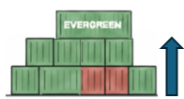
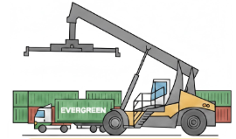

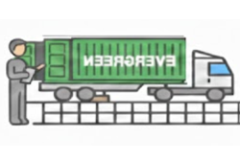
ECD KPI
Pending to confirm Buenaventura terminal to increase free pool .
Barranquilla terminal increased free pool 33%.
Storage>
93.440
66.299
Lift On/Off
2.811
494
Divert empty containers to the terminal yard or terminal-controlled depots instead of using external depots.
Reposition
181.458
68.876
Increase empty spaces at terminal yard or terminal-controlled depots instead of external depots to avoid generating RPO cost.
M&R
0
177
Remaining under control.

Slide 14

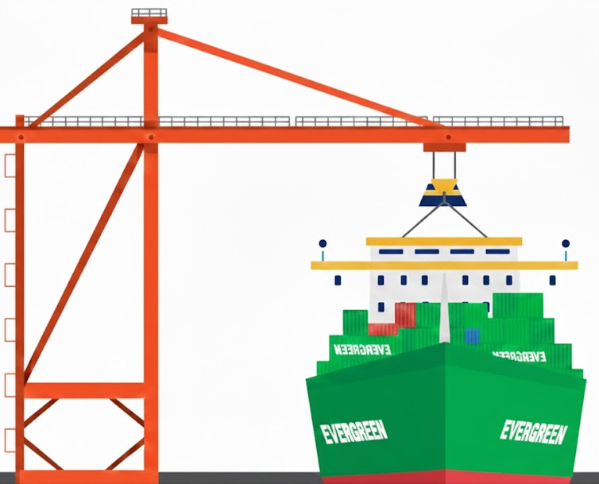



OCD / OPD KPI
BOA
ON WINDOW: 100%
OFF WINDOW:100%
ON WINDOW: 100%
OFF WINDOW:100%
Keep monitoring vessel schedule and get proper window while vessel arrive.
Port Stay
100%
100%
Get more cranes to increase operational efficiency within performa time.
Productivity
96 moves/hour
100 moves/hour
Keep monitoring SPIA´s productivity
Put 5 cranes for operation
Incentive
COBVT:77,457 BOX
COBQL:10,877 BOX
COBVT:50,000 BOX
COBQL:10,000 BOX
Keep maintaining 2026 operation volumes
COBVT: 50.000 BOX
COBQL: 10.000 BOX
Empty Storage
86.882
61.647
Pending to confirm Buenaventura terminal to increase free pool .
Barranquilla terminal increased free pool 33%.
Rate Reduction
NIL
NIL
High incentive program.

Slide 15
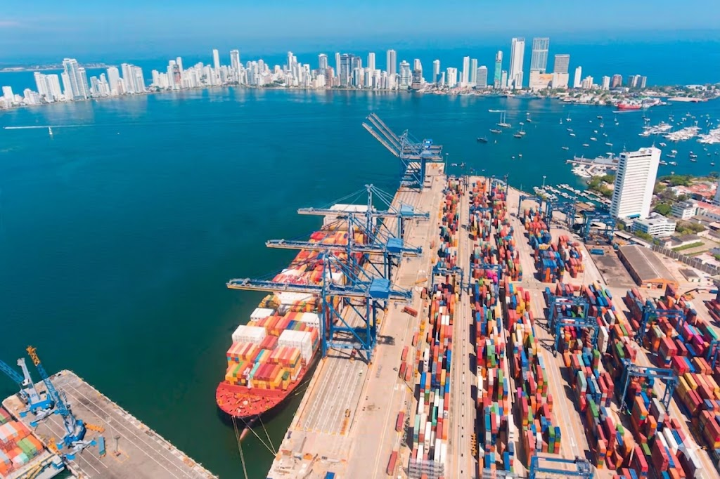
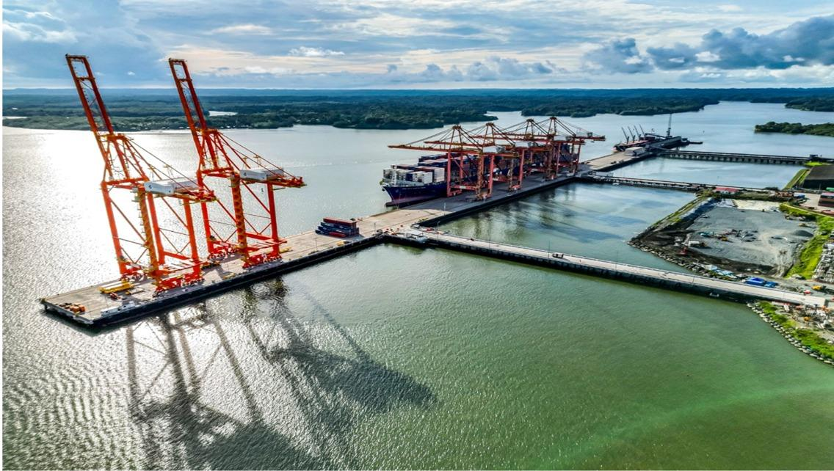
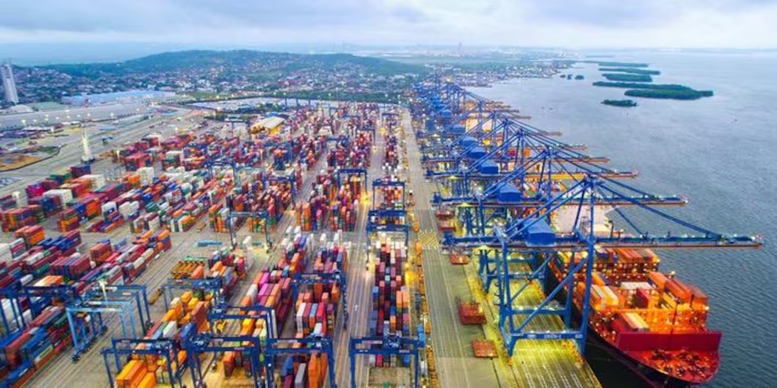
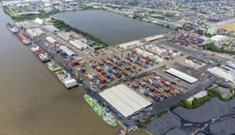
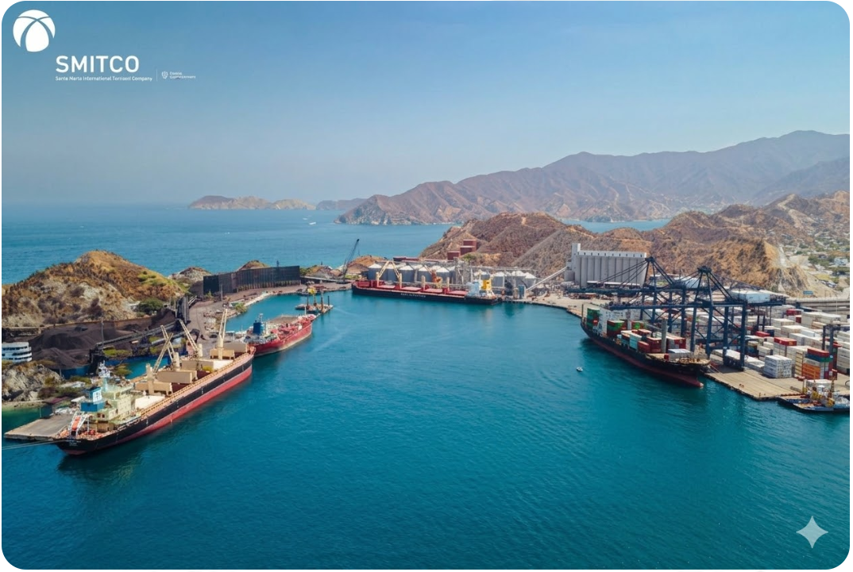
PORT INFORMATION
BUENAVENTURA
CARTAGENA
SPIA
Berth: 2 berth/825m
Draft: 14.5m
Crane: 6 STS
EVG Free Pool: 3500 TEUS
CONTECAR
Berth: 3 berth/1000m
Draft: 16.5m
Crane: 13 STS
EVG Free Pool: 530 TEUS
SPRC
Berth: 2 berth/700m
Draft: 15.5m
Crane: 6 STS
EVG Free Pool: 70 TEUS
BARRANQUILLA
SANTA MARTA
SPRB
Berth: 6 berth/1058m
Draft: 11m
Crane: 5 Mobile crane
EVG Free Pool: 600 TEUS
SMITCO
Berth: 1 berth/320m
Draft: 12.1m
Crane: 2 STS
EVG Free Pool: 100 TEUS

Slide 16
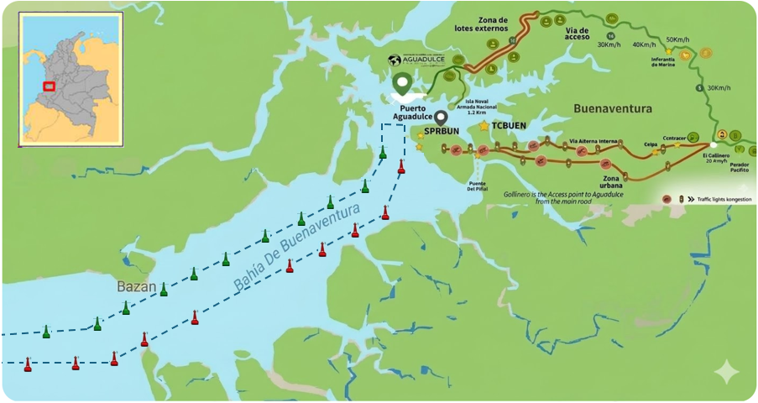
Geographical Location of Buenaventura Terminal
INSPECTION POINT - TCBUEN → 12 km
Empty return within 1 -2 hours
1.Shortest distance among the three terminals
2.Faster truck turnaround
3.More suitable for quick empty return operations
INSPECTION POINT - SPRBUN → 16 km
Empty return within 1 -2 hours
1.Slightly longer distance than TCBUEN
2.Similar return cycle under normal traffic conditions
3.Stable accessibility through main urban route
INSPECTION POINT - SPIA→ 27 km
Empty return within 3 -4 hours
1.Longest distance from inspection point
2.Higher exposure to urban congestion and road delays
3.Longer truck cycle time and higher transport cost
4.Lower flexibility for same-day empty repositioning

Slide 17



2026 Strategy
How to Achieve KPI Goals

Slide 18
HOW TO ACHIEVE 2026 OWN SQ?
Annual 2026 TEUS
C
WS
CC
7.294
9.600
3.640
G
Y
CW
610
G
21.409
2.561
720
1.040
21.409
TPE LAD TARGET
ELA TARGET
EGA TARGET
31.264
10.320
4.680

Slide 19
2026 ACTION PLAN - TPE LAD
FRAMEWORK GUIDELINES
AMP
Enlarge A/Cs & Increase cargo volumes
GREEN X
SALES LEAD
EGL Market Scope Jan-Dec 2025 81.969teus; EGL market share 25%, ranking 2 /13
* Secure Key tender (54%)
* Grow along medium A/C
* Promote FOB light BIZ.
* Close regular RH volumes
* Strengthen COBQL share
* Enlarge COCTG & COSMM volume
* Monitor T/S PACCT reducing idle cargo from ASI
G
Y
EGL Market Scope Jan-Dec 2025 568.824teus; EGL market share 16%, ranking 3 / 14
C
EGL Market Scope Jan-Dec 2025 15.153teus; EGL market share 25%, ranking 2 /12
* Secure Key Tenders (70%).
* Maintain small & medium BCO
* Develop NAC local NVOs
* Promote WSA6 (Direct)
* Report weekly potential BIZ
* Provide feedback local market trends
* Preserve regular OWN SQ Scrap, Glycerin, Sugar confection BIZ
* Find and close spot & project vols
* Develop new destinations AFR & MIDEAST
* GreenX to F.E Base Ports
* WSA6 to KRPUS, CNNBO & CNQND

Slide 20
2026 ACTION PLAN - EGA
FRAMEWORK GUIDELINES
AMP
Enlarge A/Cs & Increase cargo volumes
GREEN X
SALES LEAD
EGL Market Scope Jan-Dec 2025 33.996teus;
EGL market share 7%, ranking 6 / 10
* Protect USSVN & USBAL regular businesses
* Promote & enlarge A/C base to USNYC, USBOS, USNFK, USBAL
US Inland service
* Monitor T/S PACCT priorities
Strengthen EMC COBQL & COSMM share to US
CC
EGL Market Scope Jan-Dec 2025 51.952teus; EGL market share 8%, ranking 5 /18
610
* Focus on PA cargo promotion (IN/OUT).
* To recover share to DO & PR from COBQL
* Enlarge shipments from COSMM to CARI
* Provide permanent local market trends feedback to EGA

Slide 21
2026 ACTION PLAN - ELA MKD
FRAMEWORK GUIDELINES
AMP
Enlarge A/Cs & Increase cargo volumes
GREEN X
SALES LEAD
EGL Market Scope Jan-Dec 2025 38.491teus; EGL market share 8%, ranking 7 / 11
* WSA6 promotion from MXLZC, MXDHJ, GTZNJ
* Strong Sales Lead campaing for CIF cargo, supporting tenders closed at MX
* Promote FOB cargo (Port to port) for small BCOs and main NVOCC.
WS
EGL Market Scope Jan-Dec 2025 70.947teus; EGL market share 20%, ranking 1 /12
* Protect active businesses against low levels in the market.
* Boost CLVAL promotion for spots.
* GreenX promotions for PE & CL
* Strengthen SUGAR + BCO + NVOCC (DRY & RH)
* Monitoring on weekly basis bookings for all accounts including global & local tenders.
CW

Slide 22
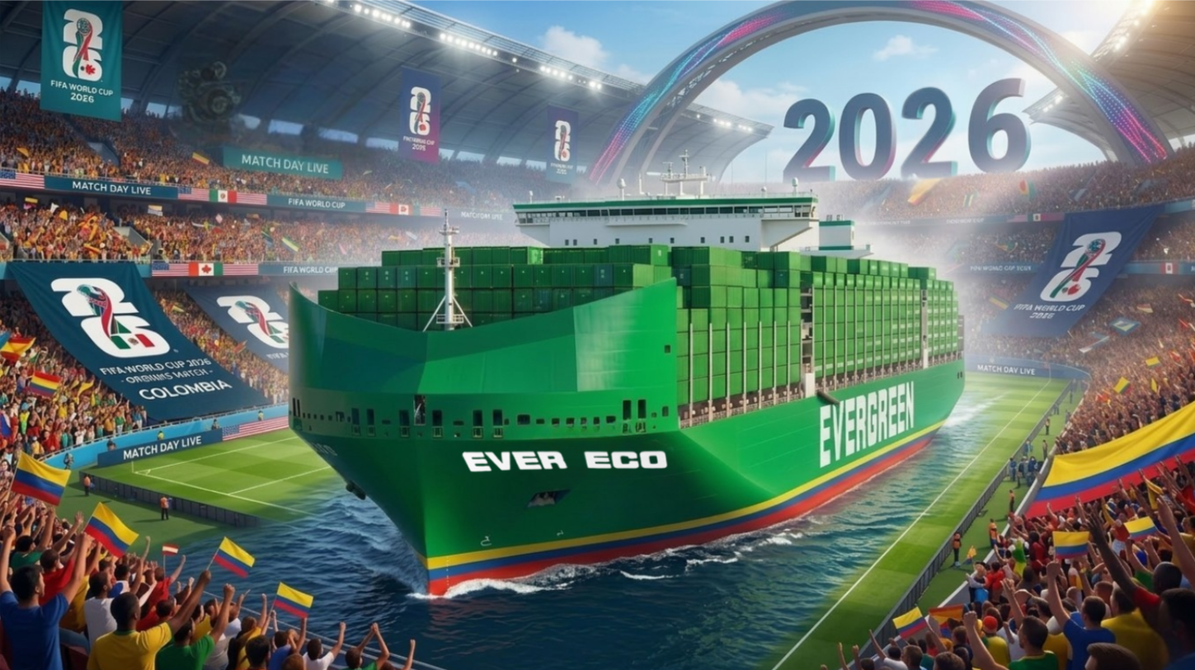

Slide 23


Slide 24
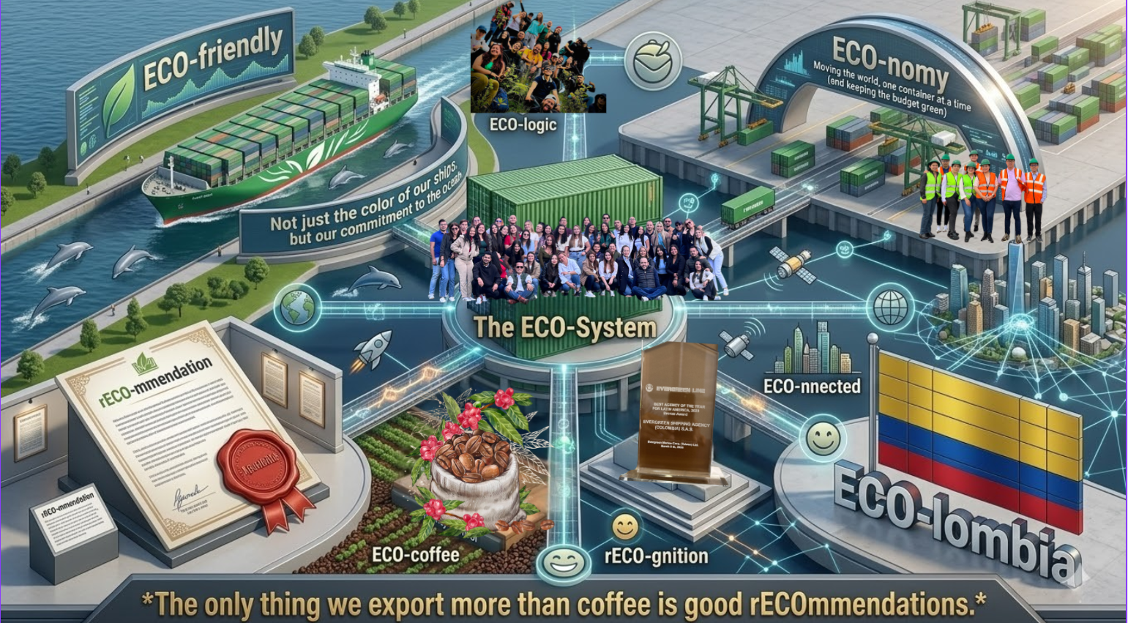

Slide 25


Slide 26
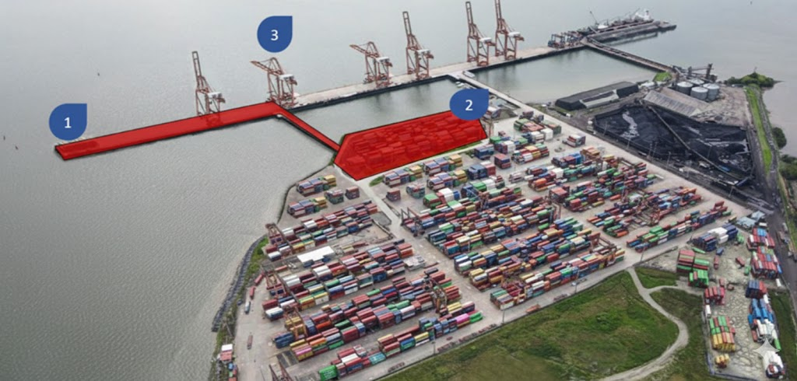
SOCIEDAD PORTUARIA INDUSTRIAL AGUADULCE-SPIA
1. QUAY EXPANSION
2025: Berth 600m, 1 berth position.
1 Trestle for SPIA.
2026: Jan- Berth 825m, 2 berth position up to 366m LOA.
Q4- Berth 900m, 2 berth position up to 400m LOA.
2 Trestle for SPIA.
2. YARD DEVELOPMENT
2025: 17.3 Ha
2026: 21.8 Ha
2027: 23 Ha
2028: 24.3 Ha
3. EQUIPMENT
2025: 4 STS Cranes + 13 RTG´s
2026: 6 STS Cranes + 16 RTG´s (5 more Nov)

Slide 27
COBVT Road Block 2025
Terminal | Roadblock-related disruptions affected terminal access roads.
SPIA | Higher truck volume and more frequent vessel operations. When vessels arrive, a large number of trucks are dispatched within a short period, making traffic congestion during peak road hours more likely. In addition, yard occupancy tends to increase, and once congestion occurs.
SPRBUN | Although cargo throughput is high, truck arrivals are generally more evenly distributed, Operations are therefore relatively more stable.
TCBUEN | Truck movements are lower during certain periods, with fewer gate peaks.

