Slide 1
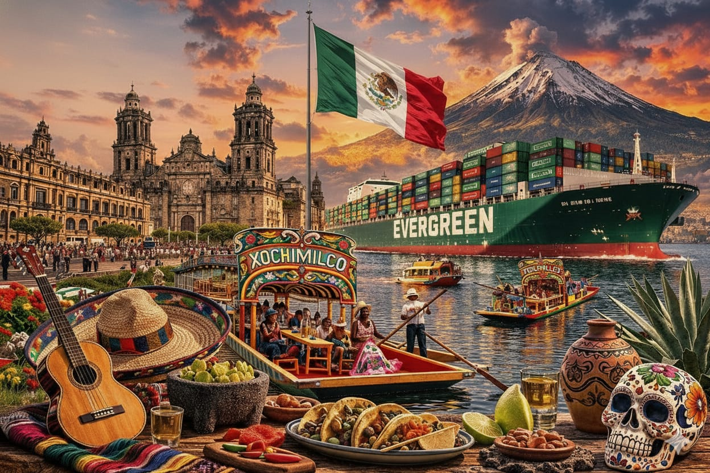
Business Report
2026 LATIN AMERICA AGENCY MEETING

Slide 2

AGENDA

Slide 3



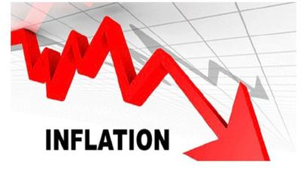
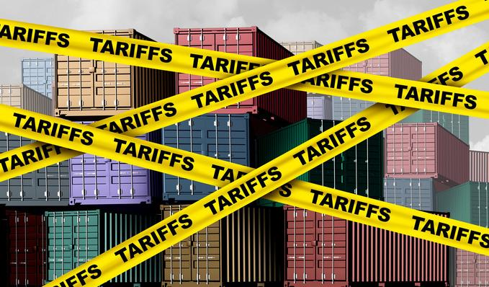
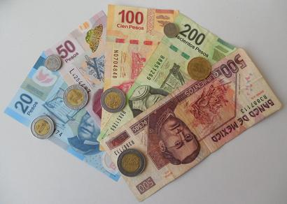


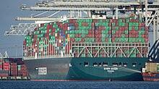

ECONOMIC STATUS
2025/2026 COUNTRY CARGO FLOW STATUS
Slow Recovery
0.5% - 0.7% in 2025
1.3% - 1.5% in 2026
USMCA Renewal
Another Possible Tariff Fight
Market uncertainty
Moderate Price Increase
3.69% for 2025/DEC
4.0% forecast in 2026
Tariffs
1463 items
5% - 50% with average at 35%
Strong Consumption
Government Behavior
Customs
ASIPONA
2026 FIFA World Cup
Shipping Lines Deployment
Capacity
Terminal Efficiency

Slide 4

2025 KPI PERFORMANCE (LAD)
Trade | OWN SQ KPI (Year) | ACTUAL | %
F.E. – MX (Q) | 20,429 | 20,319 | 99%
MX – F.E. (Y) | 9,510 | 9,740 | 102%

Slide 5


2025 KPI PERFORMANCE (ELA)
Trade | OWN SQ KPI (Year) | ACTUAL | %
MX – CARB (V) | 490 | 757 | 267%
MX – WCSA (CW) | 1,268 | 1970 | 155%
WCSA – MX (WC) | 80 | 107 | 133%
MX – WCCA (CB) | 151 | 245 | 162%

Slide 6

2025 Why can’t achieve KPI
* Please take note that many of our own SQ cargoes with T/S are been delayed in T/S port for more than 2 or 3 weeks, hence, it continues affecting our KPI target.
* Our OWN SQ Cargoes are still being affected due to roll overs in Port of Loading, only in the last December 2025, more than 230 Teus were rolled over at origin, this matter affected our KPI.

Slide 7
ECD / IMD KPI
ITEM | 2025 | 2026 | Action Plan in 2026
Storage | $0 | $2,000 | EMX will continue to ensure that the port arrival volume remains within the free pool of the TIMSA and Contecon terminals where WSA/WSA2/WSA3 in Mexico calls.
Lift on/off | $2,205,866 | $2,285,288 | EMX will continue to arrange empties through the most suitable routes.
Reposition | $7,526,815 | $5,967,524 | FXE and KCSM´s rate renewal had raised the rail costs with 3.7%/3.9%. For cost saving, EMX will prioritize the usage of MXMEX-MXMZOR, Tepalcates
M & R | $2,444 | $1,333 | All costs were incurred for emergency repairs of empty and loaded containers. We will continue to work with ELA to rigorously review the necessity of emergency repairs for each case and carry out repairs to the minimum standards.
ITEM | 2025 | 2026 | Action Plan in 2026
90% Onboard within 7 Days | 90% | 90% | Achieving by providing weekly transshipment volume to check and secure available space with space controller, and arrange shipments according to the FIFO principle.

Slide 8
OCD / OPD KPI
ITEM | 2025 | 2026 | Action Plan in 2026
BOA | MXMZO : Off slot 85% /On Slot 95%) MXLZC : Off slot 88% /On Slot 97%) | MXMZO : Off slot≧85% /On Slot≧95%) MXLZC : Off slot≧88% /On Slot≧97%) | We work with ELA in order to improve the ETA and we will negotiate with terminal have berth available on arrival.
Port Stay | MXMZO : 95% within Pro-forma MXLZC : 97% within Pro-forma | MXMZO : ≧ 95% within Pro-forma MXLZC : ≧ 97% within Pro-forma | We will work with terminals and ELA to have better Split and add more cranes at the same time. Request MX customs to add more Manpower to facilitate inspection process.
Productivity | MXMZO: 50MPH MXLZC: 70MPH | MXMZO: 50MPH MXLZC: 70MPH | Work ELA and terminal better Split and add more cranes

Slide 9
OCD / OPD KPI
ITEM | 2025 | 2026 | Action Plan in 2026
Incentive | MXMZOA 39,324 Box MXLZCC 26,507 Teu MXVRCA 856 Box | MXMZOA 42,077 Box MXLZCC 28,362 Teu MXVRCA 916 Box | We will work with OCD and terminal if they increase the incentive according every month we increase our volumen
Empty Storage | $3,500 | $2,000 | Work with contecon waive storages and open more free pool due to we have more services with this terminal
Rate Reduction | No additional fee | MXLZC/MXMZO: Reduce additional operating costs/storag fees by 5%. | Storages negotited with terminal discount an reduce the proforma imporve port stay

Slide 10


2026 Strategy
How to Achieve KPI Goals

Slide 11
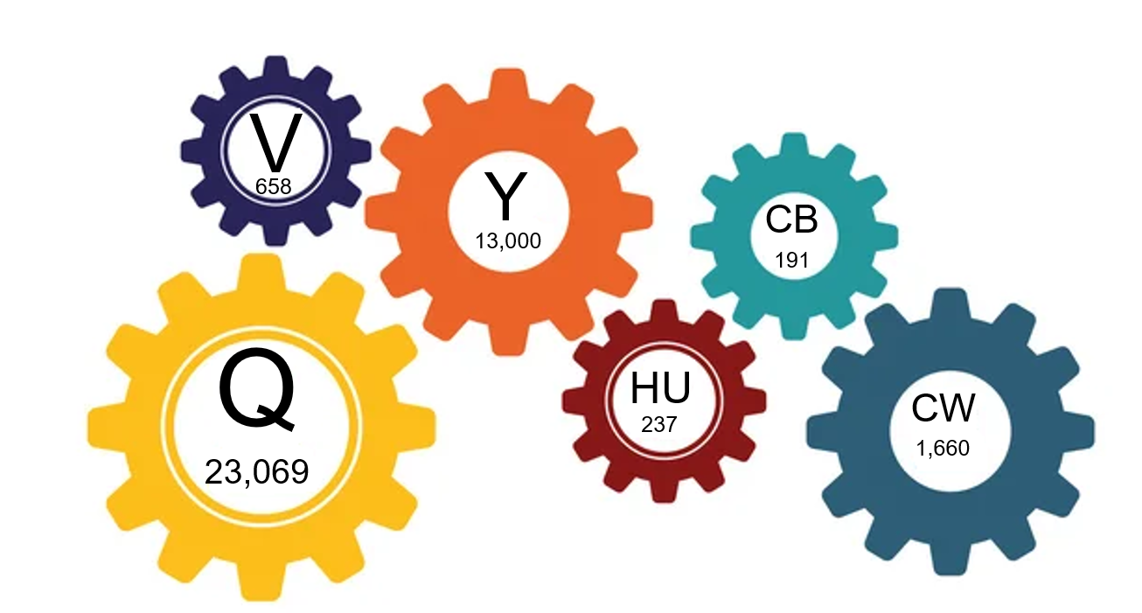
HOW TO ACHIEVE 2026 OWN SQ?
WORKING
SMARTER
WORKING
HARDER
WORKING TOGETHER

Slide 12

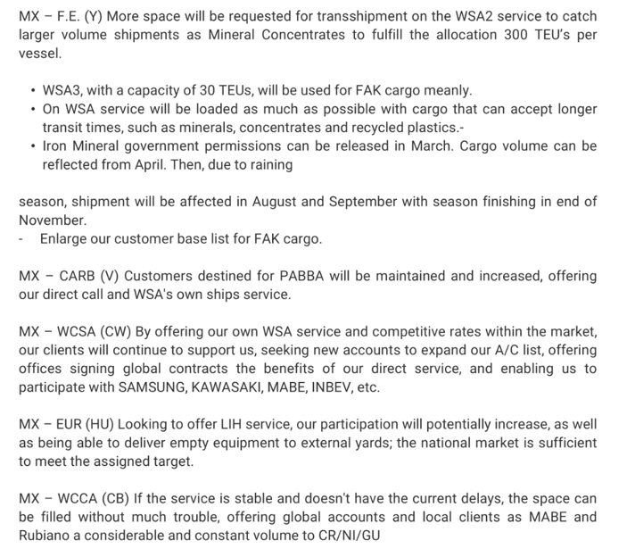
2026 ACTION PLAN EXPORT CARGO

Slide 13

HOW TO ACHIEVE 2026 OWN SQ/Q TRADE?
FAK CARGO
SPOT CARGO
PORT TO PORT CARGO
ANNUAL TENDERS

Slide 14
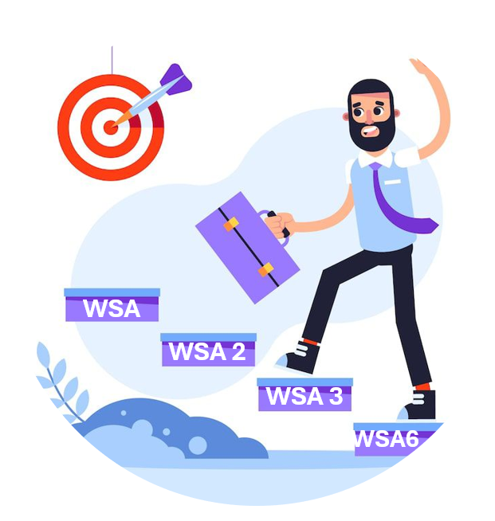
2026 ACTION PLAN (Q TRADE)
WSA
DIRECT SERVICE TO MXMZO (TIMSA)
WSA2
2026
DIRECT SERVICE TO MXLZC
WSA3
FOCUS ON POL: CNQND / CNXSM TO MXMZO
WSA6
FOCUS ON POL: CNQND/ KRPUS – MXLZC
DIRECT SERVICE TO MXDHJ

