Slide 1


Business Report
2026 LATIN AMERICA AGENCY MEETING

Slide 2









AGENDA
Economic Status
Cargo Flow
GDP Forecast , Inflation , USA Tariff
Import/Export
2025 KPI
Operations KPI
Performance Review (LAD/EGA/ELA)
ECD/IMD & OCD/OPD Review
2026 Goals
Strategy & Targets

Slide 3


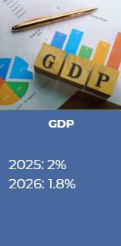
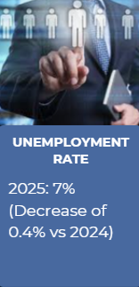
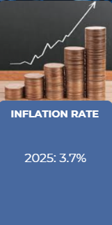
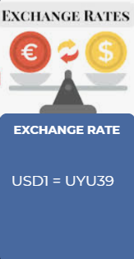
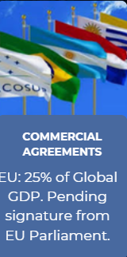
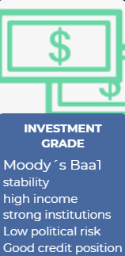
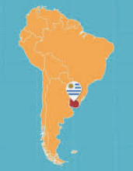
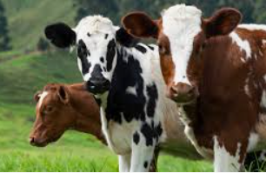

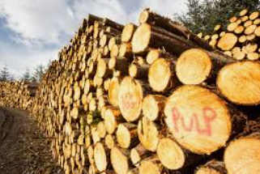
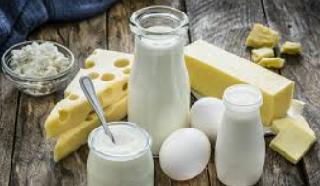
ECONOMIC STATUS

Slide 4
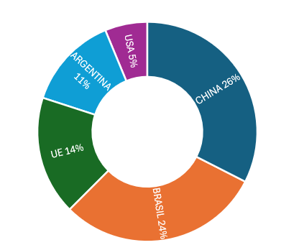
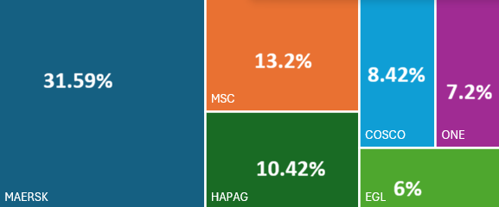
2025/2026 COUNTRY CARGO FLOW STATUS
INBOUND
OTHER GROWING ORIGINS:
SEA, INDIA

Slide 5
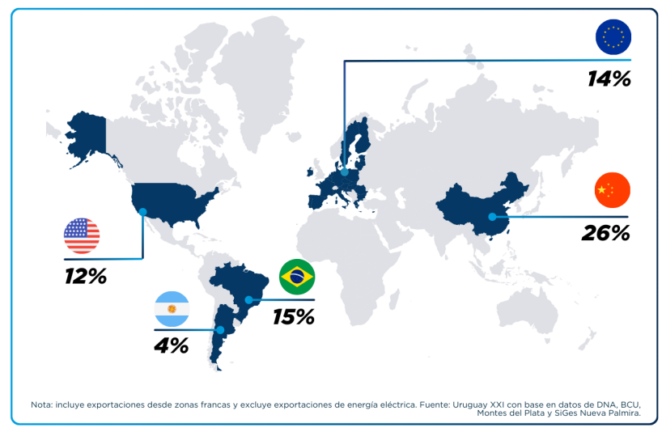
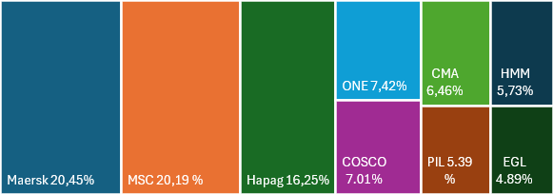
2025/2026 COUNTRY CARGO FLOW STATUS
OUTBOUND

Slide 6
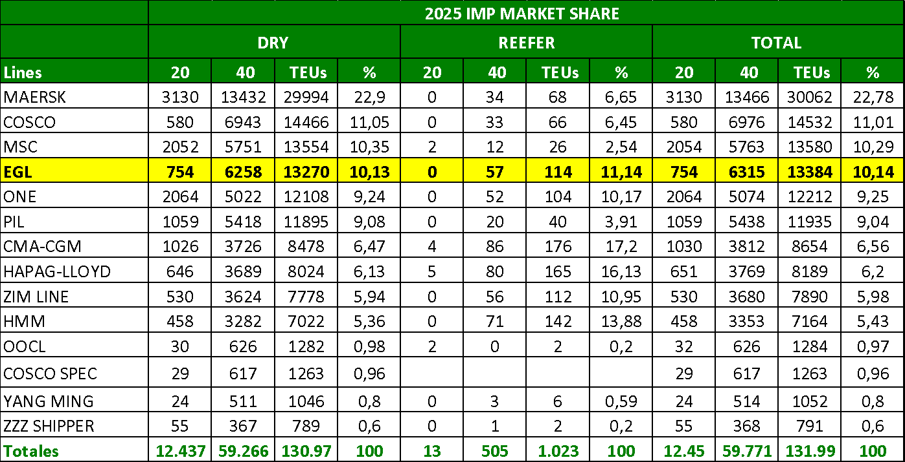
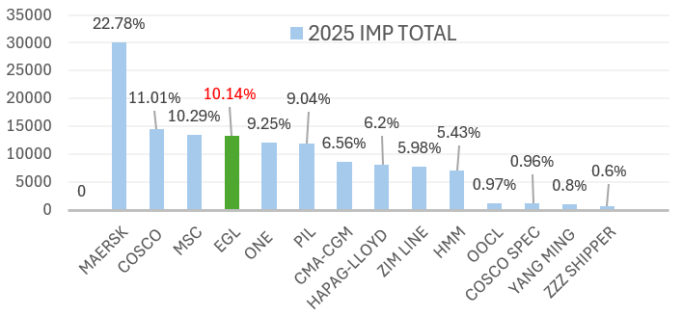
MARKET SHARE (Asia) IMPORT

Slide 7
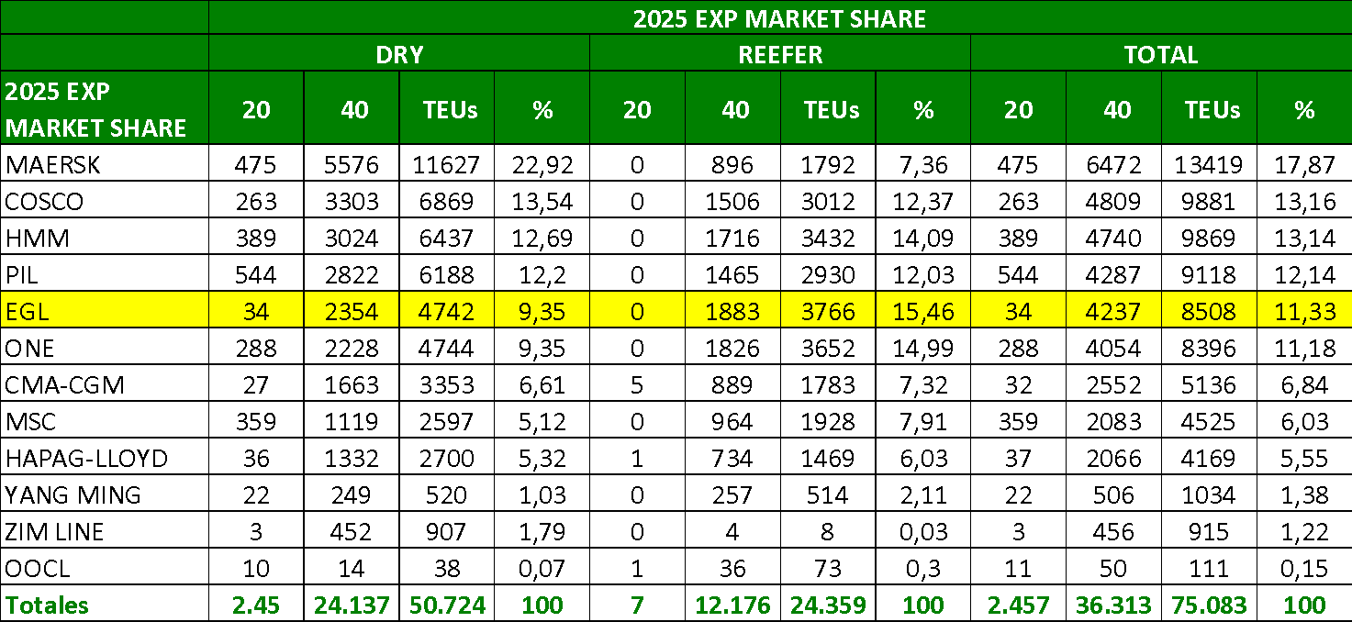
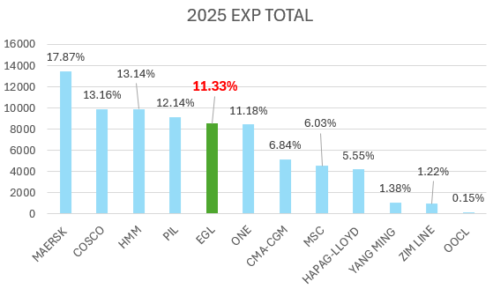
MARKET SHARE (Asia) EXPORT

Slide 8
2025 KPI PERFORMANCE (LAD)
Trade | OWN SQ KPI (Year) | ACTUAL | %
F.E. – UY (5) | 2,494 | 2,519 | 101%
UY – F.E. (6) | 8,155 | 8,452 | 104%

Slide 9
ECD / IMD KPI
ITEM | 2025 | 2026 | Action Plan in 2026
Storage | 144875 | 63900 | 2025 cost: Schedule delay, Lack of space(Draft), FEAT accident. Strategy: FIFO, Depot provide idle report bi-weekly, Return All empty to DEPOT I/O TERMINAL
Lift on/off | 32206 | 46968 | Closely work with Depot(STL) to minimize this cost.
Reposition | 70192 | 96156 | Closely work with Depot(STL) to minimize this cost.
M & R | 457 | 792 | Only RF repairs are done at our side, mainly emergency repairs or special cases.
ITEM | 2025 | 2026 | Action Plan in 2026
Cost Saving Project | 22121,8 | Keep | Closely work with Vendor. (2025 Terminal gave discount 1)Storage transit: USD5471 2)COD mtys: USD4560 3)Storage mty: USD12,090)
No Personal Negligence | 0 | 0

Slide 10
OCD / OPD KPI
ITEM | 2025 | 2026 | Action Plan in 2026
BOA | 100% | Keep | Pier C using - Cruciers seasons. (In 2025, 50% of Evergreen´s vessels arrived out of proforma.)
Port Stay | 100% | Keep | Keep coordination with ELA / Terminal closly.
Productivity | 100% (42,56MPH) | 38MPH | Keep monitor and pushing Terminal for better productivity.
ITEM | 2025 | 2026 | Action Plan in 2026
Incentive | 300,000 | 300,000 | In 2026, accomplish with volum target to archive.
Empty Storage | 104,333 | 63,900 | Explanation: Vessel delays, Lack of space (draft), FEAT. Action Plan: FIFO, Work with MCN to request cost reductions, Return empty to Depot .
Rate Reduction | 197,200 |  | Work with Terminal closely on rate reduction. (In 2025, Montecon discount in FEAT: USD 107,200 (No unstuffed units) + USD 90,000 (Courtesy Resolve Marine fee).

Slide 11


2026 Strategy
How to Achieve KPI Goals

Slide 12

HOW TO ACHIEVE 2026 OWN SQ?
Trade | Target (Year)
F.E. – UY (5) | 2,750
UY – F.E. (6) | 8,706

Slide 13
2026 ACTION PLAN
IMPORT
Own SQ Target 55 T/wk (2026)
Market is concentrated in big ff i.e HB, Navicon, or KN mostly. Which nego major vol abroad. Avg 38% of cargo with final dest UYMVD is closed by top 8 ff from which only 4 (Repremar, MSL, Central and Pluscargo) can nego at our side.
* Repremar increase +100% (2025: 64T 🡺 2026: 130T),
* Central increase +15% (2025: 215T 🡺 2026: 250T),
* Pluscargo increase +10% (2025: 106T 🡺 120T),
* MSL increase +10% (2025: 60T 🡺 2026: 66T),
* Terramar increase +10% (2025: 118T 🡺 2026: 130T),
* Aerocargas increase +10% (2025: 74T 🡺 81T),
*Tender KIA: maintain (1894 T in 2025)
(2026: 1,900-2000)

Slide 14
2026 ACTION PLAN
EXPORT
Reefer KPI: 2370x40´RH
REQUEST EMPTY REPOSITION INCREASE TO COVER THIS KPI
* MEAT: Marfrig/Minerva: (2025: 2,200T) increase 32% in 2026 as per tender winning.
Both tender accounts with contribution confirmed for 2026: 11x40´RH/wk (Minerva) + 17x40´RH/wk (Marfrig)
Other regular meat accounts (NHG, Almar, ULSA, Terramar, etc) (7x40´RH/wk)
* FISH/SQUID: (2025: 1,300T) increase 5% in 2026 🡺 1,365T (663x40´RH annual)
REEFER TARGET PER WEEK: 47X40´RH/WK
-DAIRY: maintain vol (2025: 400T).
-WOOD: 2,886T in 2025 (increase 10%)
-WOODPULP: New Target 200T in 2025. UPM tender participation in 2026 target vol: 20x40´/wk.
🡺Big lots and space only accepted for 20 teus per Booking in CIX svc. We need to increase t/s space guarantee.

