Slide 1


Business Report
2026 LATIN AMERICA AGENCY MEETING

Slide 2









AGENDA
Economic Status
Cargo Flow
GDP Forecast , Inflation , USA Tariff
Import/Export
2025 KPI
Operations KPI
Performance Review (LAD/EGA/ELA)
ECD/IMD & OCD/OPD Review
2026 Goals
Strategy & Targets

Slide 3

ECONOMIC STATUS
POPULATION: 46.38 million
PROJECTION 2030: 46.74 million
2025
GDP: 685 (Billion USD)
INFLATION: 31,5 (% )
UNEMPLOYEMENT: 7,5 (%)
2026
GDP: 720 (Billion USD)
INFLATION: 20 (% )
UNEMPLOYEMENT: 7 (%)
Source:
International Monetary Fund,
Organización para la Cooperación y el Desarrollo Económicos,
Banco Central de la Republica Argentina

Slide 4




COMMERCIAL PARTNERS
EXPORTS: USD 9.79M
IMPORTS: USD 17.95M
BALANCE: USD -8.15M
EXPORTS: USD 8.48M
IMPORTS: USD 10.47M
SURPLUS: USD -1.99M
EXPORTS: USD 8.33M
IMPORTS: USD 6.70M
SURPLUS: USD +1.63M
EXPORTS: USD12.77M
IMPORTS: USD18.42M
SURPLUS: USD -5.65M
EXPORT CNTR QTY: 44.564
IMPORT CNTR QTY: 190.537
EXPORT CNTR QTY: 74.612
IMPORT CNTR QTY: 68.702
EXPORT CNTR QTY: 24.422
IMPORT CNTR QTY: 25.591
EXPORT CNTR QTY: 17.204
IMPORT CNTR QTY: 21.939
IMPORT
General cargo
E-goods
Vehicles and auto parts
EXPORT
Frozen Meat
Raw hides & Skins
Wood
IMPORT
- Machinery & Equipments
- Chemical products
EXPORT
- Frozen foodstuff
- Dairy products
- Citric & Fruits
- Agricultural products
IMPORT
Manufactured goods
GDSM
EXPORT
Agricultural products
Raw minerals
Raw petroleum oils
IMPORT
- Autoparts
- Vehicles
EXPORT
- Pears & Apples
- Agricultural products
- Wines
- Raw petroleum oils
Source:
Instituto Nacional de Estadística y Censos

Slide 5
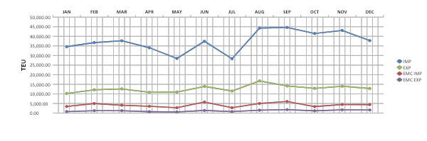
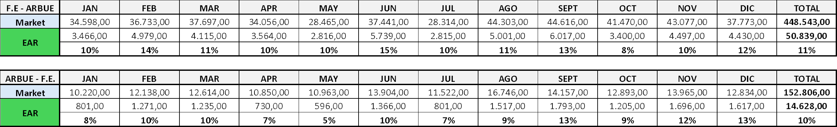
Y2025 CARGO EVOLUTION F.E.-ARBUE/ARBUE-F.E.

Slide 6
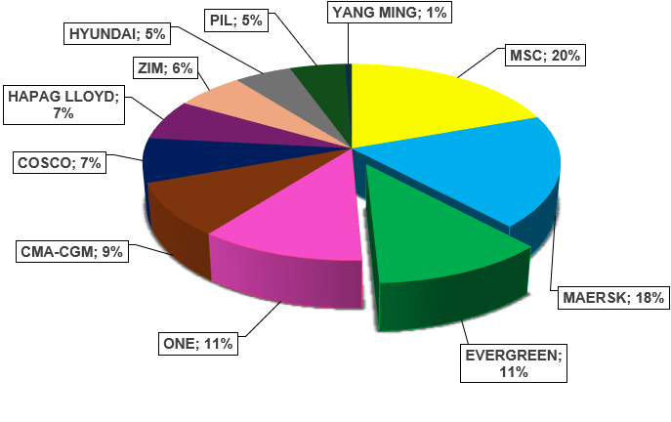
Import Market Share - 2025 Far East
Total Market | 448.543 Teus
Evergreen | 50.839 Teus

Slide 7
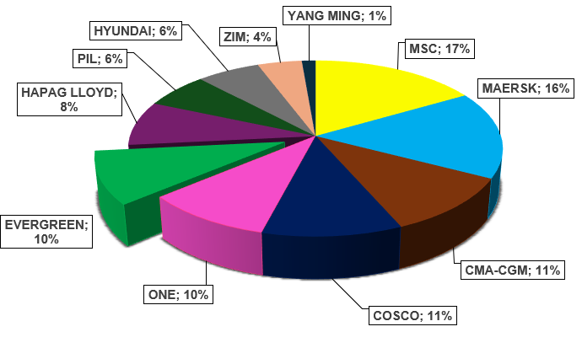
Export Market Share - 2025 Far East
Total Market | 152.836Teus
Evergreen | 14.628 Teus
Total RH Market | 50.865 Teus
Evergreen | 3.166 Teus

Slide 8
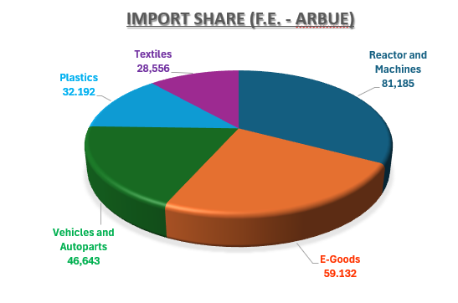
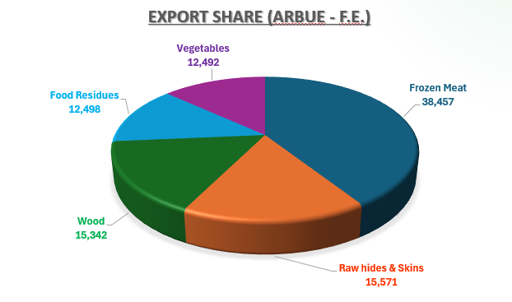
*Y2025 TOP 5* FAR EAST COMMODITIES
TOP | Commodity | TEU Total | EMC Teus | EMC Share
1 | General Cargo | 81.185 | 7.539 | 12%
2 | E-Goods | 59.132 | 9.461 | 16%
3 | Vehicles and Autoparts | 46.643 | 5.130 | 13%
4 | Plastics | 32.192 | 1.487 | 5%
5 | Textiles | 28.556 | 3.120 | 2%
TOP | Commodity | TEU Total | EMC Teus | EMC Share
1 | Frozen Meat | 38.457 | 1.349 | 3%
2 | Raw hides & Skins | 14.389 | 291 | 2%
3 | Wood | 14.489 | 3.202 | 20%
4 | Food Residues | 11.235 | 1.285 | 10%
5 | Vegetables | 12.492 | 1.192 | 10%

Slide 9
2025 KPI PERFORMANCE (LAD)
Trade | OWN SQ KPI (Year) | ACTUAL | %
F.E. – AR (5) | 23,052 | 23,495 | 102%
AR – F.E. (6) | 13,373 | 13,693 | 102%

Slide 10
2025 Why can’t achieve KPI
N/A

Slide 11
ECD / IMD KPI
ITEM | 2025 | 2026 KPI | Action Plan in 2026
Storage | USD 4.254 | USD 25.692 | 1600 TEUs free. Since we are SURPLUS area; we need support to increase empty reposition.
Lift on/off | USD 2.036 | USD 29.232 | To avoid exceed our free pool (1600 TEUs) and Deliver empties to external depot, we must increase our empty reposition. Additionally, we have SALE units, so we suggest to charge LOLO cost to buyers
Reposition | USD 12.255 | USD 438.000 | Due to the feeder cost, to load empties, is more expensive than ocean Annual, we keep delivering the empty return to our main terminal TRP (ARBUE3)
M & R | USD 0 | USD 804 | For emergency repair cases (full imp + full exp).
ITEM | 2025 | 2026 KPI | Action Plan in 2026
Cost Saving Project | USD29,023.25 | N/A | As per current practice, discounts on Storage are requested systematically when any invoice exceeds USD3,000. (T/S +Mties not included). Discount percentage is on Terminal’s discretion.
90% Onboard within 7 Days | N/A | N/A | T/S at BUE: the free time in AR is set as 14 days into contract.
No Personal Negligence | N/A | N/A | N/A

Slide 12
OCD / OPD KPI
ITEM | 2025 | 2026 KPI | Action Plan in 2026
BOA | 100 % | Keep | ARBUE BW is set as MON-WED. However, berth is in most of cases free despite out of window unless cases of ESA Annuals overlap (main berth 680mts).
Port Stay | 100 % | Keep | Present KPI is manageable under current scenario of infrastructure and manpower unchanged during 2026.
Productivity | 100% (58.4mph) | KPI 57MPH Keep | TPE KPI 57MPH & Terminal prod KPI is set as 70MPH as per contract terms. Terminal shore equipment will remain without change during this period. Reason to keep same KPI.
ITEM | 2025 | 2026 KPI | Action Plan in 2026
Incentive | Fm MAY 2025 | To APRIL 2026 | Calculated from May 2025 to Apr 2026. (fm 25.001 – 30.000 = USD 6,00 x box). Currently in process of cargo development. Previous Rebate amount received April 2025: USD171,606
Empty Storage | 1,600 Teu | 1,600 Teu | 1600Teus Free pool. Increases of free quota due to Schedule disorder is beyond our control. Monitor and reinforce our EMPTY REPO OUT
Rate Reduction | NIL | NIL | Terminal rates extensión freezed until 20270531

Slide 13


2026 Strategy
How to Achieve KPI Goals

Slide 14

HOW TO ACHIEVE 2026 OWN SQ?
Trade | Target (Year)
F.E. – AR (5) | 24,500
AR – F.E. (6) | 14,104

Slide 15
2026 ACTION PLAN BIZ DEPT.
Far East / China ↔ Argentina | TEU Targets & Growth
🟦 Imports: 490 TEUs/week – 24.500 TEUs/Annual
🔹 Maintain VIP/Base account (88%EAR Own SQ 2025)
Locksley: 16.887 EAR Teus/Annual - 60% EAR Share 2025 / Total Market: 28.321 Teus
BGH: 2.595 Teus/Annual – 52% EAR Share 2025 / Total Market: 3.944 Teus
Bonini: 877 Teus/Annual – 83% EAR Share 2025 / Total Market: 1.026 Teus
🔹 Diversified target A/C – Potential Volume via EMC: 1910 TEUs
Ombu Logistic: (1.100 Teus/Annual)
Navicon: (450 teus/Annual)
Rohlig: (250 Teus/Annual)
Dsv Argentina: (110 Teus/Annual)
🔹 Develop new markets:
Ushuaia - Target: 12% MS. 950 Teus/Annual
Vinisa Fueguina (573 Teus/Annual) - Tecnomyl: (450 Teus/Annual) - Terramar (194 Teus/Annual)
Zarate – Target: 17% MS. 1.600 Teus/Annual
Interborders (4.000 Teus/Annual)

Slide 16
2026 ACTION PLAN BIZ DEPT.
Far East / China ↔ Argentina | TEU Targets & Growth
🟦 Exports: 282 TEUs/week – 14.104 TEUs/Annual
🔹 Maintain VIP BCO (25,5% EAR Lifting 2025-3.410 Teus) /enlarge participation:
Dry: Arauco (7.776 Teus 2025), Refineria de Grasas (1.284 Teus 2025), Siderca 1.022 (Teus 2025) , Lorenzati (713 Teus 2025)
Reefer: Frigorifico Gorina (2.503 Teus 2025), Frigorico Visom (450 Teus 2025),
Friar (650 Teus 2025), Pesquera Latina (678 Teus 2025), Swift Argentina (3.550 Teus 2025)
🔹 Diversified target A/C – potential volume ttl. 830 Teus
Dry: Surpiel (230 Teus/Annual), Refinerias del Centro (100 Teus/Annual) , Establecimiento las Marias (70 Teus/Annual)
Reefer: Frigorifico Rioplatense (250 Teus/Annual), Compañia Bernal (100 Teus/Annual), Frimsa (80 Teus/Annual)
🔹 Improving the performance of Green X 720 Teus/Annual
🔹 Develop new markets
SALTA: Cooperativa de Tabacaleros de Salta (Potential 700 Teus/ Annual),
Zarate – Target: Potential 1400 teus
Target A/C: Fondo Monte (70 Teus/Annual), Arauco (180 Teus/Annual), Granja Tres Arroyos (60Teus/Annual)

