Slide 1


Business Report
2026 LATIN AMERICA AGENCY MEETING

Slide 2









AGENDA
Economic Status
Cargo Flow
GDP Forecast , Inflation , USA Tariff
Import/Export
2025 KPI
Operations KPI
Performance Review (LAD/EGA/ELA)
ECD/IMD & OCD/OPD Review
2026 Goals
Strategy & Targets

Slide 3

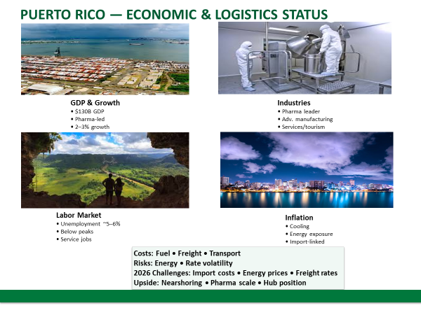
ECONOMIC STATUS

Slide 4
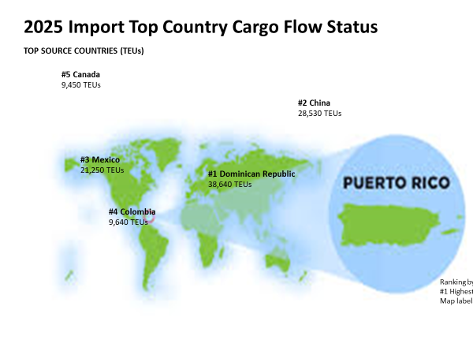

Slide 5
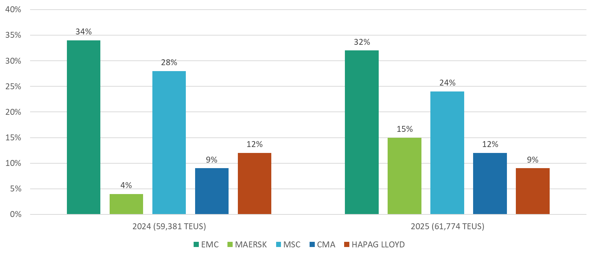
2025/2026 COUNTRY CARGO FLOW STATUS
MARKET SHARE FAR EAST TO PUERTO RICO
•Cargo increased in 2025 in comparison to 2024 mainly due to stronger demand , higher retail imports and shippers
frontloading cargo to avoid potential tariff increases.
•Although cargo increased and EMC remains top carrier, EMC own cargo decreased in comparison to 2024.
•Decrease is mostly due to inconsistent service which caused major cargo loss at beginning of the year.

Slide 6
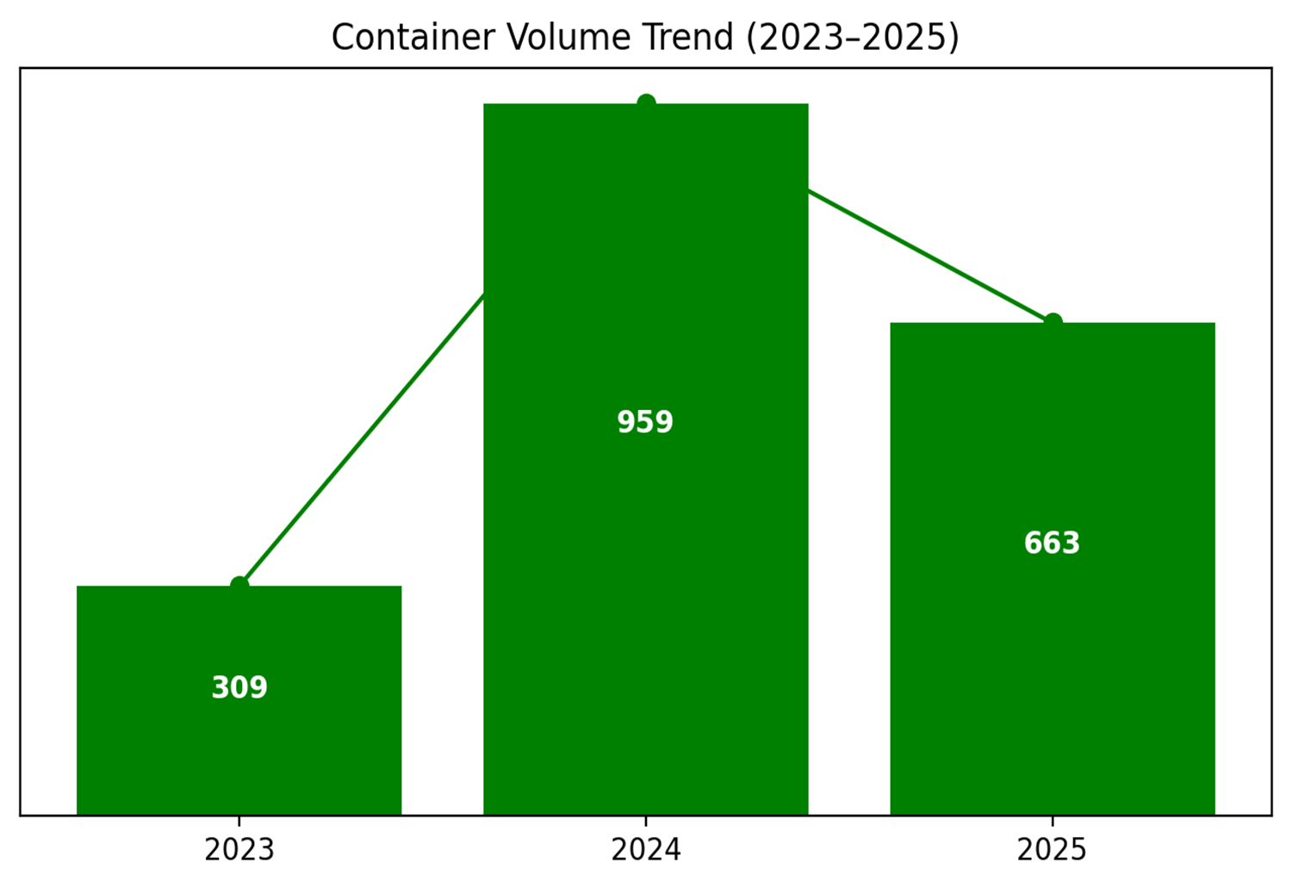
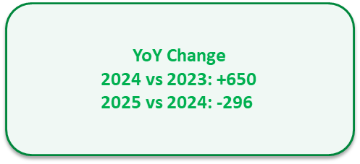

Slide 7
2025 KPI PERFORMANCE (LAD)
Trade | OWN SQ KPI (Year) | ACTUAL | %
F.E. – PR (618) | 9,848 | 7,869 | 80%

Slide 8
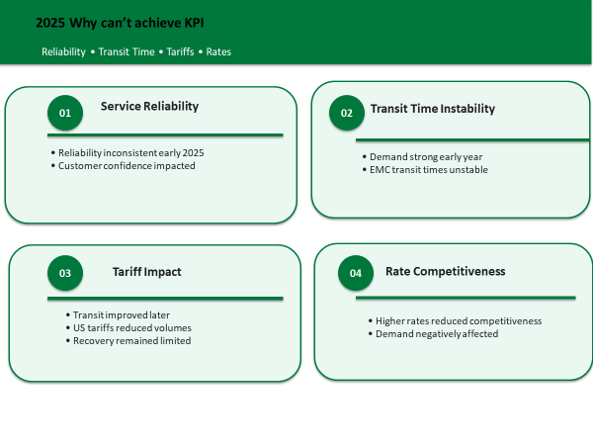

Slide 9
2025 KPI PERFORMANCE (EGA)
Trade | OWN SQ KPI (Year) | ACTUAL | %
PR – CARI (CC) | 705 | 468 | 66%
CC trade based on 47 CAN sailings, 48 CAC sailings, 28 CAJ sailings, and 43 CAW sailings.

Slide 10
ECD / IMD KPI
ITEM | 2025 | 2026 KPI | Action Plan in 2026
Storage | N/A | N/A
Lift on/off | Full - $156.68 Empty - $150.93 | Full - $161.38 Empty - $155.46 | TERMINAL CONTRACT IS NEGOTIATED DIRECTLY WITH TPE
Reposition | N/A | N/A
M & R
ITEM | 2025 | 2026 KPI | Action Plan in 2026
Cost Saving Project | N/A | N/A
90% Onboard within 7 Days | N/A | N/A
No Personal Negligence | N/A | N/A

Slide 11
OCD / OPD KPI
ITEM | 2025 | 2026 KPI | Action Plan in 2026
BOA | 100% | 100% | Keep coordination with ELA / Terminal
Port Stay | 94.20% | 94.20% | Keep coordination with ELA / Terminal
Productivity | 45.59% | 58.71% | Keep coordination with ELA / Terminal
ITEM | 2025 | 2026 KPI | Action Plan in 2026
Incentive | 0 | 0
Empty Storage | 0 | 0 | NO EMPTY STORAGE AT PR
Rate Reduction | 0 | 0 | NO EMPTY STORAGE AT PR

Slide 12


2026 Strategy
How to Achieve KPI Goals

Slide 13


HOW TO ACHIEVE 2026 OWN SQ?
Trade / BCC | Target (Year)
F.E. – PR (618) | 8,172
Trade / BCC | Target (Year)
PR – CARI (CC) | 780

Slide 14
