Slide 1


Business Report
2026 LATIN AMERICA AGENCY MEETING

Slide 2









AGENDA
Economic Status
Cargo Flow
GDP Forecast , Inflation , USA Tariff
Import/Export
2025 KPI
Operations KPI
Performance Review (LAD/EGA/ELA)
ECD/IMD & OCD/OPD Review
2026 Goals
Strategy & Targets

Slide 3

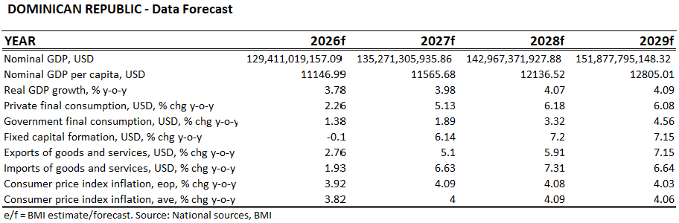
ECONOMIC STATUS
GDP GROWTH We expect real GDP growth in the Dominican Republic to accelerate to 3.8% in 2026, up from an estimated 2.1% in 2025, driven by resilient domestic consumption, supported by a strong labor market, steady remittance flows and real wage gains. INDUSTRY OVERVIEW Key industries include tourism, manufacturing through free trade zones, construction, trade, and financial services. Tourism remains a major driver of foreign exchange and employment, while export-oriented manufacturing—particularly medical devices, textiles, and tobacco—plays a significant role in international trade.
INFLATION
Inflation: around 3.7–4%, within the Central Bank target range, this indicates:
Stable prices
Effective monetary policy by the Central Bank.
USA TARIFFS Trump’s tariffs created uncertainty and placed pressure on Dominican exports, particularly within the free trade zone and textile sectors.
However, the impact was not uniform: some industries experienced a decline in competitiveness, while others were able to benefit when competing countries were subject to higher tariff rates.

Slide 4
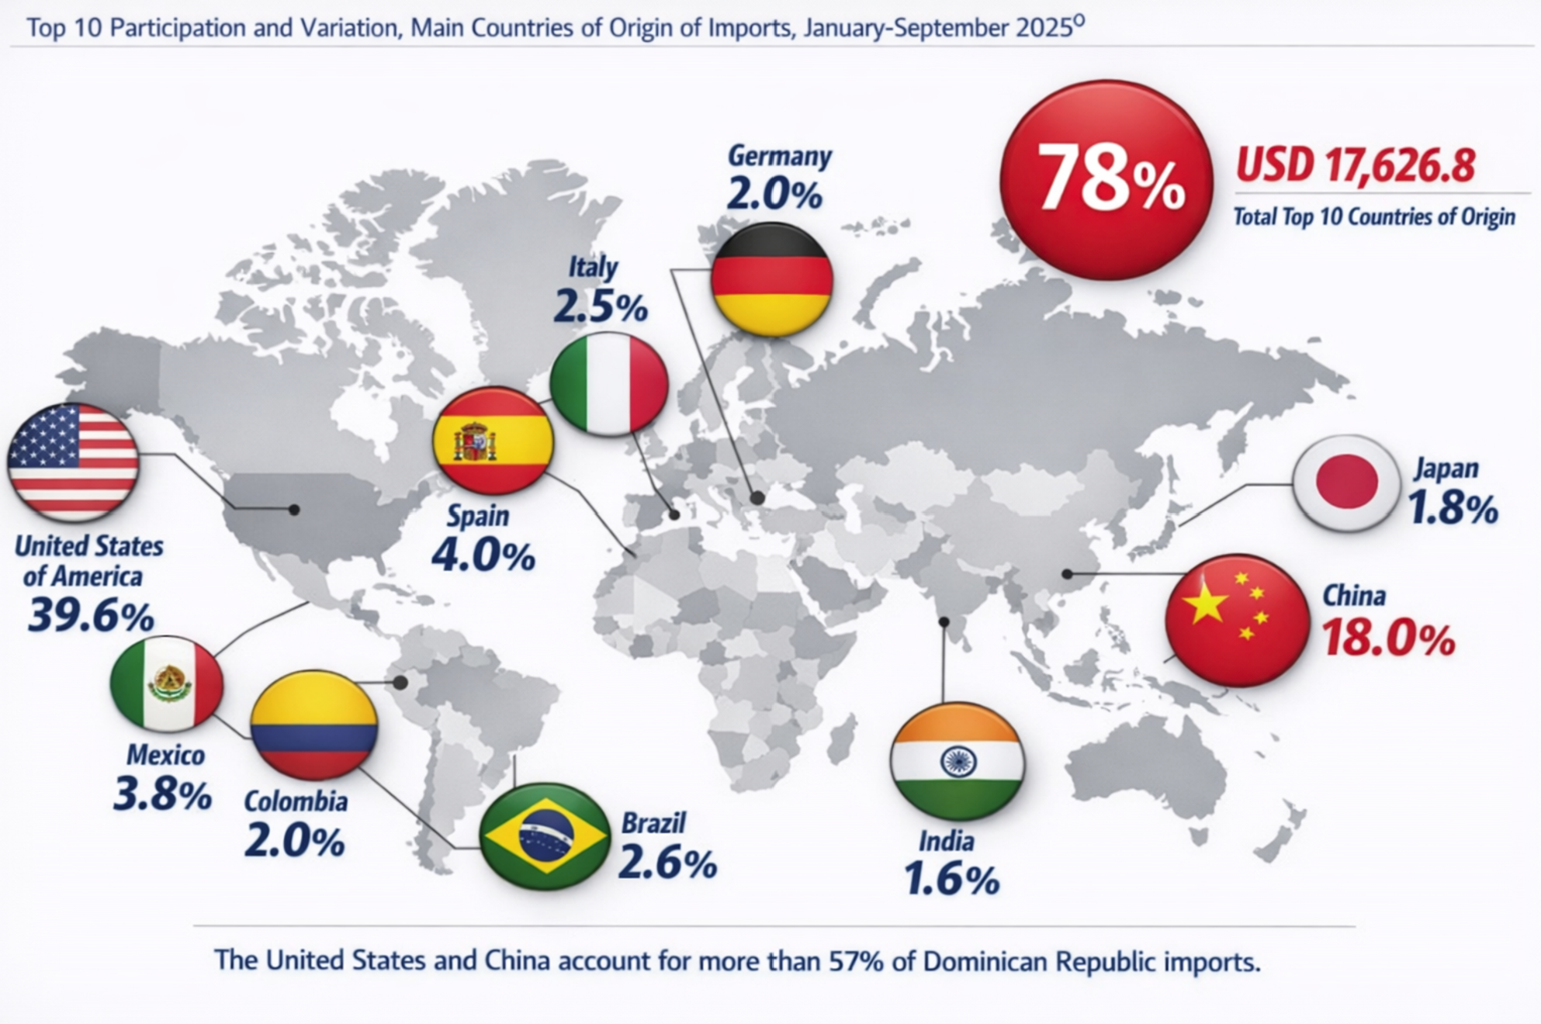
2025/2026 COUNTRY CARGO FLOW STATUS
TOP IMPORT COMMODITIES:
FOODSTUFF
PLASTIC RESIN
CHEMICALS
GDSM
CERAMIC TILES
ELECTRIC APPLIANCES
CARGO NOS, FAK
PACKING MATERIAL

Slide 5
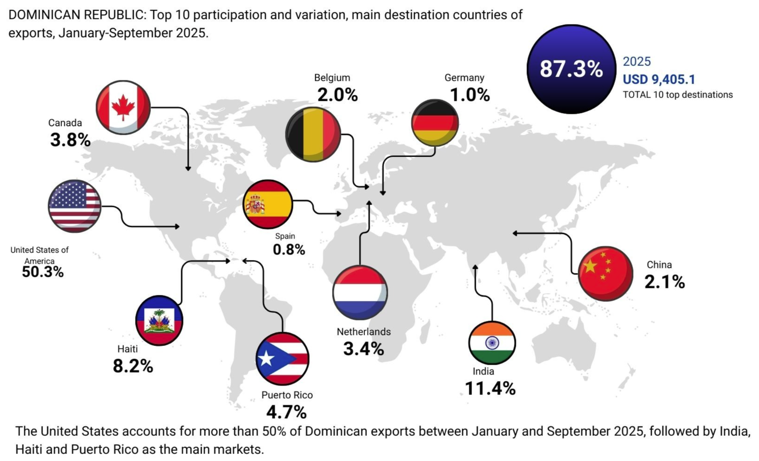
2025/2026 COUNTRY CARGO FLOW STATUS
This content should be focus on your country cargo flow, no matter for export/import ; stronghaul/ backhaul / regional.
TOP EXPORT COMMODITIES:
SCRAP METAL
MEDICAL DEVICES
TOBACCO CIGARS
WASTE PAPER
BANANAS
WEARING APPAREL
PLASTIC GOODS
FOAM PRODUCTS
COCOA

Slide 6
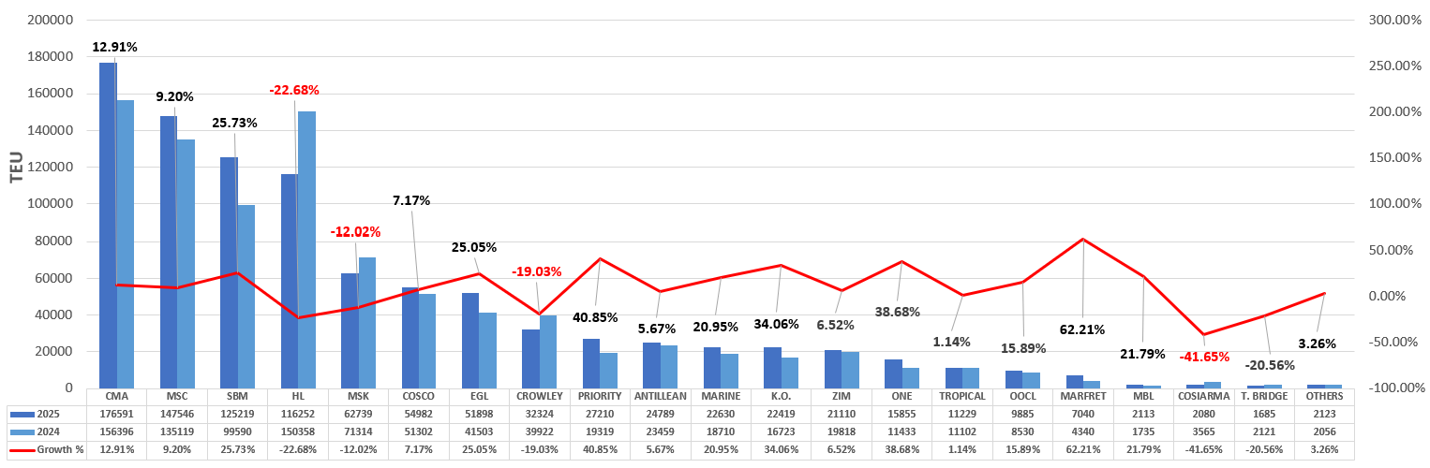
2024/2025 YOY CARRIER VOLUME COMPARISON

Slide 7
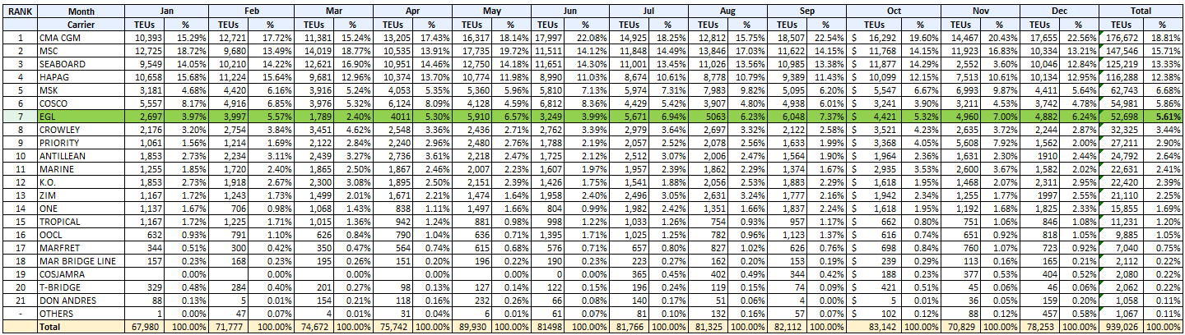
2025 DO IMPORT + EXPORT MARKET SHARE

Slide 8
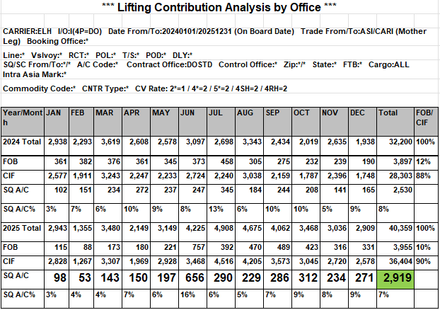
2025 KPI PERFORMANCE (LAD)
Trade | OWN SQ KPI (Year) | ACTUAL | %
F.E. – DO (C) | 4,622 | 2,517 | 54%
According to the report extracted from SOL, records show that the total own SQ lifting from the Far East to DO was 2,919 TEU, not 2,517 TEU as previously stated. Therefore, the correct total percentage of achievement should be 63%, not 54%.

Slide 9
2025 KPI PERFORMANCE (EGA)
Trade | OWN SQ KPI (Year) | ACTUAL | %
DO – USEC (610) | 246 teus | 64 teus | 26%
DO - CARI (CC) | 3,243 teus | 1,886 teus | 58%
CC trade based on 47 CAN sailings, 48 CAC sailings, 28 CAJ sailings, and 43 CAW sailings.
610 trade based on 41 weeks; wk23 and wk53 - all 610 cargo were rolled-over by LOG/NAD

Slide 10
2025 KPI PERFORMANCE (ELA)
Trade | OWN SQ KPI (Year) | ACTUAL | %
DO – WCCA/CARO (CB) | 52 | 12 | 23%

Slide 11
2025 Why can’t achieve KPI
Trade | OWN SQ KPI (Year) | ACTUAL | %
F.E. – DO (C) | 4,622 | 2,517 | 54%
Trade | OWN SQ KPI (Year) | ACTUAL | %
DO – WCCA/CARO (CB) | 52 | 12 | 23%
Impact of Can Service Instability
Trade Low Volume and LAE svc Instability
Persistent CAN service issues from January to May 2025 caused major delays and financial losses for customers. Many shifted to alternative carriers. While regaining these clients has been challenging, service levels and volumes improved significantly in the second half of 2025, with further progress expected in early 2026.
This is a very low‑volume trade lane, with only 142 TEUs moved from January to November 2025—a 48% drop from the 274 TEUs recorded in the same period of 2024. The LAE Service has also been unstable over the past two to three years. Although we have one regular customer shipping to Corinto and Acajutla, the BCC has reported several service interruptions to both ports.

Slide 12
2025 Why can’t achieve KPI
Trade | OWN SQ KPI (Year) | ACTUAL | %
DO – USEC (610) | 246 teus | 64 teus | 26%
DO - CARI (CC) | 3,243 teus | 1,886 teus | 58%
CAN
The service was unstable during the first four months of 2025, causing many former customers to shift to logistics solutions offered by other carriers and NVOCCs. DO/USEC
Over 80% of the trade is controlled by carriers offering direct services. Our current offering is limited to port‑to‑port, while competitors provide door‑to‑door coverage to virtually all inland destinations.
DO/INTRACARB: PR: We are competing against a carrier holding over 95% market share and operating a dedicated service with up to four weekly sailings. They also offer flexible cut‑off times, free chassis usage, and no VGM requirements, among other advantages.
PA: Panama is essentially our only true direct destination, where we currently lead the market. However, competitors such as Hapag and MSK are offering highly aggressive rates to erode our share.
Others transshipment Destination
Other destinations served via CCT transshipment—such as COCTG and CRMOB—consistently fall short of customer expectations on rates and transit times. Due to negative GPS, BCC cannot meet the required conditions.

Slide 13
ECD / IMD KPI
ITEM | 2025 | 2026 KPI | Action Plan in 2026
Storage | US$881,599.1 | US$750,000 | EMC should reach an agreement with the terminal to waive storage charges in cases where FIFO compliance is not met. Open depots to receive sold units, which would reduce costs because dispatch would be faster, and the line would not have to assume storage until dispatch.
Lift on/off | US$23,175 | US$20,000 | It is suggested that units in sale status and for export purpose be returned to the depot ( DORHND and DOCAUD) to reduce costs to the line for storage and lift on/off concept.
Reposition | US$244,180 | US$122,000 | . It is expected that there will be no need to evacuate empty containers via inland transportation in 2026. However, if such action is required to reduce storage costs, we would expect a 50% cost reduction.
M & R | 0 | 0
ITEM | 2025 | 2026 KPI | Action Plan in 2026
Cost Saving Project | N/A | N/A
90% Onboard within 7 Days | 34% | 90% | Our action plan as agency is continue pushing terminal to comply with FIFO to reduce overdue
No Personal Negligence | N/A | N/A | No personal negligence under line's nor agent's account

Slide 14
OCD / OPD KPI
ITEM | 2025 | 2026 KPI | Action Plan in 2026
BOA | On window 65% Off window 35 % | On window 90% Off window 10 % | Keep coordination with ELA / Terminal
Port Stay | 68.5% | 85% | Keep coordination with ELA / Terminal
Productivity | 26mph | 30mph | Keep coordination with ELA / Terminal
ITEM | 2025 | 2026 KPI | Action Plan in 2026
Incentive | -- | -- | --
Empty Storage | US$858,798.83 | - | Our action plan includes requesting EMC to provide sufficient vessel space to ensure timely loading of empty containers, avoid skips, and authorize additional calls when necessary to load empty containers during both port calls, if required. Additionally, we plan EMC to negotiate with the DOCAU terminal to increase the number of cargo movements if necessary. This is currently defined in the contract for regular calls, and any adjustment must be jointly reviewed and approved by both EMC and terminal management ( Agreed Container moves 1,600).
Rate Reduction | -- | -- | The line maintains contractual agreements with both terminals, and negotiations are handled directly between the terminals and our Principals. When intervention is required, top MGT has made the necessary efforts to secure rate adjustments or maintain existing rates when needed.

Slide 15


2026 Strategy
How to Achieve KPI Goals

Slide 16



HOW TO ACHIEVE 2026 OWN SQ?
Trade / BCC | Target (Year)
F.E. – DO (C) | 2,601
Trade / BCC | Target (Year)
DO – USEC (610) | 312
DO – CARI (CC) | 3,588
Trade / BCC | Target (Year)
DO – WCSA (CW) | 52

Slide 17
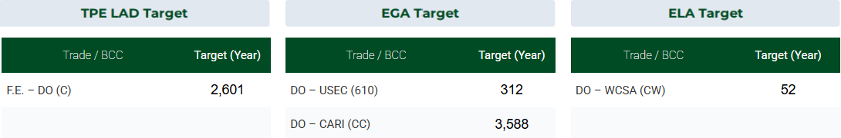
2026 ACTION PLAN
Even when KPI went down, however our goal is to increase 20%~30% over 2025 own SQ of 2919 TEU. How? 1. By continue and doubling efforts to speed up the lost account recovery. 2. At the same time, we'll be targeting new account through our Busines Intelligence data.
3. As usual is key to have a constant communication with BCC, by refreshing our FOB Guideline the fastest possible while also keeping them update of sudden market changes/trends and competitor's offer
DO/USEC:
To continue and doubling efforts to speed up the lost account recovery.
A plan it's already in motion, targeting some carrier's accounts from some port pairs with similar TT as EMC.
DO/CARI:
To maintain DO/PA leadership and even increase liftings from 10 to 20%.
Try to dig out more cargo for DO/PR support (Having a dedicated 45' cntr fleet will be key to get the support).
We need a third destination other than PA & PR to be able to comply with new KPI. Need the support from BCC to achieve competitive rate either to COCTG, COBL and/or CRMOB.
This trade is primarily driven by wastepaper, metal scrap, crushed glass, and rags, which represent over 80% of the total volumes. To meet the established targets, it is essential to align our rates with the highly aggressive pricing offered by competitors. At one point, we were able to secure support from BCC before; however, as the year progressed, BCC was unable to sustain the initial offer.
Additionally, to support target achievement and reduce reliance solely on waste and scrap commodities, we will seek opportunities within the remaining 20% of cargo segments that may allow for more stable volumes under less aggressive and more sustainable ocean freight levels.

Slide 18

Commercial Adjustment Initiative – Q2 2026
As the agents of Evergreen Marine Corporation and in recognition of the prevailing market conditions marked by a sustained decline in freight rates, MCD has carried out an in‑depth comparative assessment of the Terminal Handling Charge at Destination (THC/D) across the various shipping lines operating in the Dominican Republic.
This analysis revealed an opportunity to implement a 10% increase to the existing charge, effective Q2/26. The already approved increase intends to help to improve revenue for the principal amid persistent downward pressure in the market.
By proactively addressing these trends, we aim to safeguard profitability while ensuring the continuity and quality of services.

