Slide 1






HAITI
BUSINESS REPORT
2026 LATIN AMERICA AGENCY MEETING
SAO PAULO, MARCH 26-27

Slide 2










AGENDA
Economic Status
Cargo Flow
GDP Forecast , Inflation , USA Tariff
Import/Export
2025 KPI
Operations KPI
Performance Review (LAD/EGA/ELA)
ECD/IMD & OCD/OPD Review
2026 Goals
Strategy & Targets

Slide 3






ECONOMIC STATUS
Haiti Economic Status (2025–2026)
Haitian Tariffs
Haiti doesn’t export many commodities to the US therefore not affected by current administration tariffs.
Main export commodities are mango and textile, last month US renew the HOPE law that exempts textile manufactured or assemble in Haiti to be imported duty free to the US.
GDP Growth (Forecast)
2025: –1% to –2% (continued contraction due to insecurity and weak investment)
2026: +1% to +2% (very modest recovery if conditions stabilize)
Source consensus: IMF, World Bank
Inflation
Current (2025): ~28–30%
2026 Projection: ~24–26% (still very high, gradual easing only)
Trend:
  2022–2023: peaked near 45–50%
  2024–2025: slowed but remains structurally elevated
  Drivers: currency depreciation, food imports, security-related supply disruptions
Bottom Line
Growth: weak in 2025, fragile rebound in 2026
Inflation: persistently high
Trade: standard tariffs + VAT, no U.S.-specific advantages
Note: that the US and UN have confirmed the arrival of a military mission to fight gangs and restore security and stability in the April of 2026, with the arrival of this multinational force lead by the US we expect the economy to quickly stabilize and see a growth in imports specially from FE and LATAM countries

Slide 4






2025/2026 COUNTRY
CARGO FLOW STATUS
Haiti Cargo Flow Outlook (2025–2026)
        OVERALL CARGO BALANCE
                Import-driven market: Imports remain 4–5x larger than exports
Structural trade deficit continues in both years
Cargo flow heavily influenced by essential consumption
Import Cargo Flow (Stronghaul)
Main Origins
Asia (China, India) Primary stronghaul
Key Import Commodities
Consumer Goods & Retail Merchandise (Household appliances, Electronics, Furniture, Toys & General Merchandise)
Construction Materials (Ceramic Tiles, Sanitary Wares(toilets, sinks), LED lighting, Hand tools & Hardware)
Auto Parts & Motorcycle Units (Tires, Engine components, Spare parts & accessories)
Textiles & Garments (Ready-made garments, fabric rolls, used clothing)
Electrical & Industrial Equipment (Generators, Solar Panels, Water pumps, Electrical cables)
USA (East & Gulf Coast) – Mainly frozen meats and consumer goods
LATAM (PECAL, COBVT, COCTG, GTZNJ)
Key Import Commodities
Sugar and Confectionery (at 6,442 TEUs in 2025 mainly from Brazil & Colombia)
Milk and Frozen Poultry
Ceramic Tiles, Textile fabrics, Packaging Materials
Export Cargo Flow (Backhaul)
Main Destinations
USA – dominant export destination
Limited Caribbean regional exports
Key Export Commodities
Apparel & textiles
Scrap metal (irregular / policy-sensitive)
Agricultural products (very limited)

Slide 5

2025 KPI PERFORMANCE (LAD)
Trade | OWN SQ KPI (Year) | ACTUAL | %
F.E. – HT (C) | 2,095 | 3,077 | 147%

Slide 6
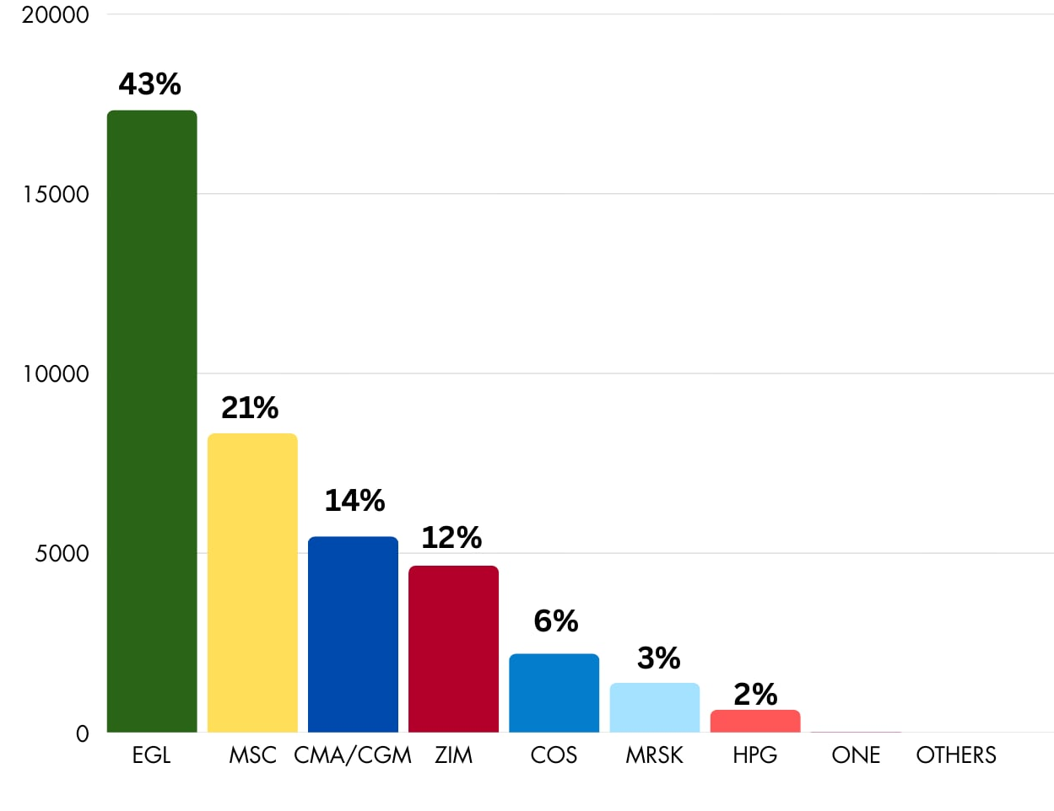


2025 Market Share (Far East Asia)
For 6 consecutive years, we have consistently maintained our position as the No. 1 carrier for imports from the Far East Asia region to Haiti, outperforming our key competitors, MSC Shipping and CMA CGM.
We would like to express our sincere appreciation to our BCCs for their steadfast support and commitment, which have been instrumental in achieving and sustaining this accomplishment.

Slide 7

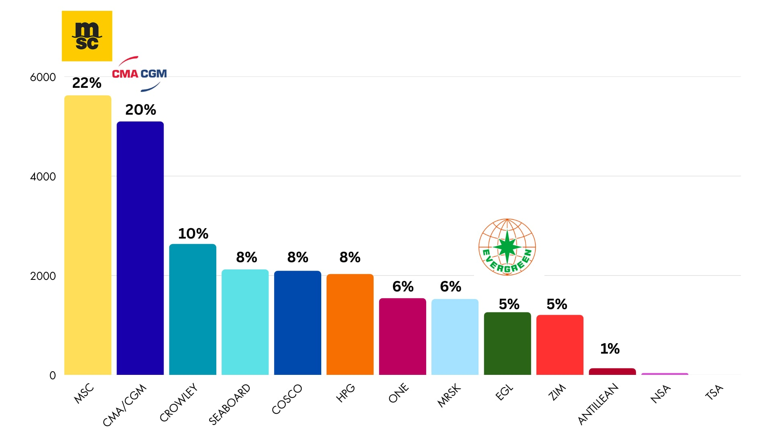
2025 Market Share (South & Central America/Carb)
TOP COMMODITIES FROM THE REGION:
SUGAR
SUGAR is the dominant commodity in this region, serving as the primary volume driver. A substantial portion originates from Brazil and Colombia (Buenaventura), both of which are ports where we currently do not offer service.
36.2%
FROZEN POULTRY
10.1%
CONDENSED MILK
9.0%
GENERAL MERCHANDISE
6.1%
TEXTILE FABRICS
5.7%

Slide 8
2025 Europe Imports to Haiti
Europe accounts for approximately 7.18% of Haiti’s total 2025 import market.
Below data is shared for reference, as we do not currently serve these POLs.
PORT OF LOADING | COUNTRY | % OF EUROPE VOLUME
Rotterdam | Netherlands | 25.27%
Antwerp | Belgium | 20.21%
Le Havre | France | 18.90%
Valencia | Spain | 3.28%
Mersin | Turkey | 3.10%
COMMODITY | % OF EUROPE
Concentrated Milk | 16.49%
Toilet Paper | 8.46%
Malt Extract (Roasted) | 7.02%
Frozen Pork | 6.98%
Onions | 4.04%

Slide 9
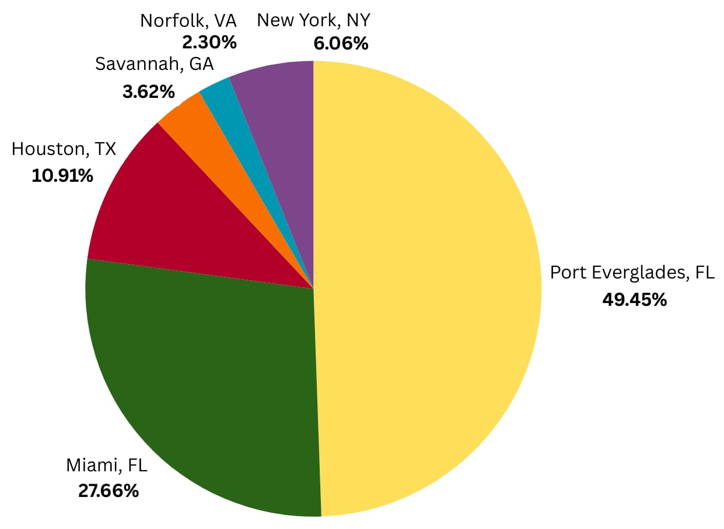
2025 U.S.A Imports to Haiti
Estimated total U.S. import volume stands at 28,836 TEUs, representing approximately 28% of Haiti’s total import market. U.S. trade is consumer and food-security dominated; Reefer cargo plays a structurally important role, especially poultry. Volume stability is heavily supported by Personal Effects, which is atypical compared to most global trades.
CARRIER | % OF U.S. REGION
King Ocean | 26.33%
Antillean Marine | 18.89%
CMA CGM | 16.31%
Seaboard Marine | 8.71%
Accordia Shipping | 6.53%
MSC Shipping | 6.11%
Crowley Liner | 5.03%
Maersk Line | 4.84%
National Shipping of America | 2.60%
Zim Lines | 2.01%
Hapag Lloyd | 0.59%
Evergreen | 0.58%
COMMODITY | % OF USA REGION
Personal Effects | 67.57%
Used Vehicles | 17.63%
Poultry Meat (Refri) | 16.11%
Food Aid | 8.38%
General Cargo | 6.95%
USA - HT
How to Improve:
Competitive Stable Rate
Reliable reefer availability
Predictable equipment supply
Key Success Factor:
In U.S.-Haiti trade, operational reliability + Equipment assurance drive growth more than aggressive rate cutting alone.

Slide 10
ECD / IMD KPI
ITEM | 2024 | 2025 | Diff | Action Plan in 2026
Storage
Lift on/off
Reposition
M & R
ITEM | 2024 | 2025 | Diff | Action Plan in 2026
Cost Saving Project | N/A | N/A | N/A | N/A
90% Onboard within 7 Days | N/A | N/A | N/A | N/A
No Personal Negligence | N/A | N/A | N/A | N/A

Slide 11
OCD / OPD KPI
ITEM | 2024 | 2025 | Diff | Action Plan in 2026
BOA | - | - | - | Continue to closely monitor the vessel schedule and maintain strong coordination with terminals to secure berthing upon arrival.
Port Stay | - | - | - | Maintain close coordination with the terminal to facilitate the provision of additional resources when necessary.
Productivity | - | - | - | Ensure that appropriate crane resources and manpower are arranged to prevent operational delays and increase the number of cargo movements.
ITEM | 2024 | 2025 | Diff | Action Plan in 2026
Incentive | N/A | N/A | N/A | N/A
Empty Storage | N/A | N/A | N/A | N/A
Rate Reduction | N/A | N/A | N/A | N/A

Slide 12


2026 Strategy
How to Achieve KPI Goals

Slide 13

HOW TO ACHIEVE 2026 OWN SQ?
Trade | Target (Year)
F.E. – HT (C) | 3,020

Slide 14

2026 ACTION PLAN
Prioritize high-volume target accounts by delivering competitive, market-aligned pricing strategies designed to capture and grow business opportunities.
Ensure rate stability and equipment guarantees to reinforce service reliability, improve planning visibility for customers, and build long-term commercial confidence.
Maintain proactive communication with BCC by providing timely updates on market rate guidelines, significant pricing developments, and competitor rate movements. Adopt a decisive and assertive strategy when managing large-volume strategic accounts.
Strengthen customer relationships and engagement through consistent, value-driven interactions, regular business reviews, and solution-oriented support. Emphasize responsiveness, operational transparency, and partnership-based collaboration to enhance customer retention and loyalty.
Intensify and expand lost-account recovery initiatives, particularly for customers affected by extended transshipment delays and rollovers. Focus on restoring confidence through service improvements, tailored commercial proposals, and direct engagement with decision-makers.
Conduct comprehensive lost-account analysis to identify underlying causes, detect patterns, and implement corrective and preventive actions aimed at minimizing future business attrition.

