Slide 1


Business Report
2026 LATIN AMERICA AGENCY MEETING

Slide 2









AGENDA
Economic Status
Cargo Flow
GDP Forecast , Inflation , USA Tariff
Import/Export
2025 KPI
Operations KPI
Performance Review (LAD/EGA/ELA)
ECD/IMD & OCD/OPD Review
2026 Goals
Strategy & Targets

Slide 3

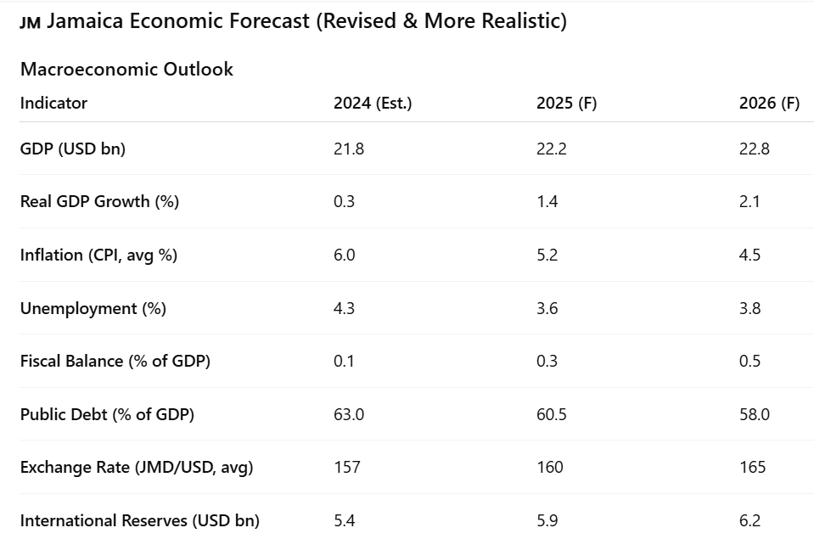
ECONOMIC STATUS
Prior to Hurricane Melissa in late October 2025, Jamaica’s economic outlook was broadly positive, supported by steady growth, rising business confidence, and strong performance in key sectors such as tourism and services. Growing by Economic activity expanded through the third quarter of 2025, with improving labour market conditions and expectations of continued investment and job creation. Tourism, a major driver of foreign exchange and national output, remained a critical pillar of growth, while fiscal conditions were gradually strengthening through improved revenue performance and ongoing progress in debt reduction. Overall, Jamaica entered the latter part of 2025 on a stable economic trajectory, with forecasts pointing toward continued expansion.
However, Hurricane Melissa caused a major disruption to this growth path, resulting in extensive damage to infrastructure, housing, agriculture, and tourism assets. The storm led to significant economic losses, interrupted supply chains, and forced downward revisions to GDP forecasts, with contraction expected into 2026. Key industries experienced immediate setbacks due to reduced arrivals, facility closures, and disruptions in domestic production, while reconstruction demands placed additional pressure on government finances through higher public spending needs. Despite these challenges, Jamaica has secured substantial international support to assist with recovery efforts, providing a foundation for gradual rebuilding and a return to economic stability over the medium term.

Slide 4
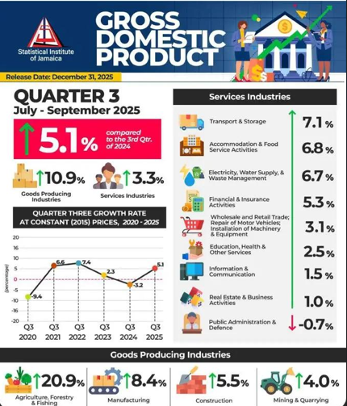
ECONOMIC STATUS
According to the Jamaica Information Service, Jamaica recorded strong economic growth of 5.1% in Q3 2025 (July–September) compared to the same period in 2024, signaling a solid post-disruption recovery following the effects of Hurricane Beryl in 2024. The expansion was primarily driven by the goods-producing industries, which grew by 10.9%, led by a sharp 20.9% increase in agriculture, forestry and fishing, alongside notable gains in manufacturing, construction, and mining. This rebound reflects improved production capacity, stronger supply chain activity, and expanding export readiness.
The services sector also expanded by 3.3%, with growth across transport and storage, accommodation and food services, and financial services—indicating sustained domestic demand and tourism-linked activity, both of which support containerized trade flows.
From a trade perspective, merchandise exports totaled US$1.21 billion for January–August 2025, while imports reached US$5.13 billion, resulting in a trade deficit of US$3.92 billion. Imports increased by 3.7%, driven by higher demand for intermediate goods (+11.8%) and consumer goods (+9.1%), underscoring continued reliance on imported inputs and consumer products. Export earnings rose modestly by 1%, supported by crude materials (excluding fuels).
Up to US$6.7 billion in total recovery and reconstruction financing has been mobilised for Jamaica’s recovery post-Melissa through multilateral partners.
🔹 About US$662 million of that financing was made available quickly via disaster risk financing tools immediately after the storm.
🔹 The Jamaican government allocated J$10 billion (~US$65 million) directly for relief and reconstruction grants.
🔹 The IMF provided US$415 million in emergency financing to help meet urgent recovery needs.

Slide 5
TOP Commodities Import / Export - JMKSN
Rank | Category | Forecast | Key Drivers
1 | Food & Beverages | 30% | High consumption and demand due to hurricane support and to potential scarcity.
2 | Furniture and Home fittings | 25% | stronger demand for housing, government increased on NHT home loans and home grant will cause a further boom in construction, increase in redevelopment of hotel projects.
3 | Vehicles | 14% | New Chinese cars has driven down market price, market is more competitive with faster loan approval from banks & other fin institutions.
4 | Construction materials | 20% | Residential, commercial, and renovation projects drive demand. roof repairs and road expansion projects across the island. Hotel construction and cansinos.
5 | Spices, coffee & spirits | 12% | increased consumption of alcoholic beverages, expansion of additional breweries in Jamaica due to US - CAN tariff war.

Slide 6
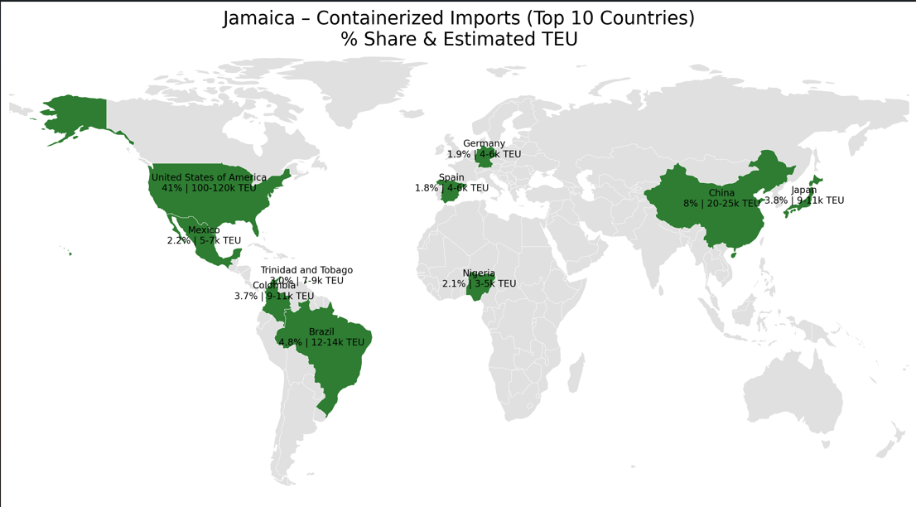
2025/2026 COUNTRY CARGO FLOW IMPORT STATUS

Slide 7
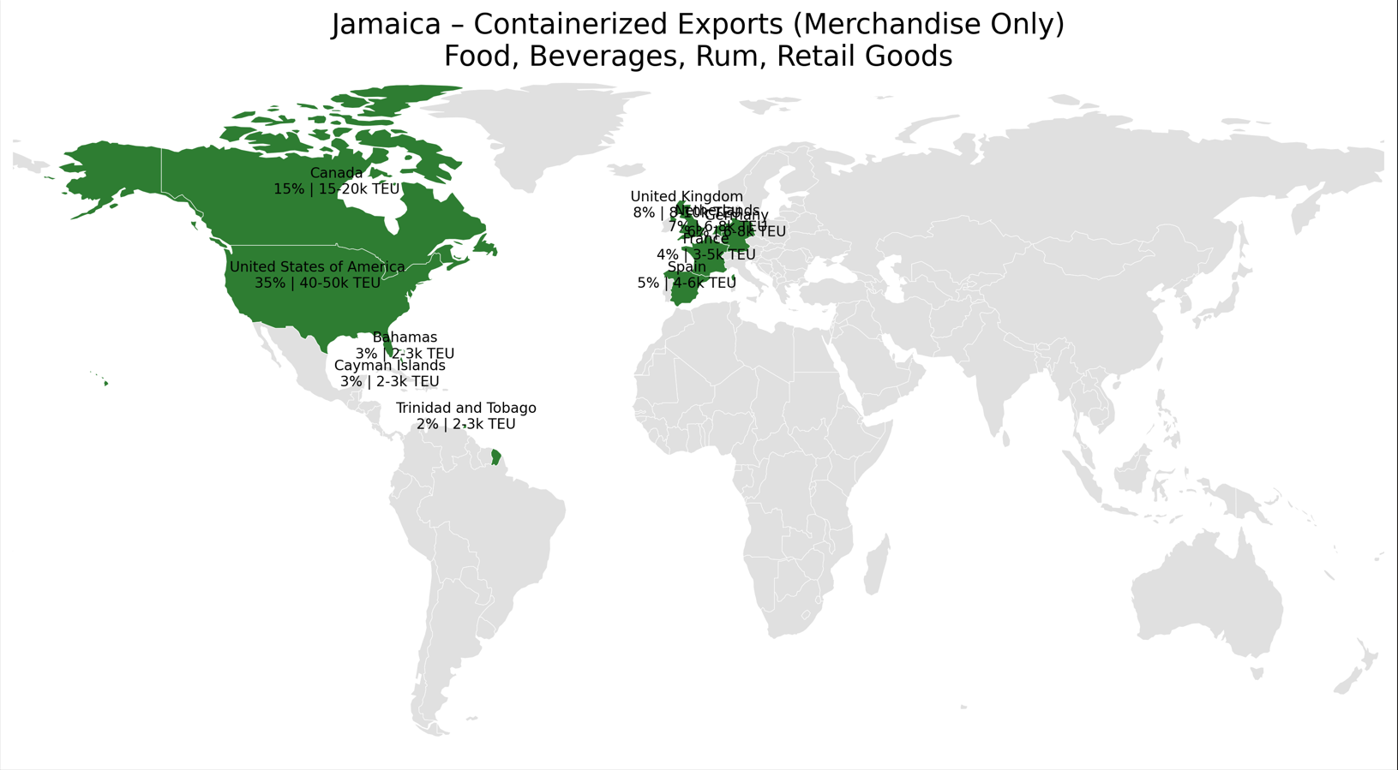
2025/2026 COUNTRY CARGO FLOW EXPORT STATUS

Slide 8
2025 KPI PERFORMANCE (LAD)
Trade | OWN SQ KPI (Year) | ACTUAL | %
F.E. – JM (C) | 555 | 424 | 76%
2025 Why can’t achieve KPI ?
Action Plan:
Limited Space securing and booking confirmation delays. Once improved, we will capture more volume from some of our high volume client. Use freight forwarders in China to assist in faster booking confirmation online.
As we recognize that some shpr also delay the process to choose their own shipping line.
Service still faces some rollovers and vessel delays, we aim to coordinate effectively with shpr and consignee to change to the next suitable date.

Slide 9
2025 KPI PERFORMANCE (EGA)
Trade | OWN SQ KPI (Year) | ACTUAL | %
JM – USEC (610) | 82 | 8 | 10%
JM – CARI (CC) | 56 | 45 | 80%
2025 Why can’t achieve KPI ?
Action Plan:
Biz Agents need to cover more of the market to find new business and lock in 3-4 months contracts. Provide frequent feedback to EGA & ELA BCC to offer competitive freight rates.
Service still faces some rollovers and vessel delays, we aim to coordinate effectively with shpr and consignee to change to the next suitable date without them feeling disappointed.
CC trade based on 47 CAN sailings, 48 CAC sailings, 28 CAJ sailings, and 43 CAW sailings.
610 trade based on 41 weeks; wk23 and wk53 - all 610 cargo were rolled-over by LOG/NAD

Slide 10
ECD / IMD KPI
ITEM | 2025 | 2026 KPI | Action Plan in 2026
Storage | USD$250,000 | USD$350,000
Lift on/off | USD$156,000 |  | We will continue cooperating with HQ assisting empty repo. of dry cargo from KWL & KFTL Terminal, iin order to improve backhaul full load ratio of CAJ svc and also the export cargo volume of dry cargo out of CAJ service via CC & USEC trade.
Reposition | 80% | 75% | Frequent feeder delays. EMC would need more space available to ship out empties, we would like to purchase all sale year units as government look to secure temp building solutions for storage, temp building solutions, etc.
M & R | 0% | 0% | Local terminal does not conduct M&R Cost for EMC Container sale, units are sold as is and loaded out as is.
ITEM | 2025 | 2026 KPI | Action Plan in 2026
Cost Saving Project | N/A | N/A | N/A
90% Onboard within 7 Days | 69% | 90% | Cargo will be load directly from KWL (JMKSNP).
No Personal Negligence | 0% | 0% | Not at this time. All safety and regulatory requirements are closely monitored by Agency personnel. Terminal following ISO safety protocols.

Slide 11
OCD / OPD KPI
ITEM | 2025 | 2026 KPI | Action Plan in 2026
BOA | On window 82% Off window 60% | On window 95% Off window 90% | Keep coordination with ELA / Terminal
Port Stay | 88.9 % | 95 % | Keep coordination with ELA / Terminal
Productivity | 22.4 mph | Keep | Keep coordination with ELA / Terminal
ITEM | 2025 | 2026 KPI | Action Plan in 2026
Incentive | – | – | –
Empty Storage | USD$19,000 | USD$7000 | –
Rate Reduction | – | – | –

Slide 12


2026 Strategy
How to Achieve KPI Goals

Slide 13


HOW TO ACHIEVE 2026 OWN SQ?
Trade / BCC | Target (Year)
F.E. – JM (C) | 463
Trade / BCC | Target (Year)
JM – USEC (610) | 104
JM – CARI (CC) | 104
2026 ACTION PLAN
Action Plan:
Biz Agents will engage the market and push to have bookings confirmed with assistance of freight forwarders if shpr is unable to complete same, pending consignee’s approval.
Focus on long haul and new business development. That will heal frequent and consistent use of service.
Negotiate rates with BCC to be more competitive than Seaboard / CMA.
Coordinate and meet with local brokers / freight forwarders who have influence over merchants logistics.

