Slide 1
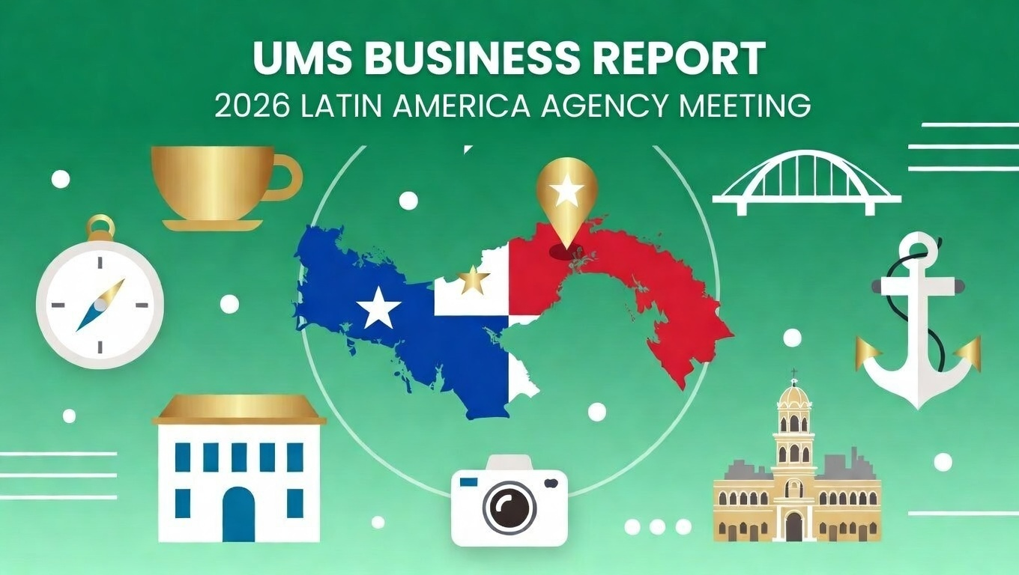

Slide 2









AGENDA
Economic Status
Cargo Flow
GDP Forecast , Inflation , USA Tariff
Import/Export
2025 KPI
Operations KPI
Performance Review (LAD/EGA/ELA)
ECD/IMD & OCD/OPD Review
2026 Goals
Strategy & Targets

Slide 3









ECONOMIC STATUS
Panama GDP Growth
2025: ~4.0%
2026F: ~4.0% (Stable outlook)
Inflation
2025: ~0.5%
2026F: ~2.0% (IMF forecast)
Unemployment
2025: ~8.0%
2026F: ~7.7%
Trade value of Colon Free Zone
2025: USD28 Billion
+12% versus 2024
🚢
Panama Canal
2025: USD5.7 Billion
+19.3% transits versus 2024
Panama Terminals
2025: 9.91 Million Teus 2025
(+3.6% versus 2024)
📦
Source: www.imf.org

Slide 4













2025 COUNTRY CARGO FLOW
(USA → Panama)
Mineral fuels and refined petroleum(largest supplier of energy),
Machinery, Pharma and Vehicles
(PA → Panama)
Seafood, Sugar, Agricultural products.
(China → Panama)
Electronics, Machinery, Steel, Plastic, Consumer goods, Textile.
China goods dominate containerized cargo volumen.
Mexico → Panama)
Food, Beverages, Construction materials, Household appliances.
Mexico is the major supplier of manufactured consumer goods and food products.
USA 25.8%
Spain 3.4%
China 25.4%
Japan 4.8%
Mexico 5.9%
Colombia 3.2%
(Japan → Panama)
Vehicles, auto parts, Industrial machinery, Electronic components.
(PA → Japan)
Cooper, Seafood, Coffee and Fruits.
(Spain → Panama)
Pharmaceutical, Cosmetics, Machinery, Construction.
Multinational companies are active in energy, construction, and port infrastructure.
(Colombia → Panama)
Plastic, Chemicals, Textile, Construction, Processed foods.
Colombia is a key regional trading partner due to geographic proximity and strong commercial ties.
Cargo Composition
Total Cargo Gross Weight
Panama Canal Route
Transshipment 89%
118 million TONS
~6% of global maritime trade passes through Panama Canal
Local IMP/EXP 11%
Source: www.inec.gob.pa

Slide 5
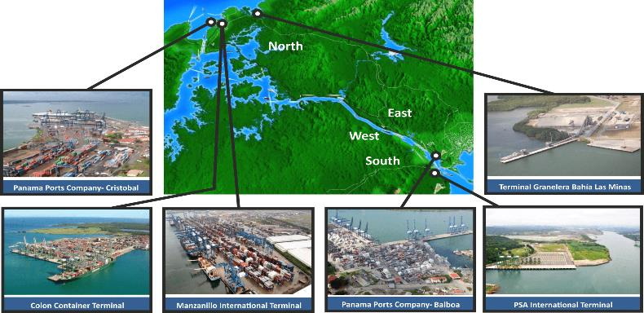

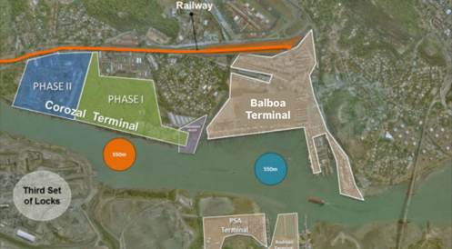
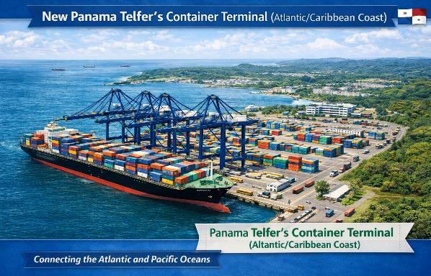
TERMINAL OVERVIEW
Main Panama Terminal 2025 | Quantity (TEUs) | Growth %
SSA Marine Manzanillo Intl. Terminal (MIT) | 2,861,352 | +5%
Panama Ports Company (Balboa) | 2,676,768 | +2%
Colon Container Terminal (CCT) | 1,736,582 | +10%
Panama International Terminal (PSA Rodman) | 1,354,708 | -2%
Panama Ports Company (Cristóbal) | 1,210,528 | +9%
Bocas Fruit | 75,419 | -53%
Corozal Container Terminal
(Pacific Coast)
Planned New Container Terminal Projects
Telfers Container Terminal
(Atlantic/Caribbean Coast)
Two new world-class container terminals planned under Panama Canal Authority concessions.
Expected to increase Panama’s container handling capacity by ~5–6 million TEUs/year on top of current levels.
Target operational timeline for these terminals is by 2029, with bidding processes and concession awards expected over 2026–2027.
AI-generated

Slide 6



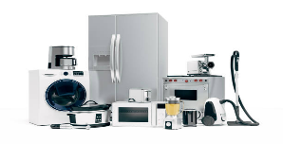

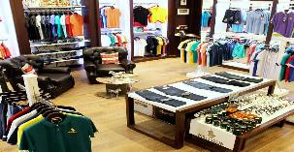
KEY CARGO COMMODITIES
Rank | Category | Estimated Share of Containerized Imports | Key Drivers
1 | Food & Beverages | 25% | Strong demand, population growth, tourism recovery, high consumption
2 | Construction | 15% | Residential, commercial and renovation projects drive demand.
3 | Electronics & Appliances | 12% | Tech innovation and middle-class growth made CFZ a key regional hub.
4 | Vehicles & Auto parts | 9% | Older vehicles need replacing; car loans rise. CFZ is a key auto transshipment hub.
5 | Textiles & Apparel | 7% | Fast fashion consumption, seasonal demand due to climate, and CFZ re-export trade

Slide 7
2025 KPI PERFOMANCE (LAD)
Trade | Own SQ KPI (Year) | Actual | %
F.E. – PA (C) | 16,599 | 19,291 | 116%

Slide 8
2025 KPI PERFOMANCE (EGA)
Trade | Own SQ KPI (Year) | Actual | %
PA – CARI | 4,732 | 4,750 | 100%
PA – F.E | 64 | 170 | 266%

Slide 9
2025 KPI PERFOMANCE (ELA)
Trade | Own SQ KPI (Year) | Actual | %
PA – WCSA | 476 | 714 | 150%
PA - WCCA | 108 | 186 | 172%

Slide 10

2025 OWN SQ KPI ACHIEVEMENT
Every single trade lane has achieved its KPI target

Slide 11
ECD / IMD KPI
ITEM | 2025 ACTUAL | 2026 KPI | Action Plan in 2026
Storage | $454,900 | $180,000 | PACCT yard utilization has dropped below 80% reducing possibility to generate DM. We will continue monitoring the empty inventory in PACCT & PABBA then request for additional FREE POOL when needed.
Lift on/off | $389,383 | $321,912 | We will continue cooperating with HQ assisting empty repo. of dry and reefer from PACCT to PABBA, in order to improve backhaul full load ratio of WSA svc and also the export cargo volume of reefer cargo out of WCSA.
Reposition | $1,076,252 | $863,376
M & R | $103,566 | $62,604 | Majority of M&R costs are for container sales following headquarter container sales policy.
ITEM | 2025 | 2026 KPI | Action Plan in 2026
90% On board within 7 Days | 46% | 90% | 1. PABBA: Have reached consensus with JV partner regarding the LAE route improvement. Fortnightly calling to Nicaragua and Honduras to reduce vessel waiting times at these heavy congested ports. 2. PACCT: Increased slot purchase on CAC service to 400TEU (+14%) per week.

Slide 12
OPD KPI
ITEM | 2025 ACTUAL | 2026 KPI | Action Plan in 2026
BOA | PACCT: OFF SLOT: 90%/ON SLOT: 96% PABBA: OFF SLOT: 91%/ON SLOT: 92% PAZJP: OFF SLOT: 86%/ON SLOT: 89% | PACCT: OFF SLOT: 90%/ON SLOT: 97% PABBA: OFF SLOT: 90%/ON SLOT: 93% PAZJP: OFF SLOT: 82%/ON SLOT: 98% | Keep monitoring vessel schedule closely. Maintain close relationship with terminals to acquire berth on arrival.
Port Stay | PACCT: 100% PABBA: 98% PAZJP: 100% | PACCT 98% PABBA 92% PAZJP 97% | 1. PACCT yard utilization has dropped below 80% since 2025H2, we have seen significant improvement since then. 2. To ensure sufficient cranes and manpower for operations and to prevent delays.
Productivity | PACCT 69 / 52 MPH PABBA 48 / 41 MPH PAZJP NIL / 35 MPH | PACCT 54 / 50 MPH PABBA 54 / 48 MPH PAZJP NIL / 52 MPH

Slide 13
OCD KPI
ITEM | 2025 | 2026 KPI | Action Plan in 2026
Incentive | PACCT: 356,538 BOXES PABBA: 11,943 BOXES | PACCT: 289,696 BOXES PABBA: 9,200 BOXES | NUE/AUE & WSA services have capacity increase of 9% and 6% respectively. We expect to achieve our target thanks to increased cargo volume.
Empty Storage | $454,900 | $180,000 | PACCT yard utilization has dropped below 80% reducing possibility to generate DM. We will continue monitoring the empty inventory in PACCT & PABBA then request for additional FREE POOL when needed.
Rate Reduction | Strive for terminal fees exemption and to increase Free Pool/Days | Strive for terminal fees exemption and to increase Free Pool/Days | Maintain good relationship and communication with the terminals and strive for exemption on empty container storage fees, reductions in transshipment container rates, terminal rates, and container shifting charges, as well as more flexible free pool for our empties.

Slide 14


2026 Strategy
How to Achieve KPI Goals

Slide 15



HOW TO ACHIEVE 2026 OWN SQ
Trade / BCC | Target (Year)
F.E. – PA (C) | 20,104 (+4%)
Trade / BCC | Target (Year)
PA – CARI | 4,762 (+1%)
Trade / BCC | Target (Year)
PA – WCSA/WCCA | 721 (+1%)
Secure NVOCC, MTA customers and Direct shipments including long-haul cargoes.
Will diversify our client portfolio and enhance revenue predictability. This strategy enables streamlined operations and stronger partnerships, driving sustained growth and improved logistics performance.
Client acquisition in new logistics park and emergins free zones.
Attracting regional and global customers seeking efficient, cost-effective, and well-connected supply chain solutions. This strategy will drive new customer growth and increased cargo volumes.
Targeted commodity and Project cargo.
By focusing on these high-impact customers, tender accounts and government projects we can increase container throughput efficiency.
Long term customer partnership.
Move from transactional relationship to strategic alliances.
Collaborates with loyal customers on growth initiatives.

Slide 16







LONG TERM CUSTOMER PARTNERSHIP
2
MAY’S
Sales Leads and BIZ cooperation with other offices.
2,281 TEUs
GDSM
04
CASA BEE’S
ABDALA ZL
03
Strategic commercial trips to the country’s interior.
3,813 TEUs
Electronics.
1,234 TEUs
Hardware tools
1
3
2025
TOP 6 A/Cs:
02
~56%
UMS
Digitalization of services such as Electronic Release and ACH express.
KENNEDY CORP
Total Own SQ
UMS
KRYSTAL
01
890 TEUs
Furniture and textile
C trade
6
1,169 TEUs
GDSM
4
Promotion of premium services including Smart reefers.
EXPEDITORS
995 TEUs
Electronics and Telecom
5

Slide 17


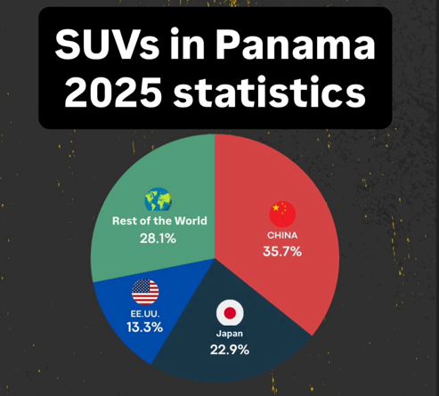
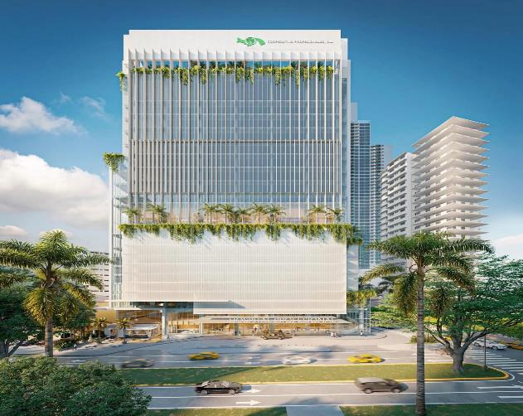
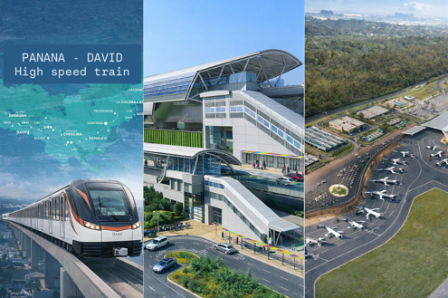






TARGETED COMMODITY AND PROJECT CARGO
Cars from China
Active Projects
Future Projects

Slide 18
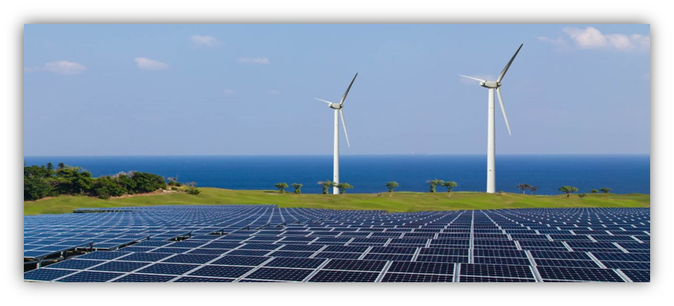

TARGETED COMMODITY AND FUTURE PROJECT
Renewable Energy & Infrastructure Projects
Potential clients: EPC contractors, energy developers, project cargo forwarders.
National projects such as:
Solar Farm Expansions (Chiriquí)
Panama Canal-Linked Energy Corridor
Target markets for Re-Export: C. America & Caribbean infrastructure projects.
Focus on containerized cargo for renewable energy projects (solar panels, inverters, lithium batteries, wind components).

Slide 19


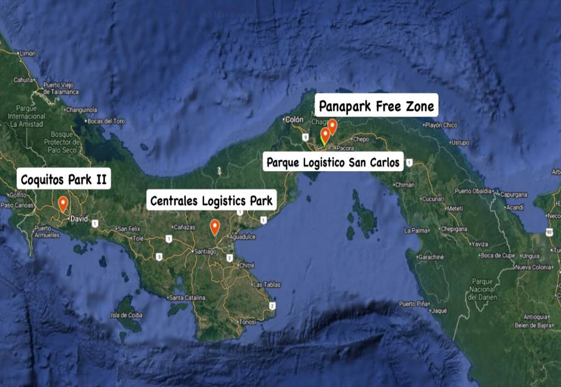
NEW LOGISTICS PARK
Logistics Parks & Warehousing Expansion
Panama is expanding its logistics footprint
beyond ports including into the provinces:
Coquitos Park II
17 ha logistics hub in San Pablo, Chiriquí
(up to ~68,000 m² warehouse space).
Centrales Logistics Park
Multi-phase ~40,000 m² warehouse facility in Herrera.
Parque Logístico
San Carlos
Panapark Free Zone
6 km from Tocumen I Airport
~ 39 km from Pacific ports
~89 km from Atlantic ports
Connected to major highways and intermodal corridors.

Slide 20





MTA CUSTOMERS AND DIRECT SHIPMENTS
Multinational Regional Headquarters & Distribution Centers in PAPNM
Nestlé Panama
Recently inaugurated an expanded distribution center in the Parque Sur, PAPNM. (40 % increase in storage space).
LG Electronics Panama
Established a new HVAC products and B2B Solutions Center for Latin America in Panama City.
Unilever Panama
Panama was chosen as a platform to centralize order processing and supply chain services for multiple countries across Central America and WCSA.
Samsung Electronics Panama
The Asia–Panama–LATAM trade lane is growing due to nearshoring of electronic components. Projected to grow 5–7% in 2026.

Slide 21


THANK YOU

