Slide 1


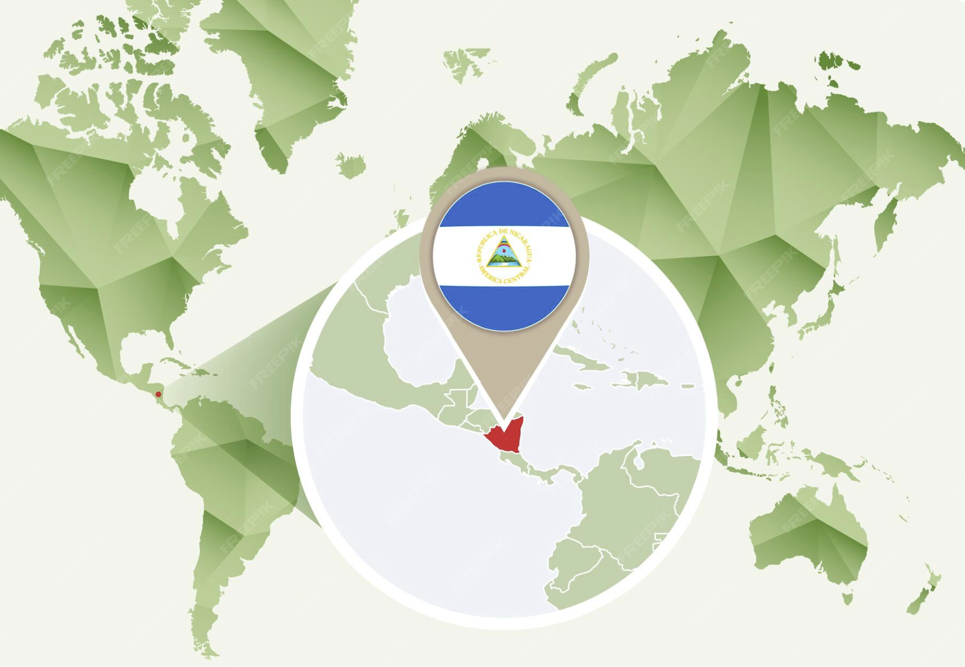

Nicaragua
Business Report
2026 LATIN AMERICA AGENCY MEETING

Slide 2









AGENDA
Economic Status
Cargo Flow
GDP Forecast , Inflation , USA Tariff
Import/Export
2025 KPI
Operations KPI
Performance Review (LAD/EGA/ELA)
ECD/IMD & OCD/OPD Review
2026 Goals
Strategy & Targets

Slide 3

CURRENCY: CORDOBA
OVERVIEW
POPULATION: 7,100,000
HONDURAS TO THE NORTH AND COSTA RICA TO THE SOUTH
GOVERNMENT
CONSTITUCIONAL DEMOCRACY WITH EXECUTIVE, JUDICIAL AND ELECTORAL BRANCHES.
TRADE AGREEMENTS
CAFTA-DR: USA,CENTRAL AMERICA, DOMINICAN REPUPLIC
FTA: CHINA
AACUE: EUROPEAN UNION
TLC: MEXICO
ALBA: CUBA, VENEZUELA, CARIBBEAN ISLANDS.
MAIN INDUSTRIES
TOURISM
APPAREL
AGRICULTURE
SERVICES

Slide 4

ECONOMIC STATUS
Nicaragua continues to show solid economic growth
Nicaragua GDP growth in 2025: 3.0%
Projected growth for 2026: ~3.5–4.5% Growth is expected to moderate slightly due to weaker global demand, but the outlook remains positive.
Nicaragua Inflation
Inflation has remained around -2.70% for 2025.
It is expected to maintain close to 3.5% for 2026.
U.S. Tariffs (Nicaragua)
U.S. tariffs on Nicaraguan exports were increased to 18% after President Donald Trump imposed a new tariff for import but excludes sensitive commodities such as beef and coffee which continue to be regulated by DR-CAFTA agreement.

Slide 5

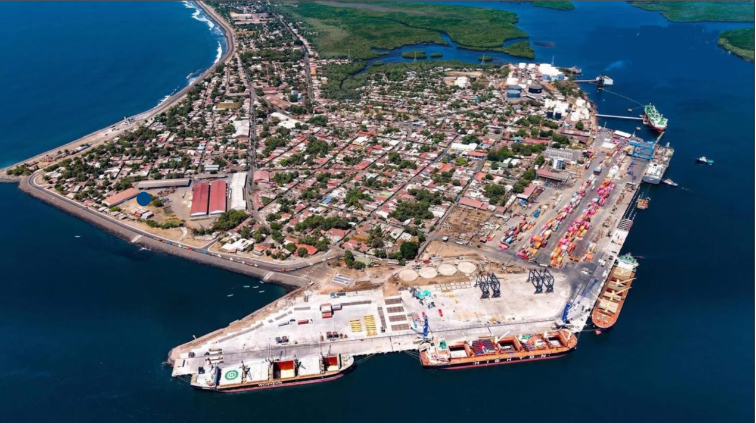






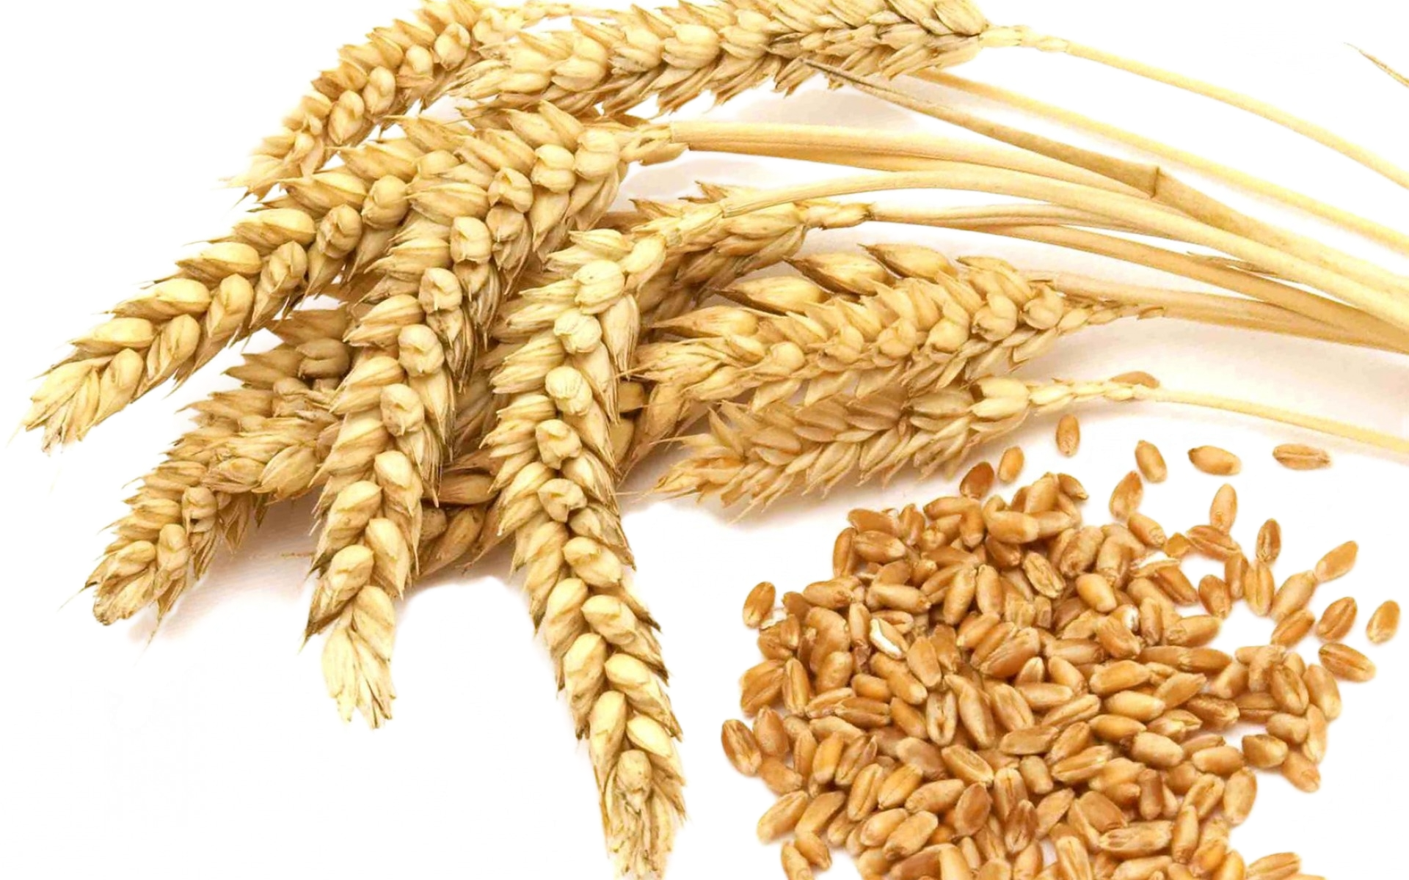




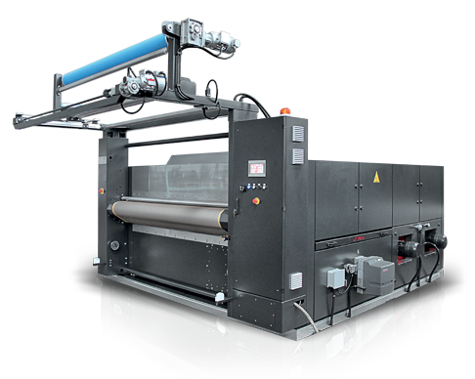
35%
2025/2026 COUNTRY CARGO FLOW STATUS / NI
IMPORTS
CORINTO PORT
EXPORTS
Asia - FAK, Fertilizers, Herbicides
- Vehicles, Tiles, Hardware
India | China
Scrap
Wood
Sugar
U.S.A | México
- Tiles, Raw Material
- Grains
United States
Bananas, Coffee,Peanuts
Apparell
Cigars
Other Origins
Machinery parts
Other Destinations
Peanuts, Sugar
Tobacco, Cigars

Slide 6

2025 Why can’t achieve KPI
The main issues experienced in 2025 to achieve the KPI
LAE in the Pacific & CAW in the Atlantic are services with extremely limited allocation.
Peak season collapse LAE & CAW services, accumulating thousand of containers at T/S ports and increased customer complaints.
Regional cargoes are limited by space with rates over market.
Central American inefficient ports creates unsteady schedules and longer transit times.
Cancelled bookings at origin ports, even with reminders due to limited space.
Frequent SKIP of vessels to NICPK with market deterioration and customer loss.

Slide 7
ECD / IMD KPI
ITEM | 2025 | 2026 KPI | Action Plan in 2026
Storage | US$11 260 | N/A | Subject to the volume in 2026 and LAE service stability. A new window for berthing in May 2026 will reduce vessel wait times.
Lift on/off | US$474 515 | N/A | Subject to the volume to be handled in 2026.
Reposition | US$684 210 | N/A | Subject to the volume in 2026. Increased Corinto Port capacity and stable service will contribute to greater efficiency and decreased costs.
M & R | US$0,00 | N/A | There is no M&R at CR
ITEM | 2025 | 2026 KPI | Action Plan in 2026
Cost Saving Project | N/A | N/A
90% Onboard within 7 Days | N/A | N/A | N/A
No Personal Negligence | N/A | N/A | No personal negligence case until now.

Slide 8
OCD / OPD KPI
ITEM | 2025 | 2026 KPI | Action Plan in 2026
BOA NICPK | No Window | No Window | Port Authority Manager has confirmed Berth Window will be available in early May 2026 as the expansion project will be completed and all piers with extensions operational.
Port Stay NICPK | 36 hrs | 36 hrs | Berth time was reduced from 40 hours to 36 due to increased operational efficiency at port, increasing vessel rotation and capacity.
Productivity (NICPK) | 35 | 35 | With port expansion project completion capacity will increase by 40%, with reduced berth wait times and quicker container mobilization.
ITEM | 2025 | 2026 KPI | Action Plan in 2026
Incentive | N/A | N/A | Port tariff are published for all users per equal conditions with no incentives
Empty Storage | N/A | N/A | No rate reduction for NICPK port or logistics yard terminals
Rate Reduction | N/A | N/A | No rate reduction for NICPK port or logistics yard terminals

Slide 9


2026 Strategy
How to Achieve KPI Goals

Slide 10



HOW TO ACHIEVE 2026 OWN SQ?
Trade | Target (Year)
F.E. – CR+NI (C) | 743
F.E. – CR+NI (Q) | 4,371
Trade | Target (Year)
CR+NI – CARI (CC) | 1,248
CR+NI – USEC (610) | 312
Trade | Target (Year)
CR+NI – CARB+WCCA (CB) | 605

Slide 11
2026 ACTION PLAN
Increased communication with POLs, BCC and Space Controller to ensure bookings are confirmed as many are currently cancelled.
Competitive rates to those within the market in order to increase bookings and SQ fillings.
Maintain minimum 17 free days NICPK for import cargoes and in the future increased to 21 as direct competitors.
Promote sales leads to POL offices for all cargoes CIF and FOB.
Request ELA office to proactively reduce transit time by allocating additional feeder space in advance, ahead of transshipment port congestion. Delays in transit are one of the primary reasons for market share loss.
Priority status for containers at PABBA and on route to NICPK.
Reduce NICPK vessel SKIP for increased customer confidence and improved service.
Secure long-term volume commitments to maximize cargo volume.
Coordinate with ELA effective empty evacuation volumes per vessel to ensure minimum idle aging containers at NICPK. Port allowing a 10-day advance coordination to evacuate up to 300 empty containers per vessel.
Q Trade
Far East – Corinto port

Slide 12
2026 ACTION PLAN
CC Trade
Need Upgrading the feeder service is critical to improve CC + 610 trade growth. Our current allocation and transit times are far from competitive market standards.
The United States is one of Nicaragua important trading partners and represents important opportunity.
Evergreen lifting from NI for 610 Trade is important and there is important volume possible.
A) NI has been unable to secure space for 610 trade in 2025 and need support for increased share.
B) Request 350 TEU space for NI in 2026.
NI - Moín port - Caribbean
610 Trade
NI - Moín port – United States
CB Trade
Manzanillo, MX drives the majority of CB trade volume. Sustained liner support and year-round allocation stability are critical to unlocking further growth.
We can boost our pipeline with accounts like SINSA (Tiles), Walmart, Mabe and Coca Cola; the main action plan must come from Evergreen by improving the LAE service and limit SKIP of NICPK.
Mexico – Corinto port

Slide 13

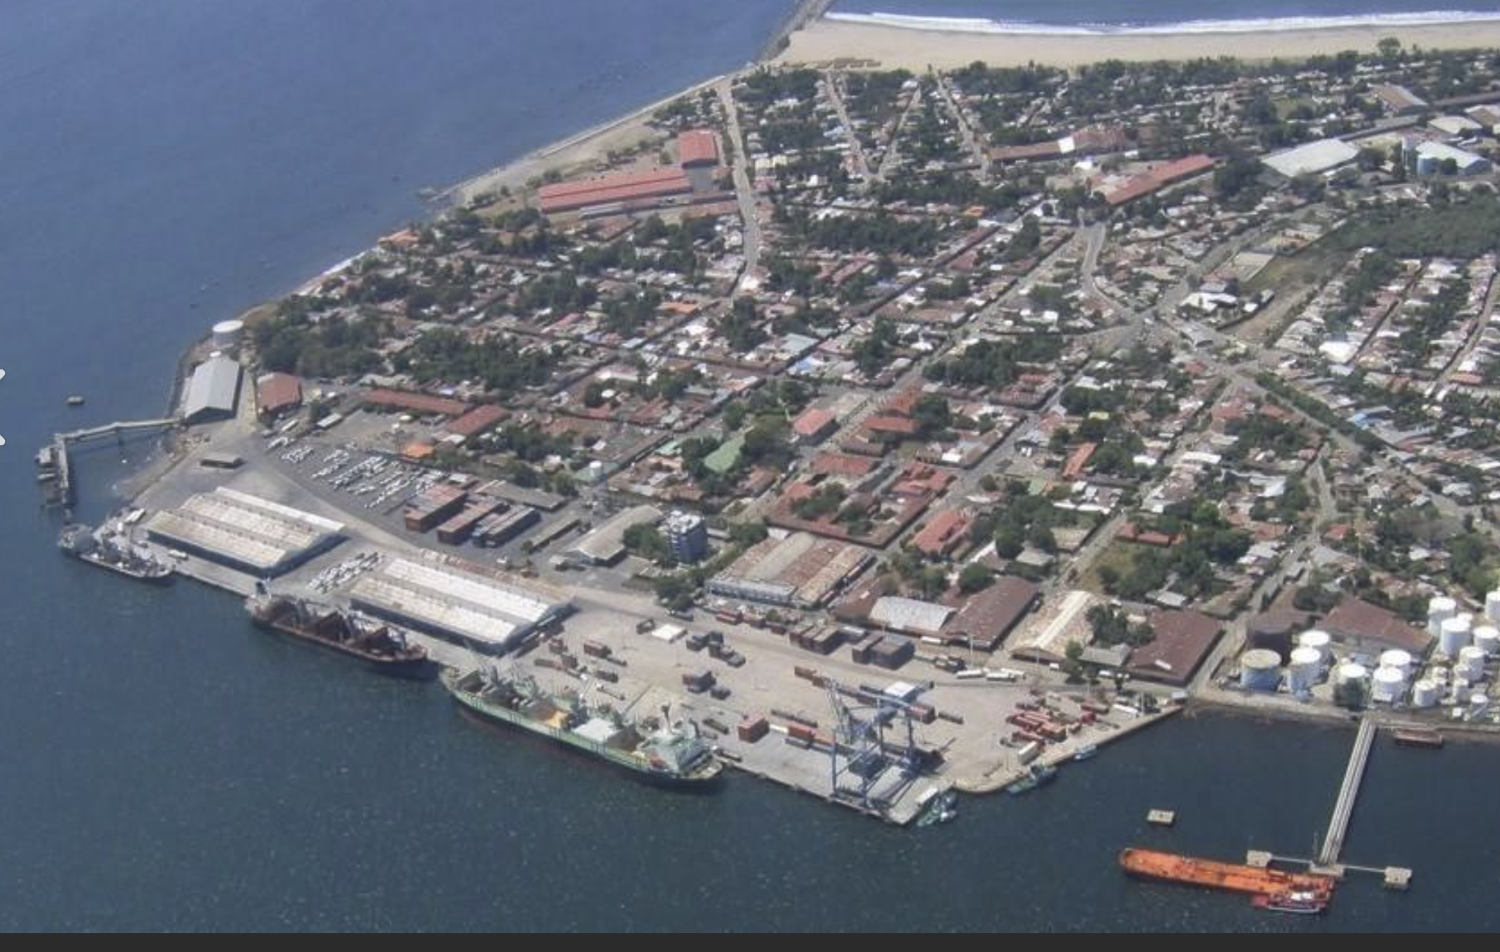
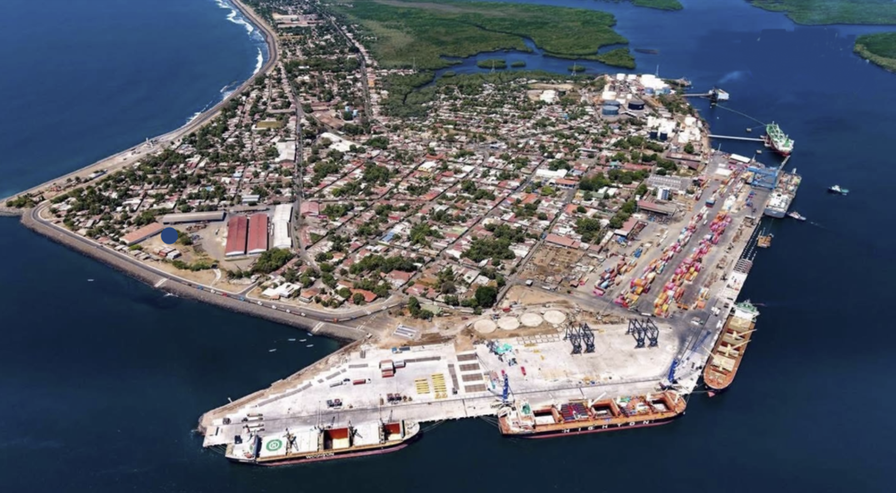
CORINTO PORT | NICARAGUA (Expansion)
PRIOR TO EXPANSION PROJECT
EXPANSION ALMOST COMPLETED
Breakwater
Yard: 62,550 m2
Capacity: 6,000 FEU
Piers: 3
Yard: 200,000 m2
Capacity: 14,000 FEU
Piers: 5
PIER No 1 / 10.5 METERS
ONLY CONTAINERS
PIER No 2 / 9.5 METERS
CRUISES & GRAL CARGO
New Berth Window opportunity in May 2026 opportunity. Pier 3 will have concluded its expansion.
Julia Herrera de Pomares Port Yard in 2023: 100,000 m2. 3,360 container capacity.
36 hour Berth window per vessel.

Slide 14
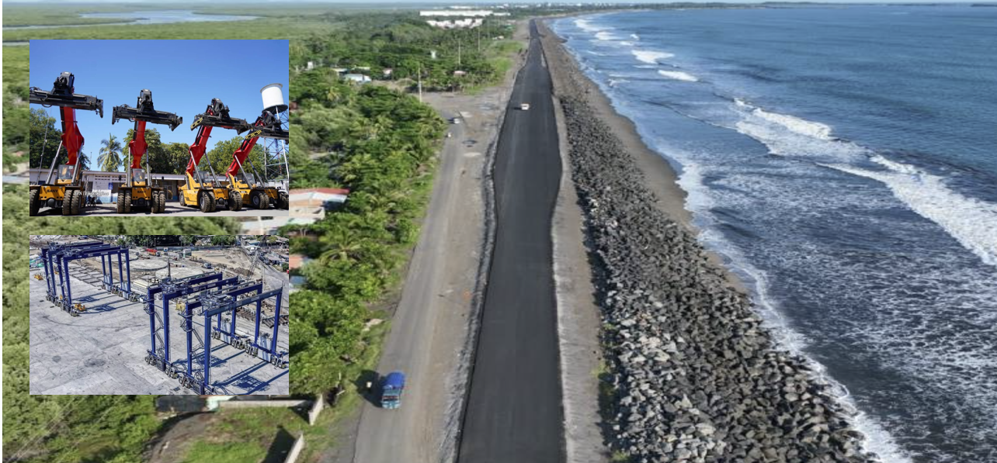
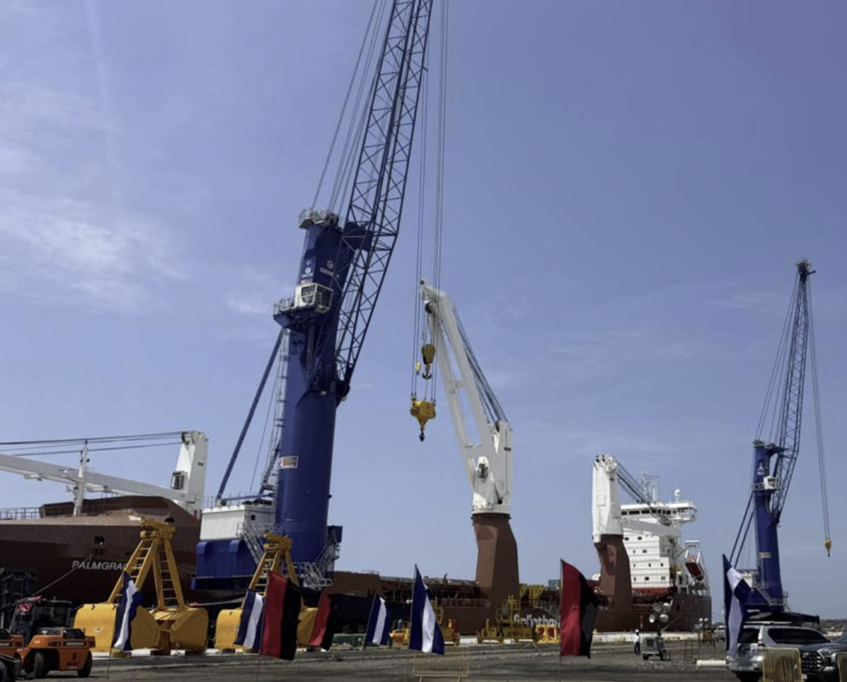
CORINTO PORT EXPANSION | NICARAGUA
Increased Efficiency
New Truck Roadway for quick dispatch and reduced delays
67% increase in Reach Stackers (12 to 20)
4 new RTGs at Port for 5 high stack and 133% increased capacity
2 new Mobile Cranes
300 empty container per vessel with 10-day advance notice.
New vessel windows in May 2026.
Increased LOA to 220m, Draft 11m in 2 new piers

