Slide 1






Costa Rica
Business Report
2026 LATIN AMERICA AGENCY MEETING
Port of Moín, CR
Port of Caldera, CR

Slide 2









AGENDA
Economic Status
Cargo Flow
GDP Forecast , Inflation , USA Tariff
Import/Export
2025 KPI
Operations KPI
Performance Review (LAD/EGA/ELA)
ECD/IMD & OCD/OPD Review
2026 Goals
Strategy & Targets

Slide 3
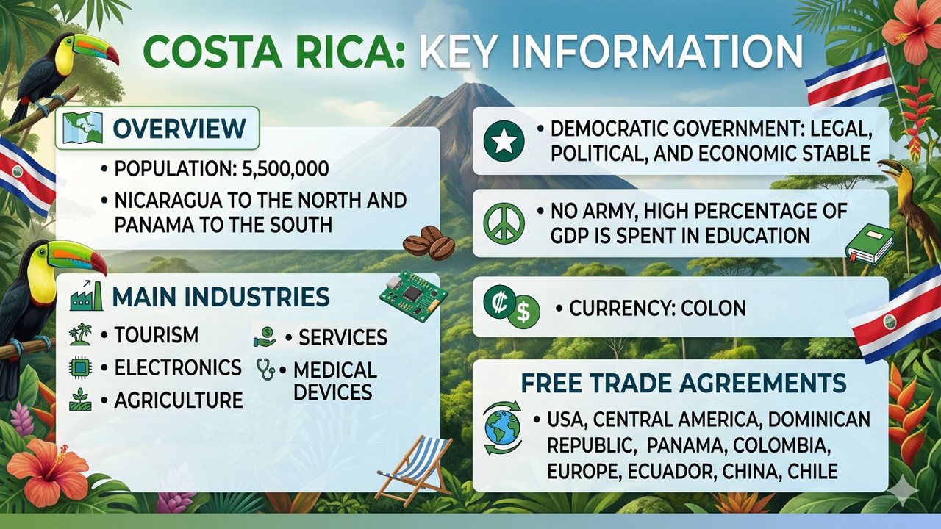

Slide 4


ECONOMIC STATUS
Costa Rica continues to show solid economic growth
Costa Rica GDP growth in 2025: 4.5%
Projected growth for 2026: ~3.7–3.9%
Growth is expected to moderate slightly due to weaker global demand, but the outlook remains positive.
Costa Rica Inflation
Inflation has remained around -1.23% for 2025.
It is expected to maintain close to 0% for 2026.
U.S. Tariffs (Costa Rica)
U.S. tariffs on Costa Rican exports were reinstated at 10% (down from 15%) after President Donald Trump reimposed them under a different legal authority.

Slide 5




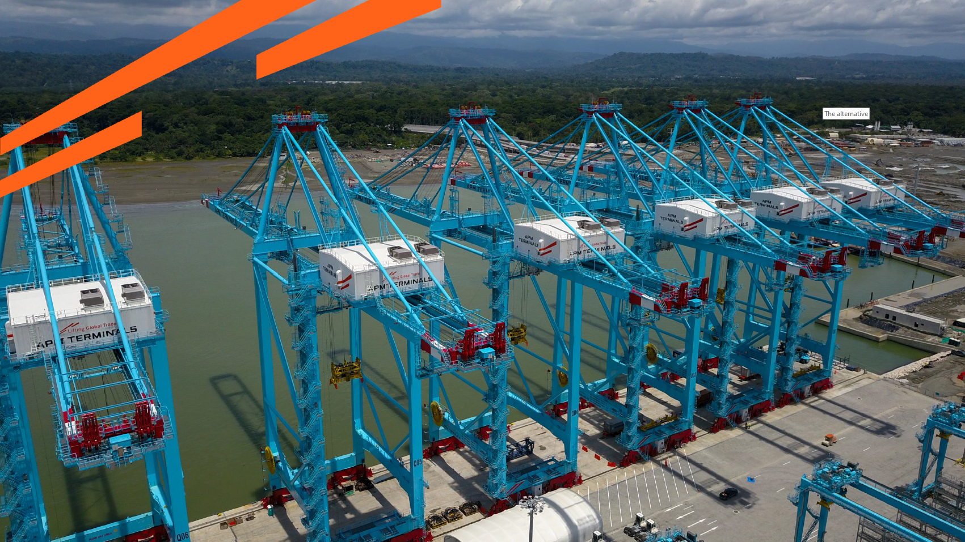



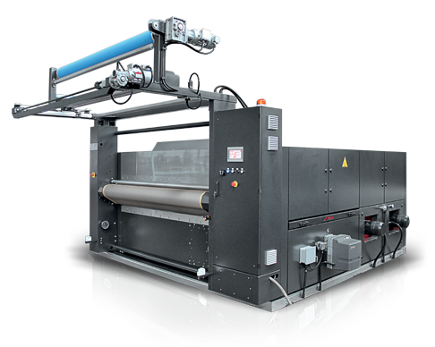




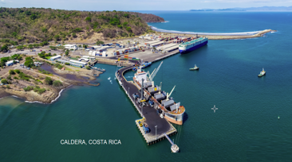




35%
2025/2026 COUNTRY CARGO FLOW STATUS / CR
IMPORTS
MOÍN PORT
EXPORTS
United States
- Raw Material
- Beverages
Europe
- Fresh Pineapples
- Bananas
South América
Raw Material
Building materials
United States
- Fresh Pineapples
- Bananas
- Medical Devices
Other Origins
Machinery parts
Chemicals
Other Destinations
Food products
Textiles
IMPORTS
CALDERA PORT
EXPORTS
Asia
- FAK
India | China
Scrap
Teak Wood
Meat
U.S.A | México
- Raw Material
- Chemical products
United States
- Fresh Pineapples
- Bananas
Other Origins
Machinery parts
Chemicals
Other Destinations
Agri-Products
Manufactures

Slide 6
2025 OWN SQ KPI PERFORMANCE (LAD)
Trade | OWN SQ KPI (Year) | ACTUAL | %
F.E. – CR (C) | 372 | 698 | 188%
F.E. – CR+NI (Q) | 5,249 | 3,642 | 69%
CR+NI – F.E. (CF) | 4,726 | 5,427 | 115%
Key Drivers
C Trade: The commercial strategy is being redirected towards developing the Port of Moín to reduce the impact caused by the limitations of the LAE service.
Q Trade: Despite all commercial efforts to increase volume, the limitations of LAE service had a significant impact on liftings, besides Caldera port facilities issues.
CF Trade: We successfully sustained stable volumes year-round, backed by solid liner support.

Slide 7
2025 KPI PERFORMANCE (EGA)
Trade | OWN SQ KPI (Year) | ACTUAL | %
CR – CARI (CC) | 1,032 | 251 | 24%
CR – USEC (610) | 246 | 195 | 79%
Key Drivers
CC / 610 Trades: We want to encourage PJD to deploy a feeder service (PACCT-CRMOB-PACCT) with enough allocation to increase lifting an improve market share.
CC trade based on 47 CAN sailings, 48 CAC sailings, 28 CAJ sailings, and 43 CAW sailings.
610 trade based on 41 weeks; wk23 and wk53 - all 610 cargo were rolled-over by LOG/NAD

Slide 8
2025 KPI PERFORMANCE (ELA)
Trade | OWN SQ KPI (Year) | ACTUAL | %
CR+NI – CARB+WCCA (CB) | 1,214 | 800 | 66%
CR+NI – WCSA (CW) | 397 | 80 | 20%
Key Drivers
CB Trade: This is one of the trades with room for growth, mainly from Mexico where the nearshoring increased the import volume. However, once again, LAE space limitations restricts our capacity to develop this trade.
CW Trade: The CW routings are heavily affected by restrictions in rate and allocation. We have a strong opportunity to grow and develop significant volume in this trade with proper liner support.

Slide 9

2025 Why can’t achieve KPI
The main issues experienced in 2025 to achieve the KPI
LAE in the Pacific & CAW in the Atlantic are services with extremely limited allocation.
Peak season collapse LAE & CAW services, accumulating thousand of containers at T/S ports.
Regional cargoes are limited by space and over market rates.
Central American inefficient ports creates unsteady schedules.

Slide 10
ECD / IMD KPI
ITEM | 2025 | 2026 KPI | Action Plan in 2026
Storage | US$109 605 | US$264 192 | Subject to the volume to be handled in 2026.
Lift on/off | US$117 792 | US$158 796 | Subject to the volume to be handled in 2026.
Reposition | US$669 113 | US$497 760 | Subject to the volume to be handled in 2026.
M & R | US$0,00 | US$0,00 | There is no M&R at CR
ITEM | 2025 | 2026 KPI | Action Plan in 2026
Cost Saving Project | N/A | N/A
90% Onboard within 7 Days | N/A | N/A | N/A
No Personal Negligence |  |  | No personal negligence case until now.

Slide 11
OCD / OPD KPI
ITEM | 2025 | 2026 KPI | Action Plan in 2026
BOA CRCAL | On Window 100% | On Window 100% | Both ports will attend container vessels as per BW agreement. In CRCAL port there’s the possibility to arrive off window (extra caller) requesting to port operator the same in advance
BOA CRMO Port Stay CRCAL | On Window 100% 24 hrs | On Window 100% 24 hrs | If LAE improves the current vessel figures, we expect to request increased port operational capacity.
Port Stay CRMOB Productivity (CRCAL) Productivity (CRMOB) | 13 hrs 35 70 | 13 hrs 35 70 | As per actual infrastructure will remain the same.
ITEM | 2025 | 2026 KPI | Action Plan in 2026
Incentive | N/A | N/A | Port tariff are published for all users per equal conditions with no incentives
Empty Storage | N/A | N/A | No rate reduction for CRCAL and CRMOB port terminals
Rate Reduction | N/A | N/A | No rate reduction for CRCAL and CRMOB port terminals

Slide 12


2026 Strategy
How to Achieve KPI Goals

Slide 13



HOW TO ACHIEVE 2026 OWN SQ?
Trade | Target (Year)
F.E. – CR (C) | 743
F.E. – CR+NI (Q) | 4,371
Trade | Target (Year)
CR – CARI (CC) | 1,248
CR – USEC (610) | 312
Trade | Target (Year)
CR+NI – CARB+WCCA (CB) | 605

Slide 14
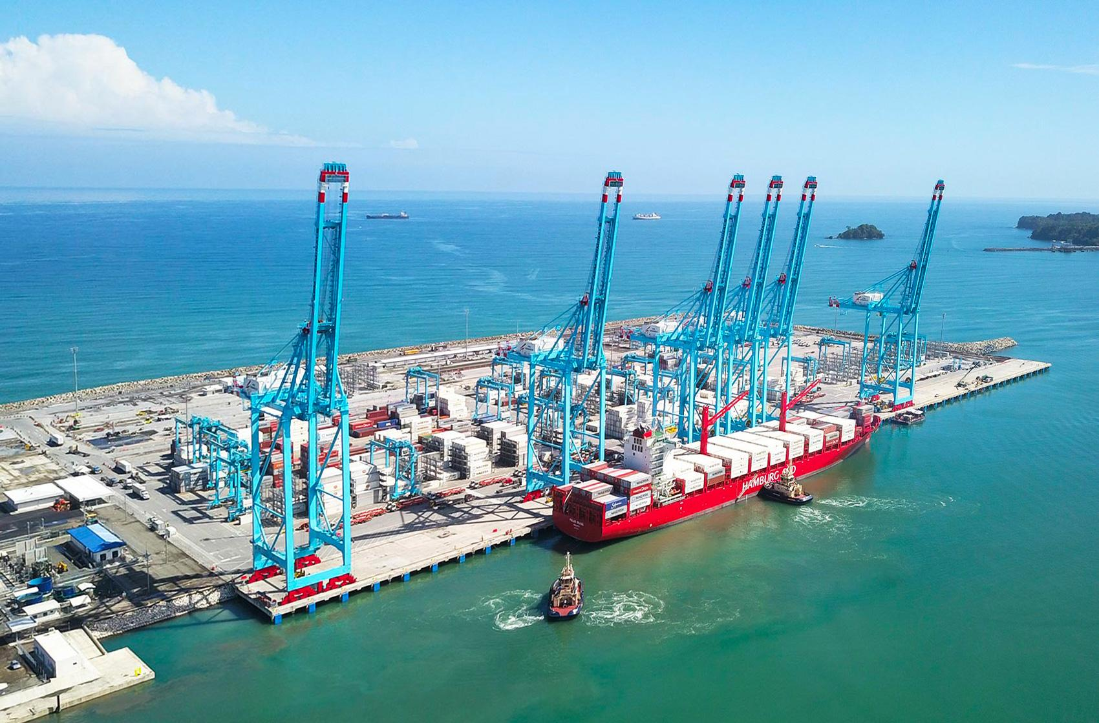
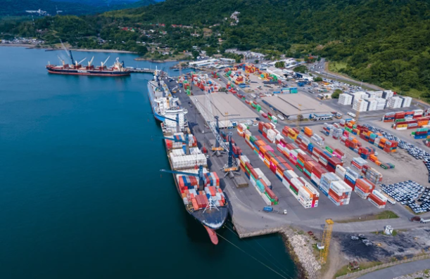
2026 ACTION PLAN
C Trade
Moín Port is strategically positioned to significantly increase Costa Rica’s import volumes from the Far East. The infrastructure, location, and market demand clearly support immediate expansion.
Allocation increase and improve transit times are the two critical growth levers to aggressively develop the C trade and capture additional market share.
We have proactively provided TPE PJD with all the information to launch a direct feeder service to connect with Moín Port to develop volume growth.
A strong, targeted commercial campaign will be executed to aggressively promote the Moín Port service and maximize market share.
Far East – Moín port
Q Trade
Increase the level of communication with POLs to secure booking confirmations on time.
Promote a systematic sales lead sharing process between POL and POD offices.
Request ELA office to proactively secure transit time by allocating additional feeder space in advance, ahead of transshipment port congestion.
Secure long-term volume commitments to maximize cargo volume.
Far East – Caldera port

Slide 15
2026 ACTION PLAN
CC Trade
Upgrading the feeder service is critical to improve CC + 610 trade growth. Our current allocation and transit times are far from competitive market standards.
Evergreen lifting is below 1% for CC & 610 trades:
A) Our share for the CC trade in 2025 was 251 TEUs out of a total market volume of 13,000 TEUs.
B) Our share for the 610 trade in 2025 was 195 TEUs out of a total market volume of 34,000 TEUs
Moín port - Caribbean
610 Trade
Moín port – United States
CB Trade
Manzanillo, MX drives the majority of CB trade volume. Sustained liner support and year-round allocation stability are critical to unlocking further growth.
We can boost our pipeline with accounts like Walmart, Mabe and Coca Cola; the main action plan must come from Evergreen by improving the LAE service.
Mexico – Caldera port

Slide 16
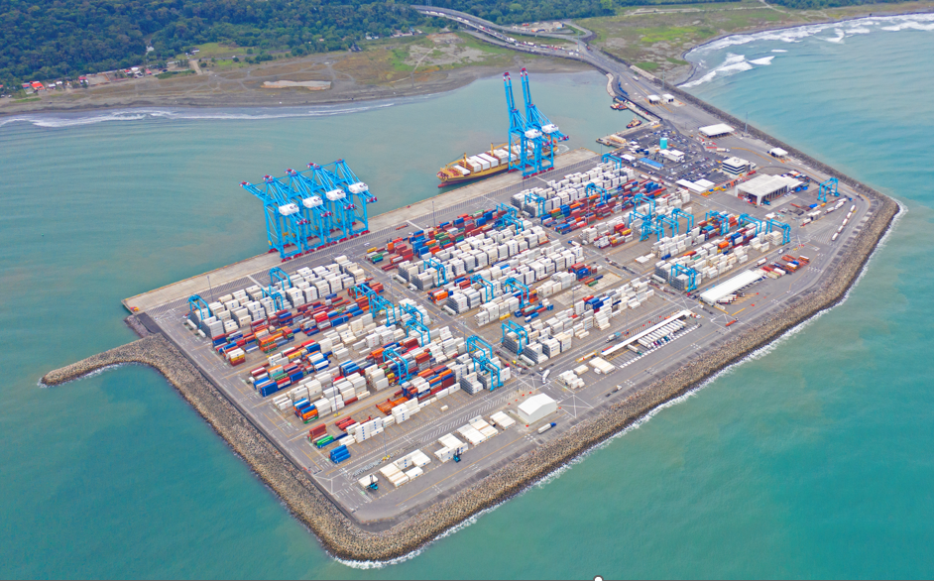
MOIN PORT | COSTA RICA
The Moín port was built on an artificial island off the Caribbean coast of Costa Rica.
It’s operational since February 2019.
At a glance
Annual capacity of 1.2m TEU
Covers around 40 hectares
650-meter quay
13.3 meters Draft
18-meters deep access channel
Super Post Panamax STS Cranes
29 electric rubber-tired gantry (eRTG) cranes
Reefer plugs: 4,000

Slide 17
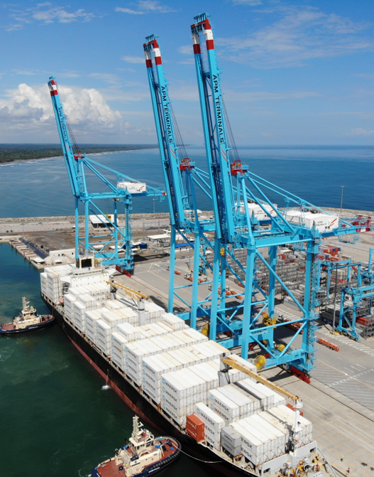
MOIN PORT | COSTA RICA
OPPORTUNITIES
The Balboa T/S removal in LAE can be mitigated by developing Moín port.
Increasing market share in the Far East–Costa Rica trade lanes. Berthing windows availability.
High productivity port – up to 84 moves/hour by vessel.
Able to berth 12.000 Teus container ships.
No delays, 0 days closed in 2025.
Reefer service to USEC.
Grow regional trade volumes.

Slide 18
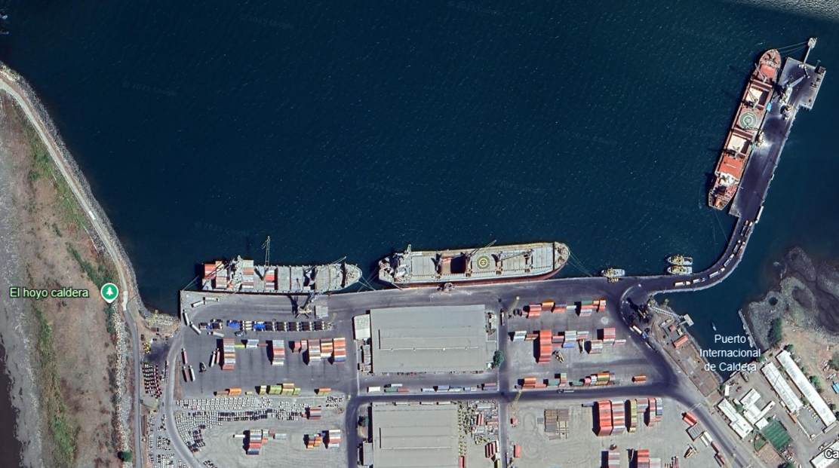

CALDERA PORT | COSTA RICA
There is only one position for container carriers.
Two mobile cranes operates at a low productivity rate of 15 moves per hour, per crane.
The port is closed an average of 45 days per year due to heavy swells.
Berthing window reduction from 36 hours to 24 hours.
Breakwater
PIER No 3 / 9.5 METERS
BULK CARRIERS ONLY
PIER No 1 / 10.5 METERS
ONLY CONTAINERS
PIER No 2 / 9.5 METERS
CRUISES & GRAL CARGO
Under concession of SAAM Terminals

Slide 19
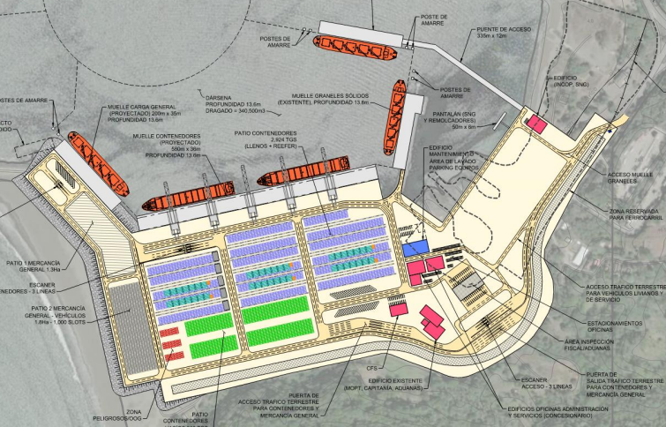
CALDERA PORT / NEW CONCESSION PROCESS
Phase 1: Q1 2026 Admissibility
Review of compliance, administrative and legal.
Phase 2: Q1 2026
Award Decision
Consortium Sunset HGT and APM Terminals were the companies awarded, they met the admissibility requirements.
Phase 3: Q2 2026
Post-Award Stage
Once the process is awarded:
An appeal period of 45 days opens, which ends on April 19th, 2026
Once this period concludes without any appeal, the concession contract is signed.
Phase 4:
Construction
2027–2028: Start of the main expansion works

Slide 20

CALDERA PORT NEW CONCESSION | COSTA RICA
New structure should be ready, 2030
OPERATIONAL LIMITATIONS DURING CONSTRUCTION AND PORT IMPROVEMENT
New concession will bring
5 STS Cranes
Draft of 13,6 mts
580 meters quay
Container Yard of 13 Hectares
Post Panamax Vessels

