Slide 1


Business Report
2026 LATIN AMERICA AGENCY MEETING

Slide 2
HONDURAS
2026 LATIN AMERICA AGENCY MEETING

Slide 3









AGENDA
Economic Status
Cargo Flow
GDP Forecast , Inflation , USA Tariff
Import/Export
2025 KPI
Operations KPI
Performance Review (LAD/EGA/ELA)
ECD/IMD & OCD/OPD Review
2026 Goals
Strategy & Targets

Slide 4
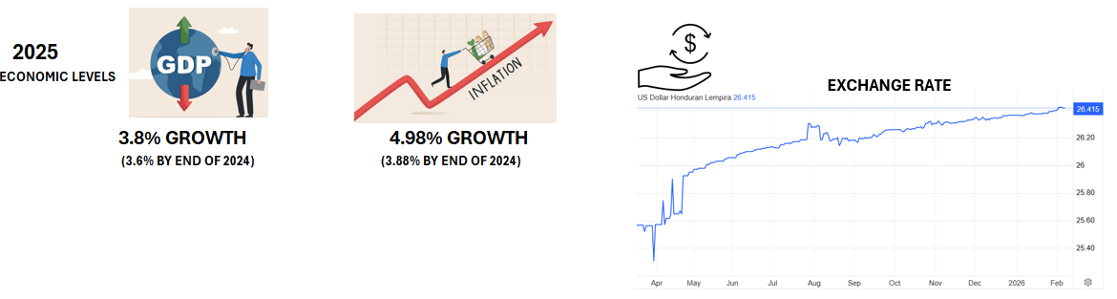


ECONOMIC STATUS
2026 FORECAST:
GPD growth expected for this year to reach a 4.0%
New government elected with high expectancy to attrack foreign and domestic investment.
Strenghthening of diplomatic and commercial relationship between Honduras and United States will bring new
economic opportunities to the country by the reduction of tariffs imposed to the past left oriented government and the new capital investments
expected because of a better economic climate.
Currency stability expected due to the implementation of local and foreign monetary programs by the new government.
Growth is supported by increased public investment in infrastructure, steady remittances, and a partial recovery in coffee exports.
New government in plans to incorporate Free Trade Agreement and diplomatic relationship with TAIWAN by mid 2026.

Slide 5
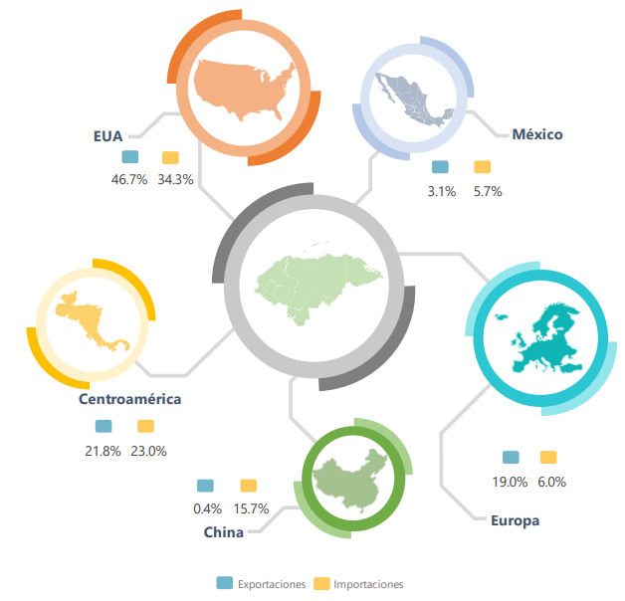
2025/2026 COUNTRY CARGO FLOW STATUS
TOTAL TEUS: 1,004,378
MAIN IMPORT COMMODOTIES:
FUELS
MACHINERY AND PARTS
VEHICLES
GDSM
TEXTILES
MAIN EXPORT COMMODOTIES:
COFFEE
FINISHED GARMENTS
BANANAS
AUTOMOTIVE TIER 2 AND COMPONENTS
SHRIMPS

Slide 6
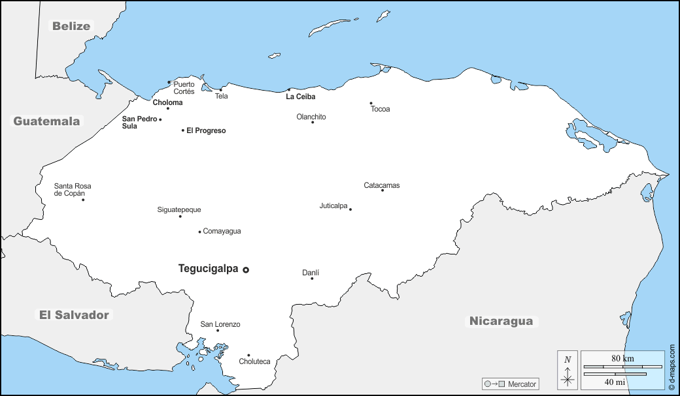
2025/2026 COUNTRY CARGO FLOW STATUS
11.70% increase
12, 003 TOTAL TEUS
27.39% increase

Slide 7
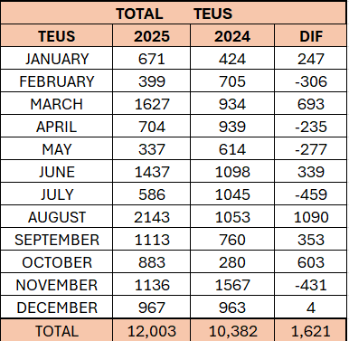
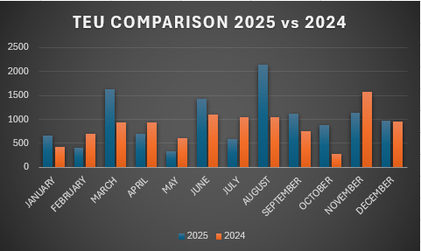

2025/2026 COUNTRY CARGO FLOW STATUS
HONDURAS TOTAL CARGO MOVEMENT
13.50 %

Slide 8
2025 KPI PERFORMANCE (LAD)
Trade | OWN SQ KPI (Year) | ACTUAL | %
F.E. – HN (Q) | 1,558 | 1,375 | 88%
F.E. – HN (C) | 364 | 512 | 141%
HN – F.E. (CF) | 383 | 397 | 104%

Slide 9
2025 KPI PERFORMANCE (ELA)
Trade | OWN SQ KPI (Year) | ACTUAL | %
HN – WCCA/CARO (CB) | 81 | 23 | 28%
HN – WCSA (CW) | 237 | 189 | 80%

Slide 10

2025 Why can’t achieve KPI
Q trade:
Could not achieve due to LAE service unstable schedule making clients choose other ports to receive cargo, some shipments got 120 days transit time which cause much insatisfaction in regular and VIP accounts
CB trade:
Rates not under market rate level, we could not be competitive with the rest of the carriers, our levels were USD500-USD800 higher most of the year. When we received the CAJ service we got competitive rate levels.
CW trade:
Rates not under market rate level, loosing around one thousand teus per year.

Slide 11
ECD / IMD KPI
ITEM | 2025 | 2026 KPI | Action Plan in 2026
Storage | N/A | N/A
Lift on/off | $148,166.10 | $200,940.80 | Difference due to increase of in/out cargo.
Reposition | $ 200,533.50 | $204,803.50 | Due to LAE service instability and accumulation of idle equipment at HNSLOT.
M & R | $4,140.00 | $4,475.86 | M&R’s were approved for empty 4RH for frozen shrimp exports only
ITEM | 2025 | 2026 KPI | Action Plan in 2026
Cost Saving Project | N/A | N/A
90% Onboard within 7 Days | N/A | N/A
No Personal Negligence | 0 | 0

Slide 12
OCD / OPD KPI
ITEM | 2025 | 2026 KPI | Action Plan in 2026
BOA | 2hrs | 2hrs | HNSLO terminal will give preference to container vessels which maintained same period as last year, although fixed berthing window is still not approved, vessels will be attended under first come, first serve.
Port Stay | 32 hrs | 32 hrs | CONSERSA, stevedore company improved vessel crane operativeness
Productivity | 19 | 20 | Expect to maintain same productivity for 2026 due to lack of investment in equipment by government in the past year.
ITEM | 2025 | 2026 KPI | Action Plan in 2026
Incentive | N/A | N/A | Terminal tariff does not offer incentives for Carriers or customers
Empty Storage | N/A | N/A | No empty storage at Terminal
Rate Reduction | N/A | N/A | No rate reduction for HNSLOT is contemplated for 2026. OPC terminal operator made general increase of 3.06% for all port tariffs at HNZPUT upon January 2026.

Slide 13


2026 Strategy
How to Achieve KPI Goals

Slide 14


HOW TO ACHIEVE 2026 OWN SQ?
Trade | Target (Year)
F.E. – HN (Q) | 1,440
F.E. – HN (C) | 655
HN – F.E. (CF) | 467
Trade | Target (Year)
HN – WCSA (CW) | 90

Slide 15
2026 ACTION PLAN
Q Trade:
We need to have stable schedule LAE Service so clients regain confidence on same having transit time between 35 to 40 days from Base POL.
C Trade:
Having more allocation for HNZPU and have rates under market level.
We need to have CAN Service so we can increase our participation in Honduras’ market.
CF Trade:
Getting more empty Equipment to support Reefer export as well realesing space for CIX Service so can have more support from clients.

Slide 16
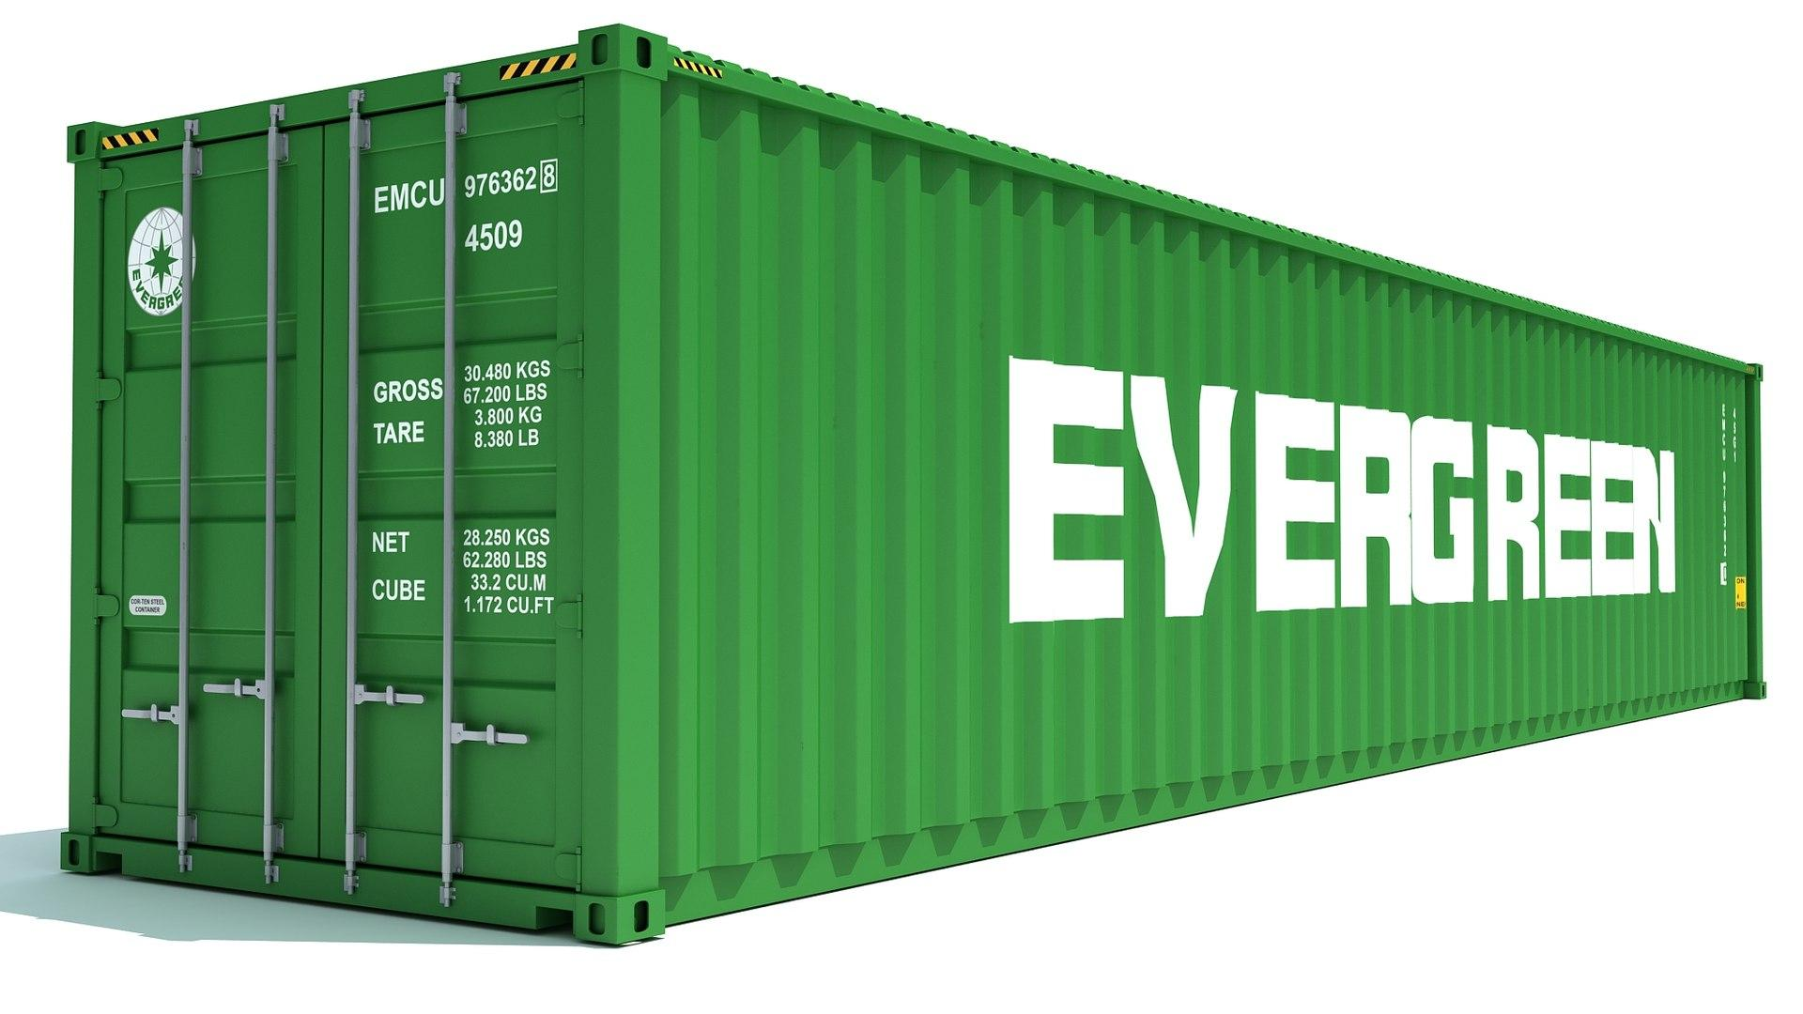
2026 ACTION PLAN
CB Trade:
We need competitive rates against market level to regain around two thousand teus lost on this trade.
CW Trade:
We need competitive rates against market level to regain one thousand teus.

Slide 17
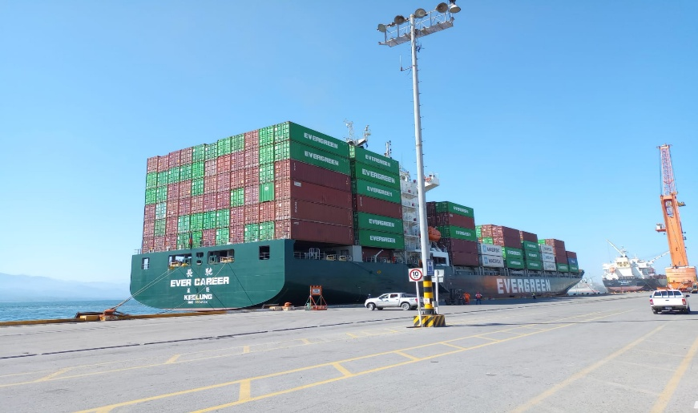
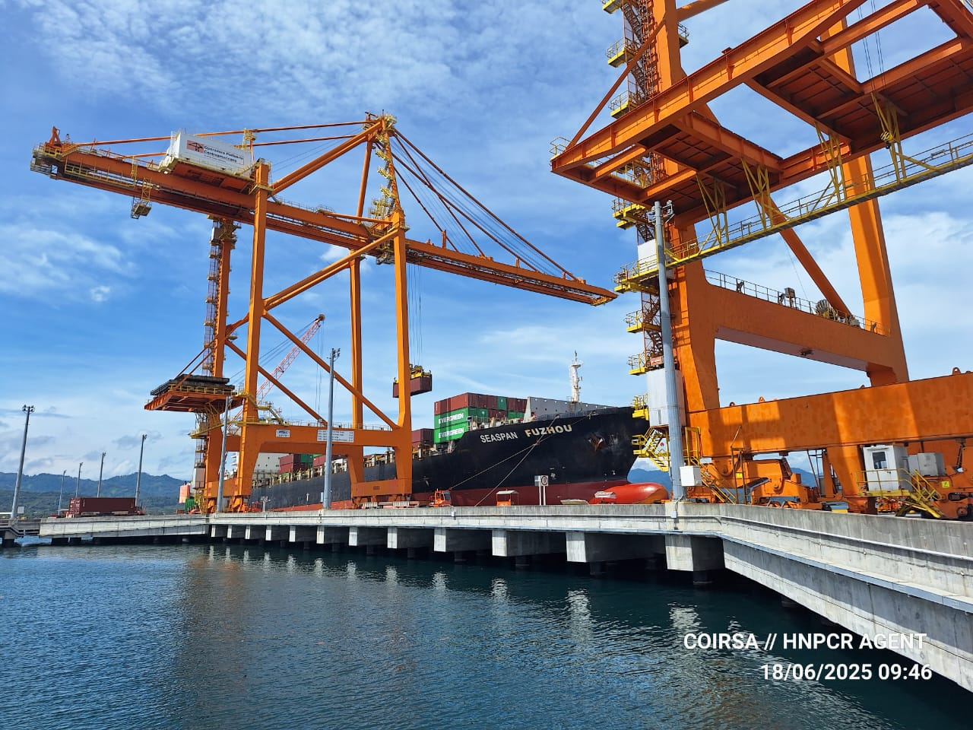
2026 ACTION PLAN
ADD ON – HNZPU TO CAN SERVICE LOOP
PRIVATE CALLS AT HNZPU
  EVER CAREER – NOVEMBER 2023 – 611 TEUS
  EVER CAREER – JANUARY 2024 – 410 TEUS
  EVER CAREER – MARCH 2024 – 204 TEUS
  SEASPAN FOZHOU – JUNE 2025 – 615 TEUS

Slide 18
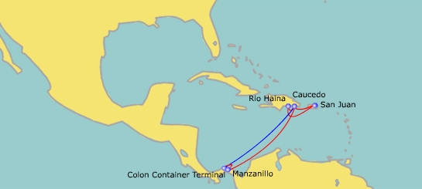
2026 ACTION PLAN

Slide 19
2026 ACTION PLAN
IMPORT CARGO VOLUME
C TRADE
POL BASE PORTS: 200 TEUS PER WEEK
BI WEEKLY SERVICE TO HNZPU
FIXED WINDOW BERTH AT HNPZUT

Slide 20
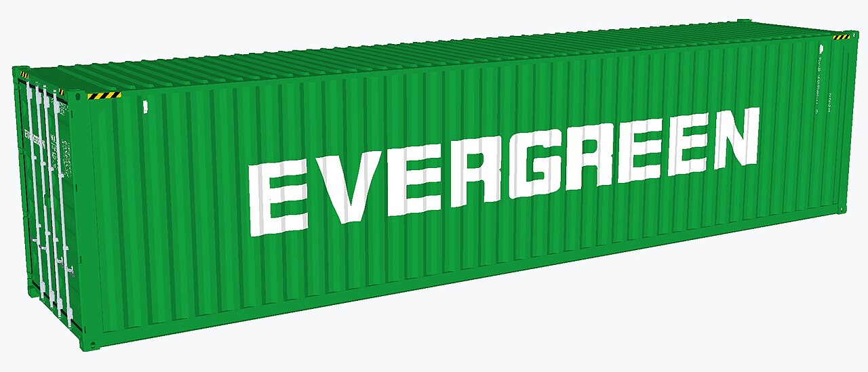
2026 ACTION PLAN
IMPORT CARGO VOLUME
CAN SERVICE
DOCAU: 80 TEUS PER MONTH - FAK
PACCT: 100 TEUS PER MONTH - FAK
COCTG: 200 TEUS PER MONTH – GDSM, Ceramic Tiles and sugar
EXPORT CARGO VOLUME
CAN SERVICE
DOCAU: 400 TEUS PER MONTH – Snacks, Textiles, gypsum boards
PACCT: 40 TEUS PER MONTH – Soft drinks
COCTG: 100 TEUS PER MONTH – Waste paper
COBVT: 100 TEUS PER MONTH – Waste paper

