Slide 1


Business Report
2026 LATIN AMERICA AGENCY MEETING

Slide 2









AGENDA
Economic Status
Cargo Flow
GDP Forecast , Inflation , USA Tariff
Import/Export
2025 KPI
Operations KPI
Performance Review (LAD/EGA/ELA)
ECD/IMD & OCD/OPD Review
2026 Goals
Strategy & Targets

Slide 3

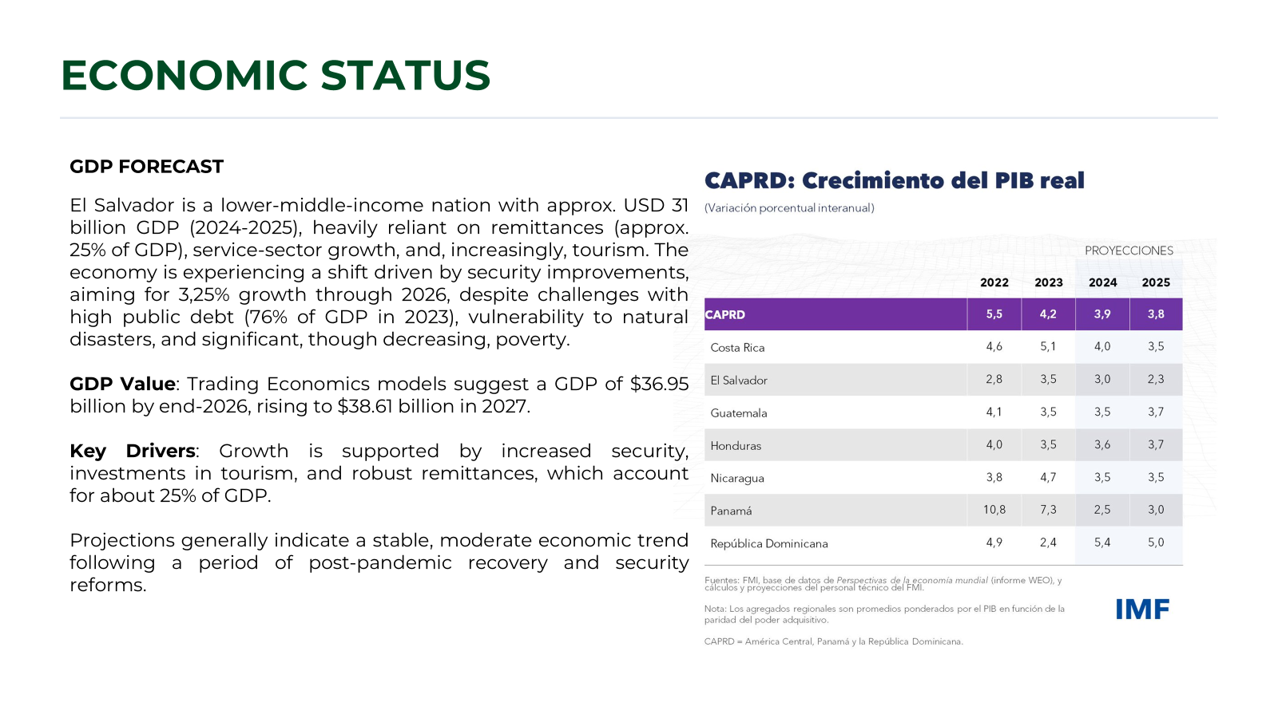
ECONOMIC STATUS

Slide 4
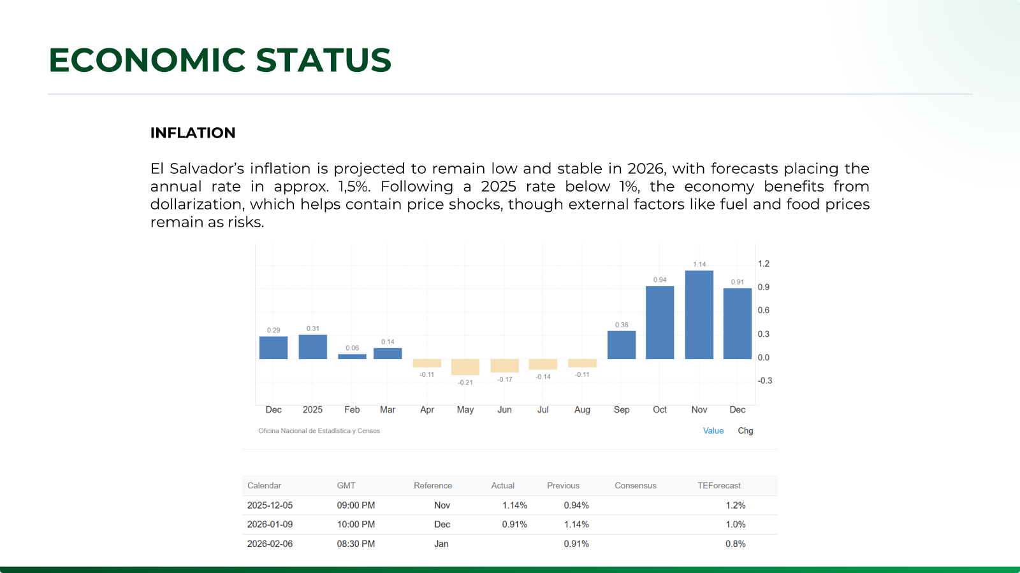
2025/2026 COUNTRY CARGO FLOW STATUS
This content should be focus on your country cargo flow, no matter for export/import ; stronghaul/ backhaul / regional.

Slide 5
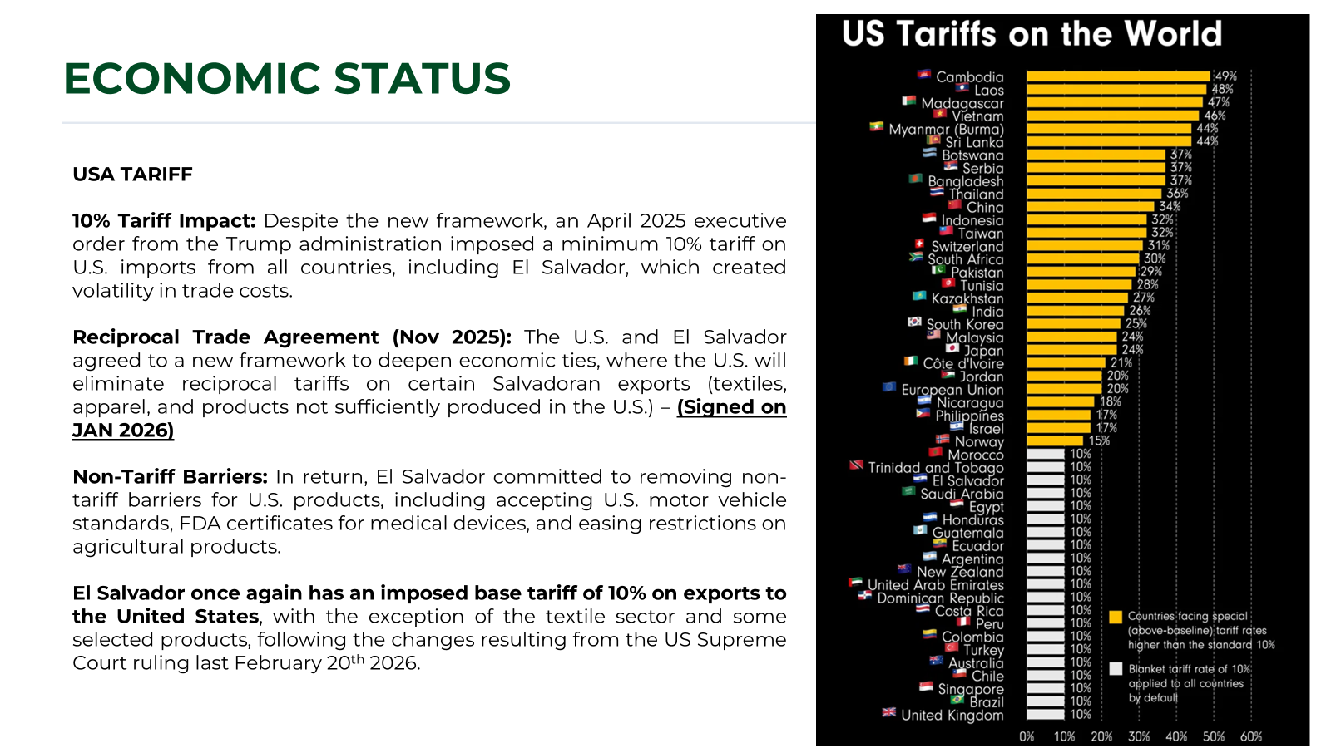

Slide 6
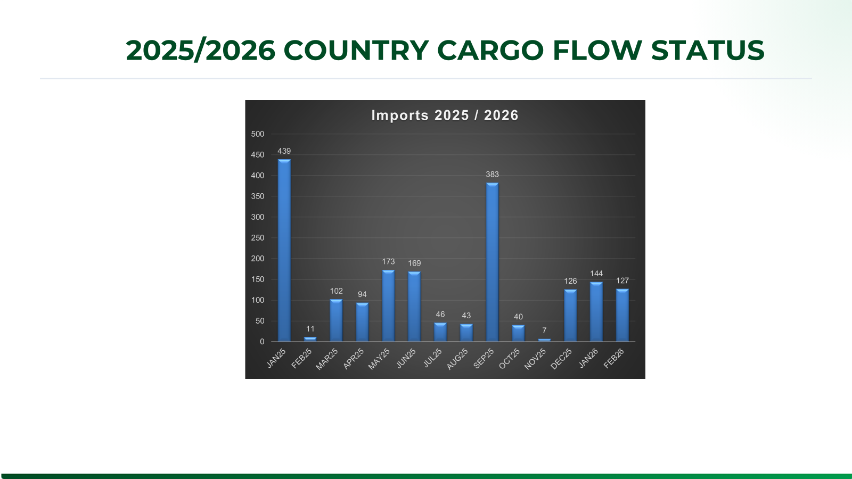

Slide 7
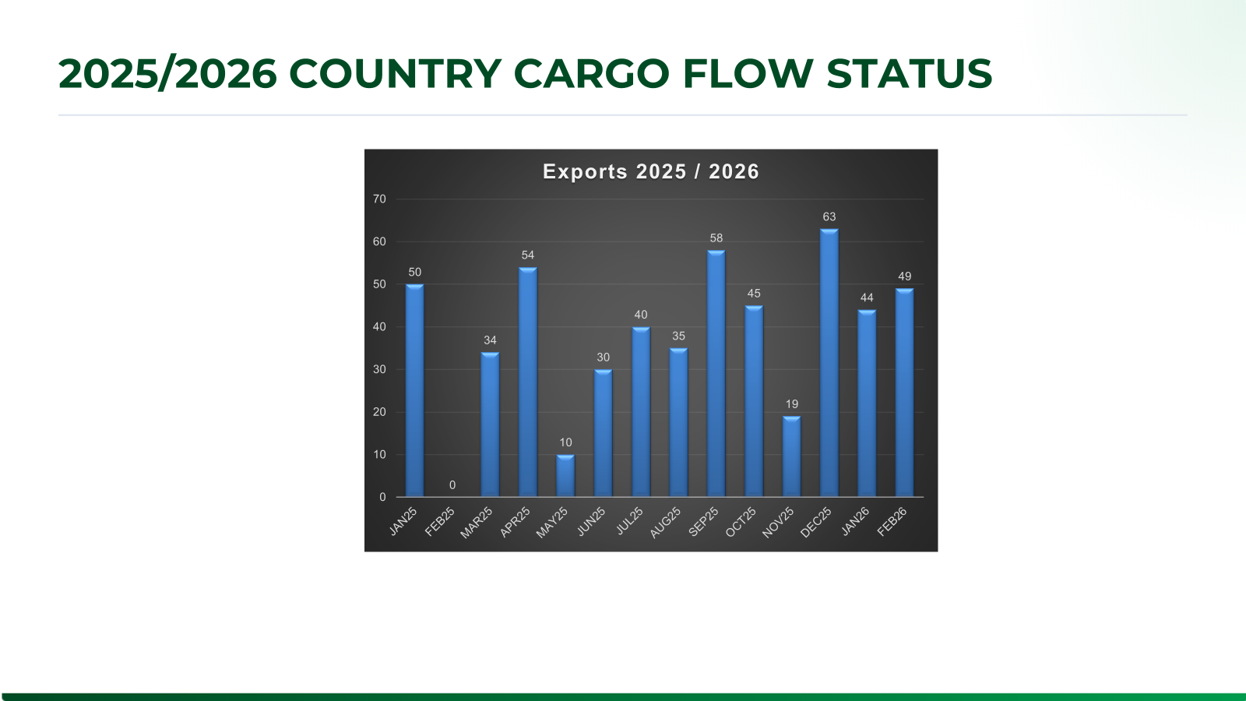

Slide 8
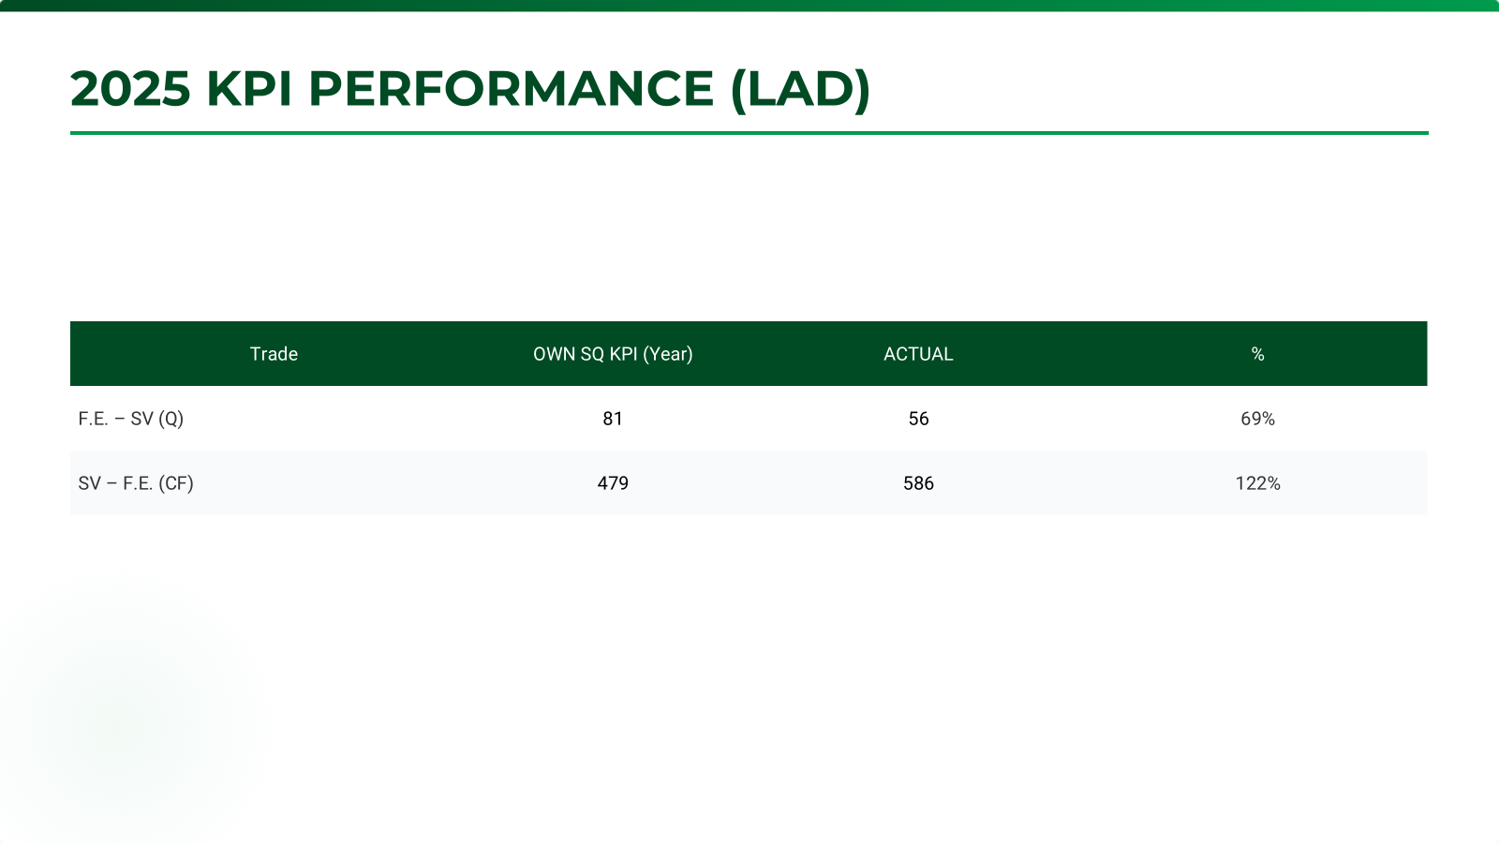
ECD / IMD KPI
ITEM | 2025 | 2026 KPI | Action Plan in 2026
Storage
Lift on/off
Reposition
M & R
ITEM | 2025 | 2026 KPI | Action Plan in 2026
Cost Saving Project
90% Onboard within 7 Days
No Personal Negligence

Slide 9
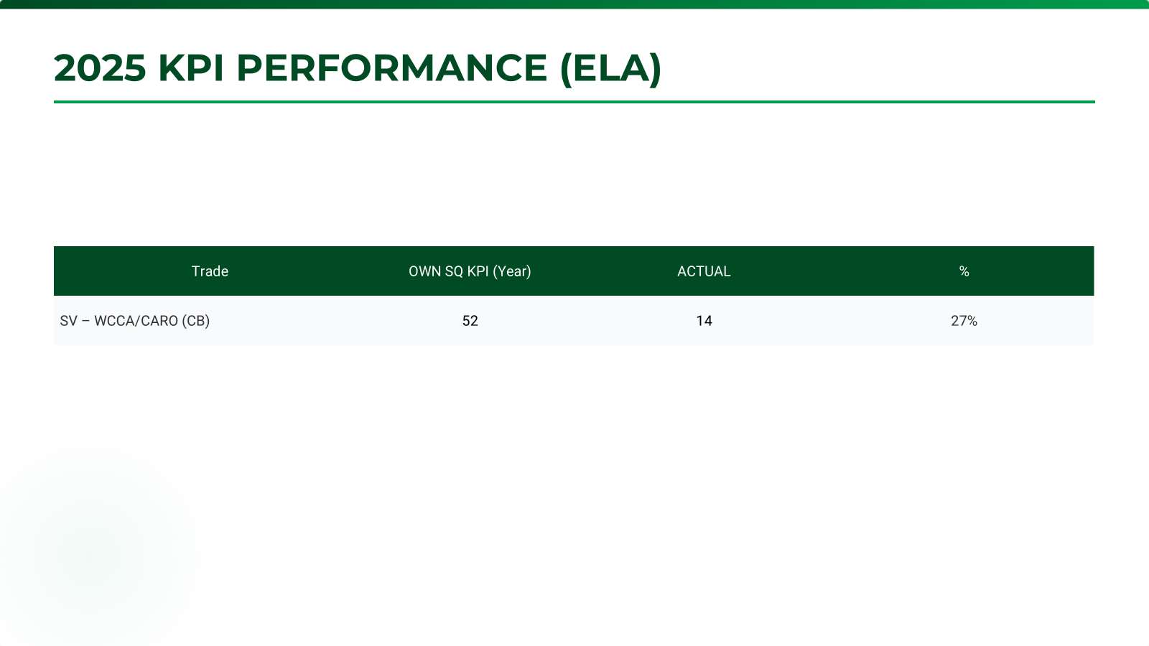
OCD / OPD KPI
ITEM | 2025 | 2026 KPI | Action Plan in 2026
BOA | On window 66% Off window 50% | On window 95% Off window 85% | Keep coordination with ELA / Terminal
Port Stay | 80 % | 95 % | Keep coordination with ELA / Terminal
Productivity | 20 mph | 20 mph | Keep coordination with ELA / Terminal
ITEM | 2025 | 2026 KPI | Action Plan in 2026
Incentive | --- | --- | ---
Empty Storage | --- | --- | ---
Rate Reduction | --- | --- | ---

Slide 10
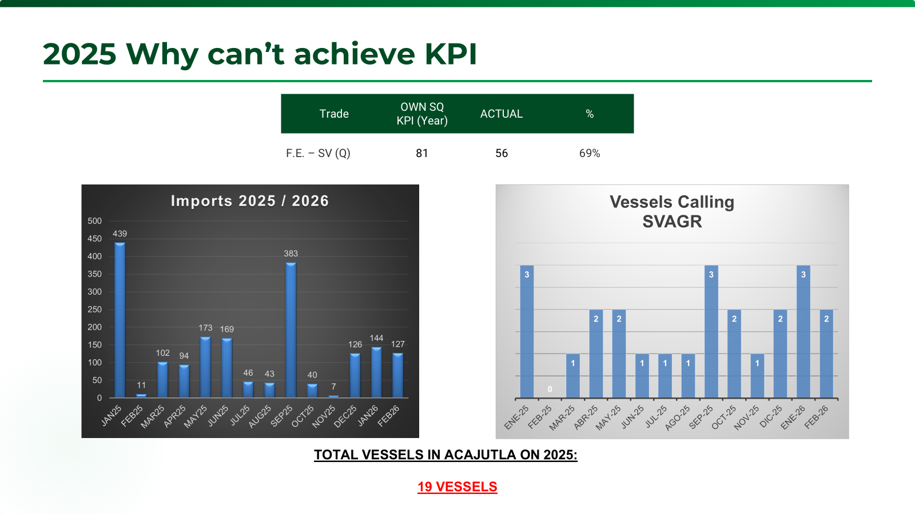

Slide 11
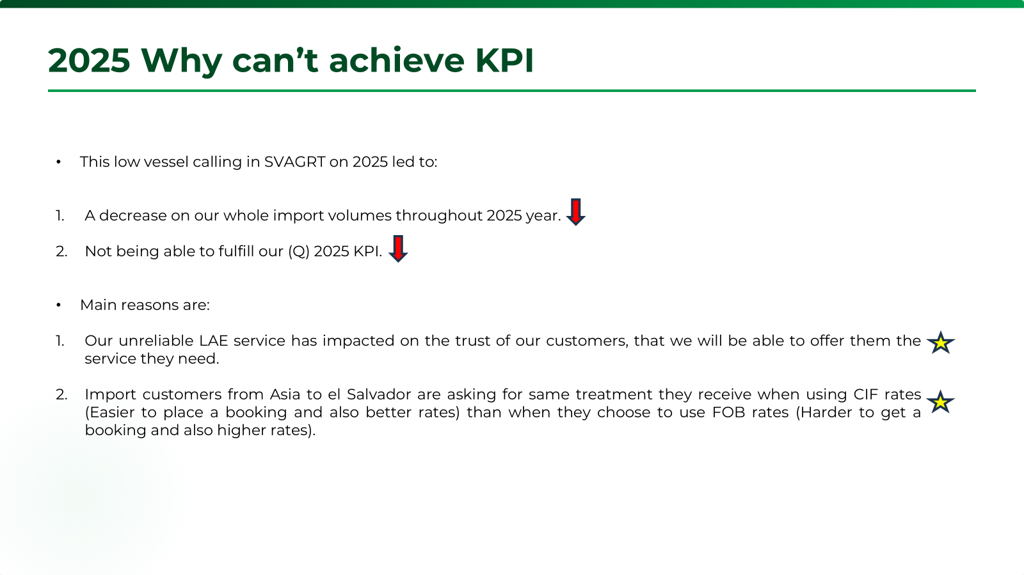

Slide 12
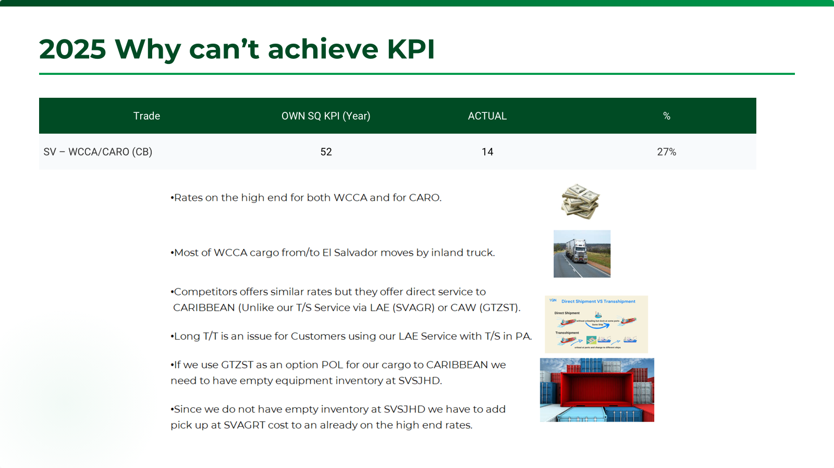

Slide 13
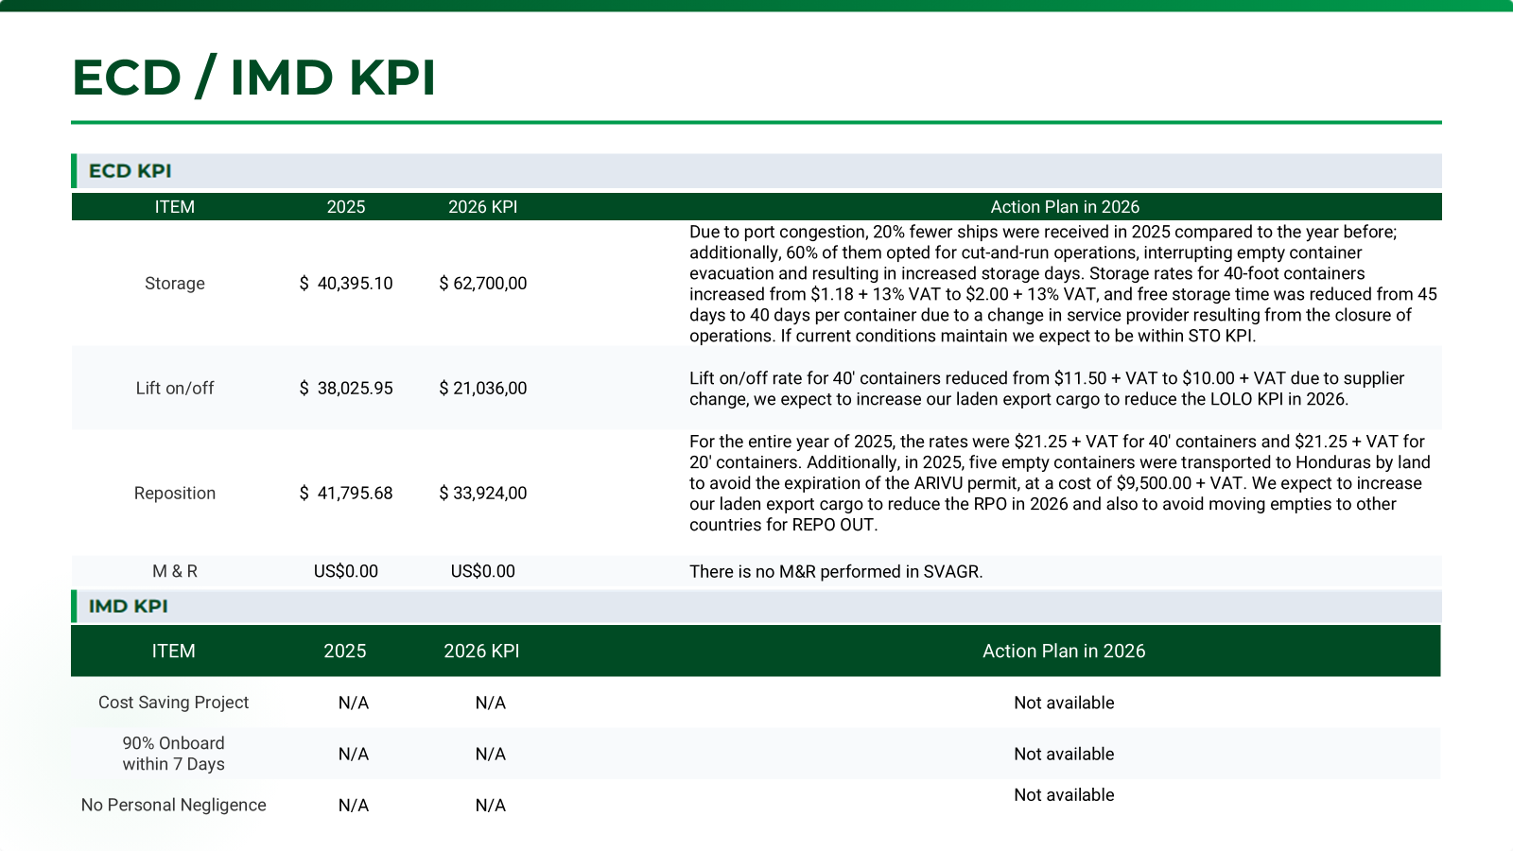

Slide 14
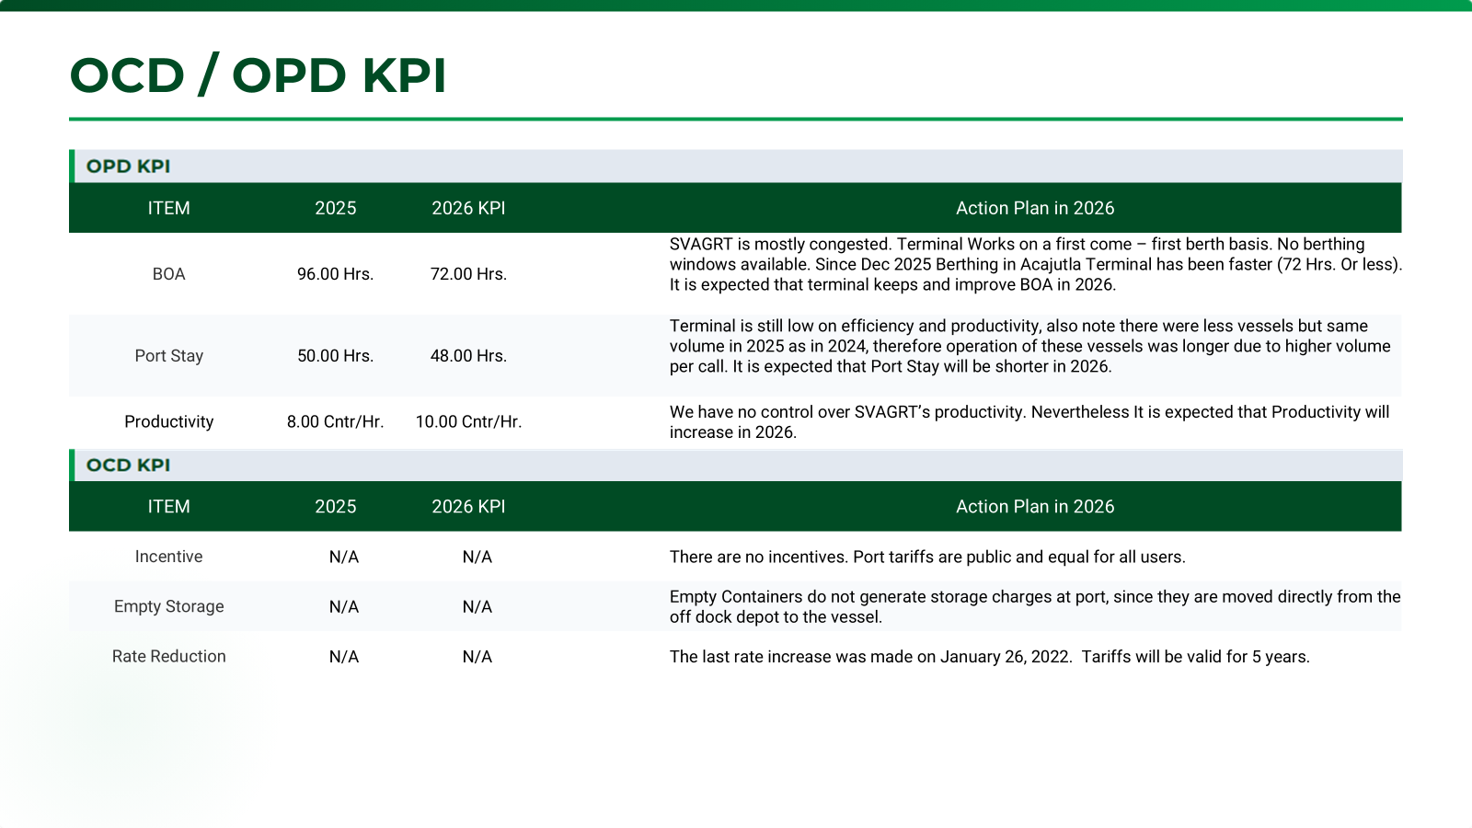

Slide 15


Q & A
CSD
Q:
BCC Comment:

Slide 16
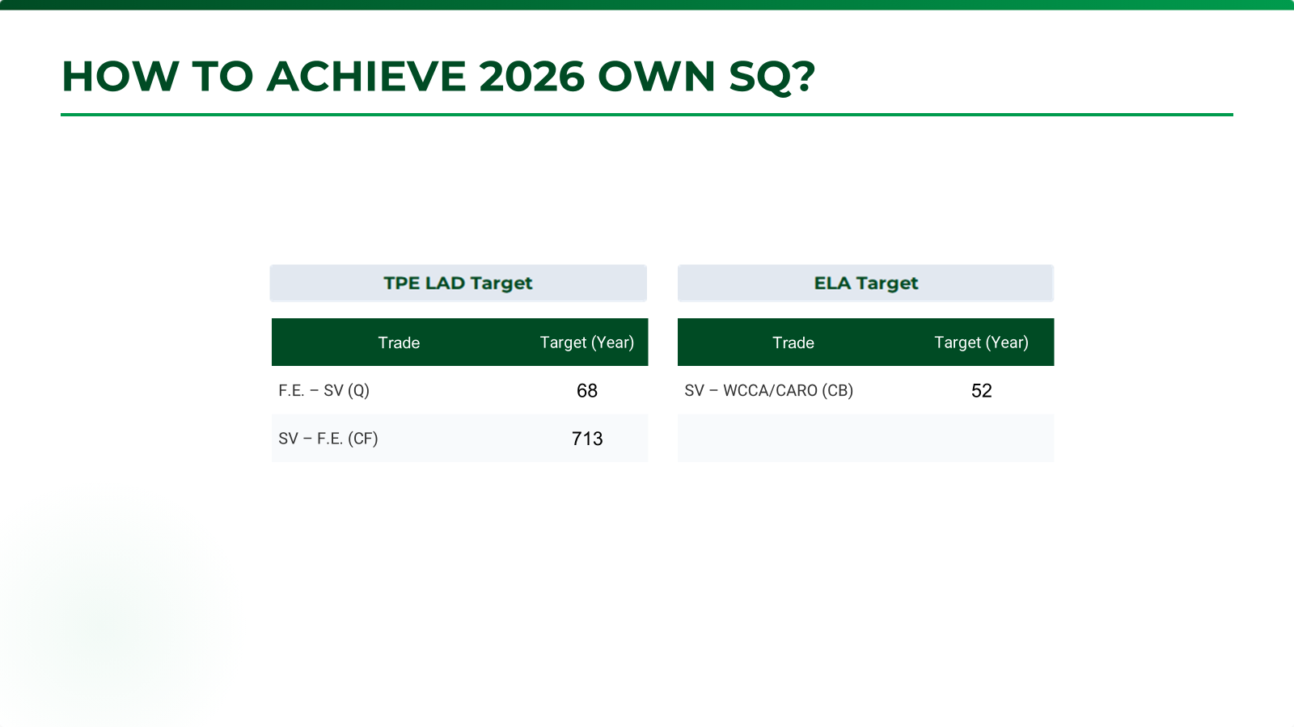

Slide 17
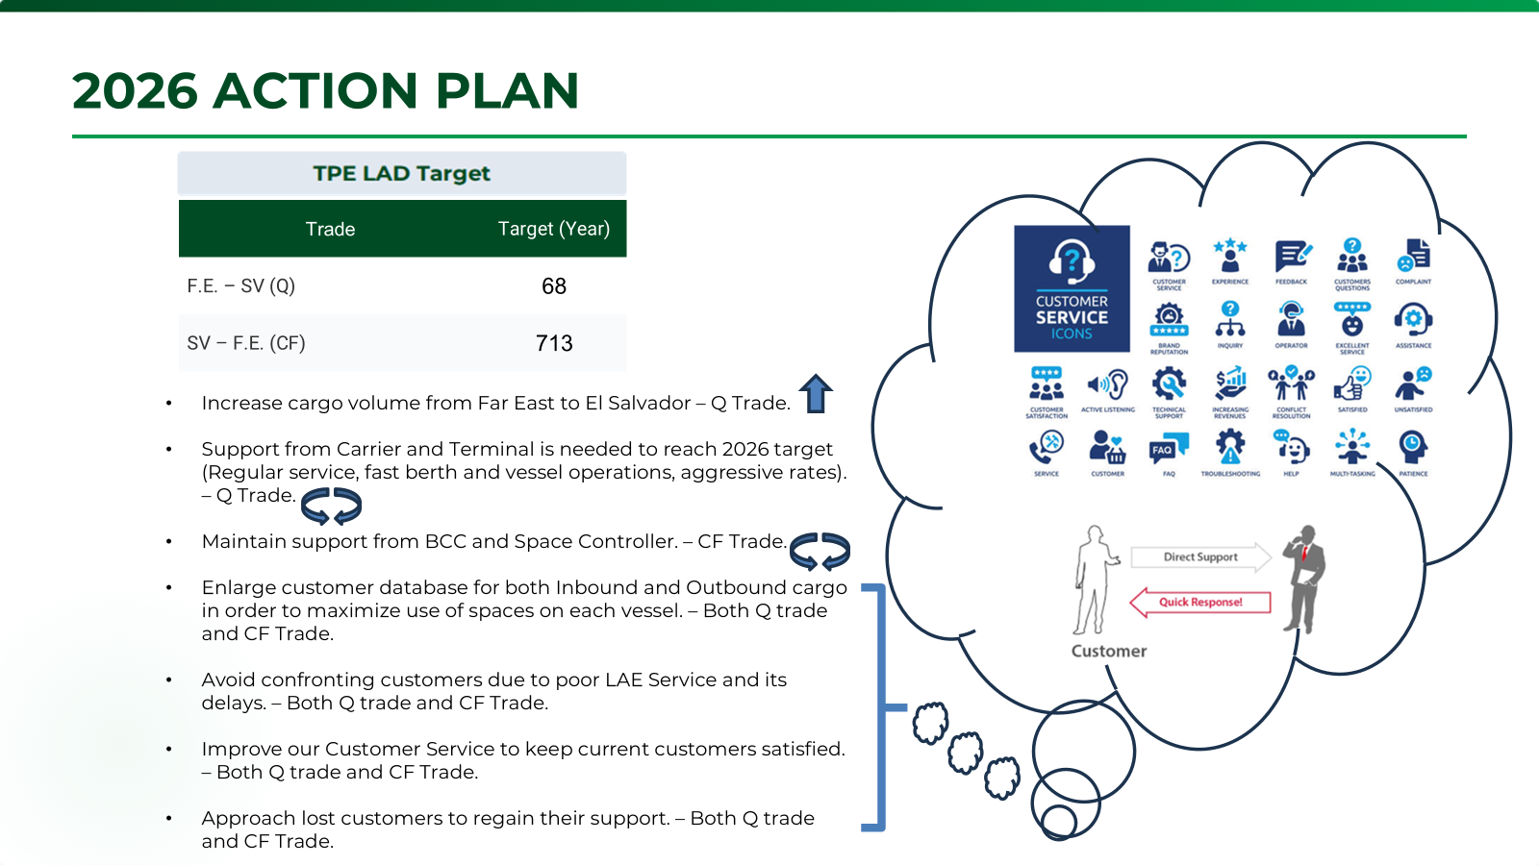

Slide 18
