Slide 1


BUSINESS REPORT
2026 LATIN AMERICA AGENCY MEETING
SERVICIOS NAVIEROS Y PORTUARIOS, S.A.
GUATEMALA

Slide 2










AGENDA
Cargo Flow
Economic Status
Import/Export
GDP Forecast , Inflation , USA Tariff
2025 KPI
Performance Review (LAD/EGA/ELA)
Operations KPI
ECD/IMD & OCD/OPD Review
2026 Goals
Strategy & Targets

Slide 3






Guatemala shows stable economic growth in 2026, supported by moderate inflationary pressures and improving remittance inflows..
ECONOMIC STATUS
Indicator
2025
2026
Est.
GDP Growth (%)
4.3%
4.1 %
Stable GDP growth
GDP Per Capita (USD)
$4,650 USD
$4,800 -$4,888 USD
Inflation Rate (%)
1.65 %
Despite moderate pressures in 2026
2.5 %
Exchange rate Stability
(%)
Q7.65 – Q 7.70
Q7.66614 – Q7.66721
Remittances Growth
(%) $ 25,597 m
2.5 %
3.6 %
Remittances from USA still growing year by year
Unemployment Rate (%)
2.8 %
3.0 %

Slide 4

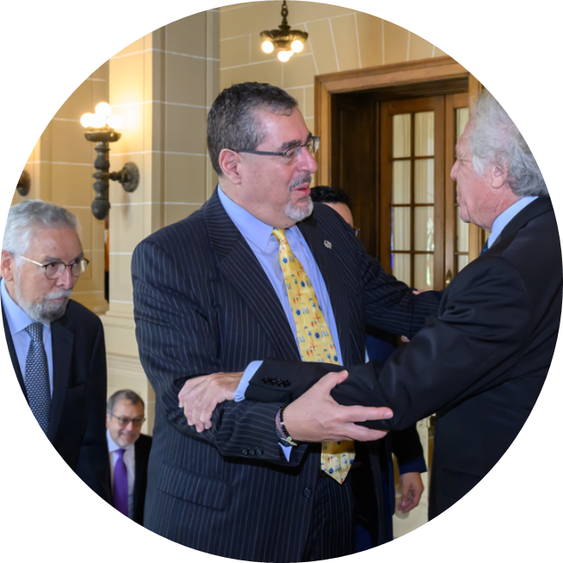
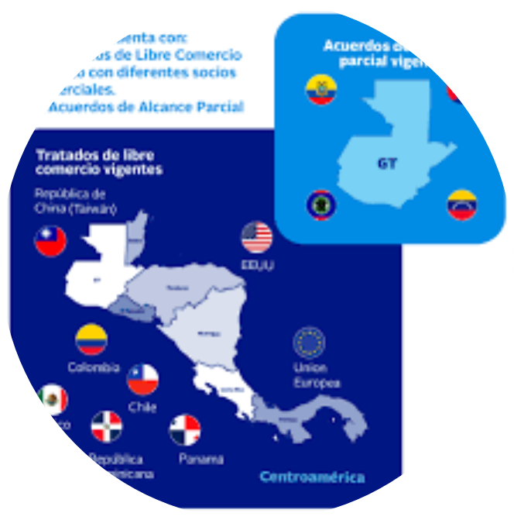
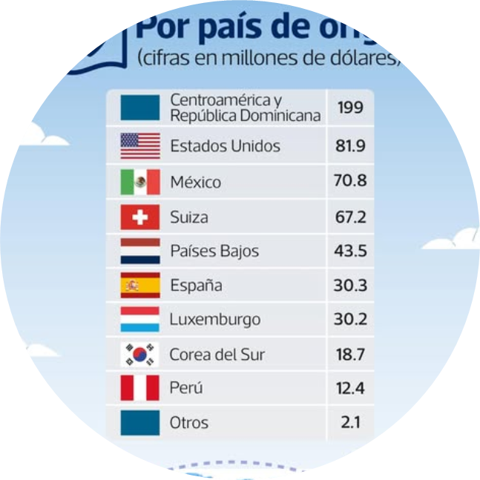
ECONOMIC STATUS
US TARIFFS
FREE TRADE AGREEMENTS
FOREIGN DIRECT INVESTMENT (FDI)
TOURISM GROWTH IN GUATEMALA
70.4% of Guatemala export products to US are entering with 0% of tariff.
Tariff Cap: For other products, a maximum limit of 10% is established for reciprocal tariffs.
DR-CAFTA (United States, Dominican Republic and Central America). New tariff agreement.
Association Agreements with the European Union and the United Kingdom.
Free Trade Agreements with Mexico, Chile, Panama, Taiwan, and Israel.
Free Trade agreement with Korean under negotiation
Steady growth since 2022.
USD 1.5–1.7 billion per year in inflows.
Key sectors: Finance, Manufacturing and Trade.
Main investors: U.S., Mexico and Central America.
Still below the regional average.
2025: ~10.6% tourism growth, record arrivals (~3.36 million)
2026: Continued growth expected, supported by strategic tourism planning.
Drivers: Improved connectivity, diversified experiences, and regional travel demand

Slide 5
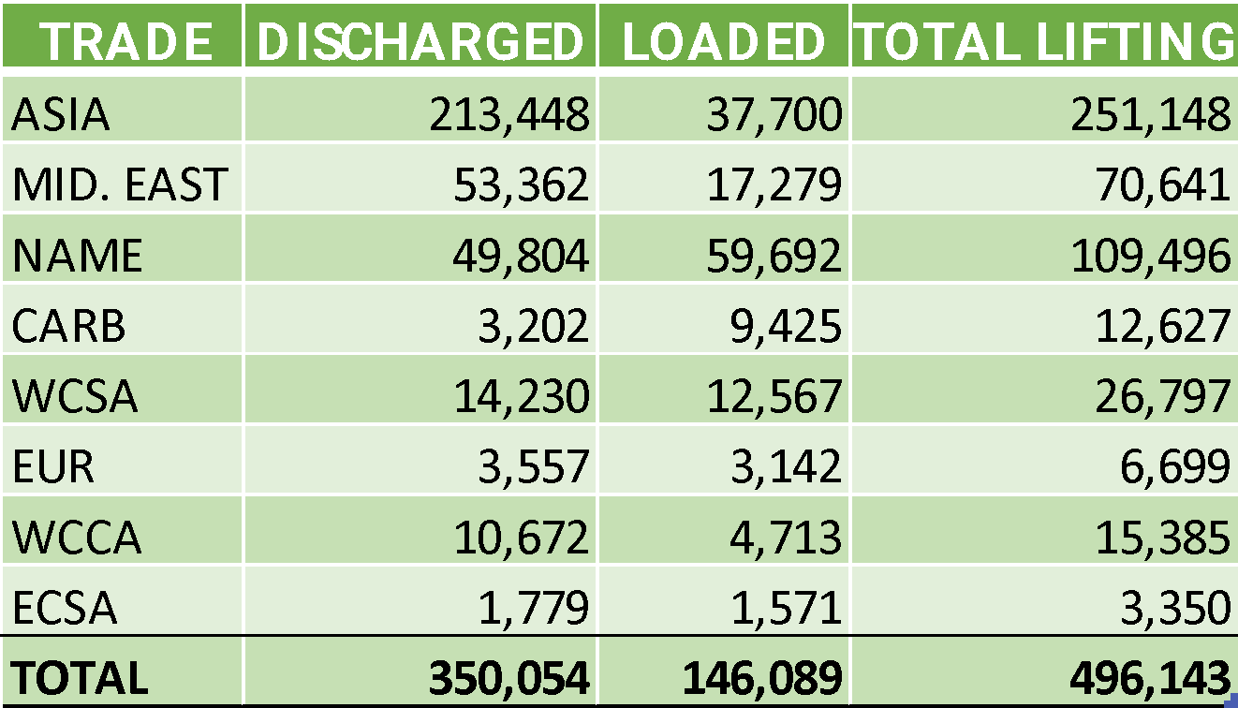
2025/2026 COUNTRY CARGO FLOW STATUS
POD/POL PUERTO QUETZAL GTZNJ 2025 - TEUS

Slide 6
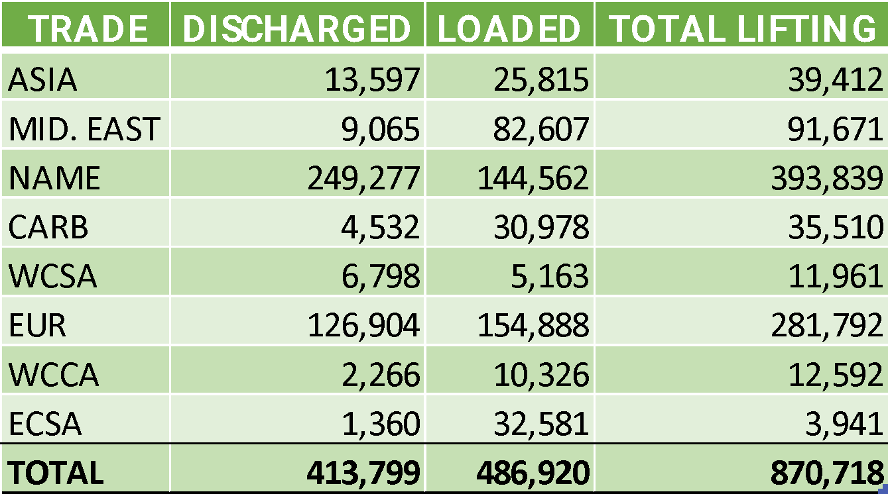
2025/2026 COUNTRY CARGO FLOW STATUS
CARIBBEAN POD/POL SANTO TOMÁS DE CASTILLA/ PUERTO BARRIOS GTZST 2025 (REGIONAL) - TEUS

Slide 7

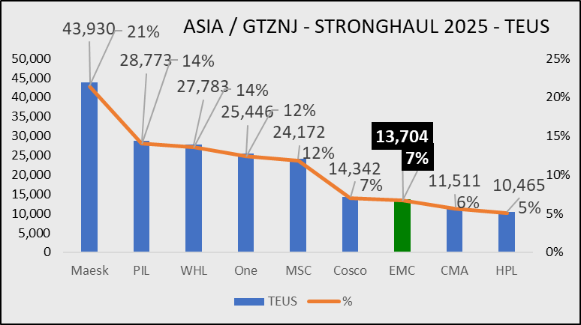







2025/2026 COUNTRY CARGO FLOW STATUS

Slide 8
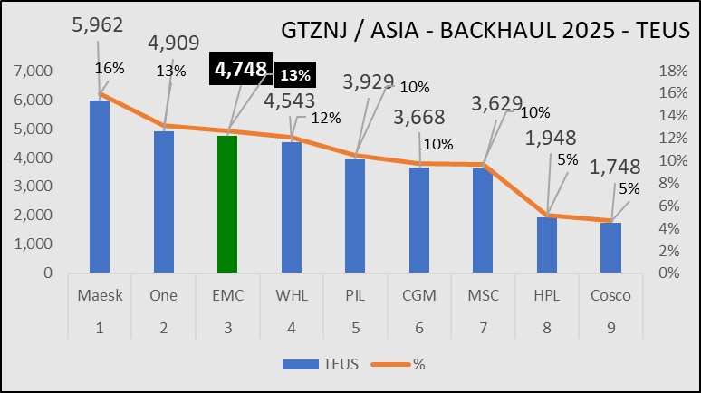

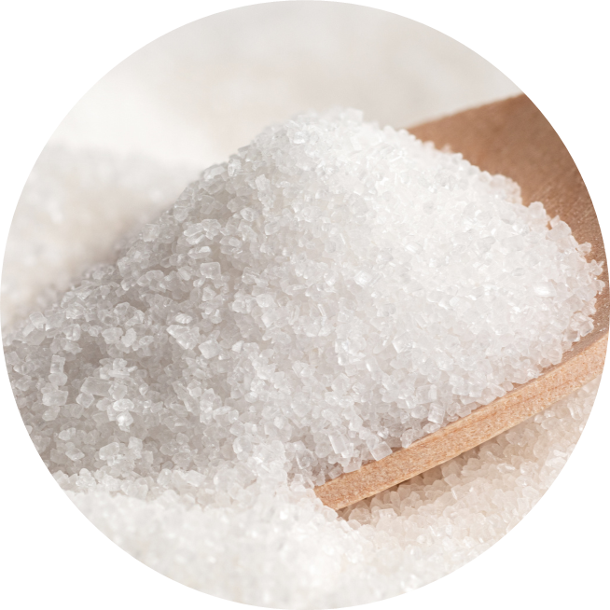






2025/2026 COUNTRY CARGO FLOW STATUS

Slide 9
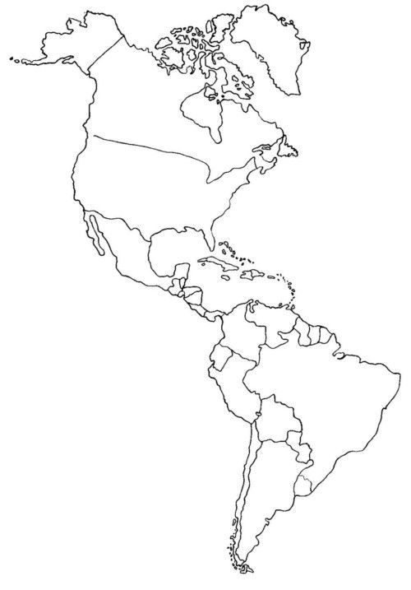
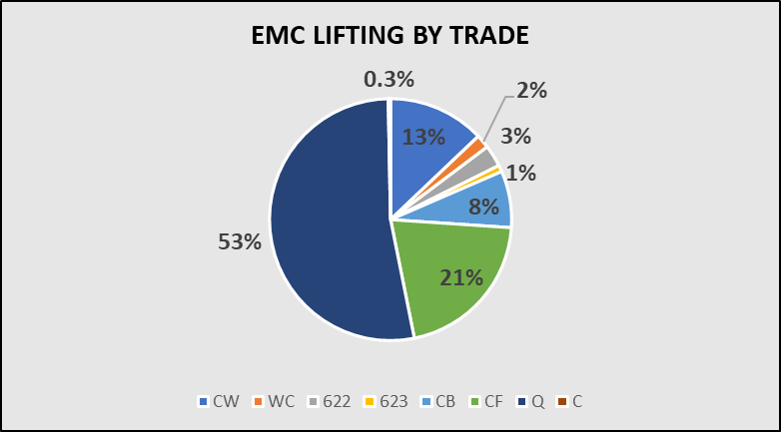
2025 EMC CARGO STATUS
EMC´s main market share is Asia/GT, but still room to increase participation across all trades.

Slide 10

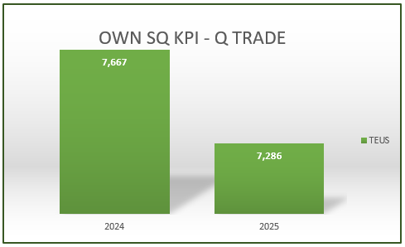
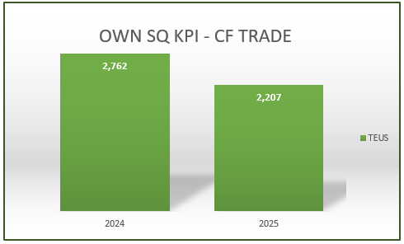
2025 KPI PERFORMANCE (LAD)
Trade | OWN SQ KPI (Year) | ACTUAL | %
F.E. – GT+BZ (Q) | 8,142 | 7,361 | 90%
GT+BZ – GT (CF) | 2,485 | 2,207 | 89%

Slide 11
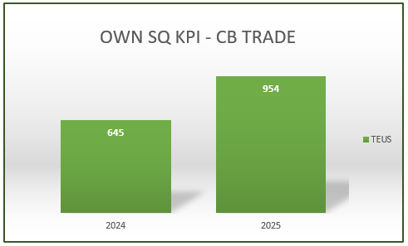
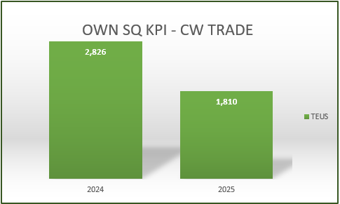
2025 KPI PERFORMANCE (ELA)
Trade | OWN SQ KPI (Year) | ACTUAL | %
GT+BZ – WCCA/CARO (CB) | 673 | 954 | 141%
GT+BZ – WCSA (CW) | 2,967 | 1,810 | 61%

Slide 12







2025 Why can’t achieve KPI
Q Trade
CB Trade
622 / 623
Move Count Limitation at APMT Puerto Quetzal Terminal to EMC.
Reduced participation in BID / Tender accounts.
Extended transit time from CNXGA /
CNQND / JP and IN ports.
Weight restriction.
Frequent roll overs despite booking confirmed.
Unstable service schedule.
Market requirement: 5 free storage days at POL.
Limited space to cover export demand certain period of the year.
Shortage of 2SD equipment availability.
Extended waiting time at transhipment port.
Freight rate level to and from Caribbean Ports.
Freight rate level to and from USEC and Caribbean Ports.
Waiting time at the transhipment port.
Limited equipment availability at USEC Ports.
Extended lead time for booking confirmation from USEC ports.
CF Trade
Limited 2SD inventory to cover sugar and coffee shipments demand.
Target rate level to IN is higher than competitors.
Storage at POL (GTZNJ). Market requirement is 3-5 free storage days.
Extended transit time to SAJED, AEJBA, PKKHI and JPYKH.
CW Trade:
Lost of market share due to uncompetitive rate level.
Market requirement: 5 free storage days.
Commercial impact due to vessel schedules delays in MX

Slide 13
ECD / IMD KPI (GT)
ITEM | 2024 | 2025 | Diff | Action Plan in 2026
Storage | 156,564.92 | 68,332.51 | -88,232.41 | Have successfully reduced the storages during 2025, optimize the empty evacuations handling . In case of VO by EMC, we continue asking the terminal for additional moves. For non-VO calls, we have a close communication with ELA/LOG and local VO operators agent to secure additional moves, subject to BSA availability as negotiated between partners and terminals.
Lift on/off | 229,500.14 | 87,924.84 | -141,575.30 | In order to reduce LOLO costs, we will focus on promoting import and export laden units.
Reposition | 125,191.00 | 123,379.75 | -1,811.25 | Although a cost reduction was reached, is important to avoid COR and tonnage limit to perform additional evacuation. Will focus on securing additional space for import cargo, while also increasing allocation for laden export units.
M & R | 1,890.82 | 11,688.19 | 9,797.37 | We would like to point out that, in most cases, we make ally efforts to assign equipment that is in suitable condition. However, under certain circumstances, we need to request authorization for repairs. Strict control is maintained at the depot, and periodic visits are conducted to ensure that estimates are performed properly and accurate.

Slide 14
ECD / IMD KPI (GT)
ITEM | 2024 | 2025 | Diff | Action Plan in 2026
Cost Saving Project | N/A | N/A |  | We do not foresee any substantial savings projects under the current economic and logistics conditions in Guatemala.
90% Onboard within 7 Days | N/A | N/A |  | N/A
No Personal Negligence | N/A | N/A |  | No personal negligence case until now.

Slide 15
OCD / OPD KPI (GT)
ITEM | 2024 | 2025 | Diff | Action Plan in 2026
BOA | WSA2 0% LAE 0% | WSA2 75% LAE 75% | 75% | GTZNJP / TPEC: Despite vessels frequent arrival delays, closed communication with the terminal has allowed us to secure an efficient operational window to complete the operations. GTZNJT / EPQ: Vessels are subject to berth arrangements due to pre-established windows for regular carriers. We will continue to maintain close communication and coordination with the terminal to evaluate whether any adjustments can be made to improve BOA.
Port Stay | WSA2 100% LAE 80% | WSA2 100% LAE 100% | 18.18% | GTZNJP / TPEC: Port stay increased due to the large number of shiftings required; however, this measure is necessary to maintain the vessel’s stability and is beyond our control. Fortunately, we have received strong support from the terminal, which has been granting between 1,500 and 1,800 moves per vessel operation. GTZNJT / EPQ: Although the necessary tools and equipment are requested ahead of each operation, delays still occur due to labor union issues. We continue in closed monitoring of each operation and coordinate with the terminals in order to avoid further port stay whenever possible.
Productivity | WSA2 46 P/H LAE 28 P/H | WSA2 64 P/H LAE 44 P/H | > 18 P/H > 16.47 P/H | GTZNJP / TPEC: With the use of three STS cranes in each VESSEL operation, an excellent performance has been maintained. GTZNJT / EPQ: Productivity has improved in the LAE service; however, we still need to continue coordinating with Port Authorities to ensure the availability of machinery and trucks in line with the total number of moves to be performed. With some investment in Private Terminal Equipment we can lift productivity.

Slide 16
OCD / OPD KPI (GT)
ITEM | 2024 | 2025 | Diff | Action Plan in 2026
Incentive |  |  |  | Guatemala has no incentive programs; market conditions may be evaluated.
Empty Storage | 96,435.58 | 15,740.72 | -80,694.86 | GTZNJP / TPEC: Although costs have been reduced, it is necessary to maintain close communication with the terminal to obtain approval for direct dispatch, which is currently not possible. GTZNJT / EPQ: Direct dispatch is not accepted; it is only allowed for up to 30% of the total volume to be evacuated, and only if the vessel berths and operates according to schedule.
Rate Reduction |  |  |  | Due to increases in the minimum wage, inflation, operational and administrative costs, a reduction is not currently feasible.

Slide 17


2026 Strategy
How to Achieve KPI Goals

Slide 18
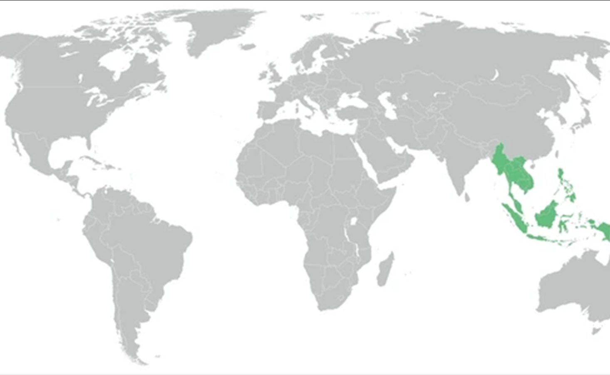


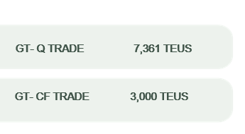
HOW TO ACHIEVE 2026 OWN SQ?
F.E. - GT / Q TRADE
Strengthen promotion of WSA6 Service.
Improve hot box management at transhipment ports.
Prioritize tender accounts.
Implement recovery plan for lost accounts.
Develop a commodity-based customer approach strategy.
GT - ASI/ CF TRADE
Implement a customer strategy based on cargo source and commodity segmentation.
Ensure competitive rate in line with market conditions.
Optimize space allocation at T/S ports to support long-haul market growth.
Grant minimum 3-month rate validity to strengthen long-term nomination.

Slide 19
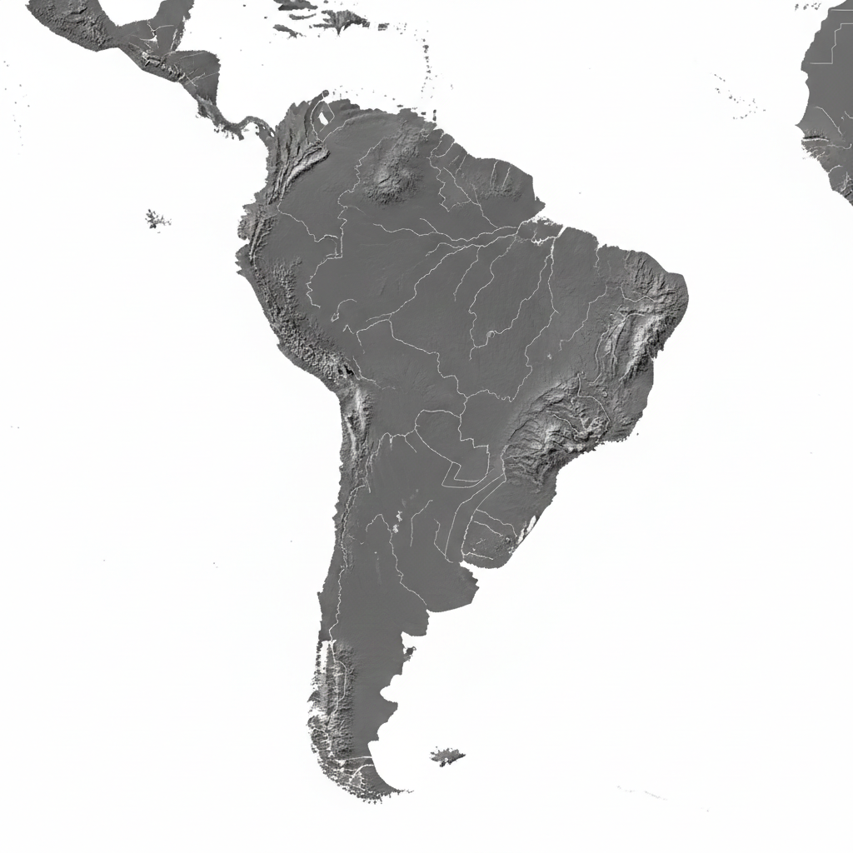


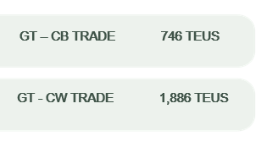
HOW TO ACHIEVE 2026 OWN SQ?
WCCA-CARO / CB TRADE
Ensure competitive rate level in line with market
condition.
Grant minimum 3-months rate validity to strengthen
long-term nominations.
Optimize space allocation for the LAE service.
Implement a commodity-focused customer strategy.
WCSA / CW TRADE
Promotion of the WSA6 service to COBVT & CLSAI.
Secure a 3-months validity to strengthen long-term nominations.
Implement a plan to recover lost accounts.

Slide 20






2026 ACTION PLAN
Engage new accounts to expand market presence.
Target and develop new accounts for business growth.
Adopt a proactive approach to convert new accounts.
GTZNJ – PUERTO QUETZAL
APMT Planned dredging starting
February 2026 to reach -14.5 m.
EPQ lease 2 MHC cranes to increase productivity.
EPQ is willing to evaluate the weekly fixed-date window for LAE
GTZNJ Planned dredging starting February 2026 to reach -11.6

Slide 21
2026 ACTION PLAN
GTZST – PUERTO SANTO TOMÁS DE CASTILLA
Promote F.E and Caribbean ports for Commodity (wood, Cardamom, waste paper)
Competitive rate level in line with market condition related to USEC and Caribbean ports
Recover lost account Engage new accounts
Engage new accounts to expand market presence.
Target and develop new accounts for business growth.
Adopt a proactive approach to convert new accounts
Protect Hot box in transhipment port PACCT

Slide 22


Business Report
2026 LATIN AMERICA AGENCY MEETING
Dan Shipping Services Limited
BZBZE

Slide 23

ECONOMIC STATUS - BZ
GDP Grow
2024: 5.0 %
2025: 2.3 %
2026: 2.4 % (Estimate)
GDP Per Capita
2024: $3.4 B USD
2025: $3.3 B USD
Inflation
2024: 3.3 %
2025: 1.1 %
Unemployment
2024: 2.5%
2025: 2.0 %
Remittances
4.8% of GDP

Slide 24
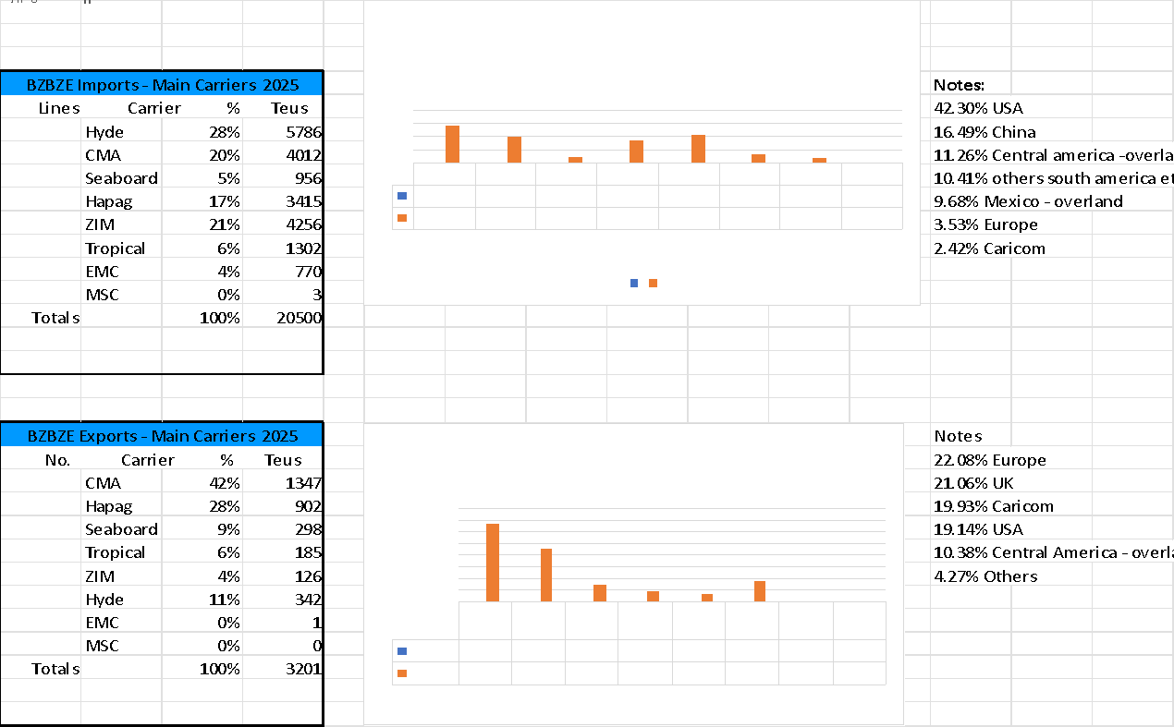
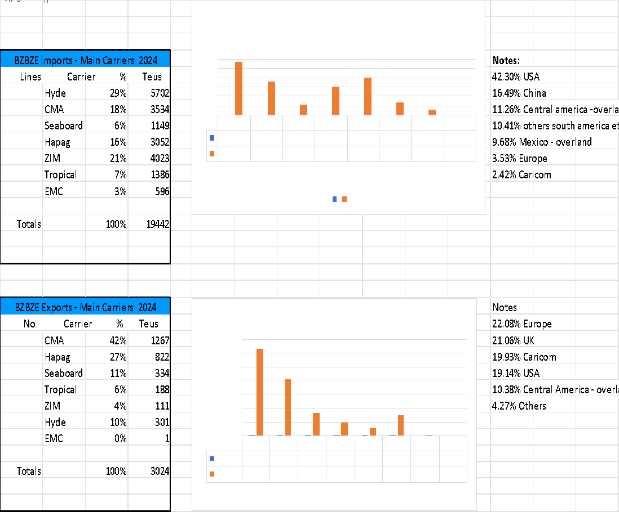
2025/2026 COUNTRY CARGO FLOW STATUS
This content should be focus on your country cargo flow, no matter for export/import ; stronghaul/ backhaul / regional.

Slide 25
ECD / IMD KPI (BZ)
ITEM | 2024 | 2025 | Diff | Action Plan in 2026
Storage | $.2,722.00 | 5,705.00 | 2,983.00 | Expedite the empty evacuation as soon as vessels available
Lift on/off | 6,135.00 | 6,870.00 | 735.00 | Expedite the empty evacuation as soon as vessels available
(Ocean) Reposition | 248,426.00 | 231,425.00 | 17,001.00 | Under ELA control.
M & R | N/A | N/A | N/A
ITEM | 2024 | 2025 | Diff | Action Plan in 2026
Cost Saving Project | N/A | N/A
90% Onboard within 7 Days | N/A | N/A
No Personal Negligence | N/A | N/A |  | No personal negligence case until now.

Slide 26

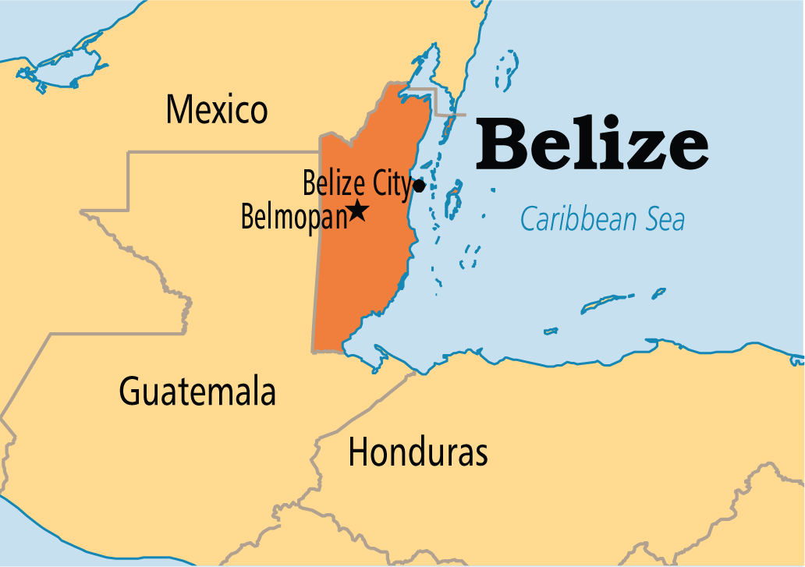
Topic discussion (BZ)
Commercial side:
Any plans to connect us with any service from East Coast South America and Europe? Currently we only have service from FE. All other Carriers operating in Belize have services from these regions.
Logistics:
Any update on utilizing new Feeder Service of Fjord Havn from Jamaica rather than CFS
Any opportunity to use X-Press Feeders service to Big Creek with very competitive rates, specially from Asia; to compensate the inland trucking from Big Creek to Belize City; as alternative to book additional volume.

