Slide 1


2026 LATIN AMERICA AGENCY MEETING
Business Report

Slide 2
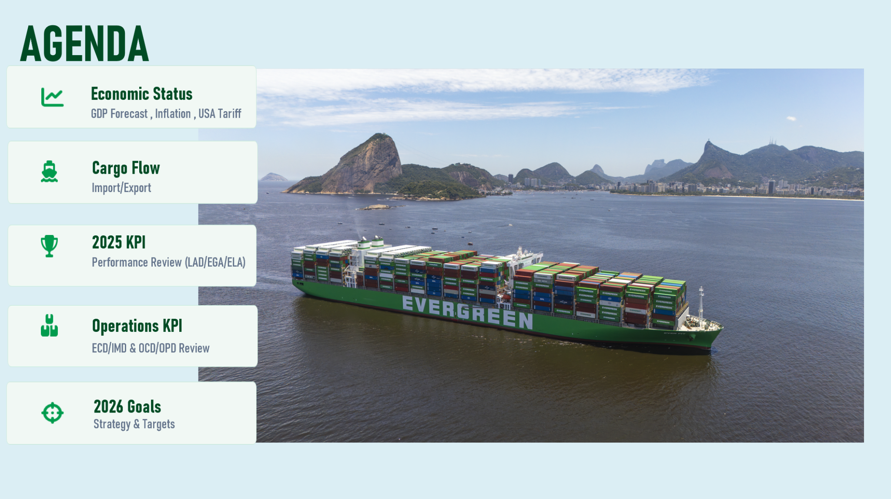
Taken in Guanabara Bay, Pão de Açúcar in the background

Slide 3
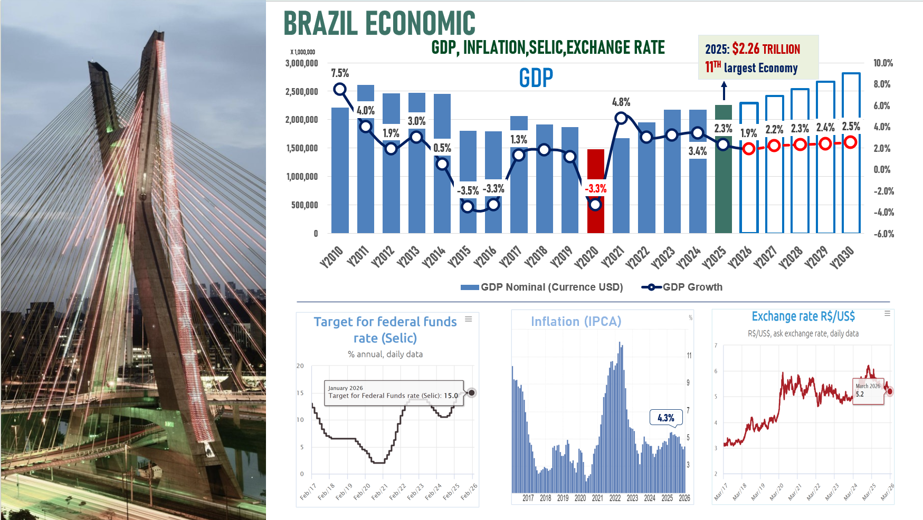

Slide 4
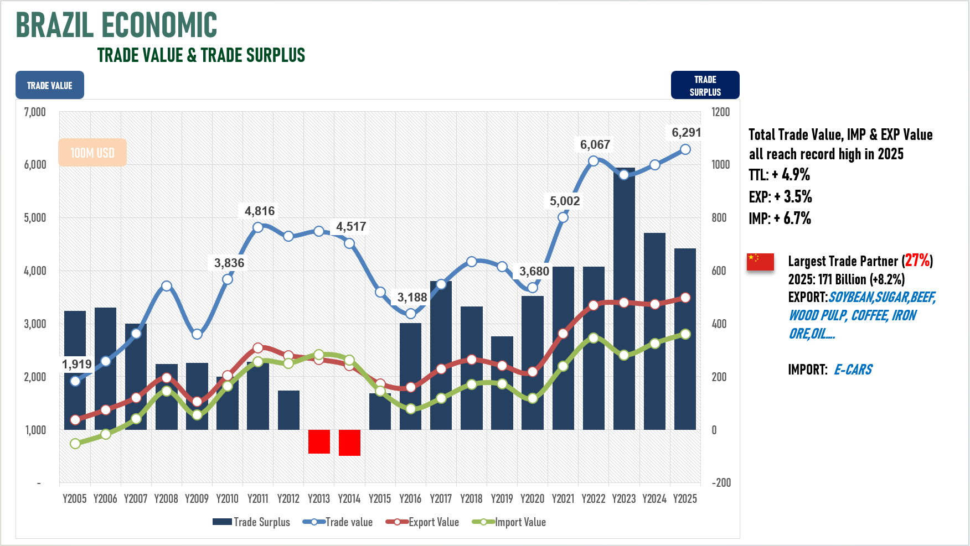

Slide 5
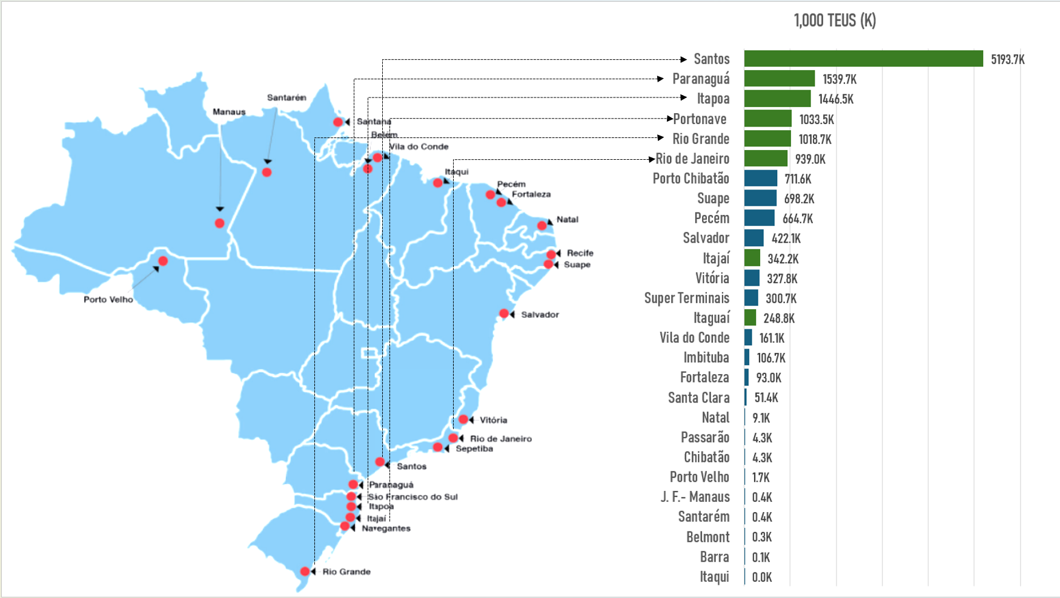
BRAZIL CARGO FLOW - 2025 TERMINAL THROUGHPUT
THROUGHPUTS-15 M TEUS
SOUTHERN PORTS-78 %
NORTH PORTS-22 %
SANTOS -34 %

Slide 6
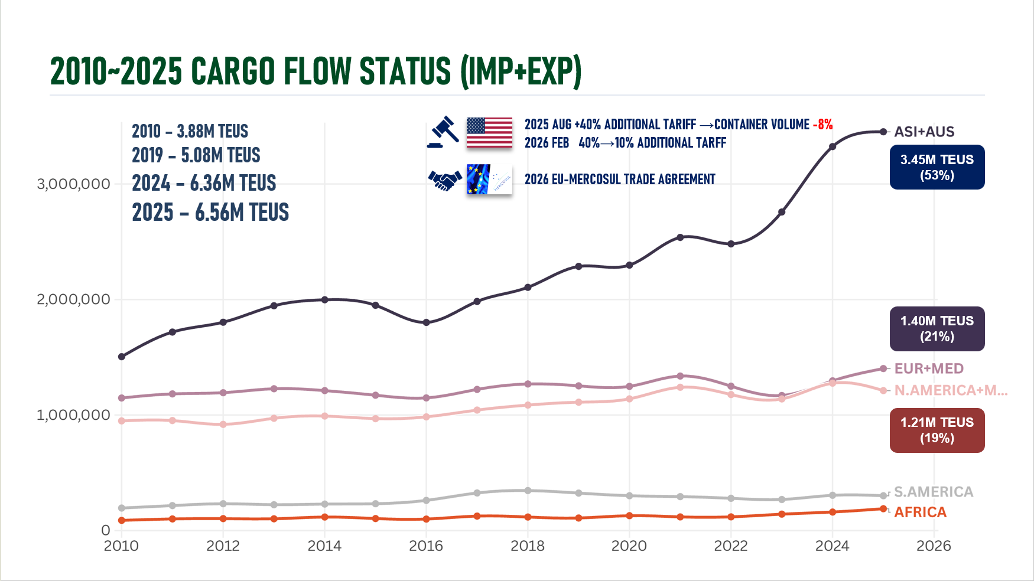

Slide 7
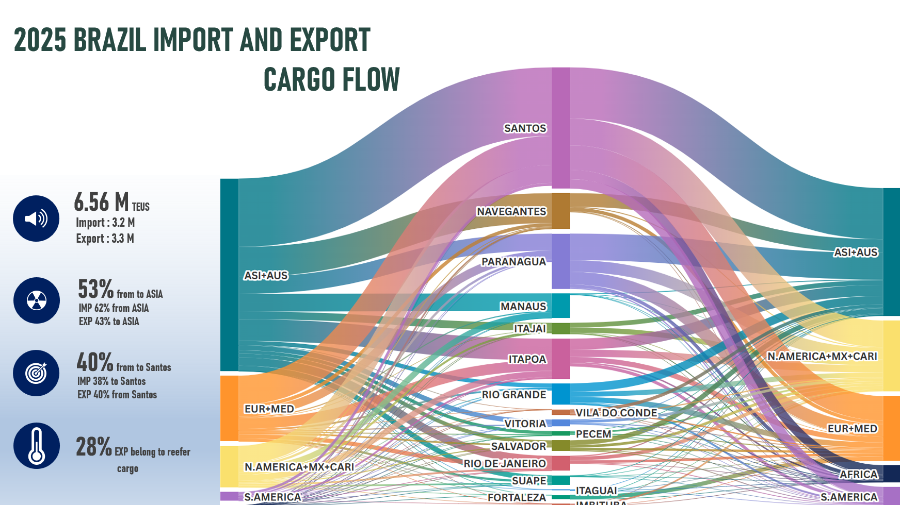

Slide 8
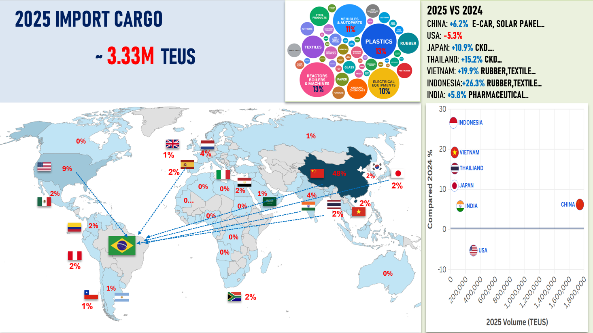

Slide 9
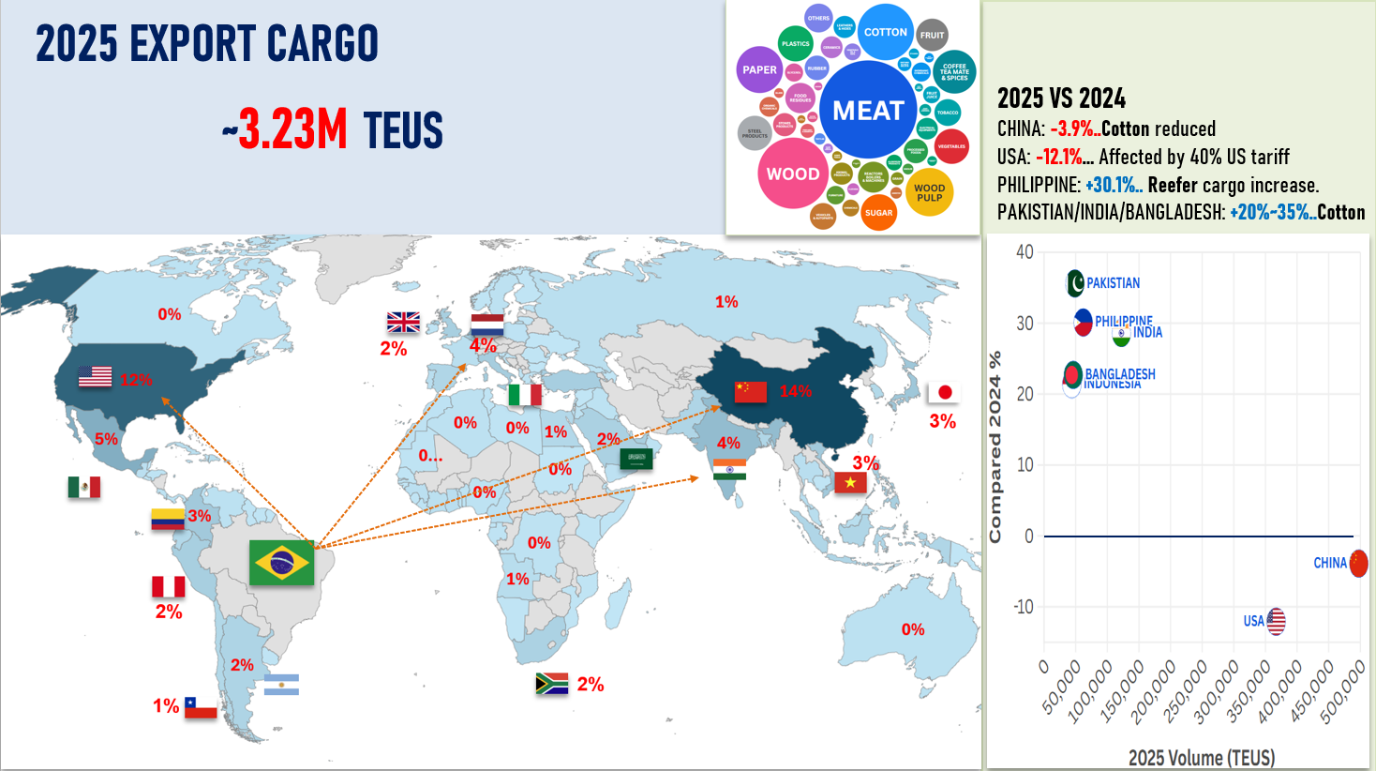

Slide 10
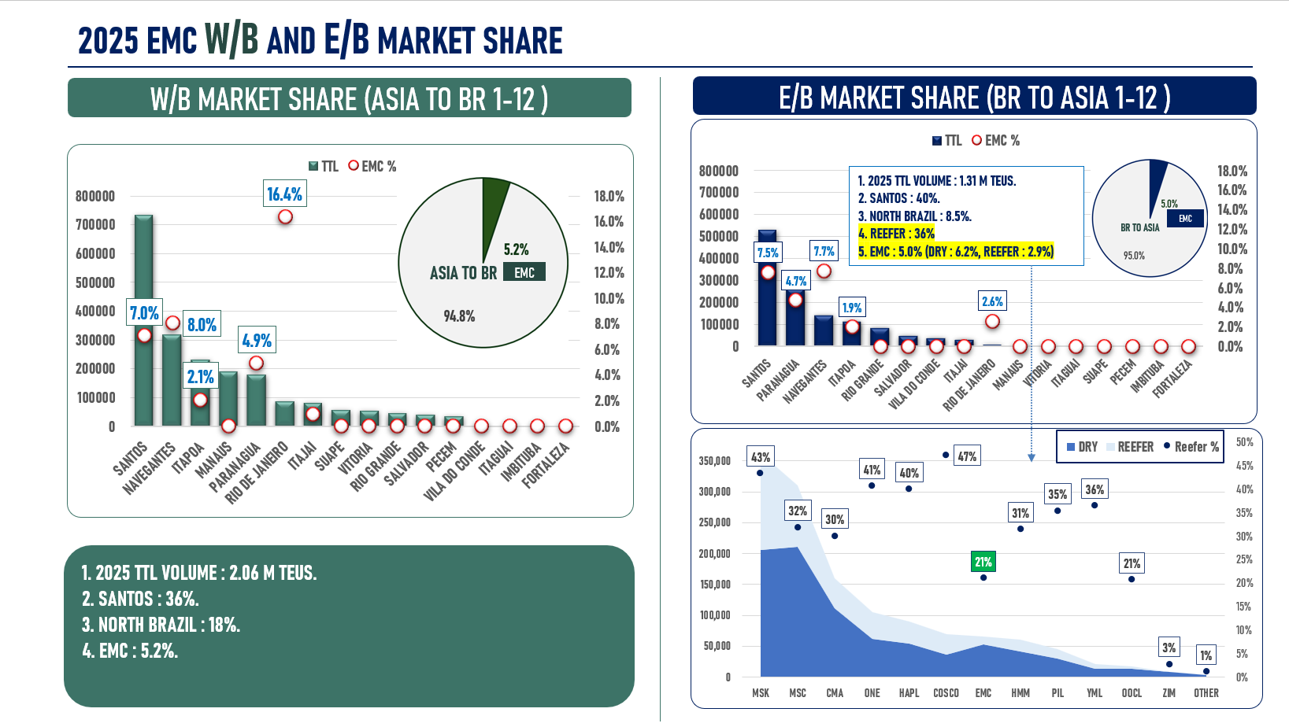

Slide 11

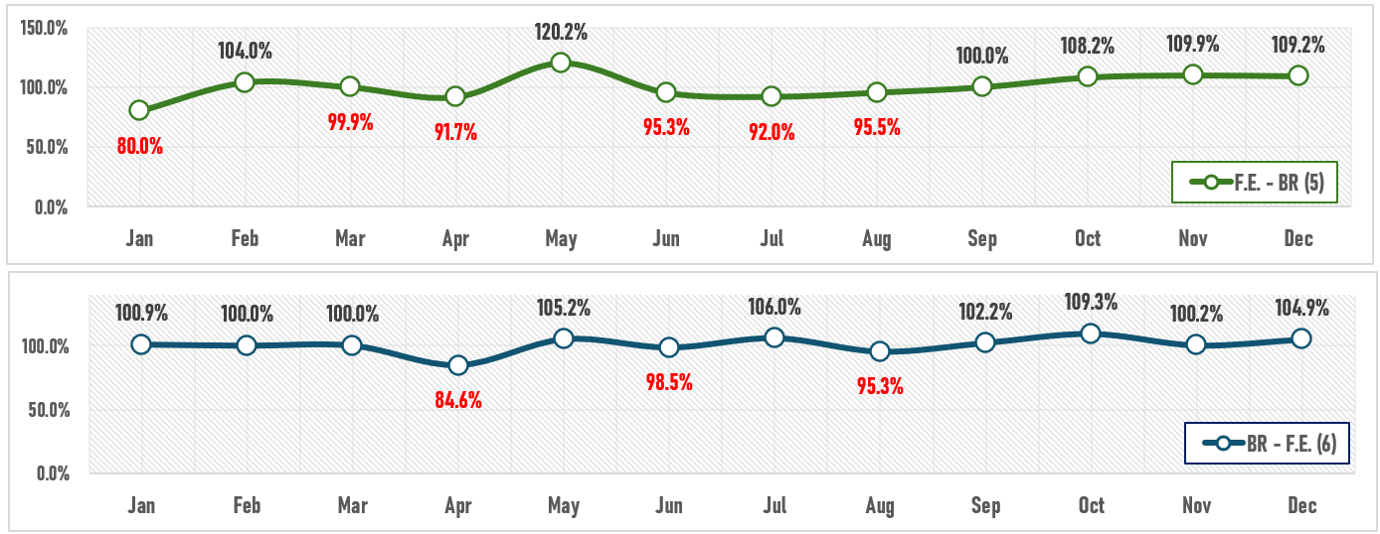
2025 KPI PERFORMANCE (LAD)
Trade | OWN SQ KPI (Year) | ACTUAL | %
F.E. – BR (5) | 11,358 | 11,559 | 102%
BR – F.E. (6) | 55,129 | 55,809 | 101%

Slide 12

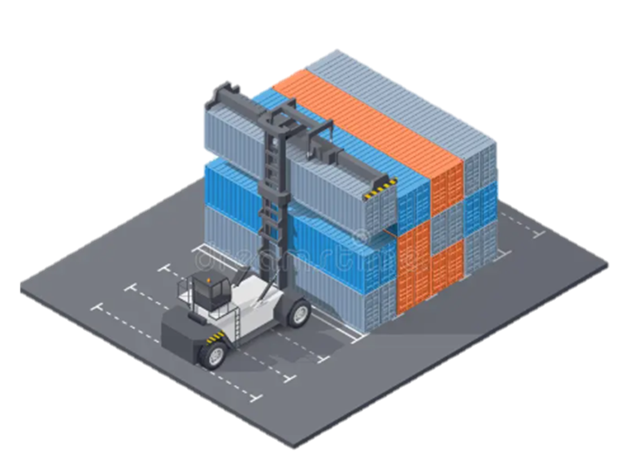
ECD KPI
ITEM | 2025 | 2026 KPI | Action Plan in 2026
Storage | 62,604 | 172,644 | 1. Transfer the empty containers closed to the ship's arrival date. 2. Avoid empty containers roll over. 3. Request terminal to grant discount when exceeding the free day.
Lift on/off | 423,142 | 451,782 | 1. Promote reuse to save the LOLO cost. 2. Adjust the LOLO charge (E24L) to reflect the cost increase.
Reposition | 2,212,555 | 2,390,168 | Negotiating with terminals to receive the empty units during normal working hours, so that we don't pay shunting overtime to the truck companies.
M & R | 65,868 | 77,603 | 1. Checking carefully each repair item. 2. Conducting regular spot checks the repair item.
18 depots
12,250 TEUS

Slide 13

5 TERMINAL: ICTSI / SBSA / TCP / PORTONAVE / ITAPOA
OCD / OPD KPI
ITEM | 2025 | 2026 KPI | Action Plan in 2026
BOA | 93.5 % | 94.8% | Keep vessels arriving into the original berthing window.
Port Stay | 98.3 % | 100 % | Reduce the restows quantity, in order to comply with move count.
Productivity | 63 % | 70 % | Push terminals to add more gangs, in order to improve cargo operation. Reduce extra moves (Restows).
ITEM | 2025 | 2026 KPI | Action Plan in 2026
Incentive | BRRIO (9,943 BOX) | BRRIO (8,560 BOX) | Continue push more volume destined for BRRIO.
Empty Storage | 51,516 | 45,270 | Well coordinate the empty reposition in Santos to avoid empties idle in SBSA over 3 days.
Rate Reduction | 21,678 | - | Continue negotiate with terminal for cost reduction.

Slide 14
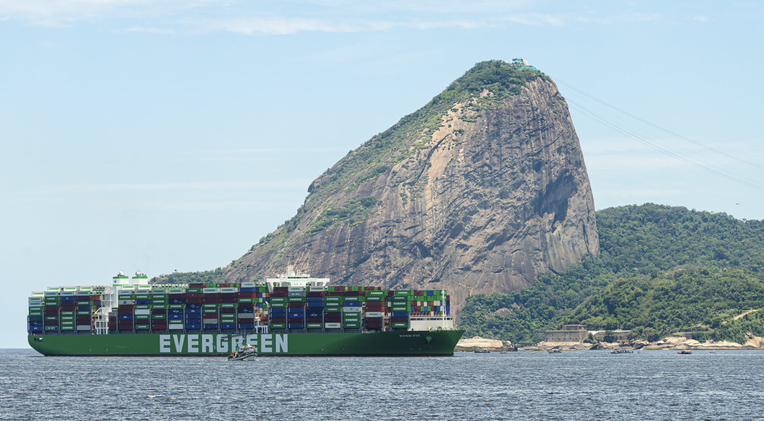
2026 Strategy
How to Achieve KPI Goals

Slide 15
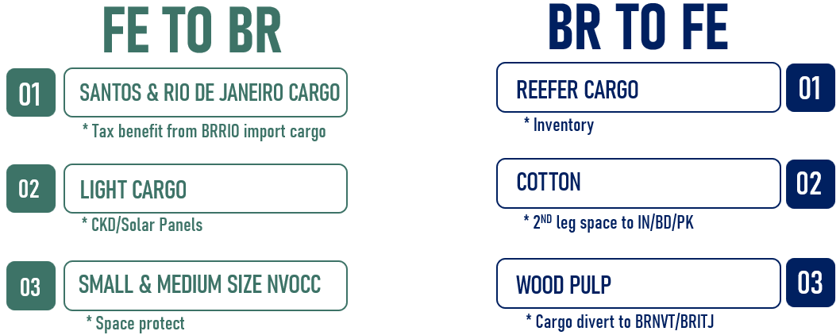
HOW TO ACHIEVE 2026 OWN SQ ?
Trade | Target (Year)
F.E. – BR (5) | 12,500
BR – F.E. (6) | 57,483

Slide 16

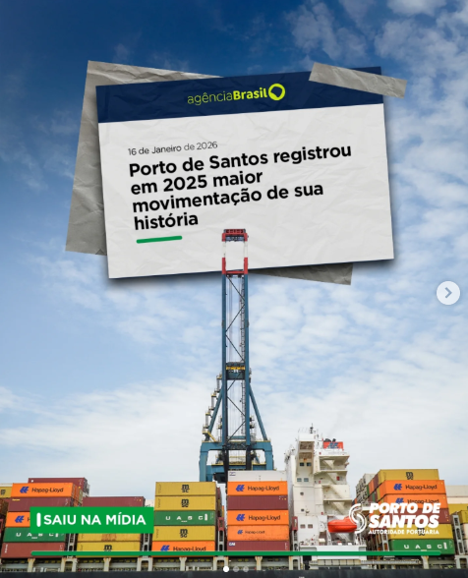
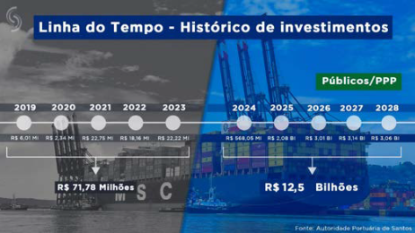
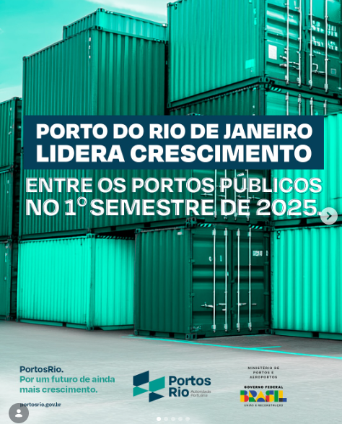
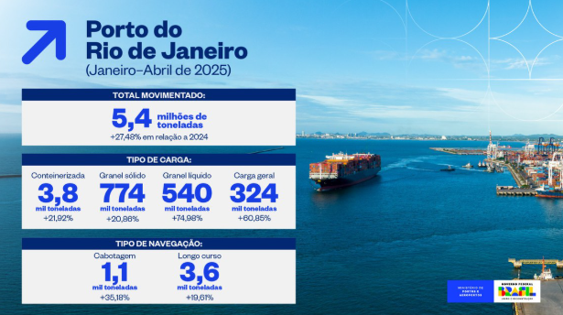
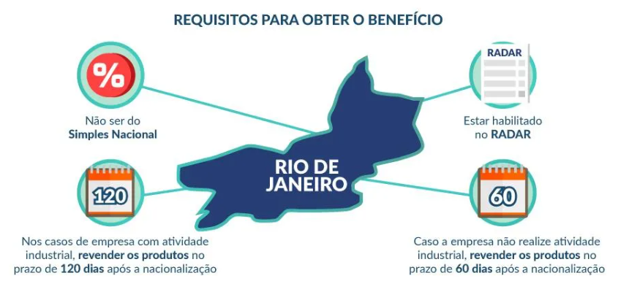
2026 ACTION PLAN - IMPORTS
(1) Santos & Rio De Janeiro Cargo
In 2025, the Santos port complex accounted for 29.6% of the country’s total international trade flows by value, measured in U.S. dollars on an FOB basis, up from 29% in 2024, so our first priority is to increase market share and import volume to Santos port.
Imports through the State of Rio de Janeiro with tax benefits. It is estimated that local imports via Rio Janeiro port will increase due to a tax benefit exclusive to the State of Rio de Janeiro.

Slide 17
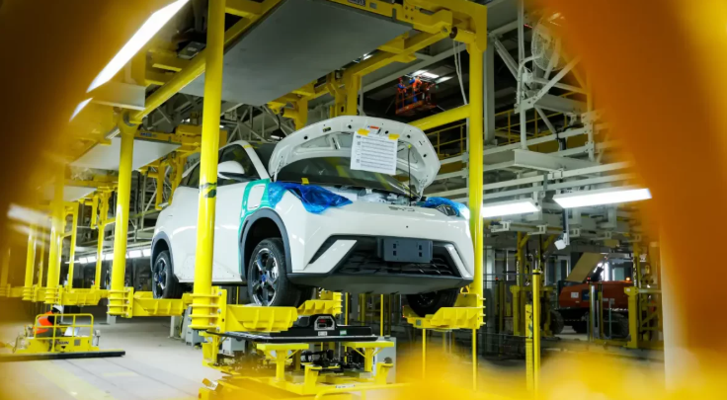

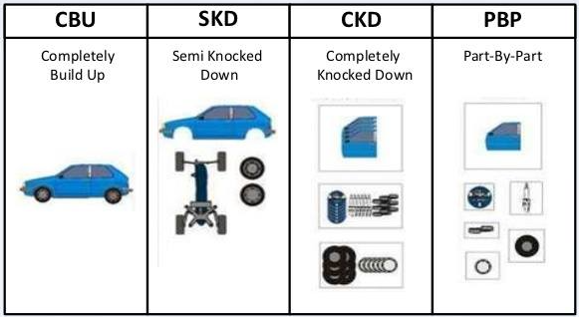



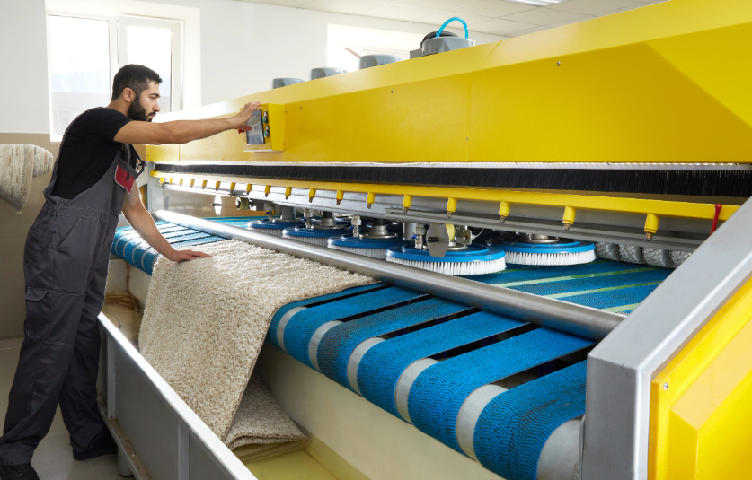
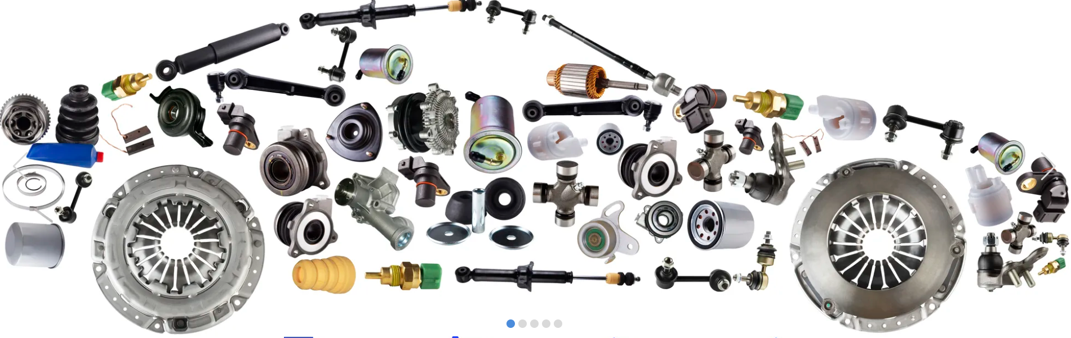
2026 ACTION PLAN - IMPORTS
(2) Light Cargo
CKD (Completely Knocked Down) vehicle manufacturers' cargo: Brazil is strongly promoting electric vehicle reforms. CKD/SKD imports will remain strong, and also the federal government has authorized 16 automakers to import disassembled electric and hybrid vehicles (SKD and CKD regimes) without paying taxes for six months.
other Light cargo such as solar panels, tires, textiles,and auto parts.

Slide 18
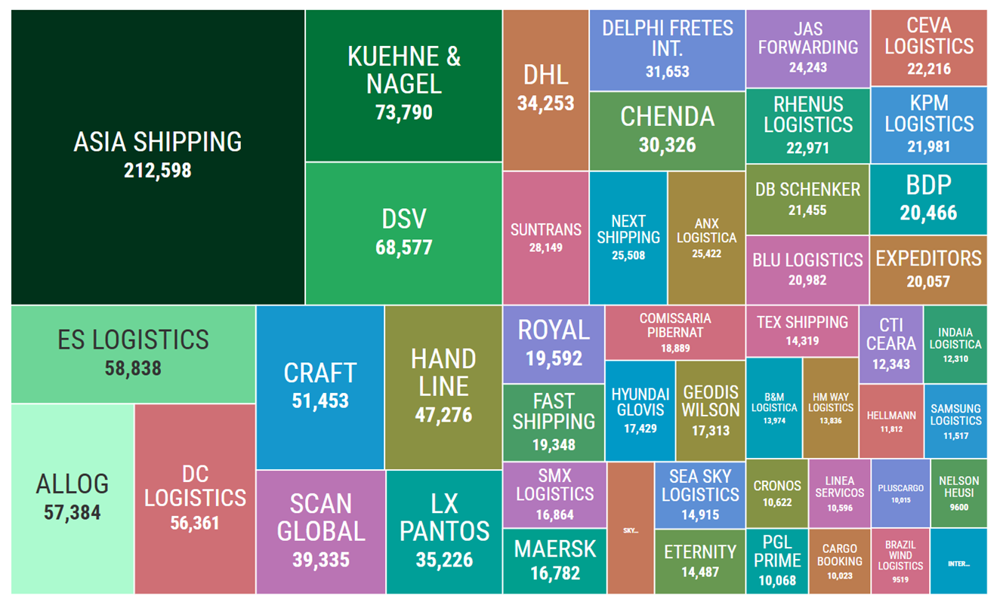
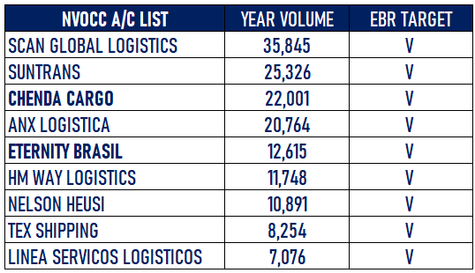
2026 ACTION PLAN - IMPORTS
(3) Small & Medium size NVOCC
1. Cargo handled by NVOCC in 2025 is 2.16 M
TEUS account for 65% of total cargo.
2. 2025 NVOCC volume increase by 5%
3. More and more Chinese NVOCC set offices
and deal the rate in Brazil.
2025 NVOCC IMPORT VOLUME (TEUS)

Slide 19
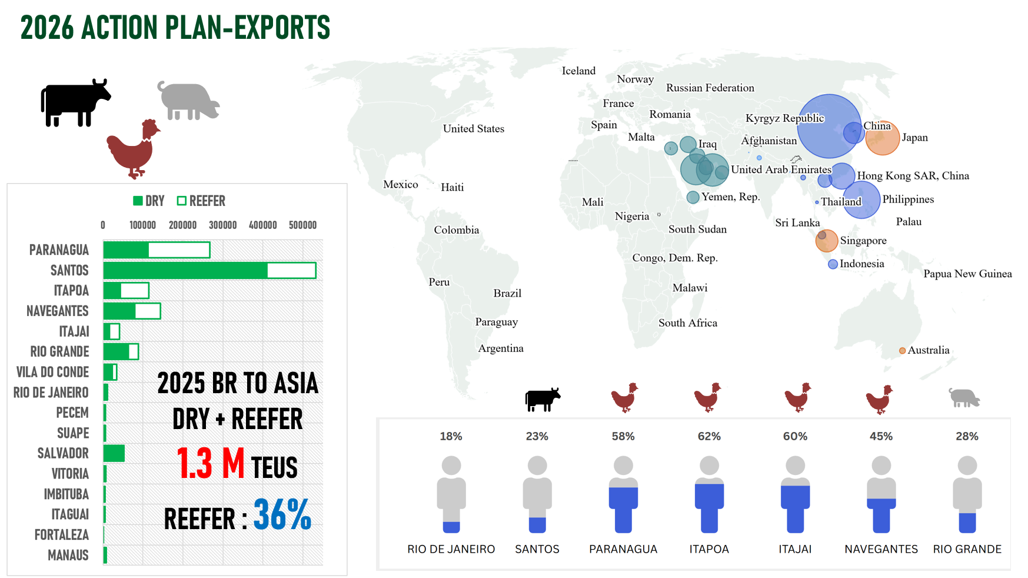







(1) Reefer Cargo

Slide 20
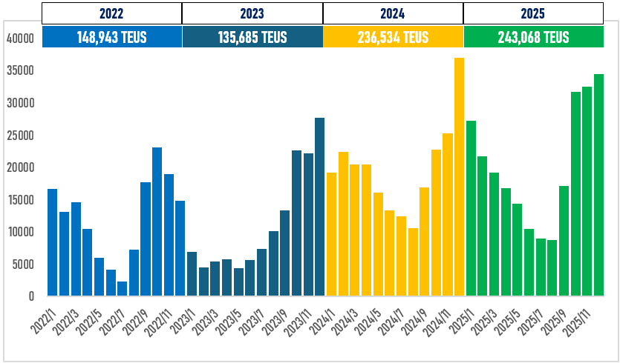

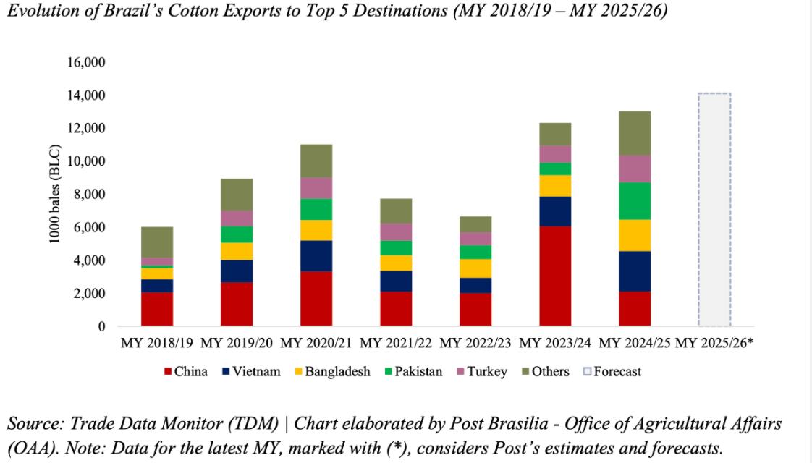
2026 ACTION PLAN-EXPORTS
(2) Cotton
Forecast: 2026 +10%
Main Buyers : China/ Vietnam/Bangladesh/Pakistan/India
Port of Loading: In addition to Santos, promote Paranaguá
Cotton Shipment Campaign-By Paranaguá
* 1-500 boxes incentive: R$150 per full box cotton volume.
* 500 -1000 boxes incentive: R$200 per full box cotton volume.
* >1,000 boxes incentive: R$300 per full box cotton volume.
minimum volume of 300 boxes performed to approve the incentive.

Slide 21
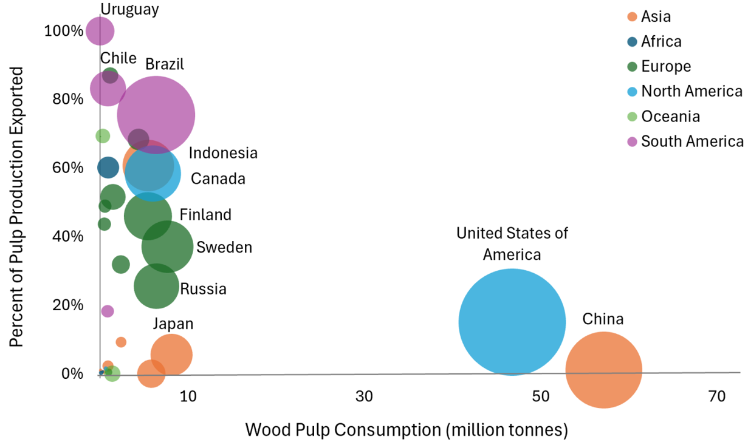
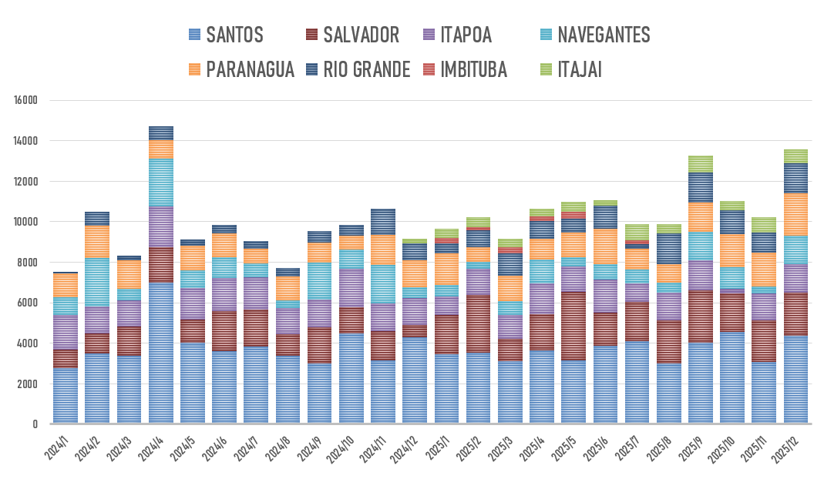
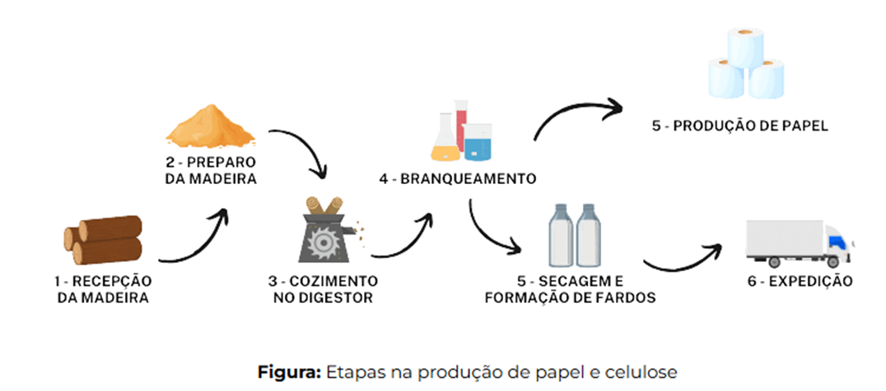



2026 ACTION PLAN-EXPORTS
(3) Wood pulp
In addition to exports carried out through the Santos port, also load a larger volume through the ports of Southern Brazil ( Navegantes and Itapoá ), following the market’s new distribution configuration.
To ASIA
2024: 115,993 TEUS
2025: 129,503 TEUS

