Slide 1

2025
Latin America
Office and Agency meeting
EMC TPE PJD-RSD
Feb 27-28, 2025

Slide 2
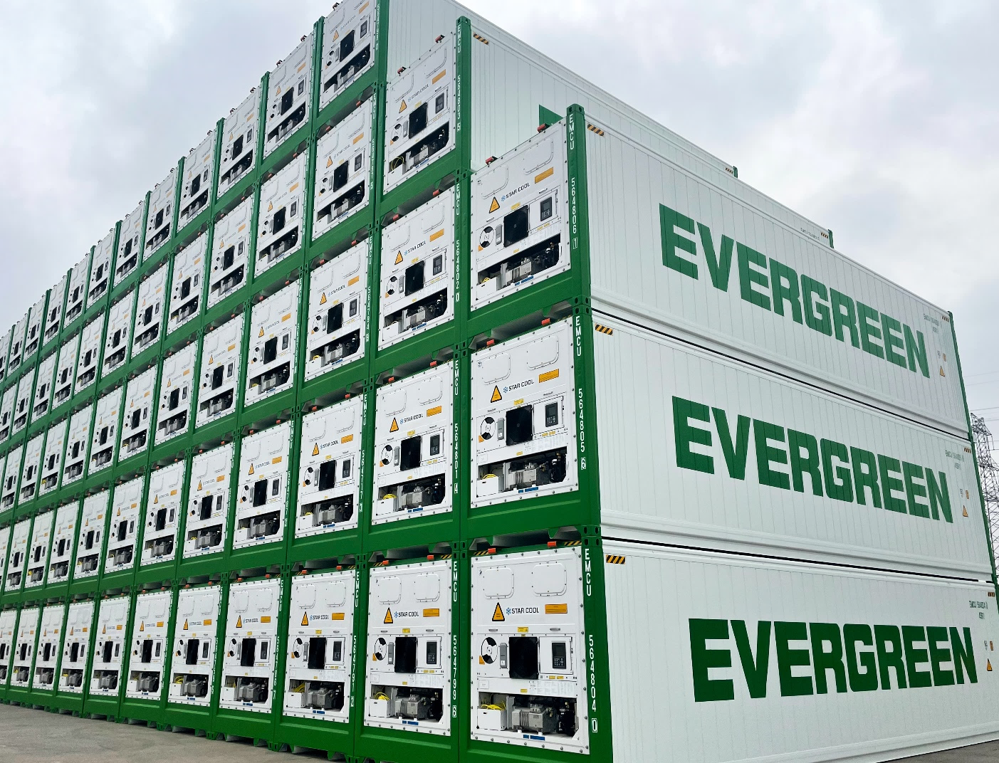
Contents
1
RSD Fleet Plan and Strategy
2
3
4
2024 Performance Review
and 2025 KPI/Plan
3
Reefer Online Service
4

Slide 3

02
RSD Fleet Plan and Strategy
EMC Reefer Fleet Plan
Container Utilization
Equipment Supply

Slide 4
02 RSD Fleet and Strategy
Opportunities、 Challenge 、Plan
Opportunities
Free Trade Agreement
Rising Demand for Perishable ( Meat from ECSA，Blueberry/Avocado and Seafood from WCSA )
Increase of Reefer Plug entitlement from ESA/ESA3
Service Rerouting ( ex. Valparaiso and probably Chancay )
( AI )
Challenge
Trade War
Logistical bottlenecks and Port Congestion
Climate Change
Empty reefer equipment supply
Plan
AMP
Target Higher Reefer Volume / Reefer Fleet / Equipment Turn around than Market to enlarge our Market Share.
Promote the match load through inbound live reefer > NOR > Empty Repo to support back haul equipment demand
ECSA seasonal apple, citrus, squid cargo + WCSA Year Round Frozen Cargo
Market diversity to POD Country
Smart Container

Slide 5
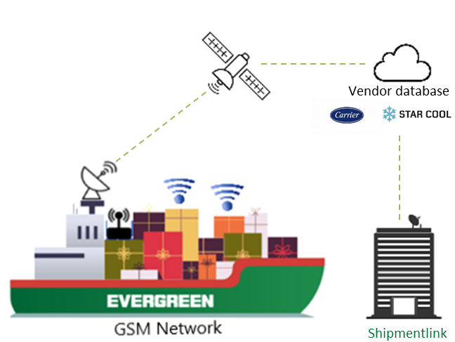
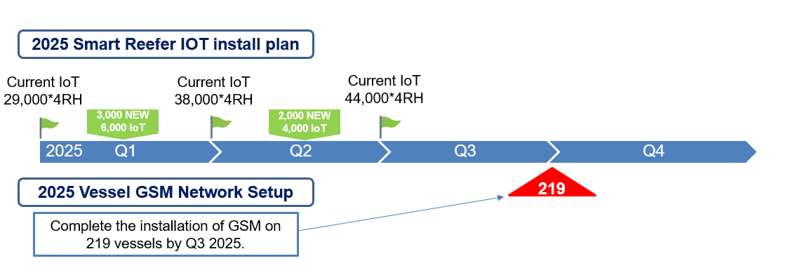

Fleet Plan
02 RSD Fleet and Strategy
EMC Reefer Fleet Plan
Average container age 3 years
2022
2023
2024
2025
2026
2027
39,000x4RH
40,200x4RH
43,500x4RH
45,300x4RH
Above 95% IoT containers of EMC reefer fleet.
7.7% Growth
10.1% Growth
4.1% Growth
2025 Smart Reefer IOT install plan
Current IoT
29,000*4RH
Current IoT
38,000*4RH
Current IoT
44,000*4RH
3,000 NEW
6,000 IoT
2,000 NEW
4,000 IoT
Above 95% IoT containers of EMC reefer fleet.
2025 Q1
Q3
Q4
Q2
2025 Vessel GSM Network Setup
219
Complete the installation of GSM on 219 vessels by Q3 2025.

Slide 6


Cargo Flow & Imbalance condition
02 RSD Fleet and Strategy
Equipment Supply -2024 Cargo Flow & Imbalance condition
ASI ⇄ WCSA/ECSA
LIVE+NOR
LIVE
IMBLANCE
USEC ➜ WCSA
EMPTY
LIVE+NOR+EMPTY
ASI+ECSA ⇄ ECSA
EMPTY
EMTYP
LIVE+EMPTY
LIVE+
NOR+
EMPTY
Regional ⇄ Regional
LIVE

Slide 7

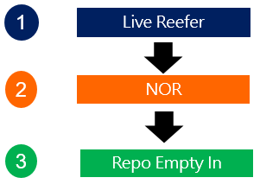
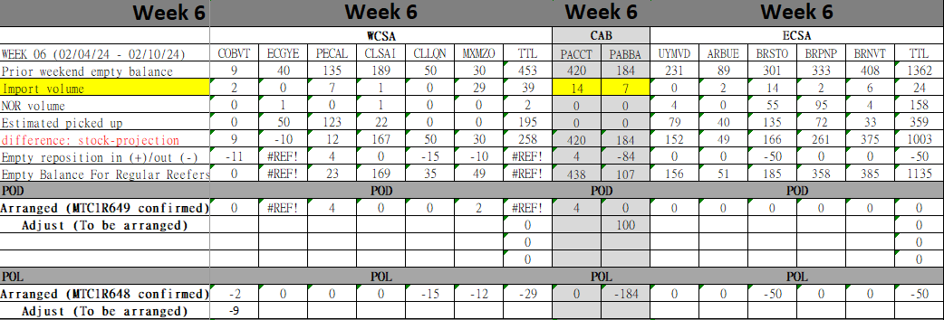
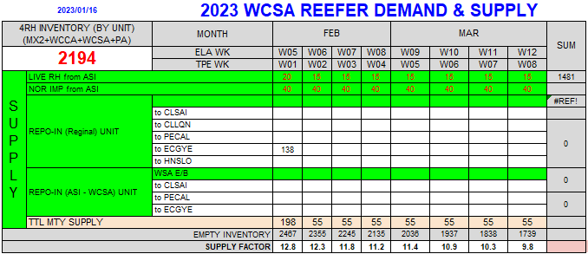
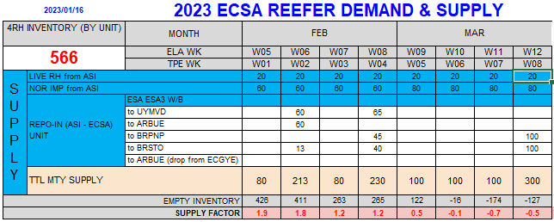
02 RSD Fleet and Strategy
Equipment Supply -Order of Precedence
Precise 1+8 prospect is requested in order to timely plan empty repo

Slide 8

03
2024 Performance and 2025 KPI/PLAN
(1) WCSA/ECSA/Regional Review in 2024
(2) 2025 KPI and Plan
(3) Strategies

Slide 9

03 2024 Performance and 2025 KPI/PLAN
WCSA to ASI MARKET SHARE- Reefer Volume Share
Country | Market TEU | EMC TEU | EMC Share
CL | 87,384 | 3,258 | 3.7%
PE | 25,984 | 3,716 | 14.3%
EC | 77,236 | 2,950 | 3.8%
CO | 780 | 80 | 10.2%
Country | Market TEU | EMC TEU | EMC Share
CL | 66,396 | 2,546 | 3.8%
PE | 11,754 | 1,776 | 15.1%
EC | 75,868 | 2,502 | 3.3%
CO | 660 | 48 | 7.3%
191,388
TEUS
152,372
TEUS

Slide 10
03 2024 Performance Review and 2025 KPI/PLAN
WCSA to ASIA KPI review and 2025 KPI
2024 KPI ACHIEVMENT
Jan-Dec loaded 6,175 UNITS
2024 KPI ACHIEVMENT：101%
4RH
6,175 UNITS
4RH

Slide 11
03 2024 Performance Review and 2025 KPI/PLAN
WCSA 2024 AMP
Commodity rely on fresh fruit and frozen meat.
Cargo source centralizes on Top5 A/C.

Slide 12
03 2024 Performance Review and 2025 KPI/PLAN
ECSA to ASI MARKET SHARE- Reefer Volume Share
Country | Market TEU | EMC TEU | EMC Share
BR | 449,784 | 11,954 | 2.7%
AR | 60,980 | 5,176 | 8.5%
UY | 30,302 | 3,500 | 11.6%
Country | Market TEU | EMC TEU | EMC Share
BR | 376,510 | 8,736 | 2.9%
AR | 39,174 | 3,072 | 7.8%
UY | 18,490 | 2,140 | 11.6%
541,066
TEUS
358,403
TEUS

Slide 13
03 2024 Performance Review and 2025 KPI/PLAN
ECSA to ASIA KPI review and 2025 KPI
2024 KPI ACHIEVMENT
Jan-Dec loaded 10,670 UNITS
2024 KPI ACHIEVMENT：102%
4RH
10,670 UNITS
4RH

Slide 14
03 2024 Performance Review and 2025 KPI/PLAN
ECSA 2024 AMP
Commodity rely on frozen meat including beef, pork and seafoods.
Cargo source centralizes on Top5 A/C

Slide 15
03 2024 Performance Review and 2025 KPI/PLAN
Regional Cargo
ELA Regional Cargo
2024 Jan-Dec YoY：898*4RH
To utilize way bound space under WSA-WSA4
To promote CL/PE-MX cargo

Slide 16

03 2024 Performance Review and 2025 KPI/PLAN
2024 WCSA Performance

Slide 17
03 2024 Performance Review and 2025 KPI/PLAN
2025 WCSA monthly KPI
3.5% growth compared to 2024 lifting

Slide 18






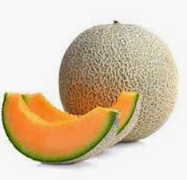













03 2024 Performance Review and 2025 KPI/PLAN
How to achieve WCSA KPI
2024 Chilled V.S. Frozen
61% V.S. 39%
Promoting O/O shipment, such big retail and MTA who can self handle truck
Mexico
Year Round Cargo
Tender A/C
More stable LAE service to promote frozen shrimp business
Honduras
Developing avocado, coffee, and frozen meat shipment to ASI
COBVT
Promoting year round shrimp, banana and market share
Ecuador
Increasing frozen seafood and juice cargo
WSA
Peru
WSA2
WSA3
Promoting year round frozen meat/salmon to support Jun-Nov fruit low season
WSA4
Chile

Slide 19
03 2024 Performance Review and 2025 KPI/PLAN
2024 ECSA Performance

Slide 20
03 2024 Performance Review and 2025 KPI/PLAN
2025 ECSA monthly KPI
3.5% growth compared to 2024 lifting

Slide 21





03 2024 Performance Review and 2025 KPI/PLAN
How to achieve ECSA KPI
Diversifying frozen meat commodity to avoid meat-borne diseases limitation and chilled apple shipment from BRNVT
Brazil
Deploying container in Q1 to promote more seasonal squid shipment
2024 Chilled V.S. Frozen
6% V.S. 94%
Uruguay
Enlarging chilled commodity including citrus, lemon, cheese up to 12% and squid shipment
Seasonal Cargo
Commodity Diversified
Argentina
ESA
ESA3

Slide 22
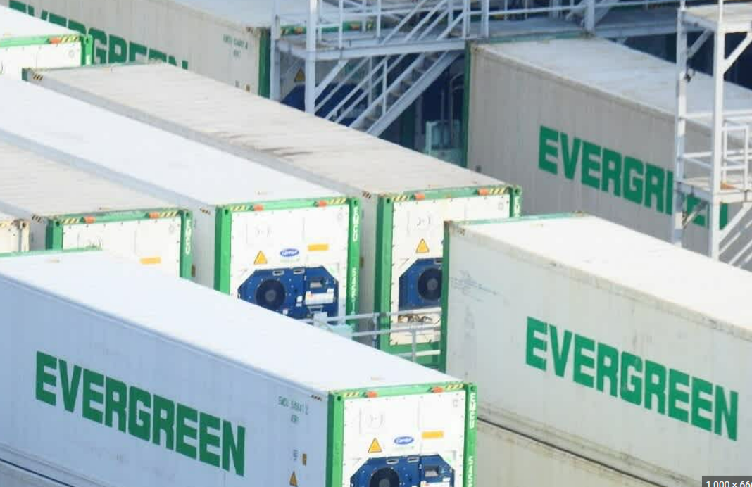
03 2024 Performance Review and 2025 KPI/PLAN
Unclaimed cargo following
Follow Unclaimed Working Manual
Consistent Approaching
Avoid Cost Cumulated
CASE CLOSED

Slide 23

03 2024 Performance Review and 2025 KPI/PLAN
WCSA/ECSA Strategies
Balance
1. Headhaul Live Reefer+ NOR
2. Demand Places
Cargo Strategies
1. WCSA Year-round Cargo
2. ECSA Seasonal Cargo Apple, Citrus, Squid
3.Tender A/C
4. Enlarging A/C Base and New A/C Developing
5. Diversifying Commodity
Cargo Management
1. M&R, PTI
2. Precise 1+8 prospect
3. Flexible Empty Repo
4. Improving Container Utilization
5.Unclaimed cargo solve

Slide 24
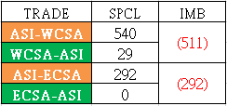
RSD SPECIAL CARGO TEAM
Target: Promoting W/B cargo
to balance
RSD-RS2 Special cargo team
Adam Hung
ASI/USA+EUR+MED, MED/ASI
Will Hung
willhung@tw.evergreen-line.com
ASI/APG+ISC+FRS+AFR+AU, EUR/ASI
Jacky Chu
FE/FE, ASI/SAME, SAME/ASI
jackychu@tw.evergreen-line.com
adamhung@tw.evergreen-line.com
ASI ⇄ WCSA/ECSA
Special cargo
(strong leg)
Special cargo (weak leg)

Slide 25


04
Reefer Online Service

Slide 26
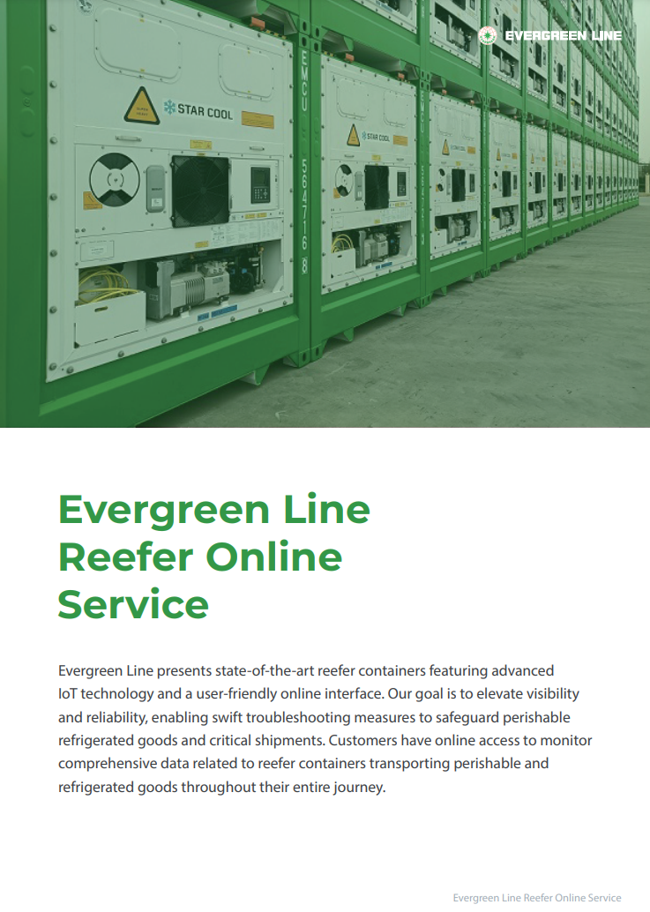

04 Reefer Online Service
Target:
Enhance the utilization of frozen and refrigerated cargo.
Develop specific cargo, such as medical supplies and Pharmaceutical products.
100% utilization is the ultimate goal.

Slide 27






¡Muchas gracias!
¡ Muito obrigado!

