Slide 1

LAAM MEETING
PJD-LAD/Tony Wu
Feb/27/2025

Slide 2






MARKET OUTLOOK
2024 RECAP
2025 CAPACITY & KPI
2025 STRATEGY
ACTION PLAN/Q&A

Slide 3

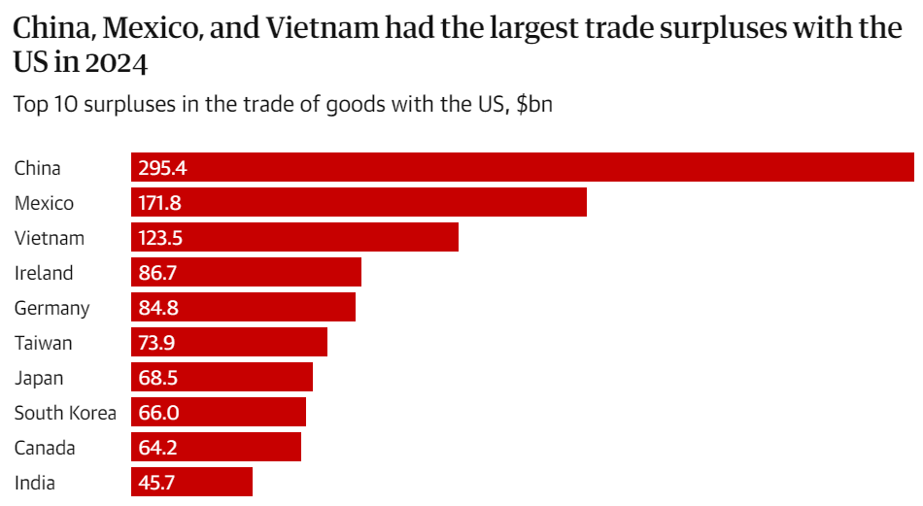
RECIPROCAL TARIFFSssss
will Reshape Global Trade Patterns
~Drewry Survey

Slide 4

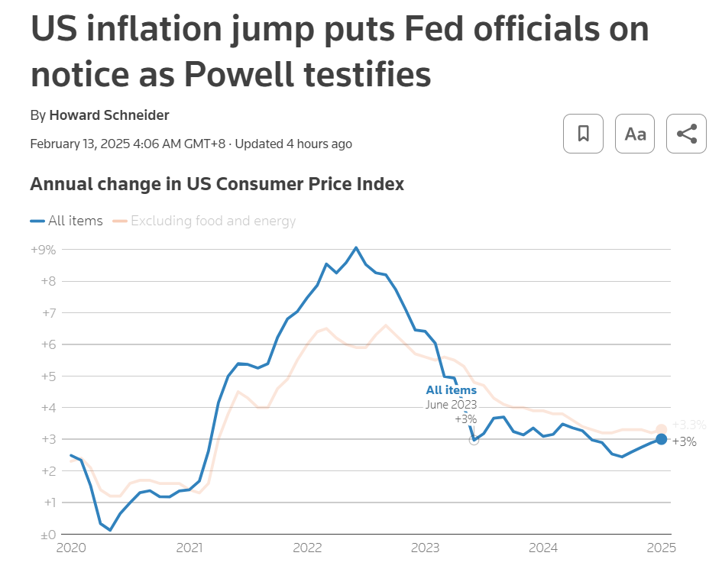
Fed Chair Jerome Powell began a second day of hearings on Capitol Hill on Feb 12.

Slide 5

FACT SHEET: PRESIDENT DONALD J. TRUMP IMPOSES TARIFFS ON IMPORTS FROM CANADA, MEXICO AND CHINA
February 1, 2025
But Trump agrees to Pause Tariffs on Mexico and Canada but not on China

Slide 6
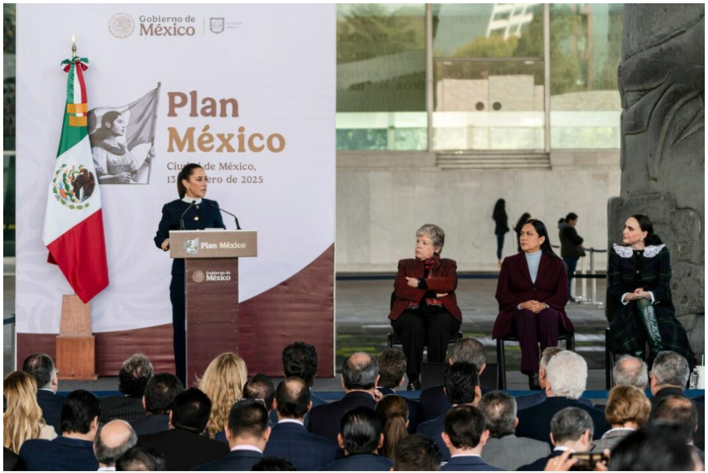
& Plans Nearshoring Incentives to Curb China Imports
Mexico pledges to shrink trade deficit with China (2025/Jan/14)
Mexico’s President Claudia Sheinbaum announced January 13 a plan to reduce the country’s imports from China in a bid to support local industry and align herself with the U.S. and Canada as a trade partners.
Amid a shrinking share of North American exports to the world, Sheinbaum stated that Mexico would offer incentives for nearshoring, including tax deductions, and develop plans for individual sectors for how to increase the local content of goods made in Mexico.
North America’s share of global trade has declined, while China’s has increased, Finance Minister Rogelio Ramirez de la O said during the event, underscoring the importance for the region of replacing its imports from the Asian giant. “If North America replaces 10% of the imports we are getting from China, and we make them in North America, Mexico’s GDP would grow 1.2% more than it normally does, the U.S. 0.8% more and Canada 0.2% more,” Ramirez de la O said.
Among the “Plan Mexico” priorities are to speed up the permit process for exporting manufacturers that import materials duty-free and boost the purchase of locally made goods. As part of that plan, Mexico wants, by 2030, to increase the percentage of Mexico-made components in each vehicle to 15%.
Source: 2025/Jan/16 Bloomberg

Slide 7
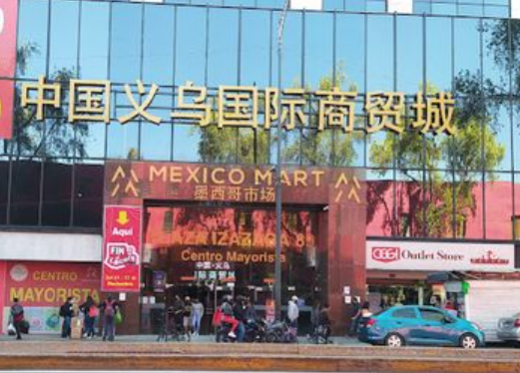
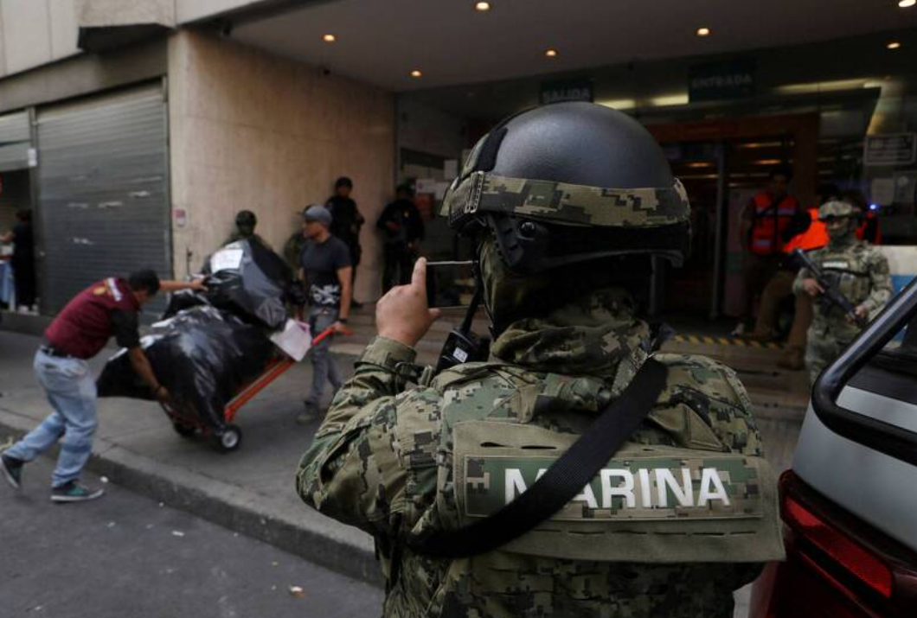
Mexico raided stores selling counterfeit Chinese goods, vows national crackdown
Mexican authorities raided a massive complex of stores selling counterfeit Chinese and other Asian goods in downtown Mexico City, and vowed on Friday to take the crackdown nationwide.
Over 200 police, marines and inspectors raided a building known as “Mexico Mart” in the city’s colonial centre on Thursday and seized around 90,000 counterfeit products that masqueraded as name-brand goods.
They seized a total of over 262,000 products that had no receipts, import documents or, in some cases, even labels.
Source: 2024/Nov/30 South China Morning Post

Slide 8

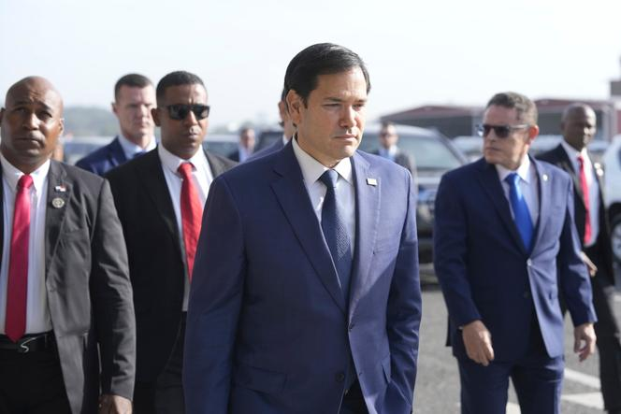
Panama Drops Belt and Road Agreement with China after US Pressure Feb 4.2025

Slide 9
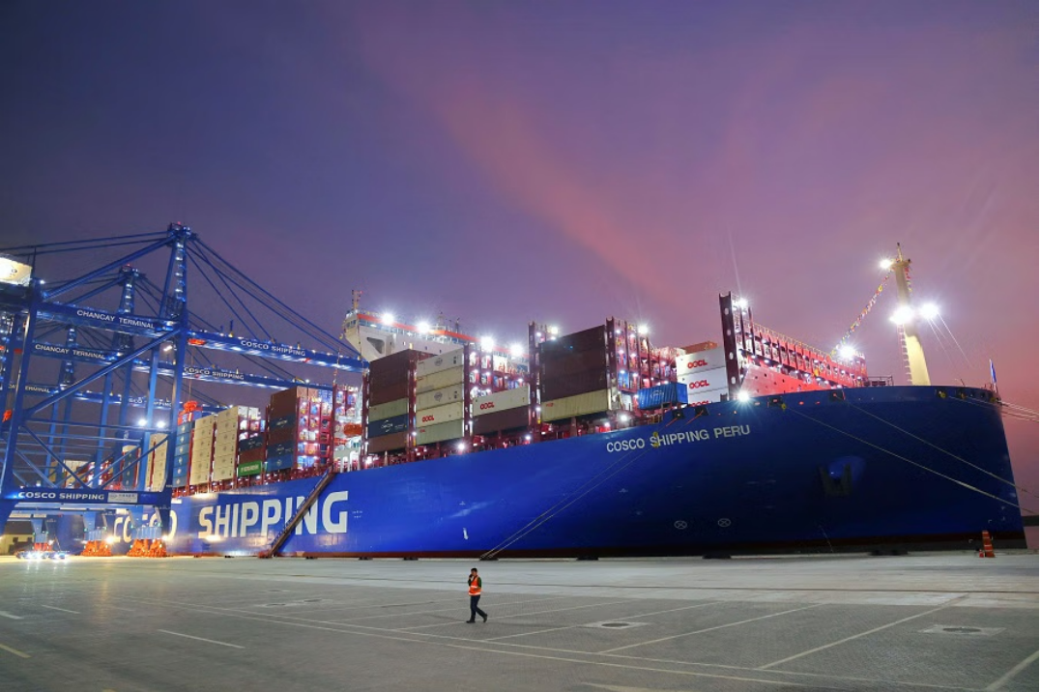

Is Peru’s Chancay Port Trump’s next target ?
Now that Trump has successfully pressured Panama into withdrawing from China’s Belt and Road initiative ,what will his next target be ?According to several experts,he might be honing in on Peru’s Chancay Port. Feb 12,2025

Slide 10
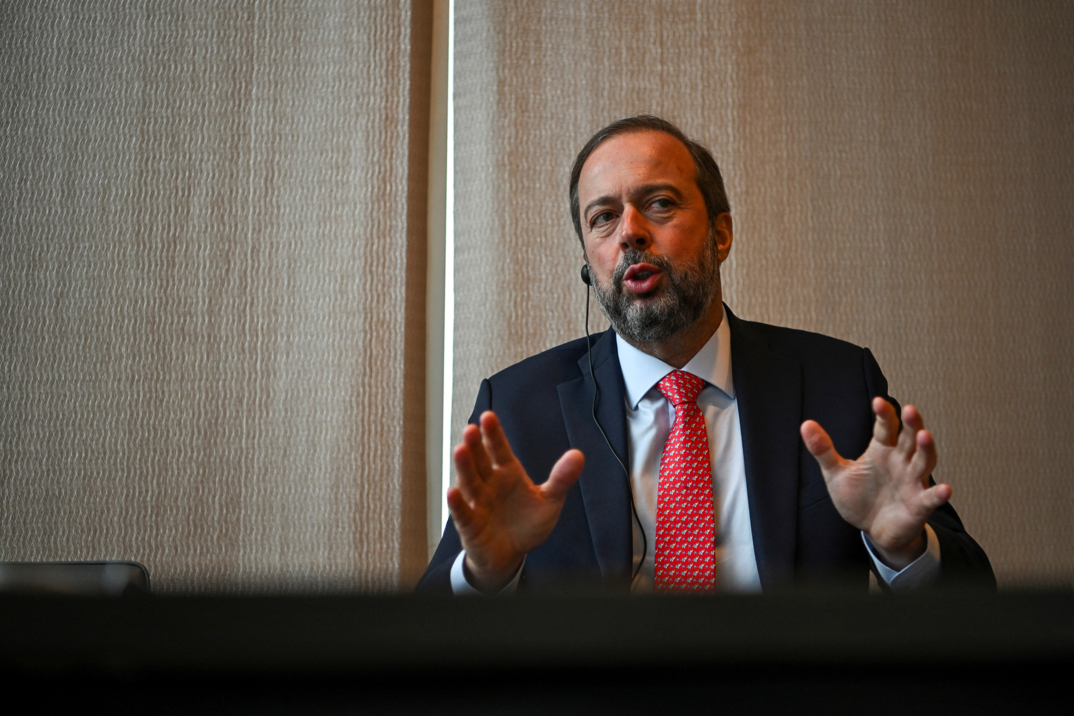

Argentina Leader orders WHO Exit in Move Mirroring Trump's
Trump was Simplifying US Tariffs without Exceptions or Exemptions
Brazil Says US Ethanol Tariff Would Be Unreasonable, Calls for Sugar Talks
Javier Milei was the first president whom Trump met after being elected last November

Slide 11
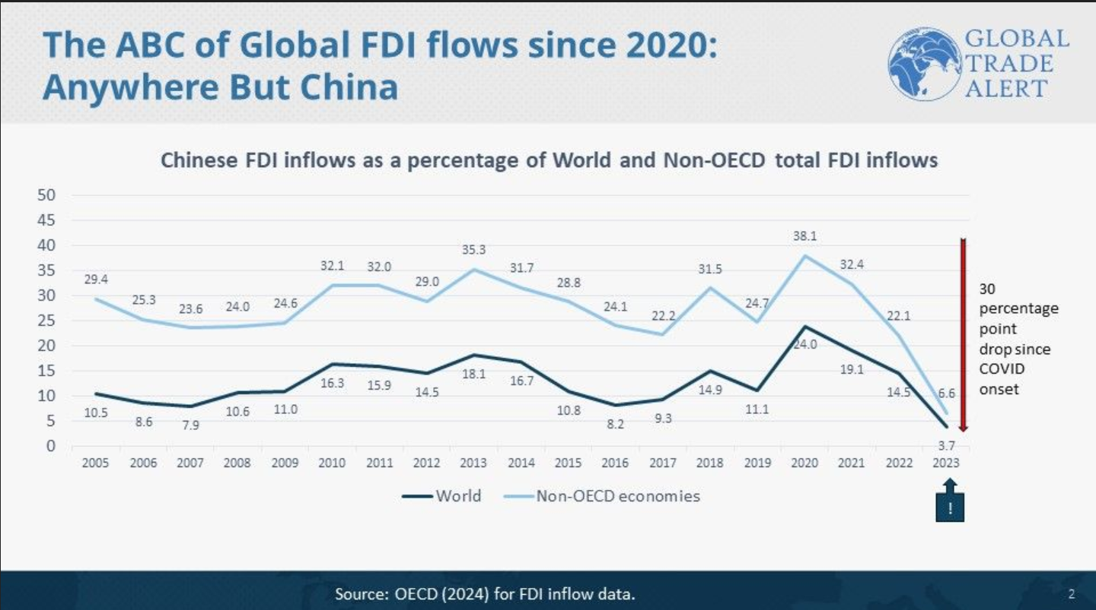
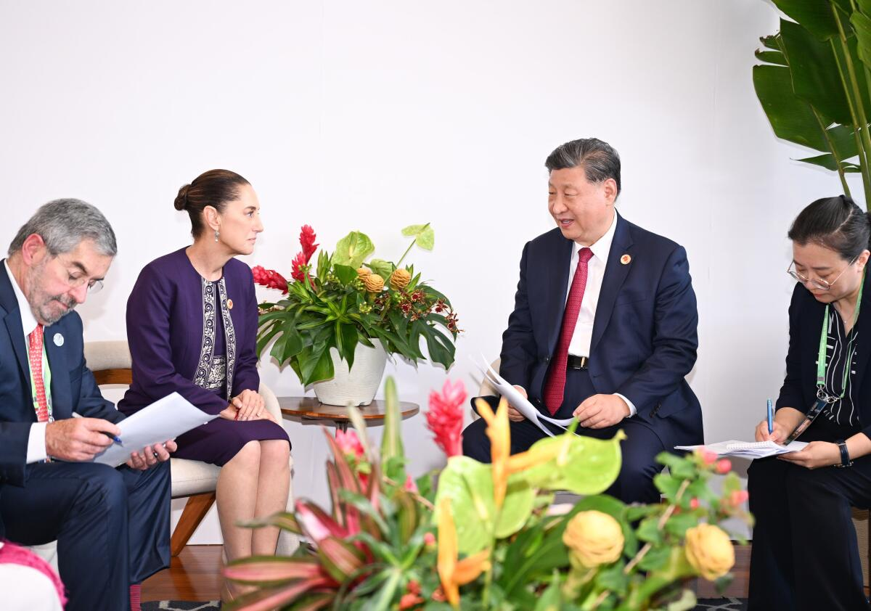
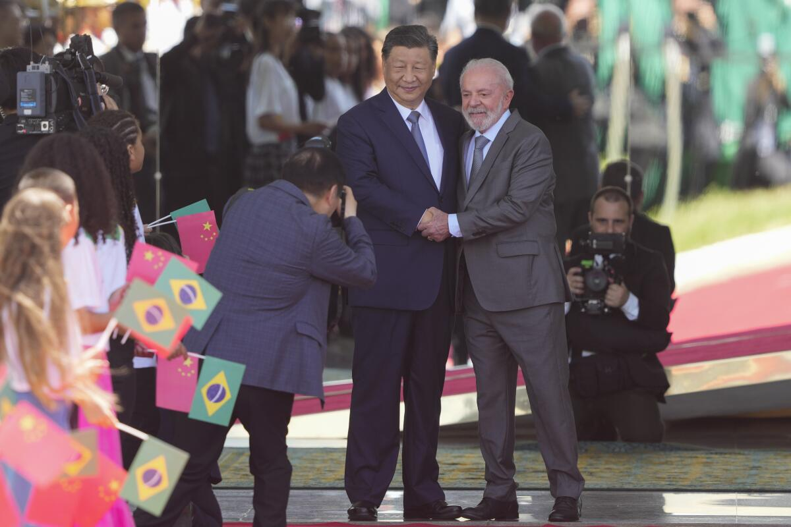
ABC(Anywhere But China) from OECD data
Latin America still is Influenced by the US but China can Provide them with Economic Benefit and also More Political Independence
2025 LAAM MEETING
11

Slide 12
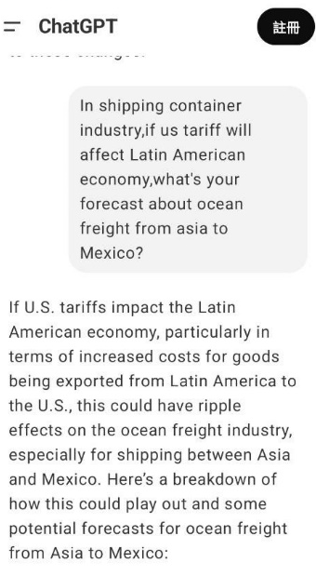





Slide 13

MARKET OUTLOOK
2025

Slide 14
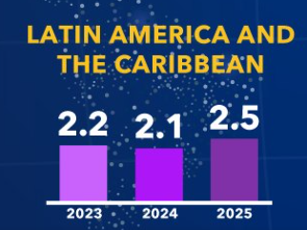
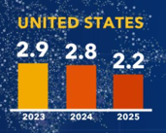
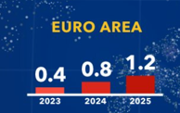
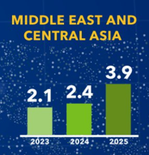
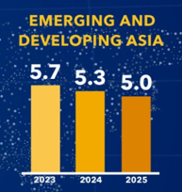
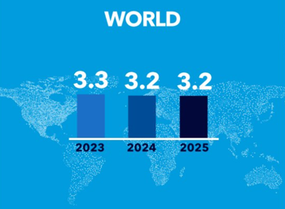
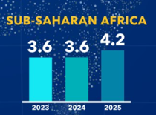
IMF World Economic Snapshot
Growth is Expected to Moderate in 2025
WORLD ECONOMIC OUTLOOK OCTOBER 2024
GROWTH PROJECTIONS BY REGION
(REAL GDP GROWTH, PERCENT CHANGE)
In Latin America and the Caribbean, growth is projected to decline from 2.2 percent in 2023 to 2.1 percent in 2024 before rebounding to 2.5 percent in 2025., compared with July 2024 World Economic Outlook Update projections, owing to stronger private consumption and investment in the first half of the year from a tight labor market, government transfers, and smaller-than-anticipated disruptions from floods. However, with the still-restrictive monetary policy and the expected cooling of the labor market, growth is expected to moderate in 2025. Overall, offsetting revisions leave the region.
Source: IMF World Economic Outlook Oct/2024

Slide 15
2025 Economy in a Good Shape
Inflation Rate %
BR
Real GDP growth %
AR
ECSA
UY
PY
CO
EC
WCSA
PE
Central
America
Caribbean
2025
2024
2025
2024
Source: IMF World Economic Outlook Oct/2024

Slide 16
2024
RECAP
2024

Slide 17
2024 ECSA Market Share Rank (Jan-Oct)
EMC AVG
8.0%
EMC AVG
8.4%
No.5
No.7
No.8
No.4
No.3
No.3
No.7
No.5
No.5
No.2
*
*
*Market extra loaders mainly call Brazil during 2024
*Market extra loaders mainly call Brazil during 2024

Slide 18
2024 WCSA Market Share Rank (Jan-Oct)
EMC AVG:
8.1%
No.7
EMC AVG:
8.7%
No.7
No.7
No.3
No.5
No.8
No.7
No.7
No.7
No.2
No.2
No.7
No.7
No.7
*
*
*Market extra loaders mainly call Mexico during 2024
*Market extra loaders mainly call Mexico during 2024

Slide 19
2024 PNM/CARI Market Share Rank (Jan-Oct)
EMC AVG:
17.2%
No.2
No.2
No.3
No.3
No.3
No.3
No.1

Slide 20



2024 ECSA & PNM/CARI Performance Review
ASI - ECSA | OWN SQ Lifting
 | Actual | KPI
BR | 10,071 | 10,006
AR | 12,673 | 12,513
UY | 1,978 | 1,907
PY | 1,298 | 1,333
ASI – PNM/CARI | OWN SQ Lifting
 | Actual | KPI
PA | 17,605 | 15,662
PR | 9,247 | 6,511
DO | 2,587 | 2,708
CO | 5,333 | 3,989
HT | 1,450 | 1,219
JM | 339 | 379
CW | 566 | 332
CR | 212 | 127
HN | 284 | 223
GT | 100 | 165
*ESA/ESA3 L/F 95.3%
ECSA - ASI | OWN SQ Lifting
 | Actual | KPI
BR | 59,540 | 55,052
AR | 13,185 | 13,016
UY | 7,871 | 6,838
PY | 3,092 | 2,691
*ESA/ESA3 L/F 50.9%
*AUE/NUE L/F 100%

Slide 21


2024 WCSA Performance Review
ASI – MX/WCSA | OWN SQ Lifting
 | Actual | KPI
MX | 22,492 | 20,581
GT | 7,430 | 9,823
HN | 1,513 | 1,766
NI | 59 | 194
SV | 83 | 129
CR | 6,295 | 6,027
CL | 8,454 | 6,870
PE | 10,622 | 9,185
CO | 12,965 | 11,883
EC | 2,476 | 1,916
MX/WCSA-ASI | OWN SQ Lifting
 | Actual | KPI
MX | 10,771 | 8,948
GT | 2,357 | 1,952
HN | 428 | 707
NI | 60 | 49
SV | 377 | 409
CR | 5,046 | 5,434
CL | 30,502 | 28,293
PE | 34,628 | 27,189
CO | 1,929 | 1,806
EC | 6,714 | 6,302
*WSA/WSA2/WSA3/WSA4/WSA5 L/F 96.7%
*WSA/WSA2/WSA3/WSA4/WSA5 L/F 34.7%

Slide 22
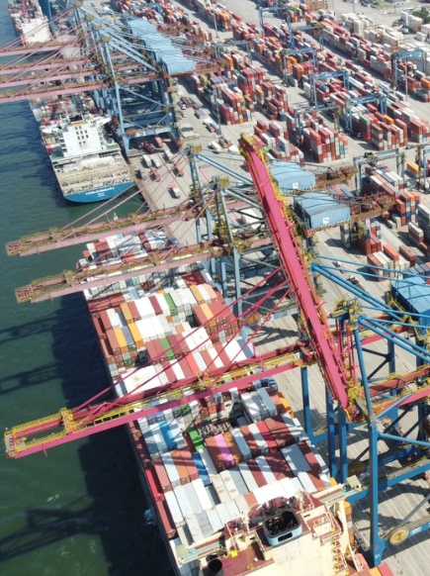
What We Have Done-THC Adjustment
Port | Original Amount | Latest Amount | Updated effective date | Remark
BRRIO | BRL650/box | BRL700/box | 2023/02/01 | Year 2025 rate freeze
BRSTO (DPW) | BRL980/box | BRL1,205/box | 2023/09/01 | Effective till 2025/Aug
BRSTO (SBSA) | BRL980/box | BRL1,205/box | 2023/09/01 | Effective till 2025/Sep/30
BRPNP | BRL1,360/box | BRL1,500/box | 2025/03/01 | Effective till 2025/Mar
BRNVT | BRL830/box | BRL955/box | 2023/09/01 | Effective till 2025/Dec/31
BRIOA | BRL900/box | BRL1,000/box | 2025/03/01 | Effective till 2025/Mar
ARBUE | USD200/230/230 | USD250/box | 2023/11/01 | Year 2025 rate freeze
UYMVD | USD220/240/240 | USD230/250/250 | 2025/03/01 | Effective 2025/Jan

Slide 23
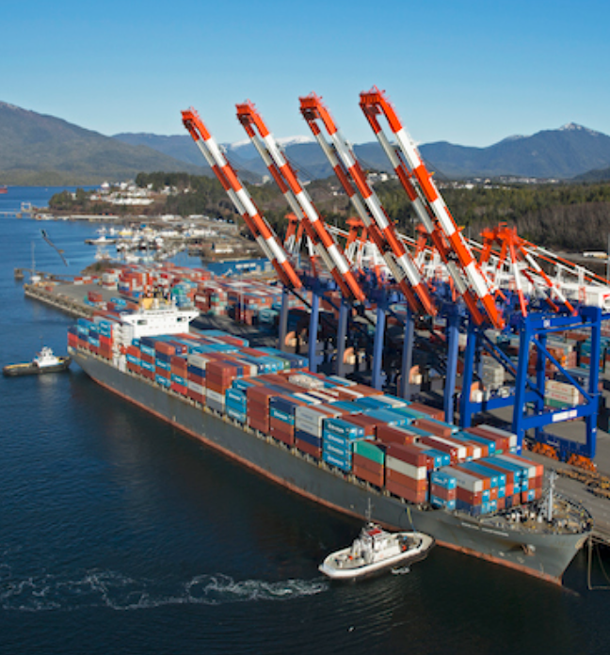
What We Have Done-THC Adjustment
Port | Original Amount | Latest Amount | Updated effective date | Remark
COBVT | USD 110/box | USD 115/box | 2025/03/15
COCTG COBQL COSMM | USD 110/110/110 | USD 115/115/115 | 2025/03/15
ECGYE | USD 190/box | USD 200/box | 2025/04/01
PECAL | USD 70/box | USD 80/box | 2020/06/01 | In Line With Market ( 55-65 / box)
CLSAI | USD 110/120 | USD 150/190 | 2025/01/01
CLVAL | USD 120/175 | USD 125/box | 2025/01/01
PABBA | USD 235/box | USD 245/box | 2025/02/21
PACCT | USD 235/box | USD 245/box | 2025/02/21

Slide 24
2025
CAPACITY
& KPI
2025

Slide 25
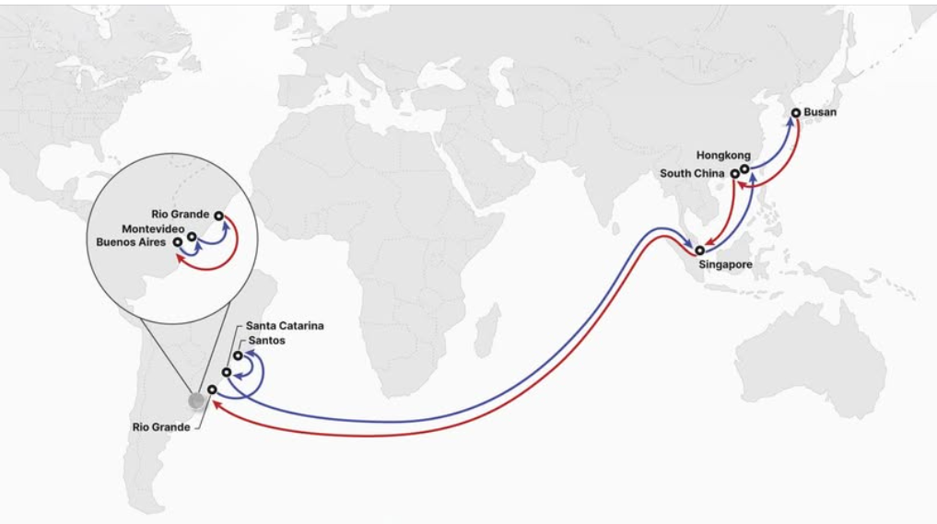
ECSA New Service in April ?
HMM and ONE (Ocean Network Express) will launch in April a new Asia - ECSA joint service.
The loop, branded ‘FL2’ by the Korean carrier and ‘SX2’ by ONE will call at Busan, one South China port (tba), Singapore, Rio Grande, Santos, Itapoa, Singapore, Hong Kong, Busan with a first sailing expected from Busan during the first week of April. The service will turn in 77 days and will offer weekly sailings.
Both carriers will provide an onward connection with Argentina and Uruguay, via transshipment in Rio Grande onto Bengal Tiger Line’s ‘RBM’ service, which calls at Rio Grande, Buenos Aires, Montevideo, Rio Grande.
It is unclear at this stage how big the ships deployed on the ‘FL2/SX2’ service will be, but it is likely that the carriers will start off with units of at least 4-5,000 teu.
For HMM, the new ‘FL2’ service will be its second major Asia - ECSA loop, adding to its Far East - India - Latin America ‘FIL’ offering. For ONE, it will be its third loop on the trade, adding to its Asia - ECSA ‘SX1’, operated jointly with MSC ('Ipanema') and Hapag-Lloyd ('AS2') and ‘SX3’, provided through slots on HMM’s ‘FIL’ service.
(Source: customer advisories / Alphaliner)
Service Rotation
East Coast South America Express 2 (SX2)
Pusan – South China – Singapore – Rio Grande – Santos – Santa Catarina – Singapore – Hong Kong – Pusan
River Plate Feeder Service
Rio Grande – Argentina – Uruguay – Rio Grande

Slide 26
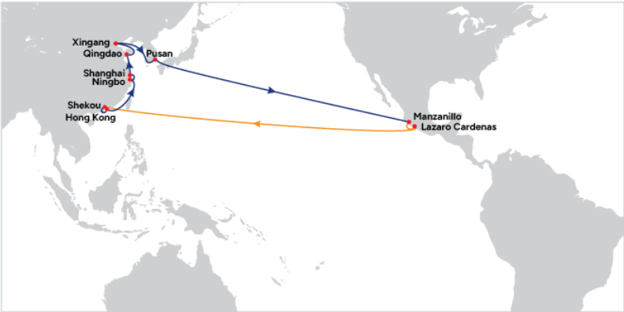
CMA WSA5 Mexico Express
WSA5(CMA)
Mexico Express
Direct svc for CNQND/CNXGA
SERVICE | DAYS | ROUTE
WSA | 77 | HKHKG, CNYYT, TWKSG, CNSHG, CNNBO, MXMZO, PABBA, COBVT, PECAL, CLVAL, HKHKG
WSA2 | 77 | TWKSG, CNXHK, HKHKG, CNNBO, CNSHG, MXMZO, MXLZC, GTZNJ, PECAL, ECGYE, MXMZO, KRPUS
WSA3 | 84 | CNXSM,CNQND,CNNBO, CNSHG, MXMZO, KRPUS, PECHY, CLSAI, MXMZO,KRPUS ,CNSHG
WSA4 | 69 | CNNBO, CNSHG, KRPUS, MXDHJ, COBVT, PECAL, ECPSJ, JPYKH, CNNBO
WSA5 | 56 | CNXHK, HKHKG, CNNBO, CNSHG, CNQND, CNXGA, KRPUS, MXMZO, MXLZC, KRPUS

Slide 27

PNM/CARI Weekly Capacity (Market + 10%)
PNM/CARI 2025 OA Day 9 PLAN
YEAR | 2024 Q4 | 2025 Q1 | 2025 Q2 | 2025 Q3 | 2025 Q4
AUE | 8T+2M +2F+1L | 8T+3M +1F | 8T+4M +1F | 5T+7M +1F | 8M+5T
NUE | 9F+2L | 11F+1T | 10F+2T | 8F+3T | 6F+5T
Weekly Capacity TEU | 2,757 | 2,884 | 2,945 | 3,034 | 3,121
Space Increase TEU | - | 127 | 188 | 277 | 364
Space Increase % | - | 4.60% | 6.82% | 10.05% | 13.20%
Our Plan (DAY 9)
AUE 8M+5T
NUE 6F+5T
EMC PNM/CARI Weekly Space
2025 Q3
Increase 277 TEU
(Compare 2024 Q4 weekly space increase 10.05%)
2025 Q4
Increase more 87 TEU
(Compare 2024 Q4 weekly space increase 13.20%)
M-type will gradually deploy into AUE and route via W/B with 7 days longer to PACCT.

Slide 28
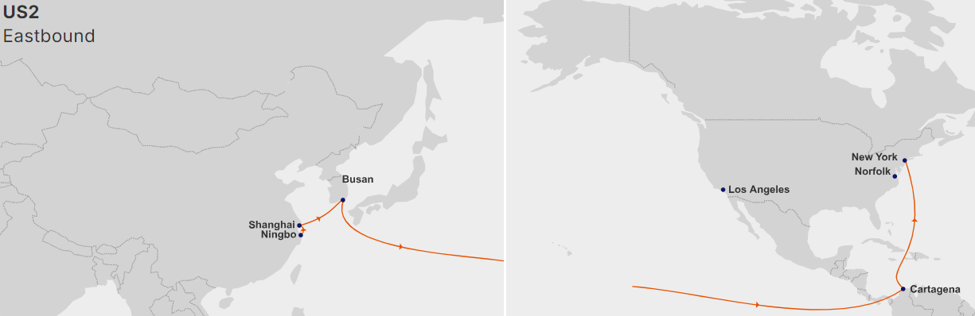
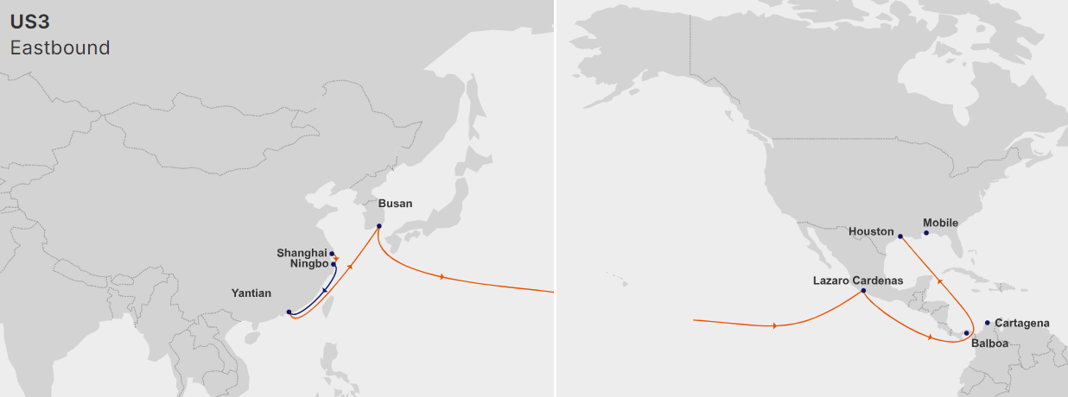
GEMINI Service(MRSK+HPL) US2/US3
Hapag-Lloyd has announced the closure of its Asia - Latin America ‘JCS’ service as from the end of February 2025. This loop is jointly operated with CMA CGM and COSCO SHIPPING Lines, who brand the connection as ‘PEX2’ and ‘CAX1’ respectively (see details).
The ‘PEX2 / CAX1 / JCS’ turns in twelve weeks with 12 x 8,800 – 13,100 teu ships calling at Singapore, Chiwan, Hong Kong, Ningbo, Shanghai, Qingdao, Busan, Manzanillo (Mex), Balboa, Manzanillo (Pan), Cartagena (Col), Kingston, Caucedo, Singapore.
CMA CGM provides seven ships and COSCO SHIPPING Lines four. The twelfth ship is the 10,010 teu ‘Seaspan Zambezi’ chartered by Hapag-Lloyd. It is expected that the German carrier will redeploy the ship in one of the services of the new Gemini Cooperation with Maersk.
As from February when the Gemini Cooperation network will be launched (see related news), Hapag-Lloyd will use Gemini services between Asia and the Caribbean.
The eastbound connection will be covered by the new ‘US2’ loop (‘TP12’ for Maersk), which has a double call at Cartagena (see details). This Colombian port will also be part of the westbound rotation of the new ‘US3’ service (‘TP15’ for Maersk) from February.
(Source: Alphaliner)
Service Rotation
US2(9,000-10,000T)
CNNBO – CNSHG – KRPUS – COCTG – USNYC – USNFK – COCTG – USLAX – CNNBO
US3(9,000-10,000T)
CNSHG – CNNBO – CNYYT – KRPUS – MXLZC – USHUS – USMBL – COCTG – PABBA – CNSHG

Slide 29
STRATEGY
HEADHAUL
2025

Slide 30


2025 Own SQ target-Headhaul
ASI-ECSA/Week
Office | TEU
BR | 260
AR | 450
UY | 54
PY | 41
ASI-MX/WCSA/Week
Office | TEU
CL | 199
CO | 300
MX | 557
EC | 65
PE | 247
SV | 2
GT | 189
NI | 1*
CR | 147
HN | 36
ASI-PNM/CARI /Week
Office | TEU
CO | 110
CR | 5
CW | 12
DO | 100
GT | 5
HN | 5
HT | 35
JM | 10
PA | 335
PR | 200
*Yearly target from 63 to 66

Slide 31
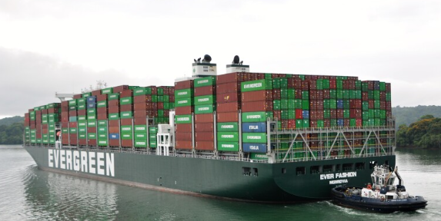

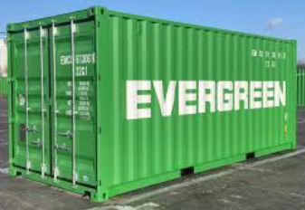
2025 ECSA Strategy
Feasible policy
Peak Season
Focus on FAK shipment, Enlarge A/C basis, space released for high GPS cargo first.
Slack Season
Short duration, flexible rate policy for NOR and special equipment
Match load
Reduce BRIOA (draft limitation)
Reduce BRNVT (port congestion, possible omit)
Enlarge BRSTO to support export equipment demand
JV TYPE promote BRSTO 2SD
High revenue and support export demand for coffee shipment
(Light cargo as first priority)
L&F TYPE (ESA) | JV TYPE (ESA3)
9 Tons 2SD as target | Accept 11 tons, but light cargo is better
Target POL: SHG/NBO | Target POL: QND/SHG
RIVER PLATE less 2SD h.w. cargo | Target POD:BRRIO/BRSTO

Slide 32
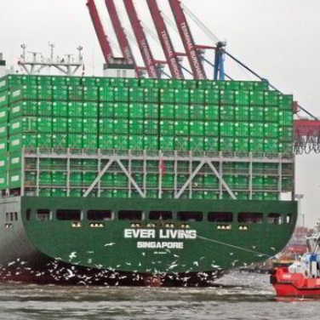
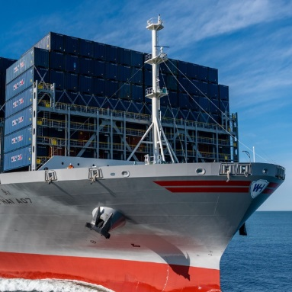
2025 WCSA Strategy
WSA
2025★
Core Svc
All Own Vessels from W7(+ 2 vessels) Target AVG Weight < 9.6t tons /TEU
MTA/Tender
light cargo from around 25 % of cargo volume
Match Load Promote 2SD light cargo to MX/PE/CL
2
WSA2
2025★
More space
AVG Weight control depend on vsl type
Own L type target < 8.12 tons
JV type 11 tons and enlarge 2SD
Focus on ECGYE and GTZNJ
Enlarge Slot Swap 800+825 (618)
More space for MXLZC、GTZNJ 、ECGYE

Slide 33
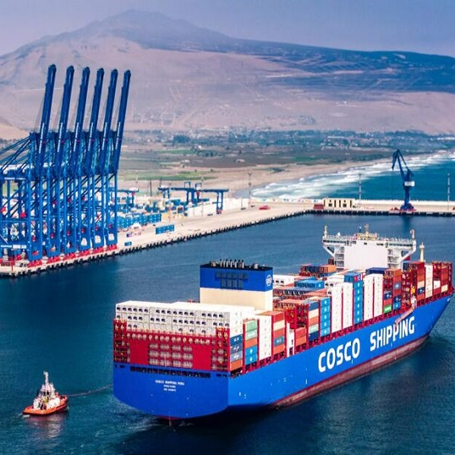

2025 WCSA Strategy
WSA3
2025★
XSM/QND/NBO/SHG
Protect Light Cargo For heavy weight cargo for N.RPC need to check with TPE in advance
Double Call CNSHG on Both W/B & E/B faster connection to Central China.
CLSAI/PECHY
WSA Alternative options
WSA4
MXDHJ
MXDHJ as the first priority Regain lost A/C, make difference offer during peak season
More LIGHT CARGO & PECAL 2SD
WSA5
XGA/QND
Mexico Express (MXMZO/MXLZC)
Direct svc at CNQND/CNXGA
Prefer More Light shipment

Slide 34
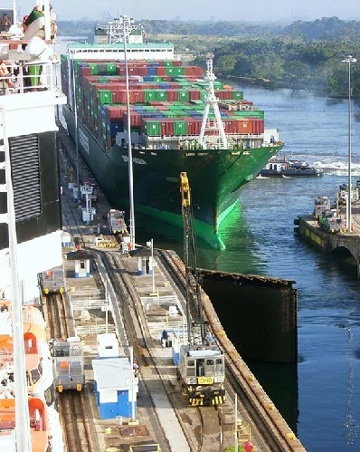




2025 PNM/CARI Strategy
More CAN Cargo(+85%)
CAN Space increase by 85%↑ from 2025Q2(1,000-1,800T/WK) after service reshuffle. More space from 2026Q1.
Cherry pick
High GPS/REV shipment would be first priority during peak season
Reduce AVG G.W.
AUE/NUE target AVG G.W. as 8 tons
Follow Space release criteria
Make sure fulfill allocation for feeder

Slide 35


F
S
STRATEGY
BACKHAUL
c
U
2025

Slide 36

Challenges Ahead
LAD trades Performance
Backhaul Trades
Depot Capacity issue
Cut & Run
Ports Congestion
VSL COR
Draft Limitation
Empty Reposition
Equipment inventory
2nd Leg Space

Slide 37






2025 BACKHAUL Premeeting Topics
FOCUS
ECSA-ASIA
WCSA-ASIA
Limit BRPNP import on ESA
Sufficient equipment inventory at BRSTO
More 2SD for coffee at BRSTO
Coffee from BRRIO
More reefer plug on ESA3
Space Shortage on 2ND Leg
No Service on BRRGR
More 4RH export from Chile ( fresh + frozen)
Sufficient 4RH Equipment
1200*2SD exports from MX in March
Matchload PE 200*2sd/wk
Space Shortage on 2ND Leg
No service on Lirquen,CL ( 11,000teus in 2024)
Mendoza in/out CLVAL

Slide 38
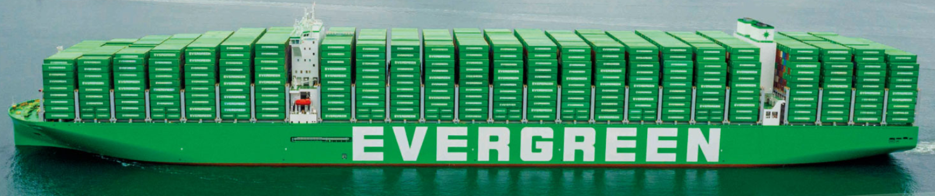
2025 Own SQ target-Backhaul
FOCUS
ECSA-ASIA | 2024 total volume | 2025 Target volume | 2024 Reefer volume | 2025 Reefer target
BR | 59,540 | 61,250 | 7,308* | 7,100
AR | 13,185 | 13,850 | 1,654 | 2,000
UY | 7,871 | 8,250 | 1,684 | 2,000
PY | 3,092 | 3,500 | 24 | -
TTL | 83,688 | 86,850 | 10,670 | 11,100
WCSA-ASIA | 2024 total volume | 2025 Target volume | 2024 Reefer volume | 2025 Reefer target
MX | 11,618 | 13,607 | 0 | 10
CO | 1,858 | 2,259 | 48 | 50
EC | 6,417 | 7,183 | 2,034 | 2,130
PE | 34,067 | 40,959 | 2,004** | 1,960
CL | 29,903 | 14,250 | 2,019 | 2,140
GT | 2,417 | 2,989 | - | -
SV | 359 | 476 | - | -
HN | 385 | 438 | 62 | 104
NI | 62 | 92 | - | -
CR | 4,812 | 5,048 | - | -
TTL | 91,898 | 87,301* | 6,167 | 6,394
*2024 BR reefer KPI 6,500
*No service on Lirquen,CL ( 11,000teus in 2024)
** 2024 PE reefer KPI 1,890

Slide 39
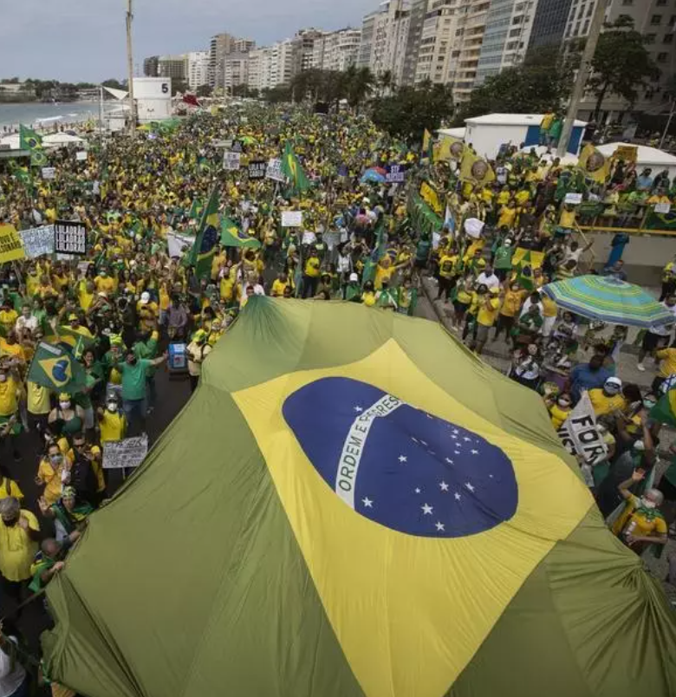
ECSA Strategy (Brazil)
FOCUS
BR | Main Commodity | 2024 EMC Volume | 2024 Market share | 2025 Target Volume | Target A/C | Action Plan
 | Frozen meat | 13,159 | 4.7% | 16,798 | JBS COTRIGUACU AURORA | 1. Study alternatives with DPW terminal to receive cargoes in advance 2. Maintain the transport to Cascavel and Cambé by train
 | Woodpulp | 12,149 | 13.6% | 13,399 | ELDORADO BRACELL COFECO | Offer space in Paranaguá as option and inform when there is an additional or E/B call in Navegantes port
 | Cotton | 11,212 | 7.9% | 14,476 | ADM EXALGO COFECO | Keep stable equipment
 | Lumber | 9,156 | 11% | 9,988 | BERNECK | Promoting shipments divert to Paranaguá port
 | Coffee | 4,818 | 24% | 6,022 | Marubeni Mitsui | 1. Contacting the shippers to enlarge our participation due to new agreement with China ( Luckin Coffee ) 2. Contact the Cecafe to know all the potential chance

Slide 40
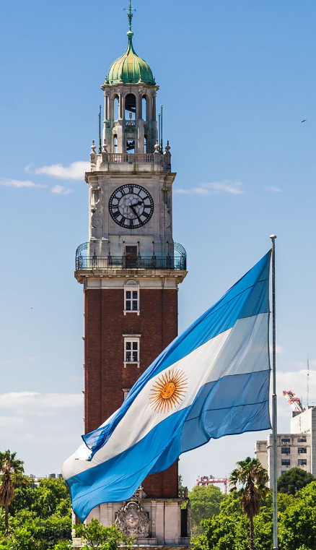
ECSA Strategy (Argentina)
FOCUS
AR | Main Commodity | 2024 EMC Volume | 2024 Market share | 2025 Target Volume | Target A/C | Action Plan
 | Wood | 2,682 | 34.1% | 2,800 | Logicon C&M | We need to receive an aggresive rate policty to wooden shipments for CN
 | Meat | 1,532 | 3.4% | 1,800 | Frigorifico Gorina Minerva | Digging in market to increase RH
 | Seafood | 604 | 5.2% | 1,000 | Vision Logistics Cargo Net Samlog | We need to receive aggresive rates for Seafood – More competitive rates for Shrimp (RH)
 | Steel Products | 378 | 8.8% | 700 | SIDERCA | TENDER – Will check with bcc to receive competitive rates so as to be chosen as 1st option for this tender.
 | Cotton | 218 | 5.0% | 500 | LDC FELPOINT TRANSCARGO | Looking PKKHI cargoes and VN. Will check with BCC about competitive rates

Slide 41

ECSA Strategy (Uruguay)
FOCUS
UY | Main Commodity | 2024 EMC Volume | 2024 Market share | 2025 Target Volume | Target A/C | Action Plan
 | Wood | 2,886 | 11.6% | 2,886 | Central Cargo, Urufor, AF Maderas, FAS, Idalen, Arboreal | We have already increased 53% of our Wood vol in 2024, so the target is to maintain wood vol in 2025 or increase if possible.
 | Meat | 2,334 | 11.7% | 2,754 | Marfrig, Minerva, Altercargo, Maralcor, Terramar, Central Cargo, ULSA, Agrolog. | Reefer KPI: 2,000 boxes in 2025 (loaded in 2024 1,684 boxes) Meat: Win meat tenders Marfrig and Minerva. Increase our vol in 18% in comparison to total vol loaded in 2024.
 | Dairy | 760 | 48% | 798 | Almar Mercator Net Cargo | Increase 5% in comparison to total vol loaded in 2024.
 | Fish/Squid | 976 | 38.5% | 1,240 | Maralcor, Suflenorsa | Increase 27% our fish (incl. squid, depending on the season) this will be determined by a positive Schedule improvement, specially during season.

Slide 42

ECSA Strategy (Paraguay )
FOCUS
PY | Main Commodity | 2024 EMC Volume | 2024 Market share | 2025 Target Volume | Target A/C | Action Plan
 | Cotton | 1,320 | 73% | 1,550 | NAVYTRANS HANSA MAR CARGOPACK | We’re in permanent contact with customers in order to know how is going negotiation for 2025
 | Metal Scrap | 517 | 13.9% | 690 | BC GLOBAL BRASSUR SA EL TORO RECICLADOS SRL | Have requested BCC to improve 2nd leg connection to INDIA, mainly Nhava Sheva, Mumbai and ICDs
 | Grains | 336 | 46% | 450 | AMERICANA NAVYTRANS | Offer competitive rates to customer in order to confirm booking as O.F level is very sensitive and have huge impact in this comm.
 | Sesame | 261 | 24% | 310 | AGRO NEBAI SA UNITEX ALPACASA | Be competitive in rates specially for JP destination which is 85% of destination in F.E trade
 | Canola | 224 | 58% | 350 | NUTREX PARAGUAY S.R.L. | Have requested to EMC to consider opening again Red sea destination. It would be very important increase vol of this comm

Slide 43

WCSA Strategy (Mexico)
FOCUS
MX | Main Commodity | 2024 EMC Volume | 2024 Market share | 2025 Target Volume | Target A/C | Action Plan
 | IRON ORE | 4,388 | 17% | 4,800 | DOLPHIN LOG SUPP CIMA GROUP RYR LOGISTICS | Provide enogh equipment in 2SD at their yard meanly for a/c Dolphin, in general with close contact with t/s for space placing bookings with a forecast with 1 month before.
 | FAK | 3,654 | 11.3% | 4,000 | LX PANTOS TRANSPORTE MULTIMODAL | Provide very close contact with medium size a/c’s offering WSA2/WSA4/WSA3 services and enlarge small a/c´s list to have 40 to 50% volume for 2025 KPI.
 | MINERAL | 2,726 | 8.9% | 4,000 | IMPALA STEINWEG LA HANSIATCA | Provide secure space on WSA5 with direct services, improve cargo from ASI in 2SD in order to place all equipment available for this main a/c´s with previous deal with bcc and customers
 | RECYCLED PLASTIC | 1,807 | 18.1% | 2,100 | MAX EXPRESS JJL PACIFIC | To make match with rates requested offering to MYPKL/MYLPK/MYPEEN/CNXHK/CNNBO/THLCH using WSA2/WSA5/WSA
 | CHEMICAL | 363 | 8% | 450 | ANCORA LOG GRUPO RUBIANO LESHACO MEXICANA | Offer long period rates 2 months at list, improve in our booking confirmation time for DG cargo in contact with own PIC and partner vessel for approvals.

Slide 44

WCSA Strategy (Colombia)
FOCUS
CO | Main Commodity | 2024 EMC Volume | 2024 Market share | 2025 Target Volume | Target A/C | Action Plan
 | Scrap | 1,198 | 52% | 931 | CI Innoambiental Trading Solutions Campak S.A | Maintain actual customers to INCEN & Other destinations Waiting news for Q2 to recover CIX’s services space in order to extend our volumes to INMUN & INNVX.
 | FAK | 250 | 55% | 784 | DSV Bio D Geodis Colombia | We want to look for new opportunities in the market with glycerin, fresh flowers & other products handled in spot basis.
 | Paper | 146 | 85% | 147 | Carvajal Pulpa y Papel Allworld | Close contact with Carvajal account in order to monitor their exports from COBVT to KRICH.
 | Iso Tanks | 140 | 24% | 147 | Meridian Logistics SA | Monitor the opportunity to close SQ in CO with competitive freight (having in mind that main volume is closed at POD).
 | Citric Acid | 84 | 77% | 98 | Sucroal | Close contact with Sucroal account in order to monitor their exports from COBVT to FE destinations. Monitor during Q2/Q3/Q4 customer bidding schedule.
 | Frozen Beef | 68 | 81% | 49 | Blu logistics Colombia SAS | Close contact with Blu Logistics/Derivados Carnicos account in order to monitor their exports. Monitor with LOG department the availability equipment in monthly basis.

Slide 45
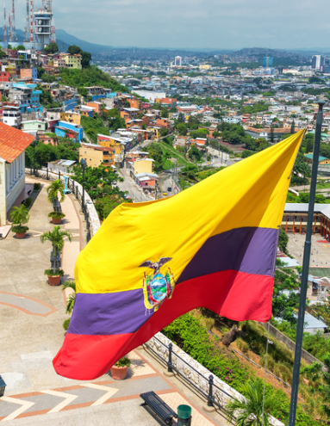
WCSA Strategy (Ecuador)
FOCUS
EC | Main Commodity | 2024 EMC Volume | 2024 Market share | 2025 Target Volume | Target A/C | Action Plan
 | Cocoa Beans | 1,914 | 18.9% | 2,300 | STONEX OLAM STEINWEG | - Stable weekly allocation on connecting services in Asia 120teus during peak season. - Quick reaction matching market rates in to increase shipping volume. - Enough 4SH FOOD GRADE equipment availability per week. (80-100 in peak season)
 | Frozen Shrimp | 1,724 | 2.9% | 2,000 | STA. PRISCILA SONGA OMARSA | - Enough equipment and enough space on connecting services to avoid bookings blockages. - Keep close contact with customers to gain support
 | Banana | 1,294 | 3.3% | 1,500 | GOODFARMER REGINABANAERA DONATELLA | - Rates aligned to the market from Ecuador to China 40RH/ $ 2100 (ALL IN)and equipment availability. - We're in close contact with these customers and as soon we have better transit time ,we will have the opportunity to handle some of their shipments to DLI, SHG & QND
 | Balsa (IND) | 945 | 11.6% | 1,200 | WORLDWIDE NAVECUADOR DSV | - Provide competitive rate to customers. - We're in close contact with all these customers, they are open to support EMC base on rates, transit times.
 | Wood and Sheets | 162 | 0.9% | 1,000 | NIRMALA INTERNATIONAL ECUATEAK | - Provide stable allocation on connecting services in Asia, 60 TEUs minimum a week. for heavy cargo. - Rates aligned to the market Ecuador to India 20SD/ $ 700 (ALL IN) - Maintain a stock of 2DV units to meet the demand

Slide 46

WCSA Strategy (Peru)
FOCUS
PE | Main Commodity | 2024 EMC Volume | 2024 Market share | 2025 Target Volume | Target A/C | Action Plan
 | Fishmeal | 17,058 | 24.4% | 20,110 | PESQUERA HAYDUK CORPORACION | - Keep Units during peak season - DG space WSA 1,000 ~ 1,200/teu in peak wks
 | Minerals | 9,849 | 15.7% | 12,000 | HUMON LATIN AMERICA S.A. JINTAI METAL | - Promote Imp 20' by S/L and keep repo in - Promotions in 40’ containers (spot rate).
 | Reefers | 3,964 | 21% | 4,340 | SOCIEDAD AGRICOLA VIRU BAIKA PERU S.A.C. | - Sufficient equipments , promote NOR - competitive T/T in the market
 | FAK | 3,757 | 12% | 4,485 | LAD LUMBER S.A.C. EXPORTADORA ROMEX S.A. | - Competitive rates and conditions - Food grade Cntrs - more space for SCRAP to India

Slide 47

WCSA Strategy (Chile)
FOCUS
CL | Main Commodity | 2024 EMC Volume | 2024 Market Share | 2025 Target Volume | Target A/C | Action Plan
 | WOODPULP | 2,572 | 11% | 1,680 | Arauco | - Spot shipments from central zone (CLVAL) considering the main volume is concentrated in the south zone in Chile (CLLQN) - Offer competitive rate from CLVAL to main pods Qingdao, Shanghai, Changhsu, Ningbo, and others. - Have enough 4SH equipment available for Woodpulp from CLSCL depots to release bookings.
 | METAL SCRAP | 5,195 | 26% | 2,940 | CBP Vanadium Norte Verde | - We need to keep empty container to cover their demand in CLVAL and CLSCL. - We need space in CIX’s service connection to India to increase volumes - Rates according to the market.
 | WINE | 3,739 | 24% | 4,400 | JF Hillebrand Inte-tank Albatrans | - We need to keep empty container to cover their demand in 2SD for the wine in flexibags and for the case of Wine in bottles 4SH from CLVAL and CLSCL. - We need to match the market rates to FE mainly from China ports like Yantai, Xingang and others.
 | FROZEN (MEAT) | 1,098 | 5% | 1,464 | Agrosuper Ariztia | - Competitive rates following the market. - CNSHG is the main destination, we need to check cost and try to match the market rate for future tender negotiation (2025-2026)
 | FRESH (FRUIT) | 1,822 | 4% | 1,520 | Global Reefer, United Cargo, Andesbhumi | - Competitive rates following the market. - Competitive transit time for fresh fruit. - Cherry service with 22 days. - Regular Reefer empty repo in. - Service with competitive transit time to HKHKG.

Slide 48



GreenX Strategy
FOCUS
Keep Promoting
We can fulfill export demand from small and medium-sized customers and improve efficiency with standardized and quick quotations
Advantage for GreenX
Space guarantee and fixed rate
2025 ECSA-ASI GreenX Monthly target
Office | TEU
BR | 80
AR | 40
UY | 40
PY | -
2025 MX/WCSA-ASI GreenX Monthly target
Office | TEU
PE | 50
MX | 70
CL | 10
CO | 10
EC | 10

Slide 49
Q&A
2025

Slide 50
ECSA Questions to discuss
 | SEQ | TYPE | Details
BR | 1 | Space | Space protection on 5 trade for OWN SQ promotion. Current 5 trade SQ under EBR is less than 10% of all.
 | 2 | Space | Any chance to renegotiate ESA3 plug allocation to increase regular reefer accounts , particularly AURORA from BRNVT ?
 | 3 | Service | Vessel reshuffle F-type X L-type program, or any other service capacity increase in sight
 | 4 | Equipment | Increase 2SD destined for Santos so to promote the coffee shipment.
AR | 1 | Service | Will be any changes in ESA service for 2025 that may impact space allocation to AR for both exports and imports and if it is considered to make changes regarding payment terms policy for AR freight?
 | 2 | Service | Is there any program to launch new trades or add-on services to Argentina?
 | 3 | Service | ARMDZ : We find difficulties developing as competitors and market policies regarding drop-off adjust case by case, so our standard quotations are always on top of their quotations. We must check how we can improve to align with the market and be competitive.
 | 4 | Equipment | CNCHG SERVICE PROFILE: The AR market expects growth for 2025 of motorbikes from CNCHG. Are there any improvements/changes to the service for 2025?
 | 5 | Depot | PROPOSAL OF ALTERNATIVE EMPTY DEPOT: Some carriers offer external depots to customers for empty returns, and some customers also request delivery on external depots and, depending on where they are located, might be an alternative to find new cargo sources. We find DEFIBE depot might be a new alternative. Note BGH asked to deliver empties there.
UY | 1 | Service | Any news regarding ESA Service changes in general in 2025?
 | 2 | Service | Will CMA CGM continue deploying vessels with size 336x51 which are skipping UYMVD and ARBUE?
 | 3 | 2nd leg | Any feeder Service and connection improvement for cargoes going to Middle EAST (very limited space)
 | 4 | 2nd leg | Any news regarding Service to Red Sea? Customers keep asking when we will resume Jeddah, etc. (Dairy)
 | 5 | 2nd leg | Any feeder Service and connection improvement for cargoes going to Philippines, Manila and india (in continuous congestión)
 | 6 | Equipment | Any plan to reposition RH units to main import ports (WB) CNNBO, CNSHG, CNYYT? These ports are very important for big consolidators and it is regular that the RF stock is not enough. Our customers are being told to use 40´-40´H instead but rate is sometimes usd1000-2000 higher so not an option when NOR units are available with other carriers.
PY | 1 | Service | Is there any expansion plan by EMC to add other service trade to/fm ECSA including PYASU? I.E USA; EU, AFR, CEN?
 | 2 | Service | Any change on ESA service prospected for 2025?
 | 3 | 2nd leg | Improve 2nd leg connection to F.E destination i.e INDIA; PAKISTAN, which are very important destination por PY’s export cargo, specially INDIA.
 | 4 | Equipment | RH stock for PYASU: Considering that F.E destination, specially TW, are taking more and more importance for Paraguayan RH cargo, we would like to know if there is any prospect to repo-in cntrs for PYASU directly in order we could offer permanent service, as in spite within 2024 we could repo-in cntrs fm UYMVD; regretfully they could not support us as long as the whole year because they depend on their own market demand. Due to this, our service is interrupted when we cannot repo-in cntrs from UY.

Slide 51
WCSA Questions to Discuss
 | SEQ | TYPE | Details
CL | 1 | Service | kindly provide a specific timeline for when the WSA service will officially combine with the CIX service?
 | 2 | Service | Service Expansion to Southern Chile, any plans to extend the current WSA service to cover southern Chilean ports, such as Lirquen to recover critical shipments of wood pulp, lumber, and frozen salmon?
CO | 1 | Service | Under current macroeconomics conditions, what is the TPE LAD perception about shipping industry for 2025? Mainly from Asia to America ( North & South )
 | 2 | TS | In the C trade , we have evidenced a general concern from importers about long transit times by mis-transshipments or transshipments delays by Panama congestion. Then we see that Evergreen needs to develop strategies to improve this operational situation. we like to ask if TPE LAD and ELA MKD are looking for new strategies to mitigate the unreliable schedules.
 | 3 | Service | When will take place the new WSA rotation including India ( East bound ) ?
PE | 1 | Service | What about the plan to add Indian ports to the WSA service? Will it finally be implemented for Q2?
EC | 1 | NOR | In view of the reefer business has significant potential in Ecuador, EECU prefers to stabilize the supply of empty reefers. Would BCC assist with the buildup of empty reefer inventory.
 | 2 | Business | To achieve this goal with DG CARGO, the DG booking approval process could be streamlined by Implementing faster digital tools ?
 | 3 | Service | ECGYE proposes establishing a dedicated team to construct shipping routes. This not only improves internal communication and real-time tracking but also accelerates problem resolution.
MX | 1 | Rate | Is there a possibility of validity of 3 months for medium and small A/C´s without the need to create SC?, since customers have this validity with the competition.
 | 2 | Own SQ | Suggest to count Green X bookings into each office’s own SQ performance.

Slide 52
PNM/CARI Questions to Discuss
 | SEQ | TYPE | Details
HN | 1 | Rate | Spot bookings via C trade, need to develop
 | 2 | Service | Promoting LAE service, competitive rates and using only service with T/S PABBA.
PA | 1 | Service | Can we request port of loading to send us the roll over list after vessel departure ?
PR | 1 | Service | WE WERE INFORMED SPACE FROM ASIA TO PR WILL INCREASE 11%. IF PANAMA CAN’T HANDLE CARGO WE ARE ACTUAL MOVING HOW THEY PLAN TO RECEIVE MORE CARGO.
DO | 1 | shipmentlink | Specially after the pandemic, some carriers such as CMA and HAPAG, have launched new and enhanced services and other logistic solutions with wide visibility in their websites, not to mention the aggressive marketing campaign in social media to support and spread the news among their customers. Although Shipmentlink presents a new face, changes in terms of added services are the same. Can we expect other improvements in terms of new services for Shipmentlink in the near future?
HT | 1 | Service | PACCT T/S Port Long Delay Issues: Can we establish priority handling for our cargo to avoid excessive delays?
JM | 1 | Rate | Is it possible to get rate guideline that covers at 30 days rate validity sent monthly from BCC to allow faster sales support from JMKSN Agent ? due to time zone difference ?

Slide 53

JESUS LOVES YOU
TPE LAD LOVE YOU , TOO

