Slide 1
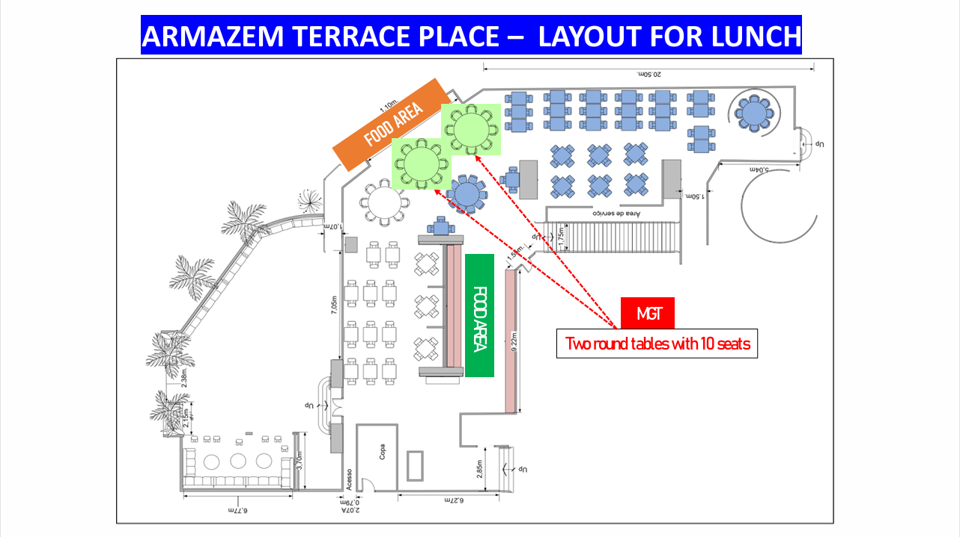
Reserved
X

Slide 2
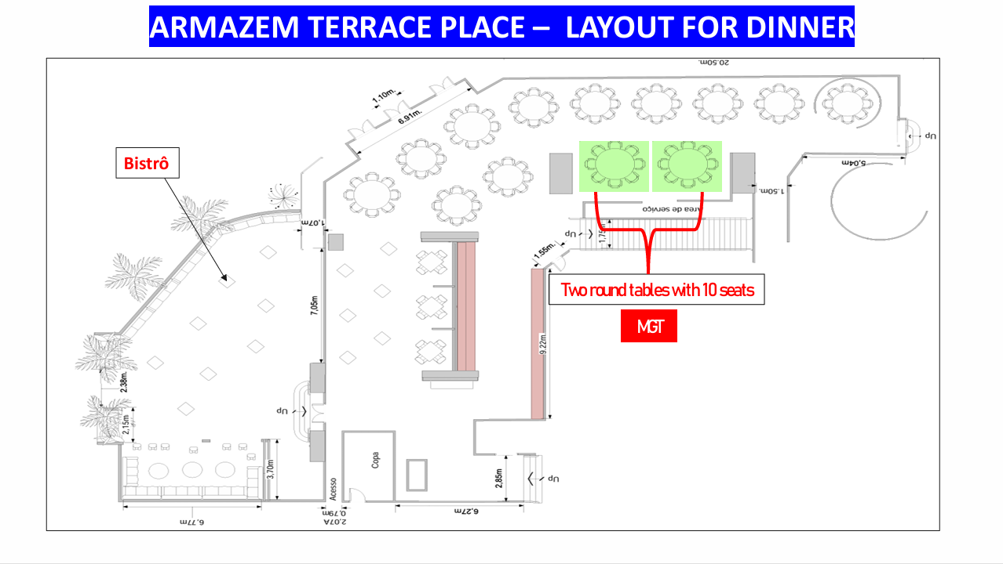
Table 1 (10 P) |  |  | Table 2 (10 P)
Name |  |  | Name
Mr. Wu, Kuang Hui | TW |  | Mr. Tony Wu | TW
Mr. Vincent Lin | ELA |  | Mr. Chris Huang | ELA
Mr. Wilson Chen | TW |  | Mr. Steven Yu | BR
Mr. Percy Mo | TW |  | Mr. Moises Woll | BO
Mrs. Elena Vizcarrondo | PR |  | Mr. George W. Runyon | US
Mr. Bernhard Surges | DO |  | Mr. Jean-Bernard Dupoux | HT
Mr. Richardo Quezada | GT |  | Mr. Karsten Paul Windler | DO
Mr. Luis Fernando Trujillo | EC |  | Mr. Carlos Leaño | CO
Mr. Jorge Oria | SV |  | Mrs. Soraya Peraez | EC
Mrs. Cynthia Papadopolo | HN |  | Mr. Jose Oller | PR

Slide 3
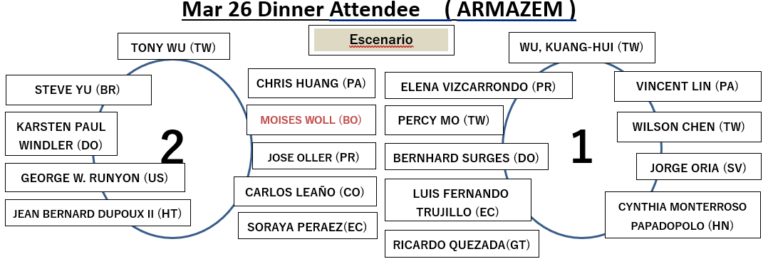

Slide 4
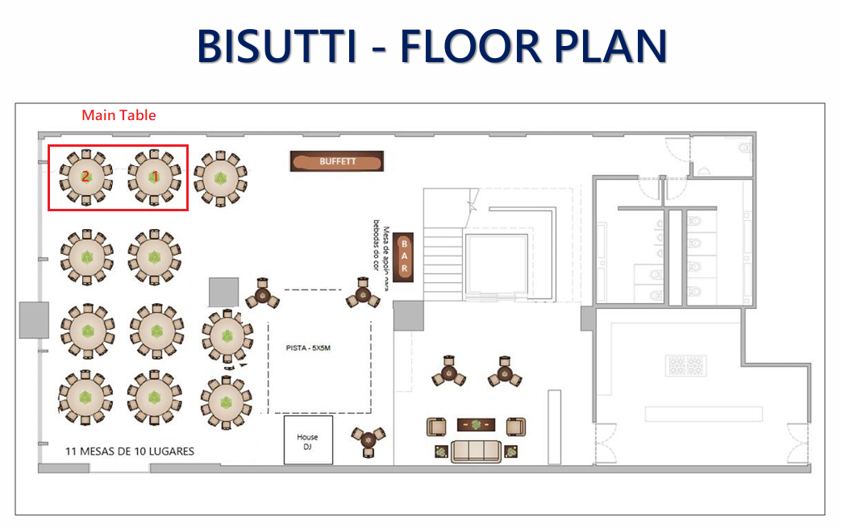
Table 1 (10 P) |  |  | Table 2 (10 P)
Name |  |  | Name
Mr. Wu, Kuang Hui | TW |  | Mr. Tony Wu | TW
Mr. Vincent Lin | ELA |  | Mr. Chris Huang | ELA
Mr. Wilson Chen | TW |  | Mr. Steven Yu | BR
Mr. Percy Mo | TW |  | Mr. Arther Hsu | TW
Mrs. Gloria Barandiarán | PE |  | Mr. Vincent Lin | AR
Mr. Moises Woll | BO |  | Mr. Yi-Syou Hwang | TW
Mr. Carlos Leaño | CO |  | Mr. Leon Chen | PE
Mr. George W. Runyon | US |  | Mr. Elton Tsai | TW
Mr. Jean-Bernard Dupoux | HT |  | Mr. Samuel Tung | CO
Mr. Karsten Paul Windler | DO |  | Mrs. Annie Chiu | TW

Slide 5
