Slide 1
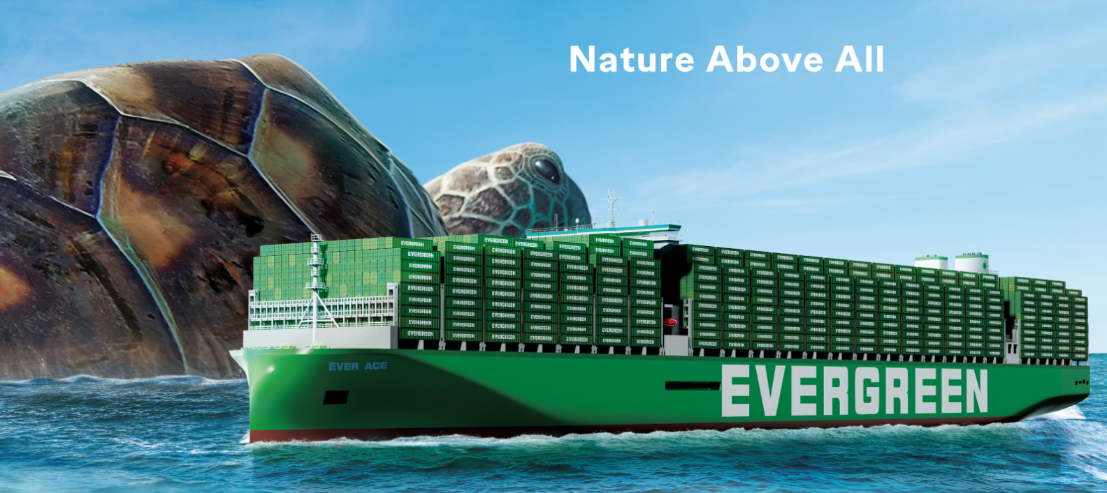
2025
LAAM Meeting (ECSA)
By LAD/EGA/ELA 2025.FEB.27~28

Slide 2
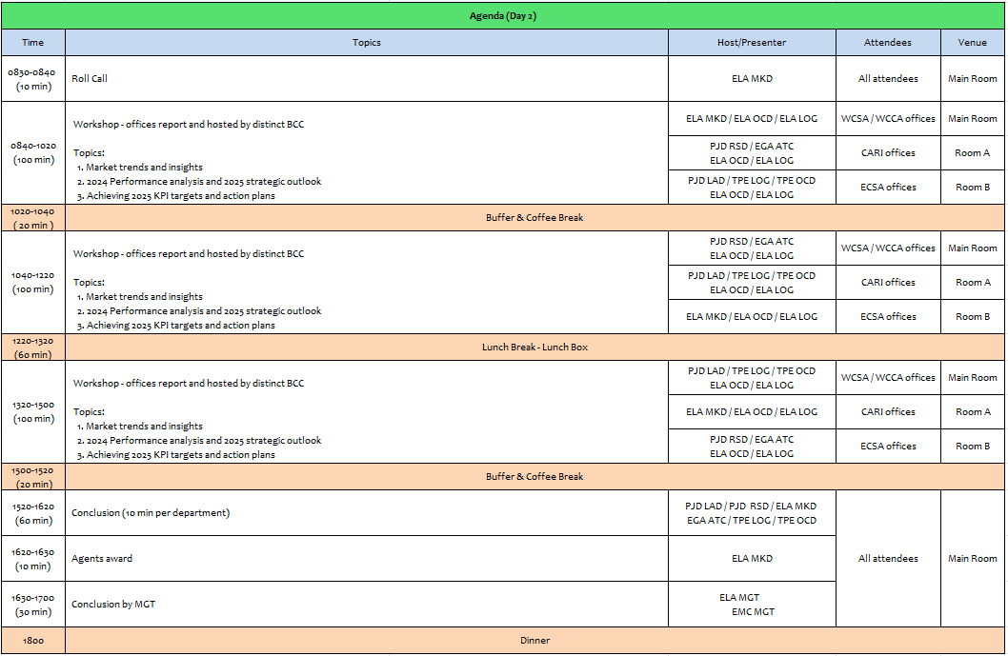
2

Slide 3
10
EAR
(ARGENTINA)

Slide 4
Performance/Space(2024) and 2025 Market Review (AR)
Subject | Segments | BCC | 2024 Target TTL Loading(TEU) | 2024 JAN~DEC TTL Loading(TEU) | Achievement (%) | 2025 JAN~DEC TTL Loading(TEU) | Market Review & Action Plan (How to achieve 2025 target?)
 |  |  | (A) | (B) | (B)/(A) | Target
Trade Lane | F.E. => AR IMP. (5 Trade) | LAD | 12,513 | 12,673 | 101% | 22,500 | Develop new sources of cargo and clients (Market monitoring and close contact with clients and meetings with clients program). Business trips plan to AR internal strategic cities such as Mendoza, Cordoba, Rosario, Ushuaia, etc. Including the case study of new depots for empty containers (DEFIBE DEPOT). Adjust drop off fee to improve Mendoza depot performance. NOR aggressive policy to enlarge our cargo sources & supply E/B reefer cargo. Promote ARLPG and resume ARUHA. Develop additional AR POD services (ARZAR/ARROS).
 | AR EXP.=> F.E. (6 Trade) | LAD | 13,016 | 13,185 | 101% | 13,850
4

Slide 5
Topic discussion (AR)
Commercial side:
To compete in the market and react quickly, we need to receive aggressive and competitive rates on time from BCC.
E/B
Empty reefer equipment availability for E/B on time.
Mineral shipments (Lithium / Silver concentrate). (50X4SH per week)
Space availability on feeders at T/S for cotton shipments to Middle East, mainly PKKHI. (110x4SH weekly)
4SH Food grade containers availability for E/B. – (50X4SH Milk powder + 10X4SH wool, per month).
Green X status.
W/B
Try to be in line with Competitors regarding S.E.A. rates to improve our performance from these POLs (W/B). (Total volume 2024: 39047TEUS – EGL Loaded 8847TEUS – Share 23%)
Equipment and feeder availability at CNCHG (W/B). (Total volume 2024: 2380TEUS – EGL Loaded 1206TEUS – Share 49%). It is expected an increase in the volume of motorbike shipments for 2025.
Equipment availability at IN main ports (INNXV, INMUN) for W/B. (Total volume 2024: 12360TEUS – EGL Loaded 1749TEUS – Share 14%)
NOR availability at POLs to achieve KPI and supply E/B demands.
Resume ARUHA Service for W/B. Depending on second feeder deployment.
Future Plan Suggestion:
Evaluate new trade services, such as USEC, CARB, EUR or MED.
Evaluate new AR ports or depots in strategic cities so as to develop with an alternative connection.
5

Slide 6
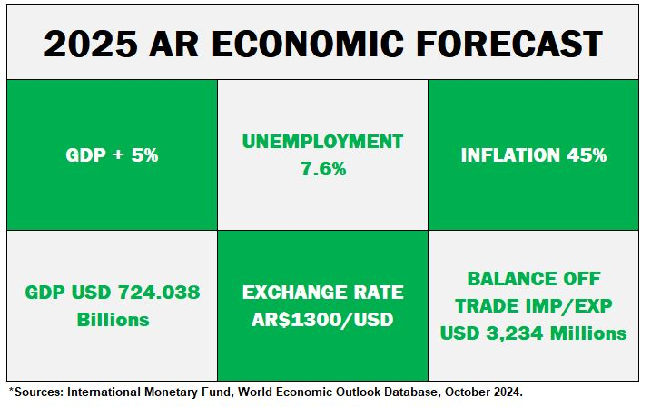
Topic discussion (AR)
Future market forecast in 2025 (Pessimistic / Optimistic / Remain the same)?
Economic background:
 | Get worse | Improve | Stay the same
2025 |  | X
6

Slide 7
Market share and Loading volume prospect 2025 (Long Haul)
Market Share
Import: 13 %
Economic background and scenario in Argentina expects to be better in 2025.
It will be possible to get an improvement for Import volume, but among other issues (such as space and schedule) it will be very important to increase of FOB shipments, thus we will need full support from BCC and pricing efforts to achieve said goal.
Export: 11%
Argentina economic outlook suggests a gradual recovery
It is expected to have better export volume than 2024 on RH market, which will require BCC support on competitive rates on time and equipment availability. Regarding dry cargoes, the government reduced or eliminated taxes some concepts for some exports such us grains/seeds up to jun/30th/2025 so it is expected that cargo volume may increase.
Volume Prospect
Import: Market lifting the same (300,000 TEUS) / EGL 38,400 TEUS
Export: Market lifting (170,000 TEUS) / EGL 18,000 TEUS

Slide 8
ECD/IMD Topic discussion (AR)
ECD KPI | Item | 2023 | 2024 | Diff | Action Plan in 2025
ECD KPI | Storage | USD16,516 | USD2,608 | -USD13,908 | Exceeding the 1600 TEU free per day, may be affected by Schedule delays and bunching of vsls beyond our control. Action plan: to move out empties, following mty repo instructions fm ELA Office.
 | Lift on/off | USD14,972 | USD1,556 | -USD13,416 | To promote empty return to Terminal, instead of outside depot making usage of Free Pool quota.
 | Reposition | USD86,645 | USD12,261 | -USD74,384 | To promote more EXPORT shipments.
 | M & R | USD0- | USD0- | USD0 | Only for emergency repair cases (full imp + full exp).
IMD KPI | Cost Saving Project | USD864 | USD60,000 | + USD59,136 | Our contract with the Terminal providor has a table scale incentive rebate, which includes Imports + Exports (exclude T/S & Mties). As per our recent contract extensión until 2027, incentive cash back has been increased for Principal’s benefit in USD2 x box, on top of former cost base on each scale. A new Signing bonus of USD60,000 has been agreed for Principal’s benefit in the negotiation of contract extension up to 2027. Both issues contribute to an important saving for the Principal.
 | 90% Onboard within 7 Days | N/A | USD5,580 | - USD5,580 | T/S FREE TIME at BUE: 14 straight days as per contract. EX LBRL1574-056W to BRRGR (FULL 48 cntrs/ 85 Teus) : USD4,230 Storage over free/p EX CSBZ002W to BRNVT (FULL 15 cntrs/ 28 Teus) : USD1,350 Storage over free/p EX LTUS1585-061W to BRRGR (FULL 3 cntrs/ 3 Teus) : NIL EX LKIN 1602-062W to BRPNP (FULL 77 cntrs/ 146 Teus) (MTYS 100cntrs/200Teus) : NIL
 | No Personal Negligence | NIL | NIL | NIL | NIL
8

Slide 9
ECD/IMD Topic discussion (AR)
Aged Container Selling / Free Reposition Plan
Selling available only for operations closed and paid abroad (transferences abroad restricted by Government).
There is no Free Reposition plan as per contract terms.
9

Slide 10
OCD/OPD Topic discussion (AR)
 |  | 2023 | 2024 | Diff | Action Plan in 2025
OPD KPI | BOA | 92,86 % | 100 % | +7,14 % | ARBUE Berth is free at all times, for our svc vsls. However 1 vsl at a time is allowed for berthing. in case of own svc vsls overlap due to out of Schedule. Navigation Channel Traffic congestion is observed at most of cases beyond our control (20 own vsls operated in 2024, all with Y BOA).
 | Port Stay | 100 % | 100 % | NIL | To keep promoting and monitoring an efficient productivity (20 own vsls operated in 2024, all with Y PORT STAY).
 | Productivity (Target is 57MPH) | 100 % | 100 % | NIL | For TPE evaluation, our Prod KPI is ≥57 MPH. Our AVG Product for 2023 was 62MPH while for 2024 was 58,6MPH. Additionally, as per Terminal contract valid until 2027, another Productivity KPI set up for cgo lifting is 70MPH (AVG PRODUCT 2024: 76,1MPH)
OCD KPI | Incentive | Fm May’23 24,047 Boxes | To Apr’24 24,047 Boxes | N/A | From May 2023 to Apr 2024, the total bonus for the period achieved, was USD48.094 (24.047 x USD 2,00). Next bonus incentive period is set as from May 2024 up to April 2025, currently in process of cgo development. Due to volume drop in 2024 as consequence to banned abroad remittances, more conservative KPI volume of 1,600 boxes/month was settled. However, volume is presently increasing. USD2 x box has been increased, in addition to former cost base on each scale.
 | Empty Storage | 1600 Teu | 1600 Teu | NIL | 1600Teus is the Free pool quota settled at ARBUE. We will keep promoting the usage of this Terminal pool, in order not to incur in extra costs in outer Depot. Eventual increase of quota due to Schedule disorder, is beyond our control. Monitor and reinforce our REPO OUT.
 | Rate Reduction | USD 212,153.40 | USD 96,355.34 | -USD 115,798.06 | It was recently achieved a competitive THC rate extensión until 2027, not applying any increase on other Terminal rates. Furthermore, in the usage of Outer Depot (GAMMA) for VIP customer TOYOTA, we achieved that the terminal does not invoice to us Gates in/out GAMMA nor TRP Gate in; when repo out Mties returned by TOYOTA into outer depot. Additionally to this benefit, 40 transportations per month were achieved as well to be under Terminal’s account service. Potential additional GATES saving of USD111,888 per year has been achieved in addition to 2024 figure.

Slide 11
OCD/OPD Topic discussion (AR)
Terminal info update (expansion/dredge/crane)
Since the change of Government by 20th December 2023, the new port project has been freeze. There are no news about the tender for the refurbishing of the port Terminals, and new & deeper berths constructions.
There are no plans for terminals investment on cranes, or other issues under this scenario.
The surrounding area of the two terminals located within the City of Buenos Aires (TRP & APM), is improving, experiencing
important changes helping to elevate the condition of the connecting surrounding roads and highways.
There are deeper depth areas all along the ARBUE Access channel, however, the Draft limitation at ARBUE keeps being 10Mts (at Zero tidal value) which is located at Basins berths (quay walls at 10mts basement construction). Our current vessels type have the green light from our Pilots to reach a maximum draft of 10,20mts in/out subject to high/slack tide to proceed.
TRP & APM have concessions valid until year 2027. Our Terminal contract is in fact valid until this deadline at the moment. According to a recent renewal process which included additional benefits for the Principal (new cash bonus + waive outer Depot gates in/out and TRP gate in for TOYOTA containers as per special agreement, freeze current terminal rates and increase cash back scales in volume incentive).
11

Slide 12
11
EBR
(BRAZIL)

Slide 13
Performance/Space(2024) and 2025 Market Review (BR)
Subject | Segments | BCC | 2024 Target TTL Loading(TEU) | 2024 JAN~DEC TTL Loading(TEU) | Achievement (%) | 2025 JAN~DEC TTL Loading(TEU) | Market Review & Action Plan (How to achieve 2025 target?)
 |  |  | (A) | (B) | (B)/(A) | Target
Trade Lane | F.E. => BR IMP. (5 Trade) | LAD | 10,006 | 10,071 | 101% | 13,000 | CKD & TIRE： HPE (Mitsubishi) and tire importers expect good forecast in 2025 as car industry will be continue boosted. SOLAR PANEL: Brazil still has strong demand of solar panel import from China as the price is cheaper, we will increase the volume from the A/C WEG. POD :Target more Santos & Rio cargo which combine with share 40% of import from ASIA, to reduce the draft issue in river plate also to provide sufficient empties to cater for export from Santos. POD : The cargo from India, Vietnam, Indonesia, Thailand, Singapore account for around 15% of total from ASIA market which have material growth in 2024, the YoY all above 20% increase. NOR cargo: Promote NOR cargo to demand place for export demand, like BRPNP. Space protection: for OWN SQ promotion.
 | BR EXP. => F.E. (6 Trade) | LAD | 55,052 | 59,540 | 108% | 61,250 | Reefer cargo : In 2024, our reefer volume hit 7,309 units, 22% increase YoY driving by the A/C Aurora’S standing out with a 169% increase compared to 2023 as well as Cotriguaçu and the beginning of its participation with JBS, but our market share just increase from 2.5% to 3% which still a big room to improve. Coffee : In addition to JP, VN market, the China market is very potential, the coffee chain LUCKIN confirm to purchase 15,000TEUS in the coming 4 year. Santos export: Santos : Woodpulp, Cotton for the base cargo there is a positive expectations for an increase in cotton by 11%.
13

Slide 14
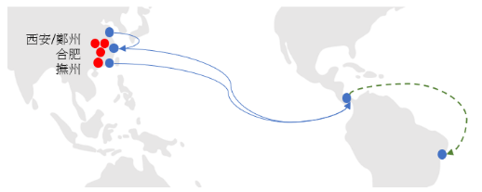
Topic discussion (BR)
Commercial side:
EXPORT
Increase volume for export cotton customer, like ADM...
Additional space to PKKHI, BDCGG and JPYKH.
ESA3 plug increase.
RIO export.
IMPORT
CKD business still increasing
The new OWN SQ proposed target from 240 to 260 on monthly basis is well accepted, but need space protection.
Increase liftings from Southeast Asia and India.
Feeder service to attend other alternative ports such as SDR and VTO, taking advantage of both services calling BRRIO 1st, and with draft to take more light cargo .
BYD prospects to Salvador.
Maintain the Rio Grande market.
Future Plan Suggestion:
14

Slide 15
Topic discussion (BR)
Future market forecast in 2025 (Pessimistic / Optimistic / Remain the same)?
Economic background.
Market share and Loading volume prospect 2025 (Long Haul)
 | Get worse | Improve | Stay the same
2025 |  |  | X
15

Slide 16
Topic discussion (BR)
16

Slide 17
ECD/IMD Topic discussion (BR)
ECD KPI | Item | 2023 | 2024 | Diff | Action Plan in 2025
ECD KPI | Storage | $ 39,677 | $ 62,031 | $ 25,523 (63%) | Due to current situation on BRRIO/BRNVT/BRRIOA where is being very difficult evacuate the empties due to several omissions, cut run and restrictions from terminal our free pool is exceeded generating empty storage costs, and also with free pool closed we don’t have other option and we need to return the empties to the Depot’s, which are also over capacity and generating storage costs. Another fact is Import cargo is very strong in this areas, so very quickly our Depot's are getting above capacity. The solution would be have vessels available to empty loading more often and evacuate this areas.
 | Lift on/off | $ 205,053 | $ 336,719 | $ 131,666 (60%) | Due to limitation of space in ours free pools all empties are being returned to our Depot’s and consequently LOLO is increasing. The solution would be use totally our free pool.
 | Reposition | $ 986,946 | $ 1.947,830 | $ 960,884 (50%) | In an attempt to evacuate our Depot’s it was necessary transport empties from Depot to sea terminal on vessels in that we had opportunity, therefore, this is the reason to the increase on shunting cost. The solution would be use totally our free pool but due to space limitation from them we don’t have other option and we need to return the empties to the Depot’s.
 | M & R | $ 117,099 | $ 82,378 | $ 347,721 (100%) | We got decrease in M&R cost regarding last year, is good, we are constantly instructing our Depot's to repair just the necessary in order to save costs to Line. We will continue monitoring in order to improve this KPI.
IMD KPI | Cost Saving Project
 | 90% Onboard within 7 Days | 100% | 100% |  | We will continue to supervision of business and closely cooperate with ELA MKD/LOG on transshipment operations in order to all process occur in accordance.
 | No Personal Negligence | N/A | N/A |  | N/A
The assistance to TPE HQ in sale of hundreds of used cntrs in local market, demands a lot of time and extra job from team, as well as controlling transit cargo from other countries and flag waiver due to omissions, without the respective recognition on the performance evaluation of the area. We suggest that above jobs have its function properly evaluated in the department performance evaluation.
17

Slide 18
OCD/OPD Topic discussion (BR)
 |  | 2023 | 2024 | Diff | Action Plan in 2025
OPD KPI | BOA | OUT 68% ON 71% | OUT 80% ON 63% | 12% (8%) | Monitor vessels that arrive out of berthing window, evaluating C.O.R and/or berthing in neighbours terminals.
 | Port Stay | 90% | 91% | 5% | Monitor along ELA-OCD/TPE-PJD/TPE-OCD for vessels arriving within PFM window to fully utilize terminal resources
 | Productivity | 97,1% | 95% | (2,1%) | DPW: Push vendor to deploy more gangs, monitor vessels to arrive on window to fully utilize terminal resources. TCP: Push vendor to deploy more gangs, monitor vessels to arrive on window to fully utilize terminal resources
OCD KPI | Incentive | - RIO: U$58.070 - STO: $0 - PNP: $0 - IOA: Slide scale 1st – jun/19/2023 2nd – aug/20/2023 - NVT(tug): U$14.207 | - RIO: U$58.200 - STO: U$2.194 - PNP: $0 (TBC in march) - IOA: Slide scale 1st - apr/24/2024 2nd - may/28/2024 - NVT(tug): U$11.812 |  | Negotiate with vendors reacheable incentives in order to set up extra revenues to the line
 | Empty Storage | U$24.518 | U$53.016 | U$28.498 | BRSTOS – LKIN unexpectedly discharged 250 teus due to stowage plan issue. Also, SBSA pool exceeded due to lack of space in other depots. Look for new depots at STO. BRSTOP – Push terminal to increase free pool capacity in 25% BRPNPP – Vessels omissions impacted repositioning, generating storage costs. Look for new depots at PNP
 | Rate Reduction | Original (1st offer) / Final BRRIOR - na / na BRSTOP - na / na BRPNPP – 7,5% / 5,79% BRIOAI - 5,79% / 4,78% BRRGRR - 8,31% / 3,98% (T/S cost reduced 100%) | Original (1st offer) / Final BRRIO – 40% / 32% BRSTOP - 112% / 92% BRPNPP – 9,89% / 5,87% BRIOAI – 7,00% / 5,50% BRRGRR - 10,43% / 5% |  | For 2025, Rejecting all offers that surpass the annual local CPI and freezing operational costs
Terminal info update (expansion/dredge/crane)
BRRIOR: Dredging completed increasing draft to 15,3m (high tide) + extra 85m quay (total 800m) pending port authority approval in 1Q25. 02 new STSs to be delivered in 4Q26.
BRSTOP: Intermediate shift to be launched in 2Q25 (4 gangs w/ 6h shift). Pier extension (190m) pending only IBAMA authorization by 1H26. 02 new STSs + 6 RTG to be delivered in 2Q26.
BRPNPP: Dredging works in order to increase draft to 13,0m by 1H25.
BRNVTP: Civil works to fortify quays in order to receive next gen vessels due in 1Q26. Acquisition of 02 STSs without restriction.
BRIOAI: 180.000 sqm yard capacity, acquisition of 01 STS, 540 plugs and dredging Babitonga bay, all for 4Q25. Extra 410m quay by 2Q27 (total 1210m)
18

Slide 19
12
UMR
(PARAGUAY)

Slide 20
Performance/Space(2024) and 2025 Market Review (PY)
Subject | Segments | BCC | 2024 Target TTL Loading(TEU) | 2024 JAN~DEC TTL Loading(TEU) | Achievement (%) | 2025 JAN~DEC TTL Loading(TEU) | Market Review & Action Plan (How to achieve 2025 target?)
 |  |  | (A) | (B) | (B)/(A) | Target
Trade Lane | F.E. => PY IMP. (5 Trade) | LAD | 1,333 | 1,298 | 97% | 2,050 | Keep promoting light cargo/POL: Base as first priority. Secure support with POL about GD MIDEA shipment which is the biggest shipper of e-goods for PYASU. Get support thru strategic alliance with main F/F like ETERNITY, FEIDA, AC GROUP, CRAFT M. Amonth other Protect and increase volume of local SQ‘s negotiaton in order to achieve not only KPI but to increase liftting. Propose spot and special biz to BCC for consideration about rate/volume specially for EMC‘s own vessel Competitive rates offered by BCC in due time to confirm bookings. Space and containers availability for PYASU cargo.
 | PY EXP. => F.E. (6 Trade) | LAD | 2,691 | 3,092 | 115% | 3,500 | Maintain support for cotton‘s trader/shippers in order to be carrier #1 to load this comm to F.E. Destination. Keep promoting seed shipments like sesame, DDGS, soybeans, chia. Try to work together with BCC in order to analyze resume back shipments of bone meal to VN destination. Keep working with BCC to improve 2nd leg connection to Indian ports, to promote metal scraps shipments. onsider opening Red Sea destination in order to recover back lifting lost. Try to have permanent repo in/NOR shipment to PYASU in order to keep increasing participation in RH shipments. Protect PYASU mv space avoiding too much roll over cases and clients complaints.
20

Slide 21
Topic discussion (PY)
Commercial side:
Import
Strengthen our participation with e-goods shipments CIF & FOB, as it’s voluminous/light cargo as we did in 2,024 with very success
Rate policy/adjustment in due time to respond to market trend.
Matching rate offer between POL and POD.
Include PYASU for tender and negotiation with global a/c to secure lifting.
Consider to get participation on tires shipments negotiated at POL QND/SHG.
Export
Protect our current main commodity: Cotton in order to support them as carrier #1 as we did last year.
Resume back bone meal shipments to VN destination, as it is 100% send to this country considering F.E. trade.
Promote metal scrap to Indian ports, mainly Nhava Sheva and Mumbai which are the main destination, to increase lifting.
Permanent 4RH repo-in program to PYASU fm F.E and/or AR o UY, not only NOR, because there are very few in the trade, also not stable volume.
Keep promoting seeds shipment as sesame, DDGS, soybeans, chia, among others.
Future Plan Suggestion:
As a new cargo source, consider transit cargo F/E to CL, with final destination PY by cnee’s risk and count, in same condition of agent/commission as we do with ECSA ports.
Enlarge EMC’s service to other trades.
21

Slide 22
Topic discussion (PY)
Future market forecast in 2025 (Pessimistic / Optimistic / Remain the same)?
Economic background:
 | Get worse | Improve | Stay the same
2025 |  |  | X
Growth: 3,6 %
Total Exports’23
$ 17.518,2 millions
Total Exports’24
$ 15.840,6 millions
Total Imports’23
$ 15.680,6 millions
Total Imports’24
$ 16.379,4 millions
Growth:
-7,7 %
2.023
4,5%
4,1%
2.024
4,0%
3,8%
2.025 (*)
3,8%
3,7%
3,7%
3,8%
N/A
GDP
INFLATION - Projection
INFLATION Interanual acum till Dec
22

Slide 23
Topic discussion (PY)
Market share and Loading volume prospect 2025 (Long Haul)
IMPORT F.E/ASU
IMPORT F.E/UDZ
EMC’ target’25 ➔ 6,197 teus / – 4% Res 2.024
F.E. Market target’25 ➔58.000 / 1% Res 2.024
EMC’ target’25 ➔ 2,930 teus / -12 % Res 2.024
F.E. Market target’25 ➔17.000 / -2 Res 2.024
23

Slide 24
Topic discussion (PY)
Market share and Loading volume prospect 2025 (Long Haul)
EXPORT DRY
EXPORT RH
EMC’ target’25 ➔ 3.789 teus / 34% Res 2.024
F.E. Market target’24 ➔14.500 / 4% Res 2.024
EMC’ target’24 ➔ N/A
F.E. Market target’24 ➔5.000 / 21% Res 2.024
24

Slide 25
ECD/IMD Topic discussion (PY)
ECD KPI | Item | 2023 | 2024 | Diff | Action Plan in 2025
ECD KPI | Storage | 1,307 | 96 | -1,211 | Most of the cases are related to cntr sold fm PYAS’s stock
 | Lift on/off | 6,270 | 825 | -5,445 | No increases on cost registered for 2024.
 | Reposition | 0 | 0 | 0 | We have repositioned cntrs in 2024 more than 2023 because of increase on import and some important comm restriction on export which caused imbalance in PY stock
 | M & R | 677 | 580 | -97 | It’s related to cntr damaged before arrival to PYASU. Usually at t/s port MVD or even before.
IMD KPI | Cost Saving Project | $ 3,903,480 $ 1,009 per unit | $ 5,686,080 $92,333 per unit |  | No costs increased about feeder’s freight tariff in 2024 compared with 2023. Import qties have increased 70% compared wtih 2023, export decreased 9%. Repo out units increased because of imbalance.in 2024. For 2025 suggest to analyze resume back mportant export comm suspended within 2024, to increase export full bookings.
 | 90% Onboard within 7 Days | N/A | N/A |  | Related to t/s port according IMD PNM
 | No Personal Negligence | N/A | N/A |  | Related to t/s port according IMD PNM
Aged Container Selling:
Keep working with EQC/TPE to keep increasing Sales containers.
Free Reposition Plan: Mainly fm UYMVD, but also Fm Brazilian ports, referred to import cargo discharged there to final destination Paraguay, by cnee’s risk and count (trucking service). We confirm that EMC as carrier don’t have extra cost with PYASU8 terminal to deliver empty there, as cnee already is in charge of trucking service to Py, it could be considered as container source in any case.
25

Slide 26
13
EUY
(URUGUAY)

Slide 27
Performance/Space(2024) and 2025 Market Review (UY)
Subject | Segments | BCC | 2024 Target TTL Loading(TEU) | 2024 JAN~DEC TTL Loading(TEU) | Achievement (%) | 2025 JAN~DEC TTL Loading(TEU) | Market Review & Action Plan (How to achieve 2025 target?)
 |  |  | (A) | (B) | (B)/(A) | Target
Trade Lane | F.E. => UY IMP. (5 Trade) | LAD | 1,907 | 1978 | 104% | 2,700 | 1.Target of 11.149 teus with 49 vessels. 2.Own SQ Target of 54 teus/wk (2700 teus in 50 weeks considered by BCC). 3.Recover Repremar and Central Cargo. Target accounts: Ceva, Pluscargo, Terramar, Enza y Belya, Santa Rosa. Enhance Tradeline. 4.Win KIA´s tender, which is announced to have a volumen of 35% increase in comparison with 2024. 5.To get and loyal at least 2 long term or (SC) or name account in 2025. 6.Revise local surcharges in 2025: increase THC usd10, increase DM/DT $5 in 20´and $10 in SH and RH.
 | UY EXP. => F.E. (6 Trade) | LAD | 6,838 | 7,871 | 115% | 8,250 | 1.Target of 8.235 teus in 2025 with 49 vessels (Budget). 2. Reefer KPI: 2000 boxes in 2025 (loaded in 2024 1684 boxes) increase of 18%. In order to accomplish our RF KPI we plan to: Meat: Win meat tenders Marfrig and Minerva. Increase 18% our volume vs 2024. Fish: increase 27% (incl. squid, depending on the season) this will be determined by a positive schedule improvement, specially during season. 3.As reference, 74% of Uruguay´s export commodities in vol belong to meat, fish, dairy and Wood. Dairy: Increase 5% in comparison to total vol loaded in 2024. Main dest: Philippines 40%, Middle East 30%, China 30%. Wood: We have already increased 24% of our Wood vol in 2024 (market grew 18%), so the target is to maintain wood vol in 2025 or increase if possible. 3.Other commodities: as bone meal/stones/wool/leather: keep some portion to be in touch with these commodities exporters, but in a situation of limited space, we have no option than to focus in higher paying cargo. We have quoted bone meal in tender agreements such as Minerva, so we will continue loading this commodity this year. Also Cardama via Greenx. 4.Greenx: we reached 7teu/wk in 2024, the target KPI for 2025 is 40 teu/month. Win Sadesa tender in next 6 month period, we won part last period but cargo deviated with ONE and HMM due to quicker t/ts.
27

Slide 28
Topic discussion (UY)
Commercial side:
Top 4 export commodities in Uruguay are meat, wood, fish and dairy (74% of total exports to Asia).
Reefer vol in our market fell -23% in 2024 vs previous year, mainly because meat decreased to Asia. We decreased only -3,8%.
As action plan, we aim at increasing 18% our meat vol and 27% our fish/squid vol in order to accomplish our Reefer KPI target of 2000 boxes in 2025 (in 2024 we loaded 1683x40´RH). Meat decreased in 2024 (-20%) however we managed to increase our market share from 10% in 2023 to 11,7% in 2024. Fish/squid decreased (-33%) in 2024 however we managed to increase our market share from 19,6% in 2023 to 38,5% in 2024.
Wood market increased 18% in 2024, we also increased from having the 11% market share in 2023 to 11,6% market share in 2024
(our growth was 24% 2886 teus) we plan to maintain this year, and focus on other better paying commodities such as reefer and wood pulp.
Dairy market increased 12% in 2024, we passed from having 16% of the market in 2023 to 48% in 2024 (our growth was 233%). Main destinations is Philippines (Manila, Cebu) and an important increasing vol in Middle East (Jeddah, Damman, Hamad, Jebel Ali).
28

Slide 29
Topic discussion (UY)
Future Plan Suggestion:
EB
More regular schedules.
Quicker booking confirmations:
-pending of allocation of BCC Panama.
-pending on the 2nd leg. -pending for getting approval for EQC for deliver Smart.
-pending of unclaimed at destination. -no routing available, we have to request special or operational routings to Panama.
More space in 2nd leg connections:
WB
More available NOR equipment in main direct pols.
Support own sq base cargo, with main FF (mentioned below).
During 2024 almost 90% of cargo belonged to FF 40% of cargo is handle by the top 10 of WB customers, from those 10 only 4 can nego rate at our side (Pluscargo, CEVA, Repremar and ULSA) Plan: Pluscargo 150 teus, Repremar 150 teus, CEVA 50 teu.
Fixed allocation for main FF with previpous forecast by port informed to TPE.
Service name | Final destination | Via | Teus needed | Important because:
AGI | AEJBA y THLCH | SGSGP | 15 | Increasing Dairy volume, connections to Middle East (Jeddah, Damman, Hamad) and Sadesa Tender main port THLCH.
CPH | PHMJJ | TWKSG | 6 | Increasing Dairy volume.
KTP | PHMNL | HKHKG | 12 | Increasing Dairy volumen and Wood.
CMEX | AQHMD - SADMN | AEJBA | 8 | Increasing Dairy volumen and Wood.
JTH Y NSA | PHCEB | HKHKG -TWKSG | 6 | Increasing Dairy volume.
CIX2 | CNXGA | SGSGP | 18 | Main destination for meat. Marfrig requested to t/s at SGSGP i/o HKHKG.
29

Slide 30
Topic discussion (UY)
Future market forecast in 2025 (Pessimistic / Optimistic / Remain the same)?
Economic background
The World Bank foresees a growth of 2,6% GDP for the Uruguayan economy in 2025 and 2026.
BCU estimates that our economy grew 3,5 in 2024 (data will be finished in Mar).
Inflation rate 5,49% in 2024
Exchange rate: 43,96 pesos per dollar.
Unemployment: 7,3%
2024 was election year. Socialist party won. More public spending expected for the next period.
Market share and Loading volume prospect 2025 (Long Haul)
 | Get worse | Improve | Stay the same
2025 |  |  | V
 |  |  |  |  |  |  |  | RF
Mkt Share |  | 2023 Jan-Dec | 2024 Jan-Dec | Market Evolution | EGL Evolution |  |  |  | Jan-Dec 2023 | Jan-Dec 2024 | Increase
EB | Market: | 60598 | 65863 | 8,8% | 18% |  |  | Market | 29442 | 22675 | -23%
 | EGL: | 6737 | 7960 |  |  |  |  | EGL | 3500 | 3366 | -3,8%
WB | Market: | 103101 | 116425 | 12,9% | 4,6%
 | EGL: | 10617 | 11104
30

Slide 31
Market Share (UY)
 |  |  |  | MARKET SHARE
Impo Jan-Dec 2025 |  |  | DRY |  |  |  | REEFER
Lines | 20 | 40 | TEUs | % | 20 | 40 | TEUs | %
MAERSK | 3603 | 12945 | 29493 | 25,57 | 0 | 32 | 64 | 6,67 | 29557 | 25,4%
MSC | 1974 | 5907 | 13788 | 11,95 | 0 | 11 | 22 | 2,29 | 13810 | 11,9%
EVERGREEN | 350 | 5347 | 11044 | 9,48 | 0 | 30 | 60 | 6,46 | 11104 | 9,5%
ONE | 1370 | 4266 | 9902 | 8,58 | 2 | 87 | 176 | 18,33 | 10078 | 8,7%
PIL | 771 | 4017 | 8805 | 7,63 | 0 | 11 | 22 | 2,29 | 8827 | 7,6%
HMM | 526 | 3893 | 8312 | 7,21 | 0 | 62 | 124 | 12,92 | 8436 | 7,2%
HAPAG | 1400 | 3210 | 7820 | 6,78 | 3 | 102 | 207 | 21,56 | 8027 | 6,9%
CMA-CGM | 766 | 3528 | 7822 | 6,78 | 1 | 68 | 137 | 14,27 | 7959 | 6,8%
COSCON | 447 | 3724 | 7895 | 6,84 | 0 | 20 | 40 | 4,17 | 7935 | 6,8%
ZIM | 357 | 3313 | 6983 | 6,05 | 0 | 22 | 44 | 4,58 | 7027 | 6,0%
YANG MING | 93 | 1168 | 2429 | 2,11 | 0 | 27 | 54 | 5,62 | 2483 | 2,1%
OOCL | 18 | 390 | 798 | 0,69 | 0 | 4 | 8 | 0,83 | 806 | 0,7%
SHIPPER OWN | 188 | 94 | 376 | 0,33 |  |  |  |  | 376 | 0,3%
SEALAND |  |  |  |  |  |  |  |  | 0 | 0,0%
Totales | 11.863 | 51.802 | 115.467 | 100 | 6 | 477 | 958 | 100 | 116.425 | 100%
 |  |  |  | MARKET SHARE
Expo jan-dec 2024 |  |  | DRY |  |  |  | REEFER
Lines | 20 | 40 | TEUs | % | 20 | 40 | TEUs | % | %
HMM | 647 | 3018 | 6683 | 15,56 | 0 | 2261 | 4522 | 19,97 | 19,97 | 11205 | 17,0%
MAERSK LINE | 108 | 3325 | 6758 | 15,74 | 0 | 1171 | 2342 | 10,34 | 10,34 | 9100 | 13,8%
COSCON | 680 | 2433 | 5546 | 12,92 | 0 | 1359 | 2718 | 12 | 12 | 8264 | 12,5%
EVERGREEN | 80 | 2257 | 4514 | 10,5 | 0 | 1683 | 3366 | 14,8 | 14,8 | 7960 | 12,1%
ONE | 539 | 2178 | 4895 | 11,4 | 2 | 1166 | 2334 | 10,31 | 10,31 | 7229 | 11,0%
PIL | 797 | 2160 | 5117 | 11,92 | 0 | 600 | 1200 | 5,3 | 5,3 | 6317 | 9,6%
HAPAG | 245 | 1758 | 3761 | 8,76 | 3 | 436 | 875 | 3,86 | 3,86 | 4636 | 7,0%
CMA-CGM | 24 | 1146 | 2316 | 5,39 | 0 | 1068 | 2136 | 9,43 | 9,43 | 4452 | 6,8%
MSC | 233 | 763 | 1759 | 4,1 | 0 | 1018 | 2036 | 8,99 | 8,99 | 3795 | 5,8%
YANG MING | 104 | 566 | 1236 | 2,88 | 0 | 365 | 730 | 3,22 | 3,22 | 1966 | 3,0%
ZIM | 1 | 251 | 503 | 1,17 | 0 | 173 | 346 | 1,53 | 1,53 | 849 | 1,3%
OOCL | 16 | 13 | 42 | 0,1 | 0 | 35 | 70 | 0,31 | 0,31 | 112 | 0,2%
SHIPPER OWN | 0 | 29 | 58 | 0,14 |  |  |  |  |  | 58 | 0,1%
Totales | 3.474 | 19.732 | 43.188 | 100 | 5 | 11.335 | 22.675 | 100 | 100 | 65.863 | 100%
31

Slide 32
ECD/IMD Topic discussion (UY)
ECD KPI | Item | 2023 | 2024 | Diff | Action Plan in 2025
ECD KPI | Storage | 51387 | 90052 | 38665 (43%) | 2024 increase 43% due to since July2024 TPE start to consider cost of mty Reefer units and also adding mties in terminal too, doubling cost which was not consider in storage KPI, therefore we suggest to adjust KPI soonest. Due to delays in the schedule vessels mainly in STO and NVT has inceased the costs,. Anyway we work together with Empty Depot to minimize long idlings, we report all empties daily and we closely monitor and instruct depot to deliver according to FIFO and avoid storage costs. We asked depot to analyze all storage costs and report back to us on monthly basis.
 | Lift on/off | 41014 | 35775 | -5239 (13%) | Closely work together with STL to minimize this cost, but will depend on the empty cntr movements
 | Reposition | 47895 | 51187 | 3292 (6%) | Reason: Empty repo out, mainly 4SH back to Asia. Uy´s general imbalance (40% EB / 60% WB), but will continue work to shorten said avg
 | M & R | 981 | 813 | -168 ( 17% ) | Only RF repairs are done at our side, very few dry mainly due to emergency repairs or special cases
IMD KPI | Cost Saving Project | 6951,83 | 1563,5 | -5388,33 ( 77%) | Corresponding to terminal UYMVDT storage bonus (discounts), This does not counting the bonus Fidelity ( Incentive )
 | 90% Onboard within 7 Days | PYASU: 9,7 BRRGR: 6,5 | PYASU: 15,75 | 6 ( 38% ) | Work together with PY office to improve mainly tts to PYASU, but depends of sailing schedules for the mothers vessel that sufer delays. we follow instruction to connect in the next vessel available and keep contact with ELA
 | No Personal Negligence | 0 | 0 | 0
Aged Container Selling / Free Reposition Plan
 | 2023 | 2024
Total cnts | 651 | 630 |  | * Incl. Commisions and taxes (IRNR)
Total Monto | USD1.309056 | USD 1.258076
32

Slide 33
OCD/OPD Topic discussion (UY)
 |  | 2023 | 2024 | Diff | Action Plan in 2025
OPD KPI | BOA | 67% | 90% | 23% | In 2024 55% of Evergreen´s vessels arrived out of proforma. MCN don´t operate more than one vessel at the same time. As action plan, at the end of 2024, a new pier for fishing vessels (Puerto Capurro) was lunched to start operations. This will release current pier (10-11) and half of Pier C . During December 2024 the Pier C has begin to used for containers vessel due to Cruise seasons so it will decongest and provide more pier availability.
 | Port Stay | 75% | 80% | 5% | During Jan to Mar of 2024 Terminal had stuff short worker affected the Port Stay but since April we work closely with Terminal to improve the KPI and they followed concrete acctions which have a possitive impact reducing about 6% of Port Stay for Evergreen’s vessel . As action plan for 2025 Will be that MCN continue working to reducing dead hours.
 | Productivity | 89% | 120% | 31% | We are constantly pushing to MCN to improve produtivity and they have made changed in the operative structue with possitve result improve about 13% for Evergreen’s vessels. It is expected to continue work to improve in 2025
OCD KPI | Incentive | 300,000 | 300,000 |  | It was accomplished in 2023 & 2024. We are trying to keep working to reach the requirement and receive incentive in 2025 again.
 | Empty Storage | 19667 | 28140 | 8473 (30%) | Explanation: storage of empties due to vessel´s schedules delays and roll overs. As Action Plan we will work with MCN to request cost reductions when these cases occur.
 | Rate Reduction |  |  |  | Signed contract with both Empty Depot and Terminal was carry out on Jan /2025, Montecon offer 50 units entrance tot the Terminal for repo out in order to reduce trucking cost . As TW/EQD suggest the issue of repairing/washing, EUY is further discussing with MONTECON/relative parties to seek the way to process.
Topic Boa and Port Stay: Considered in the figures 20 calls during 2024
Terminal info update:
The Access Channel dredging to 14 meters already started in 2024/2025
in 2024 the National Port Authorities ( ANP ) anounced that vessel with 51meters of breath and 336m of Loa can be operated by Montecon in Pier “C”
The work in TCP are delayed so we can think first part expected to be ready in 2025 ( Q3) but it would not be.
Jan De Nul is the company designated to do the expansion Works which started in 2022 and are supposed to finish in 2025 ( second semester ) but that presently situation is that The works are delayed due to claims between the Jan De Nul companies and their outsourced, which is causing delay the completion of the work. In addition, due to the change of the government, the new administration was against the project of the expansion, which could further delay more the completion of the work. We are monitor closer the developments.
Presently Evergreen has signed a Contract with Montecon for 3 years.
Another topic is situation about of the vessels with 336mtx51mtrs . According to new information received it seems PIL is planned to deploy one vessel with such dimensions “ KOTA EBONY Phase in SHG on Feb/28 and expecting to arrives to MVD on Apr/10ht. This is Good news about the possiblity this type of vessel can opérate in MVD. We would like to know if you have any information about it and share with us.
33

Slide 34


