Slide 1
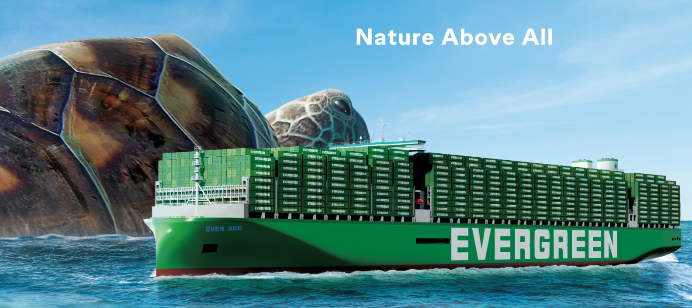
2025
LAAM Meeting (CARB)
By LAD/EGA/ELA 2025.FEB.27~28
By LAD/EGA/ELA

Slide 2
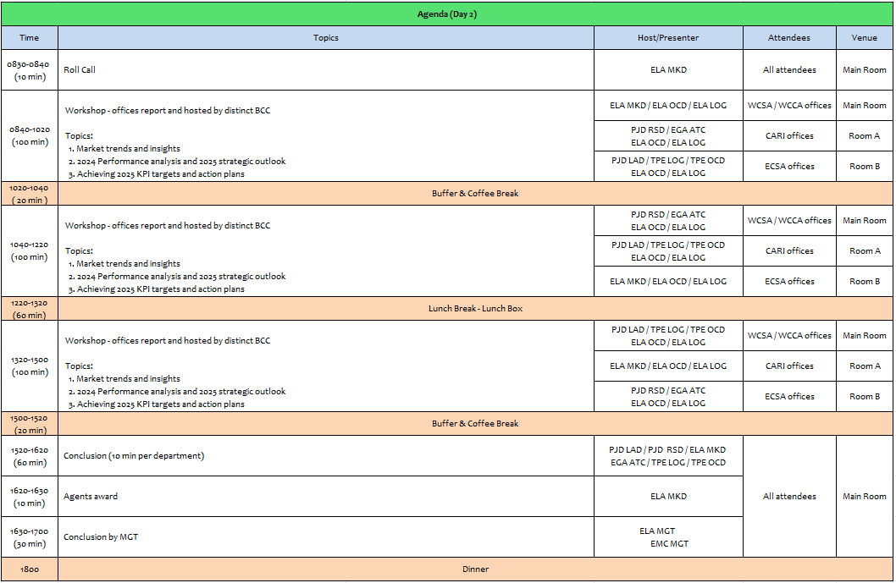
2

Slide 3
02
MIS
(COSTA RICA include NICARAGUA)

Slide 4
Performance/Space(2024) and 2025 Market Review (CR+NI)
Subject | Segments | BCC | 2024 Target TTL Loading(TEU) | 2024 JAN~DEC TTL Loading(TEU) | Achievement (%) | 2025 JAN~DEC TTL Loading(TEU) | Market Review & Action Plan (How to achieve 2025 target?)
 |  |  | (A) | (B) | (B)/(A) | Target
Trade Lane | F.E. => CR+NI IMP. (C Trade) | LAD | 127 | 212 | 167% | 245
 | F.E. => CR+NI IMP. (Q Trade) | LAD | 6,221 | 6,354 | 102% | 7,265
 | CR+NI EXP. => F.E. (CF Trade) | LAD | 5,483 | 5,106 | 93% | 5,140
Market review:
C trade is the non-natural routing for CR imports from F.E., if the rates and transit time are competitive compared to CRCAL, the accounts are willing to use CRMOB.
Action Plan: Request TPE support with competitive rates between CRCAL and CRMOB to promote more CRMOB.
Market review:
Cosco and Maersk have most of the market share volume.
LAE service schedule need to be more stable to increase volume.
China imports of electric cars is growing, we need POL support wend we send sales leads.
Tenders are a great way to increase market share.
Action Plan:
Focus on growing commodities, example, electric cars.
Increase communication with POL to develop FOB & CIF accounts
Market review:
Wood and scrap are the main commodities, those commodities main PODs are in India.
Action Plan:
Motivate Evergreen to increase allocation in CIX services for Costa Rica & Nicaragua to increase the market share in India exports.
4

Slide 5
Performance/Space(2024) and 2025 Market Review (CR+NI)
Subject | Segments | BCC | 2024 Target TTL Loading(TEU) | 2024 JAN~DEC TTL Loading(TEU) | Achievement (%) | 2025 JAN~DEC TTL Loading(TEU) | Market Review & Action Plan (How to achieve 2025 target?)
 |  |  | (A) | (B) | (B)/(A) | Target
Trade Lane | CR+NI ⬄ USEC (609+610 Trade) | EGA-ATC | 1,000 | 1,476 | 147% | 1,800
 | CR+NI ⬄ CARB+WCCA (CB Trade) | ELA | 2,350 | 1,188 | 51% | 1,350
 | CR+NI ⬄ WCSA (CW+WC Trade) | ELA | 500 | 797 | 159% | 650
 | CR+NI ⬄ USEC (622+623 Trade) | ELA | 1,100 | 1,710 | 155% | 1,500
Market review:
USEC import market has potential accounts to target, however, decision makers are located at the U.S.
The extensive transit time to USEC affects Evergreen competitiveness.
Action Plan:
Promote reefer service to secure a lower transit time.
Market review:
Main volume for CB trade is from MX to CR.
Evergreen allocation for regional cargoes is low and almost zero in F.E. peak season.
Action Plan: Evergreen needs to grant more allocation for CR & NI in LAE service to develop the service.
Market review:
The competition offers lower transit times with lower rates.
Action Plan: Liner support is needed to offer to the customers better conditions, competitive rates and lower transit time.
Market review: It’s not the natural routing to/from the U.S., but there is always opportunity to capture new customers.
Action Plan: Request to liner steady LAE service and smooth cargo move from PABBA to PACCT for connecting.
5

Slide 6
Topic discussion (CR+NI)
Future market forecast in 2025 (Pessimistic / Optimistic / Remain the same)?
 | Get worse | Improve | Stay the same
2025 |  | X
Economic background
The 2024 exports closed for Costa Rica with a 9% growth.
The OECD (Organization for Economic Cooperation and Development) and the Central bank expects that GDP will increase 3.9% for Costa Rica in 2025.
For Nicaragua the IMF expects that GDP will increase in 3.8%.
The exchange rate (USD-CRC) remains at a lower level, making exporters less competitive due to CR colon appreciation, promoting imports to the country.
6

Slide 7
Topic discussion (CR+NI)
Market share and Loading volume prospect 2025 (Long Haul)
 | FAR EAST - CR (MOIN + CALDERA) - JANUARY TO SEPTEMBER 2024
 |  | MARKET SHARE
 |  | CMA CGM | EVERGREEN | HAPAG LLOYD | MSC | MAERSK | ONE | %
 | 2024 | 15.02% | 11.67% | 11.52% | 15.52% | 34.14% | 12.13% | 100%
 |  | FAR EAST - CR (MOIN + CALDERA) / TEU'S
 |  | CMA CGM | EVERGREEN | HAPAG LLOYD | MSC | MAERSK | ONE | TOTAL Teu's
 | 2024 | 11,666 | 9,063 | 8,947 | 12,059 | 26,523 | 9,422 | 77,680
Nicaragua data not available
Volume prospect 2025
Despite the exposed situations, we will do our best to reach the liner KPI.
If the allocation and T/S situation improve, we will be able to increase market share for 2025
7

Slide 8
ECD/IMD Topic discussion (CR+NI)
ECD KPI | Item | 2023 | 2024 | Diff | Action Plan in 2025
ECD KPI | Storage |  |  |  | We need a steady Service in LAE arriving at CRCAL in order to avoid the storage charges
 | Lift on/off |  |  |  | We need depot les congested to be available to deliver the emty unit on a faster manner
 | Reposition |  |  |  | The Repo requested by LAE will be accomplish if We received the request on a weekly basis
 | M & R |  |  |  | N/A
IMD KPI | Cost Saving Project |  |  |  | N/A
 | 90% Onboard within 7 Days |  |  |  | Actually We depend of the FDR arriving to CRCAL in order to coordintate fast the repo requested by ELA
 | No Personal Negligence |  |  |  | N/A
8

Slide 9
OCD/OPD Topic discussion (CR+NI)
 |  | 2023 | 2024 | Diff | Action Plan in 2025
OPD KPI | BOA |  |  |  | We continue working with the comercial BW given by the port, the issue is the LAE Service do not have a stable schedule
 | Port Stay |  |  |  | Actually the port infraestructure will remain the same until 2026
 | Productivity |  |  |  | The actual crane moves are 20-25 moves per hour due to port is working with 110% of capacity
OCD KPI | Incentive |  |  |  | N/A
 | Empty Storage |  |  |  | The capacity of the terminal empty storage depend on the operation percentage they are handling at this momento the terminal is 110% of capacity
 | Rate Reduction |  |  |  | There are no change on the actual charges at port
9

Slide 10
03
CRE
(CURACAO)

Slide 11
Performance/Space(2024) and 2025 Market Review (CW)
Subject | Segments | BCC | 2024 Target TTL Loading(TEU) | 2024 JAN~DEC TTL Loading(TEU) | Achievement (%) | 2025 JAN~DEC TTL Loading(TEU) | Market Review & Action Plan (How to achieve 2025 target?)
 |  |  | (A) | (B) | (B)/(A) | Target
Trade Lane | F.E. => CW IMP. (C Trade) | LAD | 332 | 566 | 170% | 588 | Continue regaining support from lost ac now that rates have dropped from Usd10K/ 4Sh levels. Our main competitors CMA/CGM and Mearsk has been facing major delays at JMKSN / COCTG since last year, customers moving back slowly to EMC service. Continue improving own SQ volume.
 | CW ⬄ USEC (609+610 Trade) | EGA-ATC | 20 | 16 | 80% | 20 | Continue chasing any 609/610 opportunities in the market. Hard to compete with King Ocean & Seaboard with our high Ocean Freight Rates. Significant USEC volume move out of Port Everglades/ Miami area via direct service of King Ocean.
 | CW ⬄ CARI (CC Trade) | EGA-ATC | 20 | 23 | 115% | 20 | Continue promoting CARB – CW / CARB – CW service in order to regain support. Hard to compete with King Ocean, Seaboard Marine and Sealand/ Maersk at current EMC Ocean Freight Rates. DO – CW is dominated by local carrier Don Andres with weekly direct service with transit of 2 days.
11

Slide 12
Performance/Space(2024) and 2025 Market Review (CW)
Subject | Segments | BCC | 2024 Target TTL Loading(TEU) | 2024 JAN~DEC TTL Loading(TEU) | Achievement (%) | 2025 JAN~DEC TTL Loading(TEU) | Market Review & Action Plan (How to achieve 2025 target?)
 |  |  | (A) | (B) | (B)/(A) | Target
Trade Lane | CW ⬄ WCSA (CW+WC Trade) | ELA | 10 | 0 | 0% | 10 | No service, no transhipment options.
 | CW ⬄ WCCA+CARO (CB Trade) | ELA | 15 | 0 | 0% | 10 | No service, no transhipment options
12

Slide 13
Topic discussion (CW)
Commercial side:
FE to AW/CW rate levels are slowly decreasing from mid 2024 levels, this in line with latest market trends. Lost accounts are slowly returning due to better transit as competition is experiencing frequent delays (bad performance)
Colombia is a substantial / attractive market for which we receive frequent enquires, however we are not participating due to feeder-cost and unreliable feeder schedule.
Panama is a substantial / attractive market for which we receive frequent enquires, however we are not participating due to feeder-cost
AW/CW export volumes are extremely limited, consisting of waste materials (metal scrap/ drained batteries/waste paper) to FE & EU. We are not permitted to accept these commodities by the principle, due to Basel conference restrictions.
Future Plan Suggestion:
Continuing chasing all our lost accounts on the various trades.
Suggest to review / renegotiate CFS feeder contract for lower feeder-rates / offer rates in line with competition.
Promoting AW/ CW service to CARI in order to secure support for any incidental export cargo such as removal goods.
13

Slide 14
Topic discussion (CW)
Future market forecast in 2025 (Pessimistic / Optimistic / Remain the same)?
Economic background
AW/CW economies are growing, mainly by tourism.
CW is more focused on EU goods, AW is more focused on USA goods
Lot of construction activities, mainly for tourism
Inflation is rising, even though certain goods are price limited by Government decree.
Still no VE biz due to political situation VE – USA governments.
New elections coming up in Curacao, March 2025.
Market share and Loading volume prospect 2025 (Long Haul)
Current market share can not be indicated in % as neither government instances nor stevedore provide import statistics.
There is a recovery on the ASI – CARI trade and we hope to be able to extend this recovery also on our other trades.
Have many external factors to make a proper forecast (Politics US, War Ukraine, situation Middle East, situation Venezuela)
 | Get worse | Improve | Stay the same
2025 |  | x
14

Slide 15
04
SMS
(HAITI)

Slide 16
Performance/Space(2024) and 2025 Market Review (HT)
Subject | Segments | BCC | 2024 Target TTL Loading(TEU) | 2024 JAN~DEC TTL Loading(TEU) | Achievement (%) | 2025 JAN~DEC TTL Loading(TEU) | Market Review & Action Plan (How to achieve 2025 target?)
 |  |  | (A) | (B) | (B)/(A) | Target
Trade Lane | F.E. => HT IMP. (C Trade) | LAD | 1,219 | 1,450 | 119% | 1,715 | The decrease in volume (-2%) in 2024 was primarily due to port closures caused by civil unrests from Feb-June and again in Sept. 2024 Despite these challenges, we remain commited to keeping BCC informed with the latest market rates/share ensuring we align with our customers demand for more competitive pricing. Our key objective this year is to drive a significant increase in bookings by actively promoting Evergreen and its services to restore growth and exceed our target.
 | HT ⬄ CARI+CARO (CB Trade) | ELA | 1,000 | 222 | 22% | 500 | -Volume decline and targets have not been met due to the security crisis in the country over the past months. -The need to increase allocation, and enhance the availability of foodgrade containers, particularly for sugar/confectionery imports. -Our focus this year is on driving volume growth by actively promoting Evergreen and its reliable services.
16

Slide 17
Performance/Space(2024) and 2025 Market Review (HT)
Subject | Segments | BCC | 2024 Target TTL Loading(TEU) | 2024 JAN~DEC TTL Loading(TEU) | Achievement (%) | 2025 JAN~DEC TTL Loading(TEU) | Market Review & Action Plan (How to achieve 2025 target?)
 |  |  | (A) | (B) | (B)/(A) | Target
Trade Lane | HT ⬄ WCSA+WCCA (CW+WC+CB Trade) | ELA | 1,000 | 60 | 6% | 80 | Volume decrease due to the country insecurity. The need to increase allocation, and enhance the availability of foodgrade containers, particularly for sugar/confectionery imports especially for GTZNJ, CRCAL, SVAGR & NICPK. Services from COBVT & PECAL still suspended. [2024 Q1-Q4] COBVT – 4,051 TEU PECAL – 2,789 TEU Our primary goal this year is to significantly boost bookings by strategically promoting Evergreen and its services, aiming to restore growth and surpass our target.
 | HT ⬄ USEC (622+623 Trade) | ELA | 500 | 75 | 15% | 250 | Volume decrease due to the country insecurity. main challenges impacting this trade are equipment shortage and limited trucking schedule availability. 2024 Imports to HTPAP – 5,777 TEU USHUS – 42% USNYC – 27% USSVN – 18% Goal this year is to secure more bookings by actively promoting Evergreen and its services.
17

Slide 18
Topic discussion (HT)
Commercial side:
Pleased to share that in 2024, we have secured the 1st position in imports from Far East Asia (C Trade) despite facing significant challenges, including political instability. This achievement reflects our resilience and strategic efforts in navigating complex market conditions. However, we have yet to attain the top position in CB and other trade, primarily due to the non-resumption of COBVT, PECAL, USHUS services. Additionally, both CMACGM and MSC continue to provide services from these ports, including Europe and Brazil, which has impacted our position.
We sincerely appreciate the unwavering support and understanding of our BCC partners during this challenging period. Their cooperation and proactive efforts have played a crucial role in helping us navigate the difficulties arising from the political situation in HTPAP.
Future Plan Suggestion:
We are fully committed to reinforcing our competitive position and expanding our market presence in the Haiti imports sector. With a strong foundation established with our clients in Haiti, it is essential to address existing gaps in our service offerings to further solidify our standing and increase our market share. There is a clear demand for services to Brazil, Europe, and key ports such as COBVT and PECAL. By incorporating these routes into our service portfolio, we can effectively meet the needs of underserved clients and capitalize on new growth opportunities.
In addition, we recommend the integration of Port Everglades and USHUS into the CAJ service, which will strengthen our market presence and align with our strategic objective of becoming the leading carrier in Haiti.
18

Slide 19
Topic discussion (HT)
Future market forecast in 2025 (Pessimistic / Optimistic / Remain the same)?
Economic background:
  Haiti has been receiving international support from organizations like the World Bank and the IMF, aimed at boosting economic stability and development. Collaborations with regional partners, including the Caribbean Community (CARICOM) and other trade blocks, can open new avenues for trade and economic growth. Haiti's import dependencies in 2025 remain high in several key sectors due to its limited domestic production capacity and infrastructure challenges such as food, agricultural products, fuel, construction & machinery materials, consumer goods and healthcare supplies.
Market share and Loading volume prospect 2025 (Long Haul):
We expect to enhance our market share by re-establishing services at the ports we previously lost, COBVT, PECAL, ECGYE, CLSAI, and USHUS. Additionally, we aim to expand our offerings with the inclusion of Port Everglades (USPEV), as well as services from Brazil and European countries.
 | Get worse | Improve | Stay the same
2025 |  | ✓
19

Slide 20
05
MCD
(DOMINICAN REPUBLIC)

Slide 21
Performance/Space(2024) and 2025 Market Review (DO)
Subject | Segments | BCC | 2024 Target TTL Loading(TEU) | 2024 JAN~DEC TTL Loading(TEU) | Achievement (%) | 2025 JAN~DEC TTL Loading(TEU) | Market Review & Action Plan (How to achieve 2025 target?)
 |  |  | (A) | (B) | (B)/(A) | Target
Trade Lane | F.E. => DO IMP. (C Trade) | LAD | 2,708 | 2,530 | 96% | 4,900 | MSC leads market with 24.43% share demoting CMA-CGM which holds second place with 22.39% market share. EGL maintains third place with 14.77% share in FE/DO trade. Market share is based on our IU stats, from January through November 2024. Our OWN SQ decreased -30.87% YOY, going from 3660 TEU in 2023 to 2530 in 2024. Actual FOB/CIF ratio is 12/88. While other carriers also faced problems with congestion, it did not reach the extend of Evergreen. At some point cargoes reached 120+ days transit time. The damage in terms of reputation to the Evergreen brand was (and is) considerably. Some customers do not even take our calls and/or allow us to visit them. Action Plan: As JV will terminate in February or March, we should have a steadier CAN svc with minimal if any roll overs. Based on that premise, we will be contacting/visiting all accounts whose volumes we had lost in the last two-three years. At the same time, we will start an advertising campaign in social media and others, sending the message that Evergreen is back with reliable services and competitive rates. Same will be amplified by digital flyers, sending them directly to all accounts in our database, both FOB and CFR clients, BCO's and NVO's.
21

Slide 22
Performance/Space(2024) and 2025 Market Review (DO)
Subject | Segments | BCC | 2024 Target TTL Loading(TEU) | 2024 JAN~DEC TTL Loading(TEU) | Achievement (%) | 2025 JAN~DEC TTL Loading(TEU) | Market Review & Action Plan (How to achieve 2025 target?)
 |  |  | (A) | (B) | (B)/(A) | Target
Trade Lane | DO ⬄ USEC (609+610 Trade) | EGA-ATC | 200 | 209 | 104% | 200 | DO/USEC: As well known, our competitors have direct service to the USEC, avg 5-8 days TT, in order to keep some support, a fixed schedule is imperative. Action Plan: As JV will terminate in February or March, we should have a steadier CAN svc with minimal if any roll overs. Based on that premise, we will be contacting/visiting all accounts whose volumes we had lost in the last two-three years.
 | DO ⬄ CARI (CC Trade) | EGA-ATC | 2,900 | 3466 | 119% | 2,900 | During Q1 2024, dedicated DO-PR carrier Marine Express, faced problems with their vessel, which allowed us to quickly gain support from some of their current customers during Q2. After said carrier finally recovered, we were able to maintain some of these customers, but since problems with CAN schedule started in most of Q3-Q4, our volumes dropped significantly as customers need a reliable schedule. Action Plan: Same as above.
22

Slide 23
Performance/Space(2024) and 2025 Market Review (DO)
Subject | Segments | BCC | 2024 Target TTL Loading(TEU) | 2024 JAN~DEC TTL Loading(TEU) | Achievement (%) | 2025 JAN~DEC TTL Loading(TEU) | Market Review & Action Plan (How to achieve 2025 target?)
 |  |  | (A) | (B) | (B)/(A) | Target
Trade Lane | DO ⬄ WCSA (CW+WC Trade) | ELA | 150 | 21 | 14% | 50 | WCSA/DO current svc configuration has two T/S, increaing not only TT but also rate offer. Additionally, when requesting rates to BCC, it indicates that service it‘s temporarily unavailable in said trade. DO/WCSA: Many to cargo to WCSA is mosly waste paper and plastic waste wihch offer is very low $400-500/4sh all in. Also two of DO‘s major destinations (ECGYE & CLIQQ) have a very high offer due double T/S, and which limit our potential to grow more biz. How to improve: As JV will terminate in February or March, we should have a steadier CAN svc with minimal if any roll overs. Based on that premise, we will be contacting/visiting all accounts whose volumes we had lost in the last two-three years. Additionally, BCC support is needed to provide Waster/Recycling products special rates. that are exported to WCSA. It’s about the 90%.
 | DO ⬄ WCCA+CARO (CB Trade) | ELA | 300 | 70 | 23% | 100 | DO/WCCA: Our main problem is this svc instability. During LAAM 2024 svc was supposed to improve with the addition of new vessels, but TT didnt have major improvement and TT average is about +30 days. Additionally and from Q3 onwards we lost the ability to export cargo to SVAGR, one of DO most requested destinations in WCCA trade. How to improve: As JV will terminate in February or March, we should have a steadier CAN svc with minimal if any roll overs. Based on that premise, we will be contacting/visiting all accounts whose volumes we had lost in the last two-three years.
23

Slide 24
Topic discussion (DO)
Commercial side:
We believe that the Account Management Program (AMP) is a great tool to follow up and keep close to our dear customers, but when wrongly used, it just adds unnecessary and additional workload, at least from the agent point of view.
We're being forced to complete AMP reports on what we call practically "Dead trades“, trades in which currently cannot compete at all for reasons such as, very long transit times due to T/S (sometimes even double T/S) and in addition a disproportional high freight, whereas our competitors offer direct service with very competitive rates.
Other than FE/DO and DO to PA & PR (DO only direct calls at the moment) and DO/USEC, there's no other trades in which we're able to compete or have anything to offer. DO/WCCA, DO/WCSA & DO/FE, as of today present many challenges and what makes it very difficult to sale. In DO/FE there might be a good chance in we could compete with some commodities, but rates should be adjusted to meet our customers’ target.
In conclusion, we recommend AMP, at least in an initial phase, to apply only on those trades in what we have a real chance to compete, because the current conditions of a particular trade allows it. Make no mistake, DO will always try to make everything to get the cargo at the end of the day, but there's simply no point making the same reports over and over if our situation does not change.
Future Plan Suggestion:
Now that CAN service will have a new configuration and promise to provide a reliable weekly service soon, believe it’s a good opportunity to start making studies adding new routes in the near future. Our customers are eager for Evergreen to come up with new services and/or new origins/destinations. They often get the notices from other carriers informing about new routes, services and solutions.
For instance, perhaps having DO/NORTH EUROPE would be convenient as it’s a destination in which there are many exports, for both dry and reefer cargo.
24

Slide 25
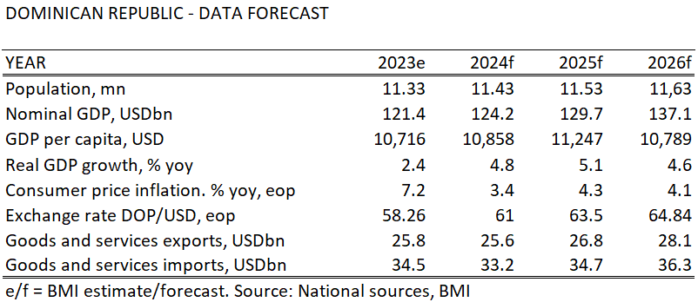
Topic discussion (DO)
Future market forecast in 2025 (Pessimistic / Optimistic / Remain the same)?
 | Get worse | Improve | Stay the same
2025 |  |  | V
Growth has resumed its historically robust pace and is projected to be the fastest growing economy in Latin America in 2024, reaching 5.1% during Q1~Q3 2024, following a slowdown to 2.3% in 2023 due to the high-interest rate environment.
Free trade zones and tourism continue to be bright spots in the economy, with tourist arrivals continuing to reach record highs.
Inflation Below Target: Inflation through October 2024 averaged 3.3%, below the BCRD’s (Central Bank) target of 4%. The BCRD has reduced its policy rate to 6.25% from a peak of 8.5% in May 2023.
25

Slide 26
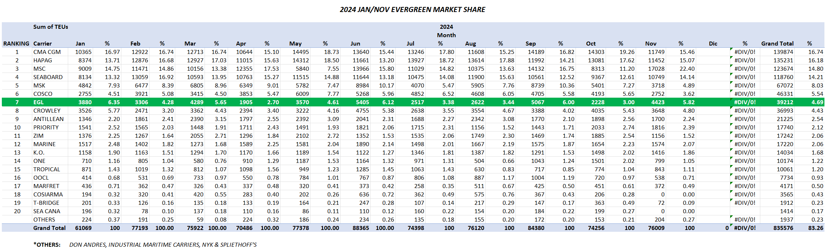
Topic discussion (DO)
Jan/Nov 2024 Market Share (DO Import + Export Volumes)
26

Slide 27
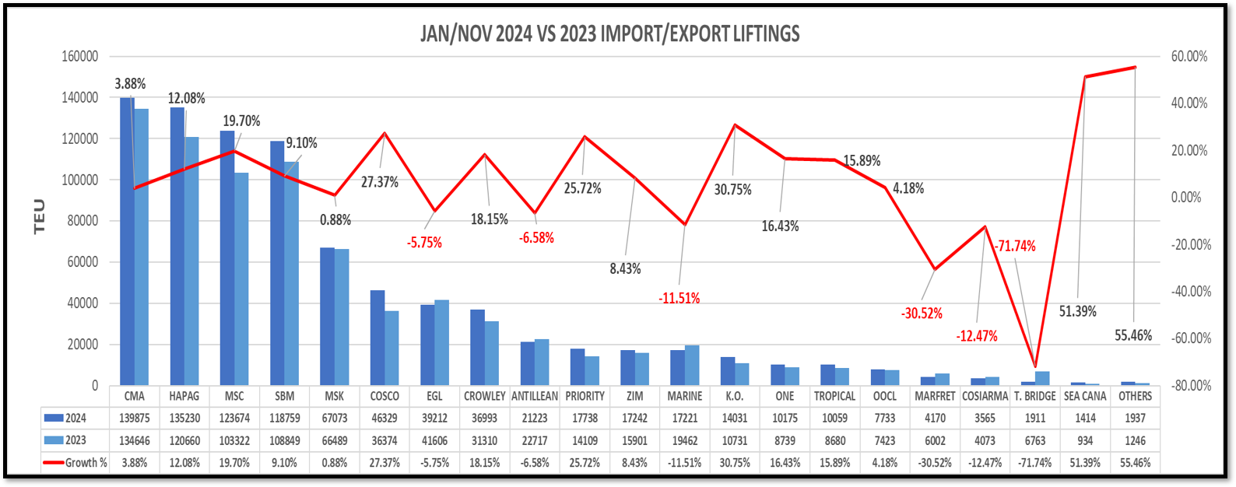
Topic discussion (DO)
JAN/NOV 2024 Vs 2023 IMPORT/EXPORT LIFTINGS / GROWTH
27

Slide 28
Topic discussion (DO)
Market share and Loading volume prospect 2025 (Long Haul)
Based on our Intelligence Unit statistics, from January through November 2024, Evergreen holds a share of 4.70% maintaining a seventh position among all carriers in DO. Overall TEU loaded (Import + Export) in said period range: 39,212. Meanwhile, in same time frame, DO overall import+export TEUs increased 9% going from 770,036 in 2023 to 835,576 in 2024.
According to our internal records in 2024 and in which there was not added services, faced strong roll over problems and several skips and delays, specifically DOCAU 2nd skips, Evergreen overall volumes decreased -5.10% going from 43,732 TEU in 2023 to 41503 TEU in 2024.
Since new CAN rotation is expected to launch during March 2025, and it would be a weekly steady service, by end of current year we can expect an 8% increase vs. 2024.
28

Slide 29
ECD/IMD Topic discussion (DO)
ECD KPI | ITEM | 2023 | 2024 | Diff | Action Plan in 2025
ECD KPI | Storage | US$539,495.34 | US$871,350.52 | US$331,855.18 | We hope that EMC will reestablish frequent calls to DO to reduce storage costs. Open depots to receive sold units, which would reduce costs because dispatch would be faster, and the line would not have to assume storage until dispatch.
 | Lift on/off | US$13,090 | US$43,274 | US$30,184 | Exports increased for 2024, and customer dispatched from DORHNT, which is where the line cover cost. Increase in units sold from DORHNT from 284 units to 288 units. In total 595 units dispatched from DORHNT in 2023 and 1064 units in 2024, which represents a percentage growth of 78.8% of dispatch from DORHN, It is suggested that units be returned to the depot to reduce costs to the line for storage and lift on/off concept.
 | Reposition | N/A | US$ 372,960 | US$ 372,960 | Repositioning costs could be eliminated by placing calls with space available to load all empty containers in port at the time of planning the vessel, for 2025 we hope to have recurring calls.
 | M & R | N/A | N/A | 0%
IMD KPI | Cost Saving Project | N/A | N/A
 | 90% Onboard within 7 Days | 0% | 0% | 0% | No units were loaded before the stipulated 7 days, for this it is necessary to have: Vessel space available to load empty units. Don't have skips, do not cut the operation to reach another window and get terminal apply the FIFO system, which its not possible due to the empty evacuated quantity does not allow to load empties in a timely manner under FIFO rules.​
 | No Personal Negligence | N/A | N/A | N/A | No personal negligence under line account
Aged Container Selling / Free Reposition Plan
  A) Since 2022 DO has been promoting the Used Container Selling among our customers, and each year demands increase, but not at the same pace of boxes availability. In 2024 we sold 351 containers. Many factors such as vessel skips, DOCAU bureaucratic process, among others represent a real challenge.
  B) There’s no free reposition plan for the used Container, extra yard moves are covered by the customer.
29

Slide 30
OCD/OPD Topic discussion (DO)
 | ITEM | 2023 | 2024 | Diff | Action Plan in 2025
OPD KPI | BOA | 80.7% | 86.79% | 7.55% | Data considered from the system evaluation under the schedule monitor, the values are expressed in %, there was an improvement of 7.55%, and we hope to continue improving
 | Port Stay
 | Productivity | 97% | 97% | 0% | Data considered from the system evaluation under the terminal productivity information, the values are expressed in %. Productivity has continued to increase, and we hope to maintain and improve this level. Note: We’re still waiting for the Line to provide productivity data from September to December 2024. .
OCD KPI | Incentive | N/A | N/A | N/A
 | Empty Storage | US$515,397.84 | US$830,496.82 | US$315,098.98 | For 2024 we had around 43 skips at DO, in addition to the lack of space for empty loading, add the cut and run that was carried out on several occasions to be able to reach the following ports on time so as not to lose the window. The partner has more space on both vessels than EMC, in addition is not allowed to load empty units on the partner's first call. The following actions must be taken: Our action plan is the same Greater availability of space to be able to load the empty cntrs in a timely manner(, avoid skips and sending extra calls, when necessary, to load empty cntrs in both DOCAU calls if necessary. Negotiate with DOCAU terminal to be able to have a greater number of cargo movements since this is defined for regular calls in the contract with the terminal and any adjustment must be previously analyzed with both managers, terminal and EMC​ (around 950 fist call and 1150 2nd call)
 | Rate Reduction | N/A | N/A | N/A | The line has a contract with both terminals and the negotiation is handled by the terminal and our principals directly. When it is necessary to intervene, MGT has made all the necessary approaches to achieve rate readjustment or maintain the same when necessary.
30

Slide 31
06
LNM
(JAMAICA)

Slide 32
Performance/Space(2024) and 2025 Market Review (JM)
Subject | Segments | BCC | 2024 Target TTL Loading(TEU) | 2024 JAN~DEC TTL Loading(TEU) | Achievement (%) | 2025 JAN~DEC TTL Loading(TEU) | Market Review & Action Plan (How to achieve 2025 target?)
 |  |  | (A) | (B) | (B)/(A) | Target
Trade Lane | F.E. => JM IMP. (C Trade) | LAD | 379 | 339 | 90% | 490 | Rate was trending down in most cases and EMC had managed to remain competitive. However, there was significant delays with feeder service, hence major decline to end the Q4. Action Plan includes: Pushing for Priority at POL and request assistance from UMS Sending weekly Rate Guideline rates to client list Follow through with daily AMP updates per trade.
 | JM ⬄ USEC (609+610 Trade) | EGA-ATC | 10 | 9 | 90% | 10 | Export booking delays due to LOI needed for sensitive cargo approval. Rates are competitive and can win big accounts, feeder service just need to be on time. Action Plan includes: Improve Customer Service traing and support Additonal Employees has been trained and added to staff for sales and lead generating support.
 | JM ⬄ CARI (CC Trade) | EGA-ATC | 25 | 28 | 112% | 25 | Rates have been competitive - Port to Port Feeder service remain unstable Cma and Seaboard has a more reliable service in the market. Action Plan includes: Improve Customer Service traing and support Additonal Employees has been trained and added to staff for sale and lead generating support. Seek additonal sale support from: Panama Team Colombia Team Costa Rica Team
32

Slide 33
Performance/Space(2024) and 2025 Market Review (JM)
Subject | Segments | BCC | 2024 Target TTL Loading(TEU) | 2024 JAN~DEC TTL Loading(TEU) | Achievement (%) | 2025 JAN~DEC TTL Loading(TEU) | Market Review & Action Plan (How to achieve 2025 target?)
 |  |  | (A) | (B) | (B)/(A) | Target
Trade Lane | JM ⬄ WCSA (CW+WC Trade) | ELA | 10 | 0 | 0% | 10 | We need more competitive rates, service tend to be unreliable. comparing to CMA and Seaboard.
 | JM ⬄ WCCA+CARO (CB Trade) | ELA | 515 | 204 | 40% | 250 | Additional Employees has been trained and added to staff for sales and lead generating support.
33

Slide 34
Topic discussion (JM)
Future market forecast in 2025 (Pessimistic / Optimistic / Remain the same)?
Economic background
In 2024, Jamaica's economy faced challenges, including a contraction of 2.8% in the third quarter, primarily due to adverse weather conditions impacting key sectors such as agriculture and mining. Despite these setbacks, the International Monetary Fund (IMF) projects a 2.1% growth in real GDP for Jamaica in 2025, indicating a positive outlook. imf.org
In support of economic development, the Government of Jamaica has allocated J$40 billion to the Shared Prosperity through Accelerated Improvement to our Road Network (SPARK) Programme. This initiative aims to rehabilitate and enhance the nation's road infrastructure, thereby facilitating commerce and contributing to sustained economic growth
Election is due for 2025. Jamaica is scheduled to hold its next general election in 2025, with the exact date yet to be determined.
 | Get worse | Improve | Stay the same
2025 |  | V
34

Slide 35
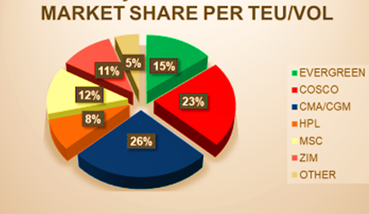
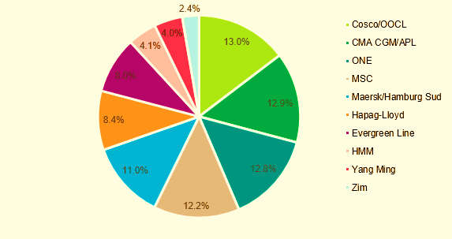
Topic discussion (JM)
Market share and Loading volume prospect 2025 (Long Haul)
35

Slide 36
ECD/IMD Topic discussion (JM)
ECD KPI | ITEM | 2023 | 2024 | Diff | Action Plan in 2025
ECD KPI | Storage | 5 FULL CONTAINER IN STORAGE | 5 FULL CONTAINER IN STORAGE | 0% | long overdue unclaimed cargo. Only two still on terminal / 1 abandoned. To frequently update unclaimed in SOL+ and advise BCC of our recommendations in our unclaimed report. EMC does not pay terminal for full container storage. (Domestic) 1x40ft Customs Hold Storage is handled by client for all units.
 | Lift on/off | Avg 20-30 units per hr/ day | Avg 20-30 units per hr/ day | 0
 | Reposition | 80% | 80% | 0 | Frequent feeder delays. EMC would need more space available to ship out empties
 | M & R | N/A | N/A | N/A | N/A
IMD KPI | Cost Saving Project | N/A | N/A | 30% | KFTL currently looking to increase their crane capacity by the end of 2024.
 | 90% Onboard within 7 Days | 80% | 80% | N/A | No change. We need more capacity on feeder service.
 | No Personal Negligence | Not AT THIS TIME | Not AT THIS TIME | 0% | All safety and regulatory requirements are closely monitored by Agency personnel.
36

Slide 37
OCD/OPD Topic discussion (JM)
 | ITEM | 2023 | 2024 | Diff | Action Plan in 2025
OPD KPI | BOA | 80% | 80% | 0% | The vessel would have to come within agreed terminal window.
 | Port Stay | 12hrs | 12hrs | 0 | We can continue to communicate to terminal to increase productivity.
 | Productivity | 20 moves per hour/crane | 20 moves per hour/crane | 0 | We can continue to communicate to terminal to increase productivity. As adjoining terminal KFTL current productivity is over 40 moves per hr/crane.
OCD KPI | Incentive | N/A | N/A | N/A | N/A
 | Empty Storage | 30 Days | 20 days | 30% | EMC would need to provide reposition options from JMKSNT.
 | Rate Reduction | N/A | N/A | N/A | N/A
37

Slide 38
07
UMS
(PANAMA)

Slide 39
Performance/Space(2024) and 2025 Market Review (PA)
Subject | Segments | BCC | 2024 Target TTL Loading(TEU) | 2024 JAN~DEC TTL Loading(TEU) | Achievement (%) | 2025 JAN~DEC TTL Loading(TEU) | Market Review & Action Plan (How to achieve 2025 target?)
 |  |  | (A) | (B) | (B)/(A) | Target
Trade Lane | F.E. => PA IMP. (C Trade) | LAD | 15,512 | 17,444 | 112% | 16,415 | Due to congestion in Dominican Republic, PJD-LAD gave us more space. We appreciate BCC’s support on flexible rates policy, equipment and space at 2024. Clients as, May´s and Amazon Zona Libre increased their cargo 30% and 13% respectively. We continue the good communication with BCC’s and update the latest market information every week for BCC’s reference. We continue working with the port of loading and BCC sending sales lead in order to release the pending bookings.
 | PA ⬄ USEC (609+610 Trade) | EGA-ATC | 210 | 138 | 66% | 210 | Main reason caused the lifting shortage is because the lower rates and faster transit time offer by MSK/Seaboard. Maintain customer relationship in order to act as a primary back up carriers and appreciate BCC’s support as always. Working with customers such as: Panama Intermoving & Relocation, Balboa Movers, Canal Movers who are moving the cargo from Panama to USEC. We keep updated information with BCC’s and looking for the support.
 | PA ⬄ CARI (CC Trade) | EGA-ATC | 5,700 | 4881 | 86% | 5,500 | Lifting was serious jeopardies by delays, skip specially on CAN, CAC and CAJ services at 2024. One of our principal market is Colombia(CARI Side) and the cargo was affected for the following issue: low purchase volume, some of the items have increased the taxes, currency issue, instability in the government. Reasons of the achievement standing at 86% due to delay on CAN services and a/cs shift their support to the others for vols goes to Dominican Republic and Puerto Rico. Our action plan is work with BCC in order to maintain the rate flexibility and share the latest sailing schedule with a/cs.
39

Slide 40
Performance/Space(2024) and 2025 Market Review (PA)
Subject | Segments | BCC | 2024 Target TTL Loading(TEU) | 2024 JAN~DEC TTL Loading(TEU) | Achievement (%) | 2025 JAN~DEC TTL Loading(TEU) | Market Review & Action Plan (How to achieve 2025 target?)
 |  |  | (A) | (B) | (B)/(A) | Target
Trade Lane | PA ⬄ WCSA (CW+WC Trade) | ELA | 310 | 289 | 93% | 310 | Has to stay on top of the delay caused by cut and run issue at PABBA. We have recovered the support from Huawei through ELA‘s assistance they are very interested in our new destination to Valparaiso also to Callao and we sent quotation to CTS International and DSV Panama two logistics companies. Our action plan is trying to secure 5-8 boxes under weekly basis and proactive to take care everything ahead of customer’s challenge.
 | PA ⬄ WCCA+CARO (CB Trade) | ELA | 950 | 291 | 31% | 350 | Reason that the cargo decreased was GPS consideration and space issue on T/S priority. Unstable schedule. Our action plan is keep post the latest saling scheduled for all a/cs reference and try to accomendate customers reqesut when they running into the trouble caused by us. Work together with our colleagues in WCCA and CARO sending sales lead when the rates is negotiable by them and vice versa.
40

Slide 41
Topic discussion (PA)
Commercial side:
Looking forward to have more stable Schedule on CAN, CAC and CAJ services in order to secure more potencial customers support and boxes from the street.
Special consideration at space support for domestic export shipment on WCCA (CB) when thetransship vols pick it up.
Continuous promote export reefer business to ASI and other region for the commodities such as Frozen Sea Food, Fruits, Medicines, to Caribbean, United States and Asia.
Future Plan Suggestion:
Open new routes for potential destinations such as: Venezuela, Brasil, and CARI regions.
Invite BCCs join sales calls visiting customers in order to reinforce the customer relationship and more understanding of the BIZ pattern at different commodity.
When the roll over issue involved at POLs, suggest to send us the notices asap in order to avoid rate retrieve after vsl departure and pacify customers complain in advance.
41

Slide 42
Topic discussion (PA)
Future market forecast in 2025 (Pessimistic / Optimistic / Remain the same)?
Economic background:
In 2025, Panama is expected to maintain strong economic growth at around 4.0%, driven by ongoing infrastructure projects and a diverse economy. The construction sector will see a boost from large-scale projects like the third Metro line, the fourth bridge over the Panama Canal, and the expansion of energy and water infrastructure, such as the Mendoza water treatment facility. These developments will not only improve infrastructure but also create jobs and stimulate economic activity
 | Get worse | Improve | Stay the same
2025 |  | V
42

Slide 43

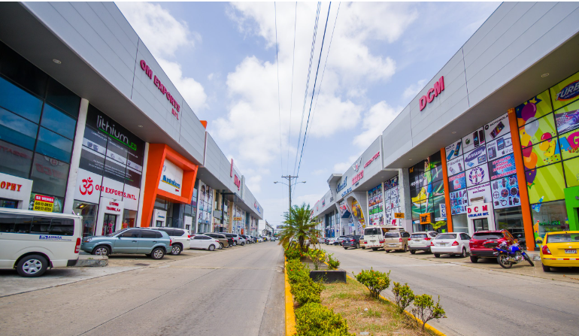
Topic discussion (PA)
ANALYSIS OF COMMERCIAL ACTIVITY IN THE COLON FREE ZONE 2023 - 2024:
Imports 2023 - 2024:
The accumulated imports in the period January-December 2024 vs 2023 registered a total of $12.6 million, reflecting a contraction of 36% compared to the previous year 2023.
The decrease in raw materials for the production of medicines in 2024 affected the imports in Colon Free Zone.
The countries with more participation in imports last year were:
Mainland China with 36%, followed by the United States of America with 20%, Belgium with 4%, followed by Mexico with 3%, France with 2% and Italy with 2%, which represent 67% of the total imports recorded for this period.
43

Slide 44
Topic discussion (PA)
Exports 2023 - 2024:
The accumulated re-exports in the period January-December 2024 vs 2023 registered a total of $12.3 million, reflecting a contraction of 8% compared to the previous year 2023.
The decrease was due to the increase of the direct shipments from Asia to Latin America.
The countries with more participation in exports last year were:
Venezuela with 9%, Costa Rica with 8%, Guatemala with 7%, followed by Colombia with 7%, Dominican Republic and the United States of America both with a share of 6%, El Salvador with 5%, Honduras with 5% and Chile with 4% respectively, representing 64% of the total re-exported.
44

Slide 45
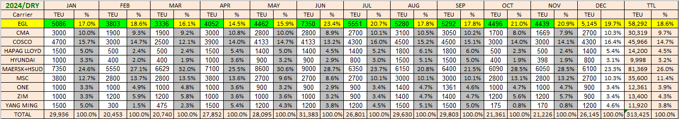
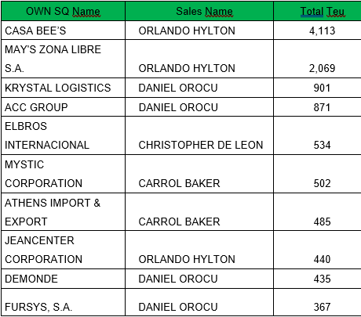
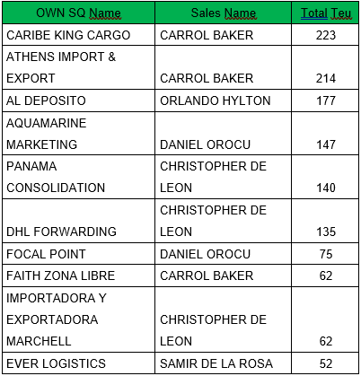



Topic discussion (PA)
Market share and Loading volume prospect 2024 (Long Haul)
2024 / Top 10 import and export account
45

Slide 46
08
PRIS
(PUERTO RICO)

Slide 47
Performance/Space(2024) and 2025 Market Review (PR)
Subject | Segments | BCC | 2024 Target TTL Loading(TEU) | 2024 JAN~DEC TTL Loading(TEU) | Achievement (%) | 2025 JAN~DEC TTL Loading(TEU) | Market Review & Action Plan (How to achieve 2025 target?)
 |  |  | (A) | (B) | (B)/(A) | Target
Trade Lane | F.E. => PR IMP. (618 Trade) | LAD | 6,511 | 9,247 | 142% | 9,800 | Market in PR is expected to remain the same. In 2025 since we keep loosing support from all A/C‘s in PR. Specially from our contract A/C‘s which is our core. The only solution is to stabilize CAN service and provide reasonable transit times and fast cargo allocations at POL‘S.
 | PR ⬄ CARI (609+610 Trade) | EGA-ATC | 830 | 354 | 43% | 500 | We keep loosing support due to the fact we don‘t have a stable service. We need to stabilize service to regain support from A/C‘S and have a higher cargo goal.
47

Slide 48
Performance/Space(2024) and 2025 Market Review (PR)
Subject | Segments | BCC | 2024 Target TTL Loading(TEU) | 2024 JAN~DEC TTL Loading(TEU) | Achievement (%) | 2025 JAN~DEC TTL Loading(TEU) | Market Review & Action Plan (How to achieve 2025 target?)
 |  |  | (A) | (B) | (B)/(A) | Target
Trade Lane | PR ⬄ WCSA (619+620 Trade) | ELA | 250 | 0 | 0% | 10 | Major export cargo is scrap which is very limited the selection allowed to be handled by our HQ. We haven‘t been able to compete with low market rate. In addition, we don‘t have a reliable service.
 | PR ⬄ WCCA+CARO (622+623 Trade) | ELA | 850 | 44 | 5% | 70 | Major export cargo is scrap which is very limited the selection allowed to be handled by our HQ. We haven‘t been able to compete with low market rate. In addition, we don‘t have a reliable service.
48

Slide 49
Topic discussion (PR)
Commercial side:
Our office can’t sell a service that is not reliable and is unpredictable . EMC has always been recognized in the PR market as one of the most reliable carriers, yet in the past years specially in 2024 and beginning of 2025 this is not the case. At the moment, EMC is considered as the most unreliable carrier in PR.
Future Plan Suggestion:
Our suggestion is a total logistic reorganization regarding the CAN service. For the past years, ELA hasn’t been able to find viable solutions which has made situation worsen. In addition, we suggest our office should have information on how much space will be granted per vessel to PR from Asia ports this will help provide more precise data to A/C’s. Lastly, web page needs to have more accurate data. In 2024 data was not updated; therefore, A/C’s couldn’t get correct information.
49

Slide 50
Topic discussion (PR)
Future market forecast in 2025 (Pessimistic / Optimistic / Remain the same)?
Economic background:
Puerto Rico economy is expected to have a moderate growth. It all depends in Federal aid and overall economic climate.
Market share and Loading volume prospect 2025 (Long Haul):
Considering actual service we can only forecast EMC market share decrease. If service improves we understand at least a 15% market share increase can be seen.
 | Get worse | Improve | Stay the same
2025 |  |  | X
50

Slide 51
Market share and Loading volume prospect
(prospect based on actual service)
51

Slide 52
ECD/IMD Topic discussion (PR)
ECD KPI | ITEM | 2023 | 2024 | Diff | Action Plan in 2025
ECD KPI | Storage | 0 | 0 | 0 | NONE
 | Lift on/off | Full - $156.68 Empty - $150.93 | Full - $161.38 Empty - $155.46 | Full - $4.70 Empty - $4.53 | TERMINAL CONTRACT IS NEGOTIATED DIRECTLY WITH TPE.
 | Reposition | 10,212 | 10,645 |  | CONTINUE LOADING AS MUCH POSSIBLE.
 | M & R | N/A | N/A | N/A | N/A
IMD KPI | Cost Saving Project | N/A | N/A | N/A | N/A
 | 90% Onboard within 7 Days | N/A | N/A | N/A | N/A
 | No Personal Negligence | N/A | N/A | N/A | N/A
Aged Container Selling / Free Reposition Plan
  Available cntrs. to sell are sold in weekly manner.
  Free reposition plan needs to be discussed with terminal directly
52

Slide 53
OCD/OPD Topic discussion (PR)
 | ITEM | 2023 | 2024 | Diff | Action Plan in 2025
OPD KPI | BOA | 100% | 100% | 0%
 | Port Stay | 97.94% | 94.20% | 3.74%
 | Productivity | 48.60% | 45.59% | 3.01%
OCD KPI | Incentive | 0 | 0 | 0
 | Empty Storage | 0 | 0 | 0 | NO EMPTY STORAGE AT PR
 | Rate Reduction | 0 | 0 | 0 | NO EMPTY STORAGE AT PR
Topic
Terminal info update (expansion/dredge/crane)
  No information has been confirmed by terminal regarding expansion, dredge or cranes.
53

Slide 54


