Slide 1
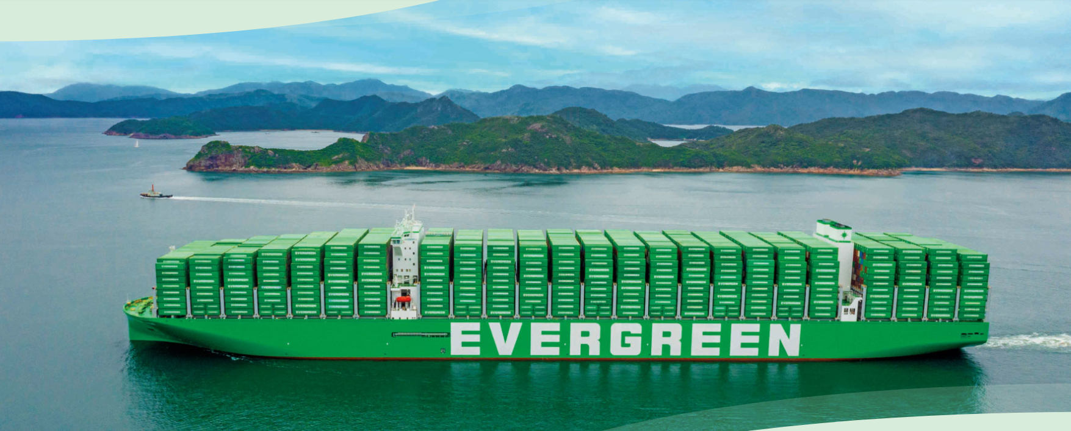
2025
LAAM FTF Meeting (WCSA)
By LAD/EGA/ELA 2025.FEB.27~28
By LAD/EGA/ELA

Slide 2
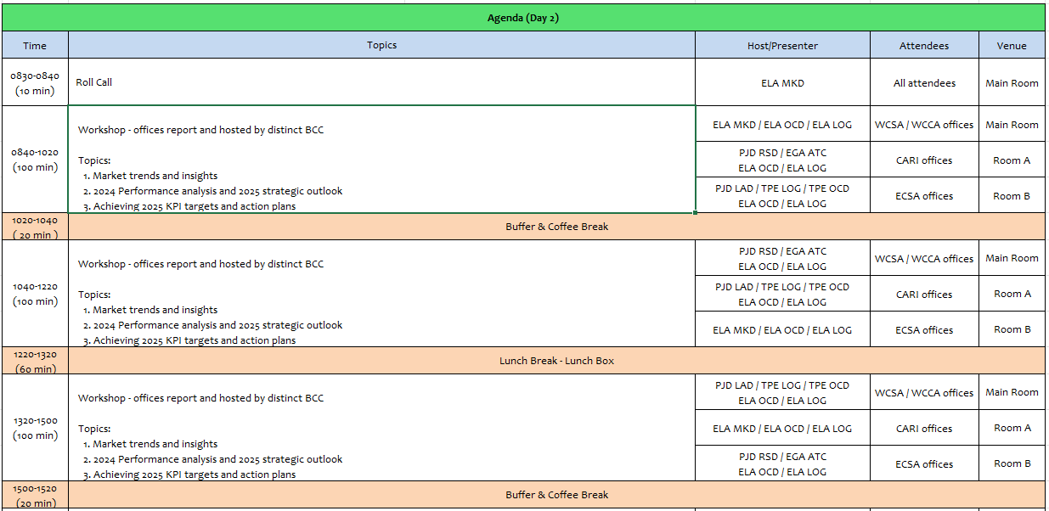
2

Slide 3
17
ECL
(CHILE)

Slide 4
Performance/Space(2024) and 2025 Market Review (CL)
Subject | Segments | BCC | 2024 Target TTL Loading(TEU) | 2024 JAN~DEC TTL Loading(TEU) | Achievement (%) | 2025 JAN~DEC TTL Loading(TEU) | Market Review & Action Plan (How to achieve 2025 target?)
 |  |  | (A) | (B) | (B)/(A) | Target
Trade Lane | F.E. => CL IMP. (G Trade) | LAD | 6,870 | 8,454 | 123% | 9,768
 | CL EXP. => F.E. (Y Trade) | LAD | 28,293 | 30,502 | 108% | 14,163
4

Slide 5
Performance/Space(2024) and 2025 Market Review (CL)
Subject | Segments | BCC | 2024 Target TTL Loading(TEU) | 2024 JAN~DEC TTL Loading(TEU) | Achievement (%) | 2025 JAN~DEC TTL Loading(TEU) | Market Review & Action Plan (How to achieve 2025 target?)
 |  |  | (A) | (B) | (B)/(A) | Target
Trade Lane | CL ⬄ USEC (619+620 Trade) | ELA | 3,100 | 2,826 | 91% | 3,100
 | CL ⬄ WCSA (WS Trade) | ELA | 6,600 | 4,947 | 75% | 5,500
 | CL ⬄ WCCA (CW+WC Trade) | ELA | 3,190 | 4,101 | 129% | 4,100
5

Slide 6
Topic discussion (CL)
Commercial side:
6

Slide 7
Topic discussion (CL)
Future Plan Suggestion:
7

Slide 8
Topic discussion (CL)
Future market forecast in 2025 (Pessimistic / Optimistic / Remain the same)?
Economic background.
 | Get worse | Improve | Stay the same
2025
8

Slide 9
ECD/IMD Topic discussion (CL)
ECD KPI | Item | 2023 | 2024 | Diff | Action Plan in 2025
ECD KPI | Storage
 | Lift on/off
 | Reposition
 | M & R
IMD KPI | Cost Saving Project
 | 90% Onboard within 7 Days
 | No Personal Negligence
Topic
9

Slide 10
OCD/OPD Topic discussion (CL)
 |  | 2023 | 2024 | Diff | Action Plan in 2025
OPD KPI | BOA
 | Port Stay
 | Productivity
OCD KPI | Incentive
 | Empty Storage
 | Rate Reduction
Topic
10

Slide 11
18
ECO
(COLOMBIA)

Slide 12
Performance/Space(2024) and 2025 Market Review (CO)
Subject | Segments | BCC | 2024 Target TTL Loading(TEU) | 2024 JAN~DEC TTL Loading(TEU) | Achievement (%) | 2025 JAN~DEC TTL Loading(TEU) | Market Review or Action Plan (How to achieve 2025 target?)
 |  |  | (A) | (B) | (B)/(A) | Target
Trade Lane | F.E. => COBVT IMP. (G Trade) | LAD | 11,883 | 12,965 | 109% | 14,710
 | COBVT EXP. => F.E. (Y Trade) | LAD | 1,806 | 1,929 | 97% | 2,151
 | COBVT ⬄ USEC (619+620 Trade) | ELA | 1,800 | 1,364 | 76% | 1,800
 | COBVT ⬄ WCSA (WS Trade) | ELA | 9,650 | 10,317 | 107% | 11,000
 | COBVT ⬄ WCCA (CW+WC Trade) | ELA | 1,150 | 3,699 | 321% | 100
12

Slide 13
Performance/Space(2024) and 2025 Market Review (CO)
Subject | Segments | BCC | 2024 Target TTL Loading(TEU) | 2024 JAN~DEC TTL Loading(TEU) | Achievement (%) | 2025 JAN~DEC TTL Loading(TEU) | Market Review or Action Plan (How to achieve 2025 target?)
 |  |  | (A) | (B) | (B)/(A) | Target
Trade Lane | F.E. => CO3 IMP. (C Trade) | LAD | 3,989 | 5,333 | 134% | 5,390
 | CO3 ⬄ CARB (CC Trade) | EGA-ATC | 3,740 | 2577 | 69% | 3,500
 | CO3 ⬄ USEC (609+610 Trade) | EGA-ATC | 1,040 | 701 | 67% | 1,040
 | CO3 ⬄ WCSA (CW+WC Trade) | ELA | 350 | 153 | 44% | 50
 | CO3 ⬄ WCCA (CB Trade) | ELA | 450 | 10 | 2% | 10
13

Slide 14
Topic discussion (CO)
Commercial side:
Market Overview
Future Suggestion
14

Slide 15
Topic discussion (CO)
Future market forecast in 2025 (Pessimistic / Optimistic / Remain the same)?
Economic background.
 | Get worse | Improve | Stay the same
2025
15

Slide 16
Topic discussion (CO)
Market share and Loading volume prospect 2025 (Long Haul)
16

Slide 17
ECD/IMD Topic discussion (CO)
ECD KPI | Item | 2023 | 2024 | Diff | Action Plan
 | Storage
 | Lift on/off
 | Reposition
 | M & R
IMD KPI | Cost Saving Project
 | 90% Onboard within 7 Days
 | No Personal Negligence
17

Slide 18
OCD/OPD Topic discussion (CO)
 | Item | 2023 | 2024 | Diff | Action Plan
OPD KPI | BOA
 | Port Stay
 | Productivity
OCD KPI | Incentive
 | Empty Storage
 | Rate Reduction
18

Slide 19
19
EECU
(ECUADOR)

Slide 20
Performance/Space(2024) and 2025 Market Review (EC)
Subject | Segments | BCC | 2024 Target TTL Loading(TEU) | 2024 JAN~DEC TTL Loading(TEU) | Achievement (%) | 2025 JAN~DEC TTL Loading(TEU) | Market Review & Action Plan (How to achieve 2025 target?)
 |  |  | (A) | (B) | (B)/(A) | Target
Trade Lane | F.E. => EC IMP. (G Trade) | LAD | 1,916 | 2,476 | 129% | 3,164 | MARKET REVIEW: Recover shipments lost from Southeast Asia (light cargo) with BCC support. China shipments under FAK terms with special negotiations based on market trends. SC being signed with NEW A/C MERCHANT GERARDO ORTIZ E HIJOS CIA. LTDA (Minimum Quantity Commitment: 3,000 TEU, over 60 TEU per week). MABE 2025 Bid: A/C increased their forecast by 40% compared to 2024. Face-to-face meeting (Round 3) scheduled for February 18th. ACTION PLAN: Maintain communication with BCC to report on market trends. Communicate with BCC to obtain competitive quotes for our own SQ. Develop new clients and maintain relationships with existing clients for AMP.
 | EC EXP. => F.E. (Y Trade) | LAD | 6,302 | 6,714 | 107% | 6,841 | MARKET REVIEW: Recover our Teak Wood shipment volume to India (20-foot container market), targeting a 1% ECM market share in 2024. Increase our Cocoa Bean shipments to Southeast Asia (40-foot container market). We lost our number one ranking in this market, and our 2024 EMC market share target is 19%. Increase our shipments of refrigerated goods (Fresh Bananas, Frozen Seafood, Broccoli) to China, Japan, and Taiwan. The 2024 EMC market share target is 3%. ACTION PLAN: Increase our space allocation on Asian services to recover Teak wood loads to India and Cocoa loads to Southeast Asia. Optimize our routes for refrigerated cargo by reducing transit times to handle significant volumes, particularly for bananas. Maintain a stock of 100–200 refrigerated containers per week to increase market share, cargo volume, and achieve the 2025 KPI.

Slide 21
Performance/Space(2024) and 2025 Market Review (EC)
Subject | Segments | BCC | 2024 Target TTL Loading(TEU) | 2024 JAN~DEC TTL Loading(TEU) | Achievement (%) | 2025 JAN~DEC TTL Loading(TEU) | Market Review & Action Plan (How to achieve 2025 target?)
 |  |  | (A) | (B) | (B)/(A) | Target
Trade Lane | EC ⬄ USEC (619+620 Trade) | ELA | 2,100 | 208 | 9% | 250 | MARKET REVIEW: If the 619/620 trade can optimize transit times and connections, we will have an opportunity to recover shipments and increase participation to/from the USEC, especially by offering pickup services from the USEC. ACTION PLAN: Improve T/T and connections to regain customer's support.
 | EC ⬄ WCSA (WS Trade) | ELA | 3,600 | 298 | 8% | 250 | MARKET REVIEW: Recover shipment volumes to Chile/Argentina (40RH), focusing primarily on fresh bananas. EMC market share in 2024: 0.16%. Regain dry cargo volumes to Chile and Peru. EMC market share in 2024: 0.06%. PECAL-ECGYE is a highly competitive market. Rates are frequently updated and tend to drop, The WSA2 service is unstable, with COR occurring quite frequently.. COBVT-ECGYE: We lack competitiveness as our service only calls at ECPSJ, while customers continue to prefer GYE. ACTION PLAN: Secure fixed weekly spaces in the feeder service to ensure export of reefer cargo. Establish a regular service with competitive rates for this trade. Coordinate with BCC to obtain competitive quotations for our SQ PECAL-ECGYE.
 | EC ⬄ WCCA (CW+WC Trade) | ELA | 450 | 2,244 | 490% | 1,650 | MARKET REVIEW: In CW trade. Opportunity to participate in MABE BID 2025 for their shipments from MXMZO. We continue to develop GT to the best of our ability with various clients, but primarily with BCOS. In the WC trade, EMC's market share in 2024 was 4% to Central America and 0% to Colombia. ACTION PLAN: To maintain our current negotiations, we require the continued support of BCC. Due to persistent congestion at LAE affecting our export cargo, we require a route review to enable CO2 recovery with minimal transit time.
21

Slide 22
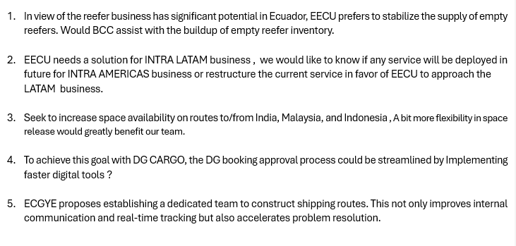
Topic discussion (EC)
Commercial side:
Future Plan Suggestion:
22

Slide 23
Topic discussion (EC)
Future market forecast in 2025 (Pessimistic / Optimistic / Remain the same)?
Economic background.
Ecuador's economy is based on the export of raw materials, such as oil, bananas, shrimp, and gold.
Key points
Economic size The economy is the eighth largest in Latin America and the 69th largest in the world.
Economic sectors The economy is based on mining, agriculture, and fishing.
Economic challenges The country faces challenges such as climate change, energy shortages, and political uncertainty.
Economic growth In 2023, GDP growth was 2.4%, down from 6.2% in 2022. The IMF projects growth of 1.8% in 2024 and 2% in 2025.
Income inequality Income inequality is a problem, with almost half of the rural population living in poverty.
Energy Ecuador is dependent on hydroelectric energy, which was disrupted by a historic drought in 2024.
Oil The oil industry is affected by the maturation of wells, insufficient investment, and a referendum to halt operations in Yasuni National Park.
Remittances Remittances from Ecuadorian emigrants employed abroad contribute to the economy.
Ecuador's economy is also affected by political uncertainty, organized crime, and climate-related events.
 | Get worse | Improve | Stay the same
2025 |  | x
23

Slide 24








Ecuador’s economy is heavily dependent on exports, as these are one of the main sources of foreign exchange earnings in the country.
In 2023, exports accounted for 26.2% of the country’s GDP. In which, Oil represent 62.27% of exports and Non-oil products represent 37.73% of exports
Bananas: Ecuador is the world’s largest exporter of bananas, this industry is generating around 7-10% of total exports.
Frozen Shrimp: The country is one of the leading global exporters of shrimp, with this sector accounting for more than 15% of exports
Cocoa beans: Ecuador leads in the production of fine and flavoured cocoa, which also contributes significantly to agricultural exports.
Non-traditional products such as flowers, tuna, coffee, tropical fruits and superfoods (quinoa, chocho) also contribute to export diversification.

Slide 25
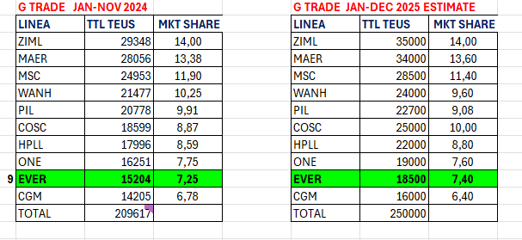
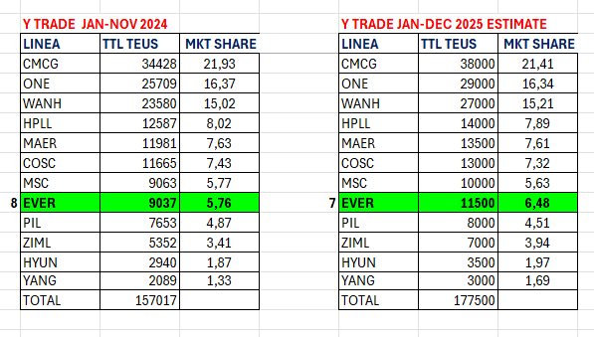
Market share and Loading volume prospect 2024 (Long Haul)
Market share and Loading volume prospect 2025 (Long Haul) (EC)
Market share and Loading volume prospect 2025 (Long Haul)
25

Slide 26
ECD/IMD Topic discussion (EC)
ECD KPI | Item | 2023 | 2024 | Diff | Action Plan in 2025
 | Storage | USD 4,502 | USD 2,899 | 55.29%
 | Lift on/off | USD 20,558 | USD 121,302 | 83.05% | We will keep monitoring and following Line instructions regarding the sale of containers and reposition plan through WSA4 service.
 | Reposition | USD 71,050 | USD 581,315 | 87. 78% | The reposition of empties using WSA4 service (arriving at PSJ) is instructed by our Principals to fullfill the allocation given by Vessel/voyage.
 | M & R | USD 11,119 | USD 4,705 | 136.32% | We only repair dry containers when needed, units that can not be loaded due to heavy damages or to increase the local available stock to cover the export demand, always requesting ELA approval.
IMD KPI | Cost Saving Project | USD 71,050 | USD 563,465 | 87.39% | 2024 was an atypical year in relation to vessel operations of the WSA2 svc, due to the movement limitations given by INARPI terminal, which led us to use the WSA4 svc for the empty reposition out, generating extra trucking costs. With the current change of terminal for the WSA2 service (Contecon), we can resume the regular loading of empties, it will allow us to reduce Reposition costs during 2025.
 | 90% Onboard within 7 Days | N/A | N/A |  | Terminals at Ecuador are not used as regular transshipment ports.
 | No Personal Negligence | N/A | N/A |  | Keep monitoring the pick up of all empty containers arriving at PSJ and need to be moved to ECGYE.
Topic
Aged Container Selling / Free Reposition Plan
  A: Currently we are following Principals instructions to sale aged containers. We have instructed customers to paint the containers and remove all Evergreen markings to avoid any problem for the Line.
  B: Repo In: there is a fumigation cost that is mandatory for all the containers arrived at Ecuador. Repo Out: no extra cost of trucking using WSA2 service arriving at ECGYET (Contecon terminal).
26

Slide 27
OCD/OPD Topic discussion (EC)
 |  | 2023 | 2024 | Diff | Action Plan in 2025
OPD KPI | BOA | 50% | 100% | 50% | Since only one of WSA2's own vessel berths at ECGYE, we will keep monitoring the performance and communicate with ELA/OPS and TPE/OPS any news.
 | Port Stay | 100% | 100% | - | Since only one of WSA2's own vessel berths at ECGYE, we will keep monitoring the performance and communicate with ELA/OPS and TPE/OPS any news.
 | Productivity | 100% | 100% | - | Since only one of WSA2's own vessel berths at ECGYE, we will keep monitoring the performance and communicate with ELA/OPS and TPE/OPS any news.
OCD KPI | Incentive | - |  |  | With the change of terminal of the WSA2 service, there is no negotiated incentive with Contecon based on discharging/loading movements.
 | Empty Storage | - |  |  | No KPI, Contecon and DP World Posorja terminal don’t include free pool for empty transshipment containers under EMC contract.
 | Rate Reduction | - |  |  | Ecuador’s main services, WSA2 and WSA4, has no regular transshipment cargo so there’s no storage or LOLO fees, but when it occurs we manage to revise with the terminals to reduce the extra costs to the Line.
27

Slide 28
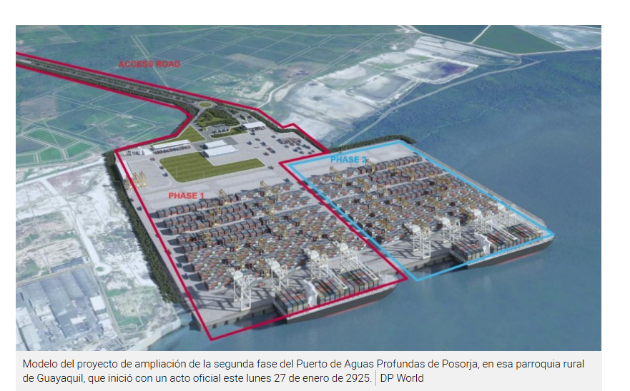
OCD/OPD Topic discussion (EC)
Topic – 2025 Projection
Terminal information update (expansion/cranes)
DPW POSORJA:
  The dock expansion officially began, to cover a total of 700 meters, and it is expected to be
  completed by mid-2026.
  This investment will allow the simultaneous operation of two fully loaded post-Panamax vessels.
  They will also add two more gantry crane to operate the new dock.
CONTECON:
  They have inaugurated the first on-dock cold storage facility for banana exports, in partnership with Cool Carriers.
  This facility is designed to give an uninterrupted cold chain preservation from cargo reception to shipment leading to reduced waiting times, optimized processes, and a guarantee that the fruits reach their destinations in the best possible condition.
  Will increase 2 more gantry crane, to have a total of 8 by the end of 2025.
TPG:
  They also has expansion plans between 2025 and 2030. They have announced an investment to extend the dock from 660 meters to 800 meters in length, as well as the acquisition and renovation of cranes and equipment for container yards and reefer plugs.
  Will increase 2 more gantry cranes by the mid-2026.
28

Slide 29
20
EPE
(PERU)

Slide 30
Performance/Space(2024) and 2025 Market Review (PE)
 | Segments | BCC | 2024 Target TTL Loading(TEU) | 2024 JAN~DEC TTL Loading(TEU) | Achievement (%) | 2025 JAN~DEC TTL Loading(TEU) | Market Review & Action Plan (How to achieve 2025 target?)
 |  |  | (A) | (B) | (B)/(A) | Target
Trade Lane | F.E. => PE IMP. (G Trade) | LAD | 9,185 | 10,622 | 116% | 12,102
 | PE EXP. => F.E. (Y Trade) | LAD | 27,189 | 64,628 | 127% | 38,560
30

Slide 31
Performance/Space(2024) and 2025 Market Review (PE)
Subject | Segments | BCC | 2024 Target TTL Loading(TEU) | 2024 JAN~DEC TTL Loading(TEU) | Achievement (%) | 2025 JAN~DEC TTL Loading (TEU) | Market Review & Action Plan (How to achieve 2025 target?)
 |  |  | (A) | (B) | (B)/(A) | Target
Trade Lane | PE ⬄ USEC (619+620 Trade) | ELA | 4,900 | 3,234 | 66% | 4,000
 | PE ⬄ WCSA (WS Trade) | ELA | 9,300 | 9,430 | 101% | 10,000
 | PE ⬄ WCCA (CW+WC Trade) | ELA | 2,900 | 5,958 | 205% | 3,500
31
31

Slide 32
Topic discussion (PE)
Commercial side:
Future Plan Suggestion:
32

Slide 33
Topic discussion (PE)
Future market forecast in 2025 (Pessimistic / Optimistic / Remain the same)?
Economic background
Market share and Loading volume prospect 2024 (Long Haul)
 | Get worse | Improve | Stay the same
2025
Economic figures | 2024 | 2025 (estimated)
GDP
Inflation
Ex. Rate
 | Market Share |  | Loading Volume - TEU
 | 2024 | 2025 (est.) | 2024 | 2025 (est)
G trade
Y trade
33

Slide 34
ECD/IMD Topic discussion (PE)
ECD KPI | Item | 2023 | 2024 | Diff | Action Plan in 2025
ECD KPI | Storage
 | Lift on/off (container sell)
 | Reposition
 | M & R
IMD KPI | Cost Saving Project
 | 90% Onboard within 7 Days
 | No Personal Negligence
34

Slide 35
OCD/OPD Topic discussion (PE)
 | Item | 2023 | 2024 | Diff | Action Plan in 2025
OPD KPI | BOA KPI : Off slot≧88% /On Slot≧97%)
 | Port Stay KPI : ≧ 97% 28HRS
 | Productivity 72.6MPH
OCD KPI | Incentive
 | Empty Storage
 | Rate Reduction
1
35

Slide 36
