Slide 1
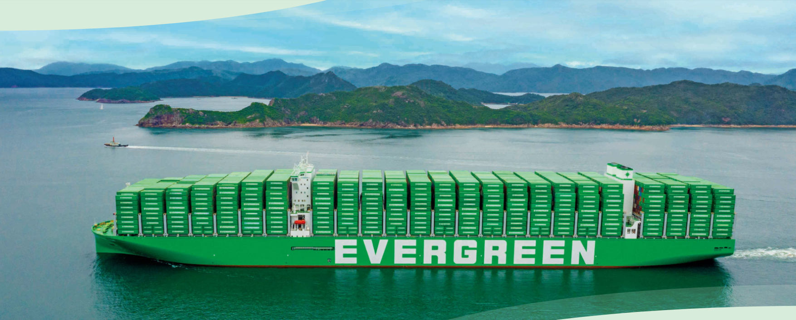
2025
LAAM FTF Meeting (WCSA)
By LAD/EGA/ELA 2025.FEB.27~28
By LAD/EGA/ELA

Slide 2
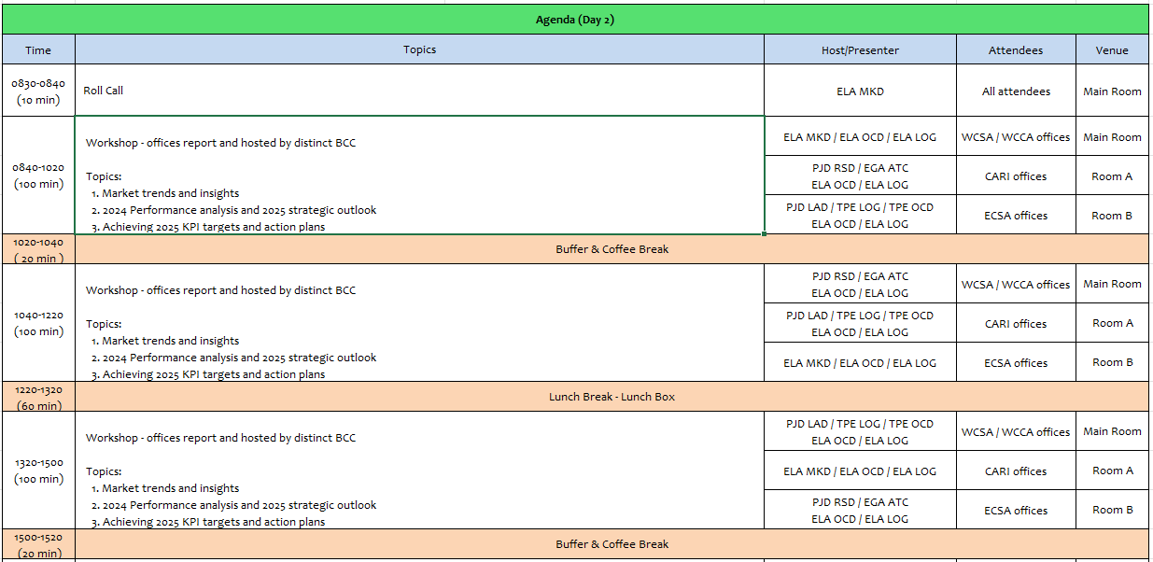
2

Slide 3
17
ECL
(CHILE)

Slide 4
Performance/Space(2024) and 2025 Market Review (CL)
Subject | Segments | BCC | 2024 Target TTL Loading(TEU) | 2024 JAN~DEC TTL Loading(TEU) | Achievement (%) | 2025 JAN~DEC TTL Loading(TEU) | Market Review & Action Plan (How to achieve 2025 target?)
 |  |  | (A) | (B) | (B)/(A) | Target
Trade Lane | F.E. => CL IMP. (G Trade) | LAD | 6,870 | 8,454 | 123% | 9,768 | The market expect that this year the volume will remain as similar than 2024 due the consumers behaviour in the retail sectors. Renew tender accounts Mabe, Comercial Eccsa and Sumitomo Rubber. Recover Walmart tender account and Sindelen BCO with market rate levels with yearly validity. Focus in NAC Business with Eternity, Globe Express, Yusen Logistics, Ceva, and others NVOCC. Maintain and enlarge FAK Business with NVOCC like DP World, Pricer, Expeditors, Gelymar, and others.
 | CL EXP. => F.E. (Y Trade) | LAD | 28,293 | 30,502 | 108% | 14,163 | The dry market expect that this year the volume will remain as similar 2024 without increase in the woodpulp, wine or foodstuff industry. The reefer market like fresh fruit even 2024 already increase with the cherry (30.000 boxes) for 2025 is expected same volume to FE. Remain spot volumes of Woodpulp from central zone around 60-80 teu per week from CLVAL. Close monitoring to possible WCSA service re structure and take the measures in advance to not affect the lifting from CLVAL. Renew Foodstuff tender accounts like G5, Carozzi and Patagoniafresh. Renew Frozen meat tender Agrosuper & Ariztia considering they have regular volumes during the year.
4

Slide 5
Performance/Space(2024) and 2025 Market Review (CL)
Subject | Segments | BCC | 2024 Target TTL Loading(TEU) | 2024 JAN~DEC TTL Loading(TEU) | Achievement (%) | 2025 JAN~DEC TTL Loading(TEU) | Market Review & Action Plan (How to achieve 2025 target?)
 |  |  | (A) | (B) | (B)/(A) | Target
Trade Lane | CL ⬄ USEC (619+620 Trade) | ELA | 3,100 | 2,826 | 91% | 3,100 | The market has been decreasing during the last year around -8.45% compare with 2023 mainly affected the food industry. Customers at US request more coverage in the Inland services in US with competitive level rates.
 | CL ⬄ WCSA (WS Trade) | ELA | 6,600 | 4,947 | 75% | 5,500 | The volumes from PE/CO during 2025 increase in around 26%, the main increase is coming from retail industry. Frozen fruit shipments from PECAL with Andes Logistics and LOGPAR (between 2-4 containers per week). Increase volume from CLSAI to COBVT via MX with beverage and foodstuff customers like Intertank and Unified Foods. Renew with Bagno for the avocado shipments from PECAL (180x4RH per year)
 | CL ⬄ WCCA (CW+WC Trade) | ELA | 3,190 | 4,101 | 129% | 4,100 | CW Trade Main source of cargo comes from Global Tenders (MT contracts) like Nestle, Procter & Gamble, Kimberly Clark, Samsung and others. Renew tenders accounts Mabe and Comercial Eccsa that secure regular volumes from MX and PA. Develop NAC business with NVOCC Eternity, Yusen Logistics and DP World from MX and GT. WC Trade Recover LAE service space available for ECL cargo with competitive level rates. Renew Wine and foodstuff business with JF Hillebrand, Patagoniafresh and Intertank who support us with at least 60 teus per week. Recover RH frozen tenders Agrosuper and Ariztia.
5

Slide 6
Topic discussion (CL)
Commercial side:
Export
Since FEB 2025 no more WSA3 calling CLLQN.
This generate a loss of around 20.000 teus going to FE, having an impact mainly in the forestry industry market participation.
Metal Scrap Restrictions to India:
Since 2nd half of 2024 we are facing restriction in NED service to INNXV and INMUN affecting the volumes with our main customers loading metal scrap like CBP and Vanadium, if the restriction continues during 2025 this will generate a loss of around 5.000 teus.
Import
FAK and NAC Level rates competition from Eastbound.
The feedback from the market is that ECL have a difference of USD 200 higher than competitors what leave us usually out of competition with key customers like Eternity, Yusen Logistics, Globe Express, Sparx and others.
WCSA/WCCA Level rates competition
During 2025 we are facing an increase in the level rates for this trades to CLVAL, leaving us out of the business for example of Sugar from COBVT and maybe from Mabe MX.
6

Slide 7
Topic discussion (CL)
Future Plan Suggestion:
1.Service expansion to Southern Chile.
The 60% of the source of export cargo from Chile is coming from CLLQN/CLSVC/CLCNL, look service option without increase rates levels.
2. Recover Export regional service for WCSA POD’s from Chile.
3.Recover Cherry Service for 2025.
EVGL has been the only carrier in Chile who has not participated in the cherry service during last year. In order to recover our position in this market that have growth in the last year a 25%, we suggest to analyze deplyoing a cherry service for this new season, considering also date of lunar new year in Y-2026 will be on February.
4.WSA+CIX Service Integration.
For the fresh fruit cargo going to India is key to offer a competitive transit time and not increase the actual one we offer, suggest around 35 to 40 days.
Not eliminate the base call to HKHKG considering that is a key terminal for the fresh fruit shipments from Chile.
7

Slide 8
Topic discussion (CL)
Future market forecast in 2025 (Pessimistic / Optimistic / Remain the same)?
Economic background.
The GDP for Y-2025 is expecting to be 2.5% without a huge economic increase for the year comparing with previous, considering at the end of the year, we are going to have a new president election process that create an unstable period.
The external economic uncertain situation after the president election in US, that might also increase the taxes for the copper which is the main income for the country, could generate an unstable inflation (near to 5% during the year) and in increase in the exchange rate, devaluating the Chilean peso.
The retail business which the main import sector in Chile, is expecting continue growing in Y-2025, not with a huge ratio but not lose participation and is monitoring the future of president elections in Chile and possible new action against the informal market candidates will be proposing to revise new investments.
 | Get worse | Improve | Stay the same
2025 |  |  | X
8

Slide 9
ECD/IMD Topic discussion (CL)
ECD KPI | Item | 2023 | 2024 | Diff | Action Plan in 2025
ECD KPI | Storage | USD 533.00 | USD 102,578.00 | -19295% | Exceptional empty units discharged from EVER Lunar 0656-067w due to congestión in MX ports. After, the storage time depended on allocacion available in the next vessels CMRS 076W and FOND 0658-012W and stay in the terminal over 15 days and charge reaching over USD 200, 000 and finally terminal agree to do a 50% of discount. For this year to reduce posible extra cost TPS agreemnet 2025 considers 7 free days for empty roll over containers.
 | Lift on/off | USD 263,867.00 | USD 305,246.00 | -15,68% | Agunsa and DPW LQN collect LOLO for empty containers. During 2024, the repo instruction in Agunsa depots increased around in 2000 boxes and in DPW depot, rates had adjustment of USPPI 1,86% accoridng to agreement conditions. For 2025, the empty LL charges should reduce with the new depot in CLVAL , Medlog doesn´t include LL charges in their current contract.
 | Reposition | USD 532,080.00 | USD 1,020,985.00 | -91,89% | The repo out volumen increased around 63,6% from CL. From CLSCL depot, the empty returne volumen increased 57%, consequently, the relase bookings and repo out volume too. For 2025, WSA services switchs to TPS, as depots are not near to terminal, the Shunting cost is higher than CLSAI depot but considering current situation, we still close a new depot agreement with Medlog which is the near depot to TPS and with the cheaper cost truck.
 | M & R | USD 59,995.00 | USD 75,127.00 | -25,22% | After the safety policy of STI terminal, meaning all corner damages of empty container had to repaired to repo out operation had a direct consequence of cost increase in around 20~25% the M&R expenses every month. For 2025, TPS can receive some empty with damages to repo out. Debris restriction in empty containers of CN china is still valid. All cotainers have to move without debris inside to avoid customs penalties in 2025 that will continue impacting the cost. For 2025, double checking with depots to verified if EOR costs are accordnlgly.
IMD KPI | Cost Saving Project | 0 | 0 | 0% | DPW LQN depot provided the rates extension until at the end of year. Liventus services extended their rates one year without increase. CLSAI depots ( Agunsa, Sitrans and DYC) maintain shunting rate without changes during all 2024.
 | 90% Onboard within 7 Days | 0 | 0 | 0% | NIL
 | No Personal Negligence | 0 | 0 | 0% | NIL
9

Slide 10
OCD/OPD Topic discussion (CL)
 |  | 2023 | 2024 | Diff | Action Plan in 2025
OPD KPI | BOA | 85% | 100% | +18% | WSA services switched to TPS ( Valparaiso) since January 2025 to guarantee better conditions to vessel schedules In Valparaiso terminal in general, the weather conditions has less impact in the vessel Operations for geographic possition. Constantly monitoring to secure the window, vessel priority and proforma berthing on time.
 | Port Stay | 100% | 100% | 0% | TPS ( Valparaiso) has better conditions to guarantee the schedule of berthing and unberthings. Monitoring vessel work planification to guarantee the conditions are in order.
 | Productivity | 57,1 MPH | 61 MPH | +6,8% | WSA service since 2025 is working in TPS and the commitment from TPS is providing around 60 – 70 moves per hour deducting the legal resting time considering 3 cranes per vessel, but in the case the operation is tight they are willing to add one additional resource in the case is possible working with 4 cranes per vessel to reach the target of MPH we are expecting.
OCD KPI | Incentive | 41,435 (Boxes) | 56,644 (Boxes) | +36,70% | In the same line, the productivity increased can guarantee the discharging/ loading movements per vessel covering approiated To near work with BIZ department and terminal facilities, to promote the Export and import volumes.
 | Empty Storage | USD 710.00 | USD 86,200.00 | -12141% | STI: Due to the congestion at MXLZC, EVER LUNAR (LUNR) 0656-067E arrived to CL were stored almost a month in terminal. DPW LQN Terminal: extend one year more the rate agreement without USPPI adjustment. For 2025, keep constantly monitoring of potential situation to report to HQ and inform changing in local practices by Chilean authorities.
 | Rate Reduction | 0 | 0 | NIL | DPW LQN Terminal: extend one year more the rate agreement without USPPI adjustment. STI: extended contract until EVER LIBRA 0705-076W (sailing date 20250103). Checking opportunities to get better rates and local conditions.
10

Slide 11
