Slide 1
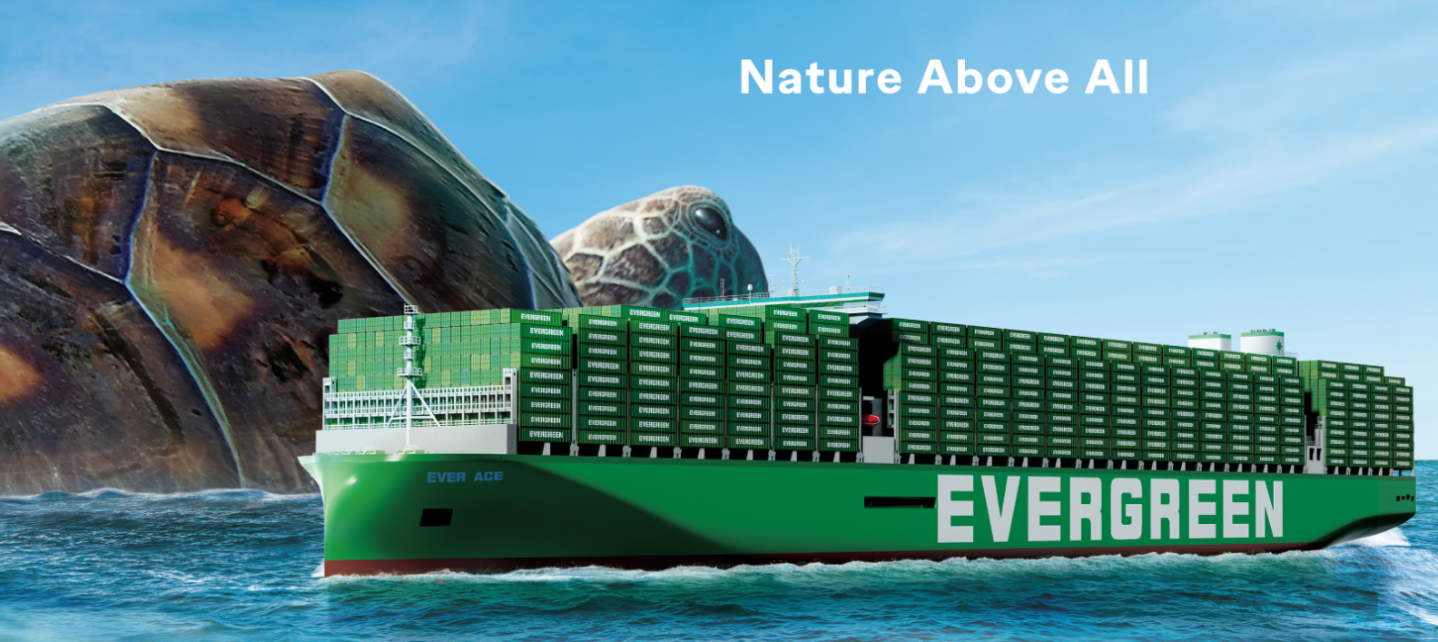
2025
LAAM Meeting (ECSA)
By LAD/EGA/ELA 2025.FEB.27~28

Slide 2
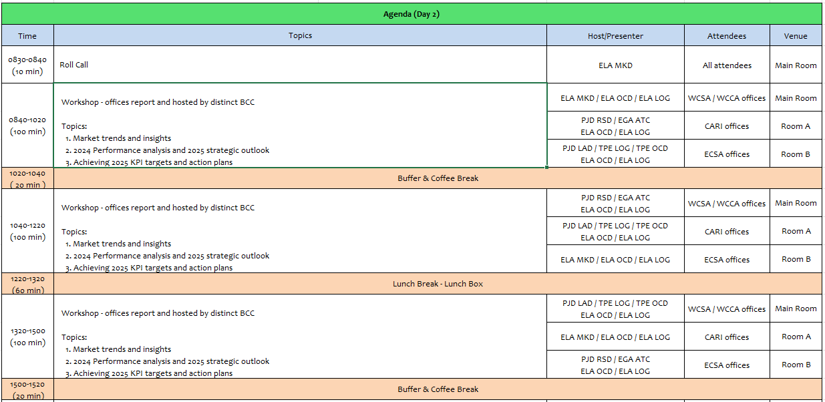
2

Slide 3
13
EUY
(URUGUAY)

Slide 4
Performance/Space(2024) and 2025 Market Review (UY)
Subject | Segments | BCC | 2024 Target TTL Loading(TEU) | 2024 JAN~DEC TTL Loading(TEU) | Achievement (%) | 2025 JAN~DEC TTL Loading(TEU) | Market Review & Action Plan (How to achieve 2025 target?)
 |  |  | (A) | (B) | (B)/(A) | Target
Trade Lane | F.E. => UY IMP. (5 Trade) | LAD | 1,907 | 1978 | 104% | 2,700 | 1.Target of 11.149 teus with 49 vessels (Budget). 2.Own SQ Target of 54 teus/wk (2700 teus in 50 weeks considered by BCC). 3.Recover Repremar and Central Cargo. Target accounts: Ceva, Pluscargo, Terramar, Enza y Belya, Santa Rosa. Enhance Tradeline. 4.Win KIA´s tender, which is announced to have a volumen of 35% increase in comparison with 2024. 5.To get and loyal at least 2 long term or (SC) or name account in 2025. 6.Revise local surcharges in 2025: increase THC usd10, increase DM/DT usd5 in 20´and usd10 in SH and RH probably starting as from June.
 | UY EXP. => F.E. (6 Trade) | LAD | 6,838 | 7,871 | 115% | 8,250 | 1.Target of 8.250 teus in 2025. 2. Reefer KPI: 2000 boxes in 2025 (loaded in 2024 1684 boxes) increase of 18%. In order to accomplish our RF KPI we plan to: Meat: Win meat tenders Marfrig and Minerva. Increase 18% our volume vs 2024. Fish: increase 27% (incl. squid, depending on the season) this will be determined by a positive schedule improvement, specially during season. 3.As reference, 74% of Uruguay´s export commodities in vol belong to meat, fish, dairy and Wood. Dairy: Increase 5% in comparison to total vol loaded in 2024. Main dest: Philippines 40%, Middle East 30%, China 30%. Wood: We have already increased 24% of our Wood vol in 2024 (market grew 18%), so the target is to maintain wood vol in 2025 or increase if possible. 3.Other commodities: as bone meal/stones/wool/leather: keep some portion to be in touch with these commodities exporters, but in a situation of limited space, we have no option than to focus in higher paying cargo. We have quoted bone meal in tender agreements such as Minerva, so we will continue loading this commodity this year. Also Cardama via Greenx. 4.Greenx: we reached 7teu/wk in 2024, the target KPI for 2025 is 40 teu/month. Win Sadesa tender in next 6 month period, we won part last period but cargo deviated with ONE and HMM due to quicker t/ts.
4

Slide 5
Topic discussion (UY)
Commercial side:
➔Top 4 export commodities in Uruguay are meat, wood, fish and dairy (74% of total exports to Asia).
Reefer vol in our market fell -23% in 2024 vs previous year, mainly because meat decreased to Asia. We decreased only -3,8%.
➔As action plan, we aim at increasing 18% our meat vol and 27% our fish/squid vol in order to accomplish our Reefer KPI target of 2000 boxes in 2025 (in 2024 we loaded 1683x40´RH). Meat decreased in 2024 (-20%) however we managed to increase our market share from 10% in 2023 to 11,7% in 2024. Fish/squid decreased (-33%) in 2024 however we managed to increase our market share from 19,6% in 2023 to 38,5% in 2024.
Wood market increased 18% in 2024, we also increased from having the 11% market share in 2023 to 11,6% market share in 2024 (our growth was 24% 2886 teus) we plan to maintain this year, and focus on other better paying commodities such as reefer and wood pulp.
Dairy market increased 12% in 2024, we passed from having 16% of the market in 2023 to 48% in 2024 (our growth was 233%). Main destinations is Philippines (Manila, Cebu) and an important increasing vol in Middle East (Jeddah, Damman, Hamad, Jebel Ali).
5

Slide 6
Topic discussion (UY)
Future Plan Suggestion:
EB
➔More regular schedules.
➔Quicker booking confirmations:
-pending of allocation of BCC Panama.
-pending on the 2nd leg. -pending for getting approval for EQC for deliver Smart.
-pending of unclaimed at destination. -no routing available, we have to request special or operational routings to Panama.
➔More space in 2nd leg connections:
WB
➔More available NOR equipment in main direct pols.
➔Support own sq base cargo, with main FF (mentioned below).
➔During 2024 almost 90% of cargo belonged to FF
40% of cargo is handle by the top 10 of WB customers, from those 10 only 4 can nego rate at our side (Pluscargo, CEVA, Repremar and ULSA)
Plan: Pluscargo 150 teus, Repremar 150 teus, CEVA 50 teu.
➔Fixed allocation for main FF with previpous forecast by port informed to TPE.
Service name | Final destination | Via | Teus needed | Important because:
AGI | AEJBA y THLCH | SGSGP | 15 | Increasing Dairy volume, connections to Middle East (Jeddah, Damman, Hamad) and Sadesa Tender main port THLCH.
CPH | PHMJJ | TWKSG | 6 | Increasing Dairy volume.
KTP | PHMNL | HKHKG | 12 | Increasing Dairy volumen and Wood.
CMEX | AQHMD - SADMN | AEJBA | 8 | Increasing Dairy volumen and Wood.
JTH Y NSA | PHCEB | HKHKG -TWKSG | 6 | Increasing Dairy volume.
CIX2 | CNXGA | SGSGP | 18 | Main destination for meat. Marfrig requested to t/s at SGSGP i/o HKHKG.
6

Slide 7
Topic discussion (UY)
Future market forecast in 2025 (Pessimistic / Optimistic / Remain the same)?
Economic background.
The World Bank foresees a growth of 2,6% GDP for the Uruguayan economy in 2025 and 2026.
BCU estimates that our economy grew 3,5 in 2024 (data will be finished in Mar).
Inflation rate 5,49% in 2024
Exchange rate: 43,96 pesos per dollar.
Unemployment: 7,3%
2024 was election year. Socialist party won. More public spending expected for the next period.
Market share and Loading volume prospect 2025 (Long Haul)
 | Get worse | Improve | Stay the same
2025 |  |  | v
 |  |  |  |  |  |  |  | RF
Mkt Share |  | 2023 Jan-Dec | 2024 Jan-Dec | Market Evolution | EGL Evolution |  |  |  | Jan-Dec 2023 | Jan-Dec 2024 | Increase
EB | Market: | 60598 | 65863 | 8,8% | 18% |  |  | Market | 29442 | 22675 | -23%
 | EGL: | 6737 | 7960 |  |  |  |  | EGL | 3500 | 3366 | -3,8%
WB | Market: | 103101 | 116425 | 12,9% | 4,6%
 | EGL: | 10617 | 11104
7

Slide 8
Market Share (UY)
 |  |  |  | MARKET SHARE
Impo Jan-Dec 2025 |  |  | DRY |  |  |  | REEFER
Lines | 20 | 40 | TEUs | % | 20 | 40 | TEUs | %
MAERSK | 3603 | 12945 | 29493 | 25,57 | 0 | 32 | 64 | 6,67 | 29557 | 25,4%
MSC | 1974 | 5907 | 13788 | 11,95 | 0 | 11 | 22 | 2,29 | 13810 | 11,9%
EVERGREEN | 350 | 5347 | 11044 | 9,48 | 0 | 30 | 60 | 6,46 | 11104 | 9,5%
ONE | 1370 | 4266 | 9902 | 8,58 | 2 | 87 | 176 | 18,33 | 10078 | 8,7%
PIL | 771 | 4017 | 8805 | 7,63 | 0 | 11 | 22 | 2,29 | 8827 | 7,6%
HMM | 526 | 3893 | 8312 | 7,21 | 0 | 62 | 124 | 12,92 | 8436 | 7,2%
HAPAG | 1400 | 3210 | 7820 | 6,78 | 3 | 102 | 207 | 21,56 | 8027 | 6,9%
CMA-CGM | 766 | 3528 | 7822 | 6,78 | 1 | 68 | 137 | 14,27 | 7959 | 6,8%
COSCON | 447 | 3724 | 7895 | 6,84 | 0 | 20 | 40 | 4,17 | 7935 | 6,8%
ZIM | 357 | 3313 | 6983 | 6,05 | 0 | 22 | 44 | 4,58 | 7027 | 6,0%
YANG MING | 93 | 1168 | 2429 | 2,11 | 0 | 27 | 54 | 5,62 | 2483 | 2,1%
OOCL | 18 | 390 | 798 | 0,69 | 0 | 4 | 8 | 0,83 | 806 | 0,7%
SHIPPER OWN | 188 | 94 | 376 | 0,33 |  |  |  |  | 376 | 0,3%
SEALAND |  |  |  |  |  |  |  |  | 0 | 0,0%
Totales | 11.863 | 51.802 | 115.467 | 100 | 6 | 477 | 958 | 100 | 116.425 | 100%
 |  |  |  | MARKET SHARE
Expo jan-dec 2024 |  |  | DRY |  |  |  | REEFER
Lines | 20 | 40 | TEUs | % | 20 | 40 | TEUs | % | %
HMM | 647 | 3018 | 6683 | 15,56 | 0 | 2261 | 4522 | 19,97 | 19,97 | 11205 | 17,0%
MAERSK LINE | 108 | 3325 | 6758 | 15,74 | 0 | 1171 | 2342 | 10,34 | 10,34 | 9100 | 13,8%
COSCON | 680 | 2433 | 5546 | 12,92 | 0 | 1359 | 2718 | 12 | 12 | 8264 | 12,5%
EVERGREEN | 80 | 2257 | 4514 | 10,5 | 0 | 1683 | 3366 | 14,8 | 14,8 | 7960 | 12,1%
ONE | 539 | 2178 | 4895 | 11,4 | 2 | 1166 | 2334 | 10,31 | 10,31 | 7229 | 11,0%
PIL | 797 | 2160 | 5117 | 11,92 | 0 | 600 | 1200 | 5,3 | 5,3 | 6317 | 9,6%
HAPAG | 245 | 1758 | 3761 | 8,76 | 3 | 436 | 875 | 3,86 | 3,86 | 4636 | 7,0%
CMA-CGM | 24 | 1146 | 2316 | 5,39 | 0 | 1068 | 2136 | 9,43 | 9,43 | 4452 | 6,8%
MSC | 233 | 763 | 1759 | 4,1 | 0 | 1018 | 2036 | 8,99 | 8,99 | 3795 | 5,8%
YANG MING | 104 | 566 | 1236 | 2,88 | 0 | 365 | 730 | 3,22 | 3,22 | 1966 | 3,0%
ZIM | 1 | 251 | 503 | 1,17 | 0 | 173 | 346 | 1,53 | 1,53 | 849 | 1,3%
OOCL | 16 | 13 | 42 | 0,1 | 0 | 35 | 70 | 0,31 | 0,31 | 112 | 0,2%
SHIPPER OWN | 0 | 29 | 58 | 0,14 |  |  |  |  |  | 58 | 0,1%
Totales | 3.474 | 19.732 | 43.188 | 100 | 5 | 11.335 | 22.675 | 100 | 100 | 65.863 | 100%
8

Slide 9
ECD/IMD Topic discussion (UY)
ECD KPI | Item | 2023 | 2024 | Diff | Action Plan in 2025
ECD KPI | Storage | 51387 | 90052 | 38665 (43%) | 2024 increase 43% due to delays in the schedule vessels mainly in STO and NVT and cancelled calls for Partners vessel affecting the repo out has inceased the costs,. Anyway we work together with Empty Depot to minimize long idlings, we report all empties daily and we closely monitor and instruct depot to deliver according to FIFO and avoid storage costs. We asked depot to analyze all storage costs and report back to us on monthly basis.
 | Lift on/off | 41014 | 35775 | -5239 (-13%) | Closely work together with STL to minimize this cost, but will depend on the empty cntr movements
 | Reposition | 47895 | 51187 | 3292 (6%) | Reason: Empty repo out, mainly 4SH back to Asia. Uy´s general imbalance (40% EB / 60% WB), but will continue work to shorten said avg
 | M & R | 981 | 813 | -168 (-17% ) | Only RF repairs are done at our side, very few dry mainly due to emergency repairs or special cases
IMD KPI | Cost Saving Project | 6951,83 | 1563,5 | -5388,33 (-77%) | Corresponding to terminal UYMVDT storage bonus (discounts),
 | 90% Onboard within 7 Days | PYASU: 9,7 BRRGR: 6,5 | PYASU: 15,75 | 6 ( 38% ) | Work together with PY office to improve mainly tts to PYASU, but depends of sailing schedules for the mothers vessel that sufer delays. we follow instruction to connect in the next vessel available and keep contact with ELA
 | No Personal Negligence | 0 | 0 | 0
Topic: Aged Container Selling
 | 2023 | 2024
Total cnts | 651 | 630 |  | * Incl. Commisions and taxes (IRNR)
Total Monto | USD1.309056 | USD 1.258076
9

Slide 10
OCD/OPD Topic discussion (UY)
 |  | 2023 | 2024 | Diff | Action Plan in 2025
OPD KPI | BOA | 67% | 90% | 23% | In 2024 55% of Evergreen´s vessels arrived out of proforma. MCN don´t operate more than one vessel at the same time. As action plan, at the end of 2024, a new pier for fishing vessels (Puerto Capurro) was lunched to start operations. This will release current pier (10-11) and half of Pier C . During December 2024 the Pier C has begin to used for containers vessel due to Cruise seasons so it will decongest and provide more pier availability.
 | Port Stay | 75% | 80% | 5% | During Jan to Mar of 2024 Terminal had stuff short worker affected the Port Stay but since April we work closely with Terminal to improve the KPI and they followed concrete acctions which have a possitive impact reducing about 6% of Port Stay for Evergreen’s vessel . As action plan for 2025 Will be that MCN continue working to reducing dead hours.
 | Productivity | 89% | 120% | 31% | We are constantly pushing to MCN to improve produtivity and they have made changed in the operative structue with possitve result improve about 13% for Evergreen’s vessels. It is expected to continue work to improve in 2025
OCD KPI | Incentive | 300,000 | 300,000 |  | It was accomplished in 2023 & 2024. We are trying to keep working to reach the requirement and receive incentive in 2025 again.
 | Empty Storage | 19667 | 28140 | 8473 (30%) | Explanation: storage of empties due to vessel´s schedules delays and roll overs. As Action Plan we will work with MCN to request cost reductions when these cases occur.
 | Rate Reduction |  |  |  | Signed contract with both Empty Depot and Terminal was carry out on Jan /2025, Montecon offer 50 units entrance tot the Terminal for repo out in order to reduce trucking cost . As TW/EQD suggest the issue of repairing/washing, EUY is further discussing with MONTECON/relative parties to seek the way to process.
Topic Boa and Port Stay: Considered in the figures 20 calls during 2024
Terminal info update:
-1) The Access Channel dredging to 14 meters already started in 2024/2025
-2) in 2024 the National Port Authorities ( ANP ) anounced that vessel with 51meters of breath and 336m of Loa can be operated by Montecon in Pier “C”
-3) The work in TCP are delayed so we can think first part expected to be ready in 2025 ( Q3) but it would not be.
Jan De Nul is the company designated to do the expansion Works which started in 2022 and are supposed to finish in 2025 ( second semester ) but that presently situation is that The works are delayed due to claims between the Jan De Nul companies and their outsourced, which is causing delay the completion of the work. In addition, due to the change of the government, the new administration was against the project of the expansion, which could further delay more the completion of the work. We are monitor closer the developments.
-4) Presently Evergreen has signed a Contract with Montecon for 3 years (20250101~20271231).
-5) Another topic is situation about of the vessels with 336mtx51mtrs . According to new information received it seems PIL is planned to deploy one vessel with such dimensions “ KOTA EBONY Phase in SHG on Feb/28 and expecting to arrives to MVD on Apr/10ht. This is Good news about the possiblity this type of vessel can opérate in MVD. We would like to know if you have any information about it and share with us.
10

Slide 11


