Slide 1
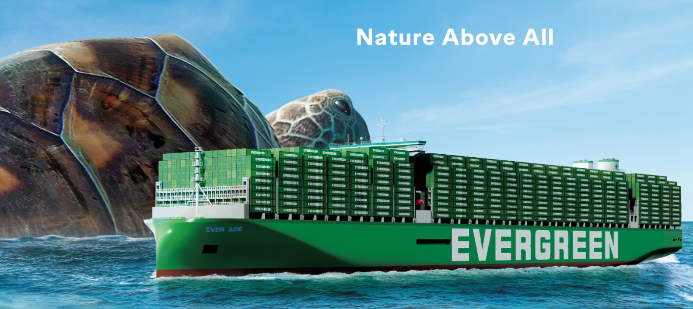
2025
LAAM Meeting (ECSA)
By LAD/EGA/ELA 2025.FEB.27~28

Slide 2
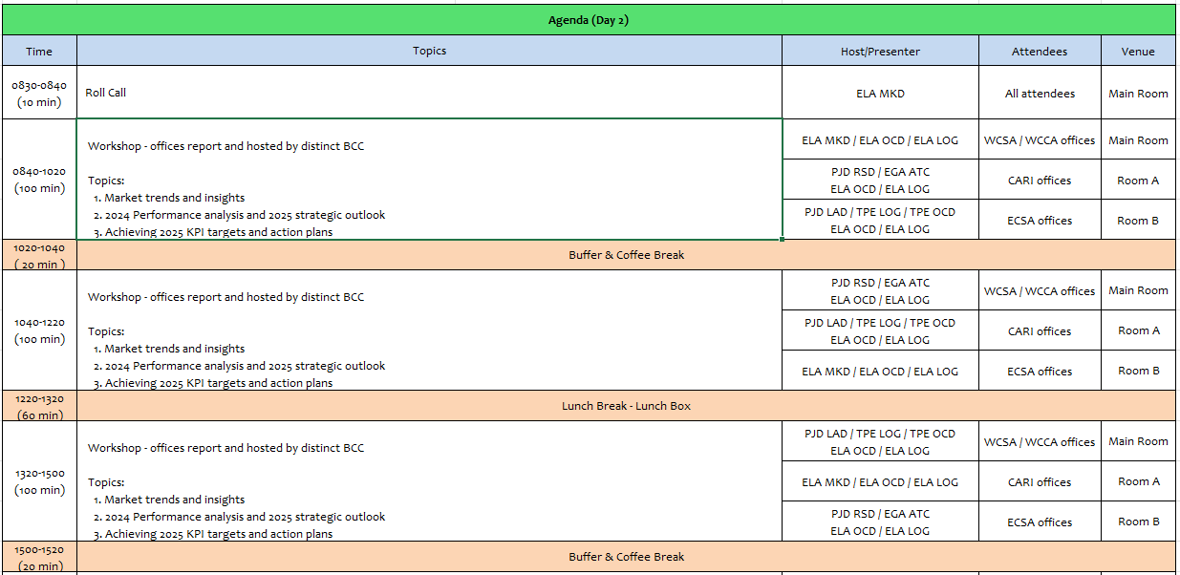
2

Slide 3
11
EBR
(BRAZIL)

Slide 4
Performance/Space(2024) and 2025 Market Review (BR)
Subject | Segments | BCC | 2024 Target TTL Loading(TEU) | 2024 JAN~DEC TTL Loading(TEU) | Achievement (%) | 2025 JAN~DEC TTL Loading(TEU) | Market Review & Action Plan (How to achieve 2025 target?)
 |  |  | (A) | (B) | (B)/(A) | Target
Trade Lane | F.E. => BR IMP. (5 Trade) | LAD | 10,006 | 10,071 | 101% | 13,000 | CKD & TIRE： HPE (Mitsubishi) and tire importers expect good forecast in 2025 as car industry will be continue boosted. SOLAR PANEL: Brazil still has strong demand of solar panel import from China as the price is cheaper, we will increase the volume from the A/C WEG. POD :Target more Santos & Rio cargo which combine with share 40% of import from ASIA, to reduce the draft issue in river plate also to provide sufficient empties to cater for export from Santos. POL : The cargo from India, Vietnam, Indonesia, Thailand, Singapore account for around 15% of total from ASIA market which have material growth in 2024, the YoY all above 20% increase. NOR cargo: Promote NOR cargo to demand place for export demand, like BRPNP. Space protection: for OWN SQ promotion.
 | BR EXP. => F.E. (6 Trade) | LAD | 55,052 | 59,540 | 108% | 61,250 | Reefer cargo : In 2024, our reefer volume hit 7,309 units, 22% increase YoY driving by the A/C Aurora’S standing out with a 169% increase compared to 2023 as well as Cotriguaçu and the beginning of its participation with JBS, but our market share just increase from 2.5% to 3% which still a big room to improve. Coffee : In addition to JP, VN market, the China market is very potential, the coffee chain LUCKIN confirm to purchase 15,000TEUS in the coming 4 year. Santos export: Santos : Woodpulp, Cotton for the base cargo there is a positive expectations for an increase in cotton by 11%.
4

Slide 5




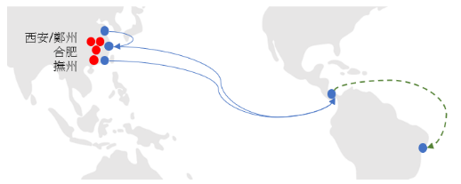



Topic discussion (BR)
Commercial side:
EXPORT
(1) Increase volume for export cotton customer, like ADM...
(2) Additional space to PKKHI, BDCGG and JPYKH.
(3) ESA3 plug increase.
  (4) RIO export.
2. IMPORT
(1) CKD business still increasing
(2) The new OWN SQ proposed target from 240 to 260 on monthly basis is
  well accepted, but need space protection.
  (3) Increase liftings from Southeast Asia and India.
Feeder service to attend other alternative ports such as SDR and VTO, taking advantage of both services calling BRRIO 1st, and with draft to take more light cargo .
BYD prospects to Salvador.
Maintain the Rio Grande market.
Future Plan Suggestion:
5

Slide 6
Topic discussion (BR)
Future market forecast in 2025 (Pessimistic / Optimistic / Remain the same)?
Economic background.
Market share and Loading volume prospect 2025 (Long Haul)
 | Get worse | Improve | Stay the same
2025 |  |  | X
6

Slide 7
Topic discussion (BR)
7

Slide 8
ECD/IMD Topic discussion (BR)
ECD KPI | Item | 2023 | 2024 | Diff | Action Plan in 2024
ECD KPI | Storage | $ 39,677 | $ 63,653 | $ 23,976 (60%) | Due to current situation on BRRIO/BRNVT/BRRIOA where is being very difficult evacuate the empties due to several omissions, cut run and restrictions from terminal our free pool is exceeded generating empty storage costs, and also with free pool closed we don’t have other option and we need to return the empties to the Depot’s, which are also over capacity and generating storage costs. Another fact is Import cargo is very strong in this areas, so very quickly our Depot's are getting above capacity. The solution would be have vessels available to empty loading more often and evacuate this areas.
 | Lift on/off | $ 205,053 | $ 344,505 | $ 139,452 (68%) | Due to limitation of space in ours free pools all empties are being returned to our Depot’s and consequently LOLO is increasing. The solution would be use totally our free pool.
 | Reposition | $ 986,946 | $ 1.973,109 | $ 986,163 (100%) | In an attempt to evacuate our Depot’s it was necessary transport empties from Depot to sea terminal on vessels in that we had opportunity, therefore, this is the reason to the increase on shunting cost. The solution would be use totally our free pool but due to space limitation from them we don’t have other option and we need to return the empties to the Depot’s.
 | M & R | $ 117,099 | $ 80,556 | $ -36,543 (-31%) | We got decrease in M&R cost regarding last year, is good, we are constantly instructing our Depot's to repair just the necessary in order to save costs to Line. We will continue monitoring in order to improve this KPI.
IMD KPI | Cost Saving Project
 | 90% Onboard within 7 Days | 47% | 78% |  | We will continue to supervision of business and closely cooperate with ELA MKD/LOG on transshipment operations in order to all process occur in accordance.
 | No Personal Negligence | N/A | N/A |  | N/A
Topic – The assistance to TPE HQ in sale of hundreds of used cntrs in local market, demands a lot of time and extra job from team, as well as controlling transit cargo from other countries and flag waiver due to omissions, without the respective recognition on the performance evaluation of the area. We suggest that above jobs have its function properly evaluated in the department performance evaluation.
8

Slide 9
OCD/OPD Topic discussion (BR)
 |  | 2023 | 2024 | Diff | Action Plan in 2025
OPD KPI | BOA | OUT 68% ON 71% | OUT 80% ON 63% | 12% (8%) | Monitor vessels that arrive out of berthing window, evaluating C.O.R and/or berthing in neighbours terminals.
 | Port Stay | 90% | 91% | 1% | Monitor along ELA-OCD/TPE-PJD/TPE-OCD for vessels arriving within PFM window to fully utilize terminal resources
 | Productivity | 97,1% | 95% | (2,1%) | DPW: Push vendor to deploy more gangs, monitor vessels to arrive on window to fully utilize terminal resources. TCP: Push vendor to deploy more gangs, monitor vessels to arrive on window to fully utilize terminal resources
OCD KPI | Incentive | - RIO: U$58.070 - STO: $0 - PNP: $0 - IOA: Slide scale 1st – jun/19/2023 2nd – aug/20/2023 - NVT(tug): U$14.207 | - RIO: U$58.200 - STO: U$2.194 - PNP: $0 (TBC in march) - IOA: Slide scale 1st - apr/24/2024 2nd - may/28/2024 - NVT(tug): U$11.812 |  | Negotiate with vendors reacheable incentives in order to set up extra revenues to the line
 | Empty Storage | U$24.518 | U$53.016 | U$28.498 | BRSTOS – LKIN unexpectedly discharged 250 teus due to stowage plan issue. Also, SBSA pool exceeded due to lack of space in other depots. Look for new depots at STO. BRSTOP – Push terminal to increase free pool capacity in 25% BRPNPP – Vessels omissions impacted repositioning, generating storage costs. Look for new depots at PNP
 | Rate Reduction | Original (1st offer) / Final BRRIOR - na / na BRSTOP - na / na BRPNPP – 7,5% / 5,79% BRIOAI - 5,79% / 4,78% BRRGRR - 8,31% / 3,98% (T/S cost reduced 100%) | Original (1st offer) / Final BRRIO – 40% / 32% BRSTOP - 112% / 92% BRPNPP – 9,89% / 5,87% BRIOAI – 7,00% / 5,50% BRRGRR - 10,43% / 5% |  | For 2025, Rejecting all offers that surpass the annual local CPI and freezing operational costs
Terminal info update (expansion/dredge/crane)
BRRIOR: Dredging completed increasing draft to 15,3m (high tide) + extra 85m quay (total 800m) pending port authority approval in 1Q25. 02 new STSs to be delivered in 4Q26.
BRSTOP: Intermediate shift to be launched in 2Q25 (4 gangs w/ 6h shift). Pier extension (190m) pending only IBAMA authorization by 1H26. 02 new STSs + 6 RTG to be delivered in 2Q26.
BRPNPP: Dredging works in order to increase draft to 13,0m by 1H25.
BRNVTP: Civil works to fortify quays in order to receive next gen vessels due in 1Q26. Acquisition of 02 STSs without restriction.
BRIOAI: 180.000 sqm yard capacity, acquisition of 01 STS, 540 plugs and dredging Babitonga bay, all for 4Q25. Extra 410m quay by 2Q27 (total 1210m)
9

