Slide 1
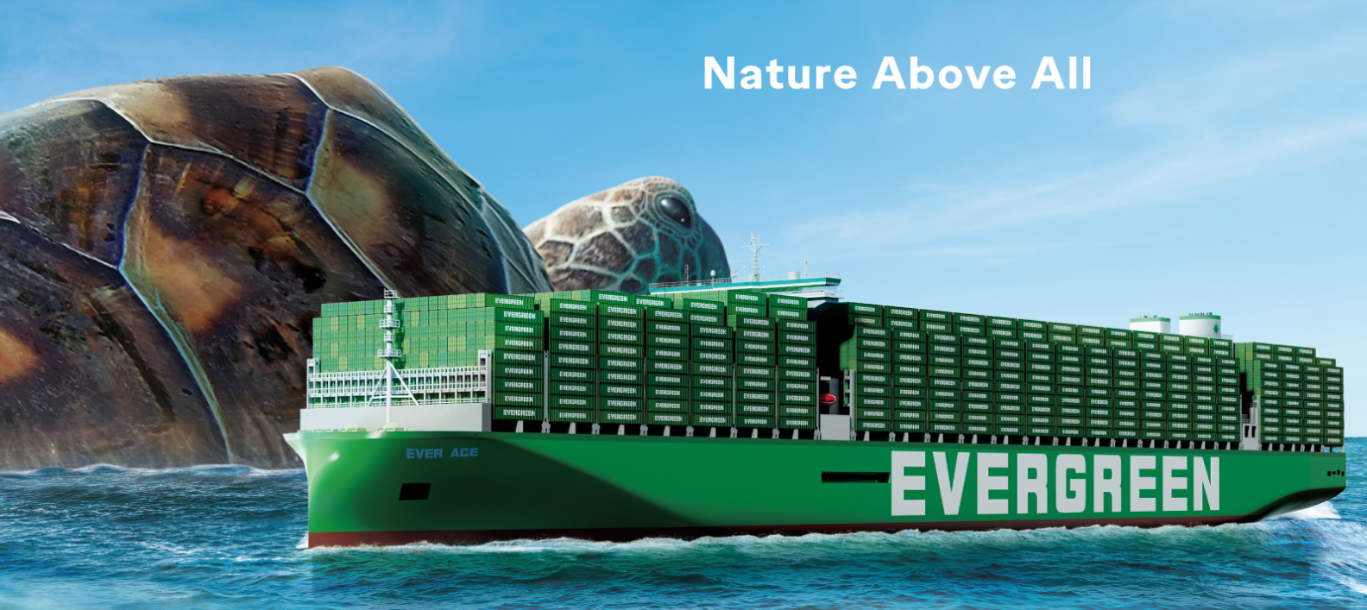
2025
LAAM Meeting (CARB)
By LAD/EGA/ELA 2025.FEB.27~28
By LAD/EGA/ELA

Slide 2
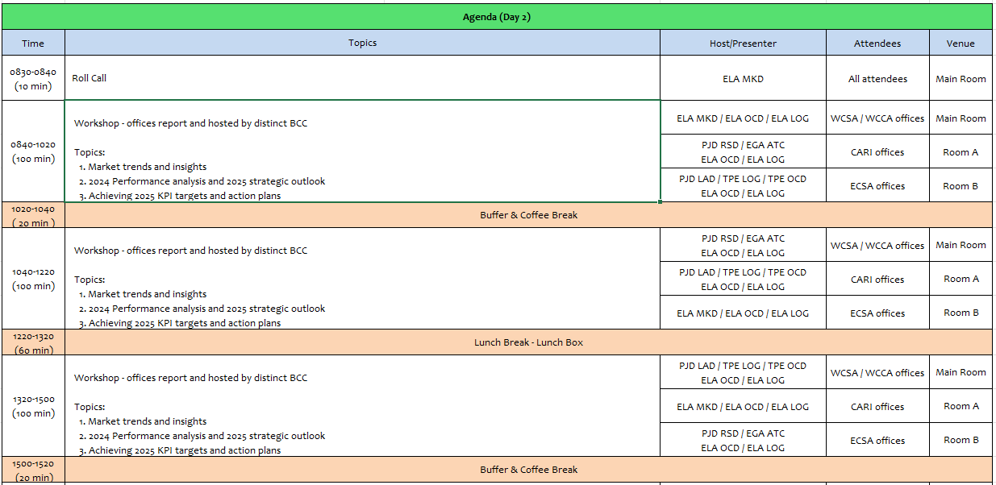
2

Slide 3
02
MIS
(COSTA RICA include NICARAGUA)

Slide 4
Performance/Space(2024) and 2025 Market Review (CR+NI)
Subject | Segments | BCC | 2024 Target TTL Loading(TEU) | 2024 JAN~DEC TTL Loading(TEU) | Achievement (%) | 2025 JAN~DEC TTL Loading(TEU) | Market Review & Action Plan (How to achieve 2025 target?)
 |  |  | (A) | (B) | (B)/(A) | Target
Trade Lane | F.E. => CR+NI IMP. (C Trade) | LAD | 127 | 212 | 167% | 245
 | F.E. => CR+NI IMP. (Q Trade) | LAD | 6,221 | 6,354 | 102% | 7,265
 | CR+NI EXP. => F.E. (CF Trade) | LAD | 5,483 | 5,106 | 93% | 5,140
4

Slide 5
Performance/Space(2024) and 2025 Market Review (CR+NI)
Subject | Segments | BCC | 2024 Target TTL Loading(TEU) | 2024 JAN~DEC TTL Loading(TEU) | Achievement (%) | 2025 JAN~DEC TTL Loading(TEU) | Market Review & Action Plan (How to achieve 2025 target?)
 |  |  | (A) | (B) | (B)/(A) | Target
Trade Lane | CR+NI ⬄ USEC (609+610 Trade) | EGA-ATC | 1,000 | 1,476 | 147% | 1,800
 | CR+NI ⬄ CARB+WCCA (CB Trade) | ELA | 2,350 | 1,188 | 51% | 1,350
 | CR+NI ⬄ WCSA (CW+WC Trade) | ELA | 500 | 797 | 159% | 650
 | CR+NI ⬄ USEC (622+623 Trade) | ELA | 1,100 | 1,710 | 155% | 1,500
5

Slide 6
Topic discussion (CR+NI)
Commercial side:
Future Plan Suggestion:
6

Slide 7
Topic discussion (CR+NI)
Future market forecast in 2025 (Pessimistic / Optimistic / Remain the same)?
Economic background.
Market share and Loading volume prospect 2025 (Long Haul)
 | Get worse | Improve | Stay the same
2025
7

Slide 8
ECD/IMD Topic discussion (CR+NI)
ECD KPI | Item | 2023 | 2024 | Diff | Action Plan in 2025
ECD KPI | Storage
 | Lift on/off
 | Reposition
 | M & R
IMD KPI | Cost Saving Project
 | 90% Onboard within 7 Days
 | No Personal Negligence
Topic
Aged Container Selling / Free Reposition Plan
  A
  B
8

Slide 9
OCD/OPD Topic discussion (CR+NI)
 |  | 2023 | 2024 | Diff | Action Plan in 2025
OPD KPI | BOA
 | Port Stay
 | Productivity
OCD KPI | Incentive
 | Empty Storage
 | Rate Reduction
Topic
Terminal info update (expansion/dredge/crane)
  A
  B
9

Slide 10
03
CRE
(CURACAO)

Slide 11
Performance/Space(2024) and 2025 Market Review (CW)
Subject | Segments | BCC | 2024 Target TTL Loading(TEU) | 2024 JAN~DEC TTL Loading(TEU) | Achievement (%) | 2025 JAN~DEC TTL Loading(TEU) | Market Review & Action Plan (How to achieve 2025 target?)
 |  |  | (A) | (B) | (B)/(A) | Target
Trade Lane | F.E. => CW IMP. (C Trade) | LAD | 332 | 566 | 170% | 588
 | CW ⬄ USEC (609+610 Trade) | EGA-ATC | 20 | 16 | 80% | 20
 | CW ⬄ CARI (CC Trade) | EGA-ATC | 20 | 23 | 115% | 20
11

Slide 12
Performance/Space(2024) and 2025 Market Review (CW)
Subject | Segments | BCC | 2024 Target TTL Loading(TEU) | 2024 JAN~DEC TTL Loading(TEU) | Achievement (%) | 2025 JAN~DEC TTL Loading(TEU) | Market Review & Action Plan (How to achieve 2025 target?)
 |  |  | (A) | (B) | (B)/(A) | Target
Trade Lane | CW ⬄ WCSA (CW+WC Trade) | ELA | 10 | 0 | 0% | 10
 | CW ⬄ WCCA+CARO (CB Trade) | ELA | 15 | 0 | 0% | 10
12

Slide 13
Topic discussion (CW)
Commercial side:
Future Plan Suggestion:
13

Slide 14
Topic discussion (CW)
Future market forecast in 2025 (Pessimistic / Optimistic / Remain the same)?
Economic background.
Market share and Loading volume prospect 2025 (Long Haul)
 | Get worse | Improve | Stay the same
2025
14

Slide 15
ECD/IMD Topic discussion (CW)
ECD KPI | Item | 2022 | 2023 | Diff | Action Plan in 2025
ECD KPI | Storage
 | Lift on/off
 | Reposition
 | M & R
IMD KPI | Cost Saving Project
 | 90% Onboard within 7 Days
 | No Personal Negligence
15

Slide 16
OCD/OPD Topic discussion (CW)
 |  | 2022 | 2023 | Diff | Action Plan in 2025
OPD KPI | BOA
 | Port Stay
 | Productivity
OCD KPI | Incentive
 | Empty Storage
 | Rate Reduction
Topic
Terminal info update (expansion/dredge/crane)
  A
  B
16

Slide 17
04
SMS
(HAITI)

Slide 18
Performance/Space(2024) and 2025 Market Review (HT)
Subject | Segments | BCC | 2024 Target TTL Loading(TEU) | 2024 JAN~DEC TTL Loading(TEU) | Achievement (%) | 2025 JAN~DEC TTL Loading(TEU) | Market Review & Action Plan (How to achieve 2025 target?)
 |  |  | (A) | (B) | (B)/(A) | Target
Trade Lane | F.E. => HT IMP. (C Trade) | LAD | 1,219 | 1,450 | 119% | 1,715
 | HT ⬄ CARI+CARO (CB Trade) | ELA | 1,000 | 222 | 22% | 500
18

Slide 19
Performance/Space(2024) and 2025 Market Review (HT)
Subject | Segments | BCC | 2024 Target TTL Loading(TEU) | 2024 JAN~DEC TTL Loading(TEU) | Achievement (%) | 2025 JAN~DEC TTL Loading(TEU) | Market Review & Action Plan (How to achieve 2025 target?)
 |  |  | (A) | (B) | (B)/(A) | Target
Trade Lane | HT ⬄ WCSA+WCCA (CW+WC+CB Trade) | ELA | 1,000 | 60 | 6% | 80
 | HT ⬄ USEC (622+623 Trade) | ELA | 500 | 75 | 15% | 250
19

Slide 20
Topic discussion (HT)
Commercial side:
Future Plan Suggestion:
20

Slide 21
Topic discussion (HT)
Future market forecast in 2025 (Pessimistic / Optimistic / Remain the same)?
Economic background.
Market share and Loading volume prospect 2025 (Long Haul)
 | Get worse | Improve | Stay the same
2025
21

Slide 22
ECD/IMD Topic discussion (HT)
ECD KPI | Item | 2023 | 2024 | Diff | Action Plan in 2025
ECD KPI | Storage
 | Lift on/off
 | Reposition
 | M & R
IMD KPI | Cost Saving Project
 | 90% Onboard within 7 Days
 | No Personal Negligence
Topic
Aged Container Selling / Free Reposition Plan
  A
  B
22

Slide 23
OCD/OPD Topic discussion (HT)
 |  | 2023 | 2024 | Diff | Action Plan in 2025
OPD KPI | BOA
 | Port Stay
 | Productivity
OCD KPI | Incentive
 | Empty Storage
 | Rate Reduction
Topic
Terminal info update (expansion/dredge/crane)
  A
  B
23

Slide 24
05
MCD
(DOMINICAN REPUBLIC)

Slide 25
Performance/Space(2024) and 2025 Market Review (DO)
Subject | Segments | BCC | 2024 Target TTL Loading(TEU) | 2024 JAN~DEC TTL Loading(TEU) | Achievement (%) | 2025 JAN~DEC TTL Loading(TEU) | Market Review & Action Plan (How to achieve 2025 target?)
 |  |  | (A) | (B) | (B)/(A) | Target
Trade Lane | F.E. => DO IMP. (C Trade) | LAD | 2,708 | 2,530 | 96% | 4,900
25

Slide 26
Performance/Space(2024) and 2025 Market Review (DO)
Subject | Segments | BCC | 2024 Target TTL Loading(TEU) | 2024 JAN~DEC TTL Loading(TEU) | Achievement (%) | 2025 JAN~DEC TTL Loading(TEU) | Market Review & Action Plan (How to achieve 2025 target?)
 |  |  | (A) | (B) | (B)/(A) | Target
Trade Lane | DO ⬄ USEC (609+610 Trade) | EGA-ATC | 200 | 209 | 104% | 200
 | DO ⬄ CARI (CC Trade) | EGA-ATC | 2,900 | 3466 | 119% | 2,900
26

Slide 27
Performance/Space(2024) and 2025 Market Review (DO)
Subject | Segments | BCC | 2024 Target TTL Loading(TEU) | 2024 JAN~DEC TTL Loading(TEU) | Achievement (%) | 2025 JAN~DEC TTL Loading(TEU) | Market Review & Action Plan (How to achieve 2025 target?)
 |  |  | (A) | (B) | (B)/(A) | Target
Trade Lane | DO ⬄ WCSA (CW+WC Trade) | ELA | 150 | 21 | 14% | 50
 | DO ⬄ WCCA+CARO (CB Trade) | ELA | 300 | 70 | 23% | 100
27

Slide 28
Topic discussion (DO)
Commercial side:
Future Plan Suggestion:
28

Slide 29
Topic discussion (DO)
Future market forecast in 2025 (Pessimistic / Optimistic / Remain the same)?
Economic background.
Market share and Loading volume prospect 2025 (Long Haul)
 | Get worse | Improve | Stay the same
2025
29

Slide 30
ECD/IMD Topic discussion (DO)
ECD KPI | ITEM | 2023 | 2024 | Diff | Action Plan in 2025
ECD KPI | Storage
 | Lift on/off
 | Reposition
 | M & R
IMD KPI | Cost Saving Project
 | 90% Onboard within 7 Days
 | No Personal Negligence
Topic
Aged Container Selling / Free Reposition Plan
  A
  B
30

Slide 31
OCD/OPD Topic discussion (DO)
 | ITEM | 2023 | 2024 | Diff | Action Plan in 2025
OPD KPI | BOA
 | Port Stay
 | Productivity
OCD KPI | Incentive
 | Empty Storage
 | Rate Reduction
Topic
Terminal info update (expansion/dredge/crane)
  A
  B
31

Slide 32
06
LNM
(JAMAICA)

Slide 33
Performance/Space(2024) and 2025 Market Review (JM)
Subject | Segments | BCC | 2024 Target TTL Loading(TEU) | 2024 JAN~DEC TTL Loading(TEU) | Achievement (%) | 2025 JAN~DEC TTL Loading(TEU) | Market Review & Action Plan (How to achieve 2025 target?)
 |  |  | (A) | (B) | (B)/(A) | Target
Trade Lane | F.E. => JM IMP. (C Trade) | LAD | 379 | 339 | 90% | 490
 | JM ⬄ USEC (609+610 Trade) | EGA-ATC | 10 | 9 | 90% | 10
 | JM ⬄ CARI (CC Trade) | EGA-ATC | 25 | 28 | 112% | 25
33

Slide 34
Performance/Space(2024) and 2025 Market Review (JM)
Subject | Segments | BCC | 2024 Target TTL Loading(TEU) | 2024 JAN~DEC TTL Loading(TEU) | Achievement (%) | 2025 JAN~DEC TTL Loading(TEU) | Market Review & Action Plan (How to achieve 2025 target?)
 |  |  | (A) | (B) | (B)/(A) | Target
Trade Lane | JM ⬄ WCSA (CW+WC Trade) | ELA | 10 | 0 | 0% | 10
 | JM ⬄ WCCA+CARO (CB Trade) | ELA | 515 | 204 | 40% | 250
34

Slide 35
Topic discussion (JM)
Commercial side:
Future Plan Suggestion:
35

Slide 36
Topic discussion (JM)
Future market forecast in 2025 (Pessimistic / Optimistic / Remain the same)?
Economic background.
Market share and Loading volume prospect 2025 (Long Haul)
 | Get worse | Improve | Stay the same
2025
36

Slide 37
ECD/IMD Topic discussion (JM)
ECD KPI | ITEM | 2023 | 2024 | Diff | Action Plan in 2025
ECD KPI | Storage
 | Lift on/off
 | Reposition
 | M & R
IMD KPI | Cost Saving Project
 | 90% Onboard within 7 Days
 | No Personal Negligence
Topic
Aged Container Selling / Free Reposition Plan
  A
  B
37

Slide 38
OCD/OPD Topic discussion (JM)
 | ITEM | 2023 | 2024 | Diff | Action Plan in 2025
OPD KPI | BOA
 | Port Stay
 | Productivity
OCD KPI | Incentive
 | Empty Storage
 | Rate Reduction
Topic
Terminal info update (expansion/dredge/crane)
  A
  B
38

Slide 39
07
UMS
(PANAMA)

Slide 40
Performance/Space(2024) and 2025 Market Review (PA)
Subject | Segments | BCC | 2024 Target TTL Loading(TEU) | 2024 JAN~DEC TTL Loading(TEU) | Achievement (%) | 2025 JAN~DEC TTL Loading(TEU) | Market Review & Action Plan (How to achieve 2025 target?)
 |  |  | (A) | (B) | (B)/(A) | Target
Trade Lane | F.E. => PA IMP. (C Trade) | LAD | 15,512 | 17,444 | 112% | 16,415
 | PA ⬄ USEC (609+610 Trade) | EGA-ATC | 210 | 138 | 66% | 210
 | PA ⬄ CARI (CC Trade) | EGA-ATC | 5,700 | 4881 | 86% | 5,500
40

Slide 41
Performance/Space(2024) and 2025 Market Review (PA)
Subject | Segments | BCC | 2024 Target TTL Loading(TEU) | 2024 JAN~DEC TTL Loading(TEU) | Achievement (%) | 2025 JAN~DEC TTL Loading(TEU) | Market Review & Action Plan (How to achieve 2025 target?)
 |  |  | (A) | (B) | (B)/(A) | Target
Trade Lane | PA ⬄ WCSA (CW+WC Trade) | ELA | 310 | 289 | 93% | 310
 | PA ⬄ WCCA+CARO (CB Trade) | ELA | 950 | 291 | 31% | 350
41

Slide 42
Topic discussion (PA)
Commercial side:
Future Plan Suggestion:
42

Slide 43
Topic discussion (PA)
Future market forecast in 2025 (Pessimistic / Optimistic / Remain the same)?
Economic background.
Market share and Loading volume prospect 2025 (Long Haul)
 | Get worse | Improve | Stay the same
2025
43

Slide 44
ECD/IMD Topic discussion (PA)
ECD KPI | ITEM | 2023 | 2024 | Diff | Action Plan in 2025
ECD KPI | Storage
 | Lift on/off
 | Reposition
 | M & R
IMD KPI | Cost Saving Project
 | 90% Onboard within 7 Days
 | No Personal Negligence
Topic
Aged Container Selling / Free Reposition Plan
  A
  B
44

Slide 45
OCD/OPD Topic discussion (PA)
 | ITEM | 2023 | 2024 | Diff | Action Plan in 2025
OPD KPI | BOA
 | Port Stay
 | Productivity
OCD KPI | Incentive
 | Empty Storage
 | Rate Reduction
Topic
Terminal info update (expansion/dredge/crane)
  A
  B
45

Slide 46
08
PRIS
(PUERTO RICO)

Slide 47
Performance/Space(2024) and 2025 Market Review (PR)
Subject | Segments | BCC | 2024 Target TTL Loading(TEU) | 2024 JAN~DEC TTL Loading(TEU) | Achievement (%) | 2025 JAN~DEC TTL Loading(TEU) | Market Review & Action Plan (How to achieve 2025 target?)
 |  |  | (A) | (B) | (B)/(A) | Target
Trade Lane | F.E. => PR IMP. (618 Trade) | LAD | 6,511 | 9,247 | 142% | 9,800 | Market in PR is expected to remain the same. In 2025 since we keep loosing support from all A/C‘s in PR. Specially from our contract A/C‘s which is our core. The only solution is to stabilize CAN service and provide reasonable transit times and fast cargo allocations at POL‘S.
 | PR ⬄ CARI (609+610 Trade) | EGA-ATC | 830 | 354 | 43% | 500 | We keep loosing support due to the fact we don‘t have a stable service. We need to stabilize service to regain support from A/C‘S and have a higher cargo goal.
47

Slide 48
Performance/Space(2024) and 2025 Market Review (PR)
Subject | Segments | BCC | 2024 Target TTL Loading(TEU) | 2024 JAN~DEC TTL Loading(TEU) | Achievement (%) | 2025 JAN~DEC TTL Loading(TEU) | Market Review & Action Plan (How to achieve 2025 target?)
 |  |  | (A) | (B) | (B)/(A) | Target
Trade Lane | PR ⬄ WCSA (619+620 Trade) | ELA | 250 | 0 | 0% | 10 | Major export cargo is scrap which is very limitted the selection allowed to be handled by our HQ. We haven‘t been able to compete with low market rate. In addition, we don‘t have a reliable service.
 | PR ⬄ WCCA+CARO (622+623 Trade) | ELA | 850 | 44 | 5% | 70 | Major export cargo is scrap which is very limitted the selection allowed to be handled by our HQ. We haven‘t been able to compete with low market rate. In addition, we don‘t have a reliable service.
48

Slide 49
Topic discussion (PR)
Commercial side: Our office can’t sell a service that is not reliable and is unpredictable . EMC has always been recognized in the PR market as one of the most reliable carriers, yet in the past years specially in 2024 and beginning of 2025 this is not the case. At the moment, EMC is considered as the most unreliable carrier in PR.
Future Plan Suggestion:
Our suggestion is a total logistic reorganization regarding the CAN service.
For the past years, ELA hasn’t been able to find viable solutions which has made
situation worsen. In addition, we suggest our office should have information on how
much space will be granted per vessel to PR from Asia ports this will
help provide more precise data to A/C’s. Lastly, web page needs to have more accurate data.
In 2024 data was not updated; therefore, A/C’s couldn’t get correct information.
49

Slide 50
Topic discussion (PR)
Future market forecast in 2025 (Pessimistic / Optimistic / Remain the same)?
Economic background.- Puerto Rico economy is expected to have a moderate growth. It all depends in Federal aid and overall economic climate.
Market share and Loading volume prospect 2025 (Long Haul)- Considering actual service we can only forecast EMC market share decrease. If service improves we understand at least a 15% market share increase can be seen.
 | Get worse | Improve | Stay the same
2025 |  |  | X
50

Slide 51
Market share and Loading volume prospect
(prospect based on actual service)
51

Slide 52
ECD/IMD Topic discussion (PR)
ECD KPI | ITEM | 2023 | 2024 | Diff | Action Plan in 2025
ECD KPI | Storage | 0 | 0 | 0 | NONE
 | Lift on/off | Full - $156.68 Empty - $150.93 | Full - $161.38 Empty - $155.46 | Full - $4.70 Empty - $4.53 | TERMINAL CONTRACT IS NEGOTIATED DIRECTLY WITH TPE.
 | Reposition | 10,212 | 10,645 |  | CONTINUE LOADING AS MUCH POSSIBLE.
 | M & R | N/A | N/A | N/A | N/A
IMD KPI | Cost Saving Project | N/A | N/A | N/A | N/A
 | 90% Onboard within 7 Days | N/A | N/A | N/A | N/A
 | No Personal Negligence | N/A | N/A | N/A | N/A
Topic
Aged Container Selling / Free Reposition Plan
  Available cntrs. to sell are sold in weekly manner.
  Free reposition plan needs to be discussed with terminal directly
52

Slide 53
OCD/OPD Topic discussion (PR)
 | ITEM | 2023 | 2024 | Diff | Action Plan in 2025
OPD KPI | BOA | 100% | 100% | 0%
 | Port Stay | 97.94% | 94.20% | 3.74%
 | Productivity | 48.60% | 45.59% | 3.01%
OCD KPI | Incentive | 0 | 0 | 0
 | Empty Storage | 0 | 0 | 0 | NO EMPTY STORAGE AT PR
 | Rate Reduction | 0 | 0 | 0 | NO EMPTY STORAGE AT PR
Topic
Terminal info update (expansion/dredge/crane)
  No information has been confirmed by terminal regarding expansion, dredge or cranes.
53

Slide 54
09
ISL
(TRINIDAD)

Slide 55
Performance/Space(2024) and 2025 Market Review (TT)
Subject | Segments | BCC | 2024 Target TTL Loading(TEU) | 2024 JAN~DEC TTL Loading(TEU) | Achievement (%) | 2025 JAN~DEC TTL Loading(TEU) | Market Review & Action Plan (How to achieve 2025 target?)
 |  |  | (A) | (B) | (B)/(A) | Target
Trade Lane | F.E. => TT IMP. (C Trade) | LAD | 130 | 0 | 0 | 10
55

Slide 56
Performance/Space(2024) and 2025 Market Review (TT)
Subject | Segments | BCC | 2024 Target TTL Loading(TEU) | 2024 JAN~DEC TTL Loading(TEU) | Achievement (%) | 2025 JAN~DEC TTL Loading(TEU) | Market Review & Action Plan (How to achieve 2025 target?)
 |  |  | (A) | (B) | (B)/(A) | Target
Trade Lane | TT ⬄ CARB (CB Trade) | ELA | 10 | 6 | 60% | 5
 | TT ⬄ WCSA (CW+WC Trade) | ELA | 10 | 0 | 0% | 5 | Continue to share market data and competitive rates from other carriers with our BCC. Aiming to offer more competitive rates to customers. Target per week is 10 TEU once competitive rates are offered. Enhance marketing communication by launching an Evergreen campaign which will build awareness of the line and services offered.
 | TT ⬄ WCCA (CB Trade) | ELA | 10 | 0 | 0% | 5 | Continue to share market data and competitive rates from other carriers with our BCC. Aiming to offer more competitive rates to customers. Target per week is 10 TEU once competitive rates are offered. Enhance marketing communication by launching an Evergreen campaign which will build awareness of the line and services offered.
56

Slide 57
Topic discussion (TT)
Commercial side:
Future Plan Suggestion:
57

Slide 58
Topic discussion (TT)
Future market forecast in 2025 (Pessimistic / Optimistic / Remain the same)?
Economic background.
Market share and Loading volume prospect 2025 (Long Haul)
 | Get worse | Improve | Stay the same
2025
58

Slide 59
ECD/IMD Topic discussion (TT)
ECD KPI | ITEM | 2023 | 2024 | Diff | Action Plan in 2025
ECD KPI | Storage
 | Lift on/off
 | Reposition
 | M & R
IMD KPI | Cost Saving Project
 | 90% Onboard within 7 Days
 | No Personal Negligence
Topic
Aged Container Selling / Free Reposition Plan
  A
  B
59

Slide 60
OCD/OPD Topic discussion (TT)
 | ITEM | 2023 | 2024 | Diff | Action Plan in 2025
OPD KPI | BOA
 | Port Stay
 | Productivity
OCD KPI | Incentive
 | Empty Storage
 | Rate Reduction
Topic
Terminal info update (expansion/dredge/crane)
  A
  B
60

Slide 61


