Slide 1

2025
LAAM Meeting (CARB)
By LAD/EGA/ELA 2025.FEB.27~28
By LAD/EGA/ELA

Slide 2
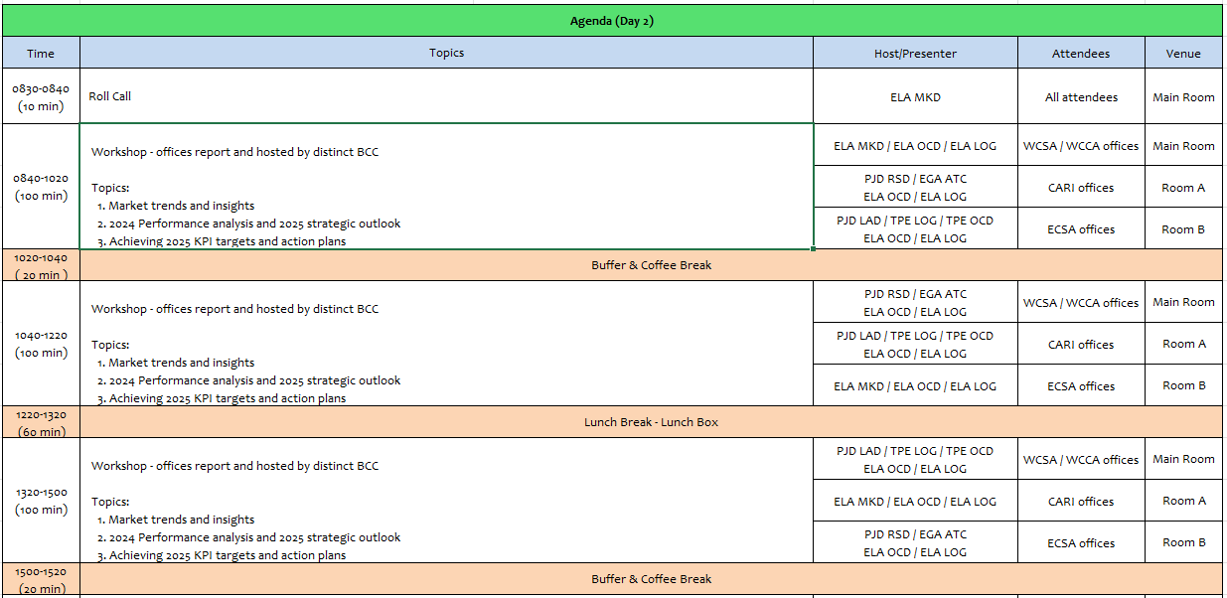
2

Slide 3
07
UMS
(PANAMA)

Slide 4
Performance/Space(2024) and 2025 Market Review (PA)
Subject | Segments | BCC | 2024 Target TTL Loading(TEU) | 2024 JAN~DEC TTL Loading(TEU) | Achievement (%) | 2025 JAN~DEC TTL Loading(TEU) | Market Review & Action Plan (How to achieve 2025 target?)
 |  |  | (A) | (B) | (B)/(A) | Target
Trade Lane | F.E. => PA IMP. (C Trade) | LAD | 15,662 | 17,605 | 112% | 16,415 | Due to congestion in Dominican Republic, PJD-LAD gave us more space. We appreciate BCC’s support on flexible rates policy, equipment and space at 2024. Clients as, May´s and Amazon Zona Libre increased their cargo 30% and 13% respectively. We continue the good communication with BCC’s and update the latest market information every week for BCC’s reference. We continue working with the port of loading and BCC sending sales lead in order to release the pending bookings.
 | PA ⬄ USEC (609+610 Trade) | EGA-ATC | 210 | 138 | 66% | 210 | Main reason caused the lifting shortage is because the lower rates and faster transit time offer by MSK/Seaboard. Maintain customer relationship in order to act as a primary back up carriers and appreciate BCC’s support as always. Working with customers such as: Panama Intermoving & Relocation, Balboa Movers, Canal Movers who are moving the cargo from Panama to USEC. We keep updated information with BCC’s and looking for the support.
 | PA ⬄ CARI (CC Trade) | EGA-ATC | 5,700 | 4881 | 86% | 5,500 | Lifting was serious jeopardies by delays, skip specially on CAN, CAC and CAJ services at 2024. One of our principal market is Colombia(CARI Side) and the cargo was affected for the following issue: low purchase volume, some of the items have increased the taxes, currency issue, instability in the government. Reasons of the achievement standing at 86% due to delay on CAN services and a/cs shift their support to the others for vols goes to Dominican Republic and Puerto Rico. Our action plan is work with BCC in order to maintain the rate flexibility and share the latest sailing schedule with a/cs.

Slide 5
Performance/Space(2024) and 2025 Market Review (PA)
Subject | Segments | BCC | 2024 Target TTL Loading(TEU) | 2024 JAN~DEC TTL Loading(TEU) | Achievement (%) | 2025 JAN~DEC TTL Loading(TEU) | Market Review & Action Plan (How to achieve 2025 target?)
 |  |  | (A) | (B) | (B)/(A) | Target
Trade Lane | PA ⬄ WCSA (CW+WC Trade) | ELA | 310 | 289 | 93% | 310 | Has to stay on top of the delay caused by cut and run issue at PABBA. We have recovered the support from Huawei through ELA‘s assistance they are very interested in our new destination to Valparaiso also to Callao and we sent quotation to CTS International and DSV Panama two logistics companies. Our action plan is trying to secure 5-8 boxes under weekly basis and proactive to take care everything ahead of customer’s challenge.
 | PA ⬄ WCCA+CARO (CB Trade) | ELA | 950 | 291 | 31% | 350 | Reason that the cargo decreased was GPS consideration and space issue on T/S priority. Unstable schedule. Our action plan is keep post the latest saling scheduled for all a/cs reference and try to accomendate customers reqesut when they running into the trouble caused by us. Work together with our colleagues in WCCA and CARO sending sales lead when the rates is negotiable by them and vice versa.
5

Slide 6
Topic discussion (PA)
Commercial side:
Looking forward to have more stable Schedule on CAN, CAC and CAJ services in order to secure more potencial customers support and boxes from the street.
Special consideration at space support for domestic export shipment on WCCA (CB) when the
transship vols pick it up.
Continuous promote export reefer business to ASI and other region for the commodities such as Frozen Sea Food, Fruits, Medicines, to Caribbean, United States and Asia.
Future Plan Suggestion:
Open new routes for potential destinations such as: Venezuela, Brasil, and CARI regions.
Invite BCCs join sales calls visiting customers in order to reinforce the customer relationship and more understanding of the BIZ pattern at different commodity.
When the roll over issue involved at POLs, suggest to send us the notices asap in order to avoid rate retrieve after vsl departure and pacify customers complain in advance.
6

Slide 7
Topic discussion (PA)
Future market forecast in 2025 (Pessimistic / Optimistic / Remain the same)?
Economic background.
In 2025, Panama is expected to maintain strong economic growth at around 4.0%, driven by ongoing infrastructure projects and a diverse economy. The construction sector will see a boost from large-scale projects like the third Metro line, the fourth bridge over the Panama Canal, and the expansion of energy and water infrastructure, such as the Mendoza water treatment facility. These developments will not only improve infrastructure but also create jobs and stimulate economic activity
 | Get worse | Improve | Stay the same
2025 |  | V
7

Slide 8

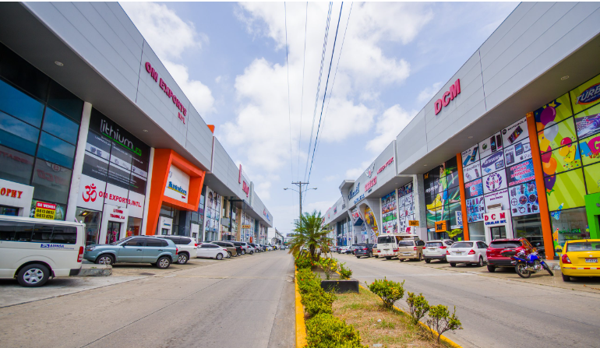
Topic discussion (PA)
ANALYSIS OF COMMERCIAL ACTIVITY IN THE COLON FREE ZONE 2024 - 2023:
Imports 2024 - 2023:
The accumulated imports in the period January-December 2024 vs 2023 registered a total of $12.6 million, reflecting a contraction of 36% compared to the previous year 2023.
The decrease in raw materials for the production of medicines in 2024 affected the imports in Colon Free Zone.
The countries with more participation in imports last year were:
Mainland China with 36%, followed by the United States of America with 20%, Belgium with 4%, followed by Mexico with 3%, France with 2% and Italy with 2%, which represent 67% of the total imports recorded for this period.
8

Slide 9
Topic discussion (PA)
Exports 2024 - 2023:
The accumulated re-exports in the period January-December 2024 vs 2023 registered a total of $12.3 million, reflecting a contraction of 8% compared to the previous year 2023.
The decrease was due to the increase of the direct shipments from Asia to Latin America.
The countries with more participation in exports last year were:
Venezuela with 9%, Costa Rica with 8%, Guatemala with 7%, followed by Colombia with 7%, Dominican Republic and the United States of America both with a share of 6%, El Salvador with 5%, Honduras with 5% and Chile with 4% respectively, representing 64% of the total re-exported.
9

Slide 10
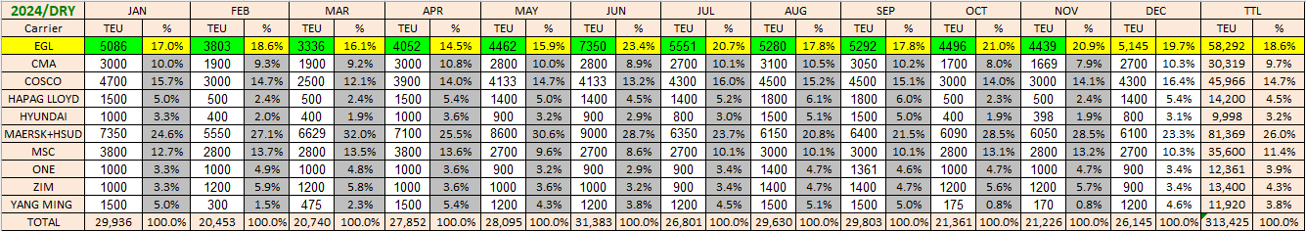
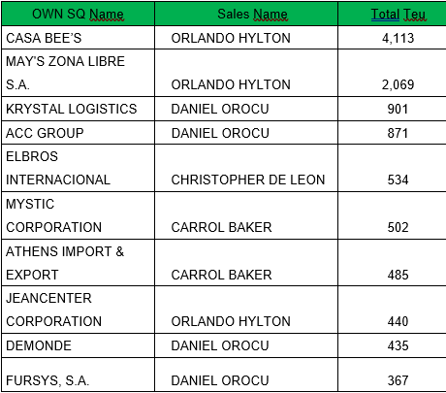
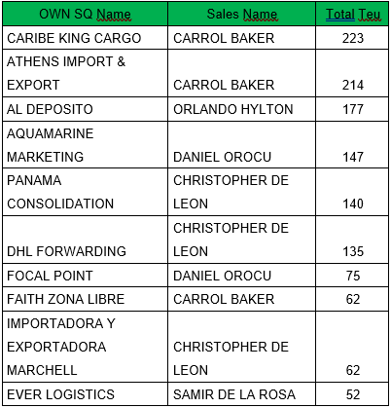



Topic discussion (PA)
Market share and Loading volume prospect 2024 (Long Haul)
2024 / Top 10 import and export account
10

Slide 11


