Slide 1
COLON CONTAINER TERMINAL S.A.
www.cct-pa.com

Slide 2
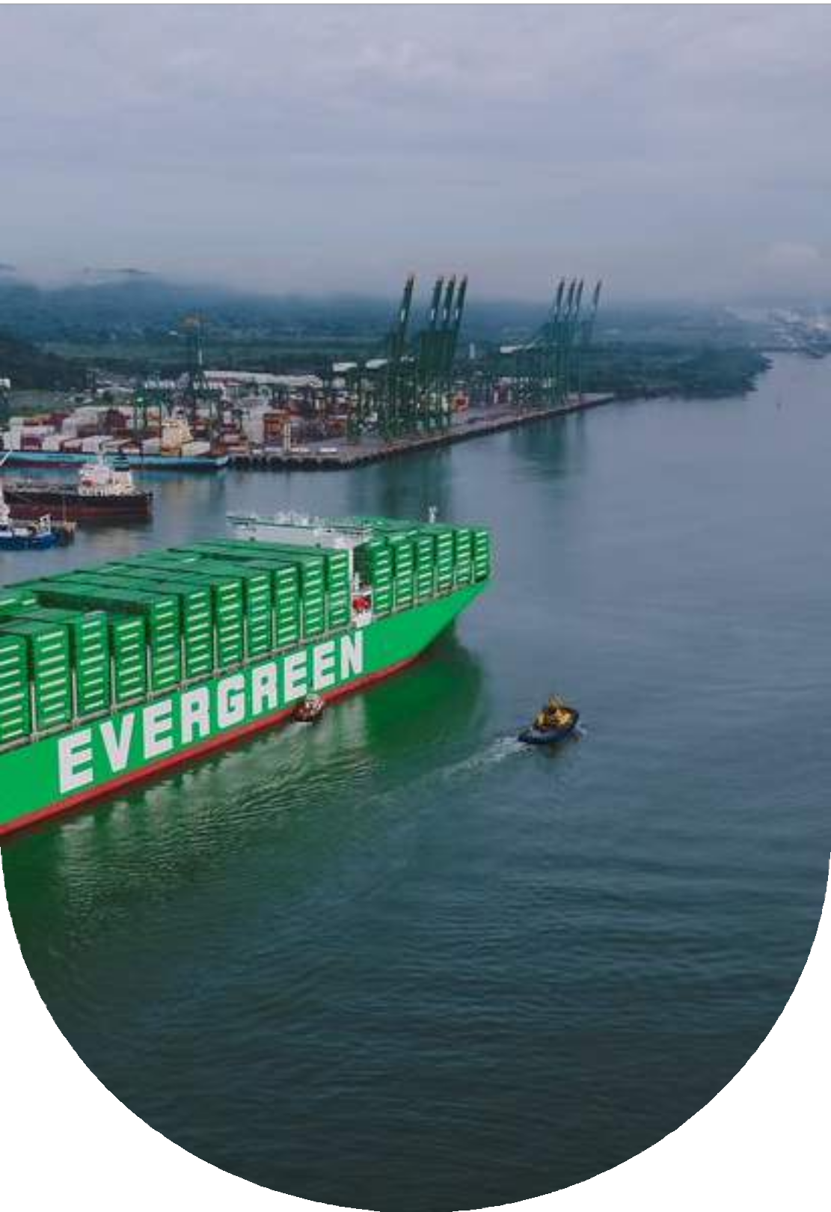
Content
CCT Timeline
01
CCT´s Facilities
02
CCT Historic Volume Per Shipping Company
03
Company Achievments
04
Challenges
05
Clients and Market Challenges
06
Diversification and Differention
07
What´s next?
08
Contact
09

Slide 3


CCT TIMELINE
Construction complete
Berth construction starts
2016: Completion of phase II
Trinorm implementation
CCT LOG 3PL initiate
1996
1998
2003
2014
2018
2024
2025
Awarded Coco Solo concession 1997: Begin operation
Land reclamation begins
2005: New Post- Panamax berth & CY enter service
Logistic Park
2018: planning and construction of a logistics park 2021: Park open for business
CLP Warehouse #1 fullfilment complete

Slide 4

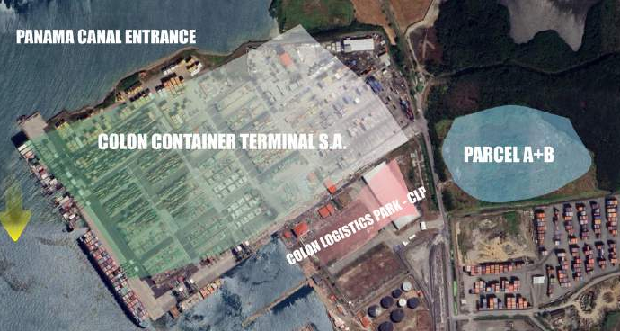
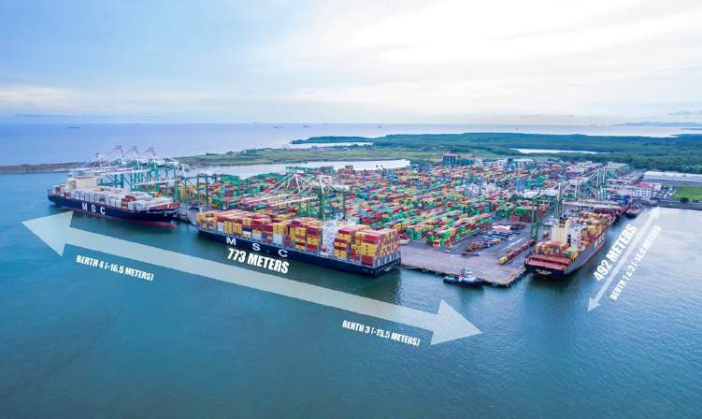

Slide 5
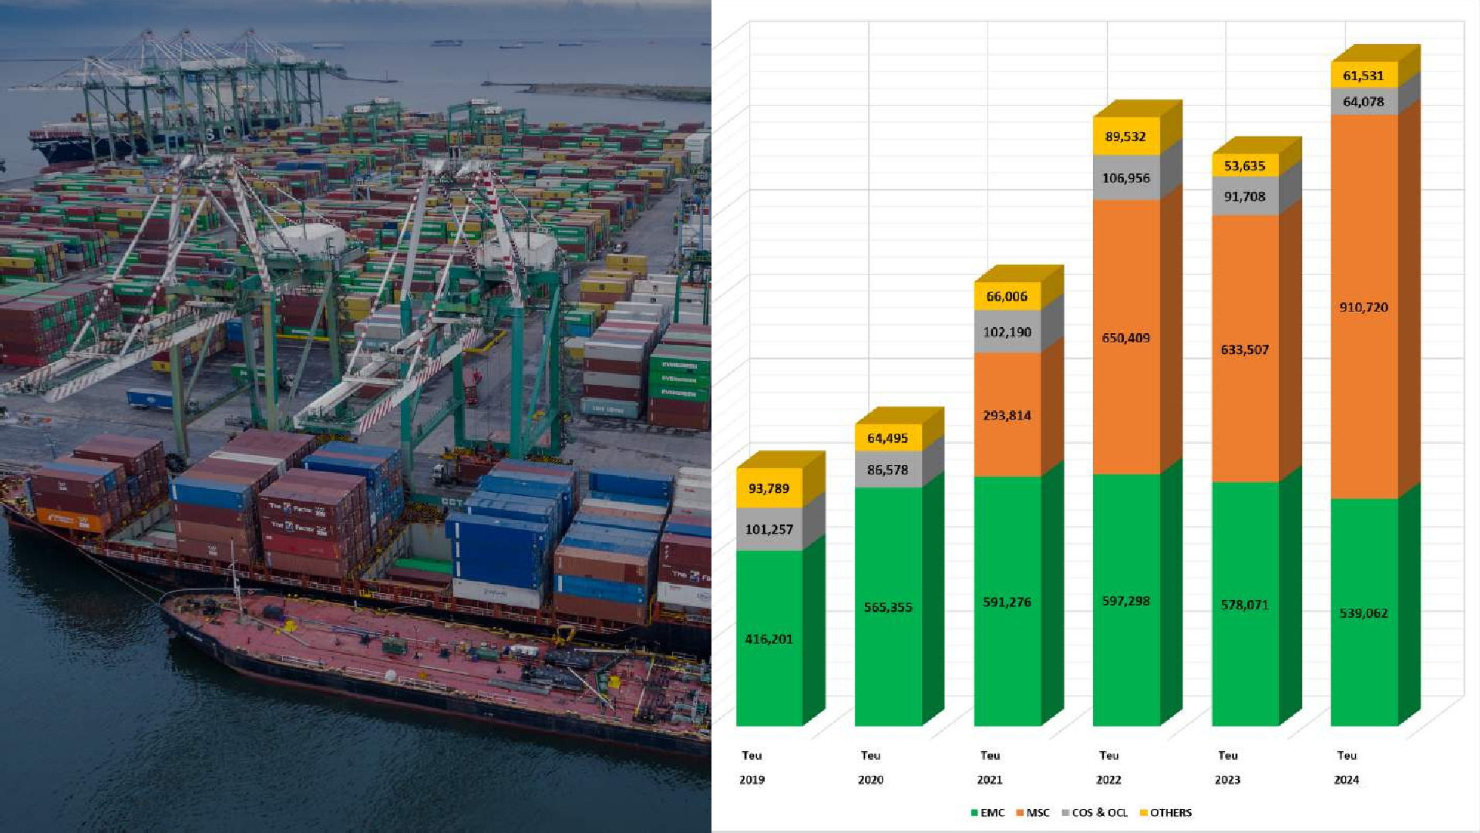




















CCT HISTORIC VOLUME PER SHIPPING COMPANY
1,575,391
1,444,195
1,356,921
1,053,286
716,428
611,247

Slide 6



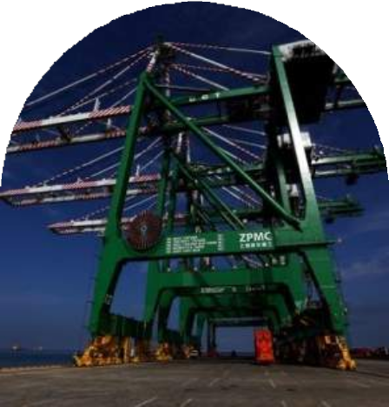
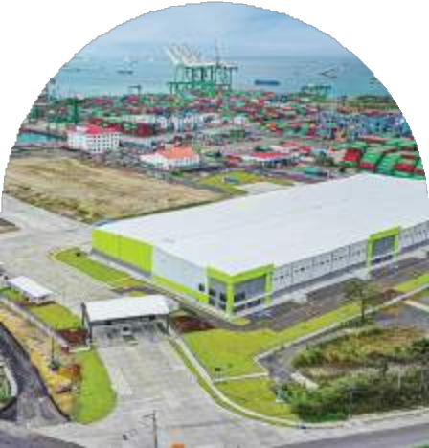




Company Achievements
CRANE CAPACITY IS INCREASED
CCT 3PL LOG IMPLEMENTATION
ISO 9001
ISO 14001
ISO 14064
ISO 45001

Slide 7



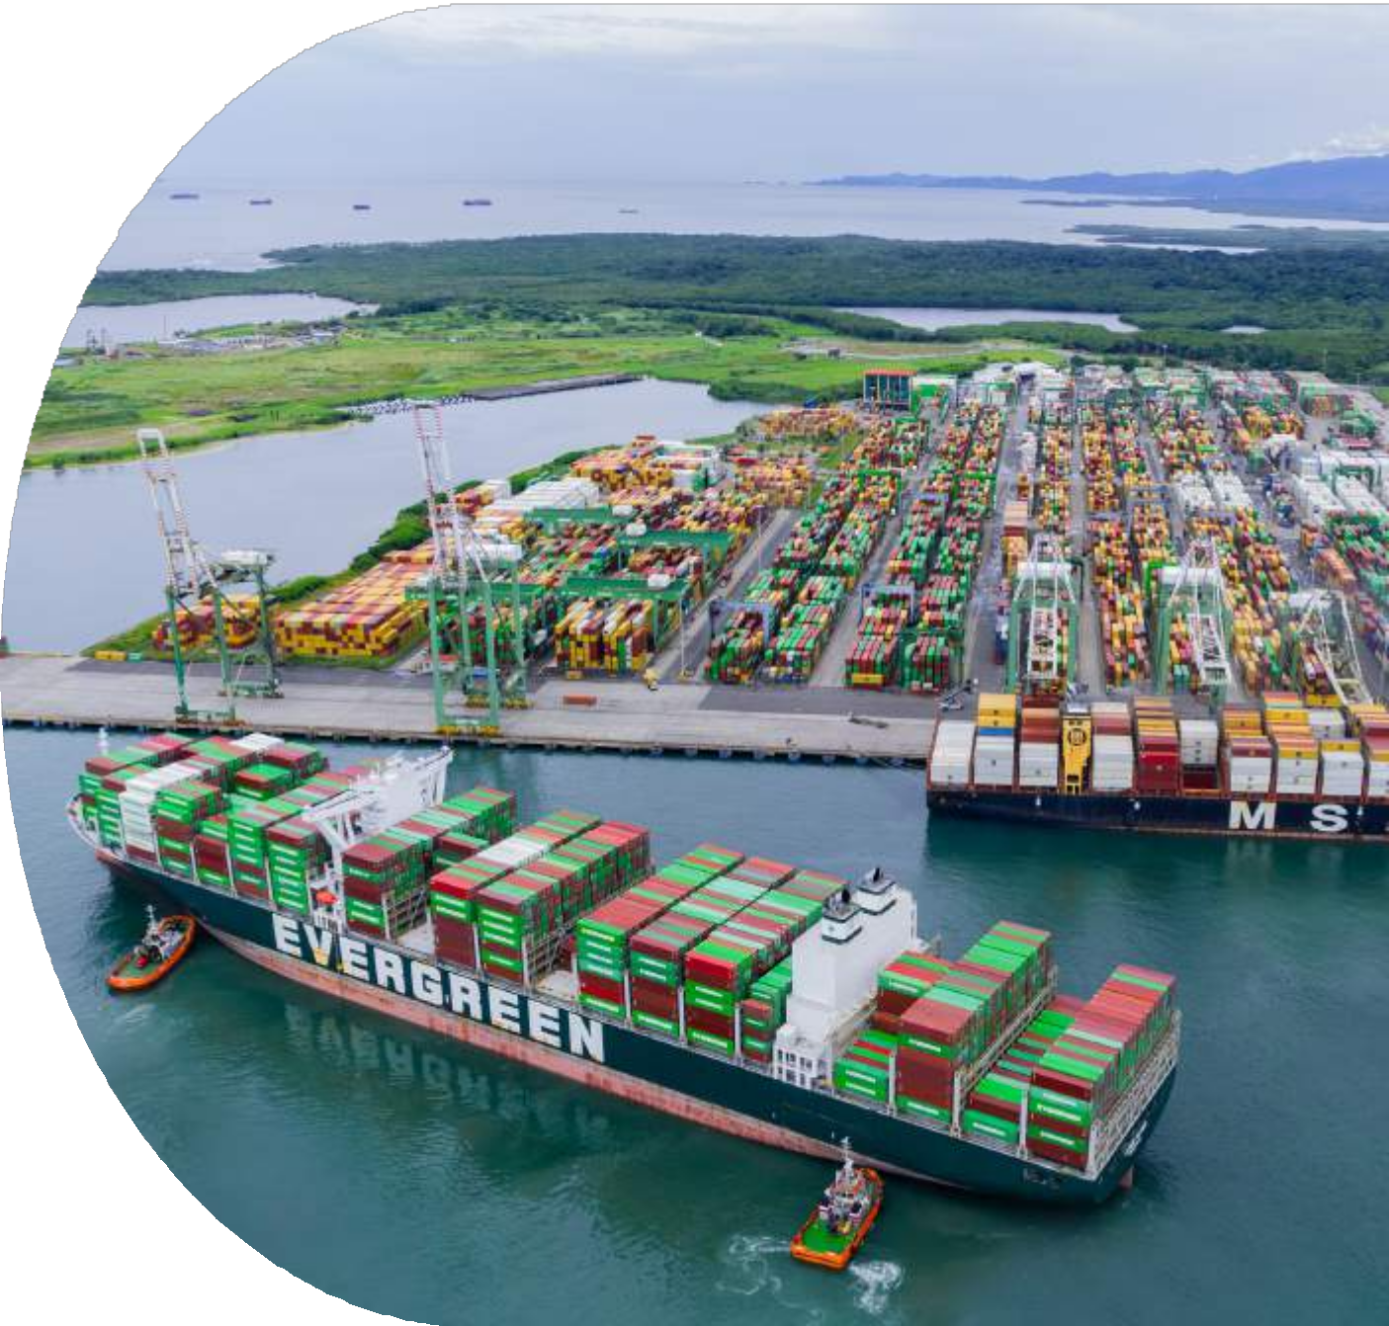





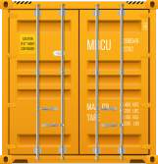



Challenges 1/2
Updating the value proposition by the integration of terminal and warehouse solutions
Increase in Container Storage Capacity

Slide 8







Challenges 2/2
CLP´S FINANCIAL TURNAROUND CLP´S WAREHOUSE CONSTRUCTION 2
AND 3
INCREASE PRODUCTIVITY IN PORT OPERATION
COST REDUCTION

Slide 9

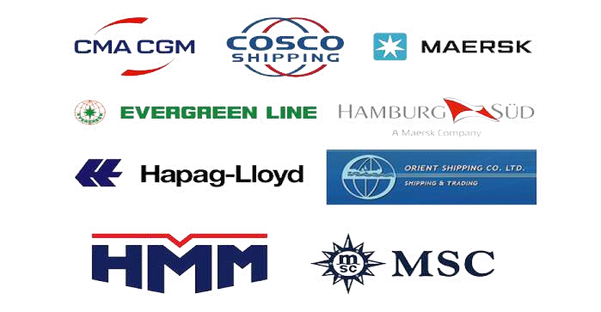

Clients and Market Challenges
Consolidate the MSC relationship
Diversification & Differentiation

Slide 10






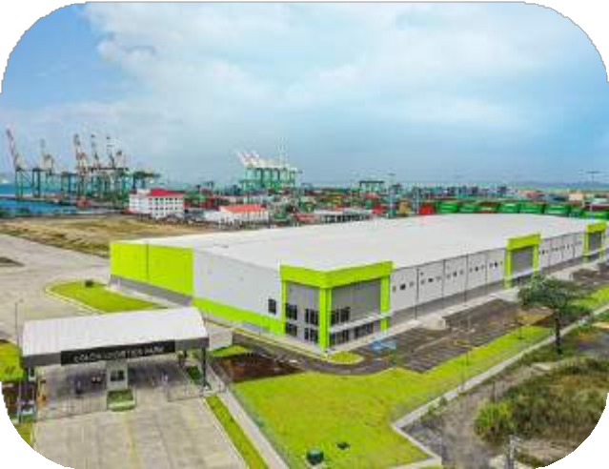
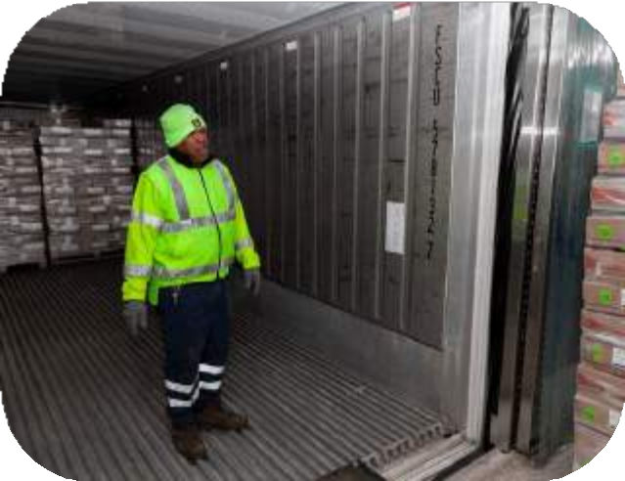


Diversification
Differentiation
Reefer Plugs & Utilization 2022
984 yard + 48 PTI + 220 Power Pack = 1,252 plugs
Reefer Plug Utilization 2021 - 2022
2,000 – 5,500 reefer boxes per month
Cold Transshipment up to
-20C°
Integration of CCT LOG 3PL

Slide 11
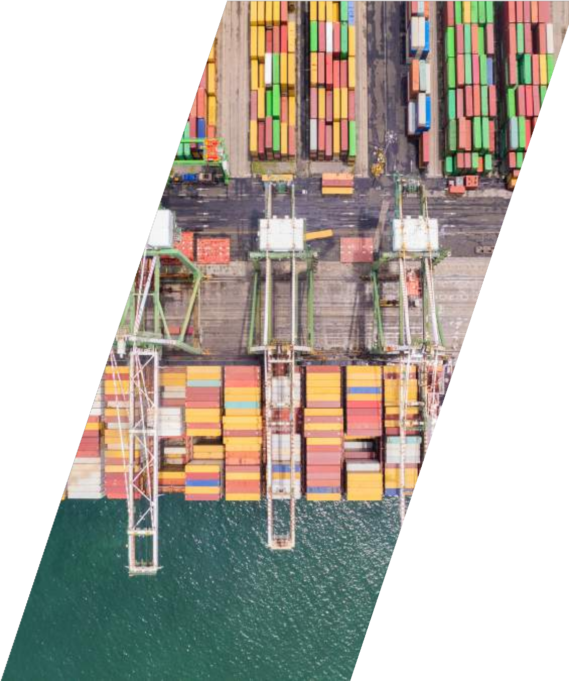
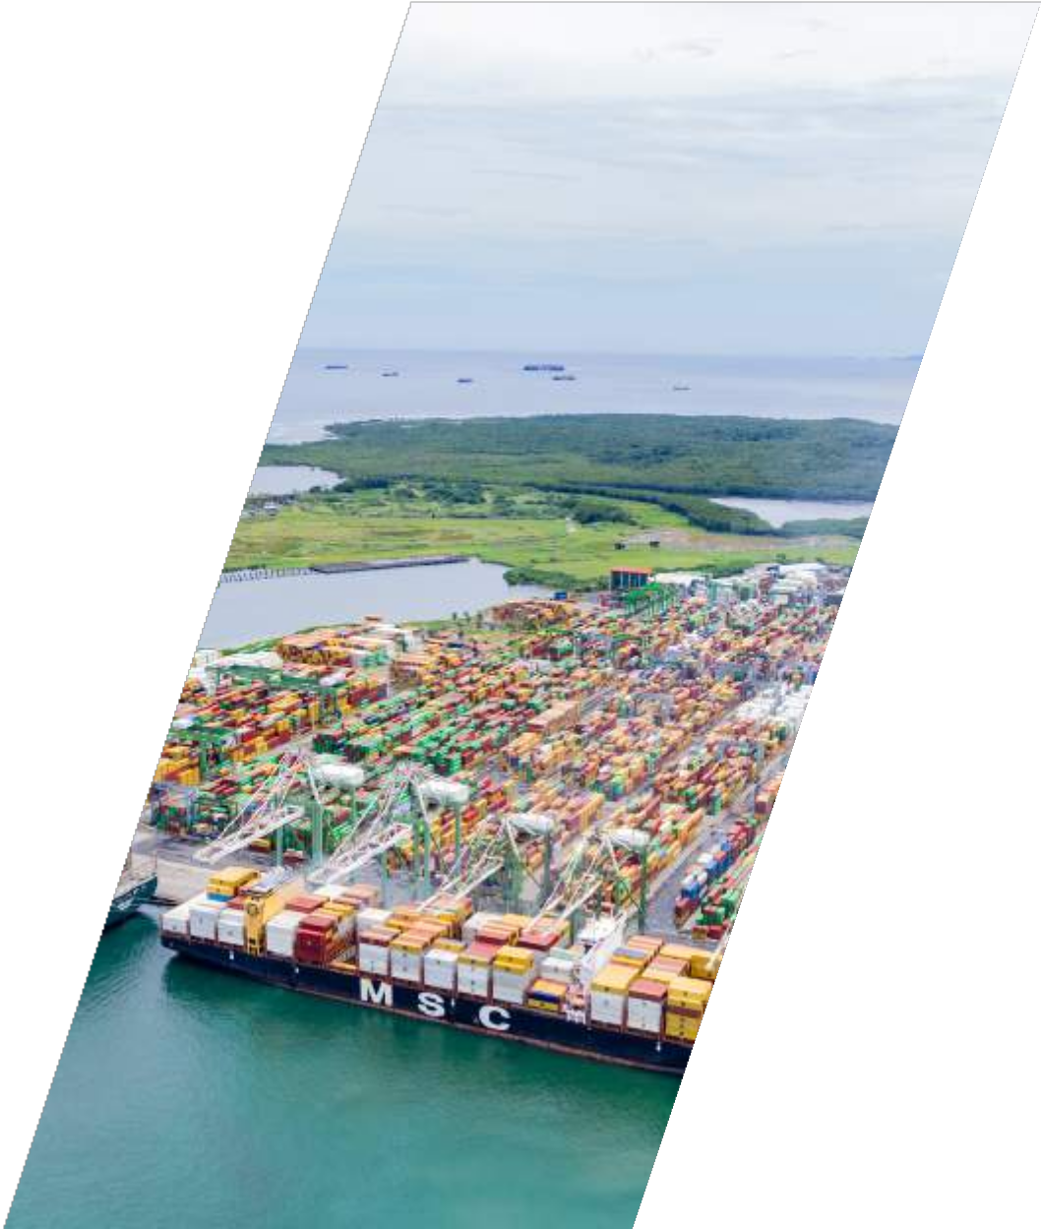
WHAT'S NEXT? 1/2
Construction of berth 5 Expansion of the Container Yard
Renewal of concession agreement beyond 2036

Slide 12
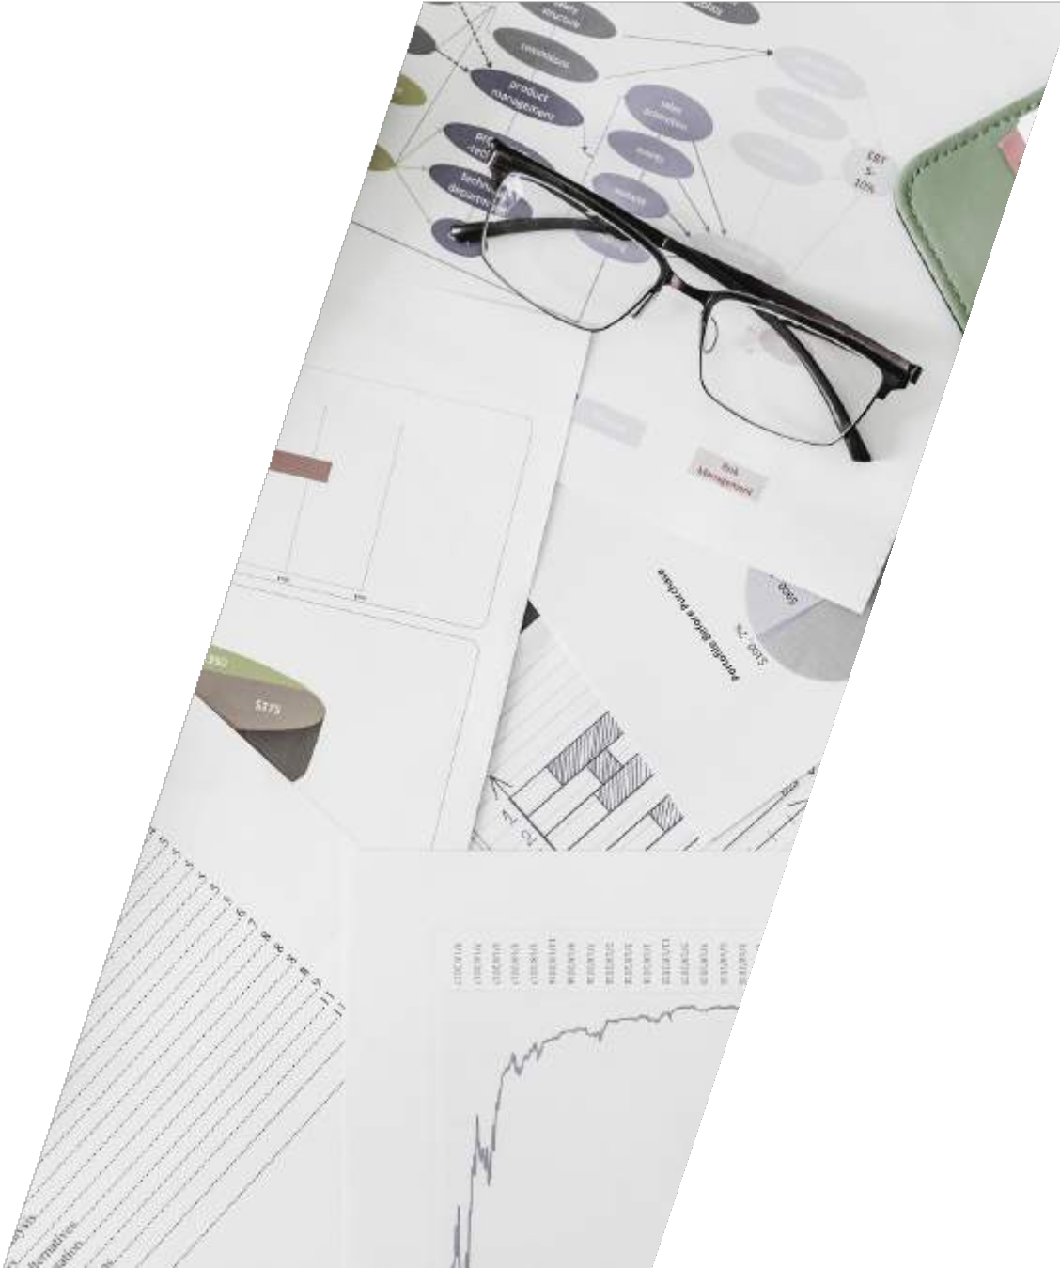

WHAT'S NEXT? 2/2
Eliminate all cash transactions, eliminate paperwork at the gate Optical Character Recognition (OCR)
Shipside operations – Eliminate paperwork, improve crane productivity, improve EIR/damage tracking

Slide 13

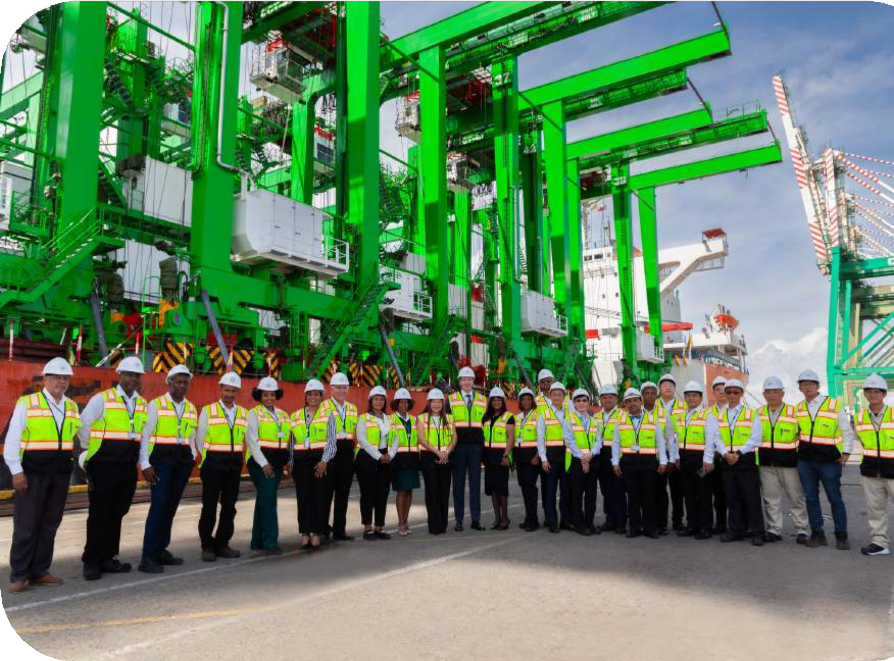

Colón Container Terminal S.A.
THANK YOU VERY MUCH
+(507) 430-9500
info@cct-pa.com www.cct-pa.com
Randolph Road, Coco Solo North
Colon, Republic of Panama

