Slide 1
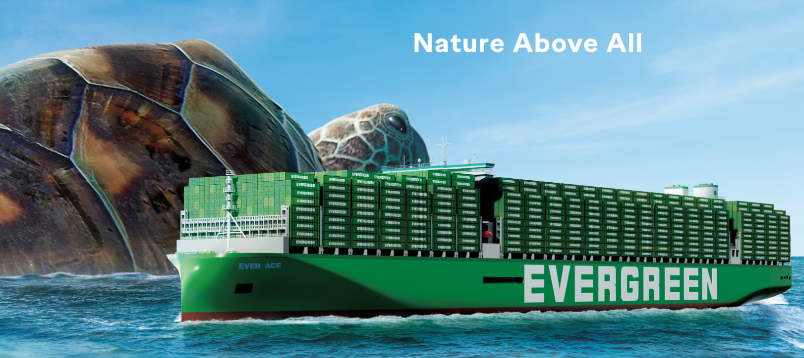
2025
LAAM Meeting (CARB)
By LAD/EGA/ELA 2025.FEB.27~28
By LAD/EGA/ELA

Slide 2
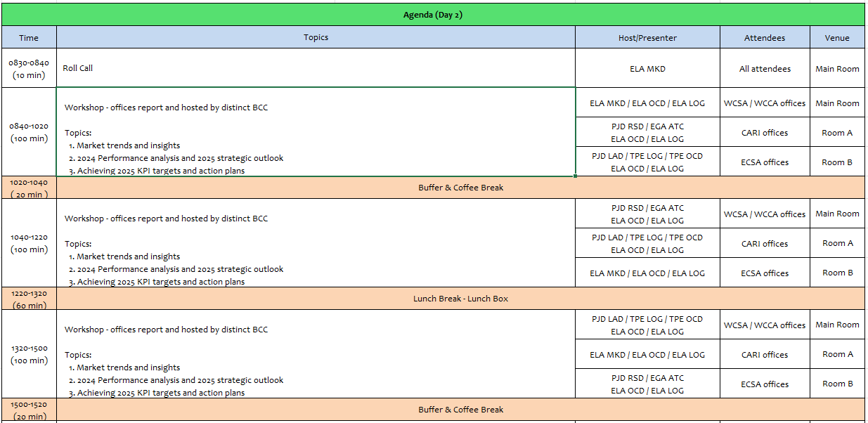
2

Slide 3
02
MIS
(COSTA RICA include NICARAGUA)

Slide 4
Performance/Space(2024) and 2025 Market Review (CR+NI)
Subject | Segments | BCC | 2024 Target TTL Loading(TEU) | 2024 JAN~DEC TTL Loading(TEU) | Achievement (%) | 2025 JAN~DEC TTL Loading(TEU) | Market Review & Action Plan (How to achieve 2025 target?)
 |  |  | (A) | (B) | (B)/(A) | Target
Trade Lane | F.E. => CR+NI IMP. (C Trade) | LAD | 127 | 212 | 167% | 245
 | F.E. => CR+NI IMP. (Q Trade) | LAD | 6,221 | 6,354 | 102% | 7,265
 | CR+NI EXP. => F.E. (CF Trade) | LAD | 5,483 | 5,106 | 93% | 5,140
4

Slide 5
Performance/Space(2024) and 2025 Market Review (CR+NI)
Subject | Segments | BCC | 2024 Target TTL Loading(TEU) | 2024 JAN~DEC TTL Loading(TEU) | Achievement (%) | 2025 JAN~DEC TTL Loading(TEU) | Market Review & Action Plan (How to achieve 2025 target?)
 |  |  | (A) | (B) | (B)/(A) | Target
Trade Lane | CR+NI ⬄ USEC (609+610 Trade) | EGA-ATC | 1,000 | 1,476 | 147% | 1,800
 | CR+NI ⬄ CARB+WCCA (CB Trade) | ELA | 2,350 | 1,188 | 51% | 1,350
 | CR+NI ⬄ WCSA (CW+WC Trade) | ELA | 500 | 797 | 159% | 650
 | CR+NI ⬄ USEC (622+623 Trade) | ELA | 1,100 | 1,710 | 155% | 1,500
5

Slide 6
Topic discussion (CR+NI)
Commercial side:
Future Plan Suggestion:
6

Slide 7
Topic discussion (CR+NI)
Future market forecast in 2025 (Pessimistic / Optimistic / Remain the same)?
Economic background.
Market share and Loading volume prospect 2025 (Long Haul)
 | Get worse | Improve | Stay the same
2025
7

Slide 8
ECD/IMD Topic discussion (CR+NI)
ECD KPI | Item | 2023 | 2024 | Diff | Action Plan in 2025
ECD KPI | Storage
 | Lift on/off
 | Reposition
 | M & R
IMD KPI | Cost Saving Project
 | 90% Onboard within 7 Days
 | No Personal Negligence
Topic
Aged Container Selling / Free Reposition Plan
  A
  B
8

Slide 9
OCD/OPD Topic discussion (CR+NI)
 |  | 2023 | 2024 | Diff | Action Plan in 2025
OPD KPI | BOA
 | Port Stay
 | Productivity
OCD KPI | Incentive
 | Empty Storage
 | Rate Reduction
Topic
Terminal info update (expansion/dredge/crane)
  A
  B
9

Slide 10
03
CRE
(CURACAO)

Slide 11
Performance/Space(2024) and 2025 Market Review (CW)
Subject | Segments | BCC | 2024 Target TTL Loading(TEU) | 2024 JAN~DEC TTL Loading(TEU) | Achievement (%) | 2025 JAN~DEC TTL Loading(TEU) | Market Review & Action Plan (How to achieve 2025 target?)
 |  |  | (A) | (B) | (B)/(A) | Target
Trade Lane | F.E. => CW IMP. (C Trade) | LAD | 332 | 566 | 170% | 588
 | CW ⬄ USEC (609+610 Trade) | EGA-ATC | 20 | 16 | 80% | 20
 | CW ⬄ CARI (CC Trade) | EGA-ATC | 20 | 23 | 115% | 20
11

Slide 12
Performance/Space(2024) and 2025 Market Review (CW)
Subject | Segments | BCC | 2024 Target TTL Loading(TEU) | 2024 JAN~DEC TTL Loading(TEU) | Achievement (%) | 2025 JAN~DEC TTL Loading(TEU) | Market Review & Action Plan (How to achieve 2025 target?)
 |  |  | (A) | (B) | (B)/(A) | Target
Trade Lane | CW ⬄ WCSA (CW+WC Trade) | ELA | 10 | 0 | 0% | 10
 | CW ⬄ WCCA+CARO (CB Trade) | ELA | 15 | 0 | 0% | 10
12

Slide 13
Topic discussion (CW)
Commercial side:
Future Plan Suggestion:
13

Slide 14
Topic discussion (CW)
Future market forecast in 2025 (Pessimistic / Optimistic / Remain the same)?
Economic background.
Market share and Loading volume prospect 2025 (Long Haul)
 | Get worse | Improve | Stay the same
2025
14

Slide 15
ECD/IMD Topic discussion (CW)
ECD KPI | Item | 2022 | 2023 | Diff | Action Plan in 2025
ECD KPI | Storage
 | Lift on/off
 | Reposition
 | M & R
IMD KPI | Cost Saving Project
 | 90% Onboard within 7 Days
 | No Personal Negligence
15

Slide 16
OCD/OPD Topic discussion (CW)
 |  | 2022 | 2023 | Diff | Action Plan in 2025
OPD KPI | BOA
 | Port Stay
 | Productivity
OCD KPI | Incentive
 | Empty Storage
 | Rate Reduction
Topic
Terminal info update (expansion/dredge/crane)
  A
  B
16

Slide 17
04
SMS
(HAITI)

Slide 18
Performance/Space(2024) and 2025 Market Review (HT)
Subject | Segments | BCC | 2024 Target TTL Loading(TEU) | 2024 JAN~DEC TTL Loading(TEU) | Achievement (%) | 2025 JAN~DEC TTL Loading(TEU) | Market Review & Action Plan (How to achieve 2025 target?)
 |  |  | (A) | (B) | (B)/(A) | Target
Trade Lane | F.E. => HT IMP. (C Trade) | LAD | 1,219 | 1,450 | 119% | 1,715
 | HT ⬄ CARI+CARO (CB Trade) | ELA | 1,000 | 222 | 22% | 500
18

Slide 19
Performance/Space(2024) and 2025 Market Review (HT)
Subject | Segments | BCC | 2024 Target TTL Loading(TEU) | 2024 JAN~DEC TTL Loading(TEU) | Achievement (%) | 2025 JAN~DEC TTL Loading(TEU) | Market Review & Action Plan (How to achieve 2025 target?)
 |  |  | (A) | (B) | (B)/(A) | Target
Trade Lane | HT ⬄ WCSA+WCCA (CW+WC+CB Trade) | ELA | 1,000 | 60 | 6% | 80
 | HT ⬄ USEC (622+623 Trade) | ELA | 500 | 75 | 15% | 250
19

Slide 20
Topic discussion (HT)
Commercial side:
Future Plan Suggestion:
20

Slide 21
Topic discussion (HT)
Future market forecast in 2025 (Pessimistic / Optimistic / Remain the same)?
Economic background.
Market share and Loading volume prospect 2025 (Long Haul)
 | Get worse | Improve | Stay the same
2025
21

Slide 22
ECD/IMD Topic discussion (HT)
ECD KPI | Item | 2023 | 2024 | Diff | Action Plan in 2025
ECD KPI | Storage
 | Lift on/off
 | Reposition
 | M & R
IMD KPI | Cost Saving Project
 | 90% Onboard within 7 Days
 | No Personal Negligence
Topic
Aged Container Selling / Free Reposition Plan
  A
  B
22

Slide 23
OCD/OPD Topic discussion (HT)
 |  | 2023 | 2024 | Diff | Action Plan in 2025
OPD KPI | BOA
 | Port Stay
 | Productivity
OCD KPI | Incentive
 | Empty Storage
 | Rate Reduction
Topic
Terminal info update (expansion/dredge/crane)
  A
  B
23

Slide 24
05
MCD
(DOMINICAN REPUBLIC)

Slide 25
Performance/Space(2024) and 2025 Market Review (DO)
Subject | Segments | BCC | 2024 Target TTL Loading(TEU) | 2024 JAN~DEC TTL Loading(TEU) | Achievement (%) | 2025 JAN~DEC TTL Loading(TEU) | Market Review & Action Plan (How to achieve 2025 target?)
 |  |  | (A) | (B) | (B)/(A) | Target
Trade Lane | F.E. => DO IMP. (C Trade) | LAD | 2,708 | 2,530 | 96% | 4,900
25

Slide 26
Performance/Space(2024) and 2025 Market Review (DO)
Subject | Segments | BCC | 2024 Target TTL Loading(TEU) | 2024 JAN~DEC TTL Loading(TEU) | Achievement (%) | 2025 JAN~DEC TTL Loading(TEU) | Market Review & Action Plan (How to achieve 2025 target?)
 |  |  | (A) | (B) | (B)/(A) | Target
Trade Lane | DO ⬄ USEC (609+610 Trade) | EGA-ATC | 200 | 209 | 104% | 200
 | DO ⬄ CARI (CC Trade) | EGA-ATC | 2,900 | 3466 | 119% | 2,900
26

Slide 27
Performance/Space(2024) and 2025 Market Review (DO)
Subject | Segments | BCC | 2024 Target TTL Loading(TEU) | 2024 JAN~DEC TTL Loading(TEU) | Achievement (%) | 2025 JAN~DEC TTL Loading(TEU) | Market Review & Action Plan (How to achieve 2025 target?)
 |  |  | (A) | (B) | (B)/(A) | Target
Trade Lane | DO ⬄ WCSA (CW+WC Trade) | ELA | 150 | 21 | 14% | 50
 | DO ⬄ WCCA+CARO (CB Trade) | ELA | 300 | 70 | 23% | 100
27

Slide 28
Topic discussion (DO)
Commercial side:
Future Plan Suggestion:
28

Slide 29
Topic discussion (DO)
Future market forecast in 2025 (Pessimistic / Optimistic / Remain the same)?
Economic background.
Market share and Loading volume prospect 2025 (Long Haul)
 | Get worse | Improve | Stay the same
2025
29

Slide 30
ECD/IMD Topic discussion (DO)
ECD KPI | ITEM | 2023 | 2024 | Diff | Action Plan in 2025
ECD KPI | Storage
 | Lift on/off
 | Reposition
 | M & R
IMD KPI | Cost Saving Project
 | 90% Onboard within 7 Days
 | No Personal Negligence
Topic
Aged Container Selling / Free Reposition Plan
  A
  B
30

Slide 31
OCD/OPD Topic discussion (DO)
 | ITEM | 2023 | 2024 | Diff | Action Plan in 2025
OPD KPI | BOA
 | Port Stay
 | Productivity
OCD KPI | Incentive
 | Empty Storage
 | Rate Reduction
Topic
Terminal info update (expansion/dredge/crane)
  A
  B
31

Slide 32
06
LNM
(JAMAICA)

Slide 33
Performance/Space(2024) and 2025 Market Review (JM)
Subject | Segments | BCC | 2024 Target TTL Loading(TEU) | 2024 JAN~DEC TTL Loading(TEU) | Achievement (%) | 2025 JAN~DEC TTL Loading(TEU) | Market Review & Action Plan (How to achieve 2025 target?)
 |  |  | (A) | (B) | (B)/(A) | Target
Trade Lane | F.E. => JM IMP. (C Trade) | LAD | 379 | 339 | 90% | 490 | Rate was trending down in most cases and EMC had managed to remain competitive. However, there was significant delays with feeder service, hence major decline to end the Q4. Action Plan includes: Pushing for Priority at POL and request assistance from UMS Sending weekly Rate Guideline rates to client list Follow through with daily AMP updates per trade.
 | JM ⬄ USEC (609+610 Trade) | EGA-ATC | 10 | 9 | 90% | 10 | Export booking delays due to LOI needed for sensitive cargo approval. Rates are competitive and can win big accounts, feeder service just need to be on time. Action Plan includes: Improve Customer Service traing and support Additonal Employees has been trained and added to staff for sales and lead generating support.
 | JM ⬄ CARI (CC Trade) | EGA-ATC | 25 | 28 | 112% | 25 | Rates have been competitive - Port to Port Feeder service remain unstable Cma and Seaboard has a more reliable service in the market. Action Plan includes: Improve Customer Service traing and support Additonal Employees has been trained and added to staff for sale and lead generating support. Seek additonal sale support from: Panama Team Colombia Team Costa Rica Team
33

Slide 34
Performance/Space(2024) and 2025 Market Review (JM)
Subject | Segments | BCC | 2024 Target TTL Loading(TEU) | 2024 JAN~DEC TTL Loading(TEU) | Achievement (%) | 2025 JAN~DEC TTL Loading(TEU) | Market Review & Action Plan (How to achieve 2025 target?)
 |  |  | (A) | (B) | (B)/(A) | Target
Trade Lane | JM ⬄ WCSA (CW+WC Trade) | ELA | 10 | 0 | 0% | 10 | We need more competitive rates, service tend to be unreliable. comparing to CMA and Seaboard.
 | JM ⬄ WCCA+CARO (CB Trade) | ELA | 515 | 204 | 40% | 250 | Action Plan includes: Additional Employees has been trained and added to staff for sales and lead generating support.
34

Slide 35
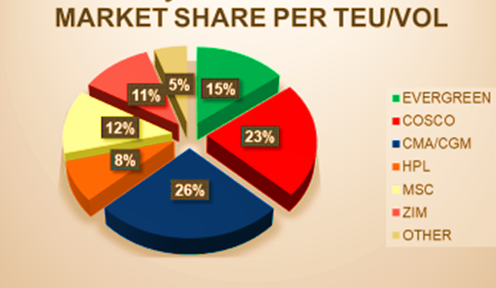
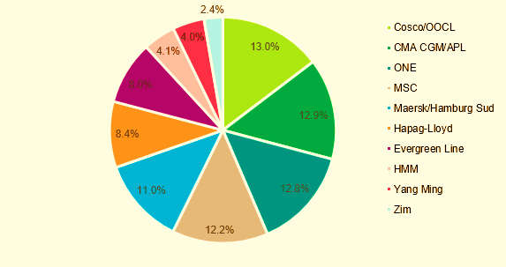
Market Share for F.E TO JMKSN

Slide 36
Topic discussion (JM)
 | Get worse | Improve | Stay the same
2025 |  | V
Future market forecast in 2025 (Remain the same)?
In 2024, Jamaica's economy faced challenges, including a contraction of 2.8% in the third quarter, primarily due to adverse weather conditions impacting key sectors such as agriculture and mining. Despite these setbacks, the International Monetary Fund (IMF) projects a 2.1% growth in real GDP for Jamaica in 2025, indicating a positive outlook. imf.org
In support of economic development, the Government of Jamaica has allocated J$40 billion to the Shared Prosperity through Accelerated Improvement to our Road Network (SPARK) Programme. This initiative aims to rehabilitate and enhance the nation's road infrastructure, thereby facilitating commerce and contributing to sustained economic growth
Election is due for 2025. Jamaica is scheduled to hold its next general election in 2025, with the exact date yet to be determined.
36

Slide 37
ECD/IMD Topic discussion (JM)
EC KPI | ITEM | 2023 | 2024 | Diff | Action Plan in 2025
ECD KPI | Storage | 5 FULL CONTAINER IN STORAGE | 5 FULL CONTAINER IN STORAGE | 0% | long overdue unclaimed cargo. Only two still on terminal / 1 abandoned. To frequently update unclaimed in SOL+ and advise BCC of our recommendations in our unclaimed report. EMC does not pay terminal for full container storage. (Domestic) 1x40ft Customs Hold Storage is handled by client for all units.
 | Lift on/off | Avg 20-30 units per hr/ day | Avg 20-30 units per hr/ day | 0
 | Reposition | 80% | 80% | 0 | Frequent feeder delays. EMC would need more space available to ship out empties
 | M & R | N/A | N/A | N/A | N/A
IMD KPI | Cost Saving Project | N/A | N/A | 30% | KFTL currently looking to increase their crane capacity by the end of 2024.
 | 90% Onboard within 7 Days | 80% | 80% | N/A | No change. We need more capacity on feeder service.
 | No Personal Negligence | Not AT THIS TIME | Not AT THIS TIME | 0% | All safety and regulatory requirements are closely monitored by Agency personnel.
37

Slide 38
OCD/OPD Topic discussion (JM)
 | ITEM | 2023 | 2024 | Diff | Action Plan in 2025
OPD KPI | BOA | 80% | 80% | 0% | The vessel would have to come within agreed terminal window.
 | Port Stay | 12hrs | 12hrs | 0 | We can continue to communicate to terminal to increase productivity.
 | Productivity | 20 moves per hour/crane | 20 moves per hour/crane | 0 | We can continue to communicate to terminal to increase productivity. As adjoining terminal KFTL current productivity is over 40 moves per hr/crane.
OCD KPI | Incentive | N/A | N/A | N/A | N/A
 | Empty Storage | 30 Days | 20 days | 30% | EMC would need to provide reposition options from JMKSNT.
 | Rate Reduction | N/A | N/A | N/A | N/A
Topic
Terminal info update (expansion/dredge/crane)
  A
  B
38

Slide 39
07
UMS
(PANAMA)

Slide 40
Performance/Space(2024) and 2025 Market Review (PA)
Subject | Segments | BCC | 2024 Target TTL Loading(TEU) | 2024 JAN~DEC TTL Loading(TEU) | Achievement (%) | 2025 JAN~DEC TTL Loading(TEU) | Market Review & Action Plan (How to achieve 2025 target?)
 |  |  | (A) | (B) | (B)/(A) | Target
Trade Lane | F.E. => PA IMP. (C Trade) | LAD | 15,512 | 17,444 | 112% | 16,415
 | PA ⬄ USEC (609+610 Trade) | EGA-ATC | 210 | 138 | 66% | 210
 | PA ⬄ CARI (CC Trade) | EGA-ATC | 5,700 | 4881 | 86% | 5,500
40

Slide 41
Performance/Space(2024) and 2025 Market Review (PA)
Subject | Segments | BCC | 2024 Target TTL Loading(TEU) | 2024 JAN~DEC TTL Loading(TEU) | Achievement (%) | 2025 JAN~DEC TTL Loading(TEU) | Market Review & Action Plan (How to achieve 2025 target?)
 |  |  | (A) | (B) | (B)/(A) | Target
Trade Lane | PA ⬄ WCSA (CW+WC Trade) | ELA | 310 | 289 | 93% | 310
 | PA ⬄ WCCA+CARO (CB Trade) | ELA | 950 | 291 | 31% | 350
41

Slide 42
Topic discussion (PA)
Commercial side:
Future Plan Suggestion:
42

Slide 43
Topic discussion (PA)
Future market forecast in 2025 (Pessimistic / Optimistic / Remain the same)?
Economic background.
Market share and Loading volume prospect 2025 (Long Haul)
 | Get worse | Improve | Stay the same
2025
43

Slide 44
ECD/IMD Topic discussion (PA)
ECD KPI | ITEM | 2023 | 2024 | Diff | Action Plan in 2025
ECD KPI | Storage
 | Lift on/off
 | Reposition
 | M & R
IMD KPI | Cost Saving Project
 | 90% Onboard within 7 Days
 | No Personal Negligence
Topic
Aged Container Selling / Free Reposition Plan
  A
  B
44

Slide 45
OCD/OPD Topic discussion (PA)
 | ITEM | 2023 | 2024 | Diff | Action Plan in 2025
OPD KPI | BOA
 | Port Stay
 | Productivity
OCD KPI | Incentive
 | Empty Storage
 | Rate Reduction
Topic
Terminal info update (expansion/dredge/crane)
  A
  B
45

Slide 46
08
PRIS
(PUERTO RICO)

Slide 47
Performance/Space(2024) and 2025 Market Review (PR)
Subject | Segments | BCC | 2024 Target TTL Loading(TEU) | 2024 JAN~DEC TTL Loading(TEU) | Achievement (%) | 2025 JAN~DEC TTL Loading(TEU) | Market Review & Action Plan (How to achieve 2025 target?)
 |  |  | (A) | (B) | (B)/(A) | Target
Trade Lane | F.E. => PR IMP. (618 Trade) | LAD | 6,511 | 9,247 | 142% | 9,800
 | PR ⬄ CARI (609+610 Trade) | EGA-ATC | 830 | 354 | 43% | 500
47

Slide 48
Performance/Space(2024) and 2025 Market Review (PR)
Subject | Segments | BCC | 2024 Target TTL Loading(TEU) | 2024 JAN~DEC TTL Loading(TEU) | Achievement (%) | 2025 JAN~DEC TTL Loading(TEU) | Market Review & Action Plan (How to achieve 2025 target?)
 |  |  | (A) | (B) | (B)/(A) | Target
Trade Lane | PR ⬄ WCSA (619+620 Trade) | ELA | 250 | 0 | 0% | 10
 | PR ⬄ WCCA+CARO (622+623 Trade) | ELA | 850 | 44 | 5% | 70
48

Slide 49
Topic discussion (PR)
Commercial side:
Future Plan Suggestion:
49

Slide 50
Topic discussion (PR)
Future market forecast in 2025 (Pessimistic / Optimistic / Remain the same)?
Economic background.
Market share and Loading volume prospect 2025 (Long Haul)
 | Get worse | Improve | Stay the same
2025
50

Slide 51
ECD/IMD Topic discussion (PR)
ECD KPI | ITEM | 2023 | 2024 | Diff | Action Plan in 2025
ECD KPI | Storage
 | Lift on/off
 | Reposition
 | M & R
IMD KPI | Cost Saving Project
 | 90% Onboard within 7 Days
 | No Personal Negligence
Topic
Aged Container Selling / Free Reposition Plan
  A
  B
51

Slide 52
OCD/OPD Topic discussion (PR)
 | ITEM | 2023 | 2024 | Diff | Action Plan in 2025
OPD KPI | BOA
 | Port Stay
 | Productivity
OCD KPI | Incentive
 | Empty Storage
 | Rate Reduction
Topic
Terminal info update (expansion/dredge/crane)
  A
  B
52

Slide 53
09
ISL
(TRINIDAD)

Slide 54
Performance/Space(2024) and 2025 Market Review (TT)
Subject | Segments | BCC | 2024 Target TTL Loading(TEU) | 2024 JAN~DEC TTL Loading(TEU) | Achievement (%) | 2025 JAN~DEC TTL Loading(TEU) | Market Review & Action Plan (How to achieve 2025 target?)
 |  |  | (A) | (B) | (B)/(A) | Target
Trade Lane | F.E. => TT IMP. (C Trade) | LAD | 130 | 0 | 0 | 10
54

Slide 55
Performance/Space(2024) and 2025 Market Review (TT)
Subject | Segments | BCC | 2024 Target TTL Loading(TEU) | 2024 JAN~DEC TTL Loading(TEU) | Achievement (%) | 2025 JAN~DEC TTL Loading(TEU) | Market Review & Action Plan (How to achieve 2025 target?)
 |  |  | (A) | (B) | (B)/(A) | Target
Trade Lane | TT ⬄ CARB (CB Trade) | ELA | 10 | 6 | 60% | 5
 | TT ⬄ WCSA (CW+WC Trade) | ELA | 10 | 0 | 0% | 5 | Continue to share market data and competitive rates from other carriers with our BCC. Aiming to offer more competitive rates to customers. Target per week is 10 TEU once competitive rates are offered. Enhance marketing communication by launching an Evergreen campaign which will build awareness of the line and services offered.
 | TT ⬄ WCCA (CB Trade) | ELA | 10 | 0 | 0% | 5 | Continue to share market data and competitive rates from other carriers with our BCC. Aiming to offer more competitive rates to customers. Target per week is 10 TEU once competitive rates are offered. Enhance marketing communication by launching an Evergreen campaign which will build awareness of the line and services offered.
55

Slide 56
Topic discussion (TT)
Commercial side:
Future Plan Suggestion:
56

Slide 57
Topic discussion (TT)
Future market forecast in 2025 (Pessimistic / Optimistic / Remain the same)?
Economic background.
Market share and Loading volume prospect 2025 (Long Haul)
 | Get worse | Improve | Stay the same
2025
57

Slide 58
ECD/IMD Topic discussion (TT)
ECD KPI | ITEM | 2023 | 2024 | Diff | Action Plan in 2025
ECD KPI | Storage
 | Lift on/off
 | Reposition
 | M & R
IMD KPI | Cost Saving Project
 | 90% Onboard within 7 Days
 | No Personal Negligence
Topic
Aged Container Selling / Free Reposition Plan
  A
  B
58

Slide 59
OCD/OPD Topic discussion (TT)
 | ITEM | 2023 | 2024 | Diff | Action Plan in 2025
OPD KPI | BOA
 | Port Stay
 | Productivity
OCD KPI | Incentive
 | Empty Storage
 | Rate Reduction
Topic
Terminal info update (expansion/dredge/crane)
  A
  B
59

Slide 60


