Slide 1
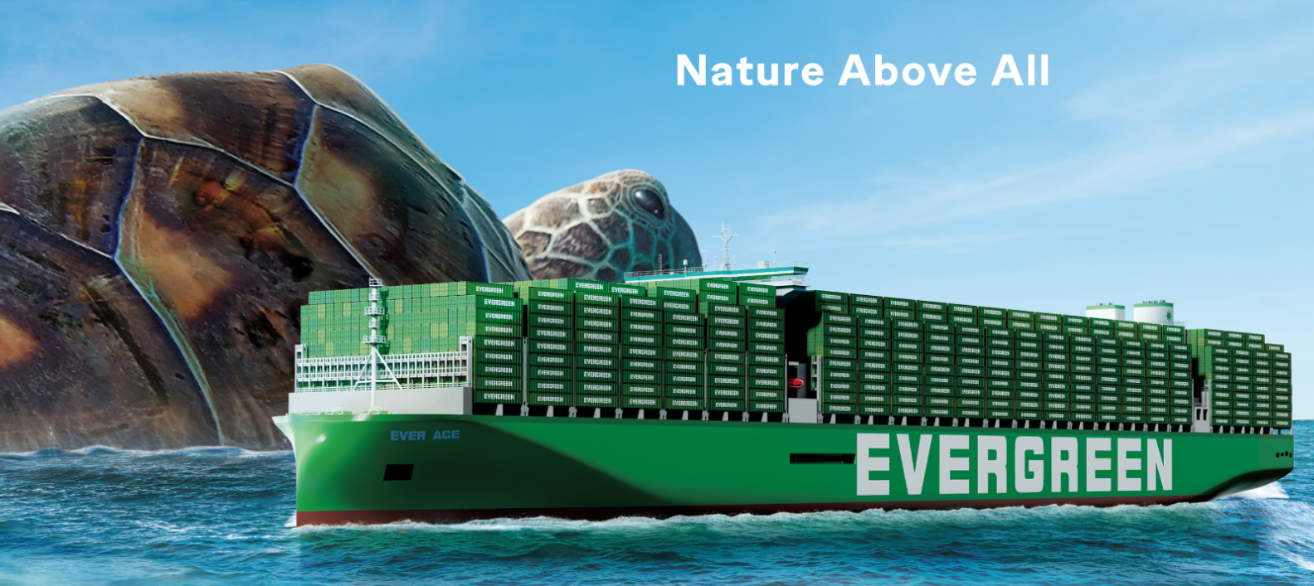
2025
LAAM Meeting (CARB)
By LAD/EGA/ELA 2025.FEB.27~28
By LAD/EGA/ELA

Slide 2
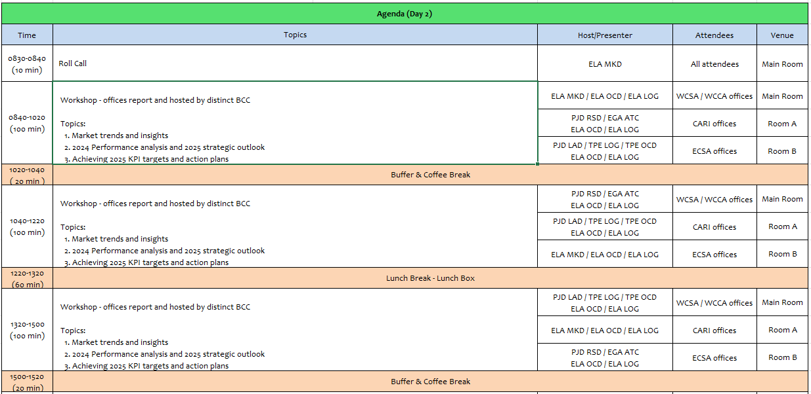
2

Slide 3
05
MCD
(DOMINICAN REPUBLIC)

Slide 4
Performance/Space(2024) and 2025 Market Review (DO)
Subject | Segments | BCC | 2024 Target TTL Loading(TEU) | 2024 JAN~DEC TTL Loading(TEU) | Achievement (%) | 2025 JAN~DEC TTL Loading(TEU) | Market Review & Action Plan (How to achieve 2025 target?)
 |  |  | (A) | (B) | (B)/(A) | Target
Trade Lane | F.E. => DO IMP. (C Trade) | LAD | 2,708 | 2,530 | 96% | 4,900 | MSC leads market with 24.43% share demoting CMA-CGM which holds second place with 22.39% market share. EGL maintains third place with 14.77% share in FE/DO trade. Market share is based on our IU stats, from January through November 2024. Our OWN SQ decreased -30.87% YOY, going from 3660 TEU in 2023 to 2530 in 2024. Actual FOB/CIF ratio is 12/88. While other carriers also faced problems with congestion, it did not reach the extend of Evergreen. At some point cargoes reached 120+ days transit time. The damage in terms of reputation to the Evergreen brand was (and is) considerably. Some customers do not even take our calls and/or allow us to visit them. Action Plan: As JV will terminate in February or March, we should have a steadier CAN svc with minimal if any roll overs. Based on that premise, we will be contacting/visiting all accounts whose volumes we had lost in the last two-three years. At the same time, we will start an advertising campaign in social media and others, sending the message that Evergreen is back with reliable services and competitive rates. Same will be amplified by digital flyers, sending them directly to all accounts in our database, both FOB and CFR clients, BCO's and NVO's.
4

Slide 5
Performance/Space(2024) and 2025 Market Review (DO)
Subject | Segments | BCC | 2024 Target TTL Loading(TEU) | 2024 JAN~DEC TTL Loading(TEU) | Achievement (%) | 2025 JAN~DEC TTL Loading(TEU) | Market Review & Action Plan (How to achieve 2025 target?)
 |  |  | (A) | (B) | (B)/(A) | Target
Trade Lane | DO ⬄ USEC (609+610 Trade) | EGA-ATC | 200 | 209 | 104% | 200 | DO/USEC: As well known, our competitors have direct service to the USEC, avg 5-8 days TT, in order to keep some support, a fixed schedule is imperative. Action Plan: As JV will terminate in February or March, we should have a steadier CAN svc with minimal if any roll overs. Based on that premise, we will be contacting/visiting all accounts whose volumes we had lost in the last two-three years.
 | DO ⬄ CARI (CC Trade) | EGA-ATC | 2,900 | 3466 | 119% | 2,900 | During Q1 2024, dedicated DO-PR carrier Marine Express, faced problems with their vessel, which allowed us to quickly gain support from some of their current customers during Q2. After said carrier finally recovered, we were able to maintain some of these customers, but since problems with CAN schedule started in most of Q3-Q4, our volumes dropped significantly as customers need a reliable schedule. Action Plan: Same as above.
5

Slide 6
Performance/Space(2024) and 2025 Market Review (DO)
Subject | Segments | BCC | 2024 Target TTL Loading(TEU) | 2024 JAN~DEC TTL Loading(TEU) | Achievement (%) | 2025 JAN~DEC TTL Loading(TEU) | Market Review & Action Plan (How to achieve 2025 target?)
 |  |  | (A) | (B) | (B)/(A) | Target
Trade Lane | DO ⬄ WCSA (CW+WC Trade) | ELA | 150 | 21 | 14% | 50 | WCSA/DO current svc configuration has two T/S, increaing not only TT but also rate offer. Additionally, when requesting rates to BCC, it indicates that service it‘s temporarily unavailable in said trade. DO/WCSA: Many to cargo to WCSA is mosly waste paper and plastic waste wihch offer is very low $400-500/4sh all in. Also two of DO‘s major destinations (ECGYE & CLIQQ) have a very high offer due double T/S, and which limit our potential to grow more biz. How to improve: As JV will terminate in February or March, we should have a steadier CAN svc with minimal if any roll overs. Based on that premise, we will be contacting/visiting all accounts whose volumes we had lost in the last two-three years. Additionally, BCC support is needed to provide Waster/Recycling products special rates. that are exported to WCSA. It’s about the 90%.
 | DO ⬄ WCCA+CARO (CB Trade) | ELA | 300 | 70 | 23% | 100 | DO/WCCA: Our main problem is this svc instability. During LAAM 2024 svc was supposed to improve with the addition of new vessels, but TT didnt have major improvement and TT average is about +30 days. Additionally and from Q3 onwards we lost the ability to export cargo to SVAGR, one of DO most requested destinations in WCCA trade. How to improve: As JV will terminate in February or March, we should have a steadier CAN svc with minimal if any roll overs. Based on that premise, we will be contacting/visiting all accounts whose volumes we had lost in the last two-three years.
6

Slide 7
Topic discussion (DO)
Commercial side:
We believe that the Account Management Program (AMP) is a great tool to follow up and keep close to our dear customers, but when wrongly used, it just adds unnecessary and additional workload, at least from the agent point of view.
We're being forced to complete AMP reports on what we call practically "Dead trades“, trades in which currently cannot compete at all for reasons such as, very long transit times due to T/S (sometimes even double T/S) and in addition a disproportional high freight, whereas our competitors offer direct service with very competitive rates.
Other than FE/DO and DO to PA & PR (DO only direct calls at the moment) and DO/USEC, there's no other trades in which we're able to compete or have anything to offer. DO/WCCA, DO/WCSA & DO/FE, as of today present many challenges and what makes it very difficult to sale. In DO/FE there might be a good chance in we could compete with some commodities, but rates should be adjusted to meet our customers’ target.
In conclusion, we recommend AMP, at least in an initial phase, to apply only on those trades in what we have a real chance to compete, because the current conditions of a particular trade allows it. Make no mistake, DO will always try to make everything to get the cargo at the end of the day, but there's simply no point making the same reports over and over if our situation does not change.
Future Plan Suggestion:
Now that CAN service will have a new configuration and promise to provide a reliable weekly service soon, believe it’s a good opportunity to start making studies adding new routes in the near future. Our customers are eager for Evergreen to come up with new services and/or new origins/destinations. They often get the notices from other carriers informing about new routes, services and solutions.
For instance, perhaps having DO/NORTH EUROPE would be convenient as it’s a destination in which there are many exports, for both dry and reefer cargo.
7

Slide 8
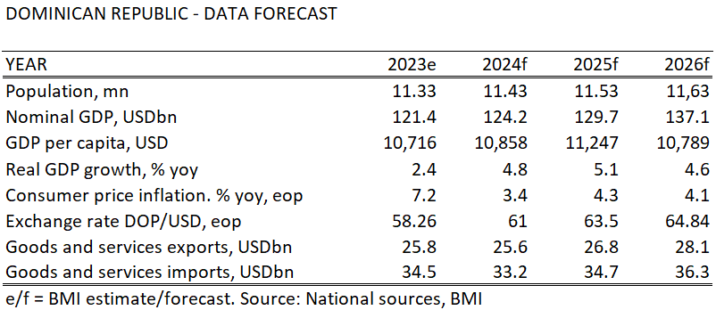
Topic discussion (DO)
Future market forecast in 2025 (Pessimistic / Optimistic / Remain the same)?
 | Get worse | Improve | Stay the same
2025 |  |  | V
Growth has resumed its historically robust pace and is projected to be the fastest growing economy in Latin America in 2024, reaching 5.1% during Q1~Q3 2024, following a slowdown to 2.3% in 2023 due to the high-interest rate environment.
Free trade zones and tourism continue to be bright spots in the economy, with tourist arrivals continuing to reach record highs.
Inflation Below Target: Inflation through October 2024 averaged 3.3%, below the BCRD’s (Central Bank) target of 4%. The BCRD has reduced its policy rate to 6.25% from a peak of 8.5% in May 2023.
8

Slide 9
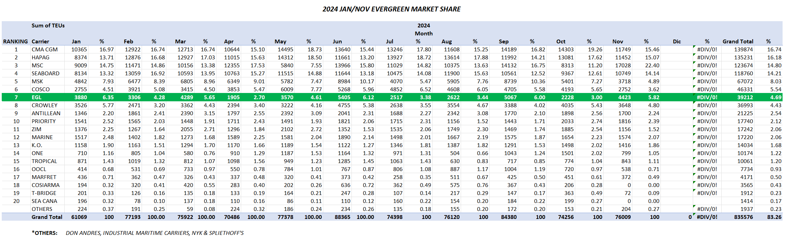
Topic discussion (DO)
Jan/Nov 2024 Market Share (DO Import + Export Volumes)
9

Slide 10
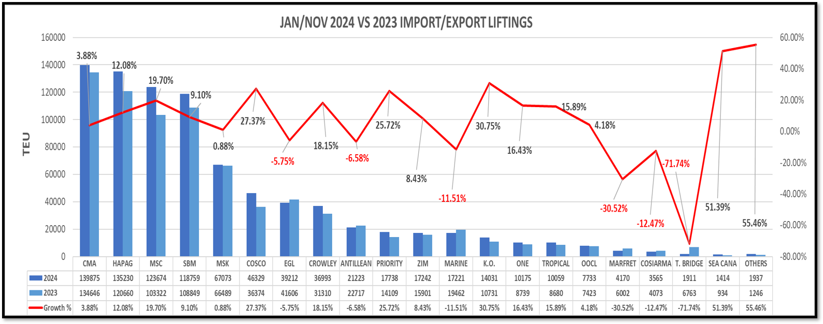
Topic discussion (DO)
JAN/NOV 2024 Vs 2023 IMPORT/EXPORT LIFTINGS / GROWTH
10

Slide 11
Topic discussion (DO)
Market share and Loading volume prospect 2025 (Long Haul)
Based on our Intelligence Unit statistics, from January through November 2024, Evergreen holds a share of 4.70% maintaining a seventh position among all carriers in DO. Overall TEU loaded (Import + Export) in said period range: 39,212. Meanwhile, in same time frame, DO overall import+export TEUs increased 9% going from 770,036 in 2023 to 835,576 in 2024.
According to our internal records in 2024 and in which there was not added services, faced strong roll over problems and several skips and delays, specifically DOCAU 2nd skips, Evergreen overall volumes decreased -5.10% going from 43,732 TEU in 2023 to 41503 TEU in 2024.
Since new CAN rotation is expected to launch during March 2025, and it would be a weekly steady service, by end of current year we can expect an 8% increase vs. 2024.
11

Slide 12
ECD/IMD Topic discussion (DO)
ECD KPI | ITEM | 2023 | 2024 | Diff | Action Plan in 2025
ECD KPI | Storage | US$539,495.34 | US$871,350.52 | US$331,855.18 | We hope that EMC will reestablish frequent calls to DO to reduce storage costs. Open depots to receive sold units, which would reduce costs because dispatch would be faster, and the line would not have to assume storage until dispatch.
 | Lift on/off | US$13,090 | US$43,274 | US$30,184 | Exports increased for 2024, and customer dispatched from DORHNT, which is where the line cover cost. Increase in units sold from DORHNT from 284 units to 288 units. In total 595 units dispatched from DORHNT in 2023 and 1064 units in 2024, which represents a percentage growth of 78.8% of dispatch from DORHN, It is suggested that units be returned to the depot to reduce costs to the line for storage and lift on/off concept.
 | Reposition | N/A | US$ 372,960 | US$ 372,960 | Repositioning costs could be eliminated by placing calls with space available to load all empty containers in port at the time of planning the vessel, for 2025 we hope to have recurring calls.
 | M & R | N/A | N/A | 0%
IMD KPI | Cost Saving Project | N/A | N/A
 | 90% Onboard within 7 Days | 0% | 0% | 0% | No units were loaded before the stipulated 7 days, for this it is necessary to have: Vessel space available to load empty units. Don't have skips, do not cut the operation to reach another window and get terminal apply the FIFO system, which its not possible due to the empty evacuated quantity does not allow to load empties in a timely manner under FIFO rules.​
 | No Personal Negligence | N/A | N/A | N/A | No personal negligence under line account
Topic
Aged Container Selling / Free Reposition Plan
  A) Since 2022 DO has been promoting the Used Container Selling among our customers, and each year demands increase, but not at the same pace of boxes availability. In 2024 we sold 351 containers. Many factors such as vessel skips, DOCAU bureaucratic process, among others represent a real challenge.
  B) There’s no free reposition plan for the used Container, extra yard moves are covered by the customer.
12

Slide 13
OCD/OPD Topic discussion (DO)
 | ITEM | 2023 | 2024 | Diff | Action Plan in 2025
OPD KPI | BOA | 80.7% | 86.79% | 7.55% | Data considered from the system evaluation under the schedule monitor, the values are expressed in %, there was an improvement of 7.55%, and we hope to continue improving
 | Port Stay
 | Productivity | 97% | 97% | 0% | Data considered from the system evaluation under the terminal productivity information, the values are expressed in %. Productivity has continued to increase, and we hope to maintain and improve this level. Note: We’re still waiting for the Line to provide productivity data from September to December 2024. .
OCD KPI | Incentive | N/A | N/A | N/A
 | Empty Storage | US$515,397.84 | US$830,496.82 | US$315,098.98 | For 2024 we had around 43 skips at DO, in addition to the lack of space for empty loading, add the cut and run that was carried out on several occasions to be able to reach the following ports on time so as not to lose the window. The partner has more space on both vessels than EMC, in addition is not allowed to load empty units on the partner's first call. The following actions must be taken: Our action plan is the same Greater availability of space to be able to load the empty cntrs in a timely manner(, avoid skips and sending extra calls, when necessary, to load empty cntrs in both DOCAU calls if necessary. Negotiate with DOCAU terminal to be able to have a greater number of cargo movements since this is defined for regular calls in the contract with the terminal and any adjustment must be previously analyzed with both managers, terminal and EMC​ (around 950 fist call and 1150 2nd call)
 | Rate Reduction | N/A | N/A | N/A | The line has a contract with both terminals and the negotiation is handled by the terminal and our principals directly. When it is necessary to intervene, MGT has made all the necessary approaches to achieve rate readjustment or maintain the same when necessary.
Topic
Terminal info update (expansion/dredge/crane)
  A
  B
13

Slide 14


